Slide 1


Torque is a function of force and distance. (Torque is the tendency of a system to rotate about a point.)

Slide 2
Definition If the forces are all gravitational, then
If the net torque is zero, then the system will balance.
Since gravity is the same throughout the system, we could factor g out of the equation.
This is called the moment of the system about the origin.

Slide 3
If we divide M_{o} by the total mass, we can find the center of mass (balance point or centroid.)
.

Slide 4
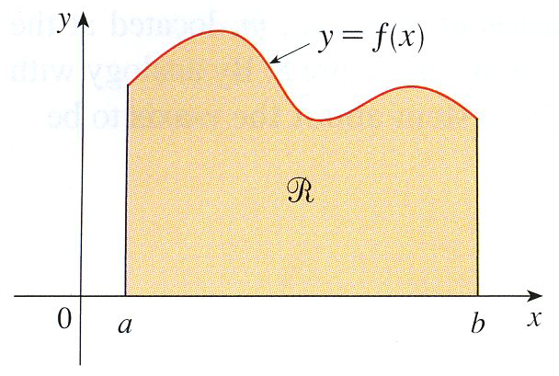
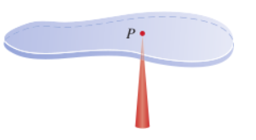
Lamina

Slide 5
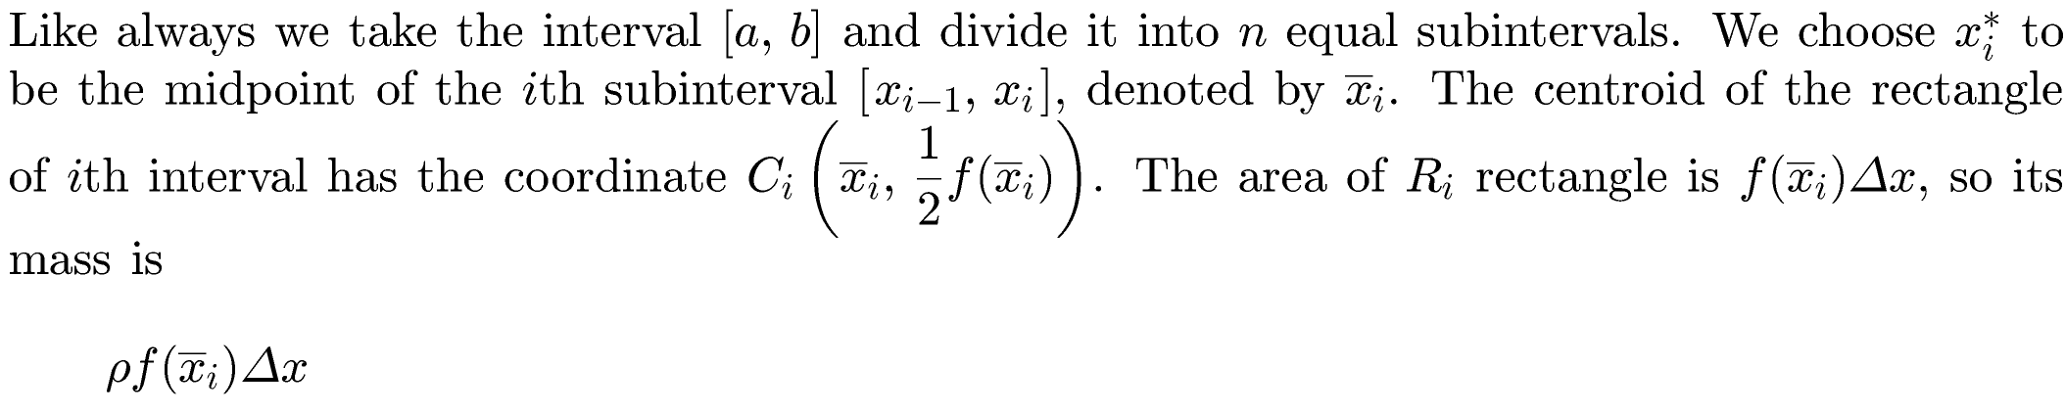
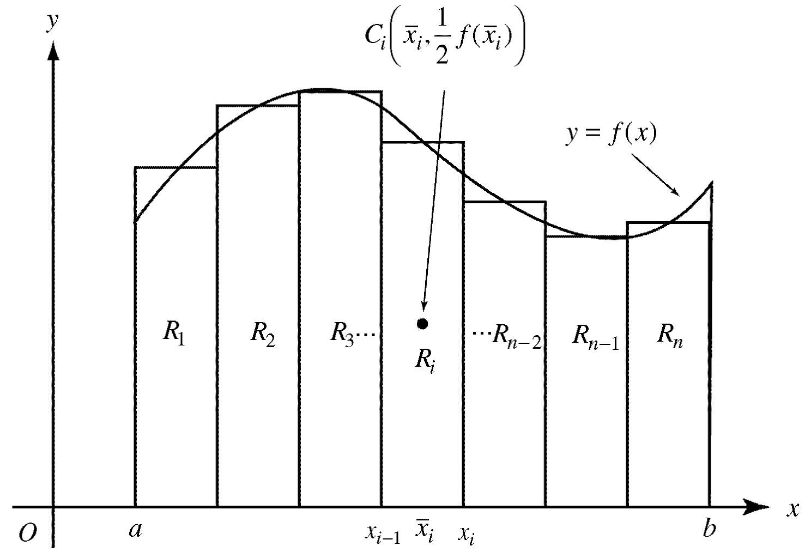

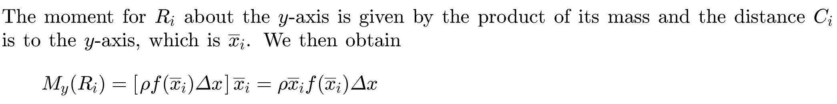


Slide 6

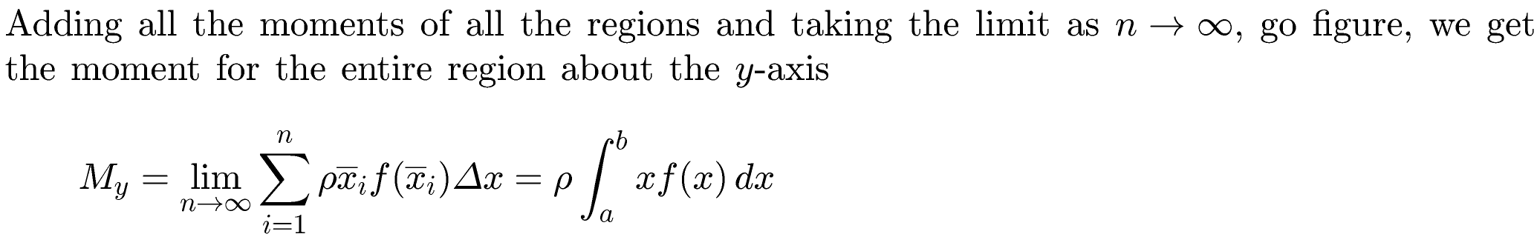
Mass of each rectangle

Slide 7
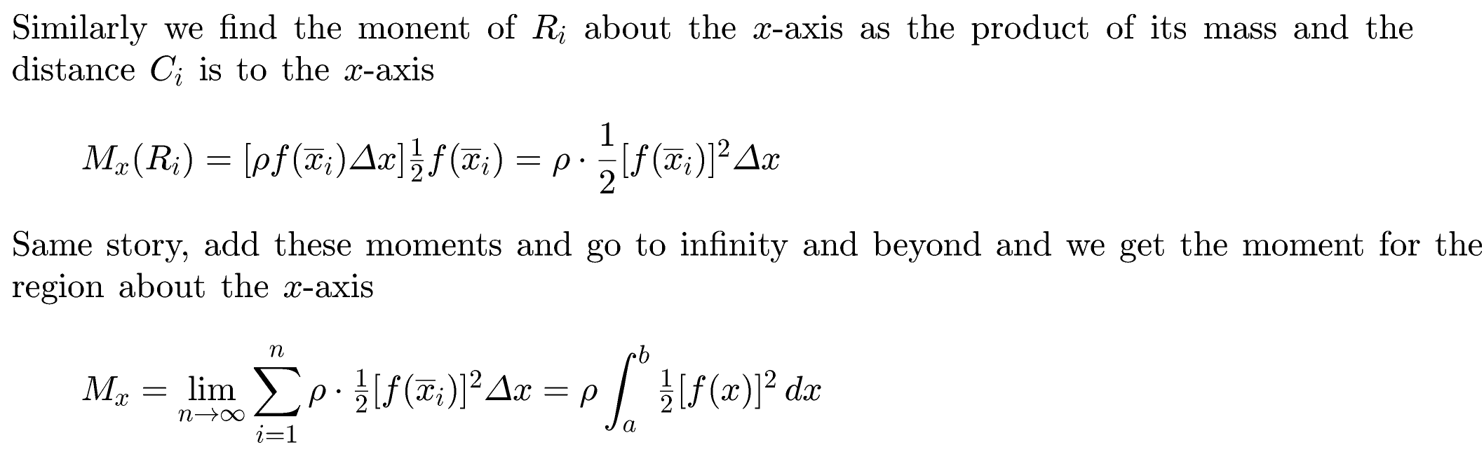
Mass of each rectangle

Slide 8
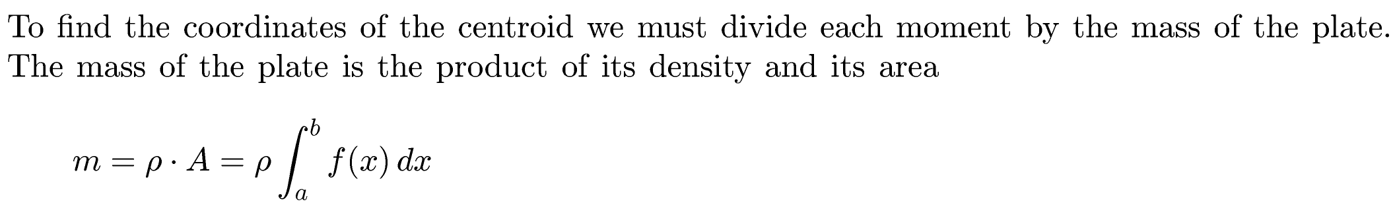
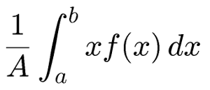
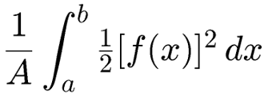




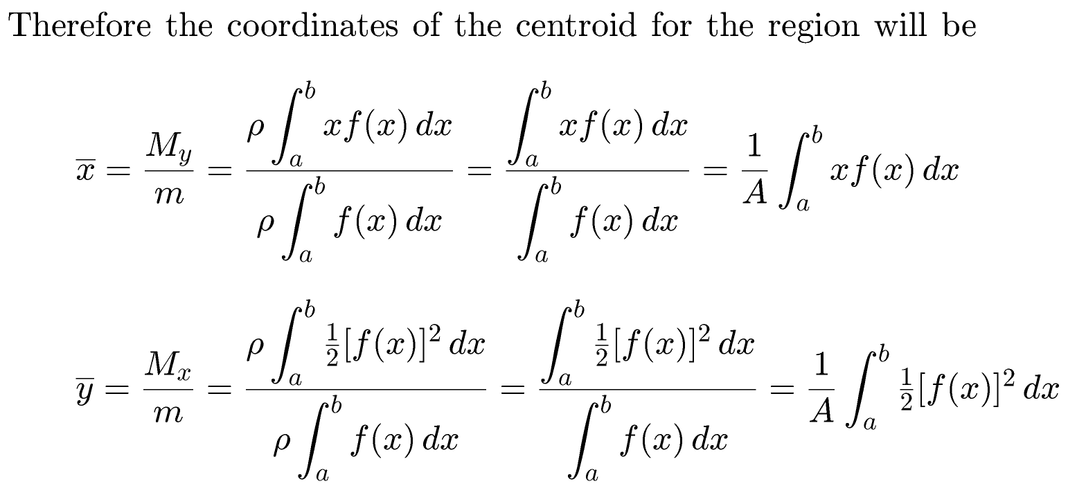



$$\overline{x}=$$
$$\overline{y}=$$
Centroid of Lamina $(\overline{x},\overline{y})$
Lamina

Slide 9
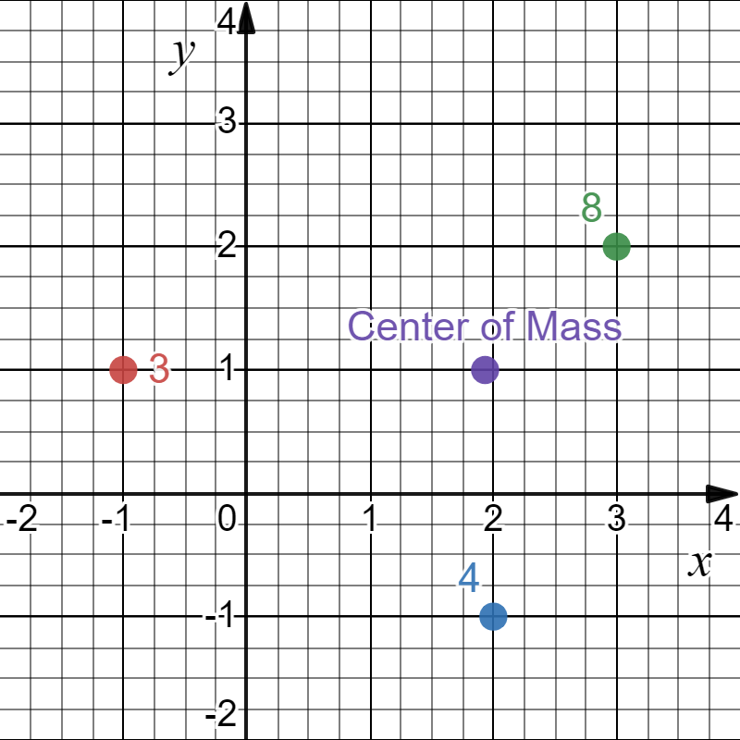

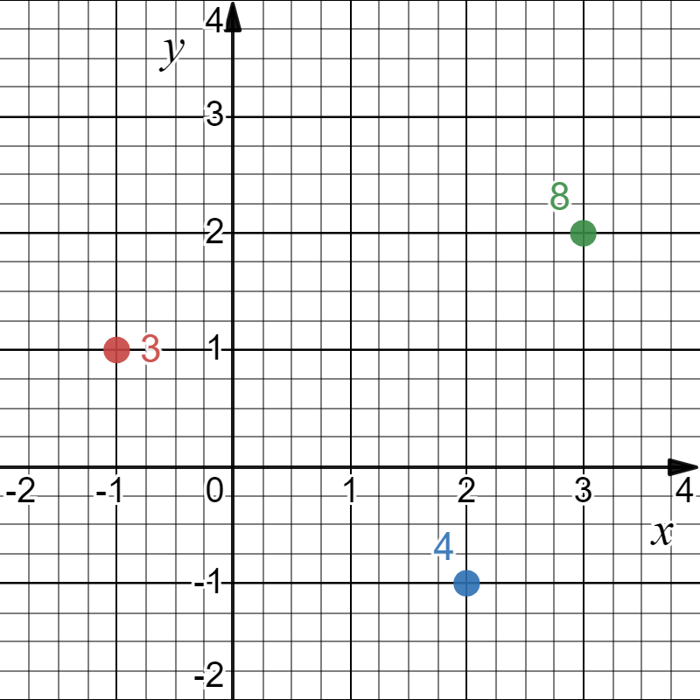






Example:

Slide 10
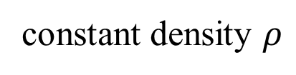
Vocabulary:
center of mass
= center of gravity
= centroid
constant density $ρ$
= homogeneous
= uniform

Slide 11
Note: The centroid does not have to be on the object.
If the center of mass is obvious, use a shortcut:
square
rectangle
circle
right triangle

Slide 12

Lamina
$$\overline{x}=$$
$$\overline{y}=$$
Centroid of Lamina $(\overline{x},\overline{y})$

Slide 13
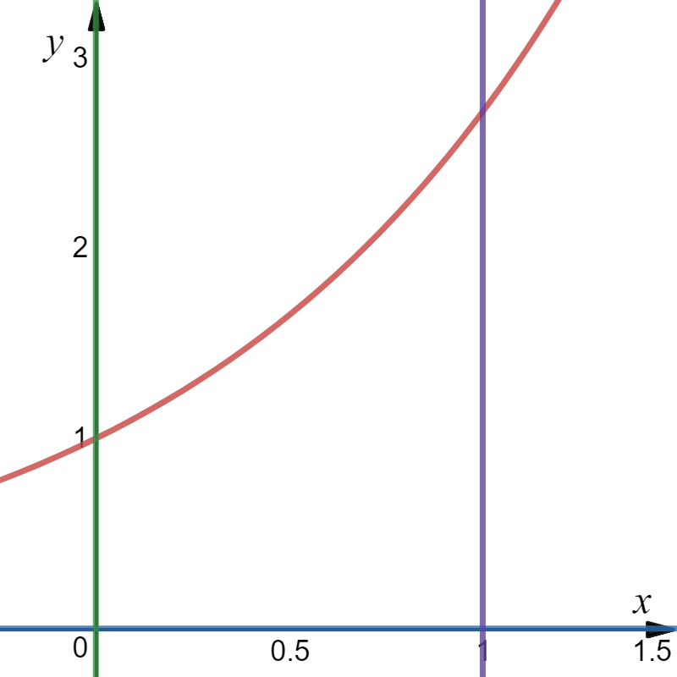






Example: Given the region bounded by y = e^{x}, y = 0, x = 0, and x = 1. Find the location of the centroid.
$$\overline{x}=$$
$$\overline{y}=$$
cas
cas

Slide 14
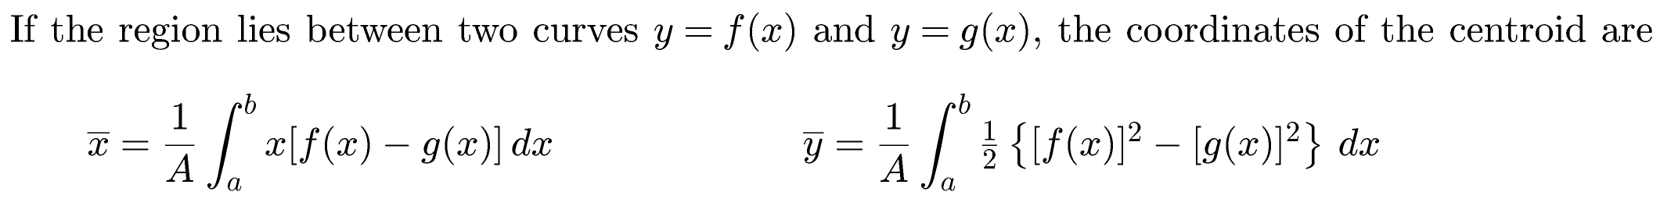
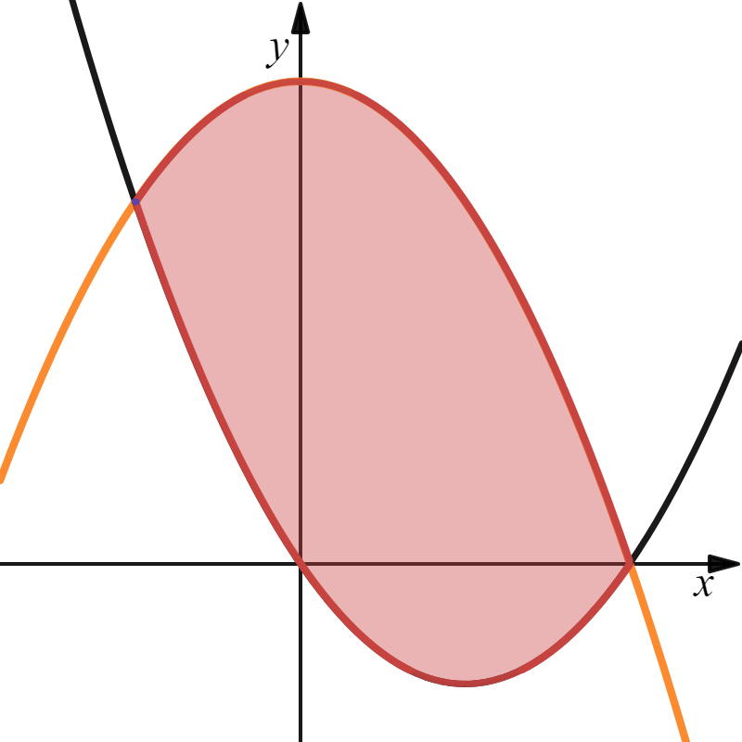
a
b

Slide 15
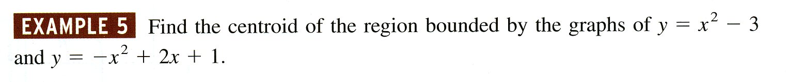


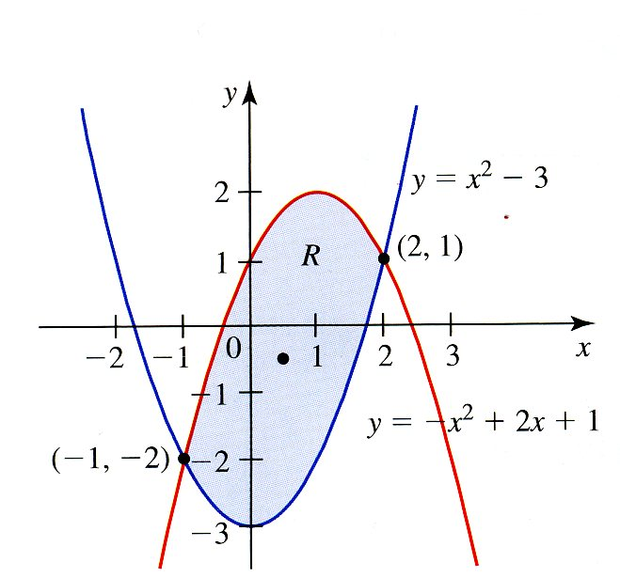
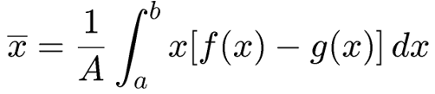
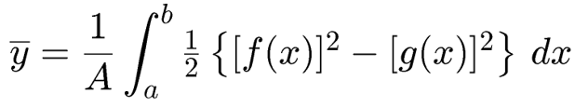

Example:
cas
cas
cas

Slide 16


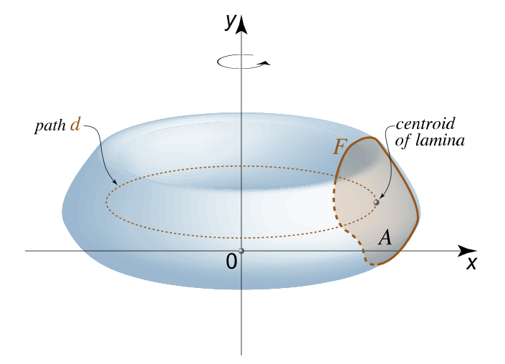


Let R be a plane region that lies entirely on one side of a line l in the plane. If R is rotated about l, then the volume V of the resulting solid is the product of the area A of R and the distance d traveled by the centroid of R.
$$\overline{x}=$$
$$\overline{y}=$$

Slide 17

THEOREM OF PAPPUS Let R be a plane region that lies entirely on one side of a line l in the plane. If R is rotated about l, then the volume V of the resulting solid is the product of the area A of R and the distance d traveled by the centroid of R.
Example: Consider an 8 cm diameter torus (donut) with a 3 cm diameter cross section. Find the volume of the torus.
8
Distance Traveled by Centroid d
3/2
5/2

Slide 18
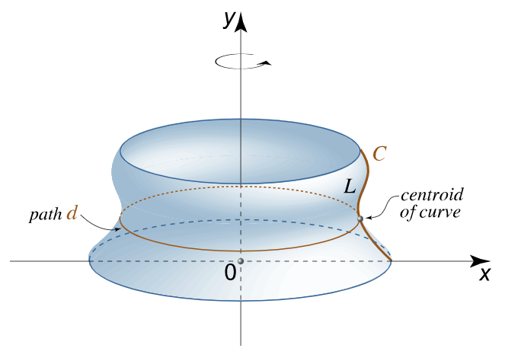


SECOND THEOREM OF PAPPUS is in the same spirit as Pappus’s Theorem, but for surface area rather than volume: Let C be a curve that lies entirely on one side of a line l in the plane. If C is rotated about l, then the area of the resulting surface is the product of the arc length L of the curve C and the distance d traveled by the centroid of the curve C.

Slide 19
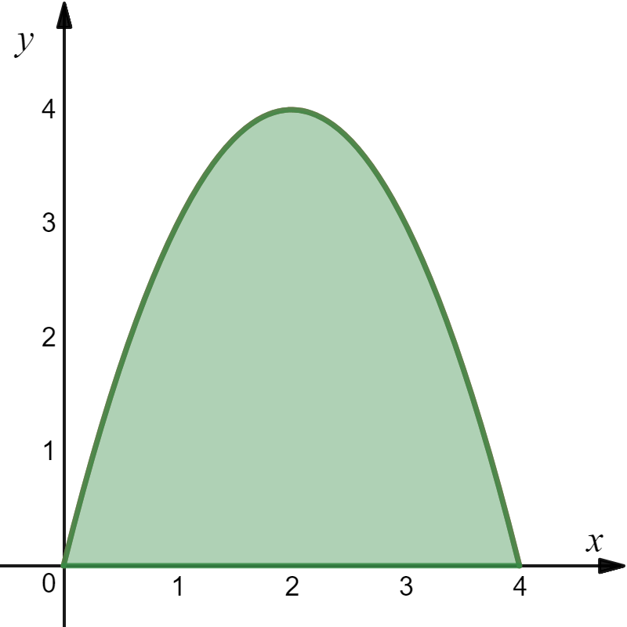
Example
R

Slide 20
Area of Lamina
cas
R
Arc Length
cas

Slide 21


Centroid for Lamina
$$\overline{x}=$$
$$\overline{y}=$$
R
cas
cas
Centroid for Curve
cas
cas

Slide 22


R

Slide 23

R

