Slide 1
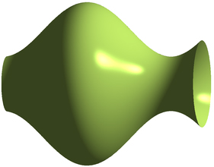

Slide 2
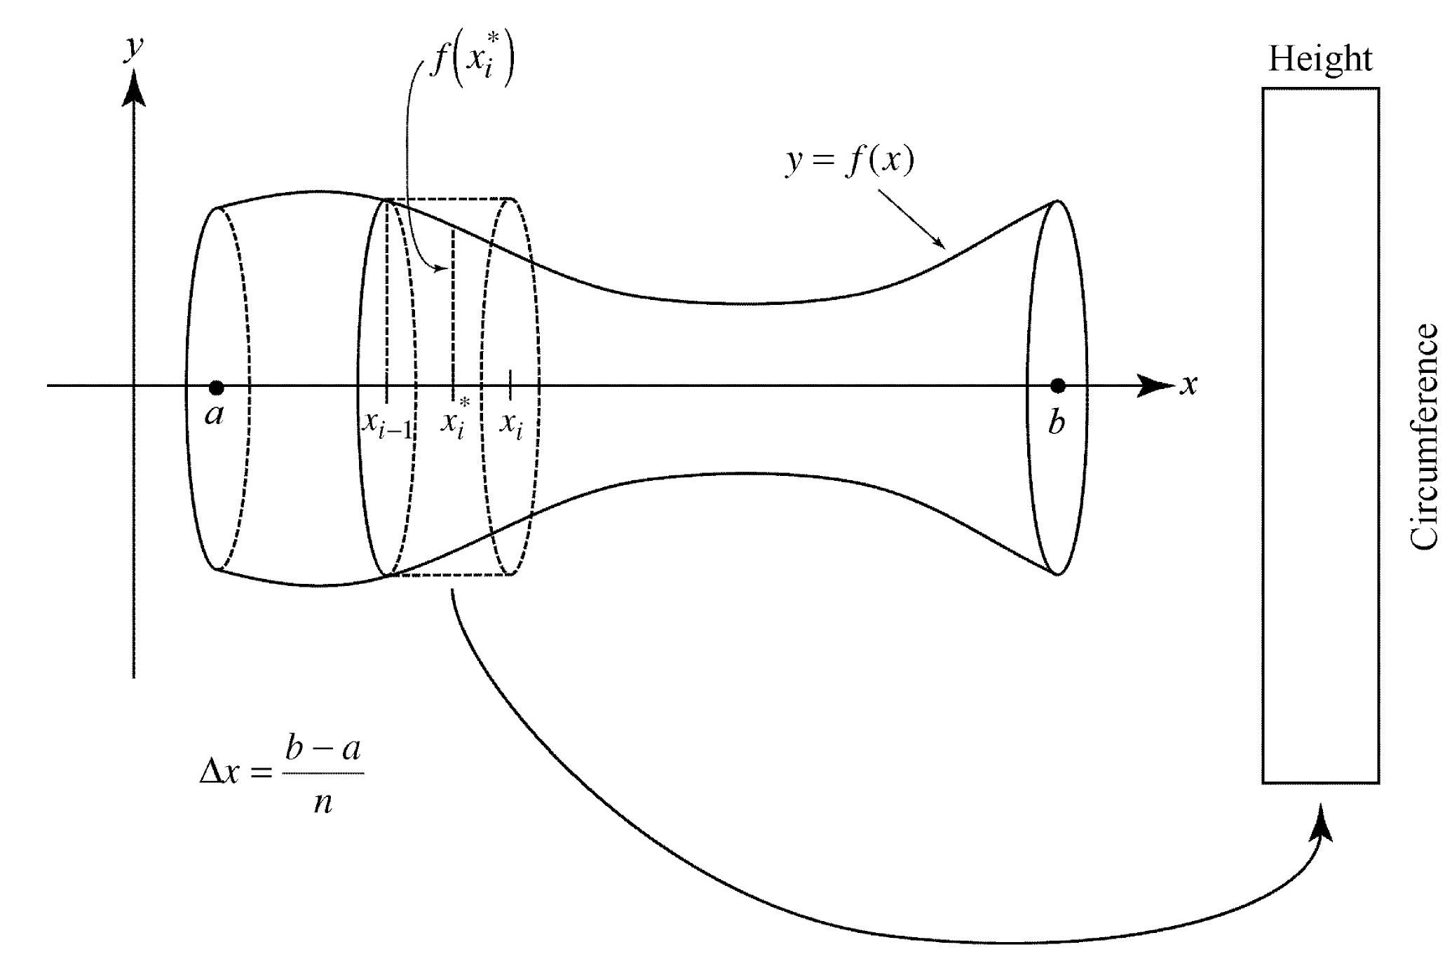

Slide 3



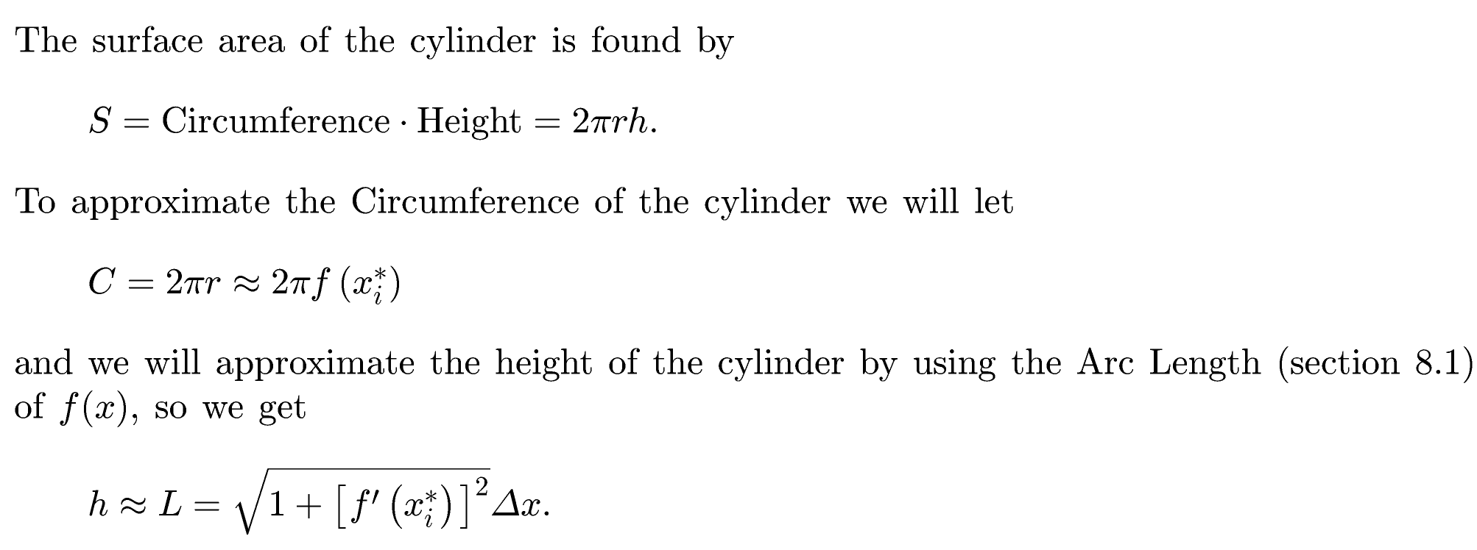

Slide 4
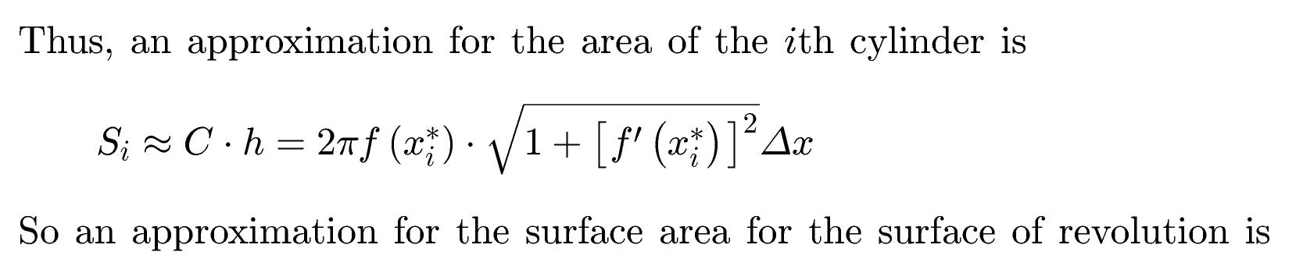
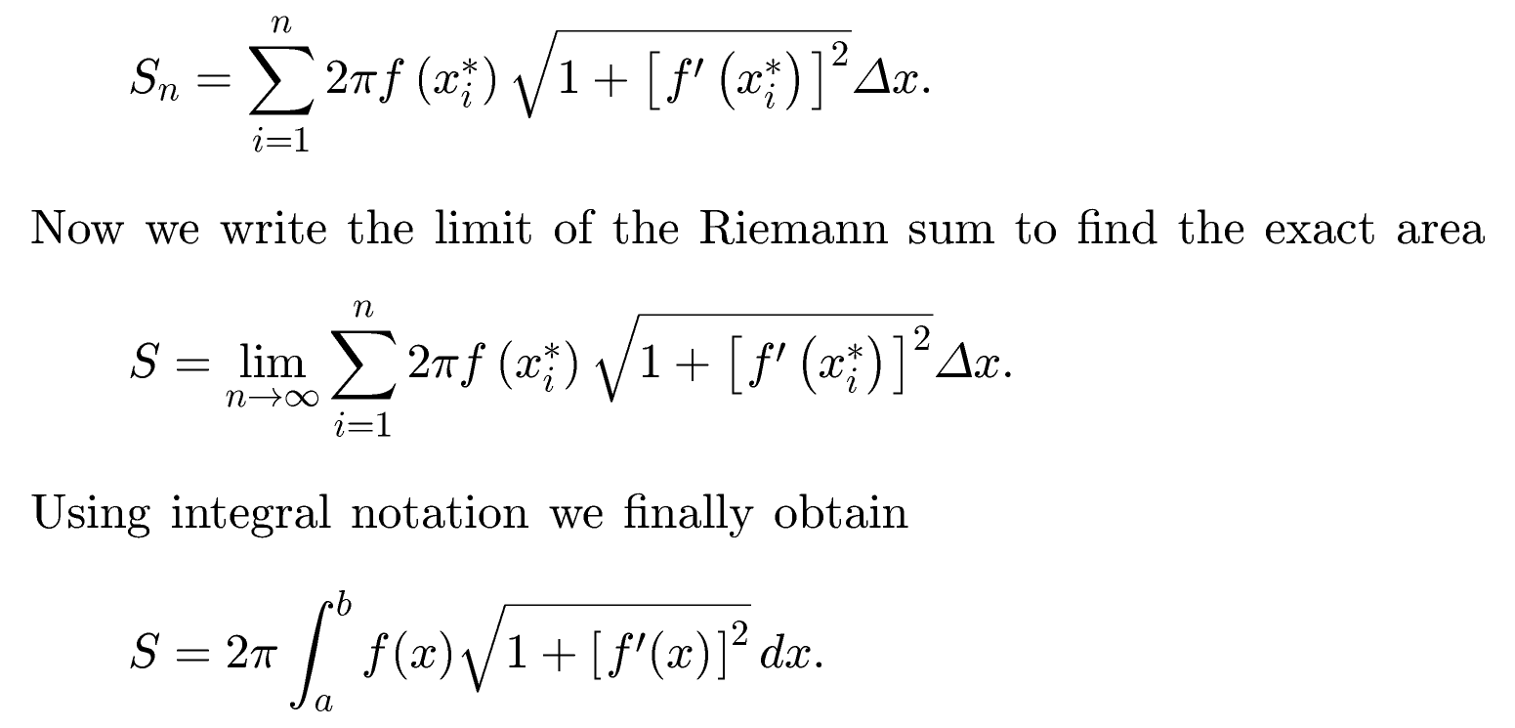

Slide 5

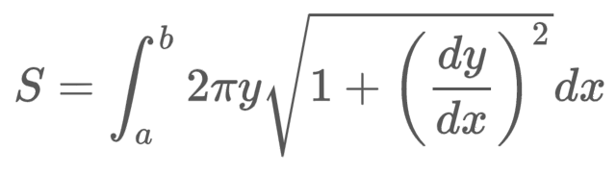
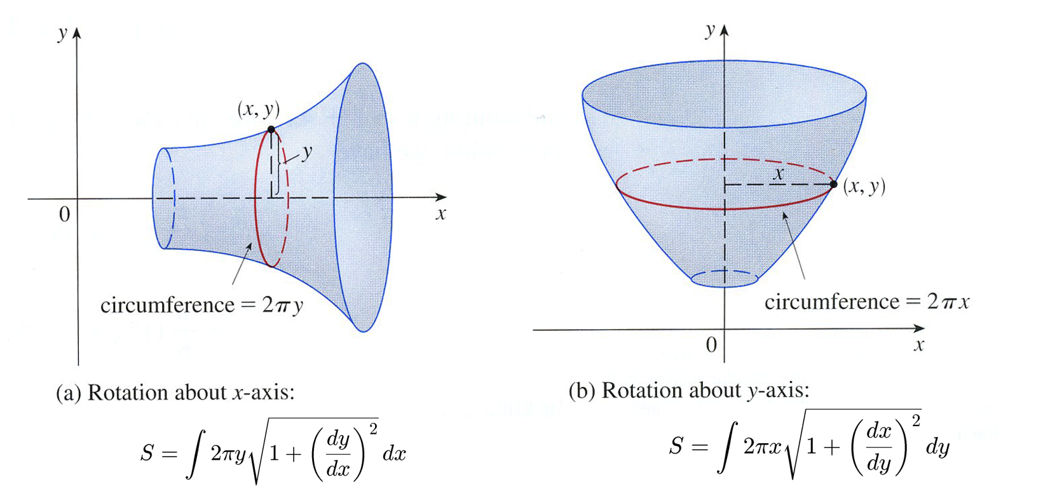



Arc Length
Circumference
$$y=f(x)$$
$$x=g(y)$$

Slide 6
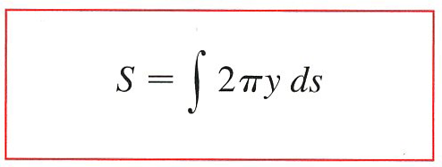
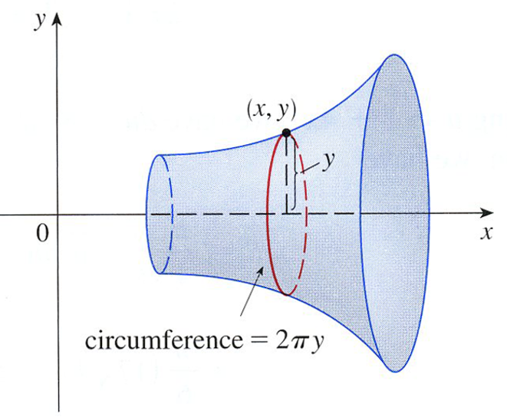
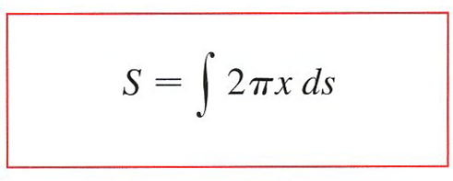
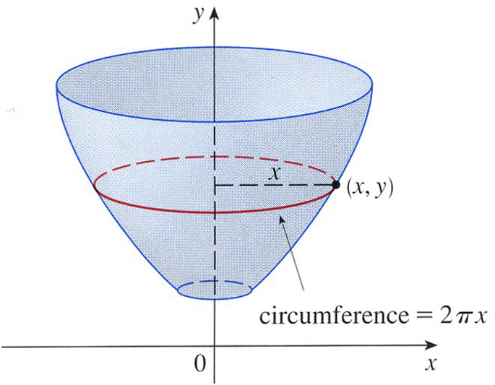
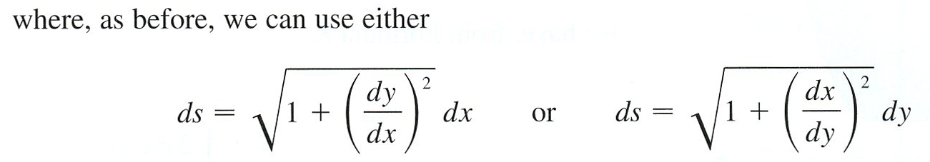



For rotation about the x-axis, the surface area formula becomes
$$y=f(x)$$
$$x=g(y)$$

Slide 7



Example:
Rotate about the y-axis.
Rotate about the y-axis.
y
x

Slide 8
Example:
Rotate about the y-axis.
y
x

Slide 9

Example:
Rotate about the y-axis.
y
x

Slide 10
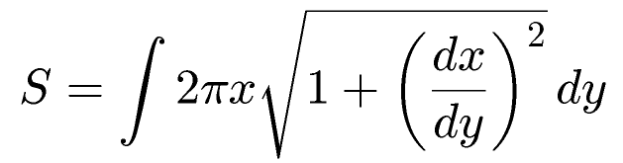
Example:
Rotate about the y-axis.
y
x

Slide 11
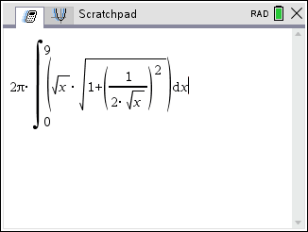
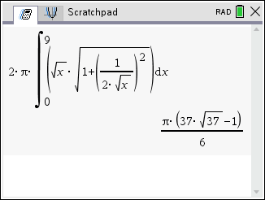
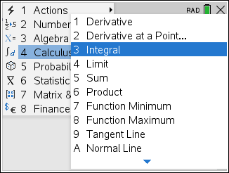
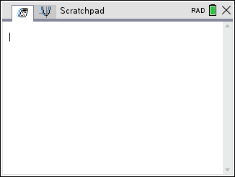
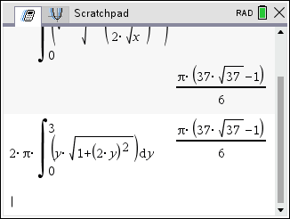
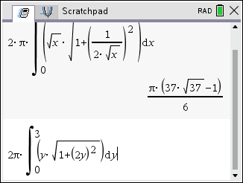
Example:
rotated about x-axis, find it’s surface area by CAS.
ds
ds
or
or
cas
cas

Slide 12
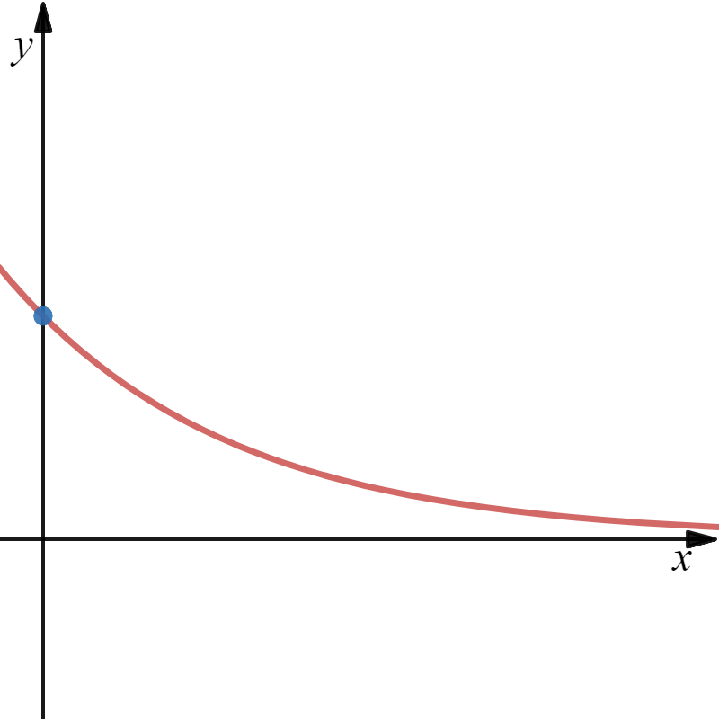
Example:
(0,1)
y
Disk

Slide 13
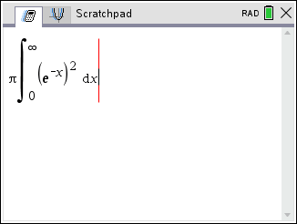
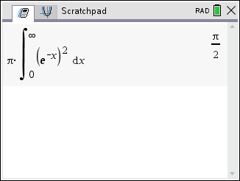
(0,1)
y
Disk
0
Convergent.

Slide 14
(0,1)
y

Slide 15

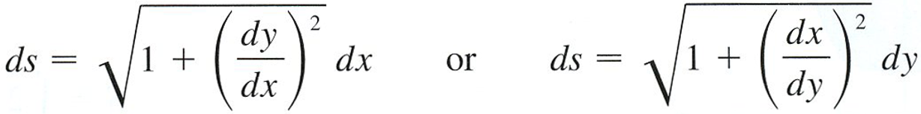
(0,1)
y

Slide 16
0
(0,1)
21
Both the volume and area are convergent.
Convergent.

Slide 17
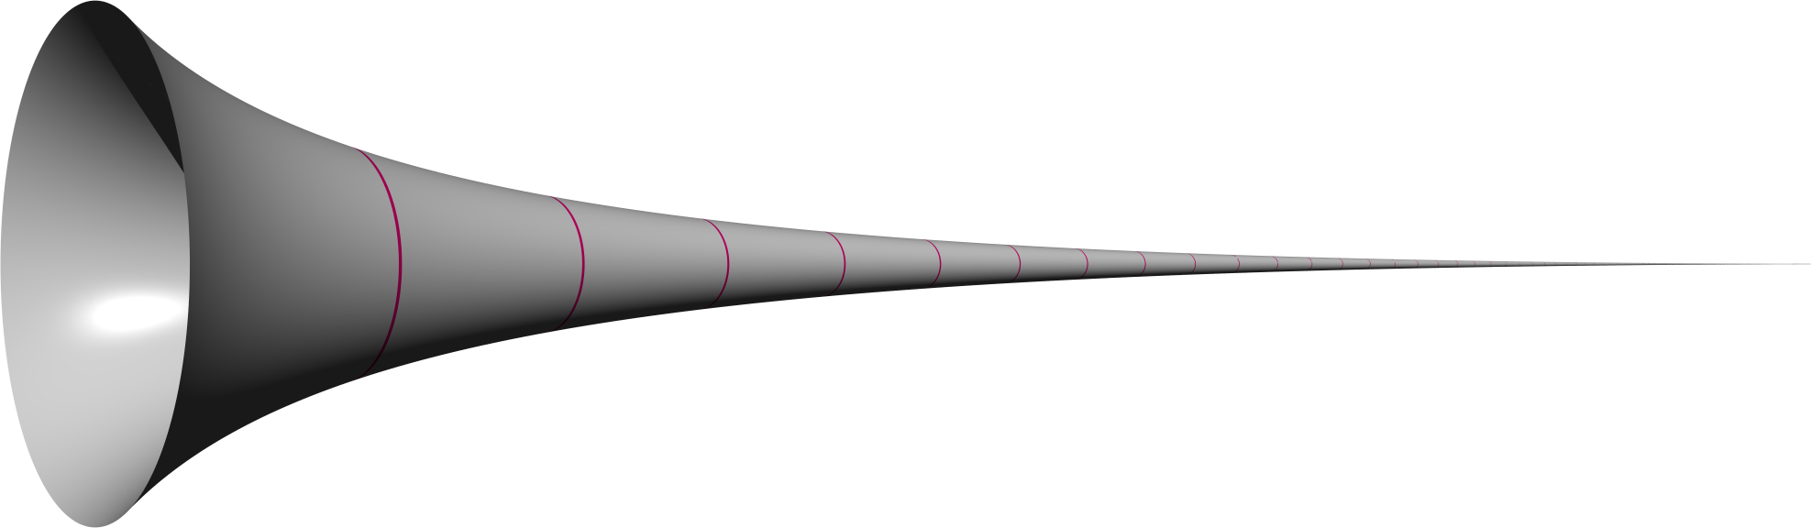
Example:

Slide 18
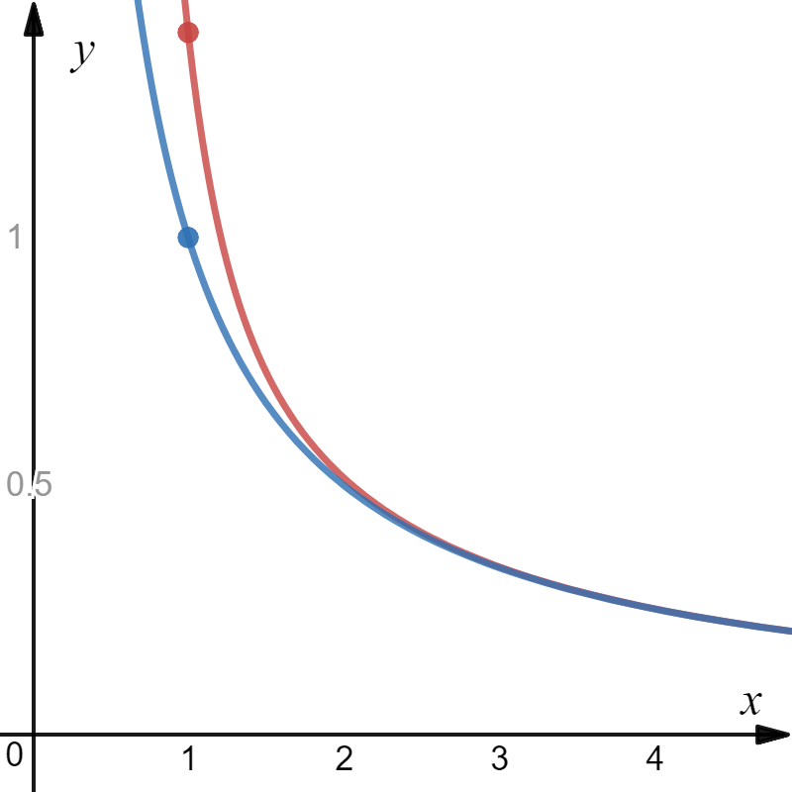
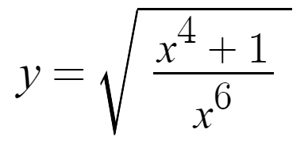
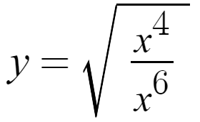

Slide 19
Divergent.
The surface area of Gabriel’s Horn is infinite.

Slide 20
So, you can fill Gabriel’s Horn, but there is not enough paint to cover it’s surface.
0
Convergent.
The volume of Gabriel’s Horn is finite.

