Slide 1



Slide 2
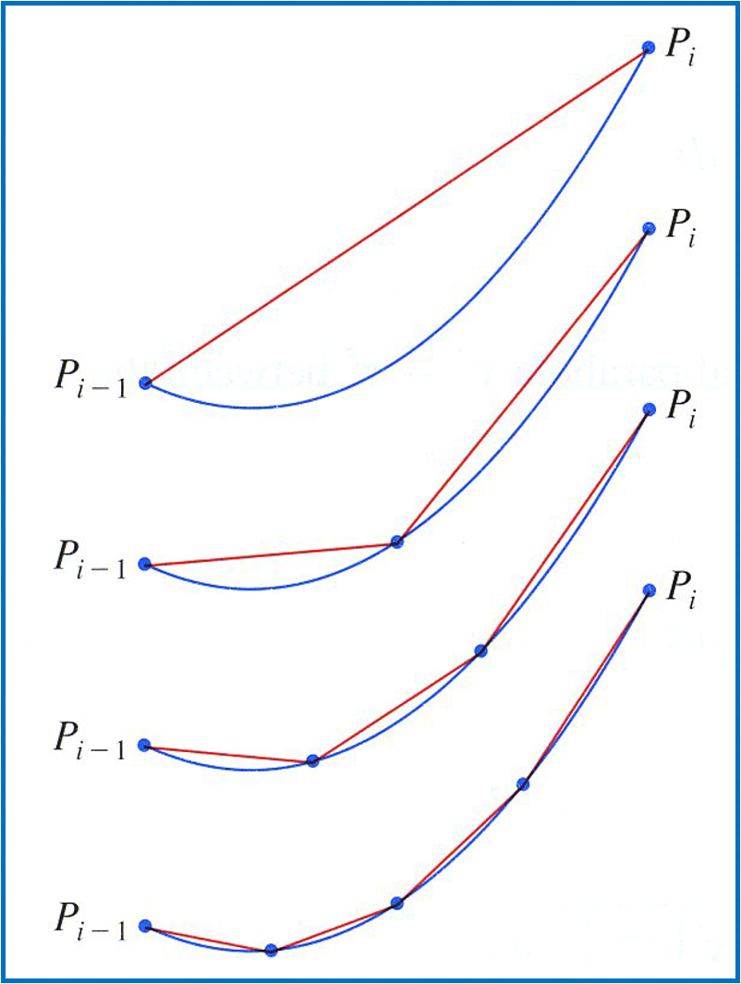
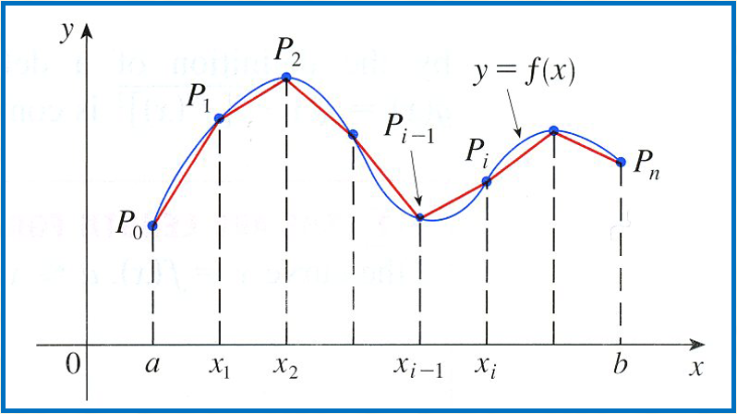
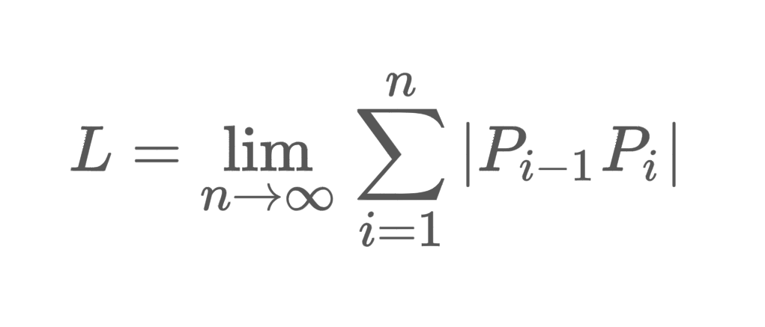

Slide 3
Lengths of Curves:
If we want to approximate the length of a curve, over a short distance we could measure a straight line.
By the pythagorean theorem:
Length of Curve (Cartesian)

Slide 4
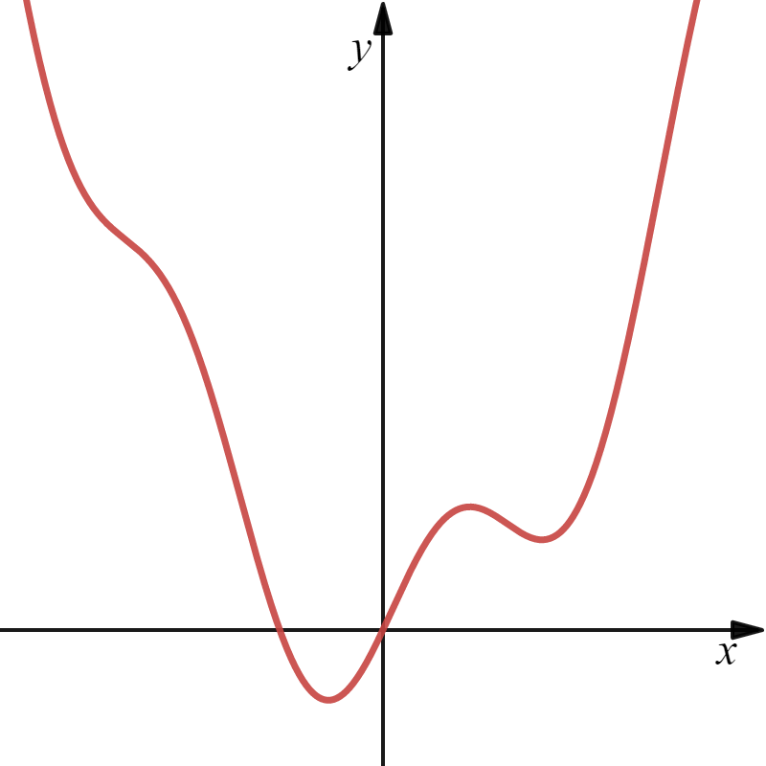
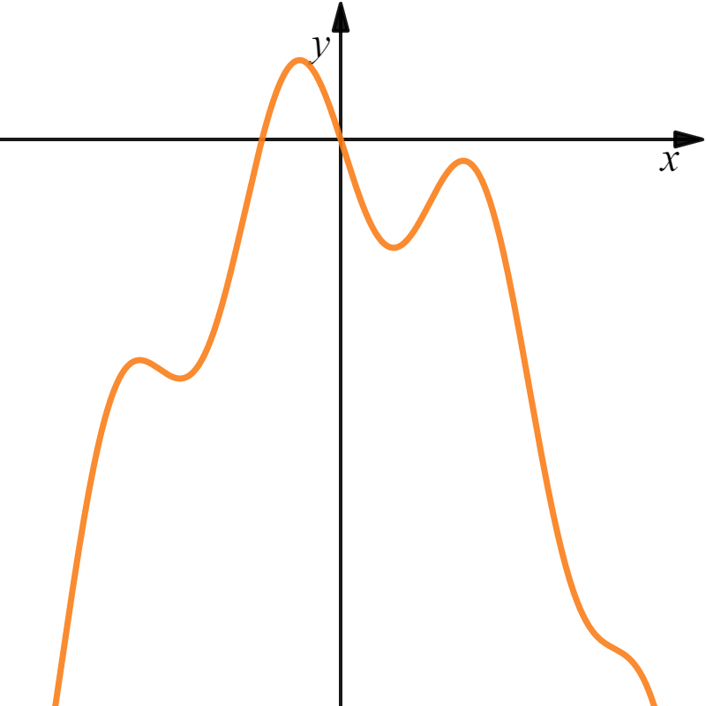
Arc Length Formula

Slide 5
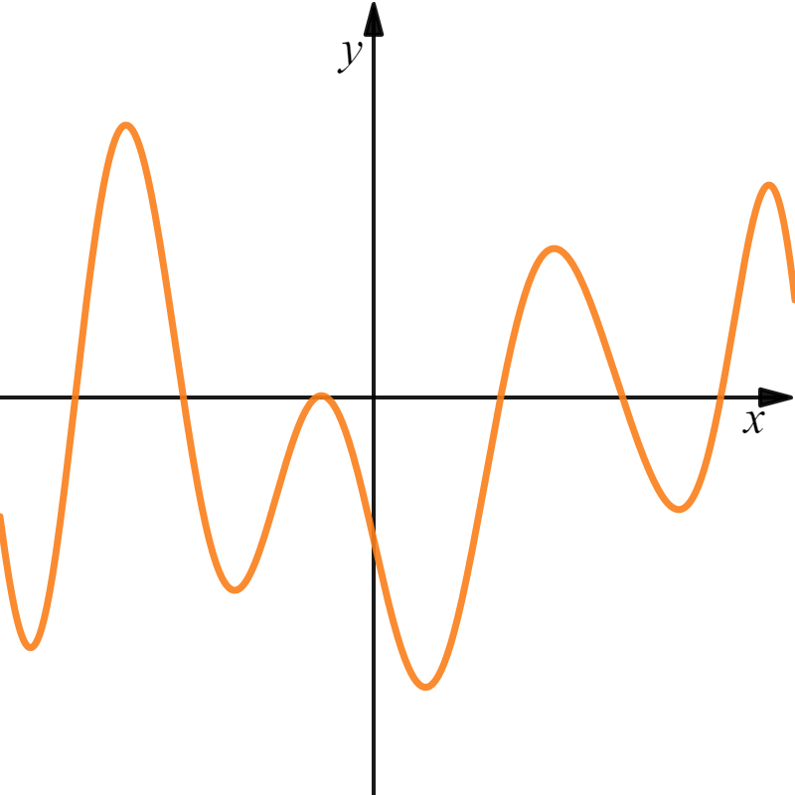



Slide 6
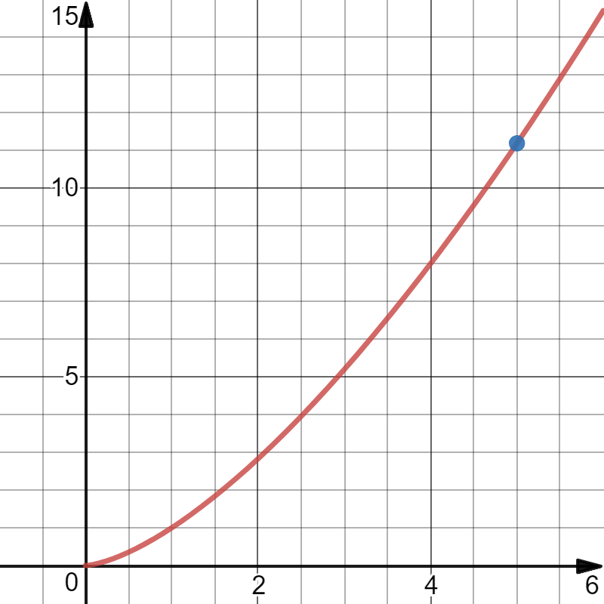

Example: Find the arc length for the function over the specified interval.

Slide 8
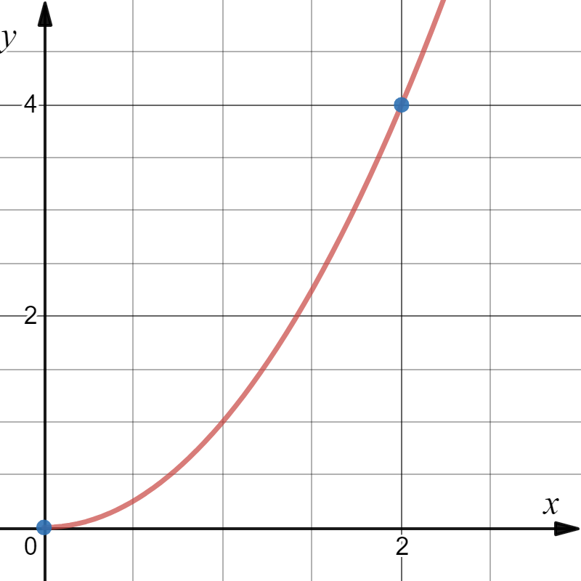
Example: Find the arc length for the function over the specified interval.

Slide 9

Now what?
Obviously, Trig-Sub!!

Slide 10
Wow!!

Slide 11
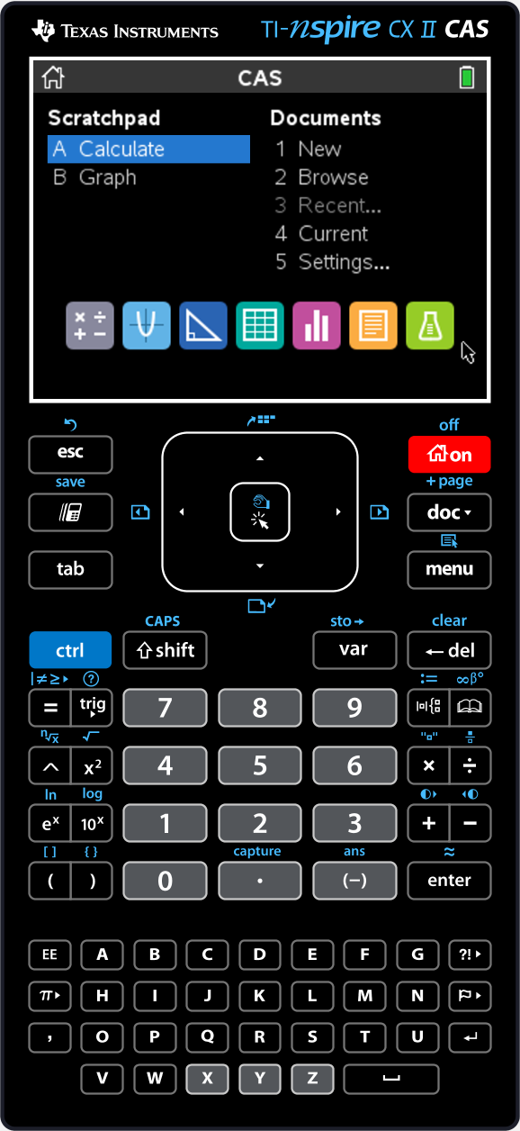
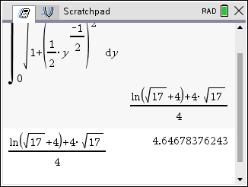
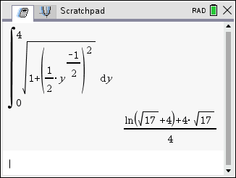

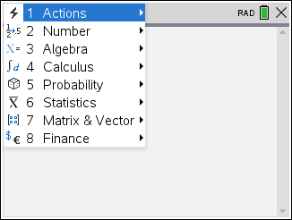
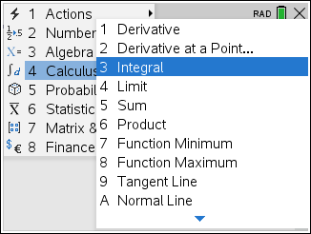
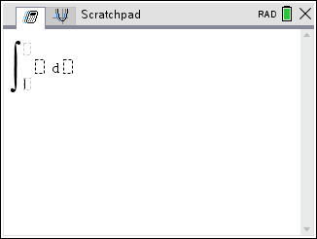
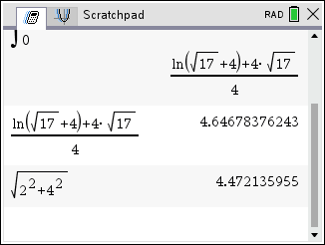
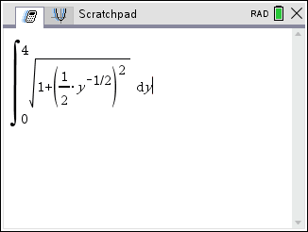
Computer Algebra Systems

Slide 12
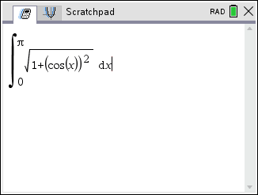
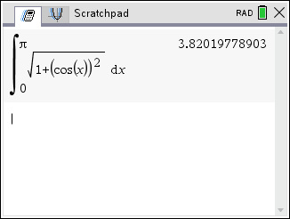
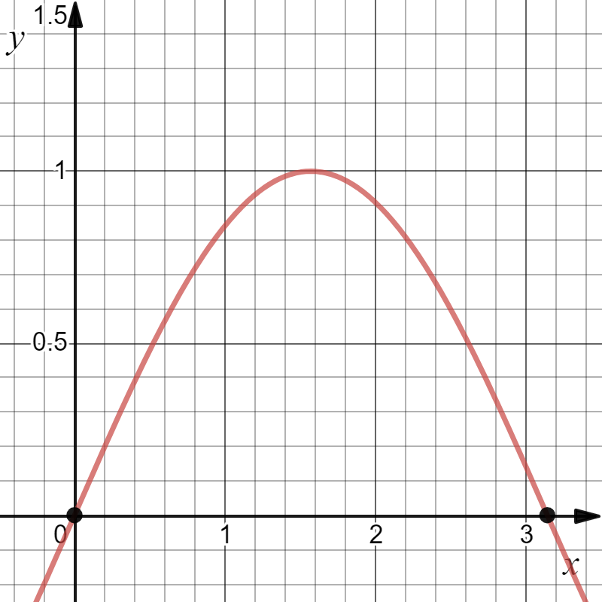
Example: Find the arc length for the function over the specified interval.
s
No exact answer, just an approximation.
F, the antiderivative, is not an elementary function.

Slide 13
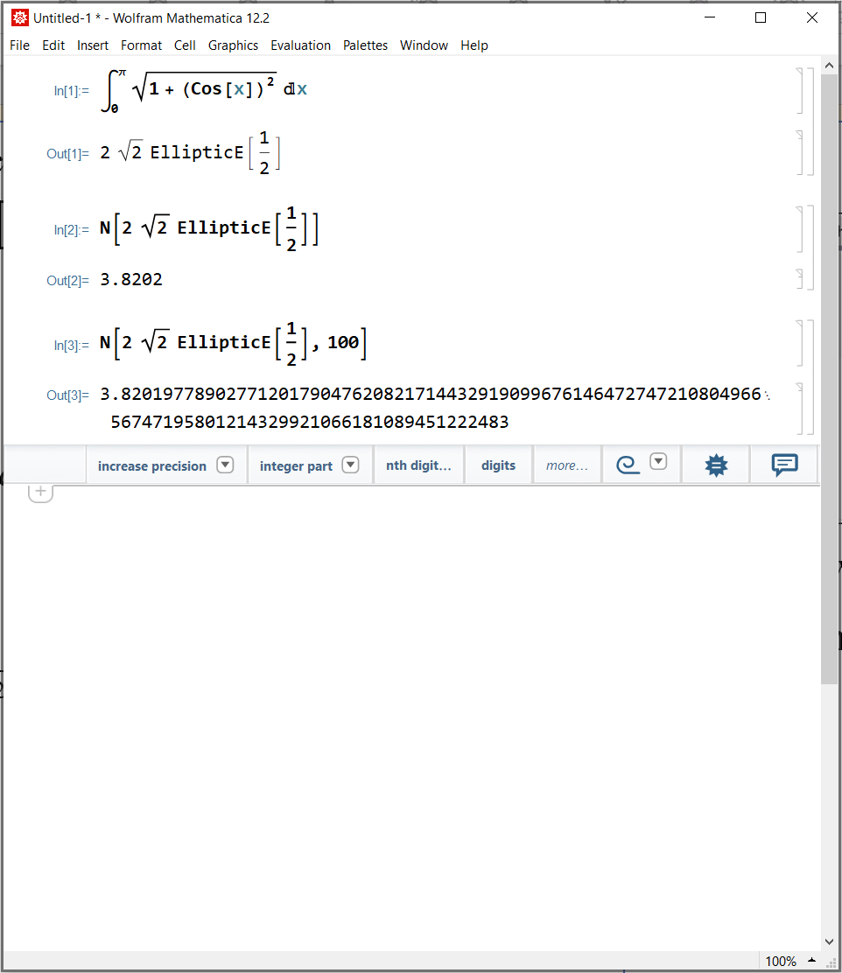
Example: Find the arc length for the function over the specified interval.
s
F, the antiderivative, is not an elementary function.

