Slide 1
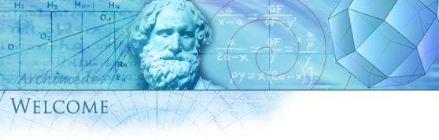

Santa Rosa Junior College
Mathematics
Gale Bach
Second Course in Calculus
Math 1B – Sections 5087 & 7219
Spring 2026

Slide 2
Math 1A

Slide 3
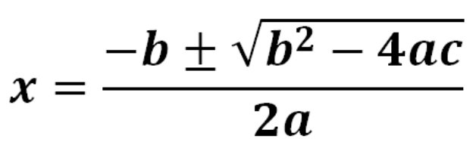
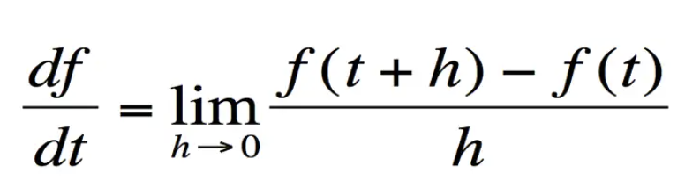
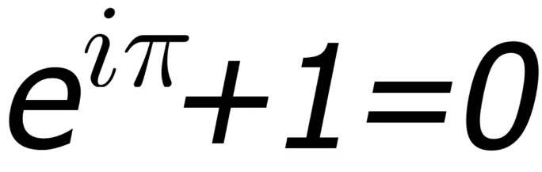
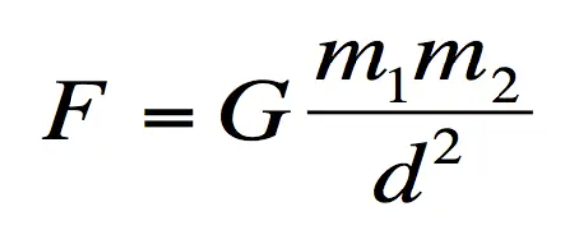
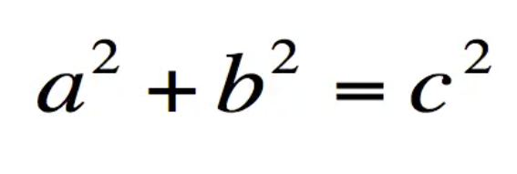
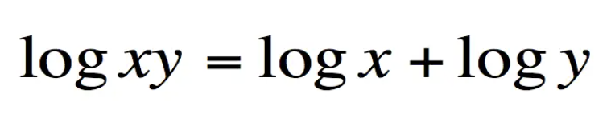
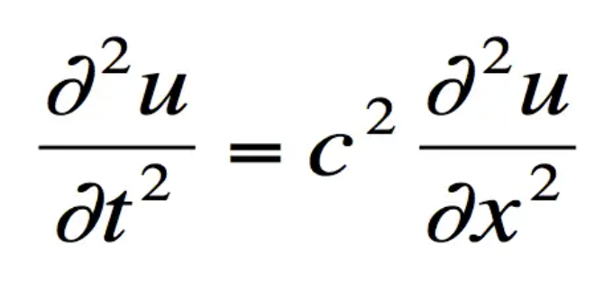
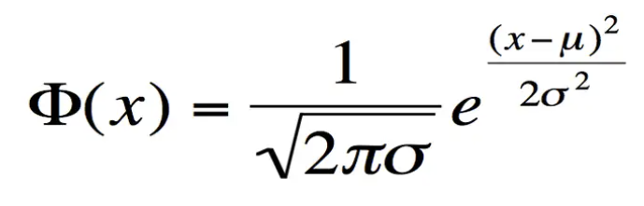
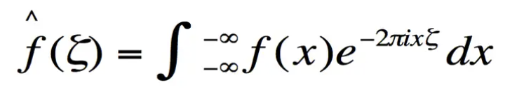
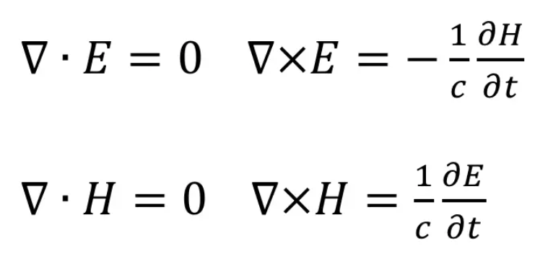
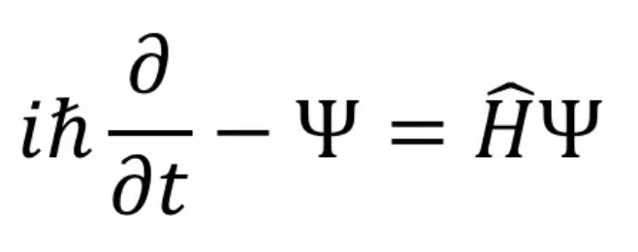
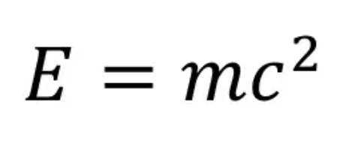

Slide 4

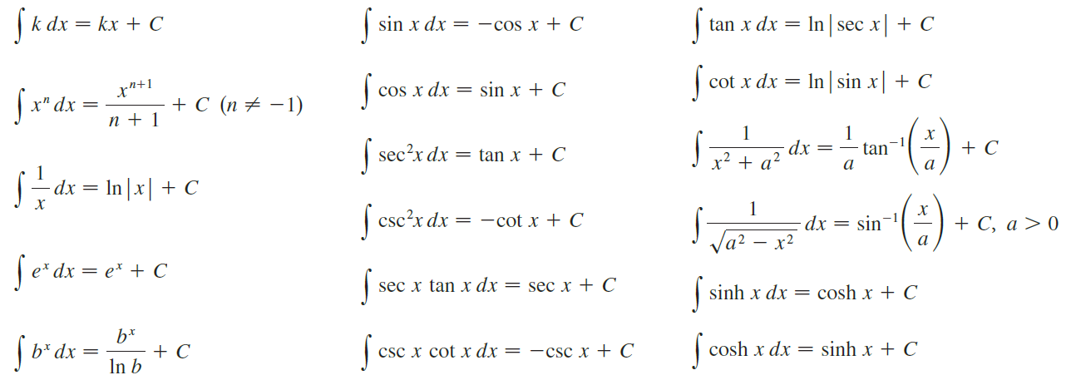

Slide 6


Example
Logs, Inverse trig, Power, Exponential, Trig
LIPET
Parts again!
This is the expression we started with!

Slide 7
Example:
LIPET
This is called “ the wrap around integral.”
It works when both factors integrate and differentiate forever.

Slide 8
A shortcut to Integration by Parts: Tabular Integration
Tabular integration works for integrals of the form:
where:
Differentiates to zero in several steps.
Integrates repeatedly.
Let’s see how it works.

Slide 9
Example

Slide 11
Example Combination of cosine and sine functions.

Slide 12

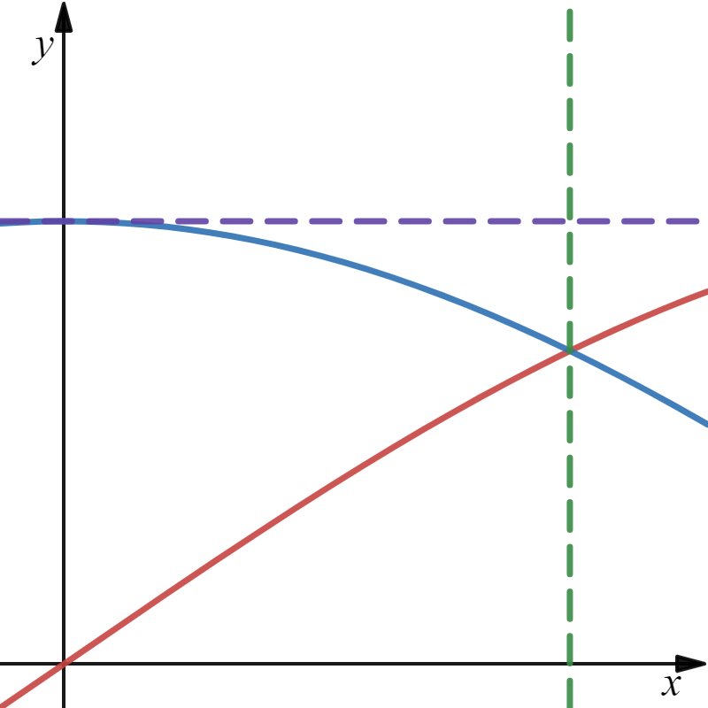
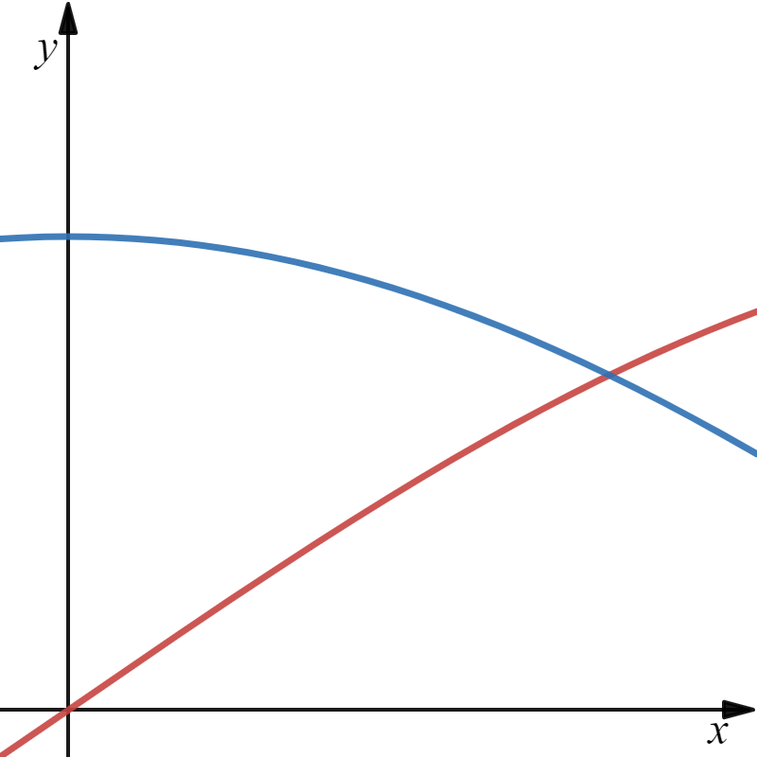
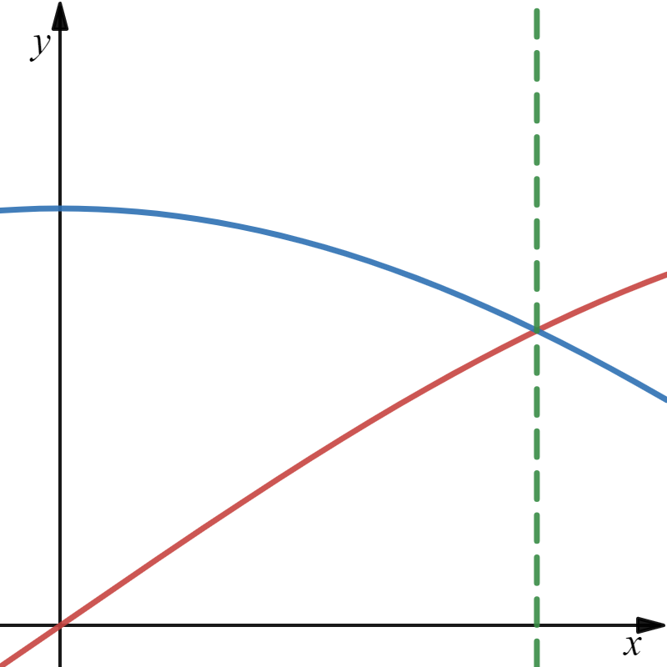
Example
Find the volume obtained by rotating the region bounded by the curves $y=\sin{x},$ $y=\cos{x,}$ x = 0 and $x=\frac{π}{4}$ about the line $y=1$.
“Washer Method”
$$x=\frac{π}{4}$$
x = 0
$$y=1$$
$$y=\sin{x}$$
$$y=\cos{x}$$
x

Slide 13







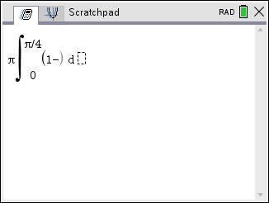
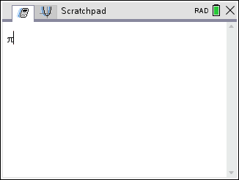
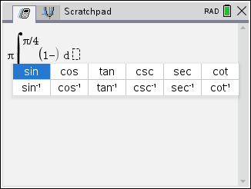
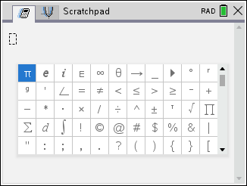
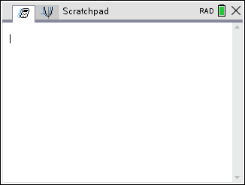
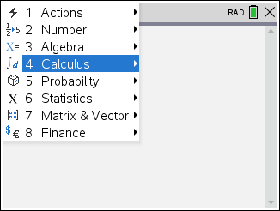
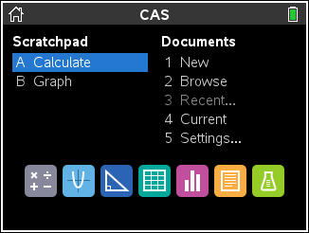
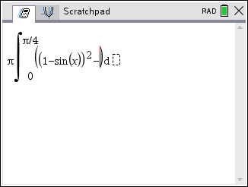
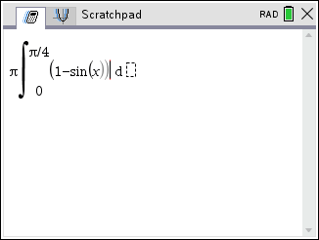
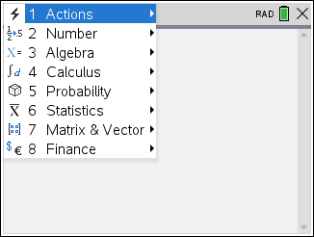

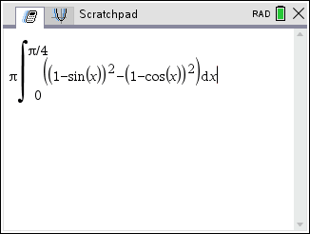
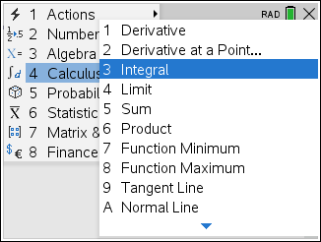
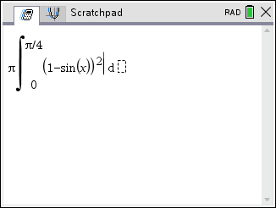
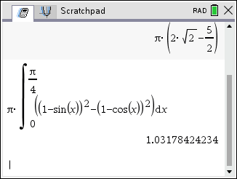
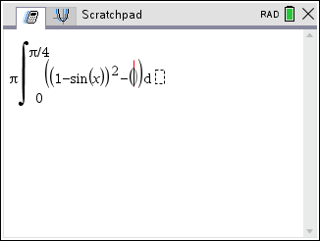
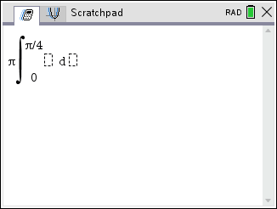
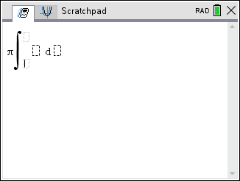
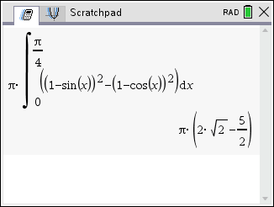



Example
Find the volume obtained by rotating the region bounded by the curves $y=\sin{x},$ $y=\cos{x,}$ x = 0 and $x=\frac{π}{4}$ about the line $y=1$.
“Washer Method”
$$x=\frac{π}{4}$$
x = 0
$$y=1$$
Deceitful Decimal!!
$$y=\sin{x}$$
$$y=\cos{x}$$
x
Note: At least 3 decimal places of accuracy.

Slide 15
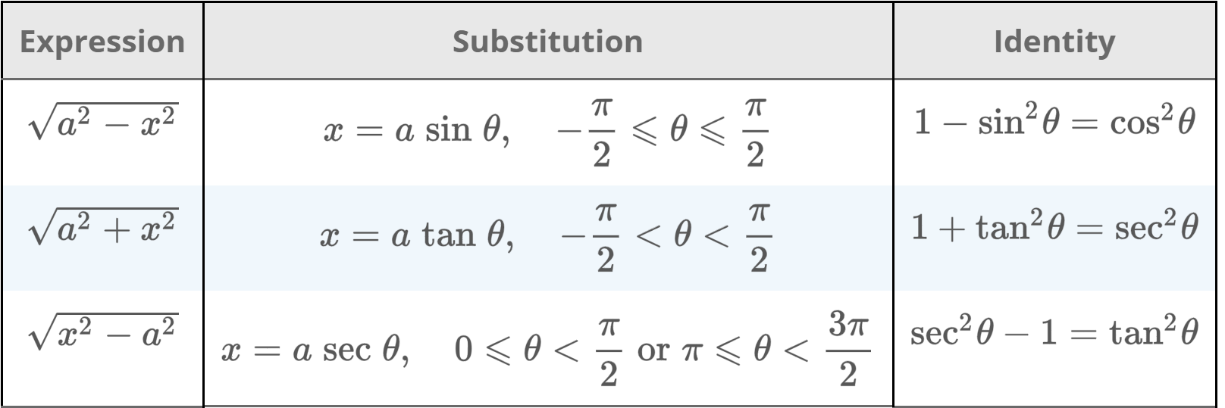


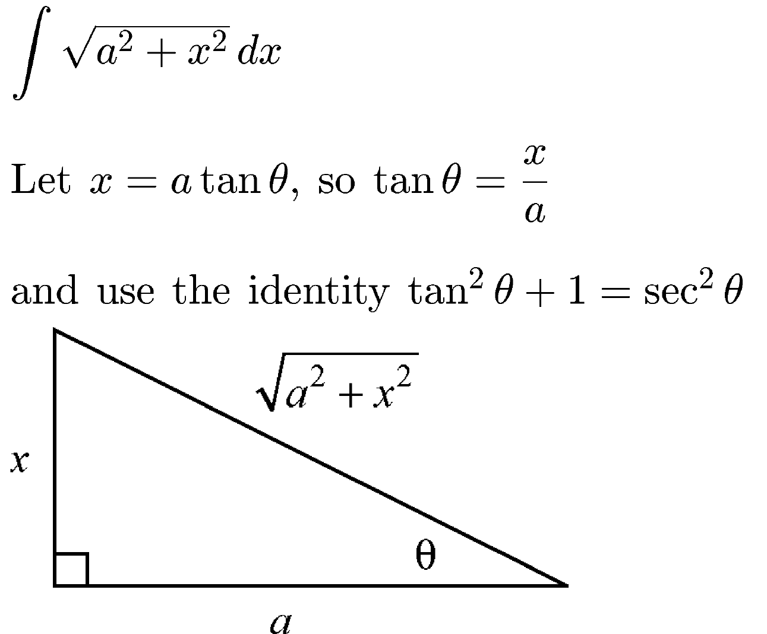
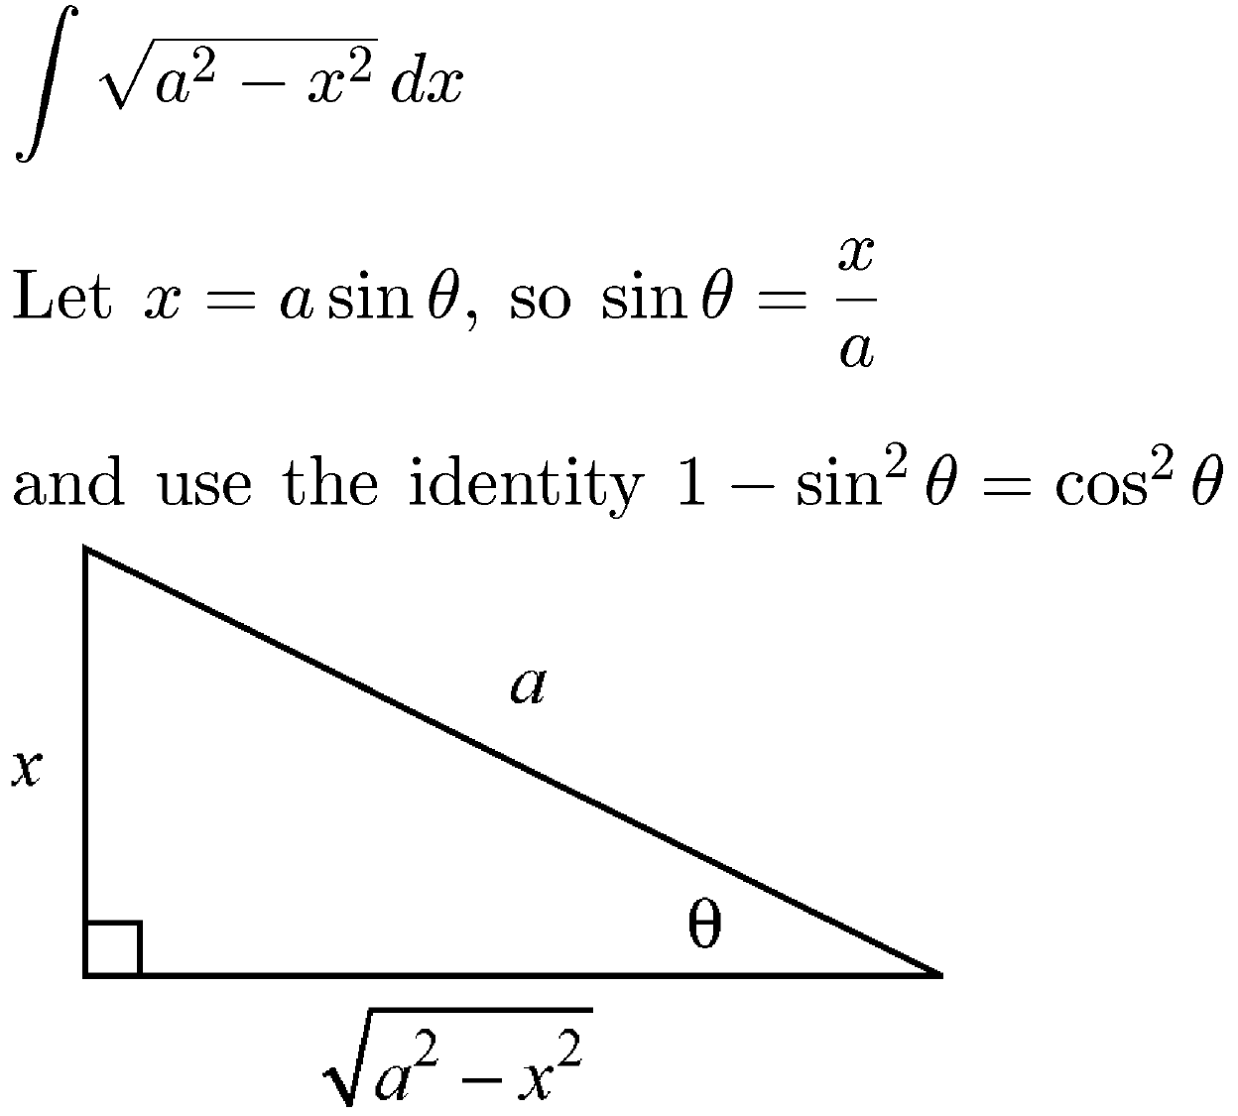

Slide 16
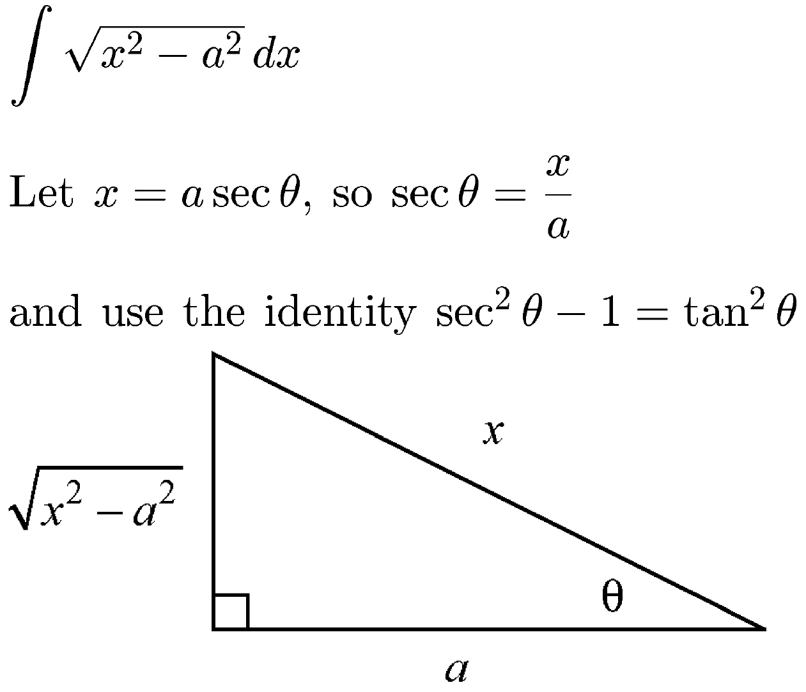

Slide 17
Example
Are we done?
NO!!

Slide 19
That was fun!!

Slide 21
Example
This would be a lot easier if we could rewrite it as two separate terms.
Factor the denominator.
Separate into individual fractions
Multiply by the common denominator.
Clever choice for x.

Slide 23
This technique is called
Partial Fractions

Slide 24

7.5
STRATEGY FOR INTEGRATION

Slide 25


Example
Let:
LIPET
Let:
New Bounds for t
Lower Bound
Upper Bound

Slide 26
Recall in a right triangle:
That was fun!!!

Slide 27

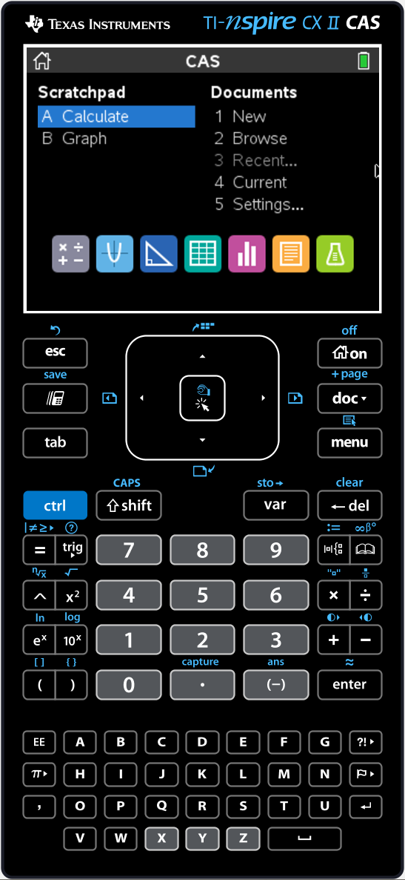




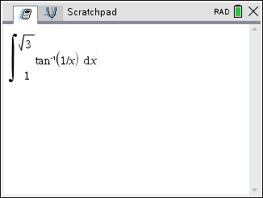
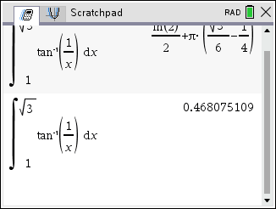

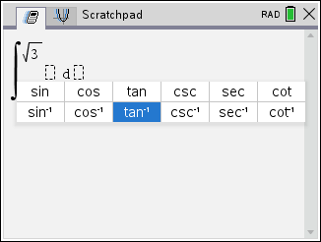
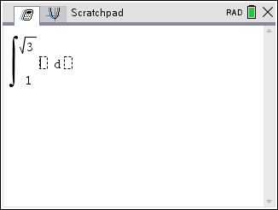
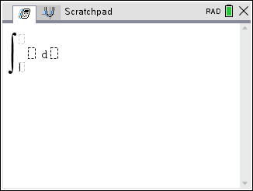
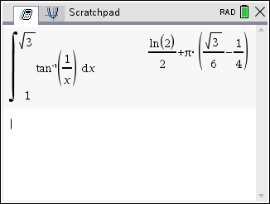
Example
Using a Computer Algebra System (CAS), we can just do this!
Deceitful Decimal!!
Note: At least 3 decimal places of accuracy.

Slide 29
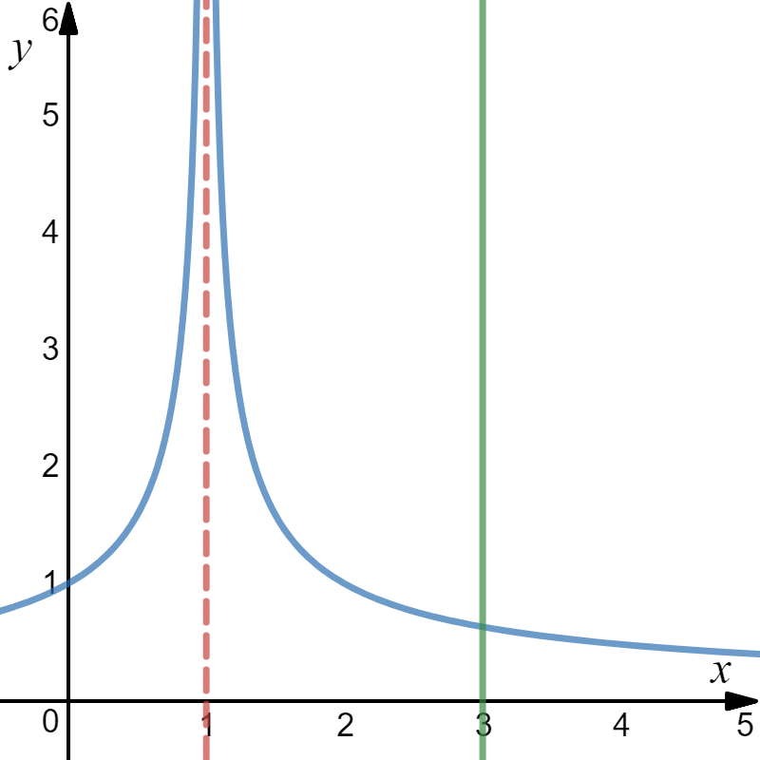
Example: Evaluate the improper integral, if possible.
The function approaches
when .

Slide 30
The integral converges.

Slide 31
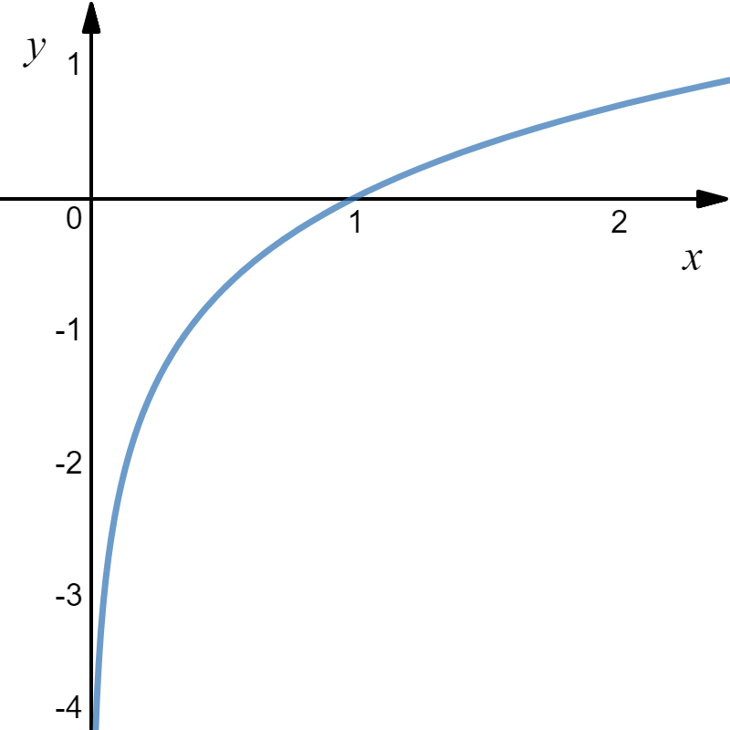
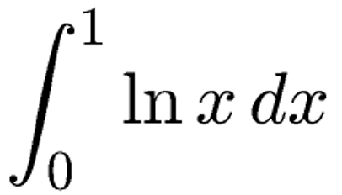
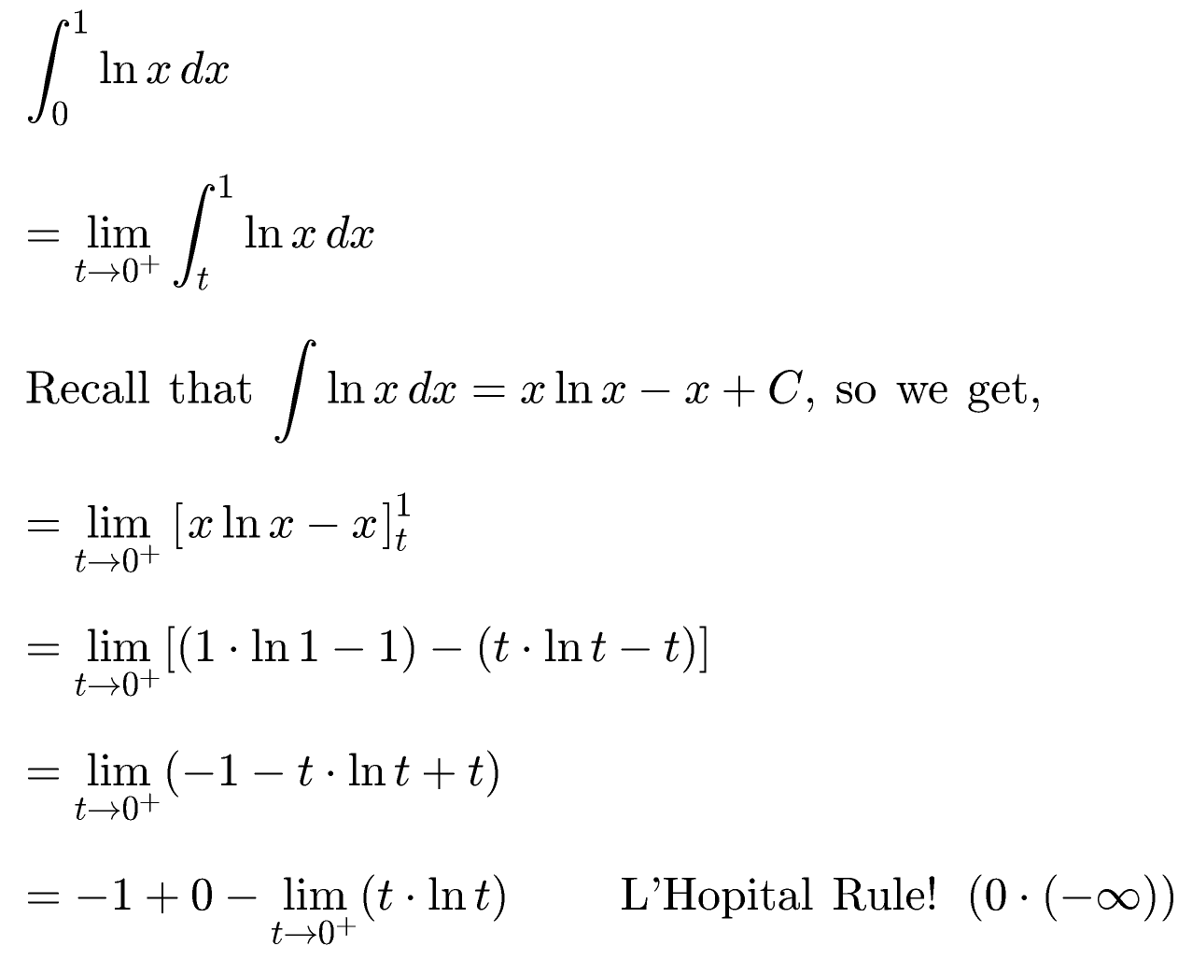
Example: Evaluate the improper integral, if possible.

Slide 32



Slide 33

Example: Evaluate the improper integral, if possible.
Tabular Integration
Diff
Int

Slide 34
1

Slide 35



