Slide 1
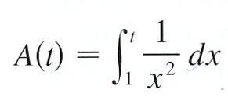
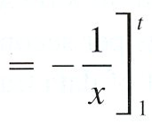
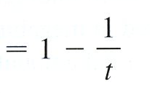
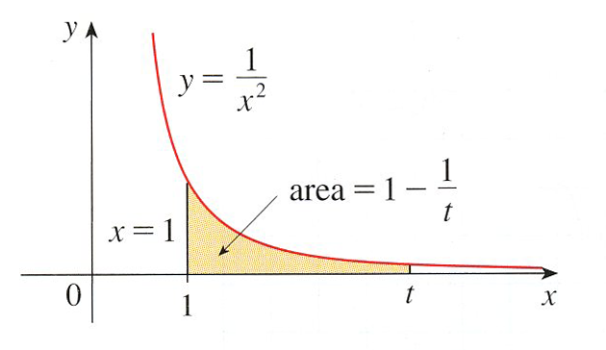
Consider the integral:

Slide 2
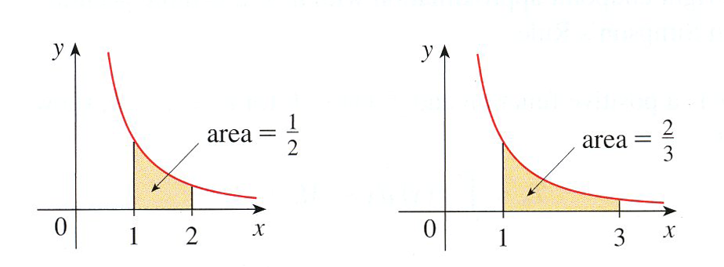
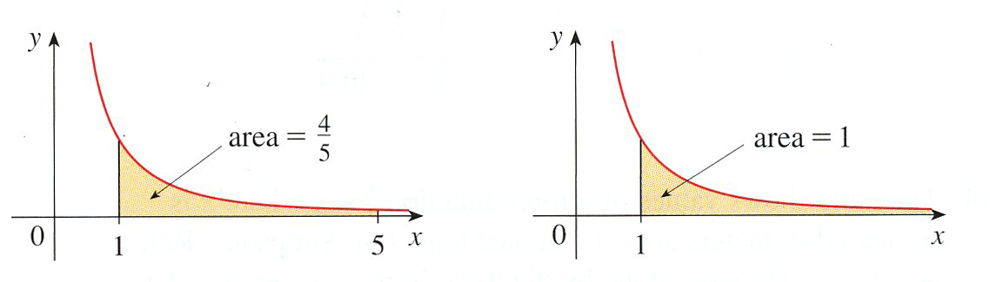
t = 2
t = 3
t = 5
?

Slide 3
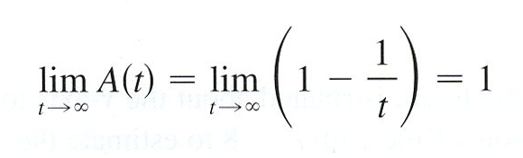
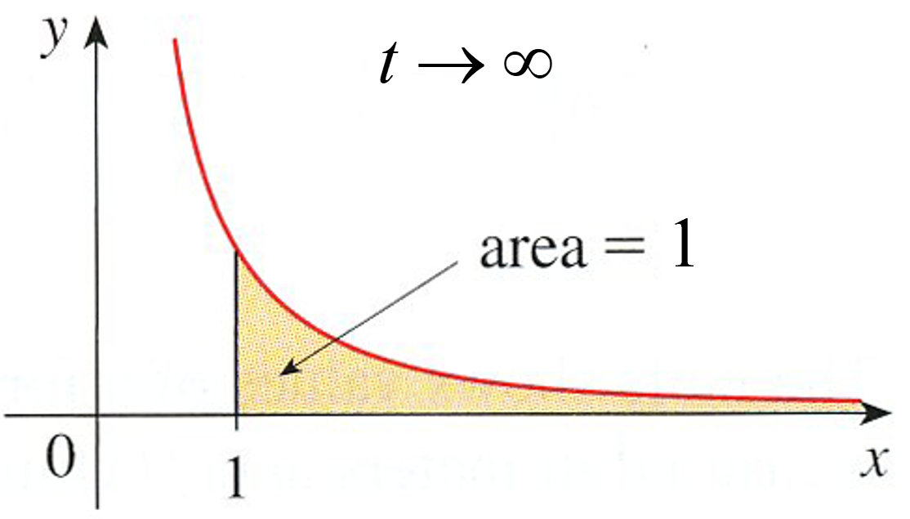
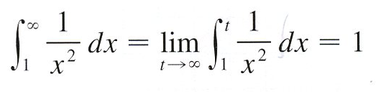

So, this is how we will deal with these kinds of integrals in general. We will replace the infinity with a variable (usually t), do the integral and then take the limit of the result as t goes to infinity.
On a side note, notice that the area under a curve on an infinite interval was not infinity as we might have suspected it to be. In fact, the area was a surprisingly small number, 1. Of course, this won’t always be the case, but it is important enough to point out that not all areas on an infinite interval will yield infinite areas.
Let’s now get some definitions out of the way. We will call these integrals convergent if the associated limit exists and is a finite number and divergent if the associated limit either doesn’t exist or it is plus or minus infinity.

Slide 4
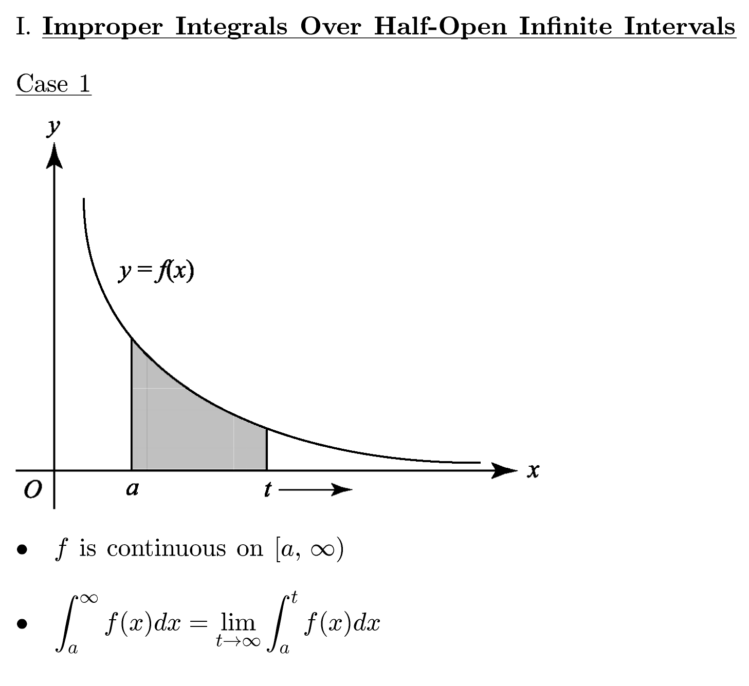
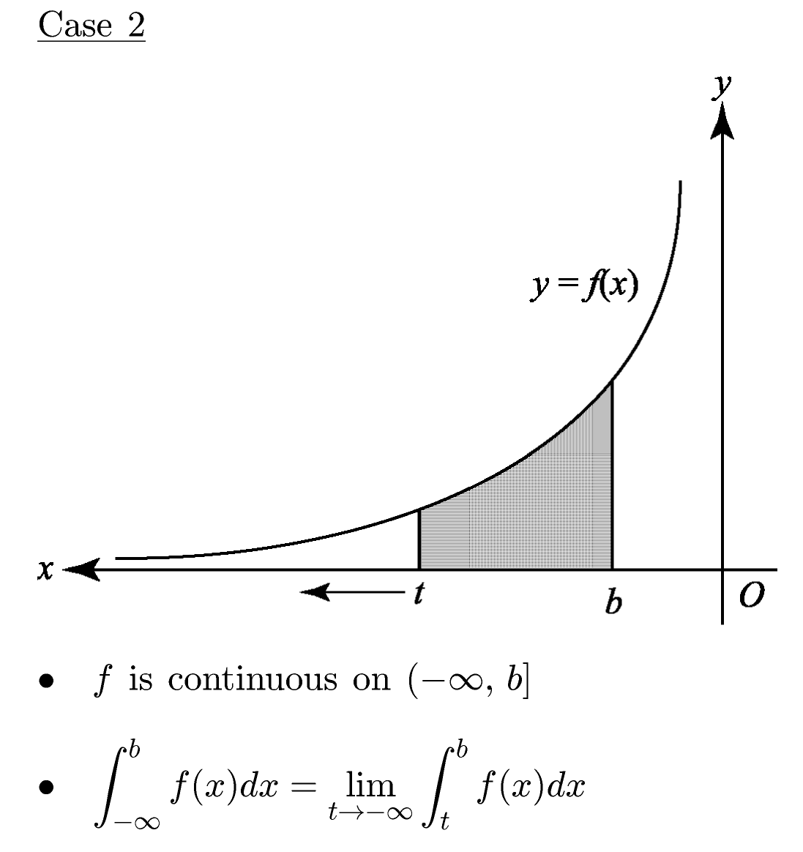

Let’s now formalize the methods for dealing with improper integrals. There are several cases that we’ll need to examine.

Slide 5
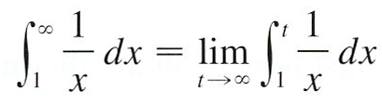
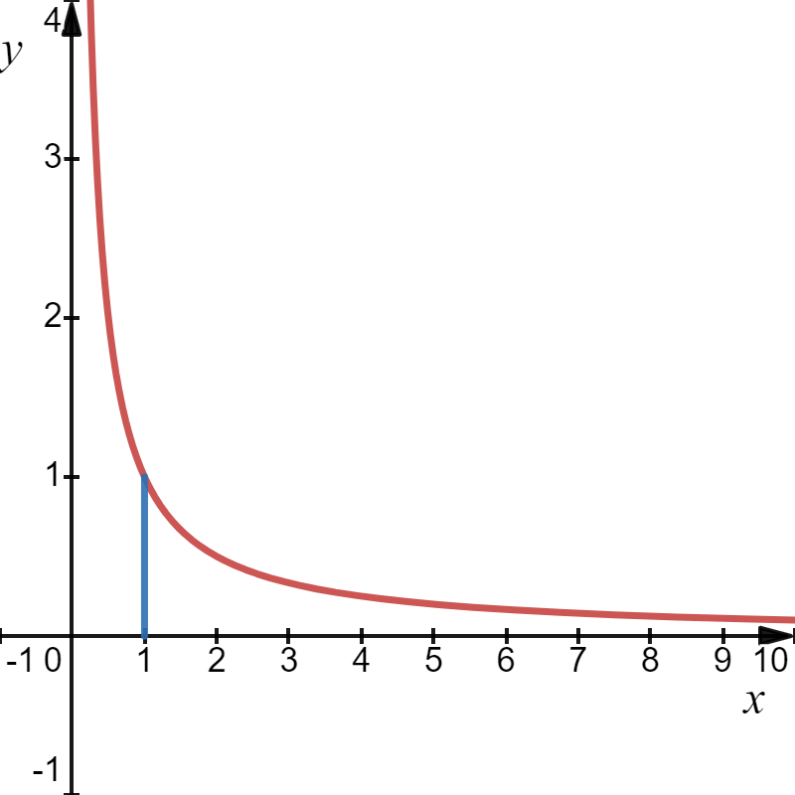
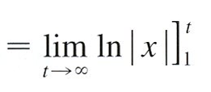




Example: Evaluate the improper integral, if possible.

Slide 6
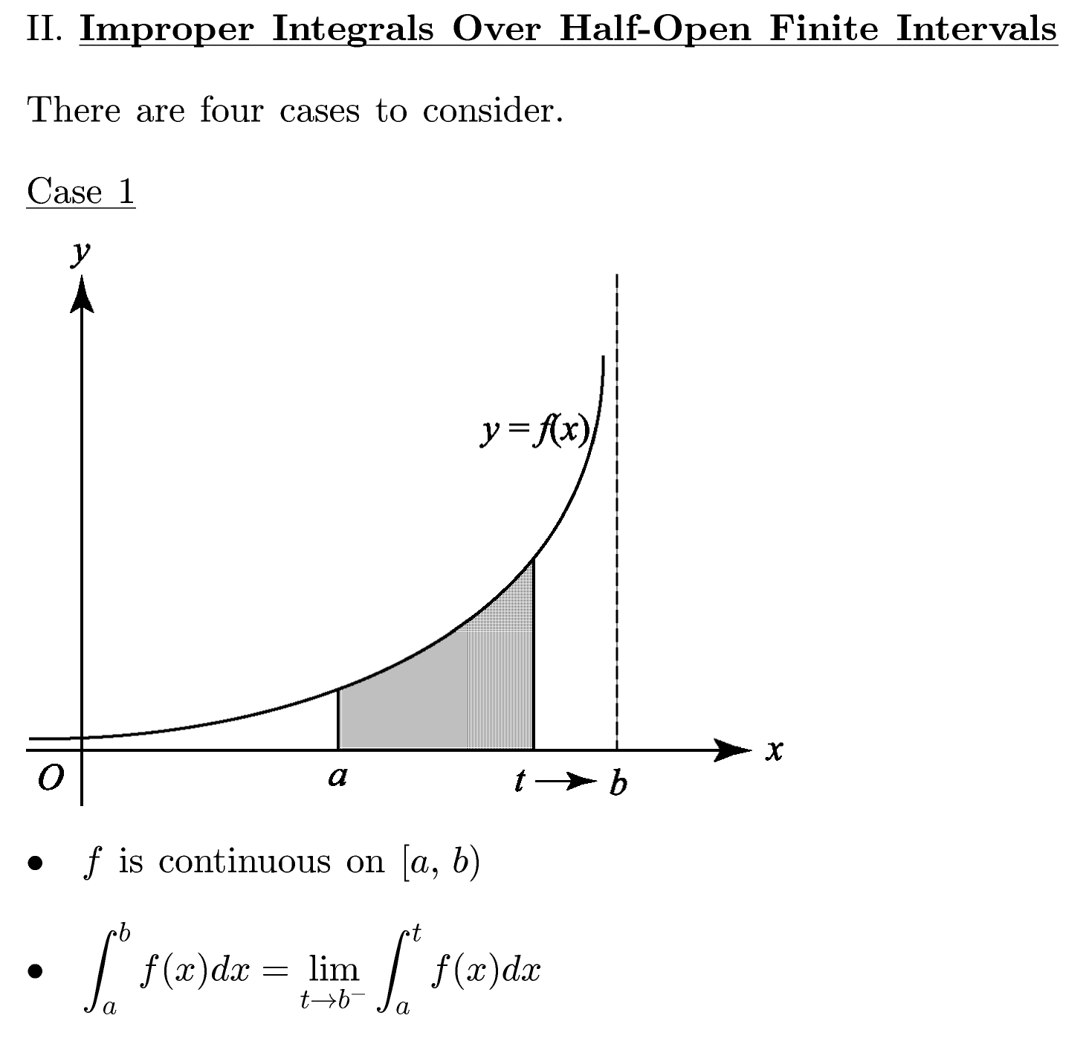
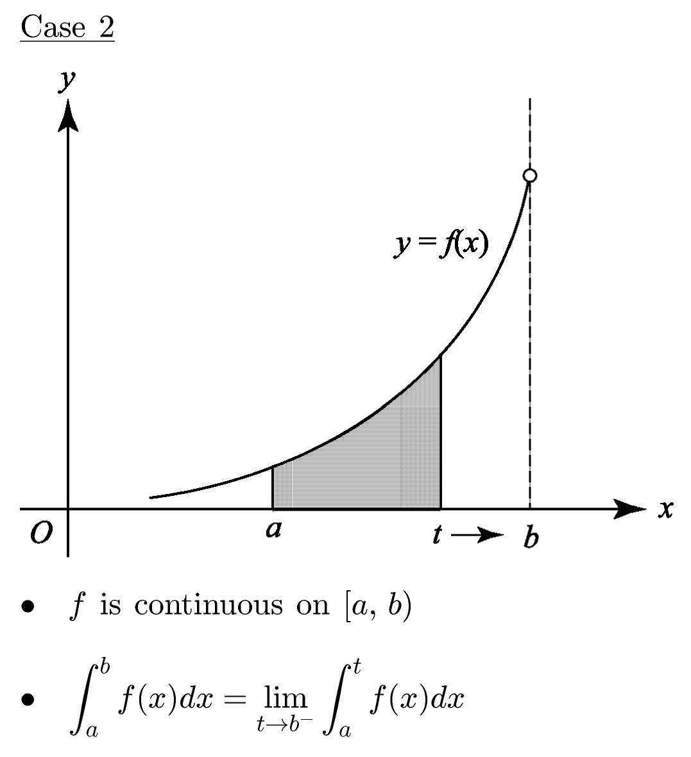

Slide 7

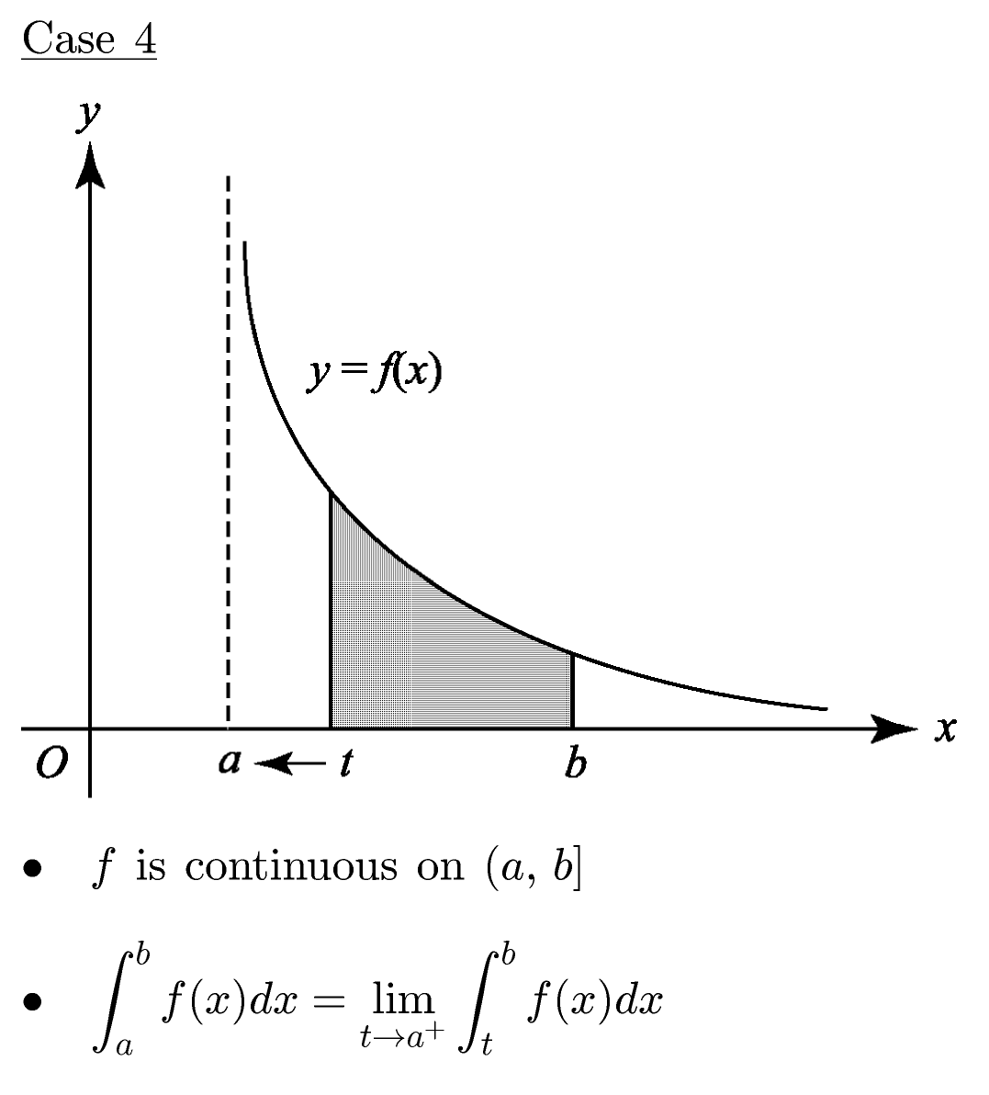

Slide 8
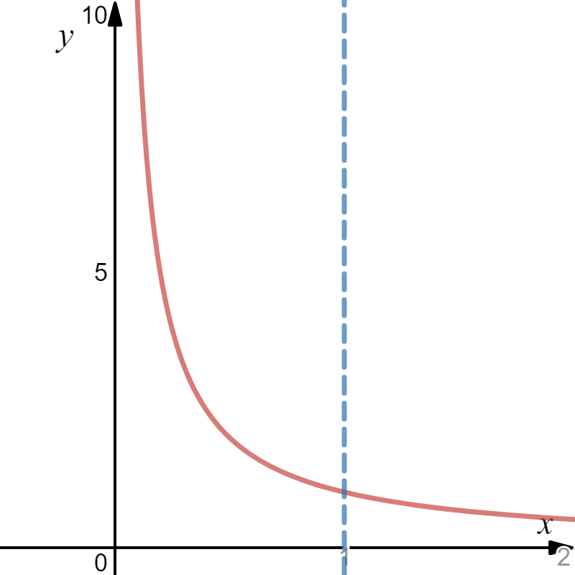

Example: Evaluate the improper integral, if possible.
$$x=1$$
(right hand limit)
We approach the limit from inside the interval.
This integral diverges.

Slide 9
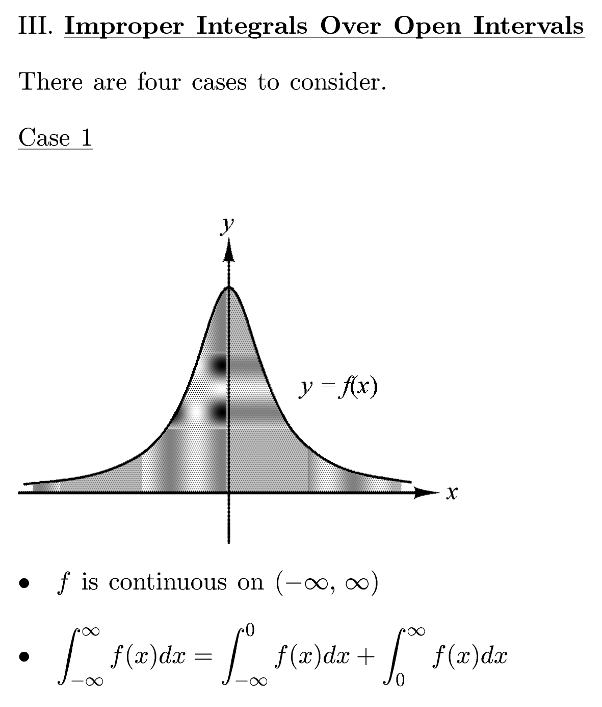
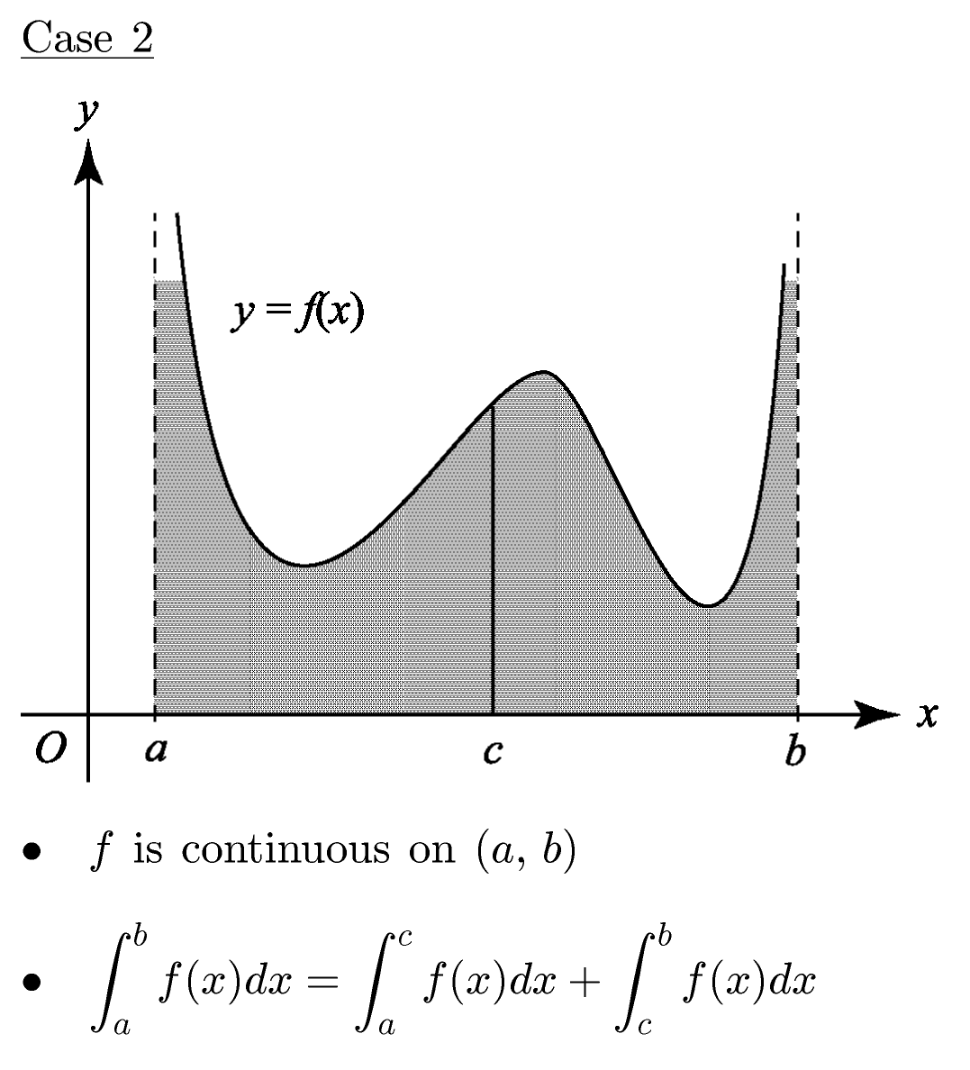

Slide 10
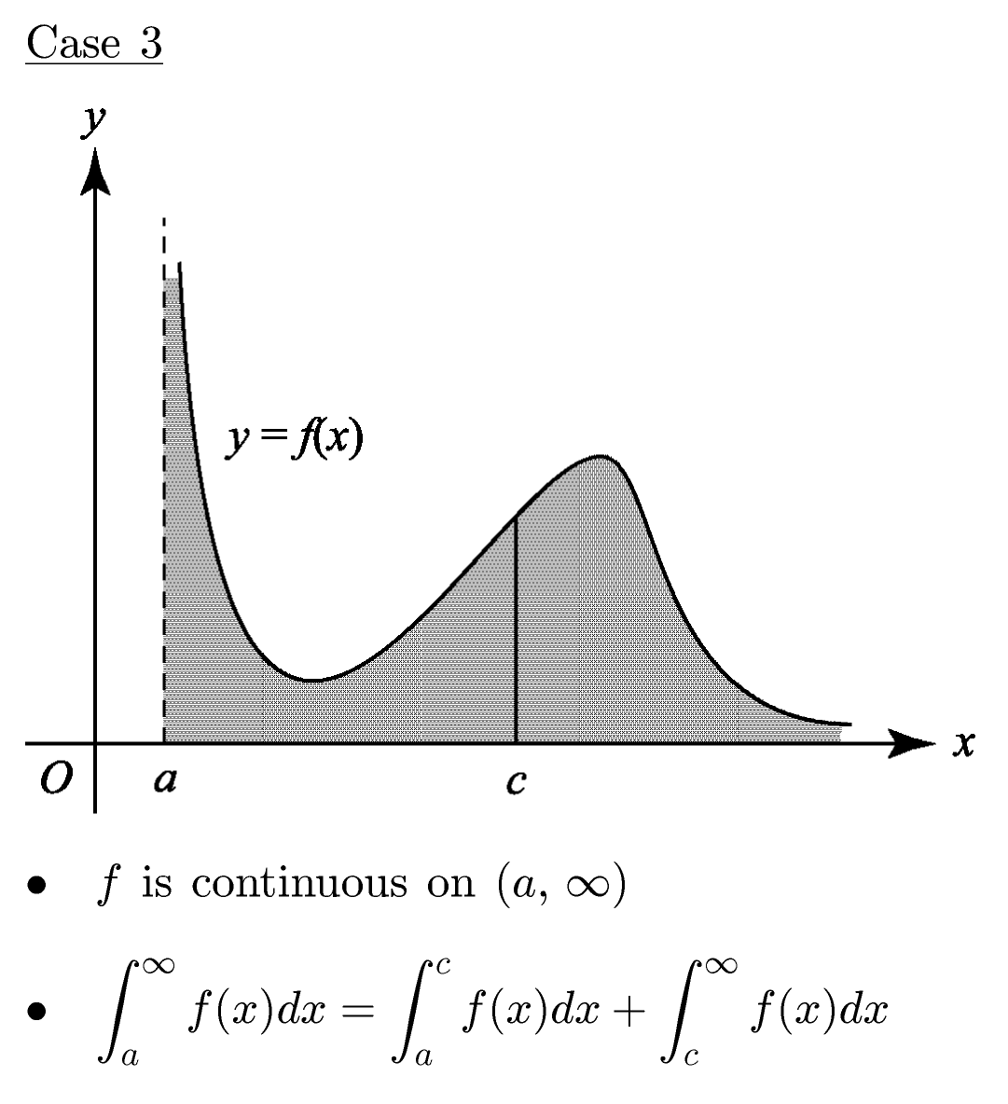
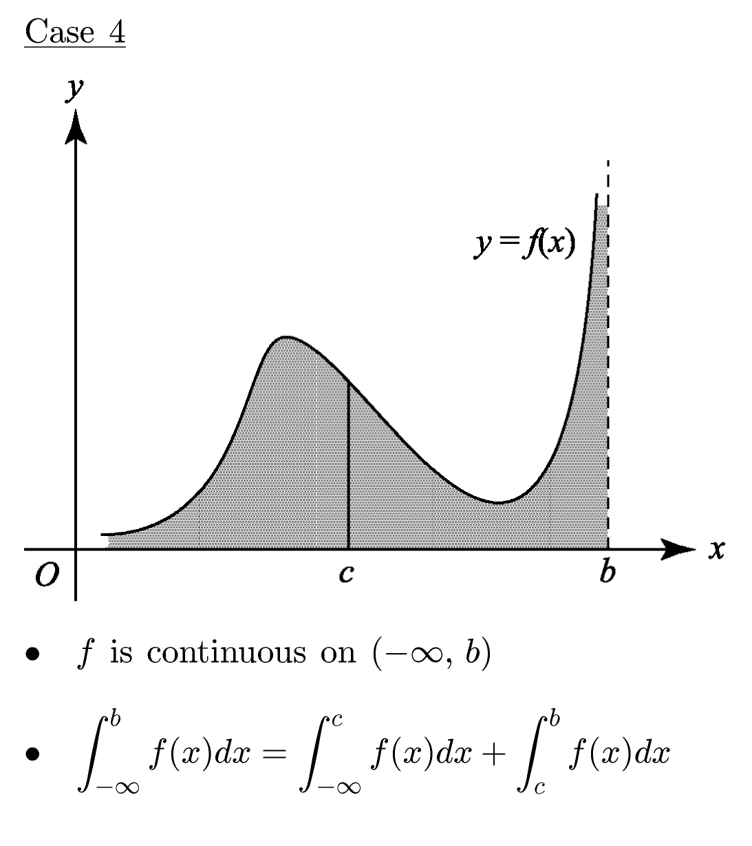

Slide 11
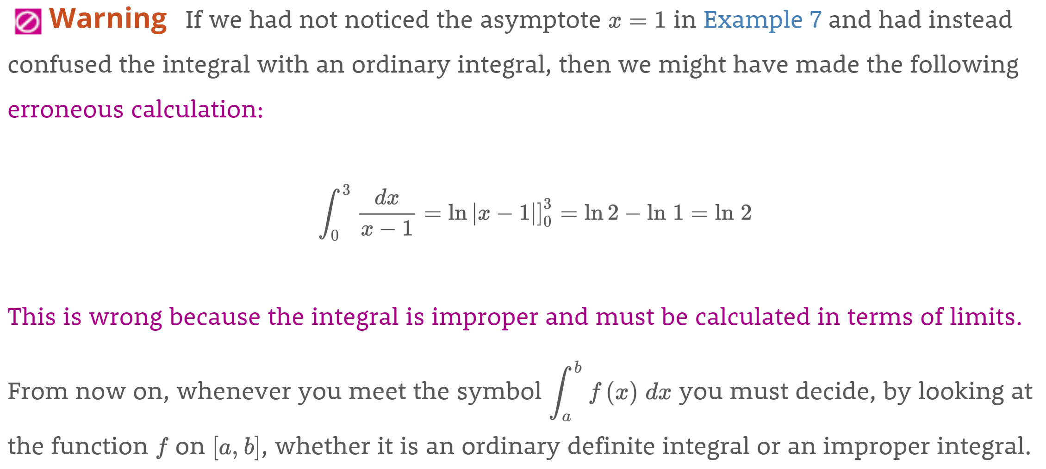


Slide 12
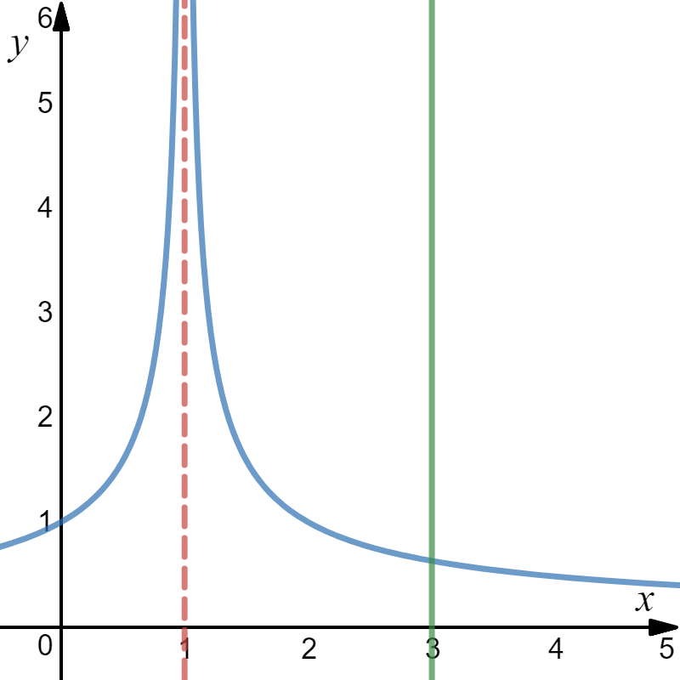
Example: Evaluate the improper integral, if possible.
The function approaches
when .

Slide 13
The integral converges.

Slide 14
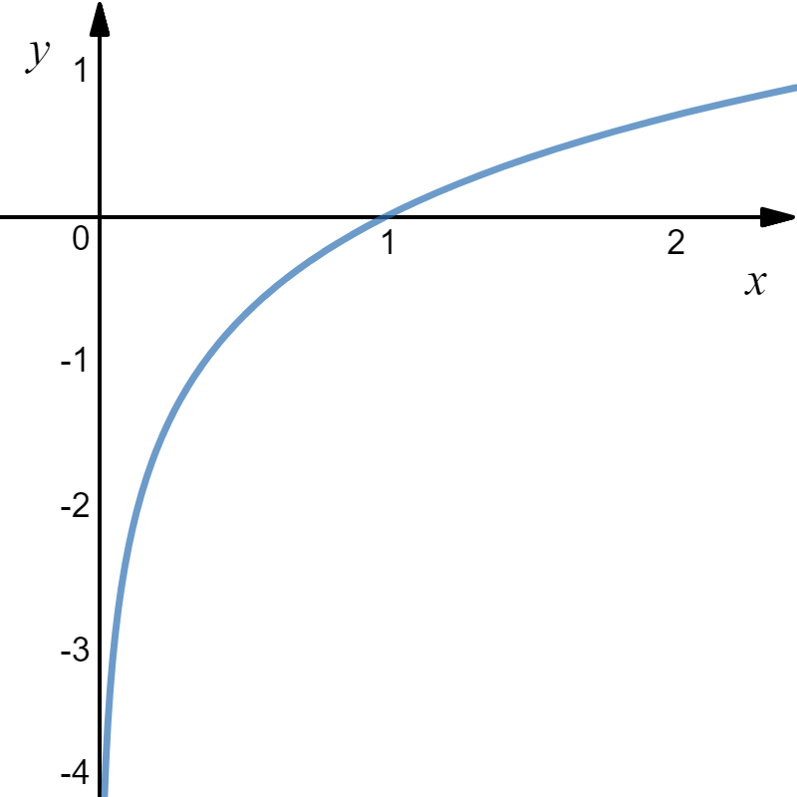
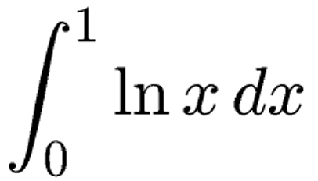
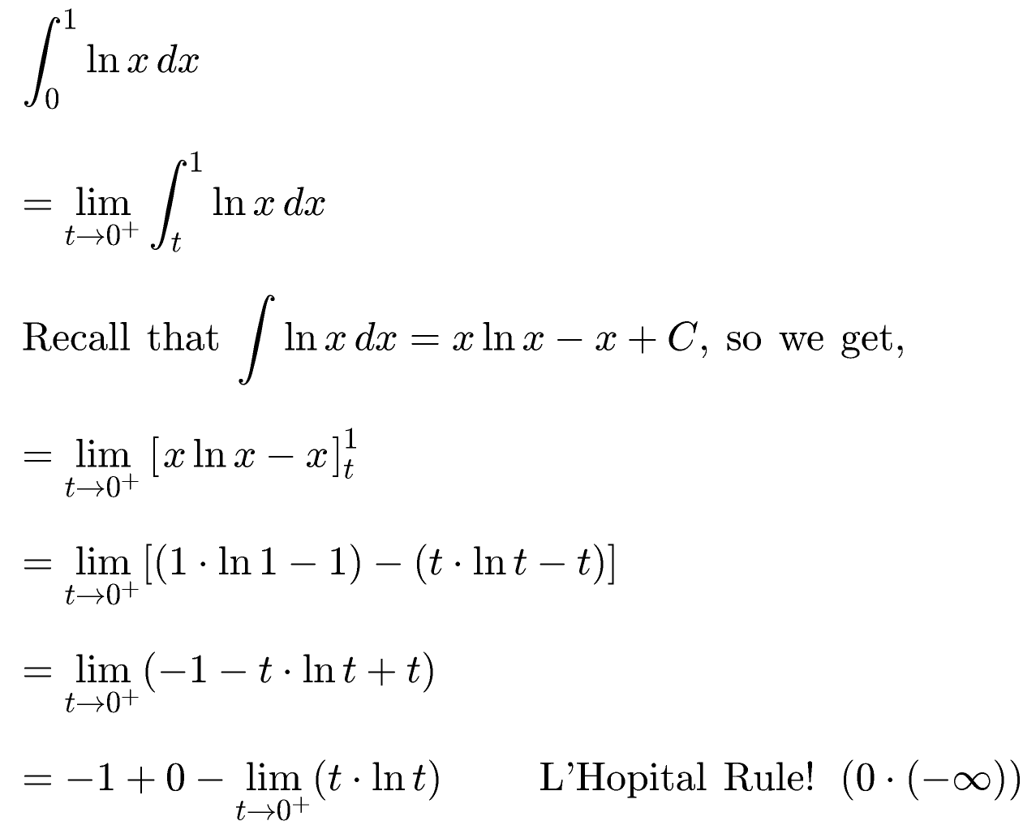
Example: Evaluate the improper integral, if possible.

Slide 15
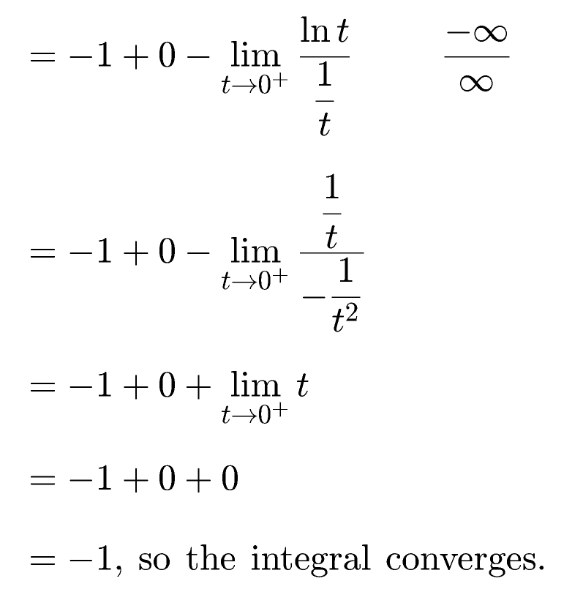

Slide 16
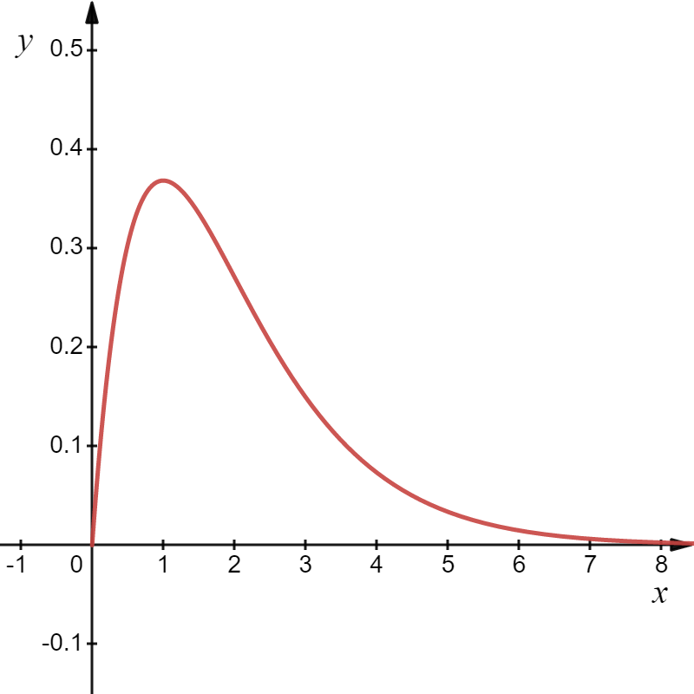
Example: Evaluate the improper integral, if possible.
Tabular Integration
Diff
Int

Slide 17
1

Slide 18
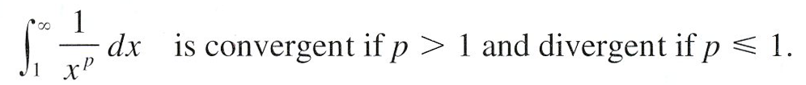
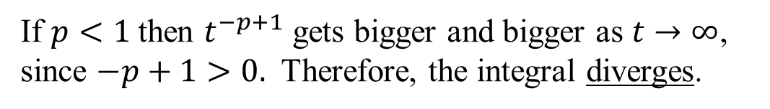



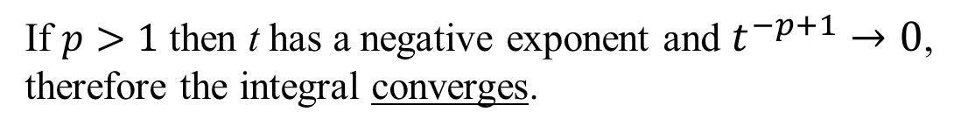
Theorem
Proof:
Now what happens?
(p is a constant.)
Case 1 $p=1$
Case 2 $p<1$
If $p<1$then $t^{−p+1}$ gets bigger and bigger as $t→∞$, since $−p+1>0.$ Therefore, the integral diverges.
Case 3 $p>1$
If $p>1$ then t has a negative exponent and $t^{−p+1}→0$, therefore the integral converges.

