Slide 1

7.5
STRATEGY FOR INTEGRATION
As we have seen, integration is more challenging than differentiation. In finding the derivative of a function it is obvious which differentiation formula we should apply. But it may not be obvious which technique we should use to integrate a given function.
In this section we present a collection of miscellaneous integrals in random order and the main challenge is to recognize which technique or formula to use. No hard and fast rules can be given as to which method applies in a given situation, but we give some general guidelines that you may find useful.
A prerequisite for applying a strategy is a knowledge of the basic integration formulas. In the following table we have collected the integrals from our previous list together with several additional formulas that we have learned in this chapter.

Slide 2

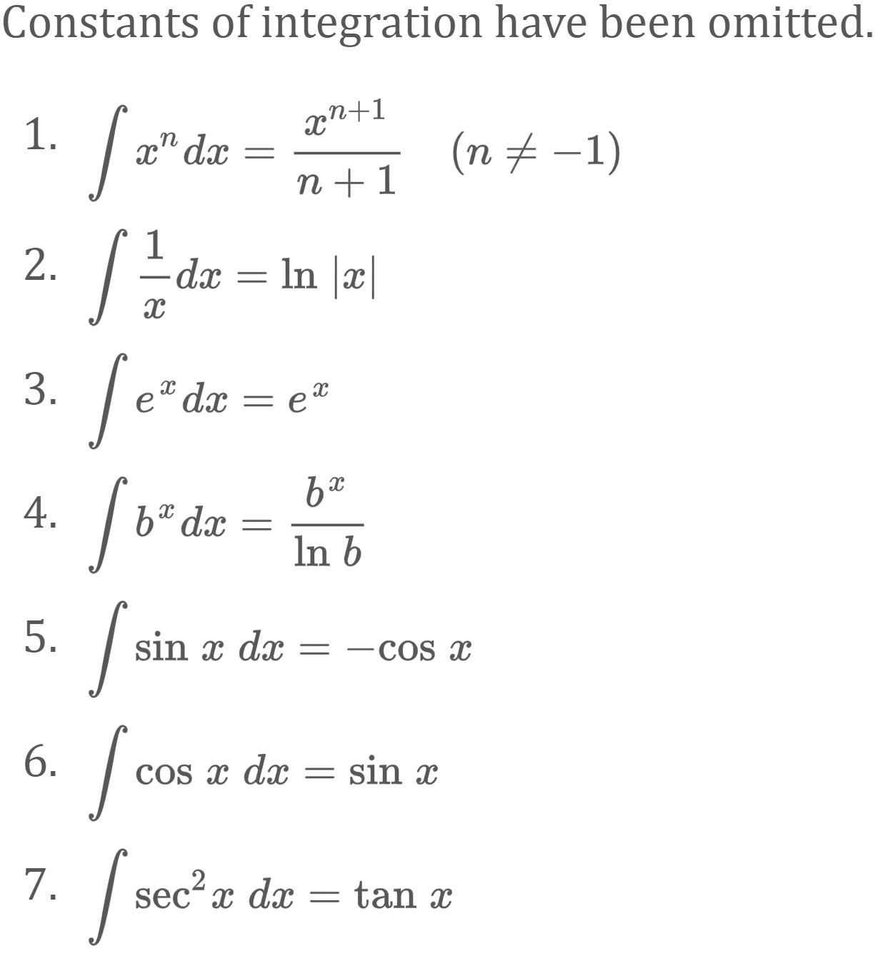
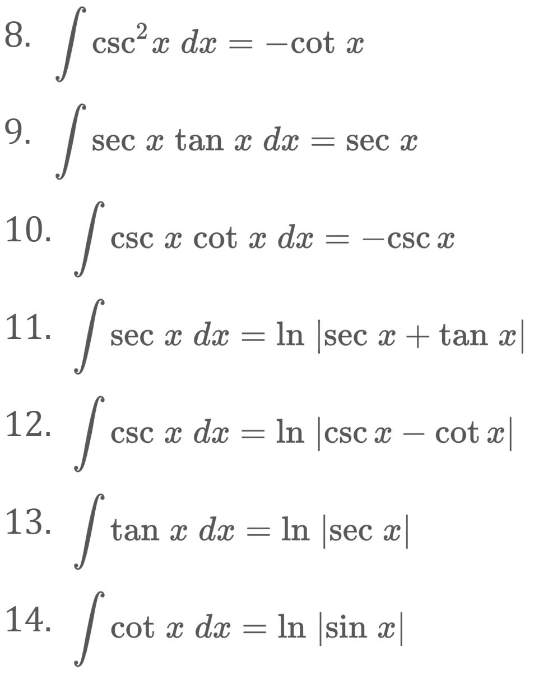
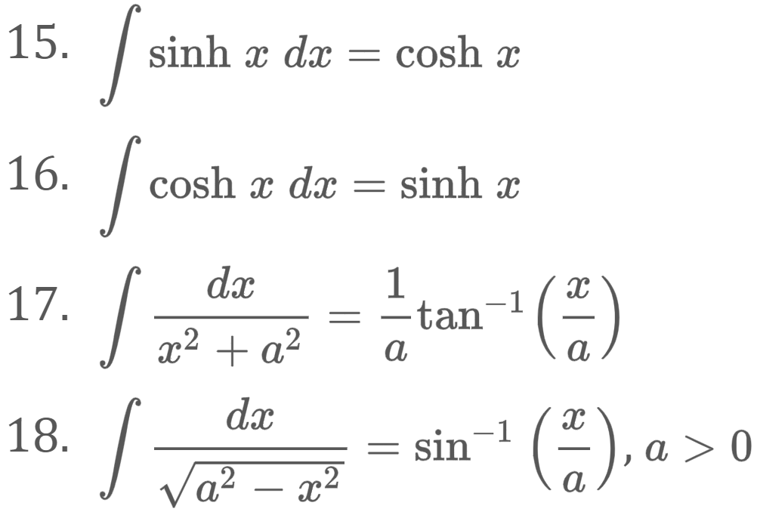
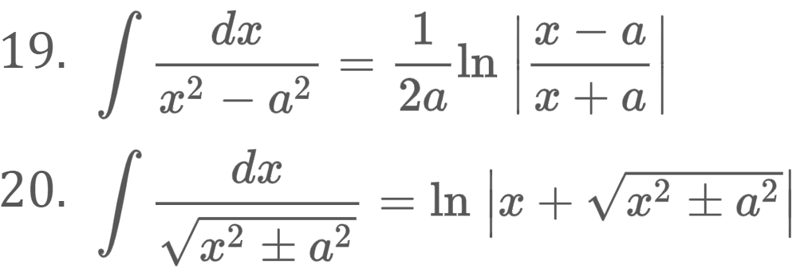

Slide 3
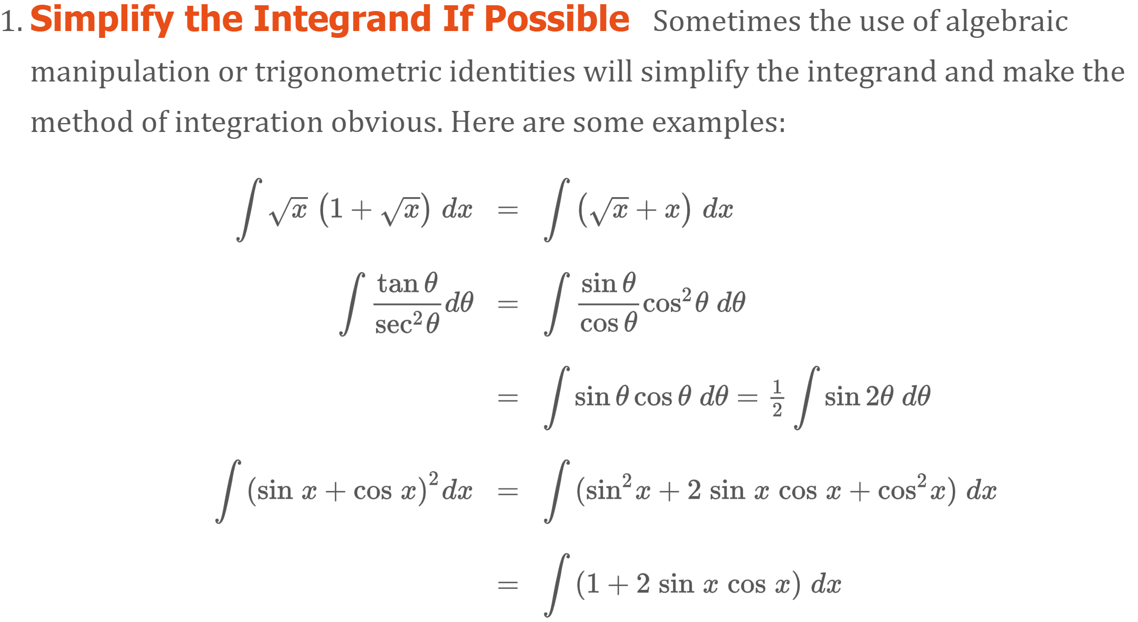

Once you are armed with these basic integration formulas, if you don’t immediately see how to attack a given integral, you might try the following four-step strategy if the integrand is not an obvious derivative.

Slide 4
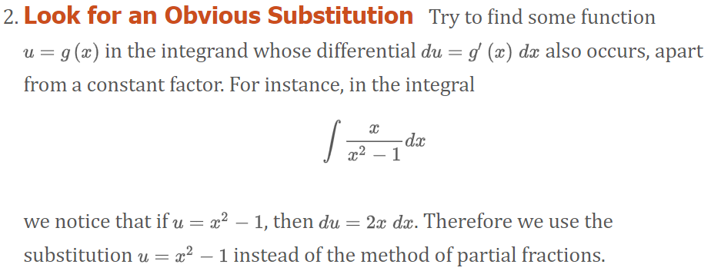

Slide 5
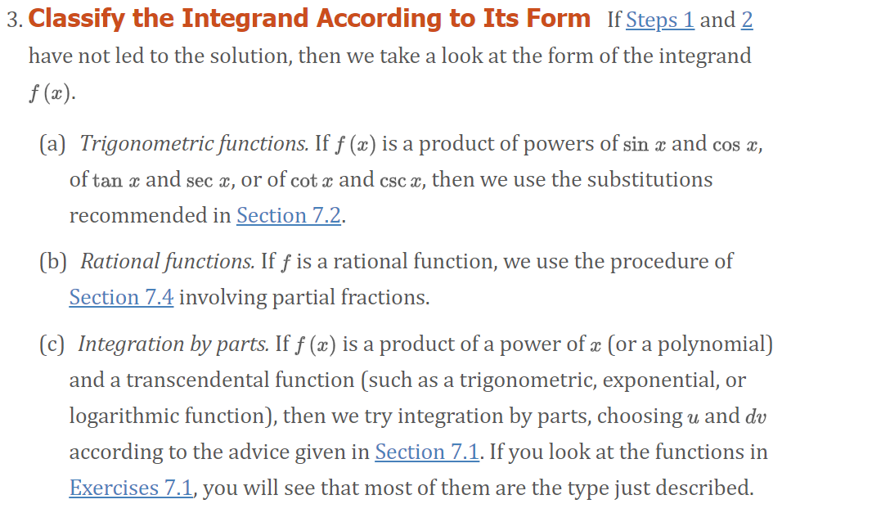

Slide 6
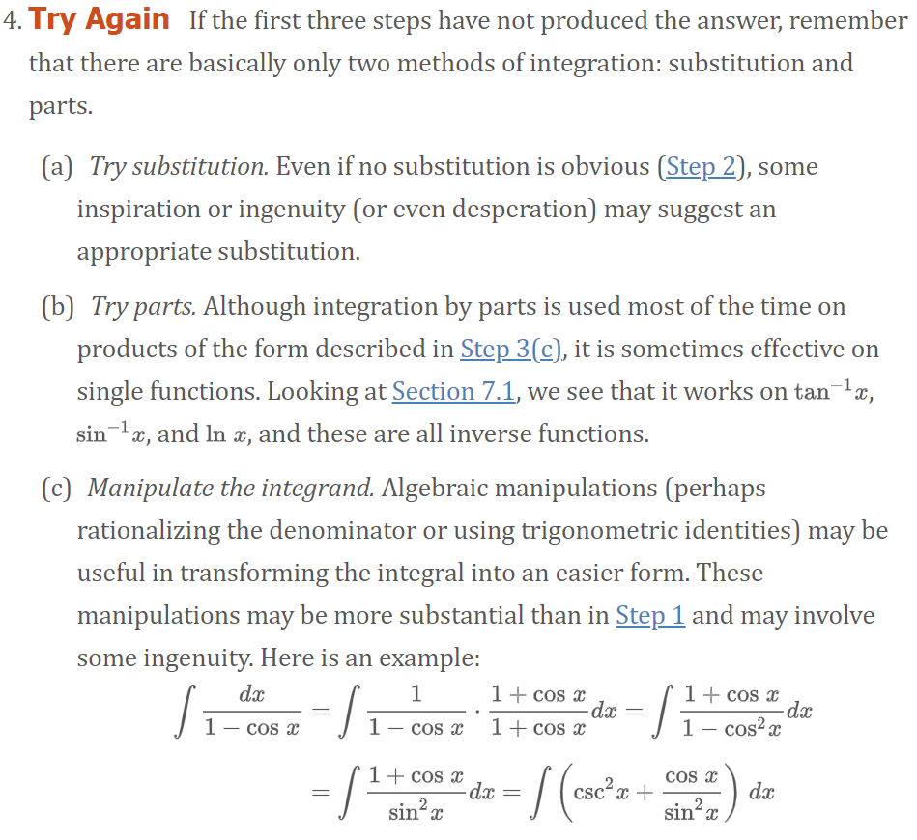

Slide 7

Example Evaluate the integral.
Let:

Slide 8
Example Evaluate the integral.
Let:
Let:

Slide 9
Example Evaluate the integral.
Getting Cancel Crazy

Slide 10
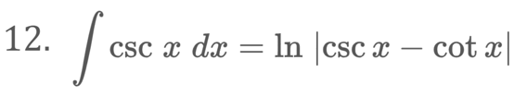
Trig-Substitution is so much fun!!

Slide 11
Example Evaluate the integral.
Let:
Let: u = 0
Let: u = 1

Slide 13
Example Evaluate the integral.
Let:

Slide 14
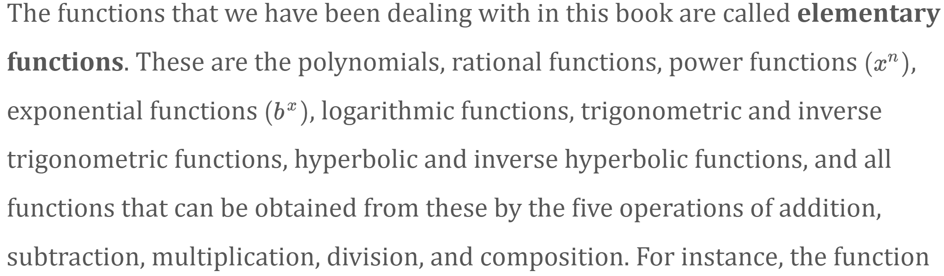

Can We Integrate All Continuous Functions?

Slide 15
