Slide 1
Consider the antiderivative of a rational function.
There are 5 cases we need to explore.
Let’s check them out.

Slide 2

Example
This would be a lot easier if we could rewrite it as two separate terms.
Factor the denominator.
Separate into individual fractions
Multiply by the common denominator.
Clever choice for x.

Slide 4
This technique is called
Partial Fractions

Slide 5
Example

Slide 6
Example
irreducible
quadratic
factor
Linear factor
first degree numerator

Slide 7

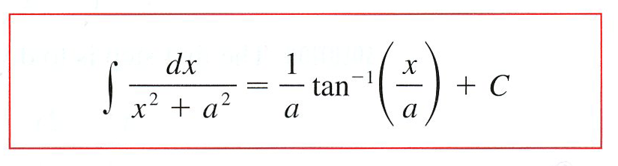
u - sub

Slide 8
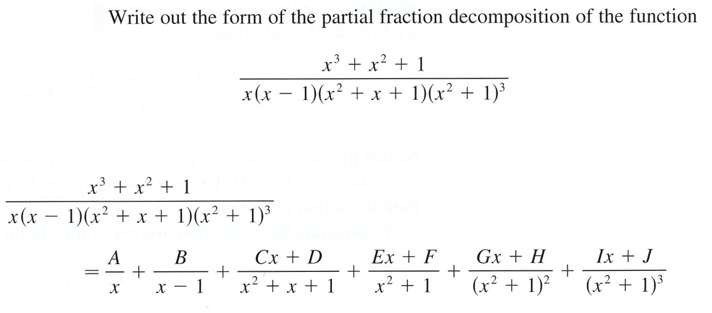
Example

Slide 9

Case V Rational Express is an Improper Fraction
Example
If the degree of the numerator is equal to or higher than the degree of the denominator, we use long division first.
(From the first example)

Slide 10
Example

Slide 11

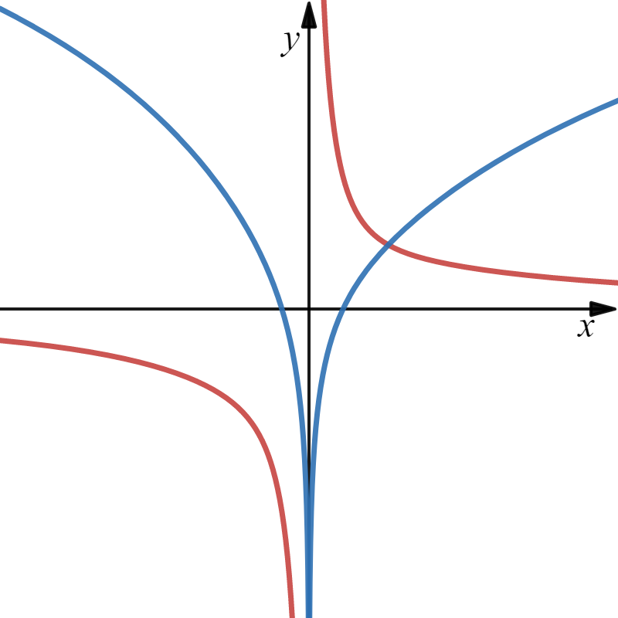

Identify each function.

Slide 12

