Slide 1

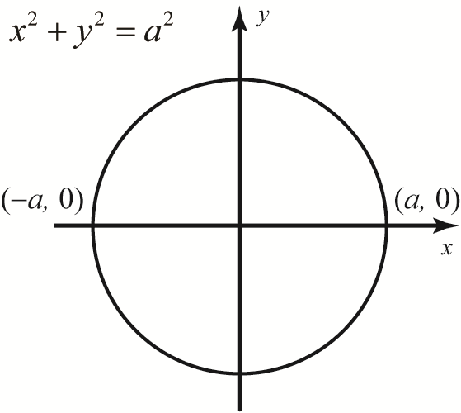
U-substitution or Parts doesn’t work!
What do we do now?
Clever Mathematics of course!

Slide 2






The clever Mathematics is called Trigonometric Substitution, “trig-sub”. Remember that every technique of integration transforms the integrand into an obvious derivative.
.
Here is how it works.

Slide 3


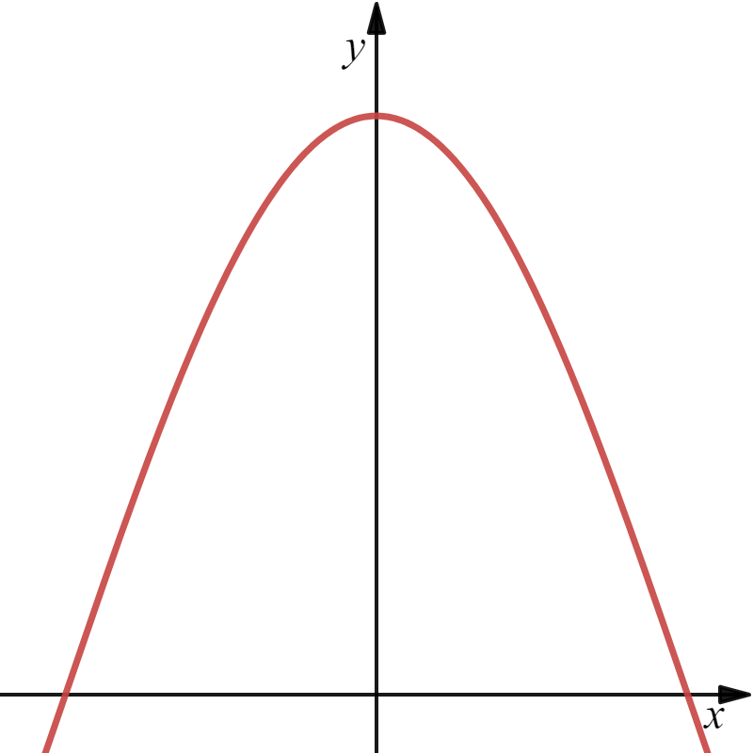
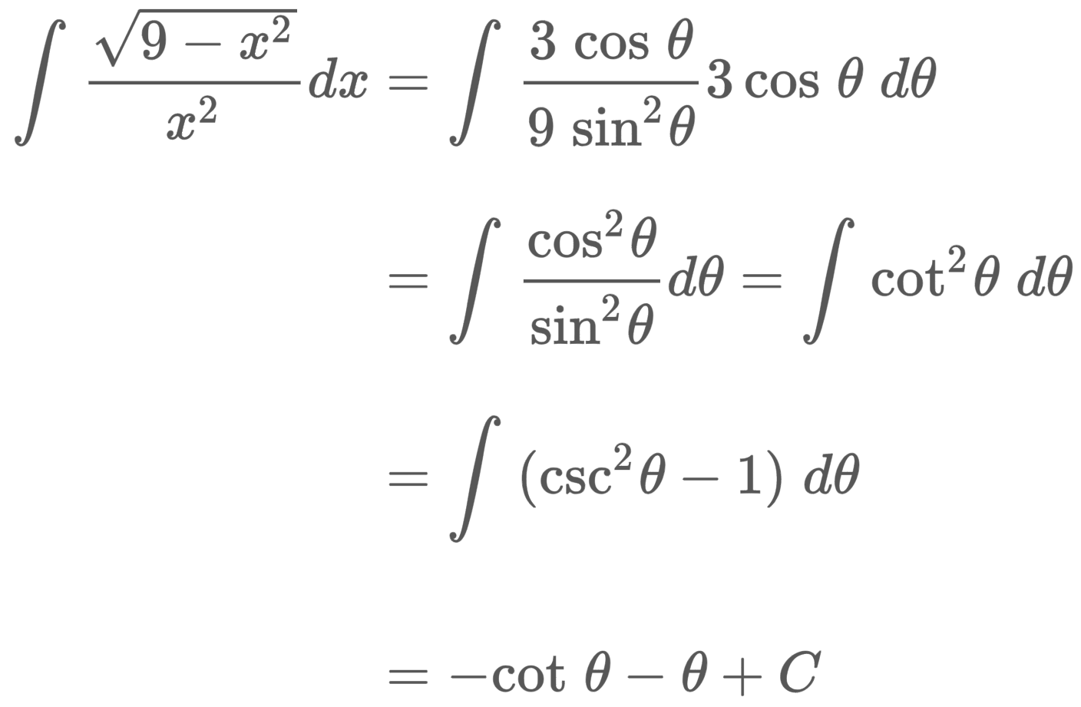





Let’s see how it works.
Example
$$1$$
Trig-Sub
$$y=\cos{x}$$
$$−\frac{π}{2}$$
$$\frac{π}{2}$$
Are we done?
NO!
We want the antiderivative in terms of x.

Slide 4
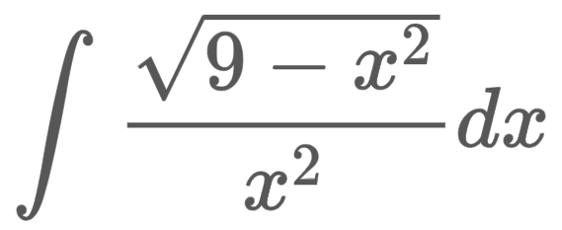


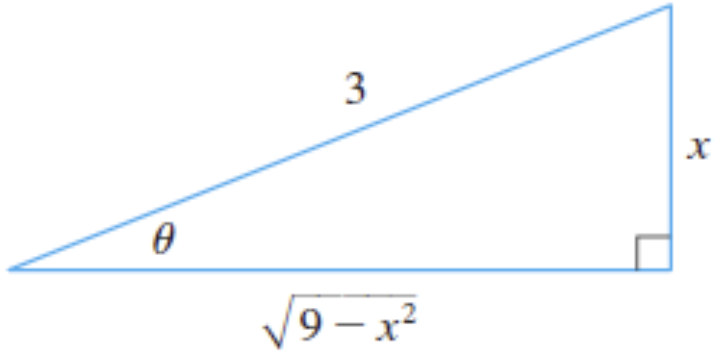
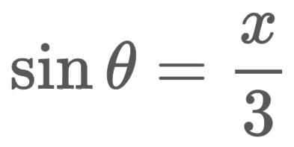

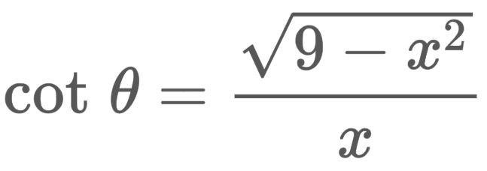
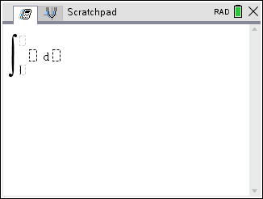
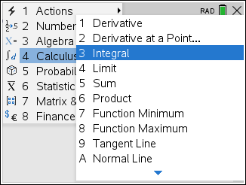
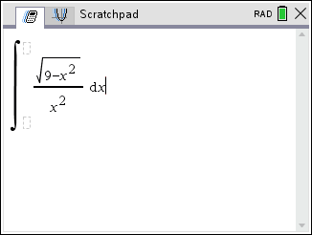
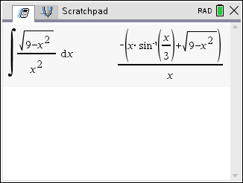
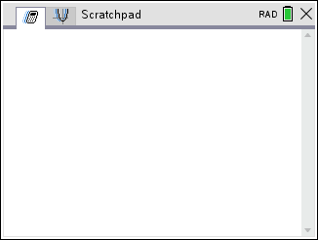

We let
so we get,
Right trigonometry gives us,
This looks like FUN!! Let’s do more!

Slide 5


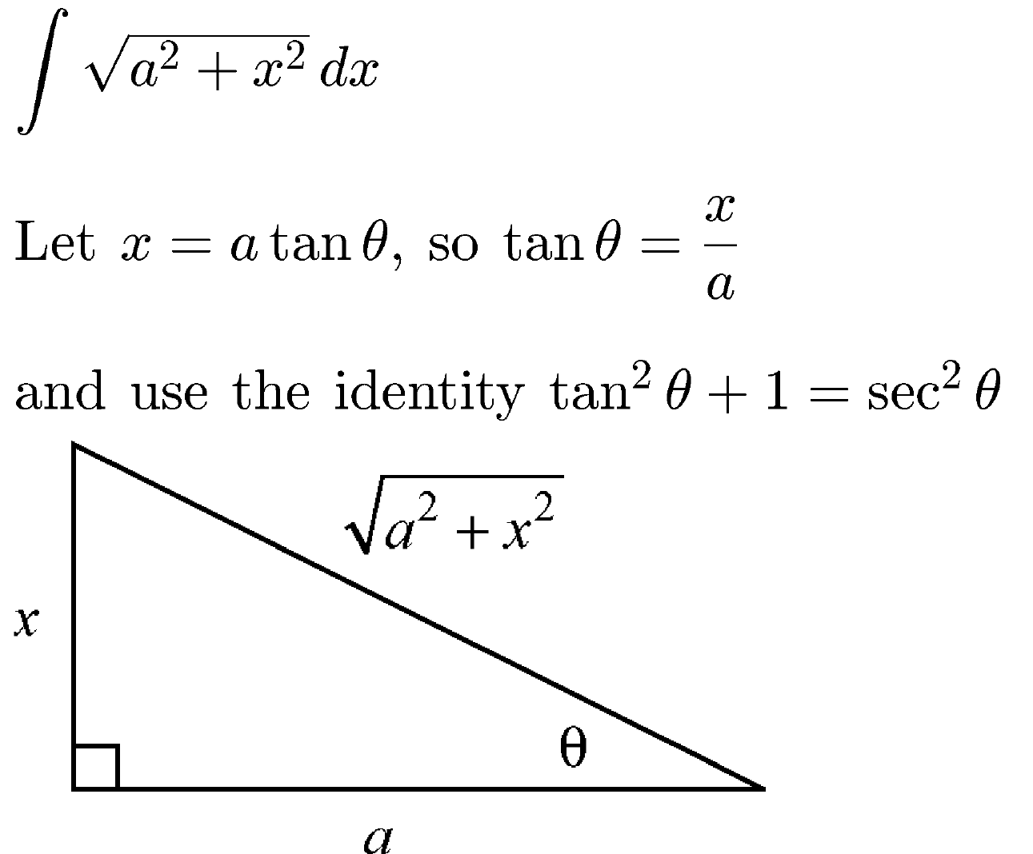
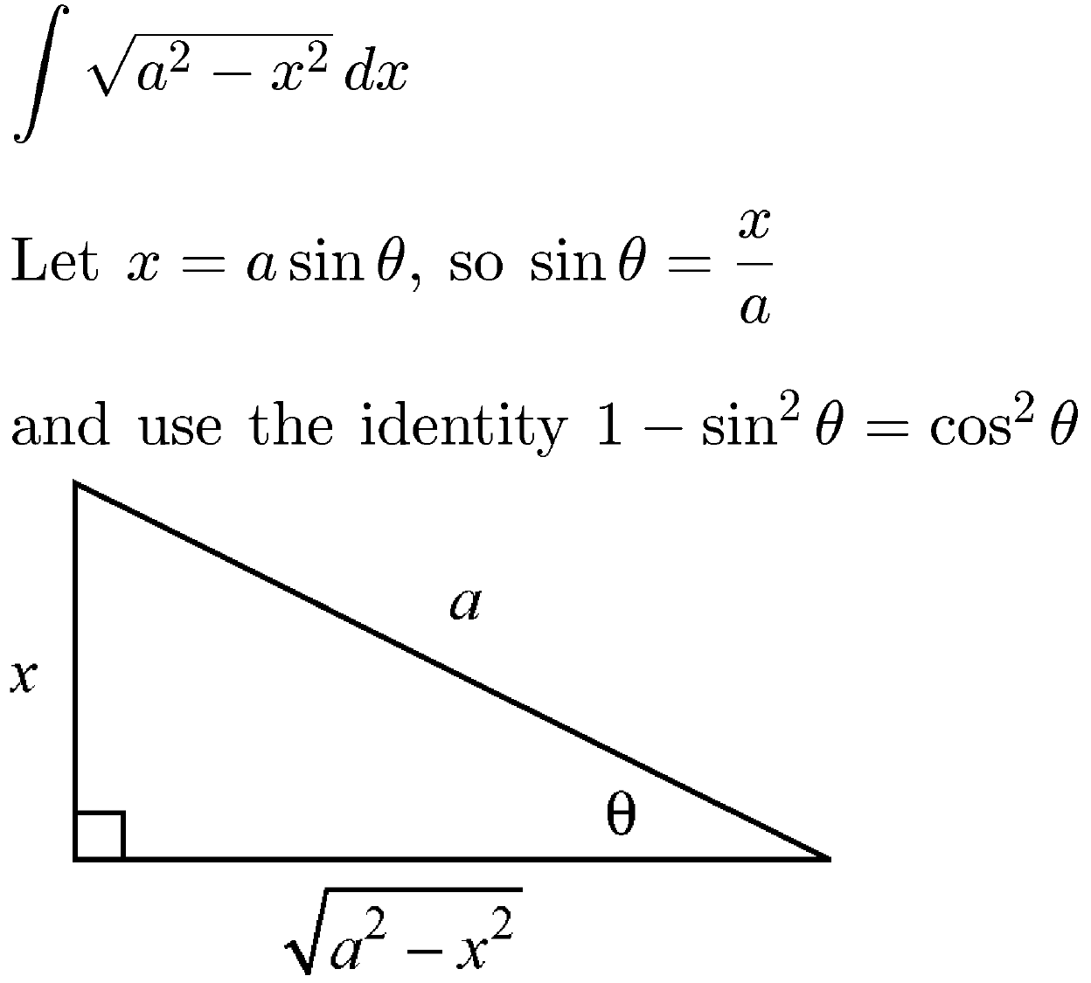

Slide 6
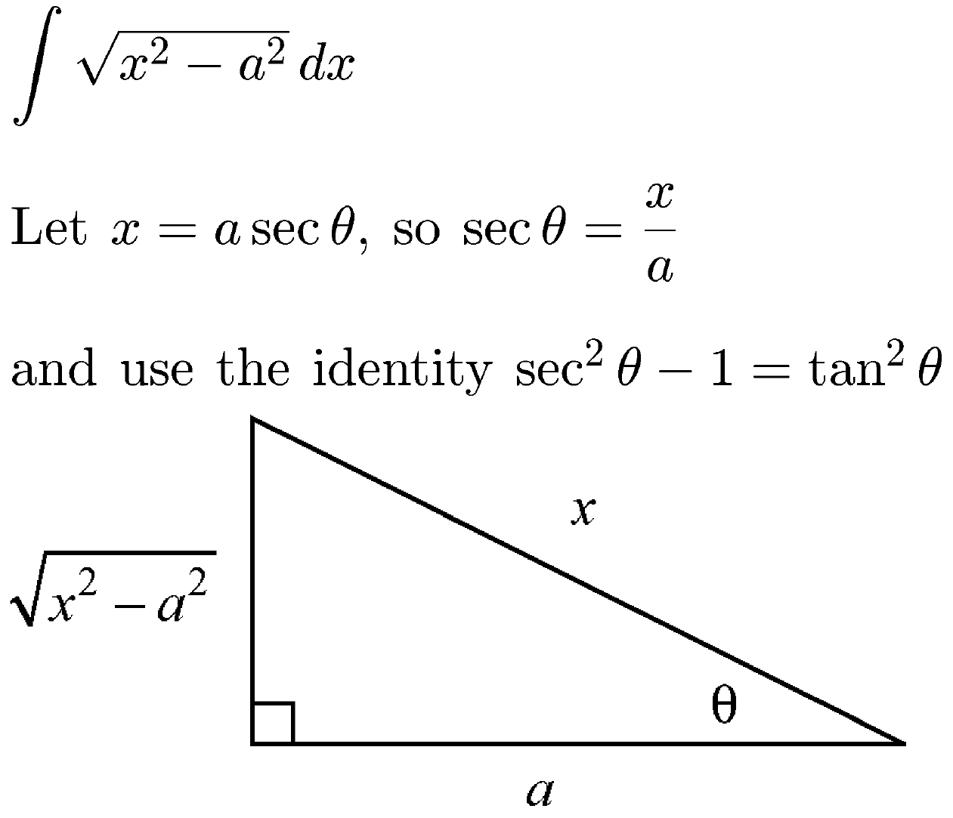

Slide 7
Example
Are we done?
NO!!

Slide 9
That was fun!!

Slide 10
Example

Slide 12
Example

Slide 14
Wow!! That was fun!!
I can’t wait to do my homework!!

Slide 15
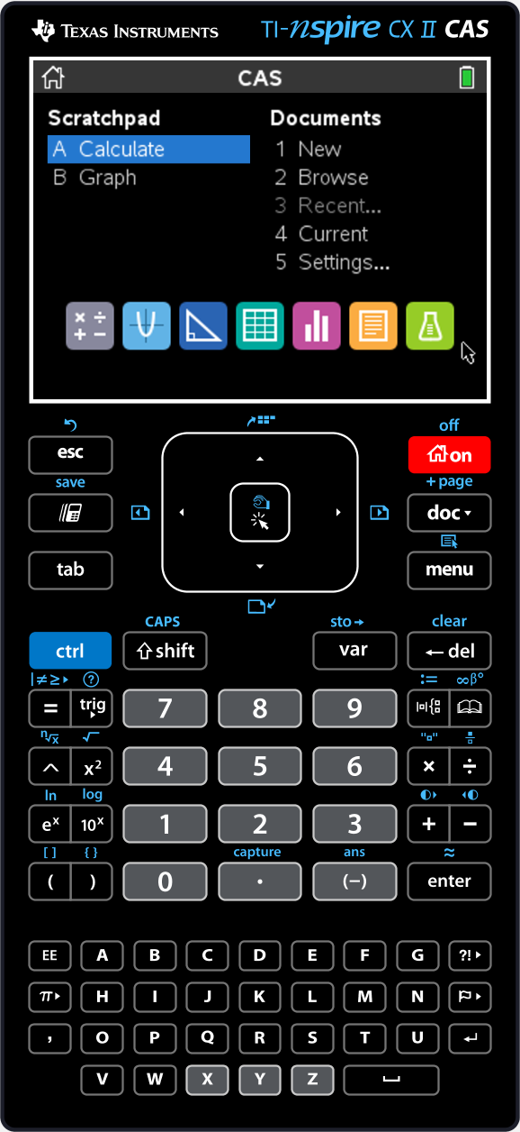




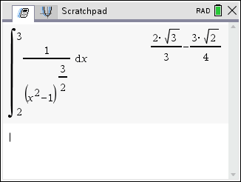
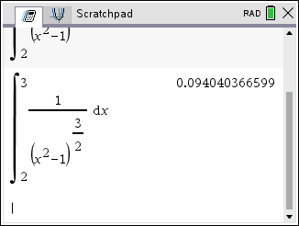
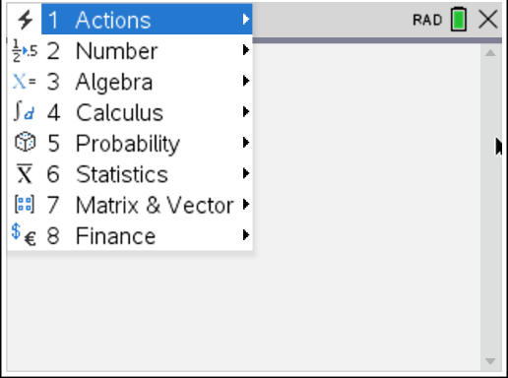
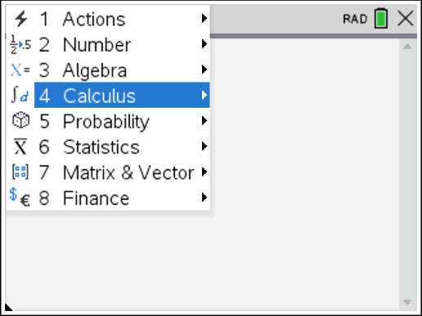
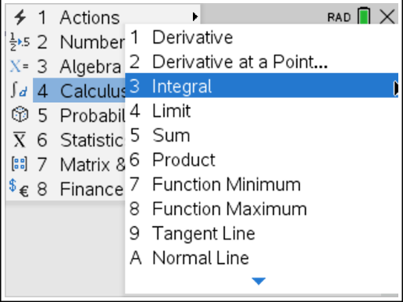
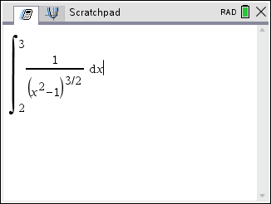
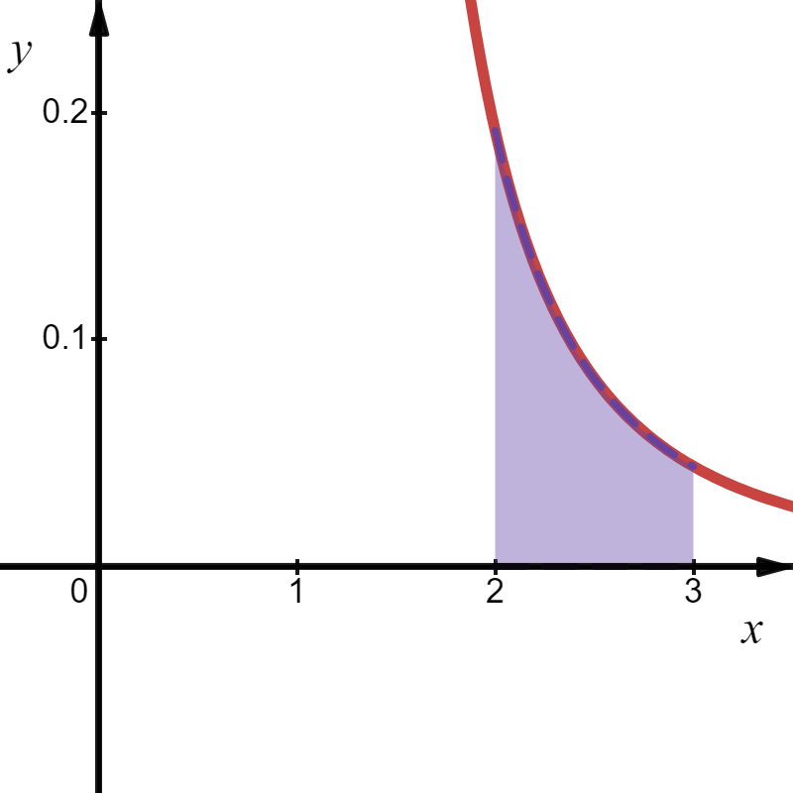
Computer Algebra Systems
Closed Form, Exact Answer
Deceitful Decimal!!
12 Sig – Figs!!

Slide 16
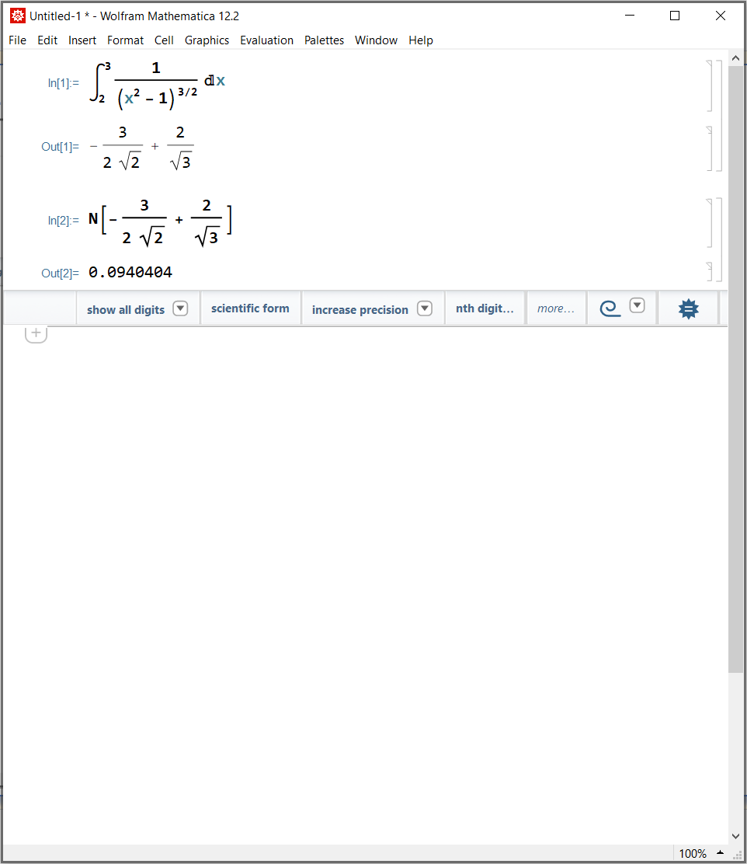
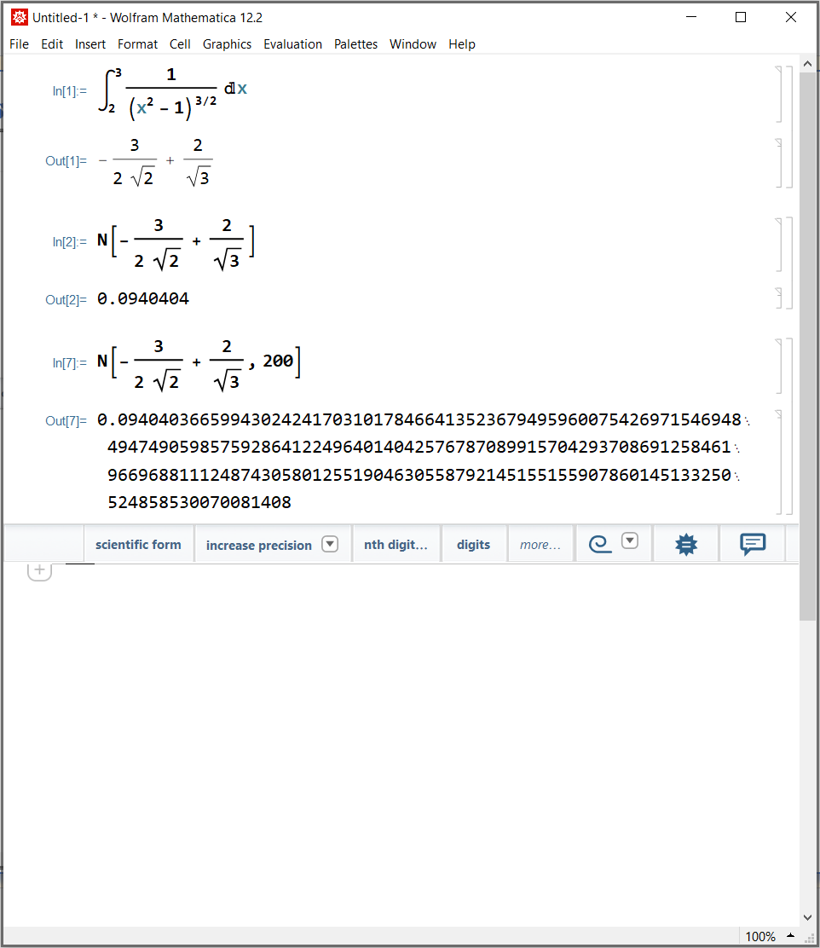
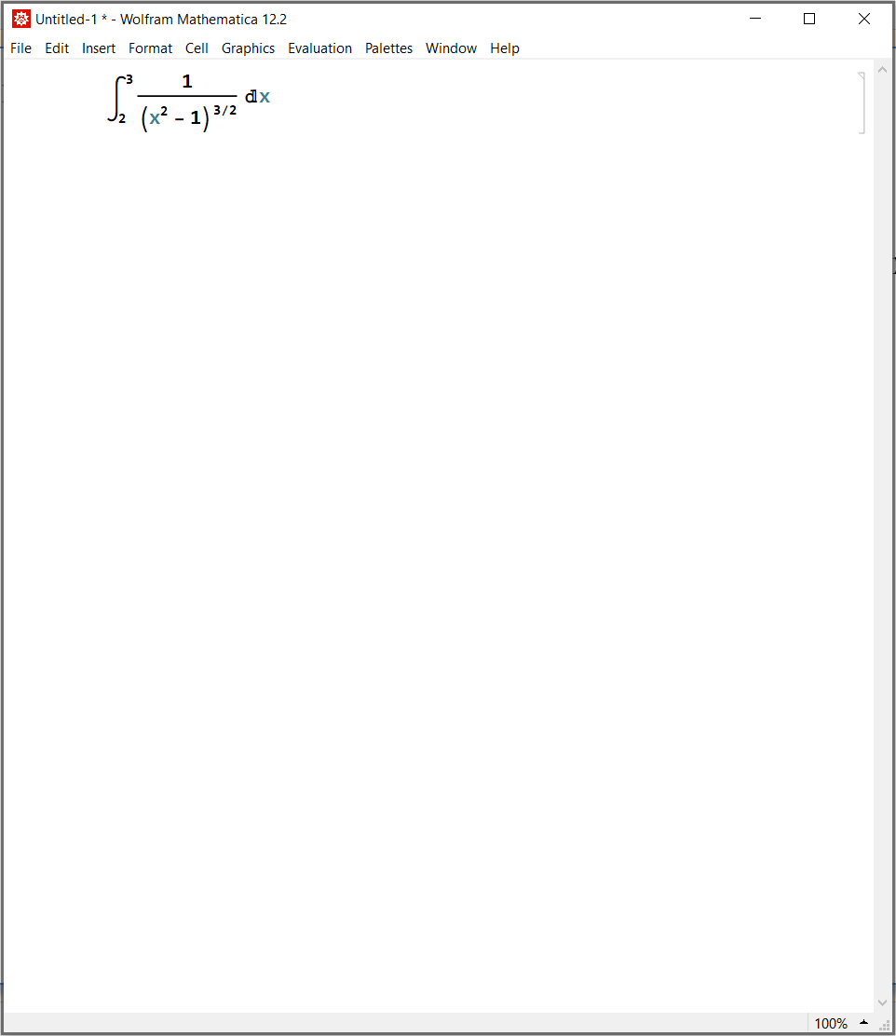
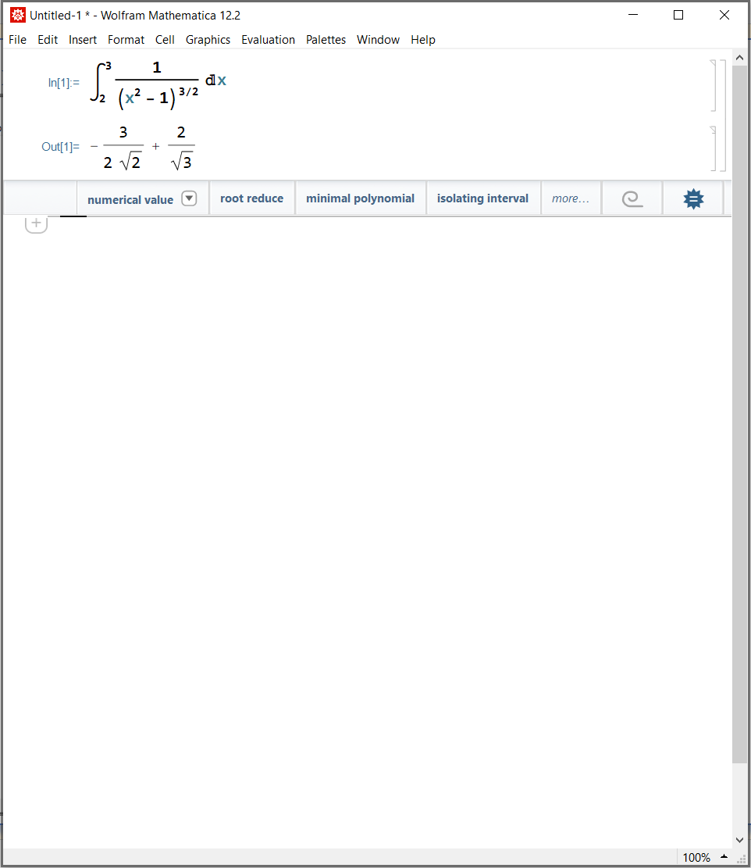
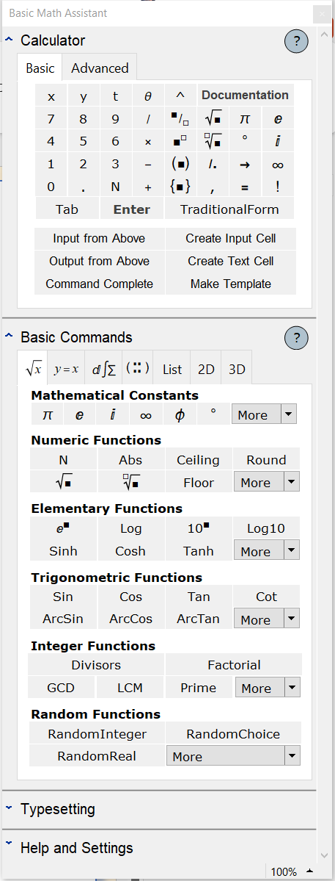
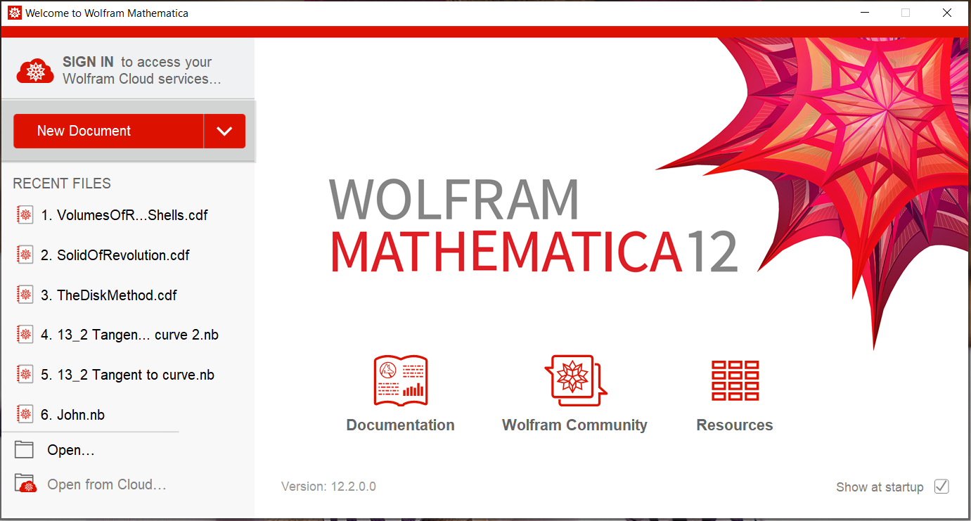
Computer Algebra Systems

Slide 17
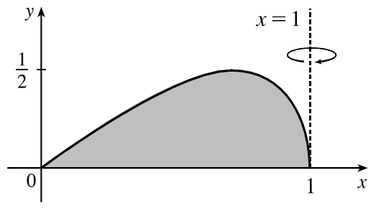










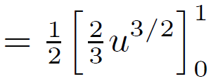




Example
Find the volume of the solid obtained by rotating about the line x = 1 the region under the curve $y=x\sqrt{1−x^{2}}, 0≤x≤1.$
units³

