Slide 1
In this section we use trigonometric identities to integrate certain combinations of trigonometric functions. We start with powers of sine and cosine.
Even Powers
If the exponent is even, use the power
reducing identity.

Slide 2
Odd Powers
If the exponent is odd use the Pythagorean Identity
and u-substitution.

Slide 3



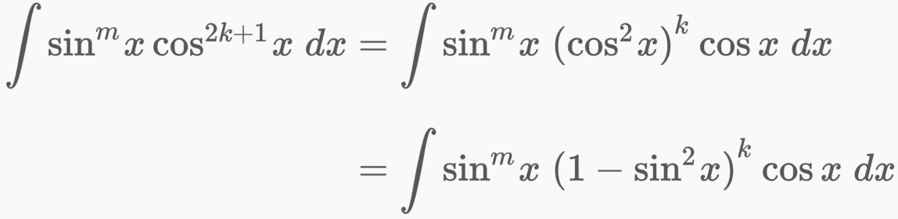
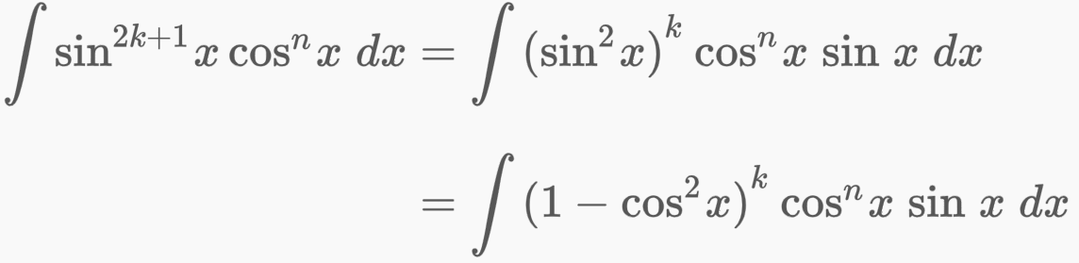
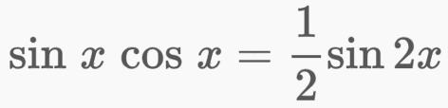

Slide 4

Example Combination of cosine and sine functions.

Slide 5

In summary
Similarly

Slide 6
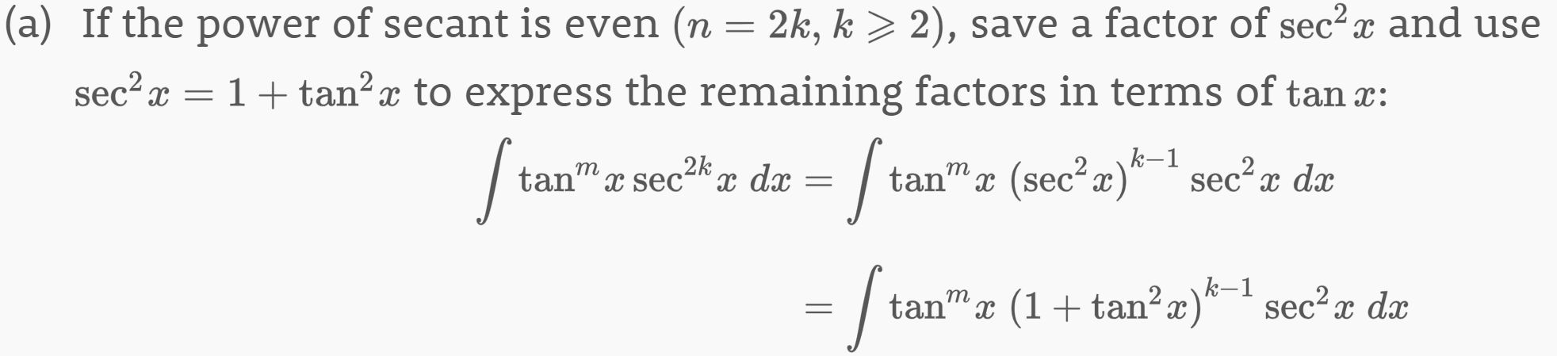

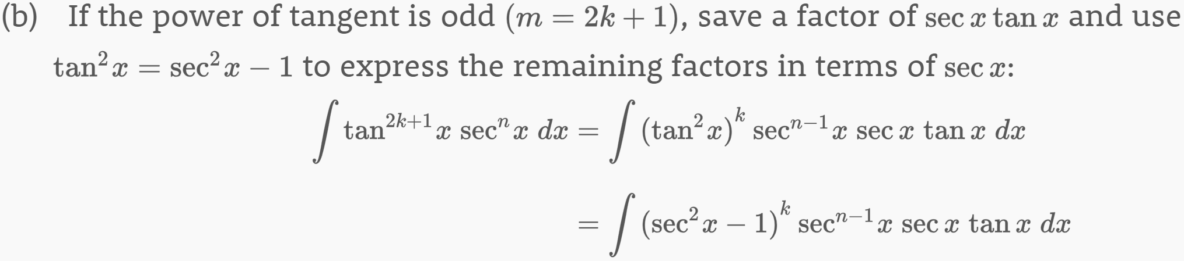


Slide 7
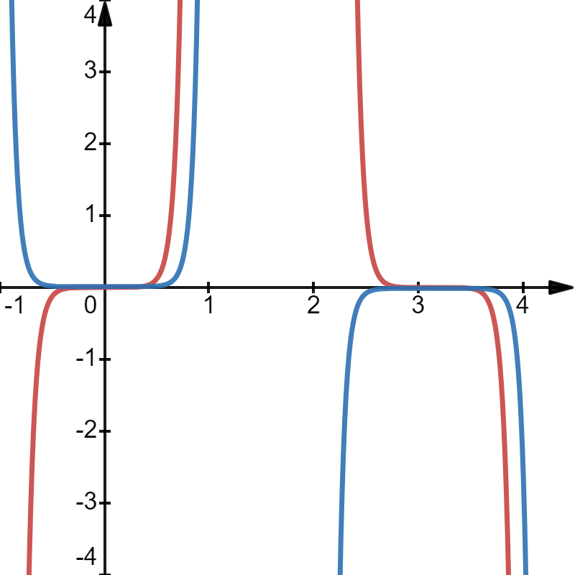
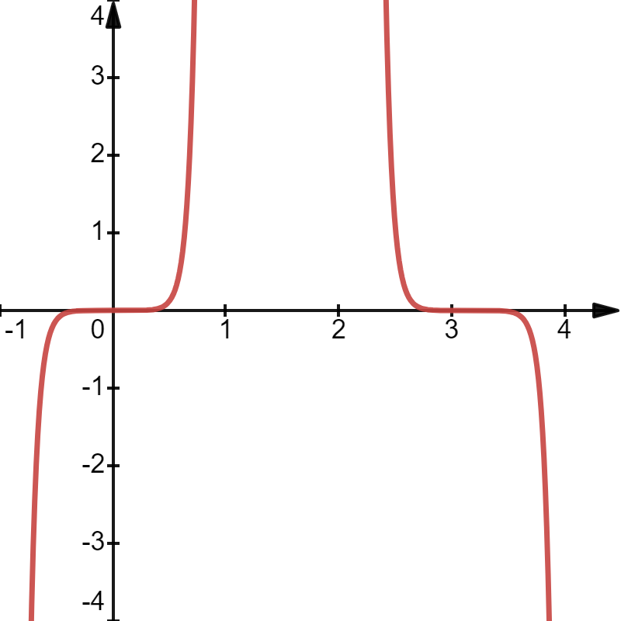
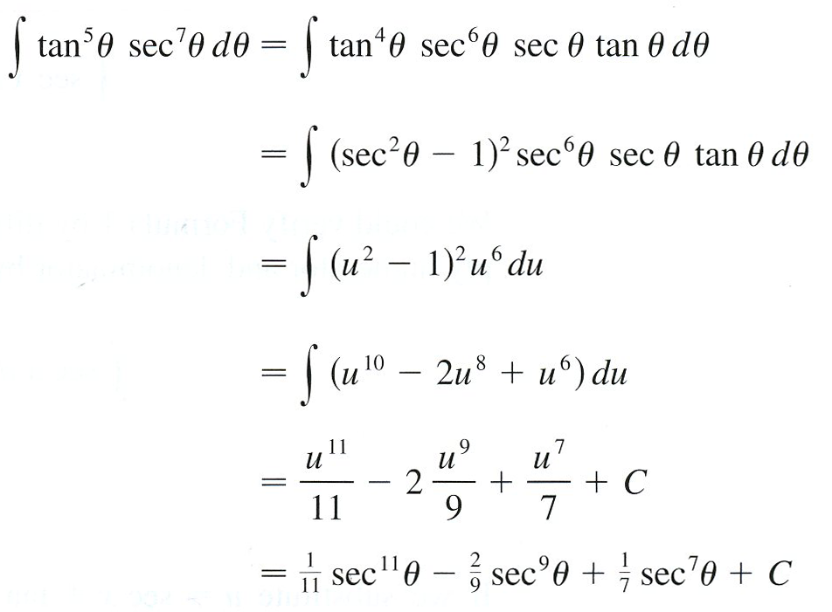



Let

Slide 8
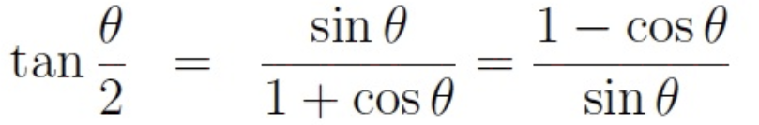
Example
Recall the half angle identities for tangent
Done?
If you’re a rookie!
Jimmy’s answer, of course!

Slide 9
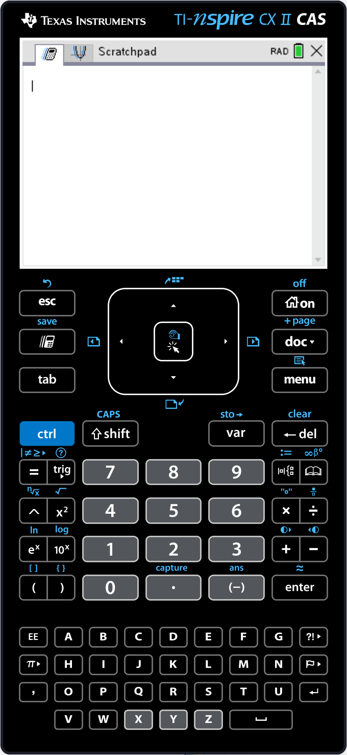

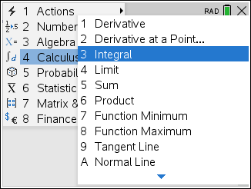
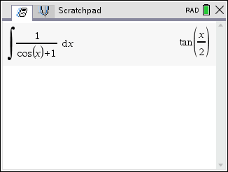
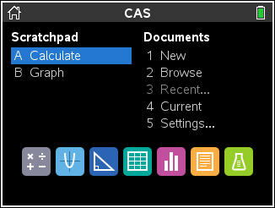

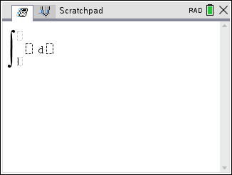
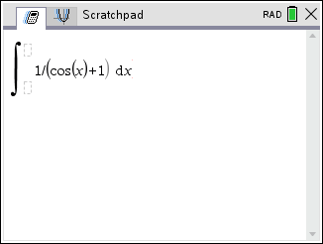
Example

Slide 10
Example

Slide 12



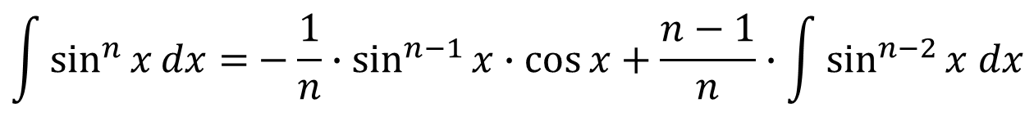
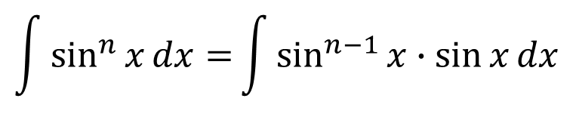
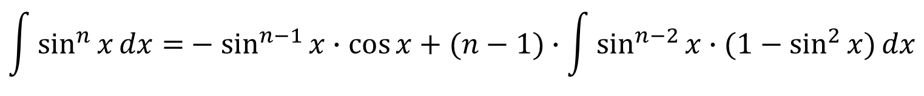

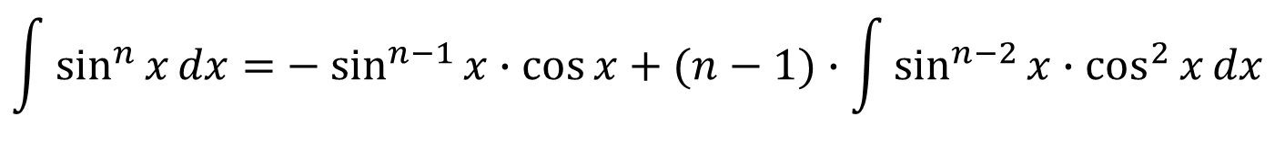
Example
Prove the reduction formula
$${\int{\sin^{n}{x}dx=}−\frac{1}{n}∙sin}^{n−1}{x∙\cos{x}}+\frac{n−1}{n}∙\int{\sin^{n−2}{x dx}}$$
where $n≥2$ is an integer.
Proof
Let
$$\int{\sin^{n}{x}dx=}\int{\sin^{n−1}{x∙\sin{x}}dx}$$
So, integration by parts gives
$${\int{\sin^{n}{x}dx=}−sin}^{n−1}{x∙\cos{x}}+(n−1)∙\int{\sin^{n−2}{x∙\cos^{2}{x}}dx}$$
$${\int{\sin^{n}{x}dx=}−sin}^{n−1}{x∙\cos{x}}+(n−1)∙\int{\sin^{n−2}{x∙(1−\sin^{2}{x)}}dx}$$

Slide 13
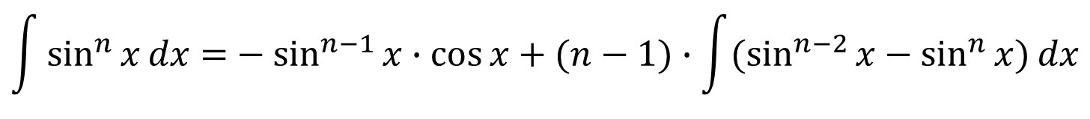
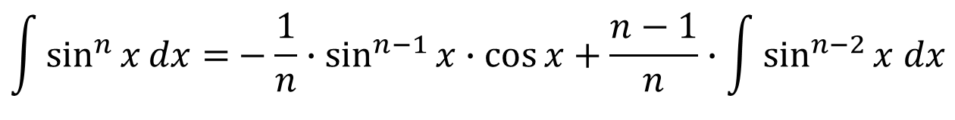
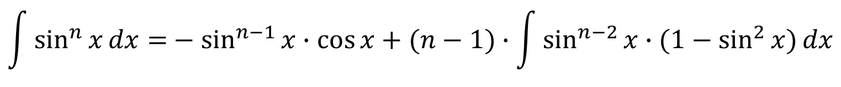
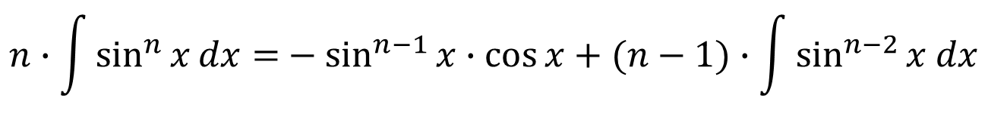
$${\int{\sin^{n}{x}dx=}−sin}^{n−1}{x∙\cos{x}}+(n−1)∙\int{\sin^{n−2}{x∙(1−\sin^{2}{x)}}dx}$$
$${\int{\sin^{n}{x}dx=}−sin}^{n−1}{x∙\cos{x}}+(n−1)∙\int{(\sin^{n−2}{x−\sin^{n}{x)}}dx}$$
$${\int{\sin^{n}{x}dx=}−sin}^{n−1}{x∙\cos{x}}+(n−1)∙\int{\sin^{n−2}{x dx−}(n−1)∙\int{\sin^{n}{x} dx}}$$
Wrap around integral!
$${\int{\sin^{n}{x}dx+(n−1)∙\int{\sin^{n}{x} dx}=}−sin}^{n−1}{x∙\cos{x}}+(n−1)∙\int{\sin^{n−2}{x dx}}$$
$${n∙\int{\sin^{n}{x}dx=}−sin}^{n−1}{x∙\cos{x}}+(n−1)∙\int{\sin^{n−2}{x dx}}$$
$${\int{\sin^{n}{x}dx=}−\frac{1}{n}∙sin}^{n−1}{x∙\cos{x}}+\frac{n−1}{n}∙\int{\sin^{n−2}{x dx}}$$
This equation is called a reduction formula because the exponent n has been reduced to $n−1$ and $n−2$.

Slide 14
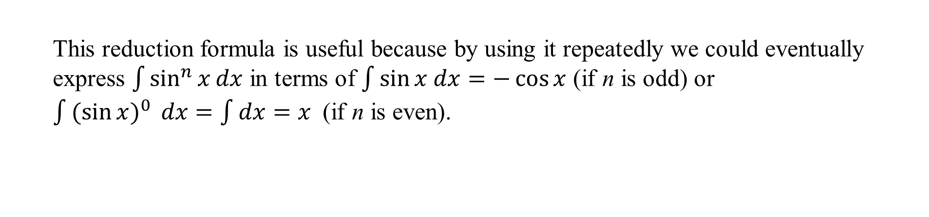
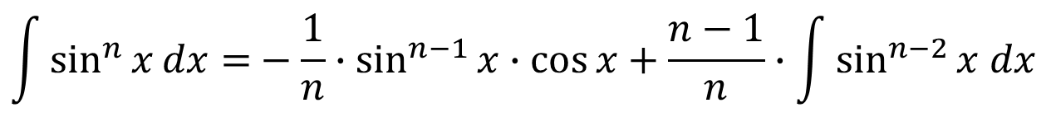
$${\int{\sin^{n}{x}dx=}−\frac{1}{n}∙sin}^{n−1}{x∙\cos{x}}+\frac{n−1}{n}∙\int{\sin^{n−2}{x dx}}$$
This reduction formula is useful because by using it repeatedly we could eventually express $\int{\sin^{n}{x}dx}$ in terms of $\int{\sin{x dx=−\cos{x}}}$ (if n is odd) or
$\int{{(\sin{x})}^{0}{ dx}}=\int{dx=x}$ (if n is even).

Slide 15
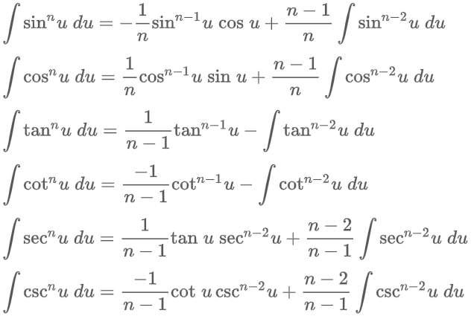

Power Reduction Formulas.

Slide 16
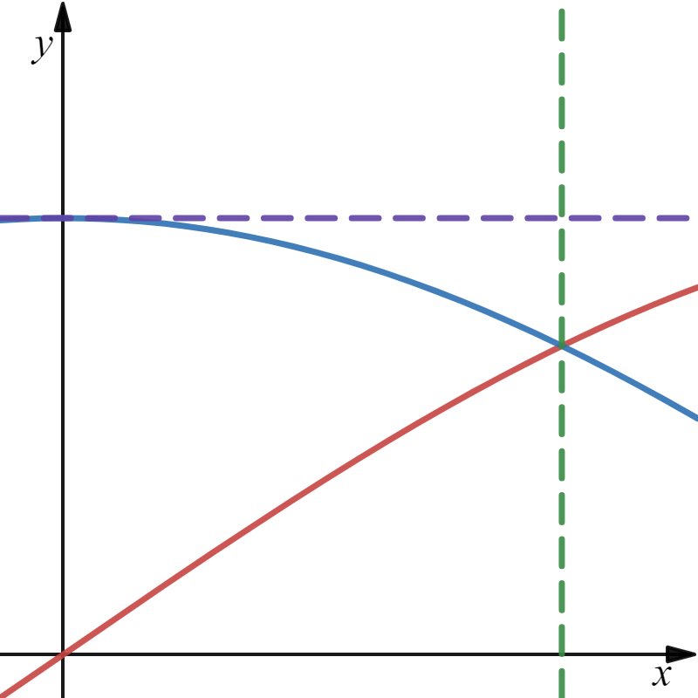
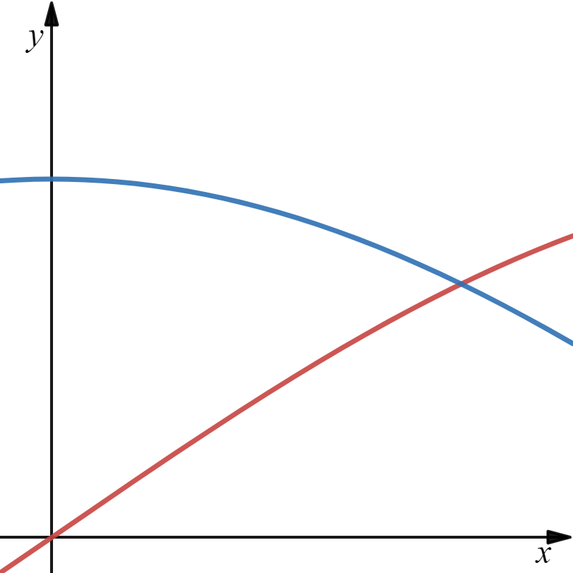
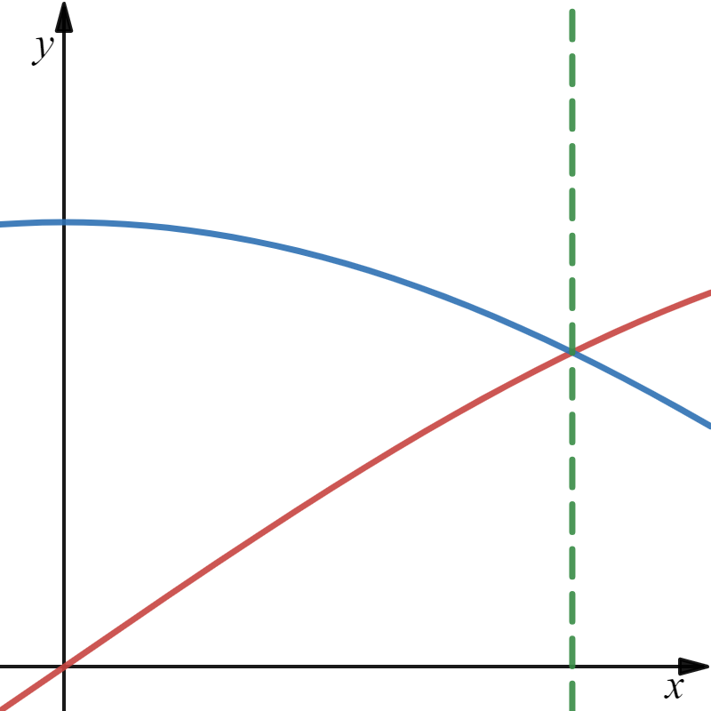




Example
Find the volume obtained by rotating the region bounded by the curves $y=\sin{x},$ $y=\cos{x,}$ x = 0 and $x=\frac{π}{4}$ about the line $y=1$.
“Washer Method”
$$x=\frac{π}{4}$$
x = 0
$$y=1$$
$$y=\sin{x}$$
$$y=\cos{x}$$
x

Slide 17






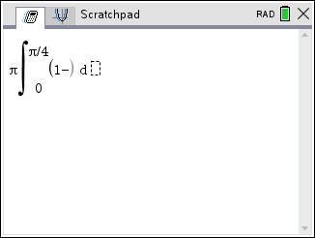
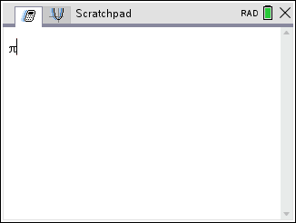
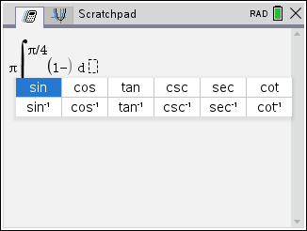
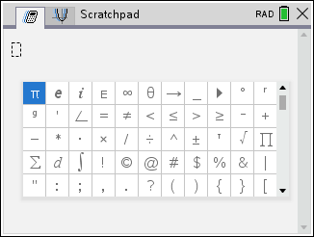
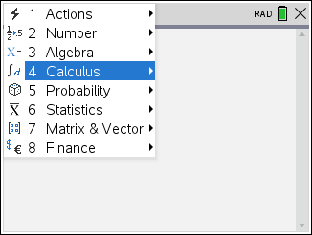
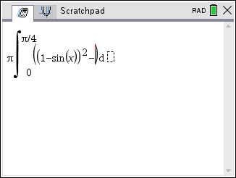
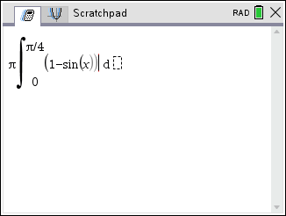
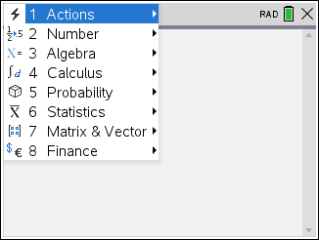

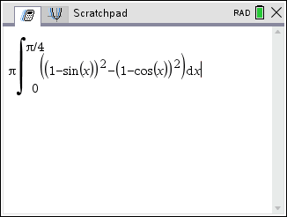
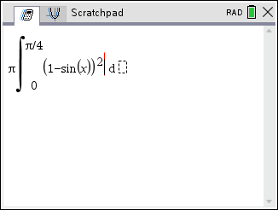
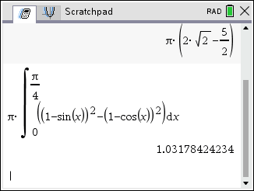
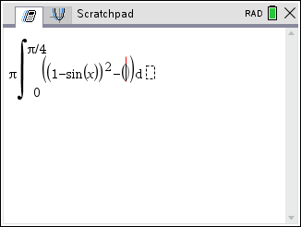
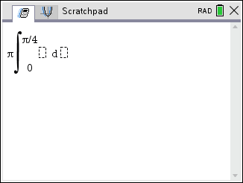
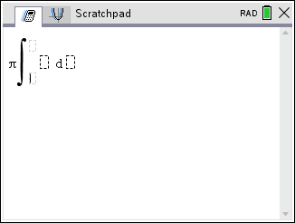
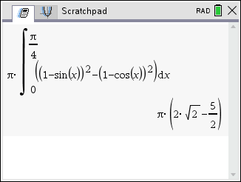



Example
Find the volume obtained by rotating the region bounded by the curves $y=\sin{x},$ $y=\cos{x,}$ x = 0 and $x=\frac{π}{4}$ about the line $y=1$.
“Washer Method”
$$x=\frac{π}{4}$$
x = 0
$$y=1$$
Deceitful Decimal!!
$$y=\sin{x}$$
$$y=\cos{x}$$
x
Note: At least 3 decimal places of accuracy.

