Slide 1

Santa Rosa Junior College
Mathematics
Gale Bach
Second Course in Calculus
Math 1B – Sections 5087 & 7219
Spring 2026
https://profiles.santarosa.edu/gale-w-bach
Syllabus

Slide 2

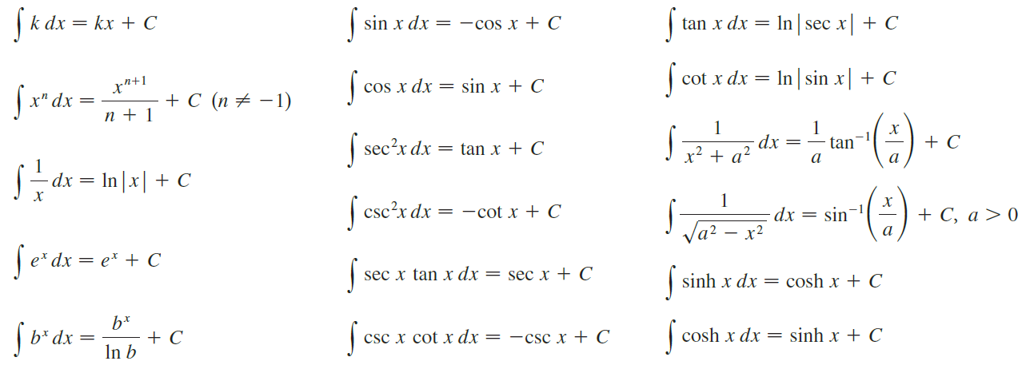

Slide 3
Integrate:
Not an obvious derivative, and u-substitution doesn’t work.
Start with the product rule:
This is the Integration by Parts Formula.

Slide 4
dv is the remainder
of the integral
LIPET
The Integration by Parts formula is the “product rule” for integration.
To get the process started, first we must choose u (one of the factors in the integrand) in this order:
LIPET
Logs, Inverse trig, Power, Exponential, Trig
Let’s see how it works.

Slide 5


Example
LIPET
Power Function
Differentiate
Integrate

Slide 6
Example
LIPET
logarithmic factor
Differentiate
Integrate

Slide 7

Example
LIPET
This is still a product, so we need to use integration by parts again.

Slide 8
Example
LIPET
Parts again!
This is the expression we started with!

Slide 9
Example:
LIPET
This is called “ the wrap around integral.”
It works when both factors integrate and differentiate forever.

Slide 10
A shortcut to Integration by Parts: Tabular Integration
Tabular integration works for integrals of the form:
where:
Differentiates to zero in several steps.
Integrates repeatedly.
Let’s see how it works.

Slide 11
Example
Compare this with the same problem done the other way:

Slide 12
Example
LIPET
This is still a product, so we need to use integration by parts again.
This is easier and quicker to do with tabular integration!

Slide 13
Example
Differentiate
Integrate
Note: Tabular integration does not replace integration by parts!

Slide 14
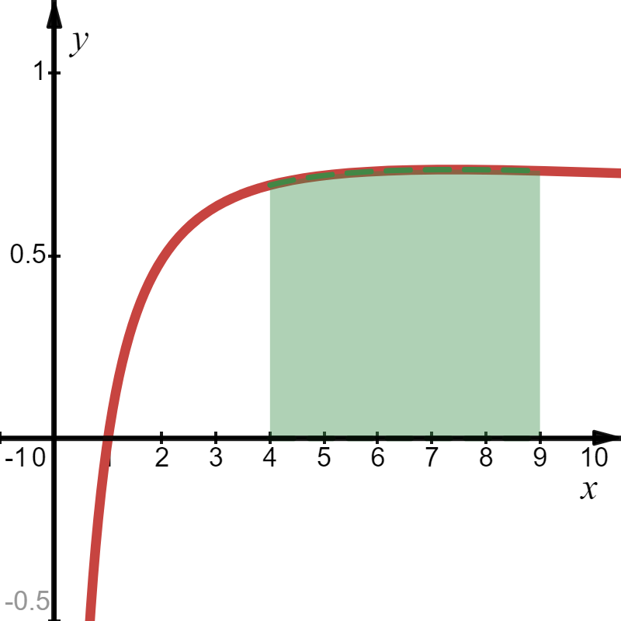
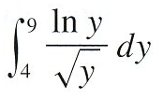
Example
LIPET
Jimmy’s Answer?
NO!
Jimmy’s Answer!

Slide 15

Example
Let:
LIPET
Let:
New Bounds for t
Lower Bound
Upper Bound

Slide 16
Recall in a right triangle:
That was fun!!!

Slide 17


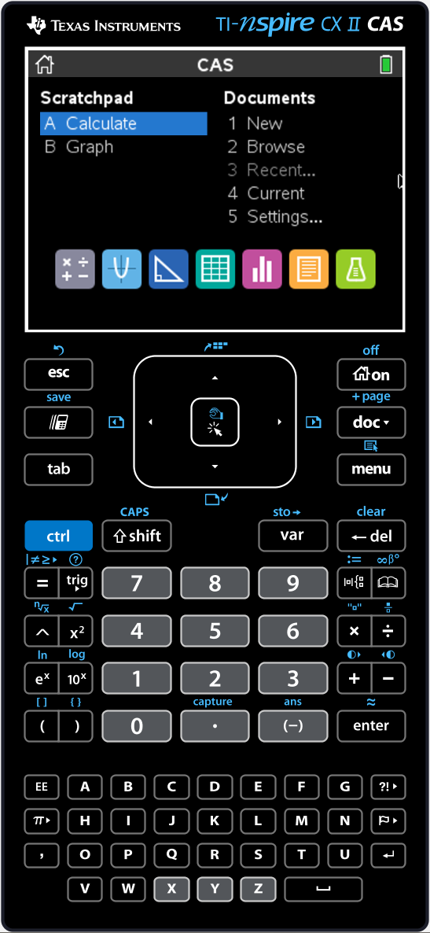





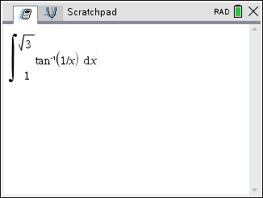
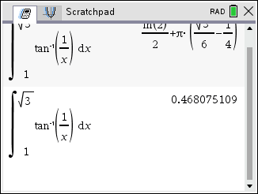

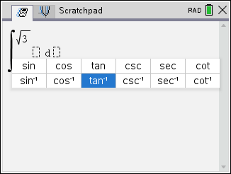
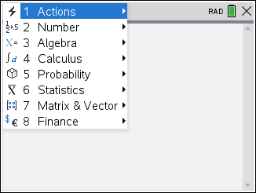
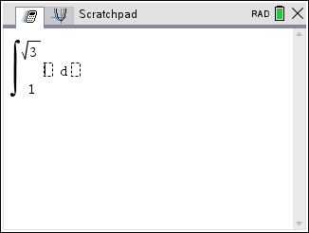
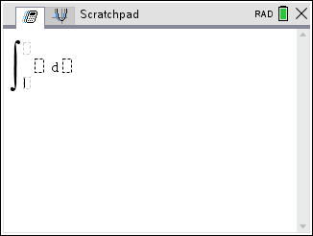
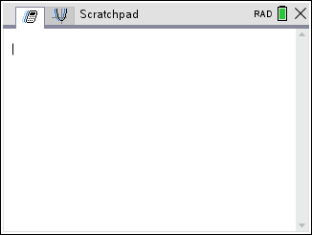
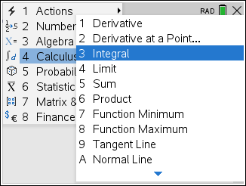
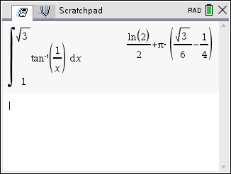

Example
Using a Computer Algebra System (CAS), we can just do this!
Deceitful Decimal!!
Note: At least 3 decimal places of accuracy.

Slide 18
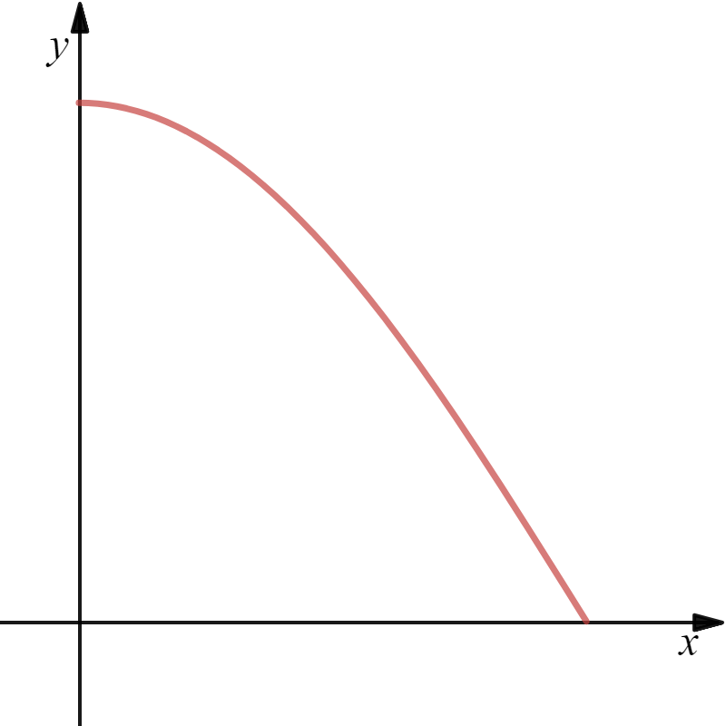



Example
$$y=\cos{x}$$
Tabular Integration
Diff
Int
x
$$\frac{π}{2}$$
Cylindrical Shell

