Slide 1


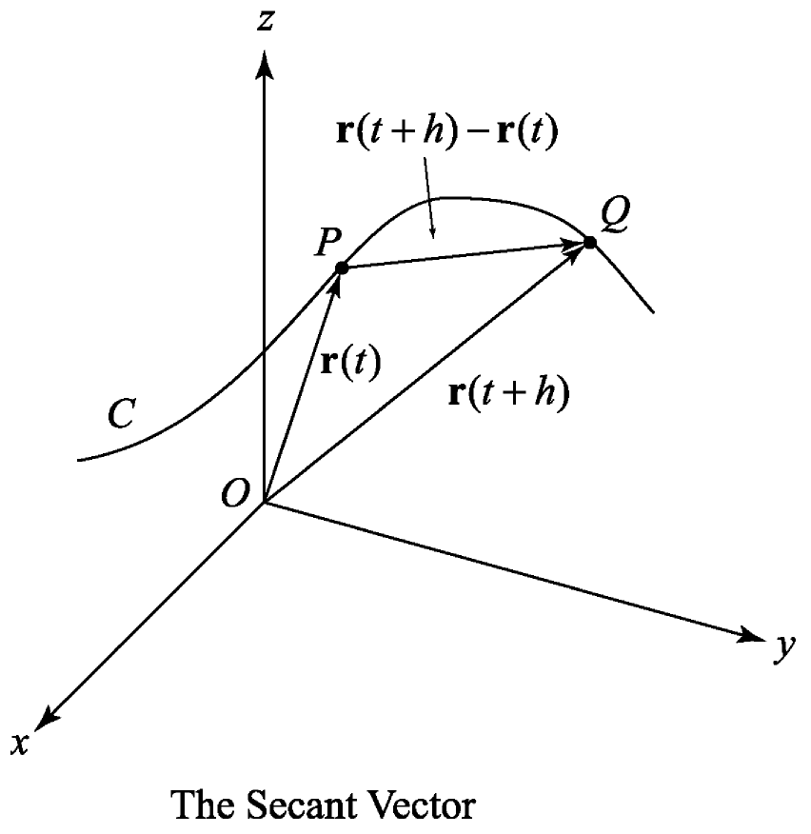
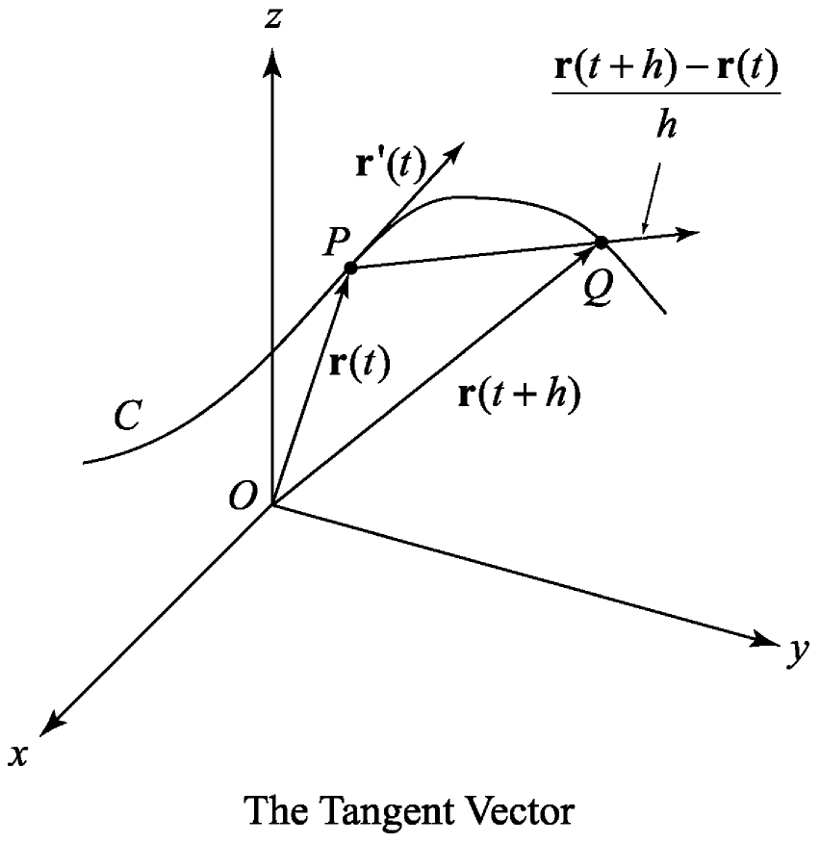

Slide 2

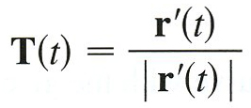

Slide 3

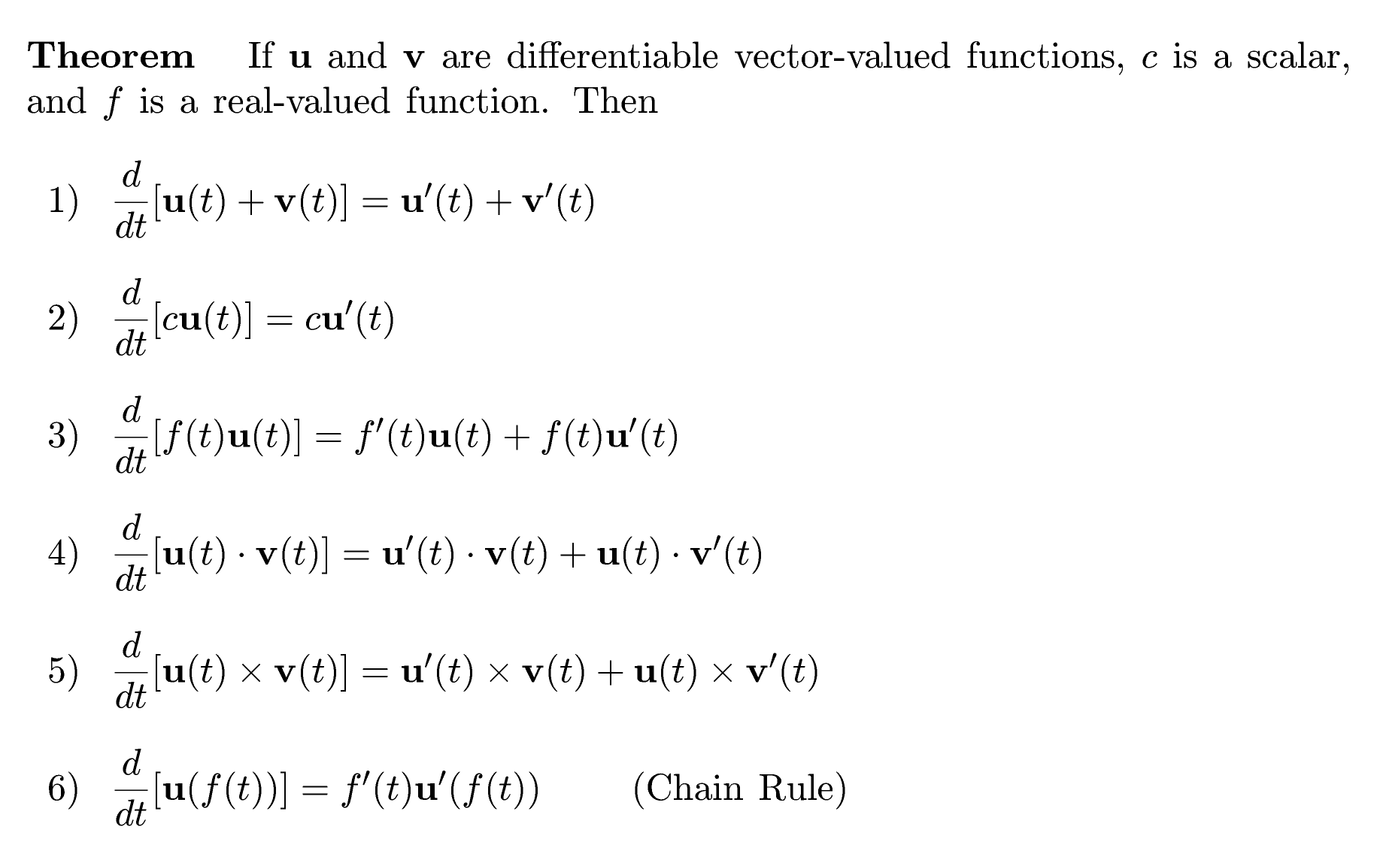

Slide 4



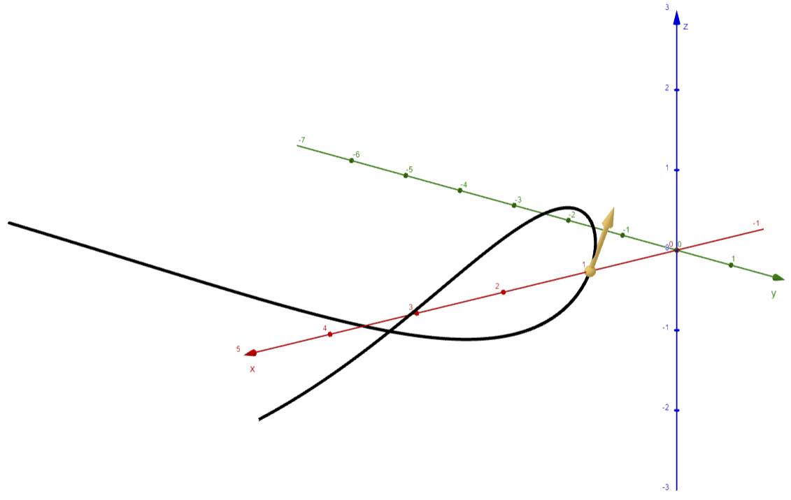
Example

Slide 5
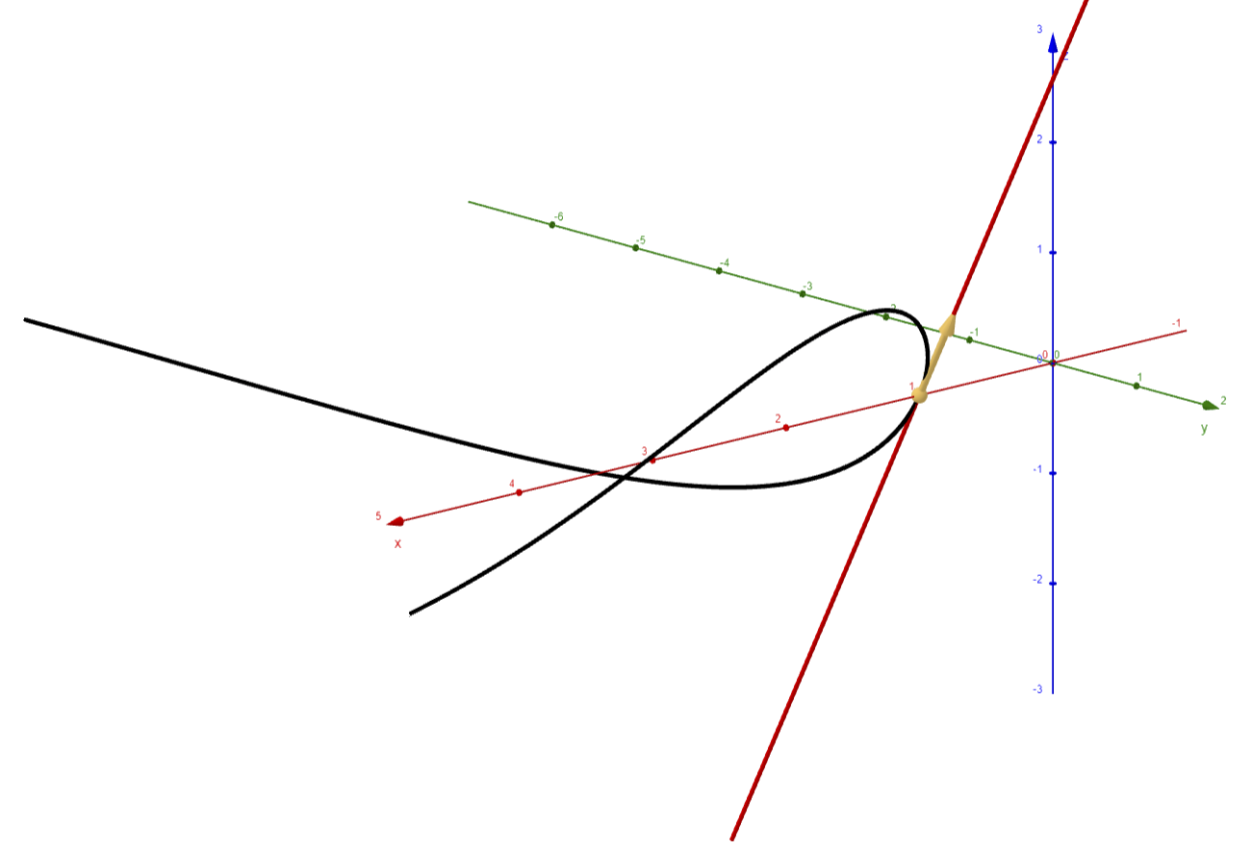
Example
c) First let’s find a point on the curve when t = 0.
So, the point is

Slide 6
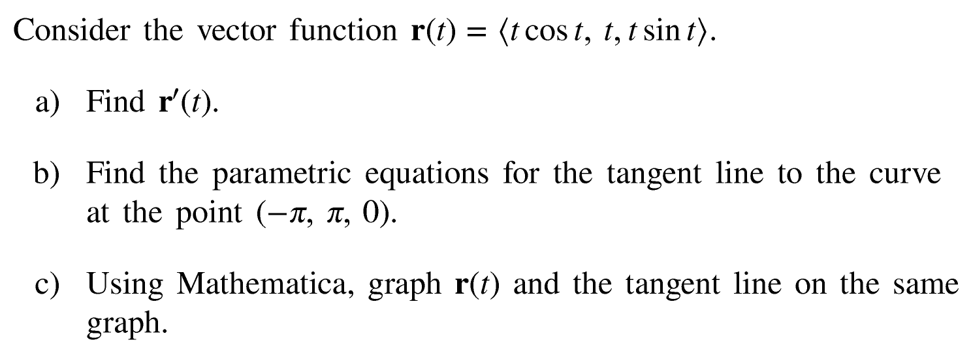
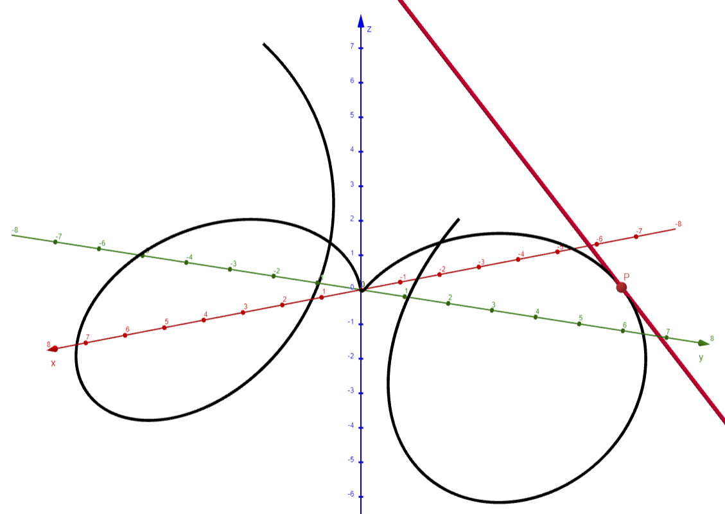
Example

Slide 7




Slide 8


Example
Tabular Integration
Diff
Int

Slide 9



Example
Tabular Integration
Diff
Int
Initial Conditions

