Slide 1


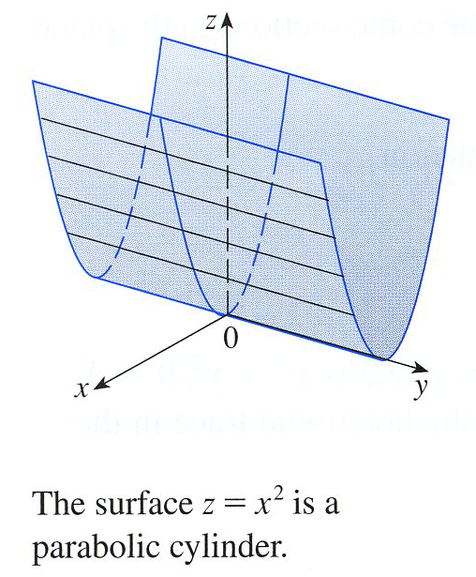



Example
Parabolic Cylinder

Slide 2
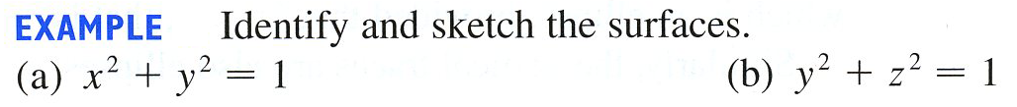

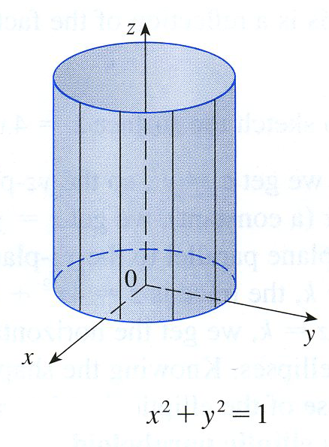
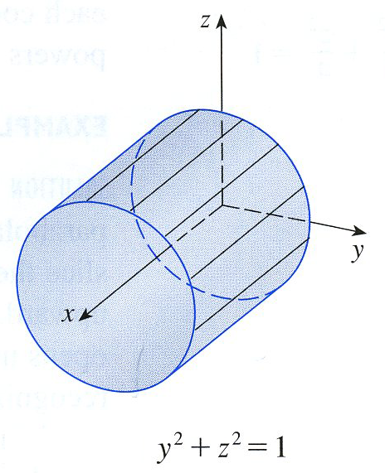
Example
Circular Cylinder
Circular Cylinder

Slide 3

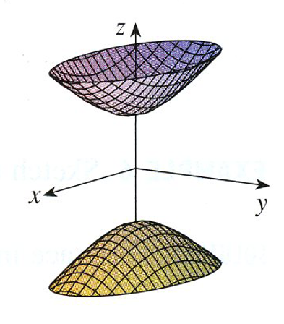
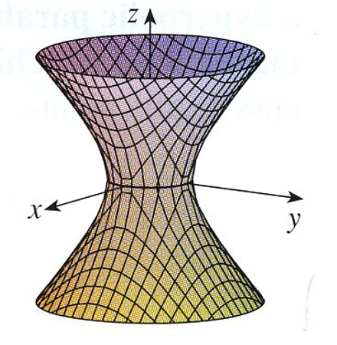
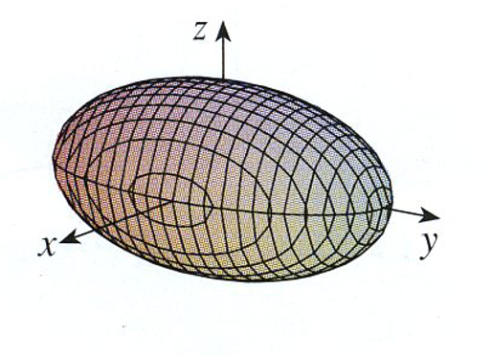



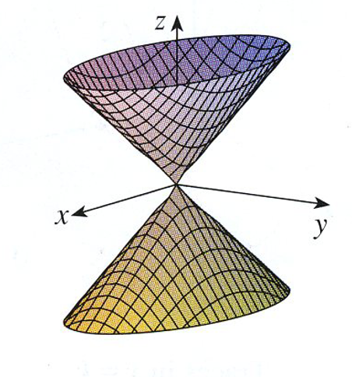
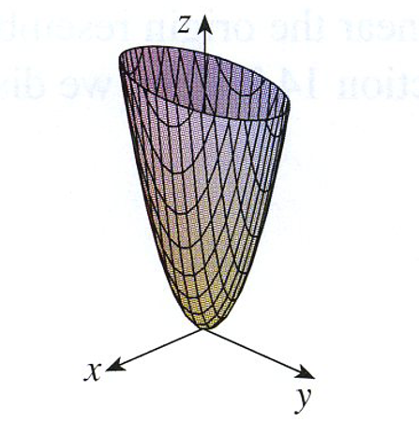
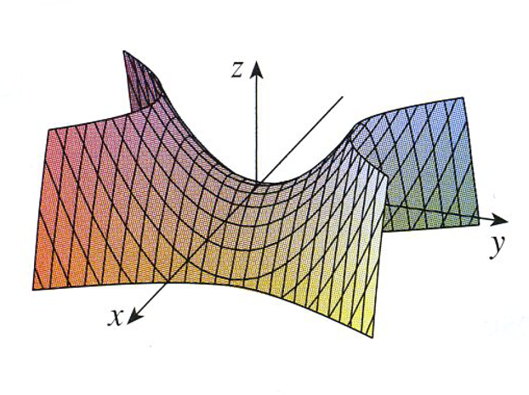




Slide 4
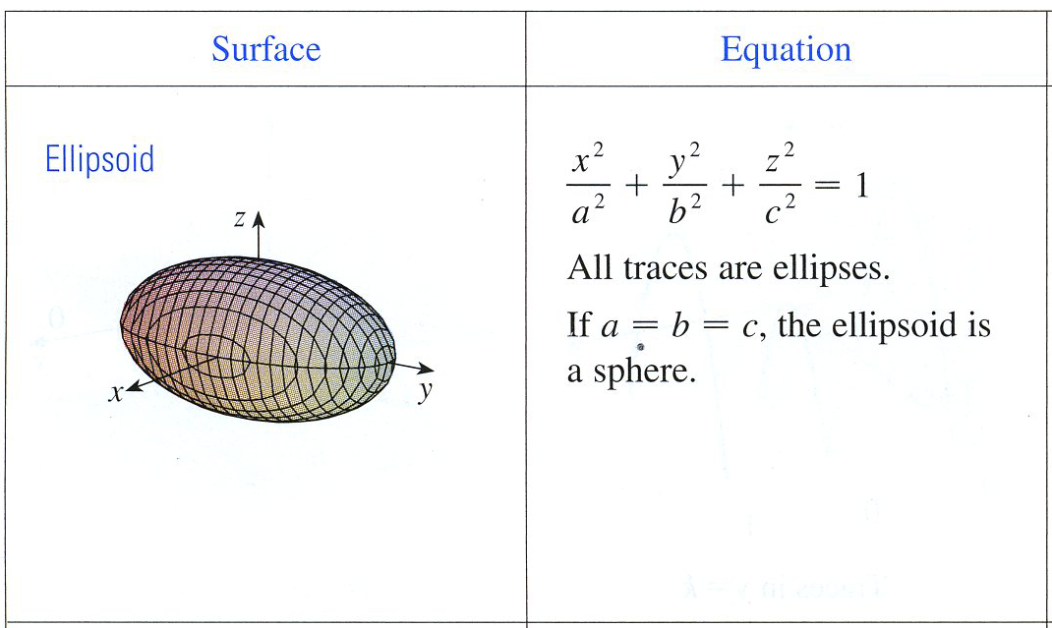
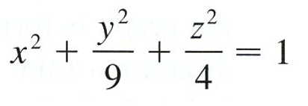

Example Given the quadric surface below,
identify the horizontal, vertical traces and
identify the surface.
Ellipsoid
Horizontal Traces
Vertical Traces
Vertical Traces
Ellipse
Ellipse
Ellipse

Slide 5
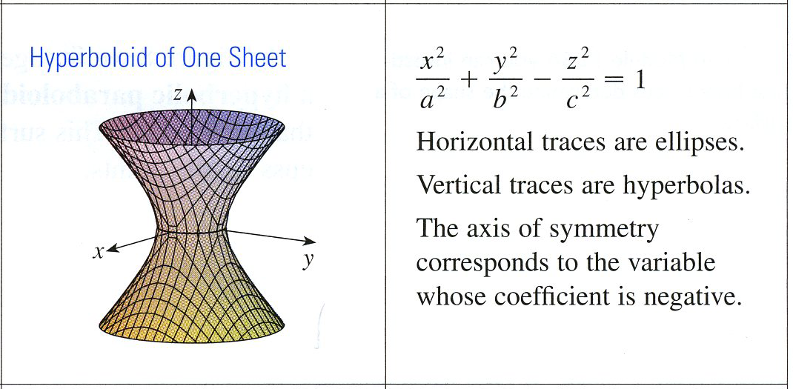

Example Given the quadric surface below,
identify the horizontal, vertical traces and
identify the surface.
Hyperboloid of One Sheet
Horizontal Traces
Vertical Traces
Vertical Traces
Hyperbola
Ellipse
Hyperbola

Slide 6
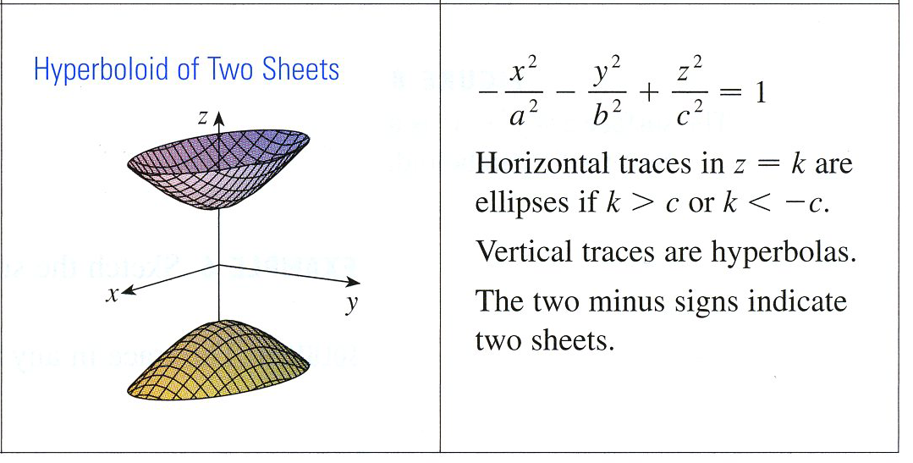

Example Given the quadric surface below,
identify the horizontal, vertical traces and
identify the surface.
Hyperboloid of Two Sheet
Horizontal Traces
Vertical Traces
Vertical Traces
Circle or
Ellipse
Hyperbola
Hyperbola

Slide 7
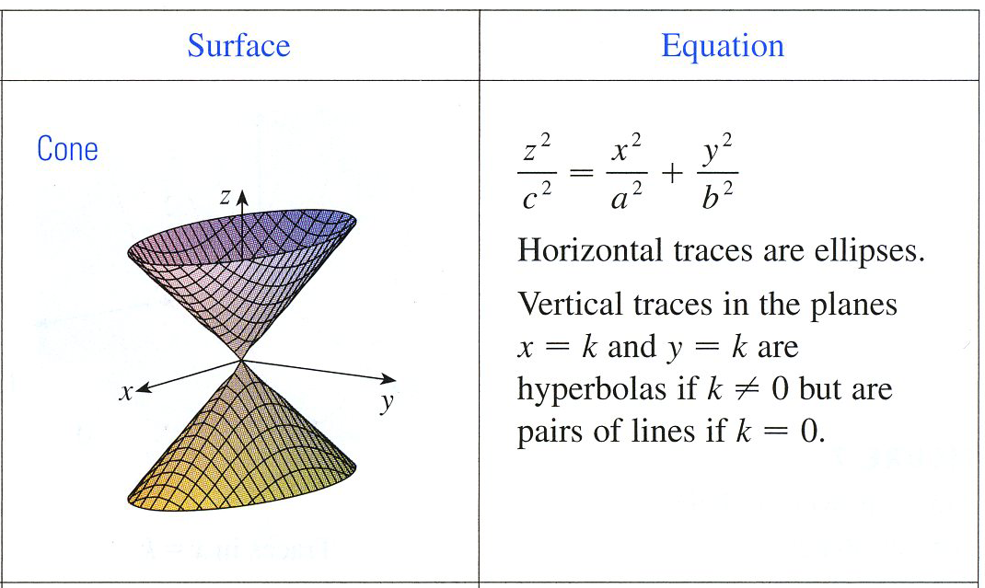

Example Given the quadric surface below,
identify the horizontal, vertical traces and
identify the surface.
Elliptic Cone
Horizontal Traces
Vertical Traces
Vertical Traces
Hyperbola
Ellipse
Hyperbola

Slide 8
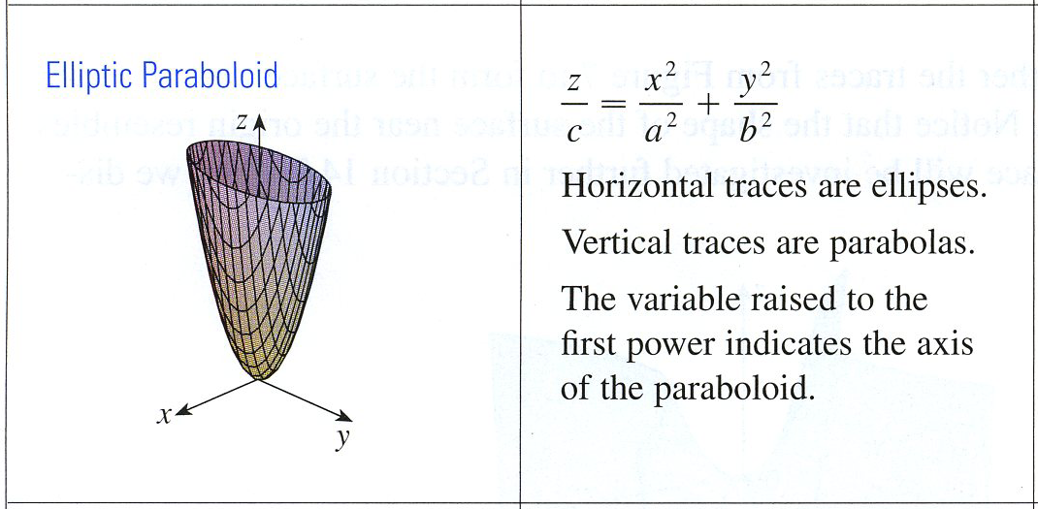

Example Given the quadric surface below,
identify the horizontal, vertical traces and
identify the surface.
Elliptic Paraboloid
Horizontal Traces
Vertical Traces
Vertical Traces
Parabola
Parabola
Ellipse

Slide 9
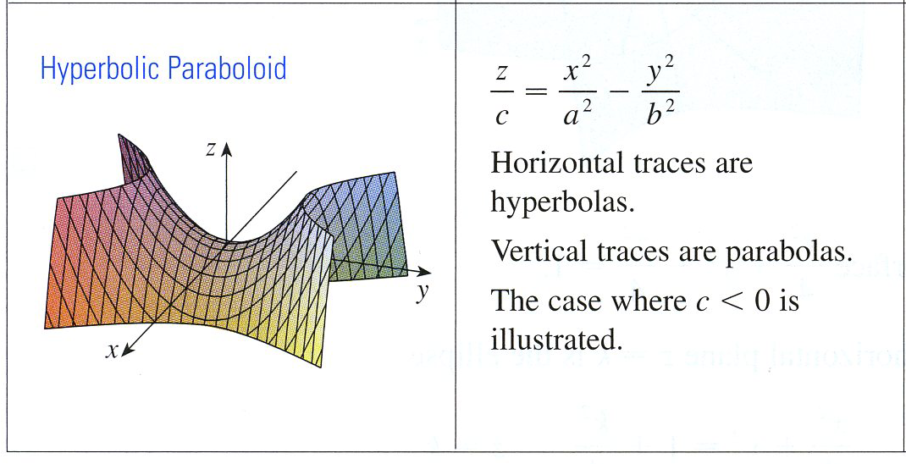

Example Given the quadric surface below,
identify the horizontal, vertical traces and
identify the surface.
Hyperbolic Paraboloid
Horizontal Traces
Vertical Traces
Vertical Traces
Hyperbola
Parabola
Parabola

Slide 10
