Slide 1

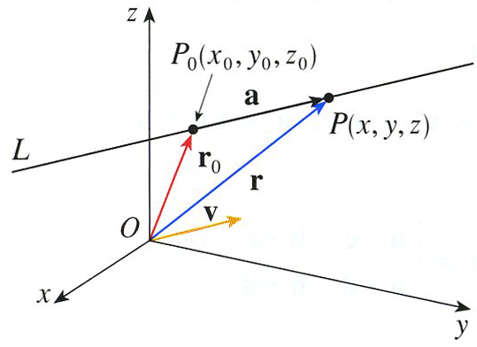
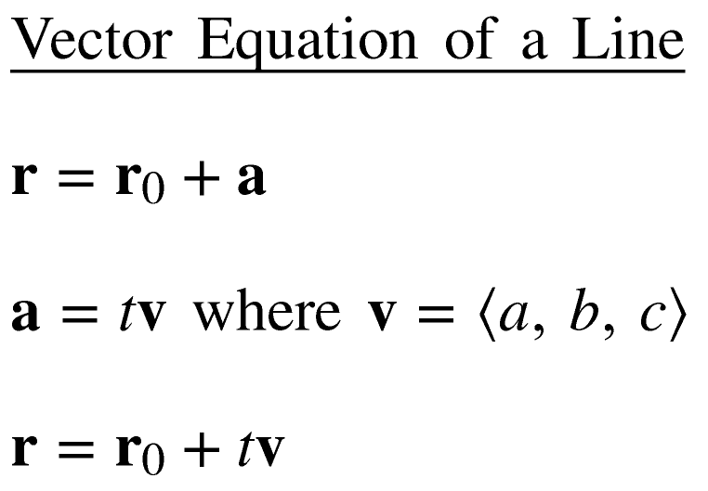


Slide 2


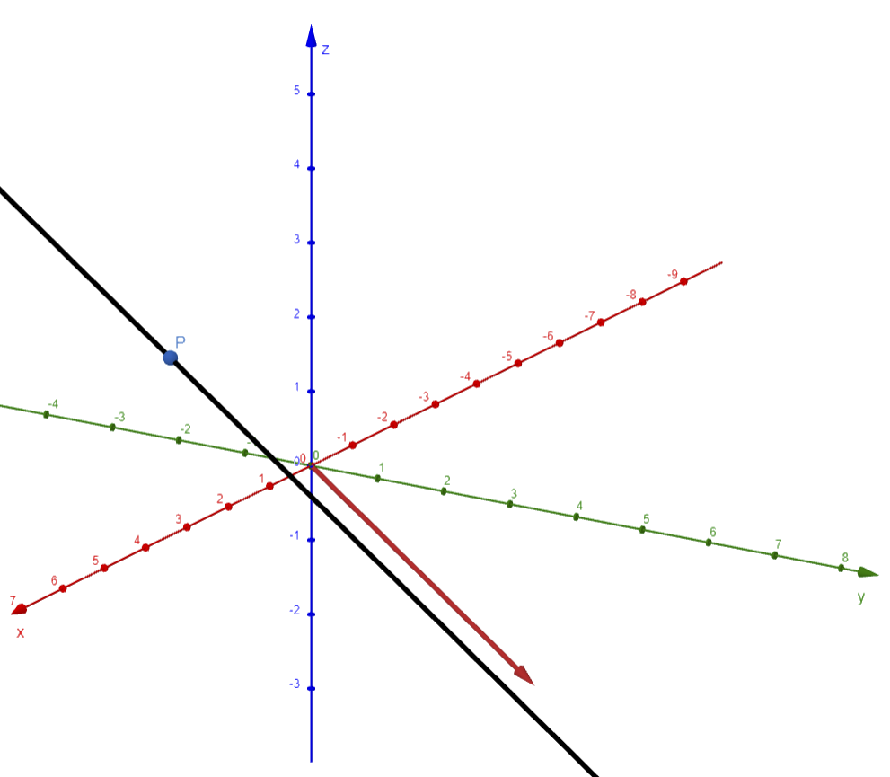
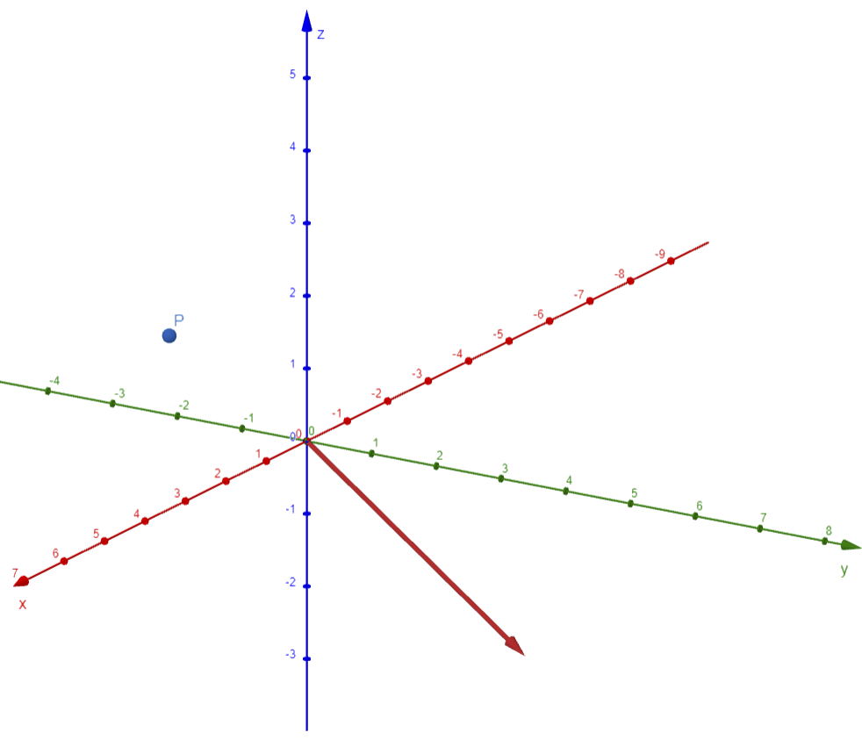

Example

Slide 3

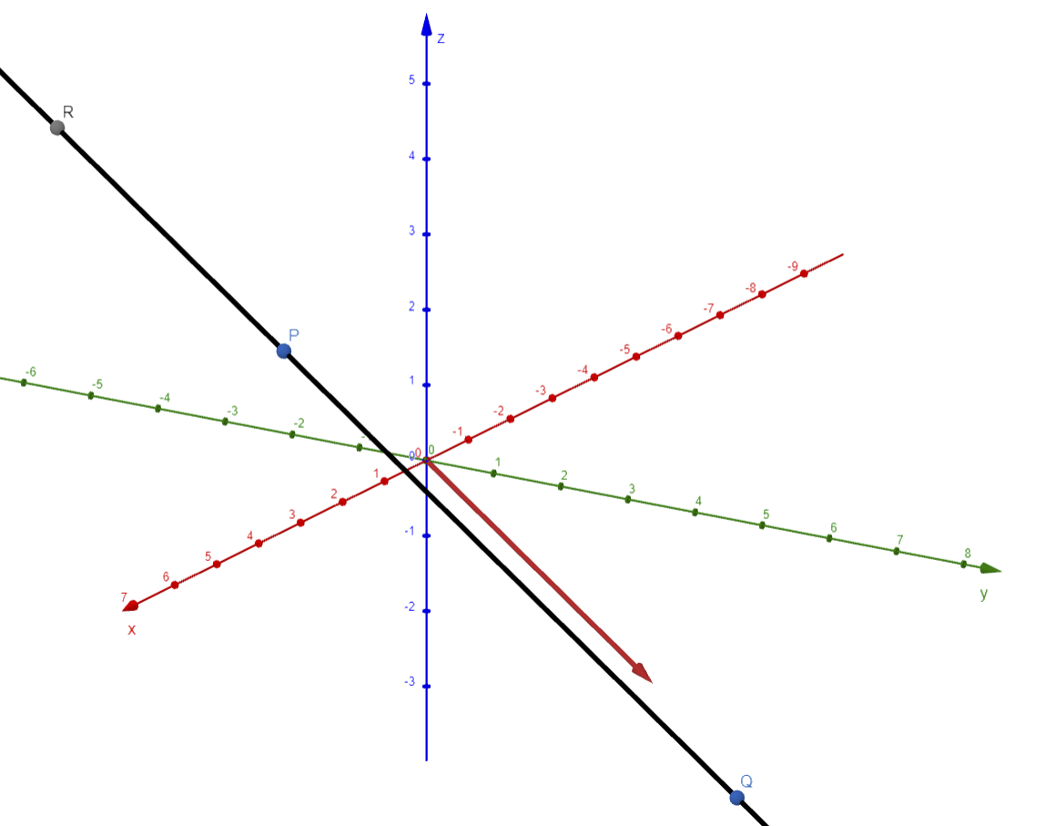


Example

Slide 4




v is also called the steering vector.

Slide 5
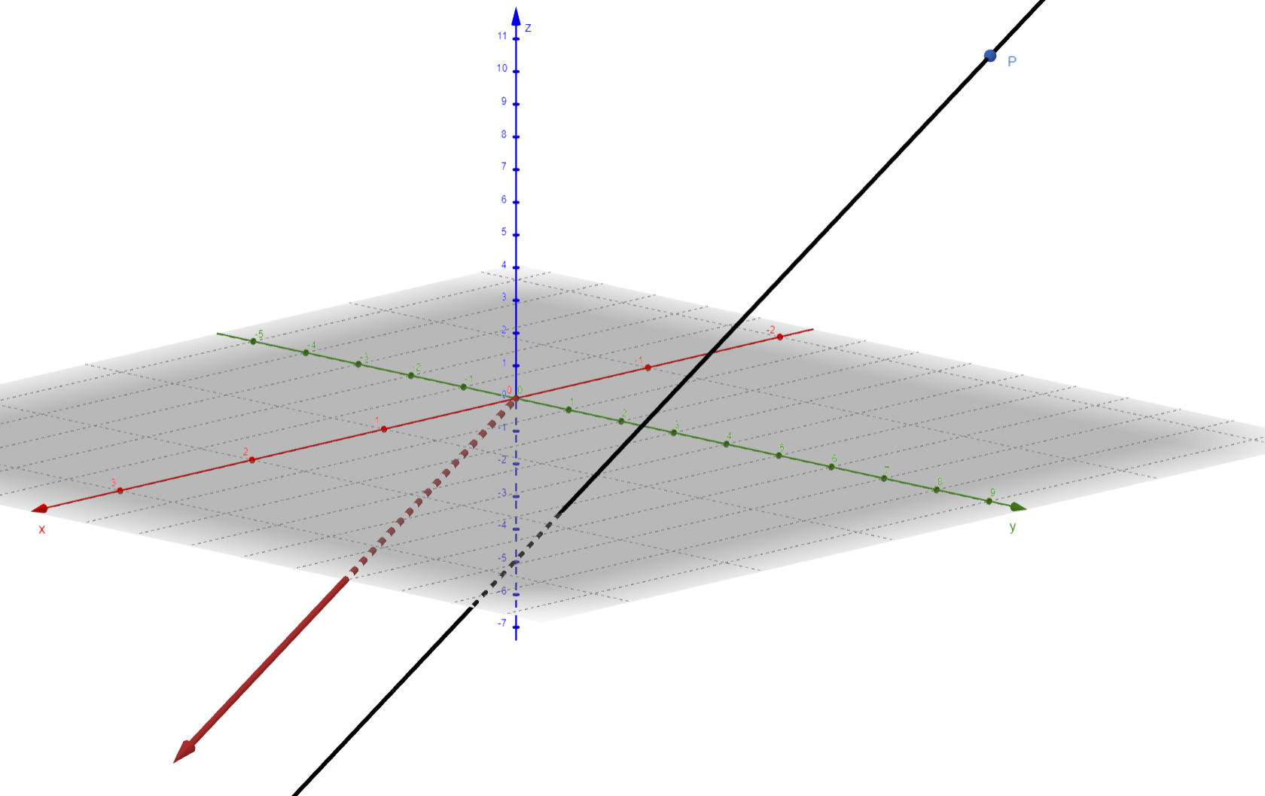
Example

Slide 6

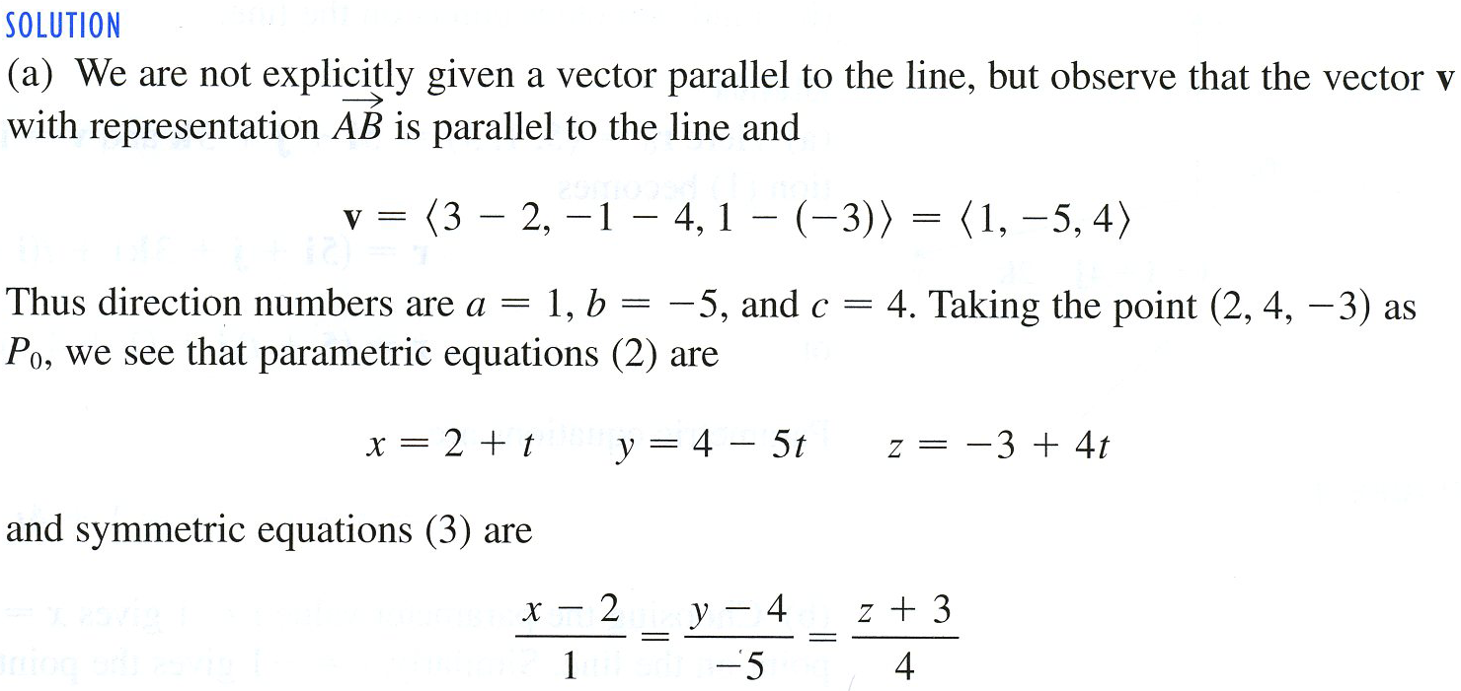
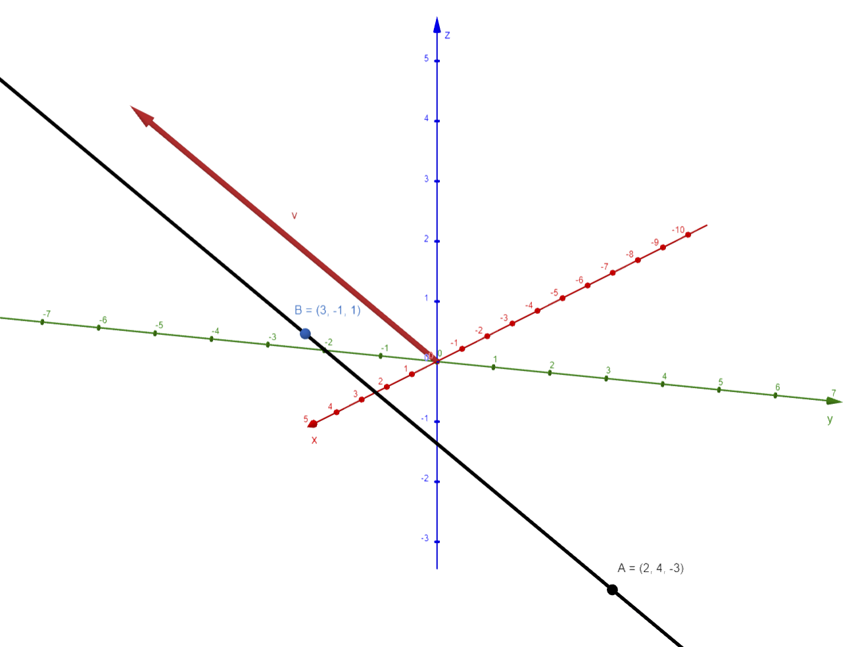
Example

Slide 7

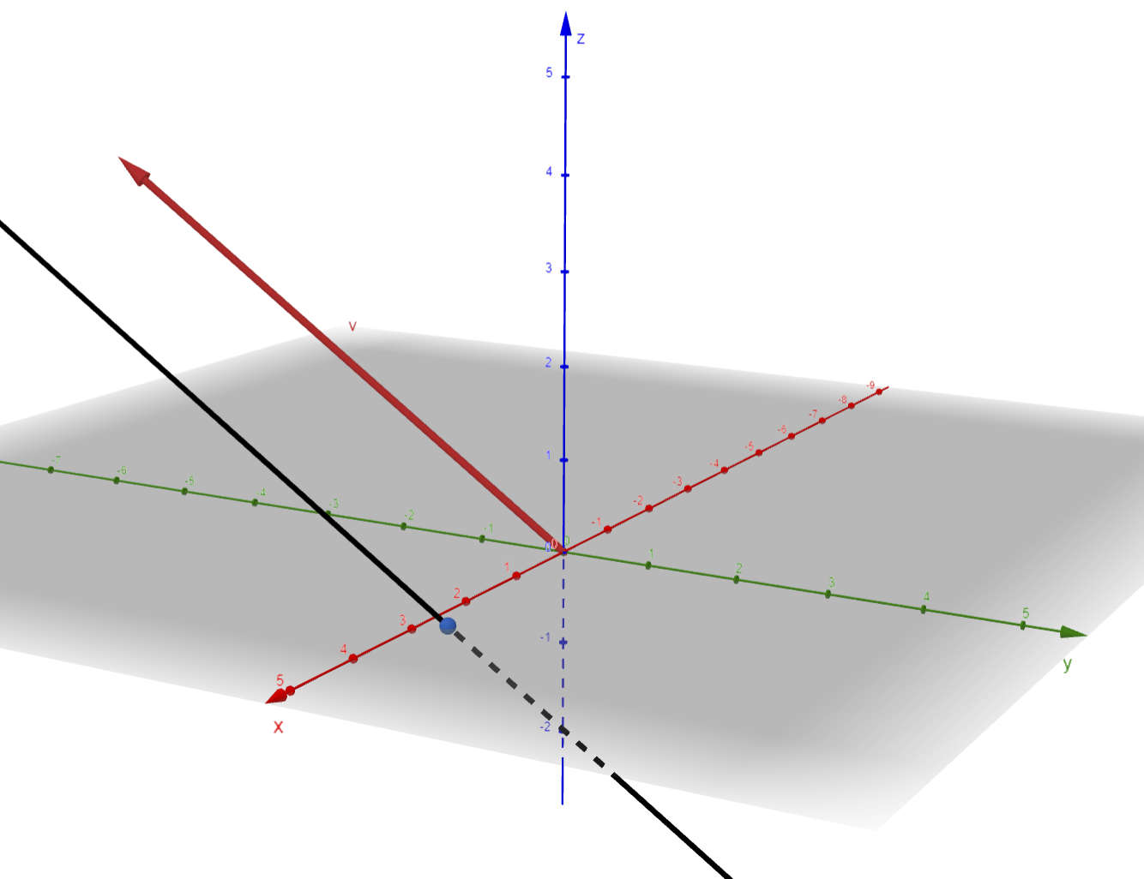

Slide 8





Slide 9


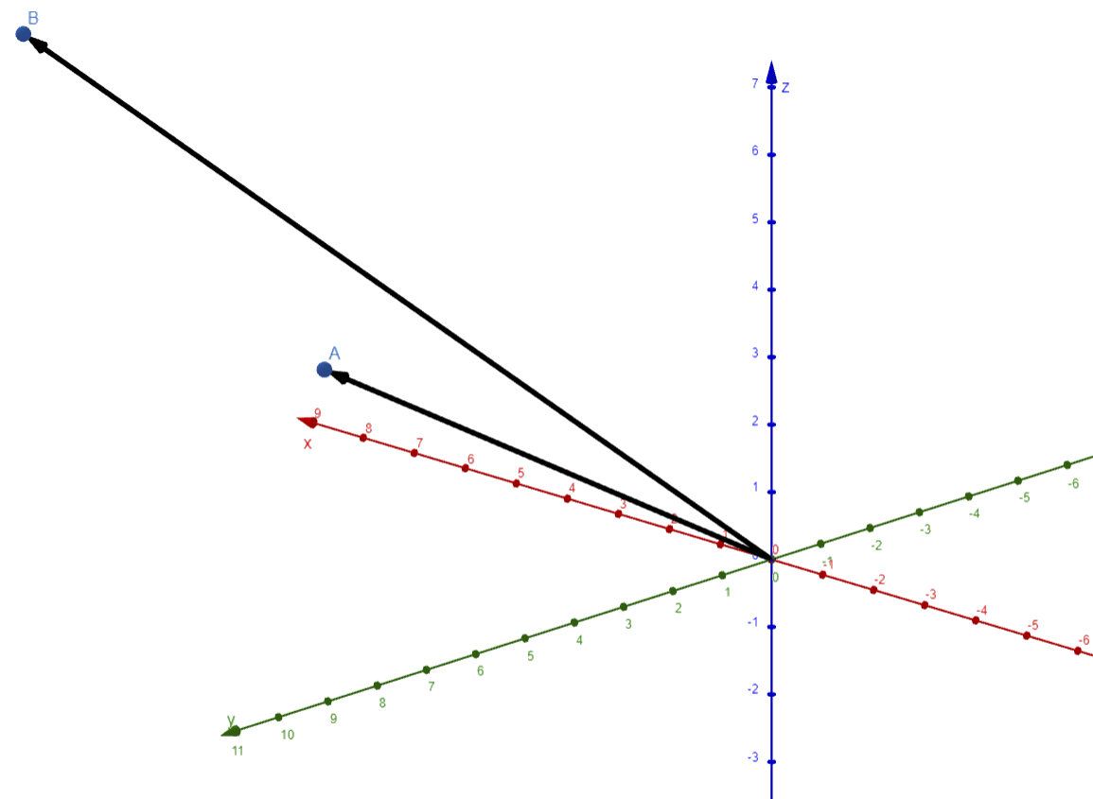



Example

Slide 10

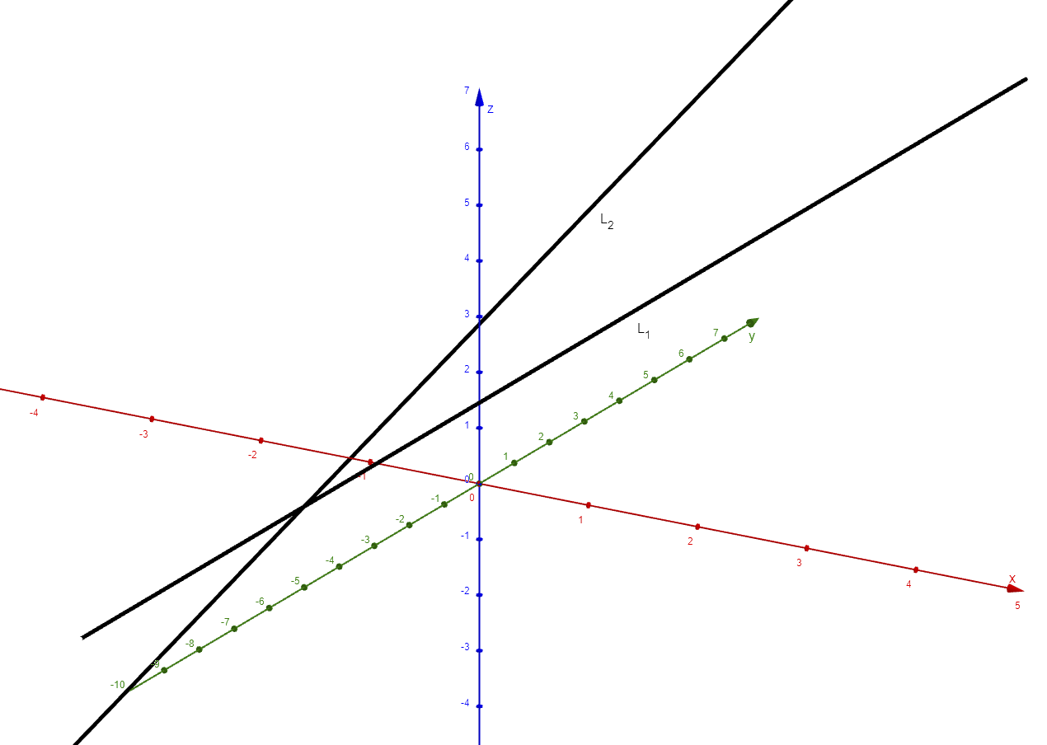
Example
Now we will check to see if they intersect at a point. So, we solve the system

Slide 11

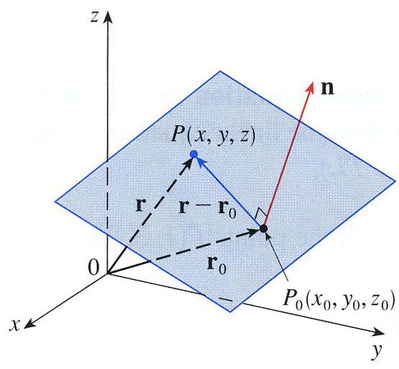





A

Slide 12







Slide 13




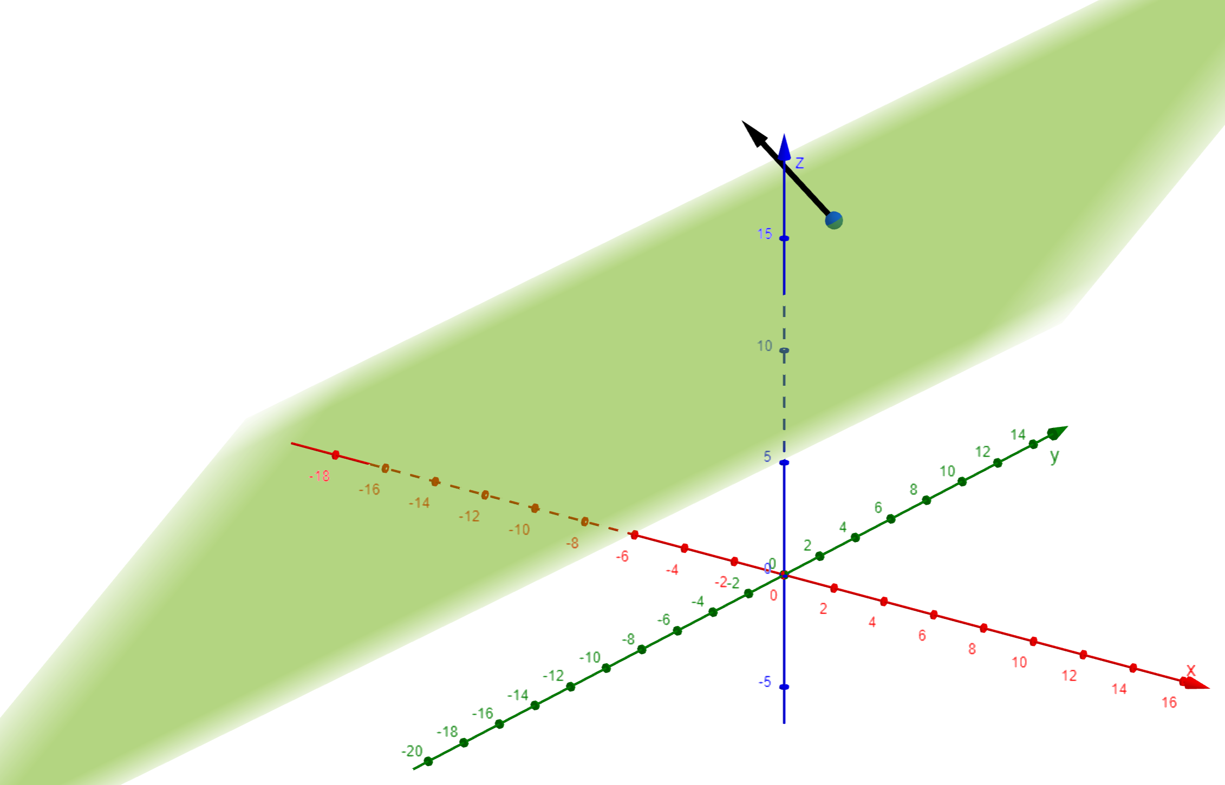
Example

Slide 14
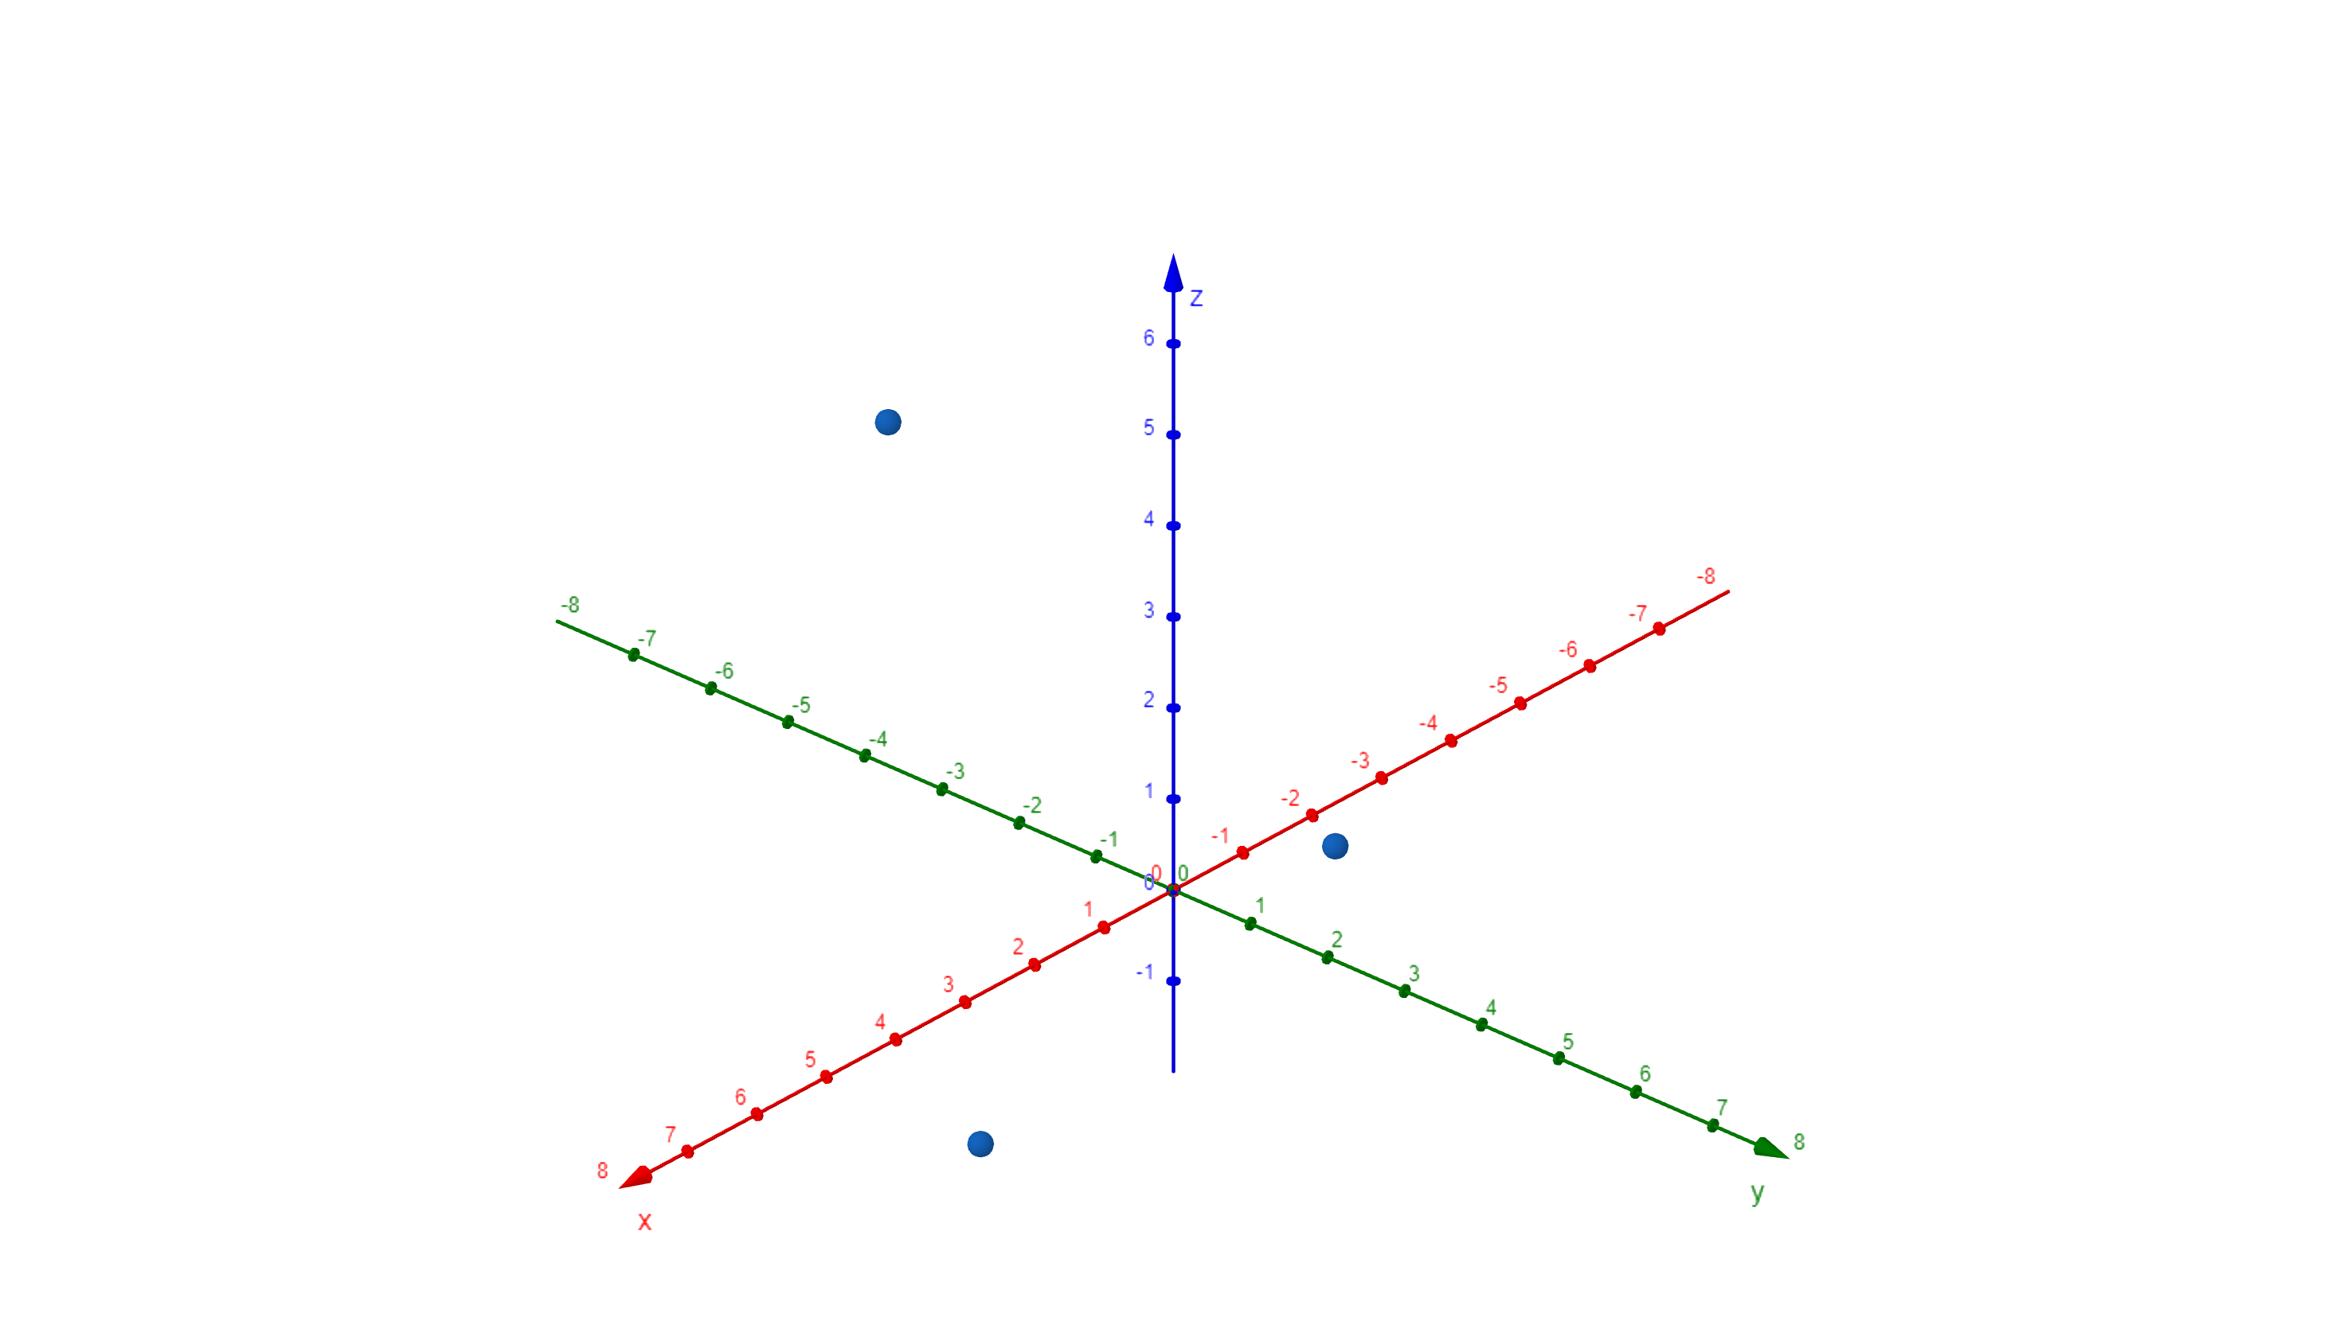





$$\vec{AB}=\left\langle 2,−4,4\right\rangle$$
$$\vec{AC}=\left\langle 4,−1,−2\right\rangle$$
$$\vec{AB}$$
$$\vec{AB}×\vec{AC}$$
$$\vec{AC}$$

Slide 15
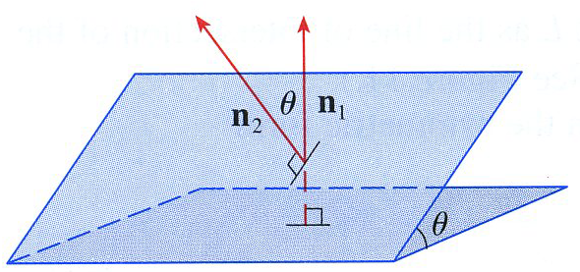
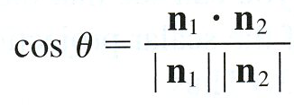
Angle Between Planes

Slide 16

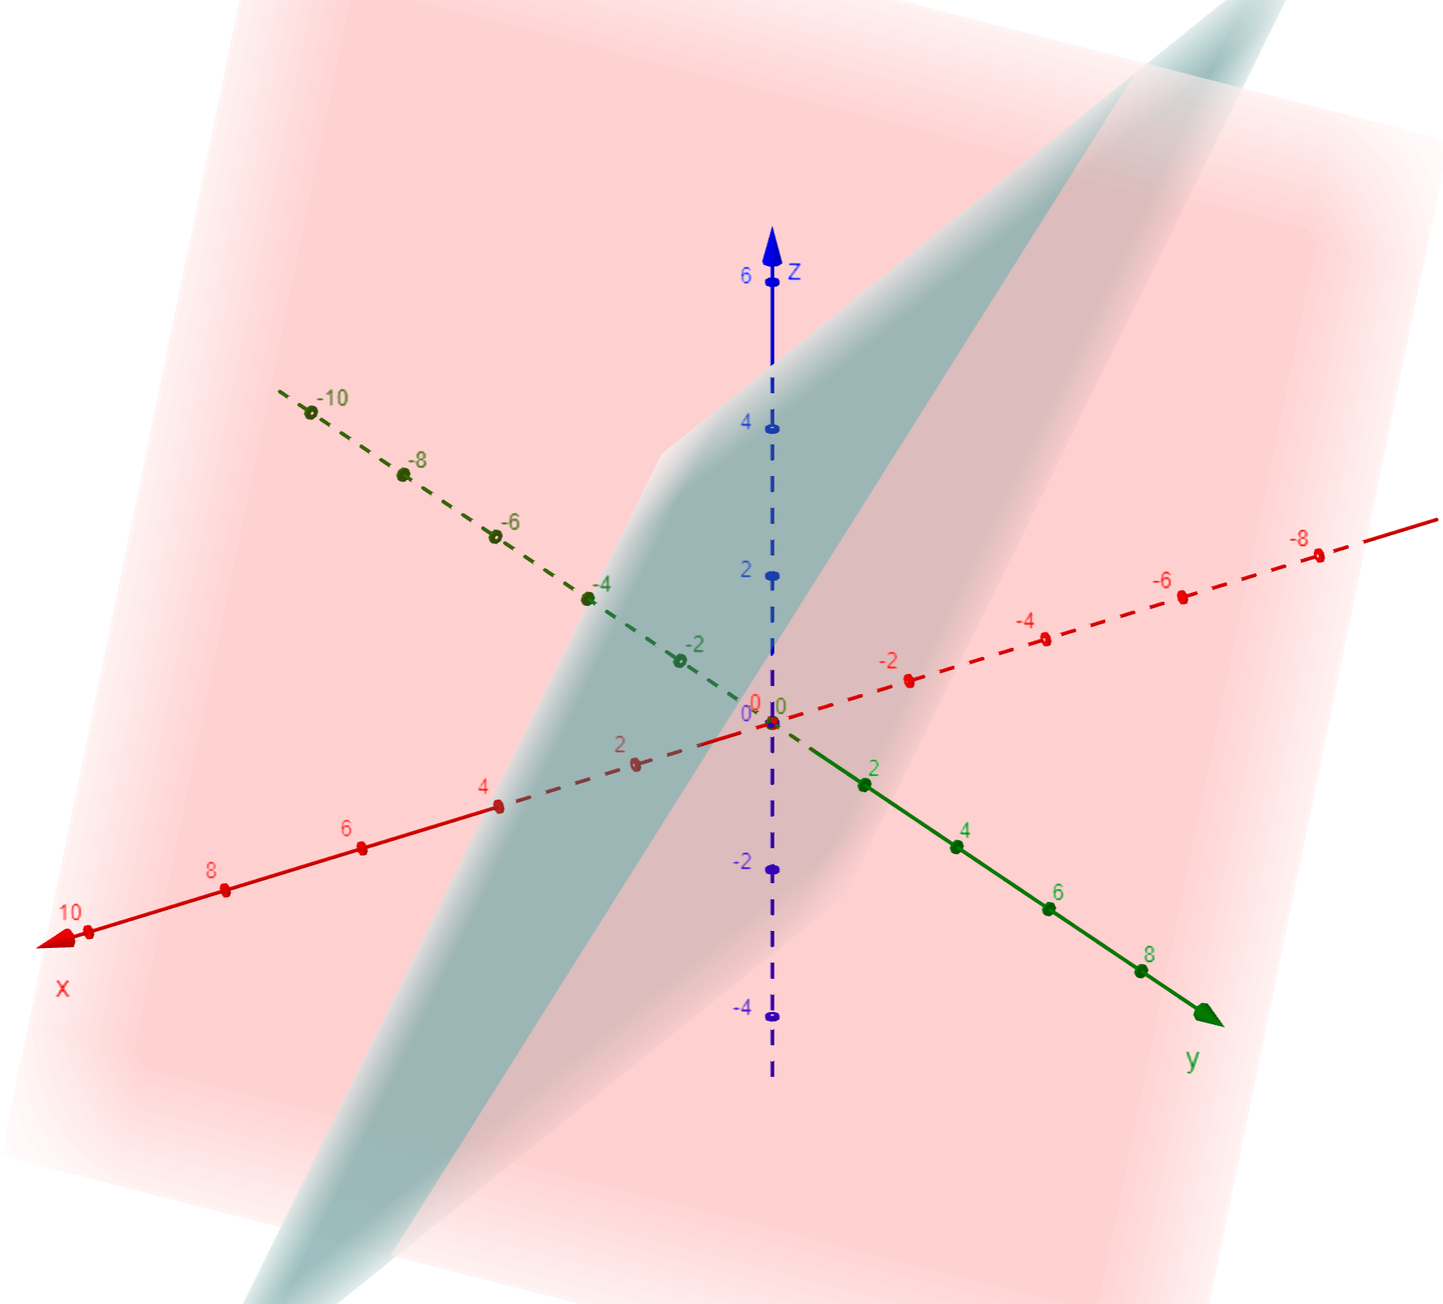
Example

Slide 17

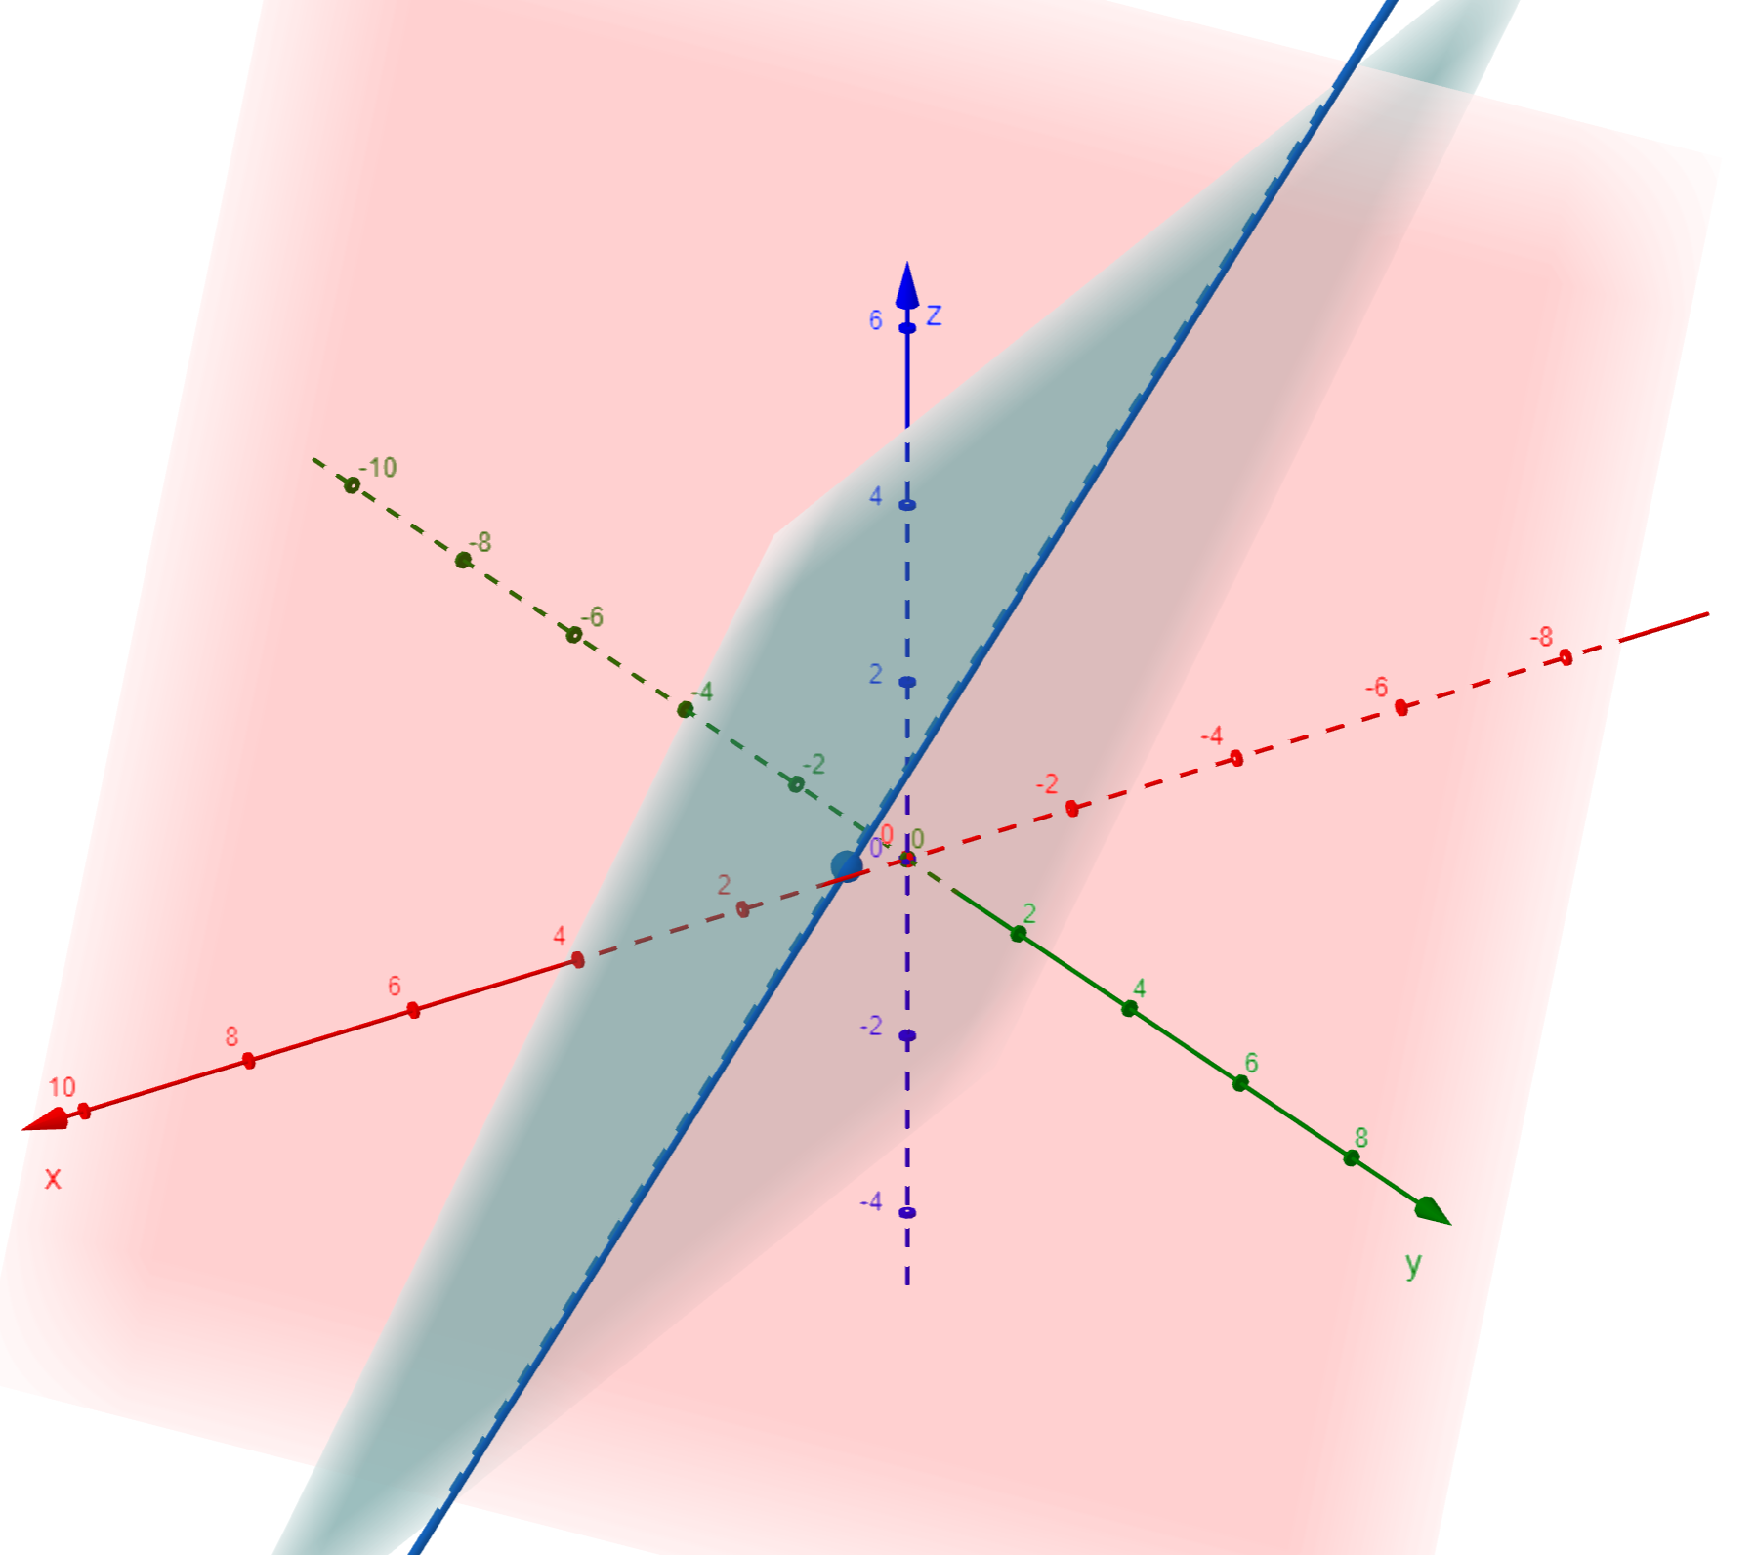


Slide 18

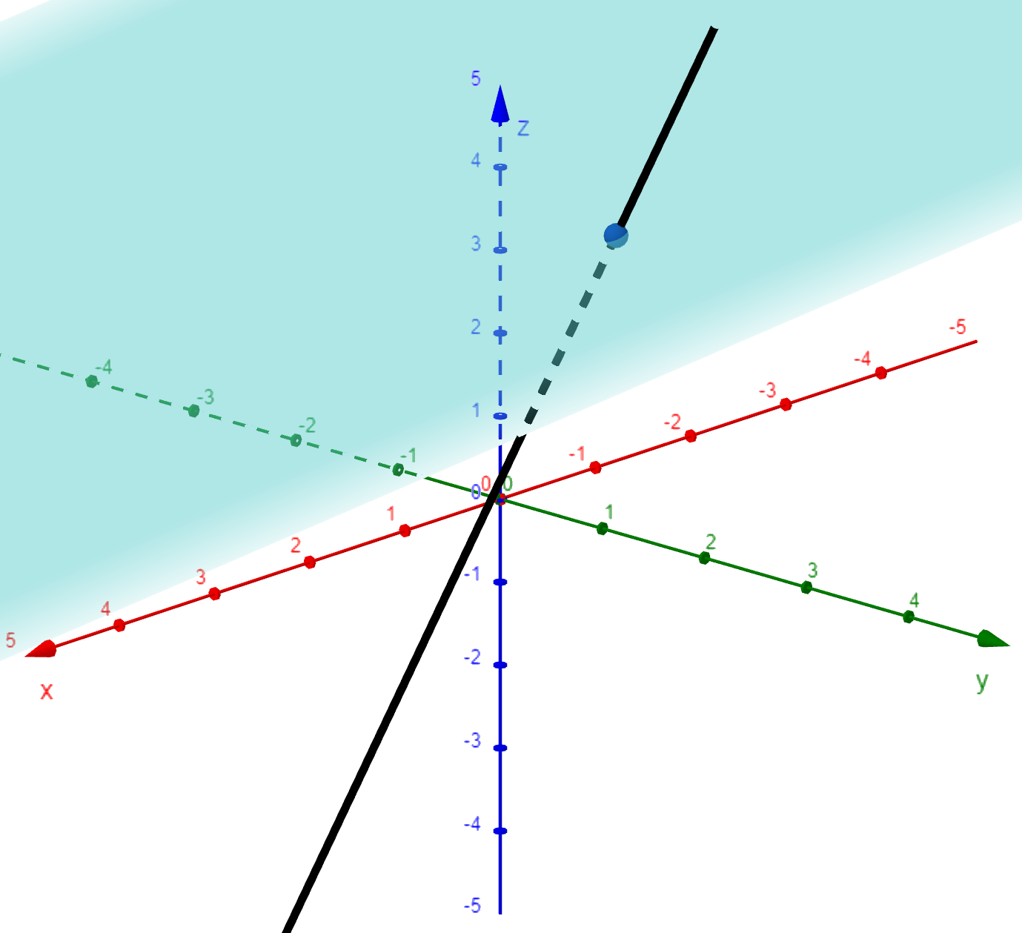
Example

Slide 19
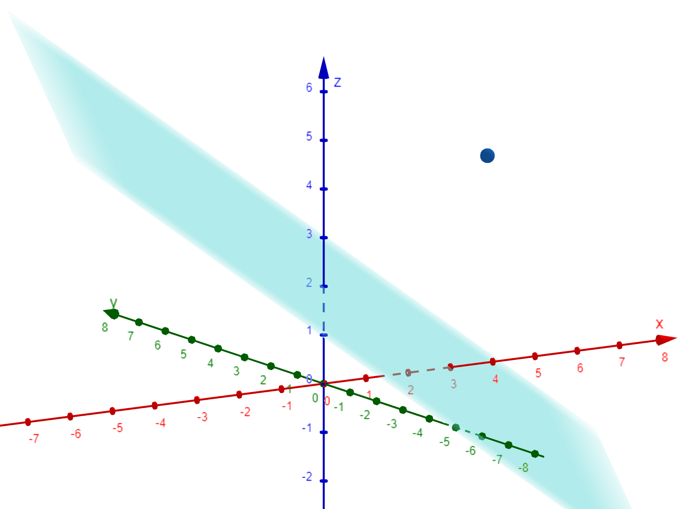
Distance from a point to a plane.

Slide 20

Example

Slide 21

Distance from a point to a line.
P
d
l
Q

Slide 22

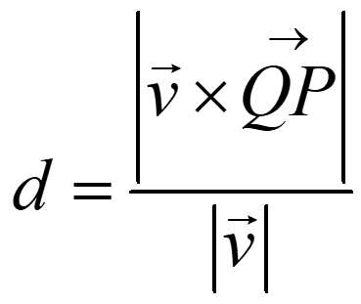
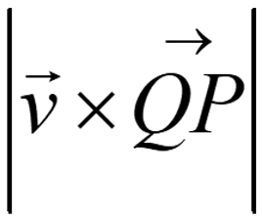
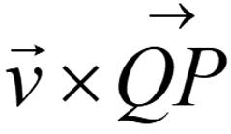

Example
P(3,−1,4)
d
$$\vec{QP}=\left\langle 5,−1,3\right\rangle$$
l
Q

