Slide 1
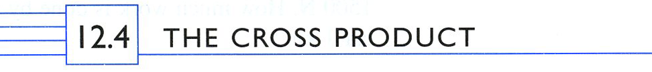





The Handle
“The Handle.”
So

Slide 2
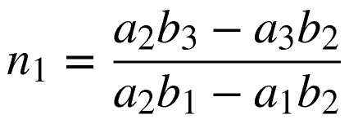
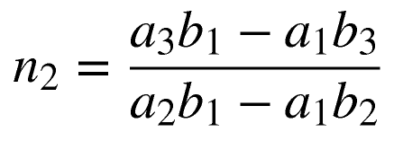
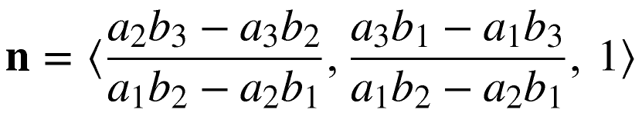
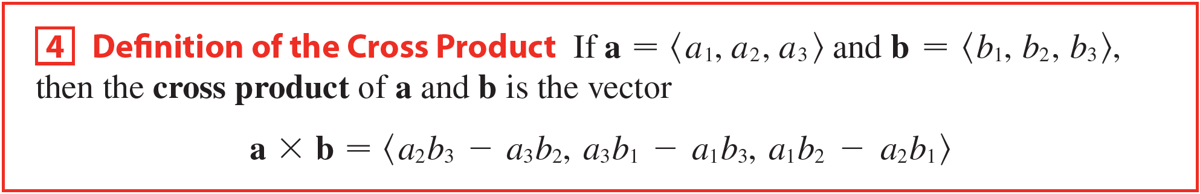

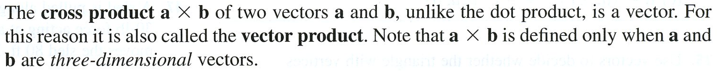
So

Slide 3
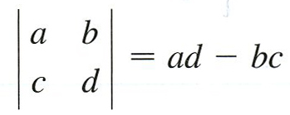
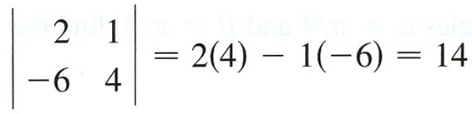

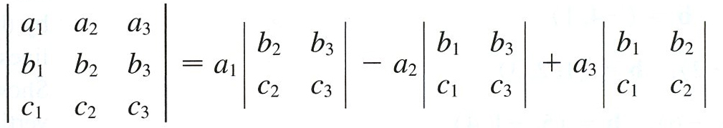

Slide 4
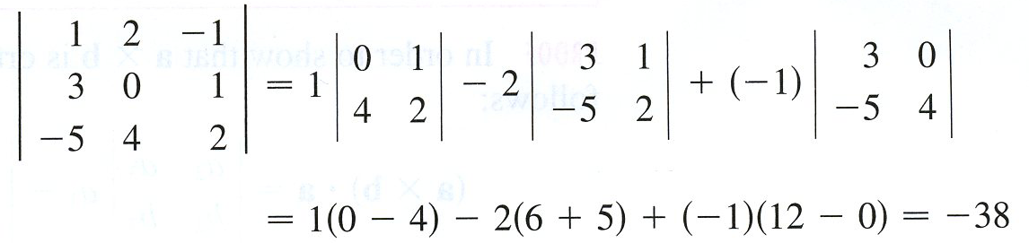
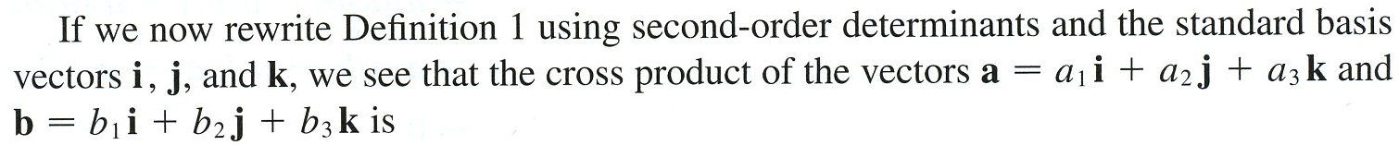
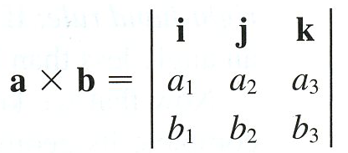
Example

Slide 5
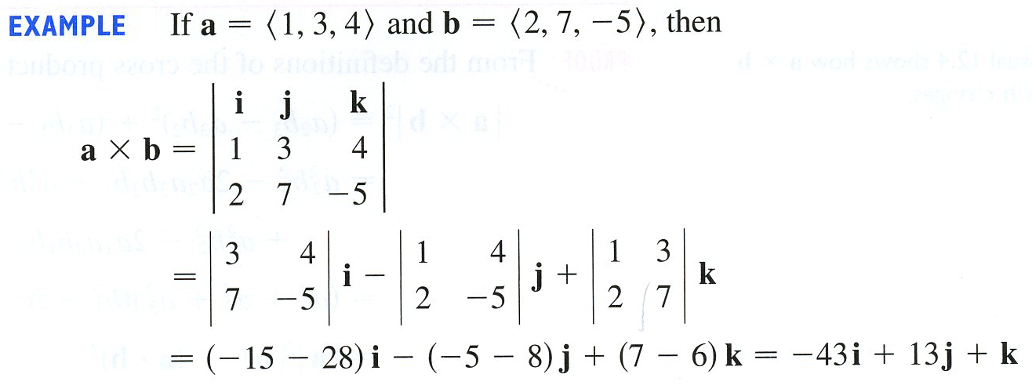
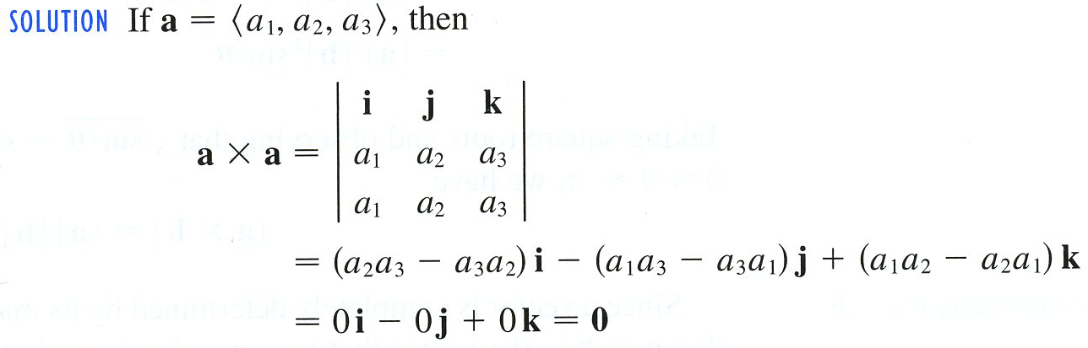
Example
Example

Slide 6
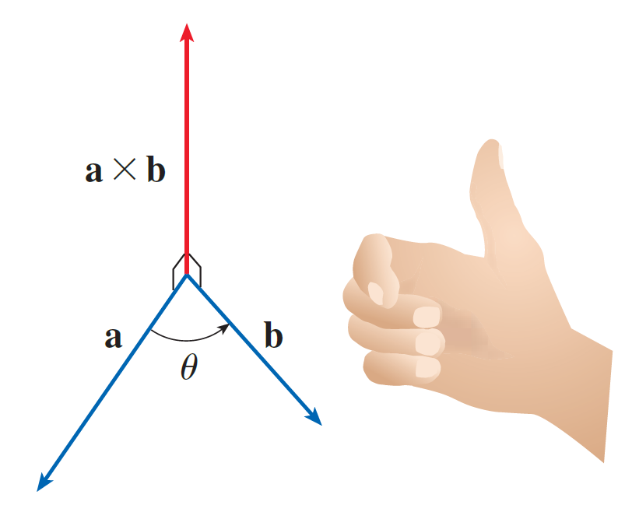
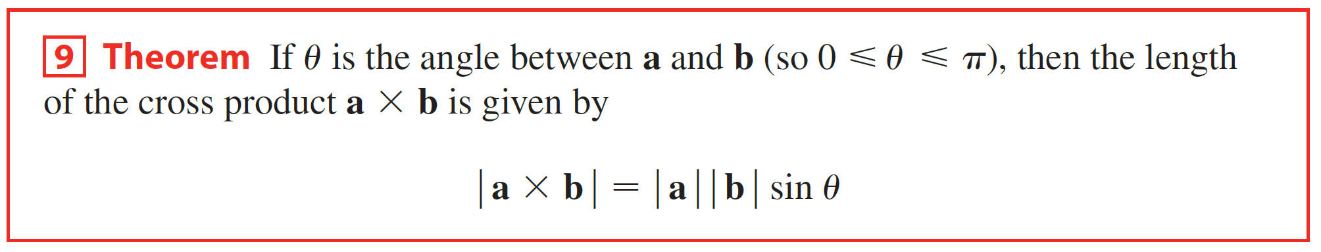

Slide 7

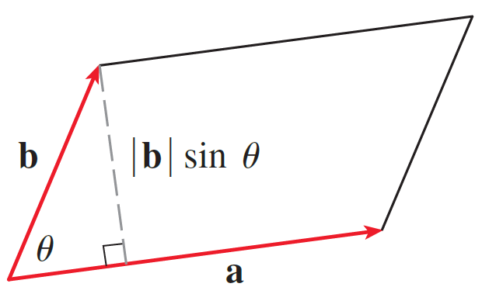

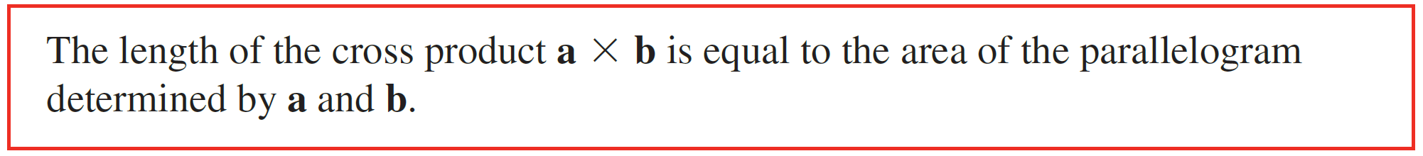
So, the area of the triangle is

Slide 8
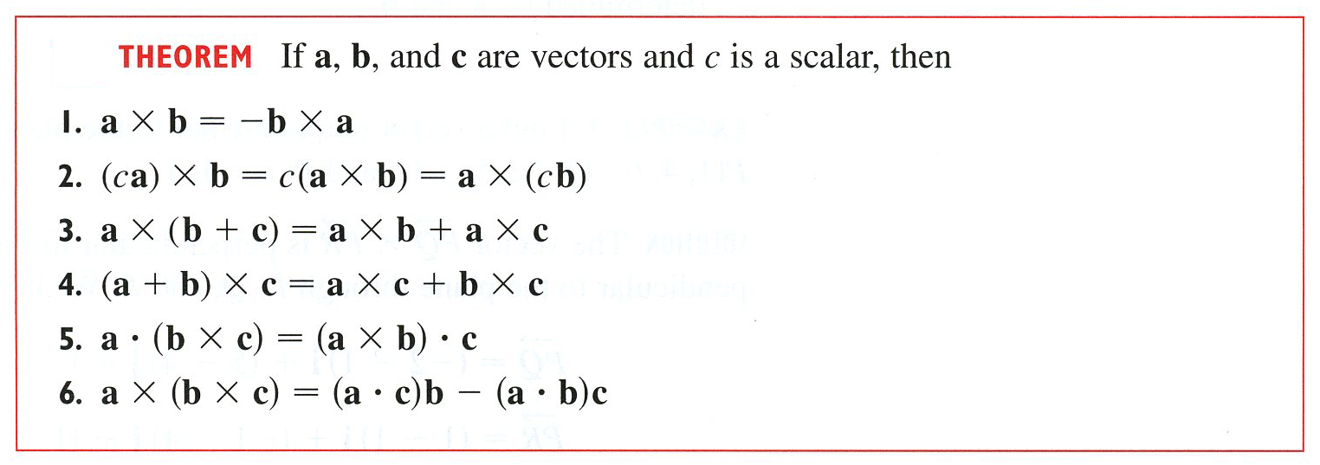


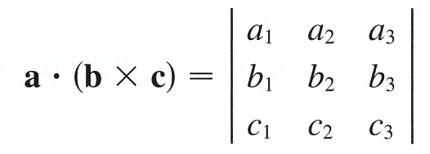
, it can be shown that

Slide 9
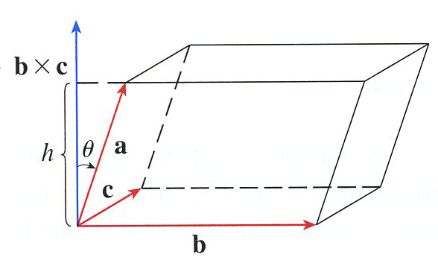


Absolute Value of Scalar Triple Product
Volume of the Parallelepiped

Slide 10
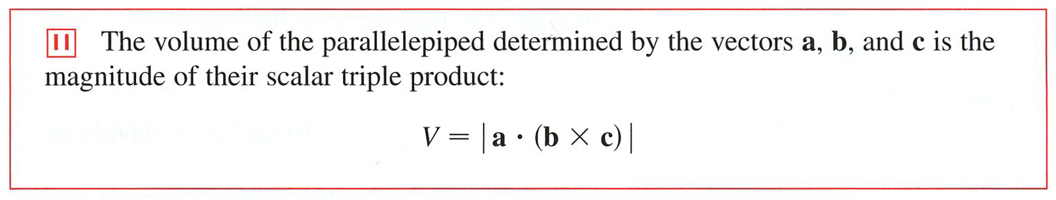

Slide 11



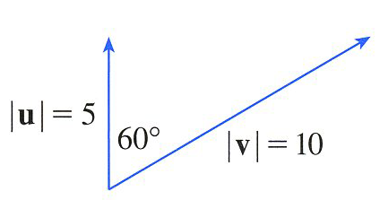

Example

Slide 12

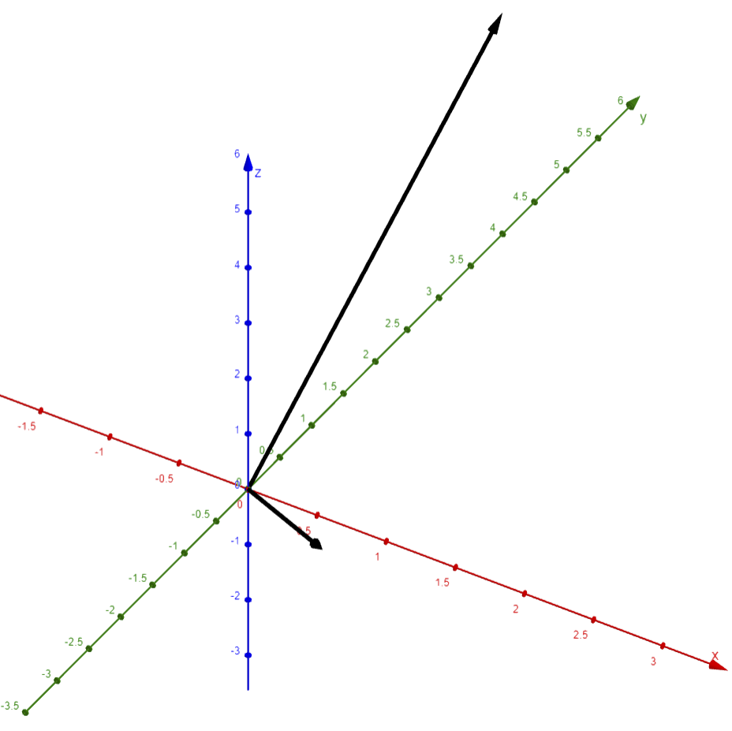
Example

Slide 13
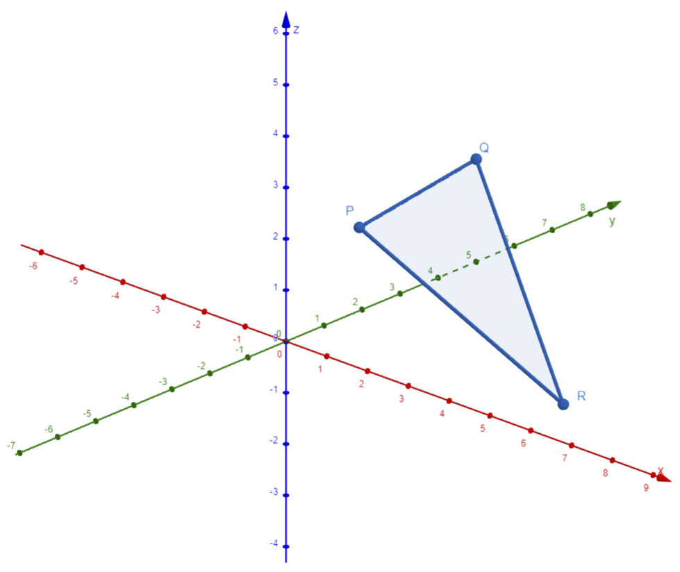




Example
$$\vec{PQ}=\left\langle 1,2,1\right\rangle$$
$$\left|\vec{PQ}×\vec{PR}\right|$$
$$\vec{PR}=\left\langle 5,0,−2\right\rangle$$
$$\vec{PQ}×\vec{PR}$$

Slide 14

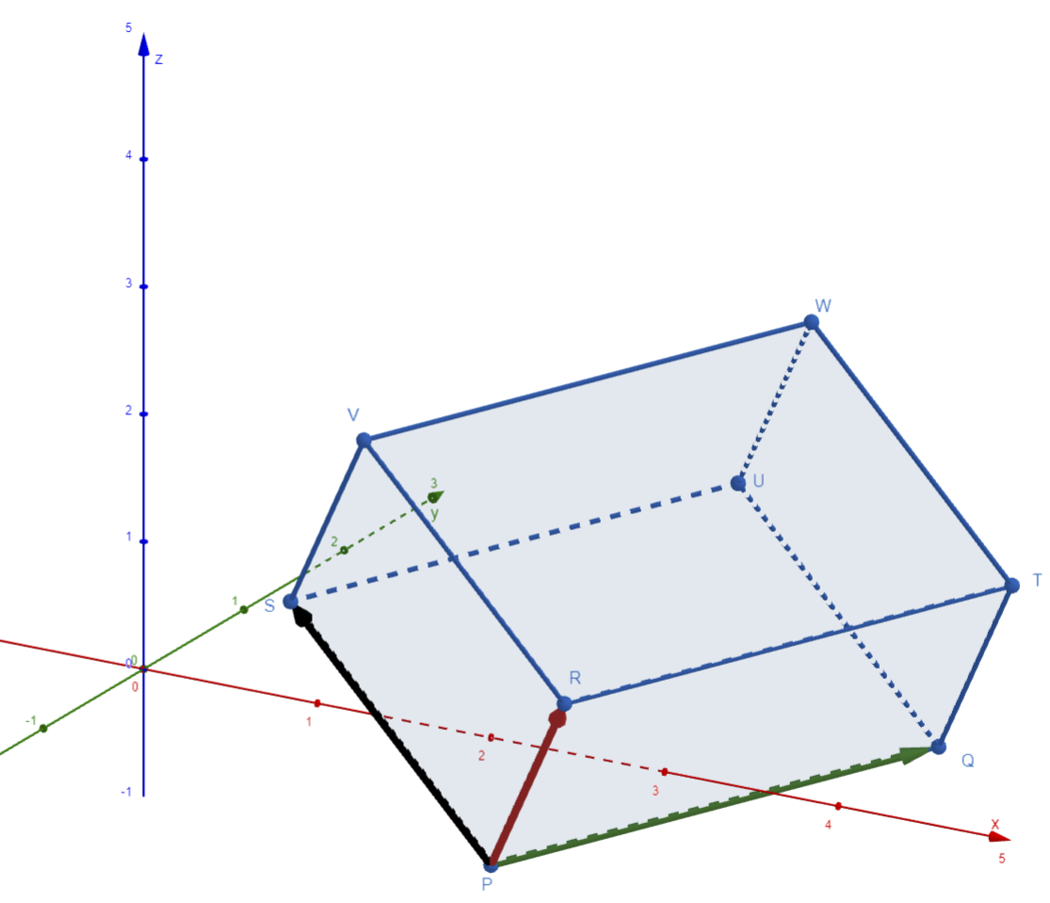
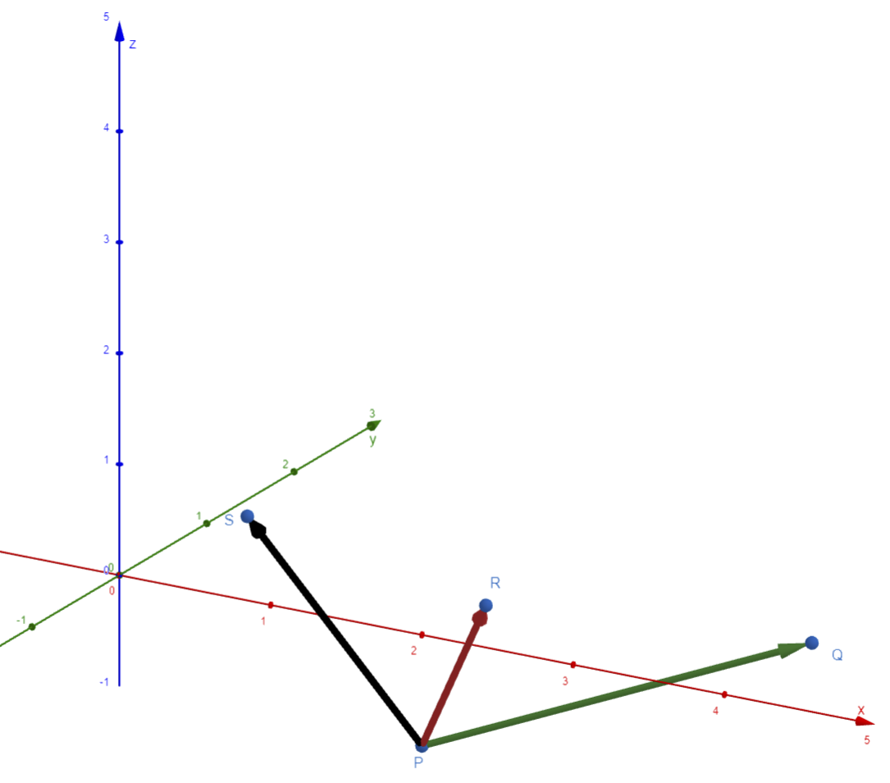





Example
$$\vec{PQ}=\left\langle 2,1,1\right\rangle$$
$$V=\left|\vec{PQ}∙\left(\vec{PR}×\vec{PS}\right)\right|$$
$$\vec{PR}=\left\langle 1,−1,2\right\rangle$$
$$\vec{PS}=\left\langle 0,−2,3\right\rangle$$
$$\vec{PQ}∙\left(\vec{PR}×\vec{PS}\right)$$

Slide 15
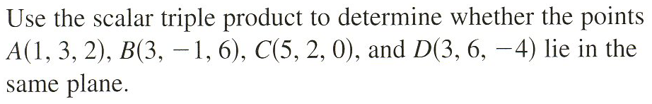
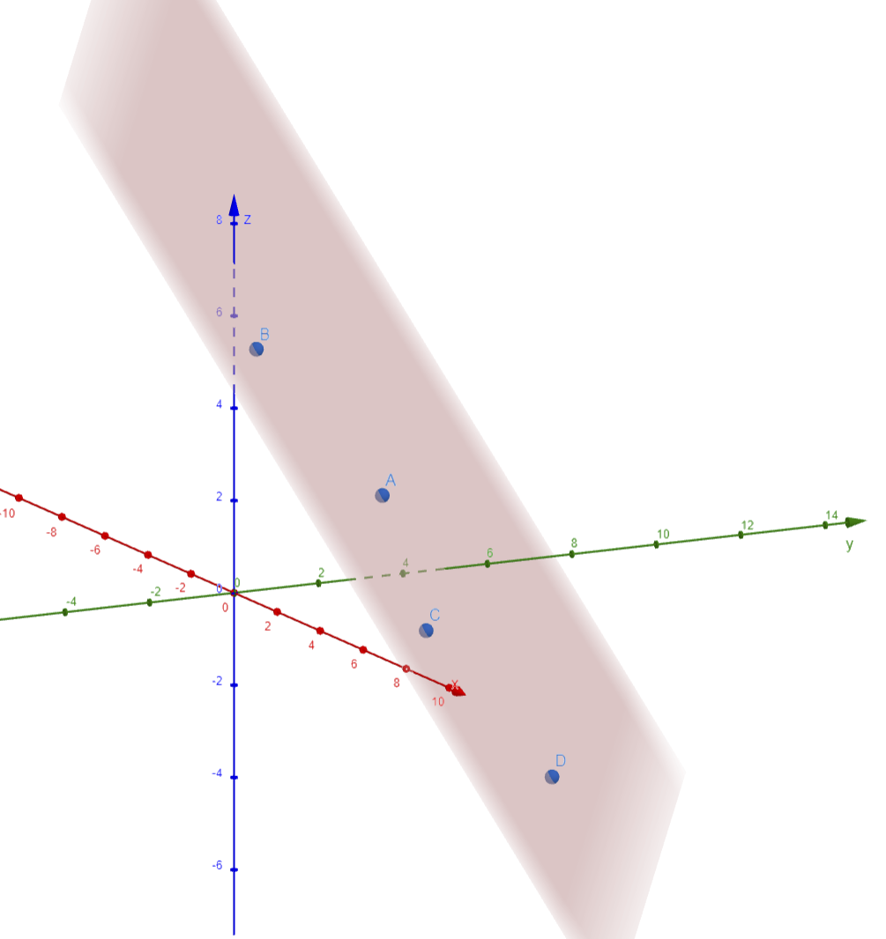




Example
$$\vec{AB}=\left\langle 2,−4,4\right\rangle$$
$$\vec{AC}=\left\langle 4,−1,−2\right\rangle$$
$$\vec{AD}=\left\langle 2,3,−6\right\rangle$$
$$\vec{AB}∙\left(\vec{AC}×\vec{AD}\right)$$

