Slide 1
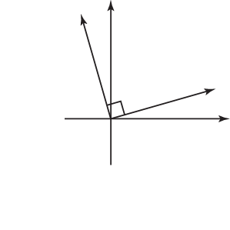



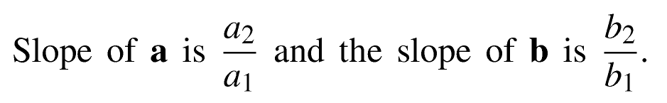
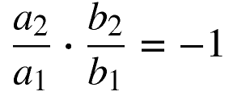
y
x

Slide 2

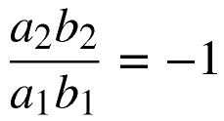






We call the calculation above the Dot Product of vectors a and b.

Slide 3
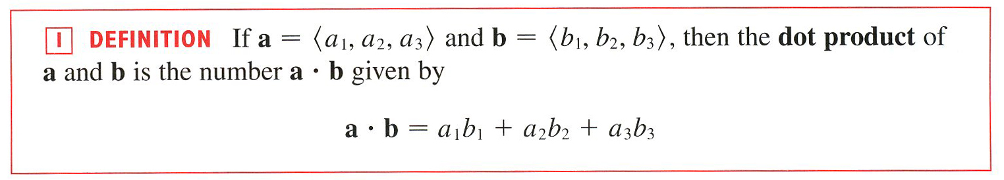
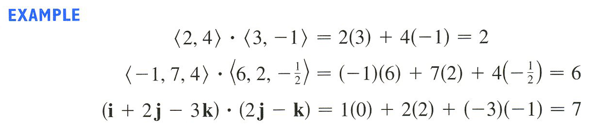
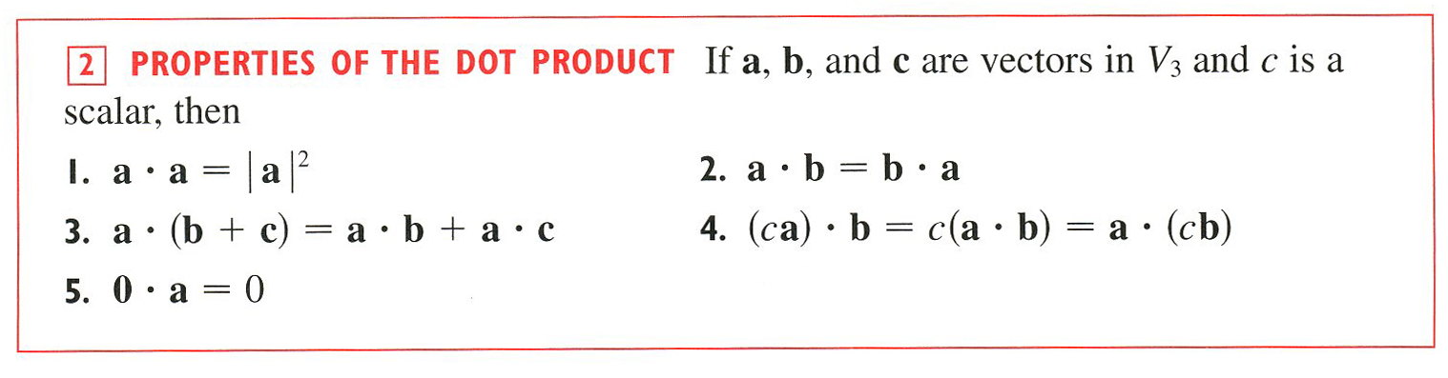

Slide 4
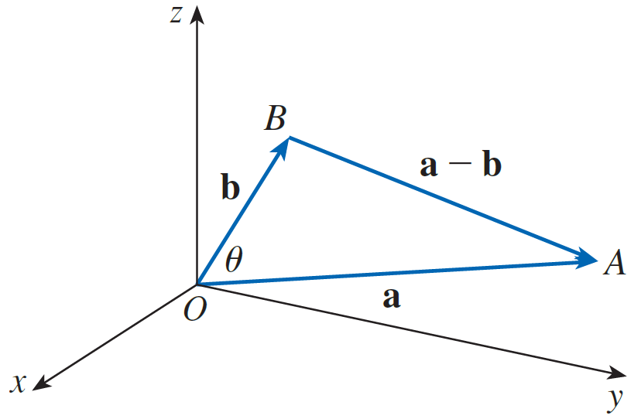

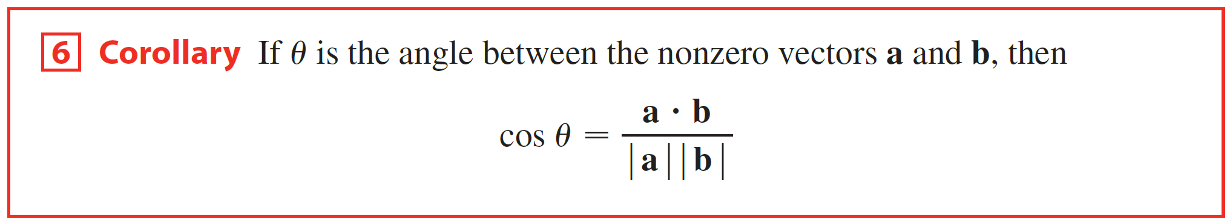
Angle Between Vectors

Slide 5
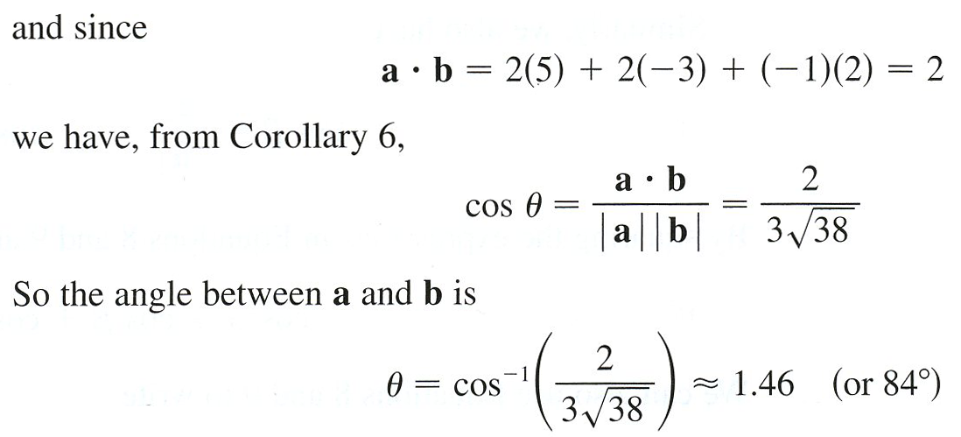


Example
$≈1.462$ or $83.791°$

Slide 6

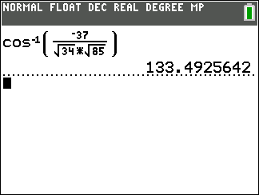
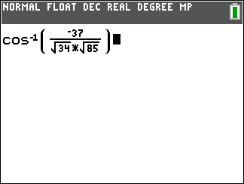


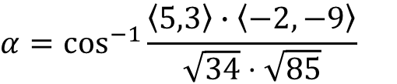
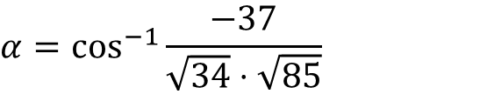


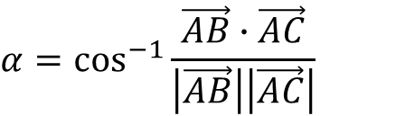

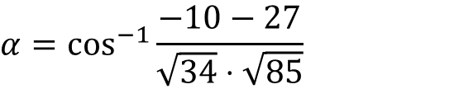





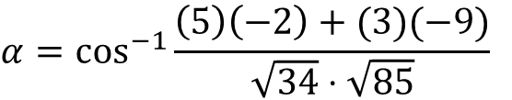




Example
Solve the triangle whose vertices have coordinates A(−2,5), B(3,8), and C(−4,−4).
A(−2,5)
$$\vec{AB}=\left\langle 3−\left(−2\right),8−5\right\rangle$$
$$\vec{AC}=\left\langle −4−\left(−2\right),−4−5\right\rangle$$
$$α$$
$$\vec{AB}$$
$$\vec{AB}=\left\langle 5,3\right\rangle$$
$$\vec{AC}=\left\langle −2,−9\right\rangle$$
$$\vec{AC}$$
$$\left|\vec{AB}\right|=\sqrt{{(5)}^{2}+{(3)}^{2}}$$
$$\left|\vec{AC}\right|=\sqrt{{(−2)}^{2}+{(−9)}^{2}}$$
C(−4,−4)
B(3,8)
$$\left|\vec{AB}\right|=\sqrt{25+9}$$
$$\left|\vec{AC}\right|=\sqrt{4+81}$$
$$\left|\vec{AB}\right|=\sqrt{34}$$
$$\left|\vec{AC}\right|=\sqrt{85}$$
$$α=\cos^{−1}{\frac{\vec{AB}∙\vec{AC}}{\left|\vec{AB}\right|\left|\vec{AC}\right|}}$$
$$α=\cos^{−1}{\frac{−10−27}{\sqrt{34}⋅\sqrt{85}}}$$
$$α=\cos^{−1}{\frac{\left\langle 5,3\right\rangle ∙\left\langle −2,−9\right\rangle }{\sqrt{34}⋅\sqrt{85}}}$$
$$α=\cos^{−1}{\frac{−37}{\sqrt{34}⋅\sqrt{85}}}$$
$$α=\cos^{−1}{\frac{\left(5\right)\left(−2\right)+(3)(−9)}{\sqrt{34}⋅\sqrt{85}}}$$
$$α≈133.493°$$

Slide 7
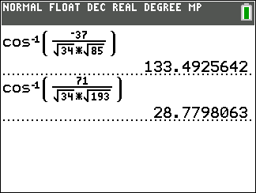
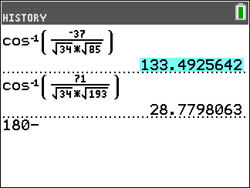
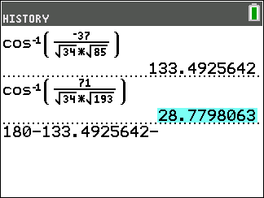
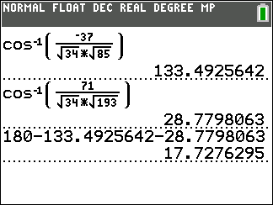
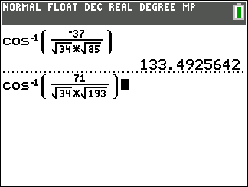

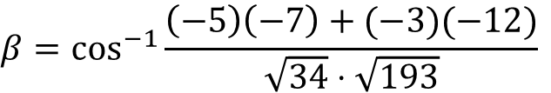


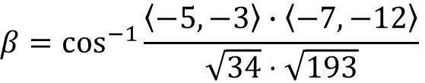




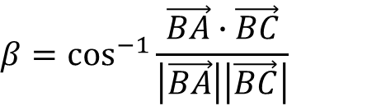


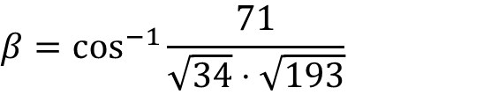





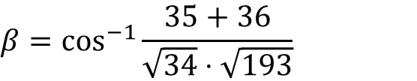
Example
Solve the triangle whose vertices have coordinates A(−2,5), B(3,8), and C(−4,−4).
A(−2,5)
$$\vec{BA}=\left\langle −5,−3\right\rangle$$
$$\vec{BC}=\left\langle −4−3,−4−8\right\rangle$$
$$α$$
$$\left|\vec{BA}\right|=\sqrt{34}$$
$$\vec{BC}=\left\langle −7,−12\right\rangle$$
$$\vec{BA}$$
$$γ$$
$$β$$
$$\left|\vec{BC}\right|=\sqrt{{(−7)}^{2}+{(−12)}^{2}}$$
C(−4,−4)
$$\vec{BC}$$
B(3,8)
$$\left|\vec{BC}\right|=\sqrt{49+144}$$
$$\left|\vec{BC}\right|=\sqrt{193}$$
$$β=\cos^{−1}{\frac{\vec{BA}∙\vec{BC}}{\left|\vec{BA}\right|\left|\vec{BC}\right|}}$$
$$β=\cos^{−1}{\frac{35+36}{\sqrt{34}⋅\sqrt{193}}}$$
$$β=\cos^{−1}{\frac{\left\langle −5,−3\right\rangle ∙\left\langle −7,−12\right\rangle }{\sqrt{34}⋅\sqrt{193}}}$$
$$β=\cos^{−1}{\frac{71}{\sqrt{34}⋅\sqrt{193}}}$$
$$β=\cos^{−1}{\frac{\left(−5\right)\left(−7\right)+(−3)(−12)}{\sqrt{34}⋅\sqrt{193}}}$$
$$β≈28.780°$$
$$γ≈180°−133.493°−28.780$$
$$γ≈17.728°$$

Slide 8
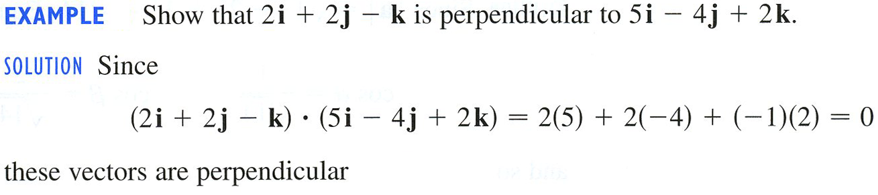
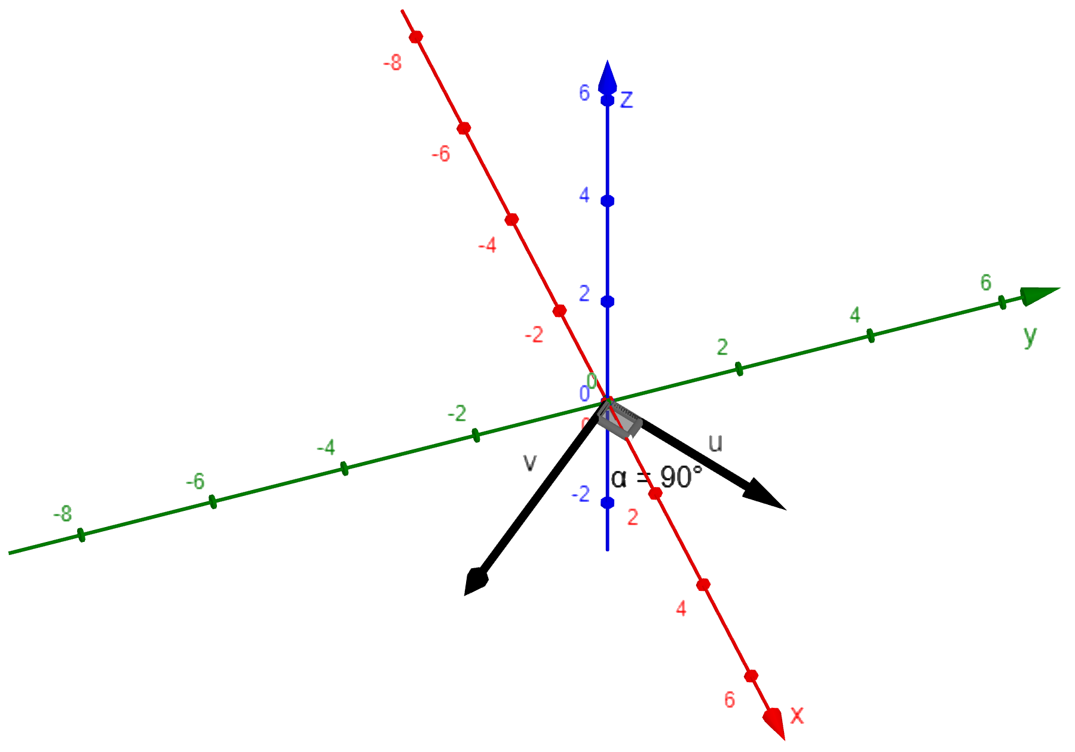

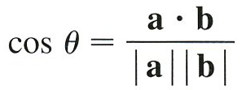
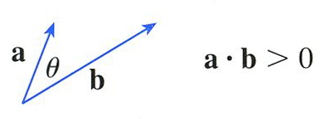
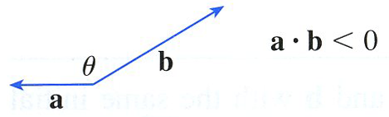
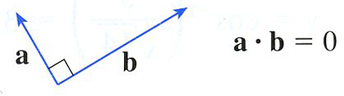

Slide 9
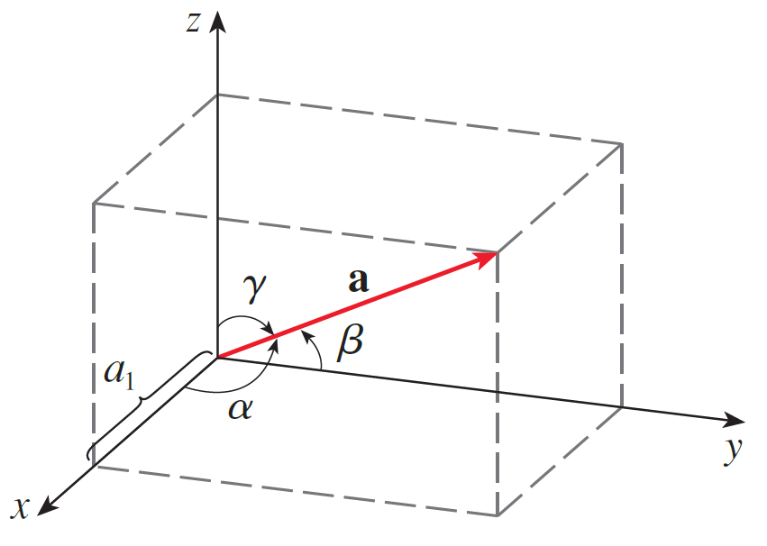

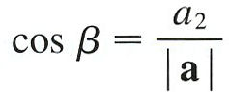
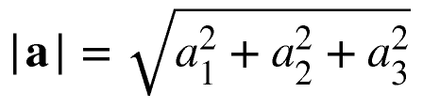

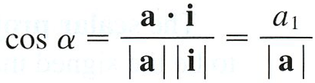
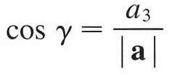
b replaced by j, we obtain
b replaced by k, we obtain

Slide 10
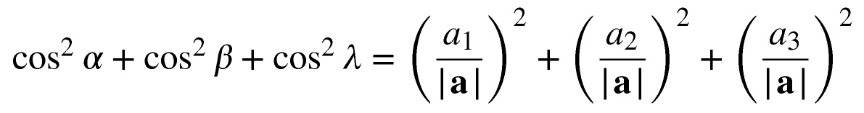

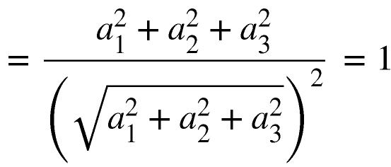

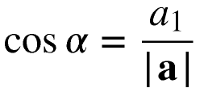

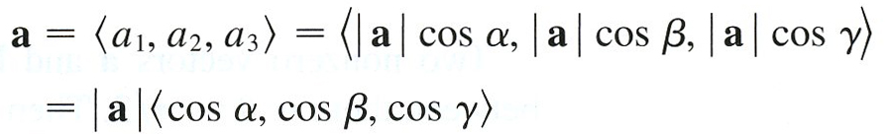
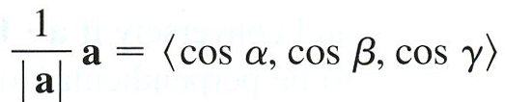


Slide 11
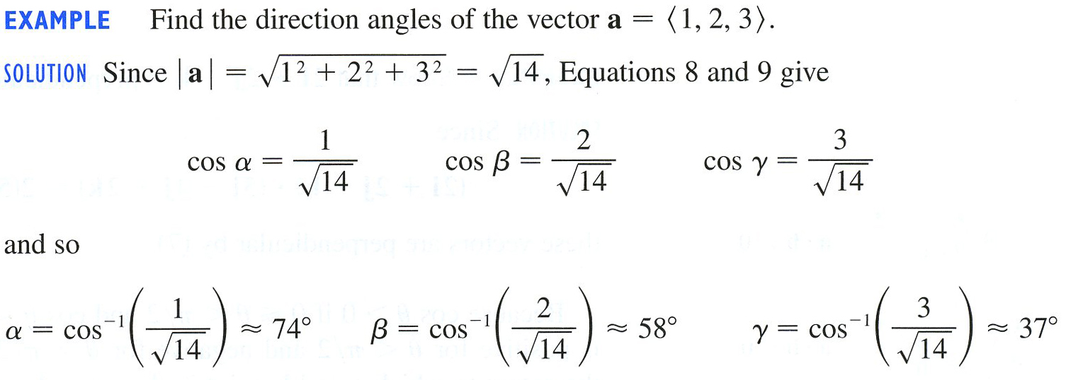
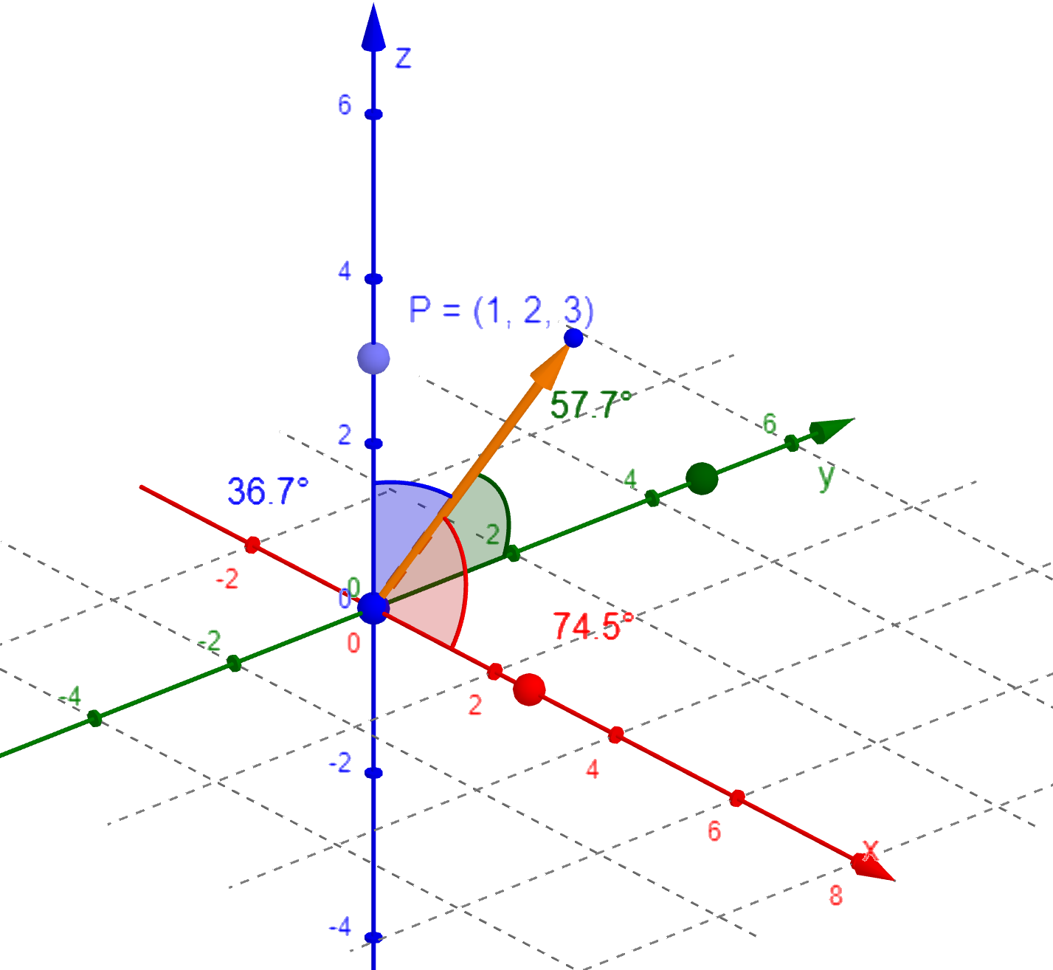
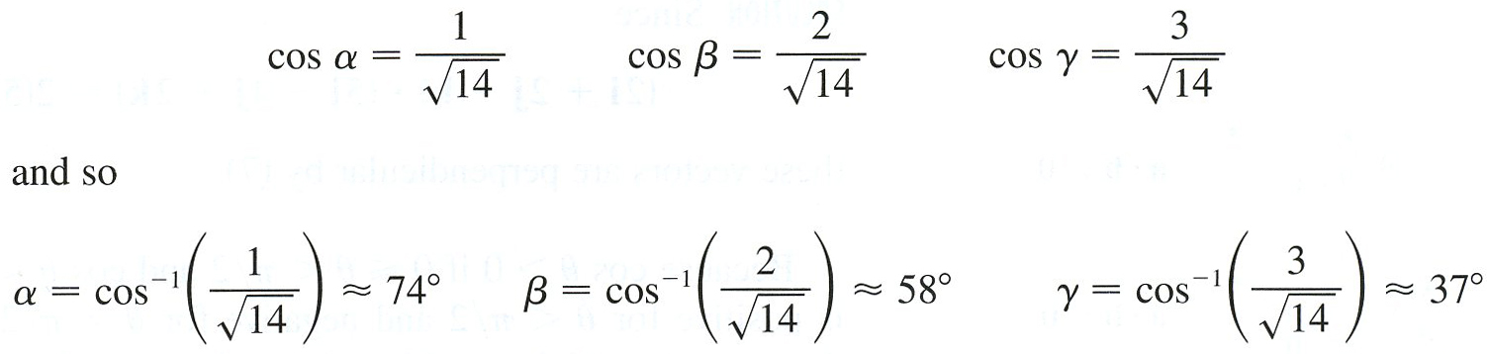

Slide 12



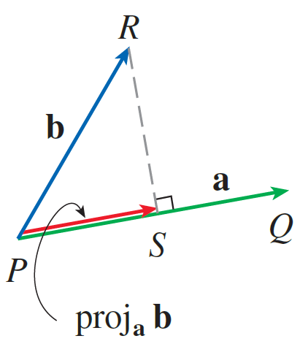
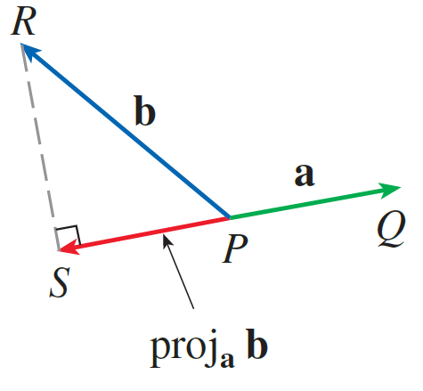


Slide 13

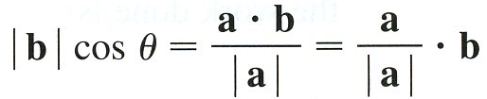
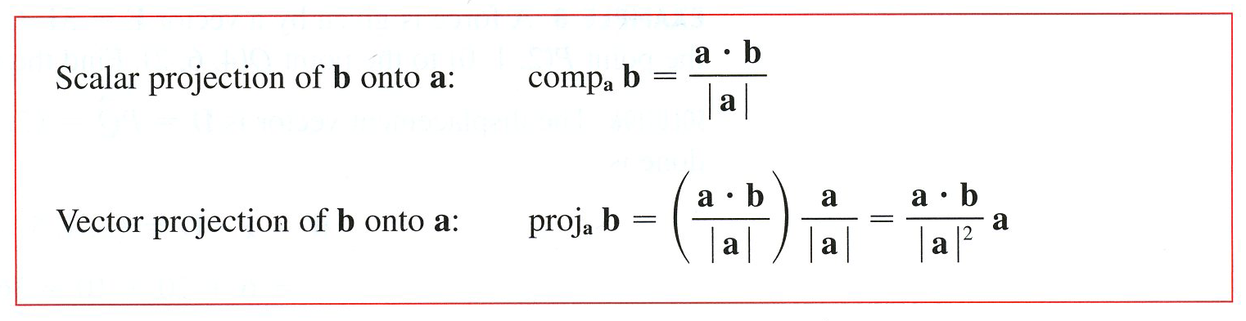

Slide 14




Example

Slide 15




An example of projections is Work.
product of the component of the force along D and the distance
moved:
We have

Slide 16



Example

