Slide 1
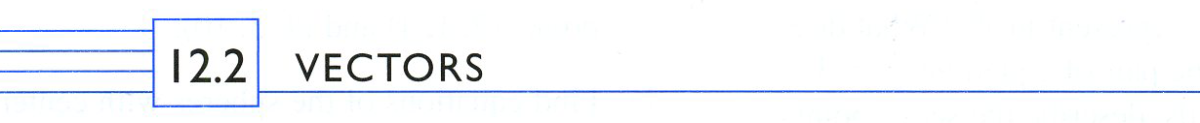
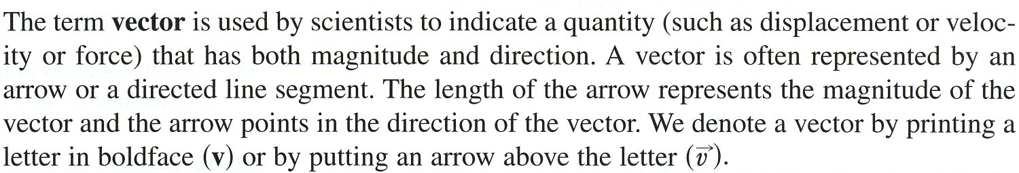
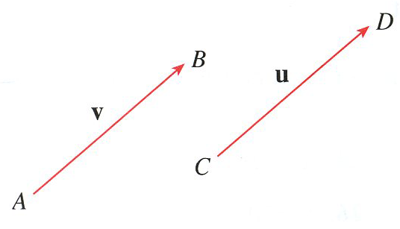





Slide 2
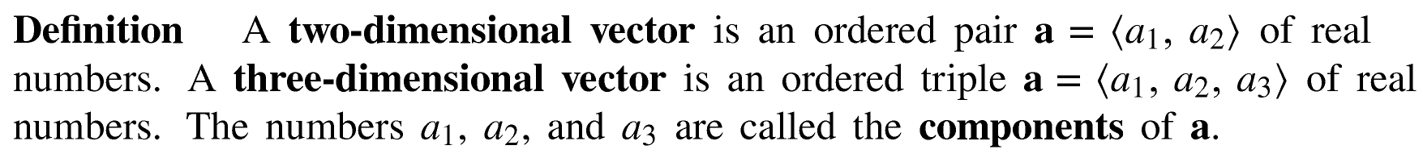
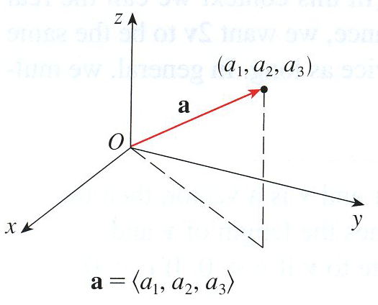
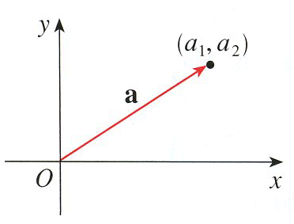

Vector in Standard Position
Two-dimensional Vector
Three-dimensional Vector

Slide 3
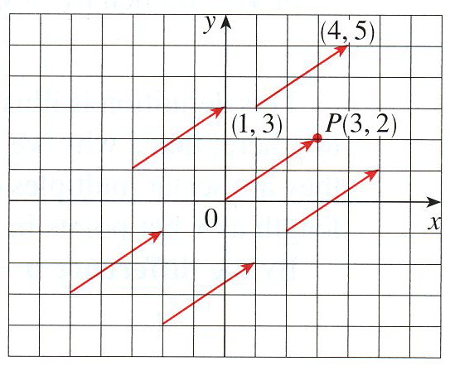
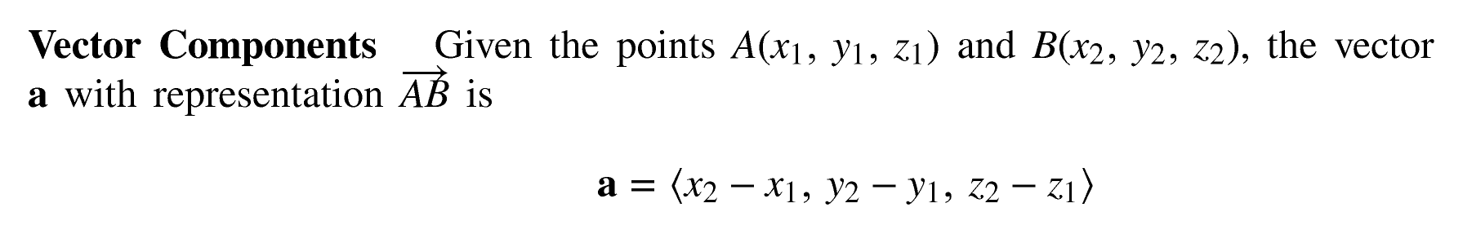
“Tip” – “Tail”

Slide 4
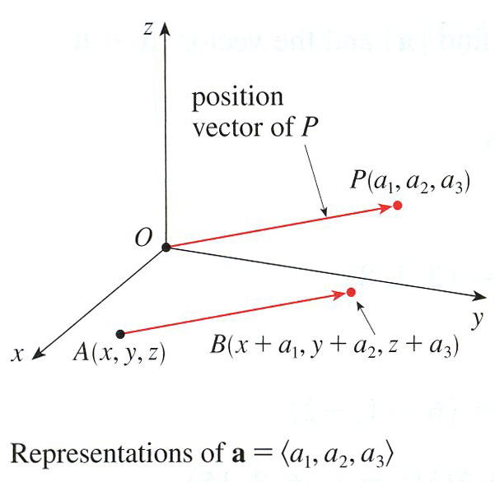
“Tip” – “Tail”

Slide 5
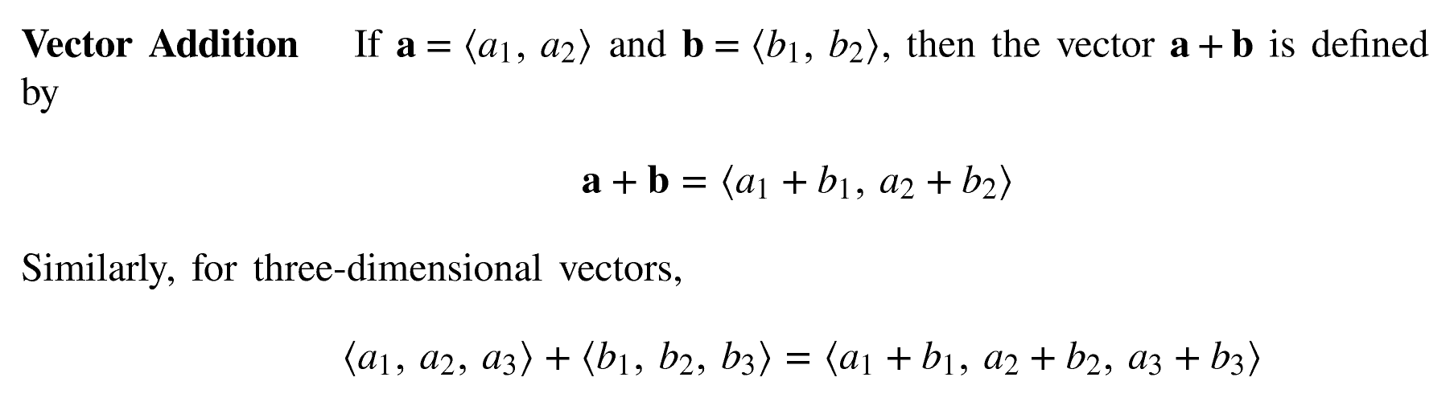

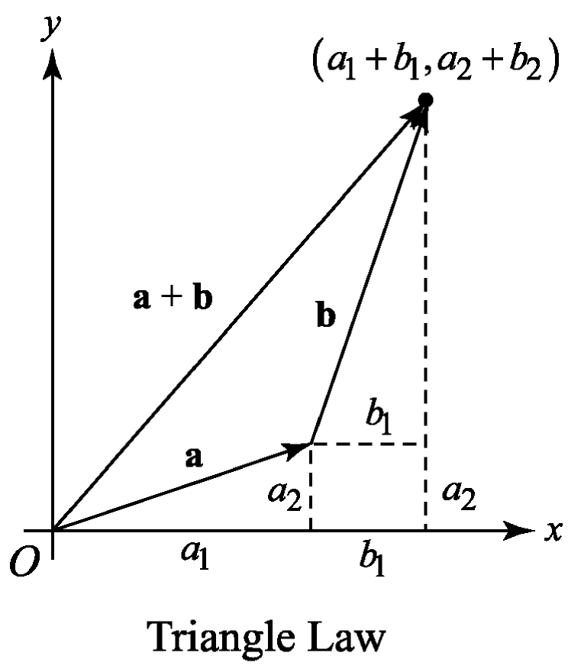
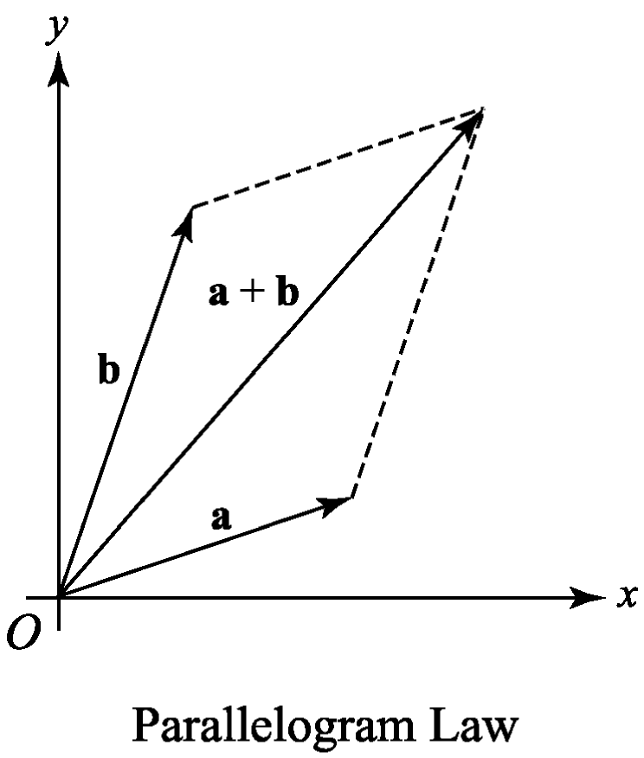
b₂

Slide 6


Vector Subtract

Slide 7
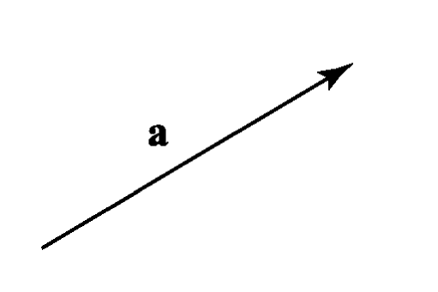
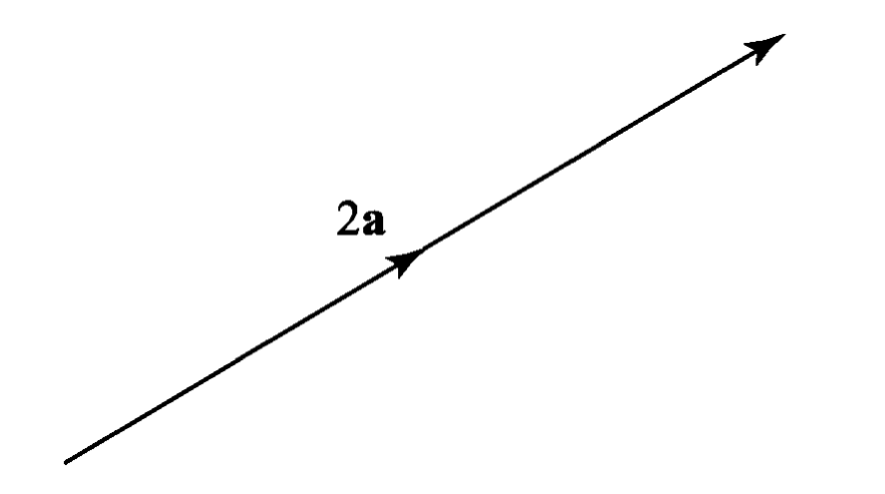
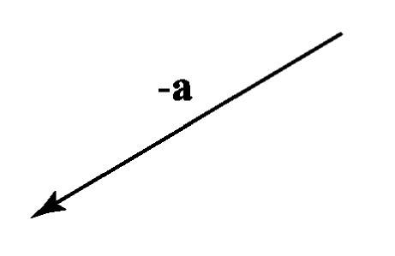
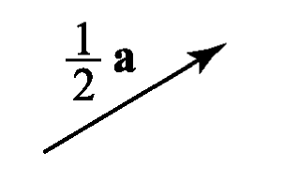
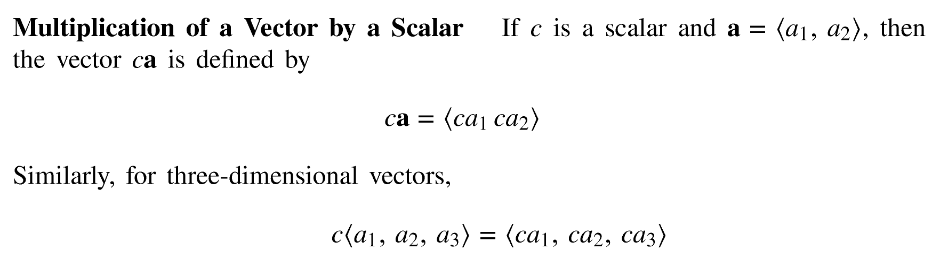
Scalar Multiplication

Slide 8
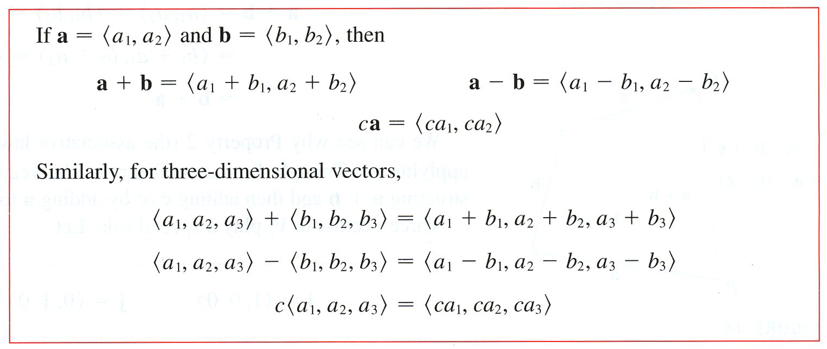

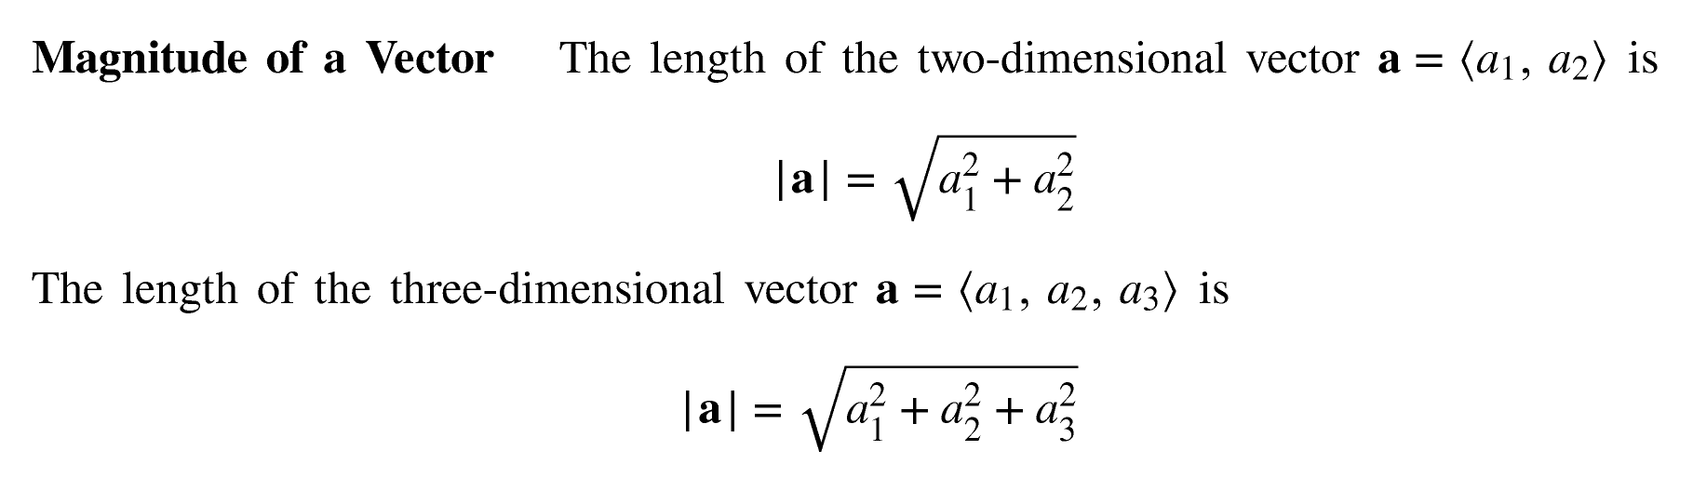

Slide 9


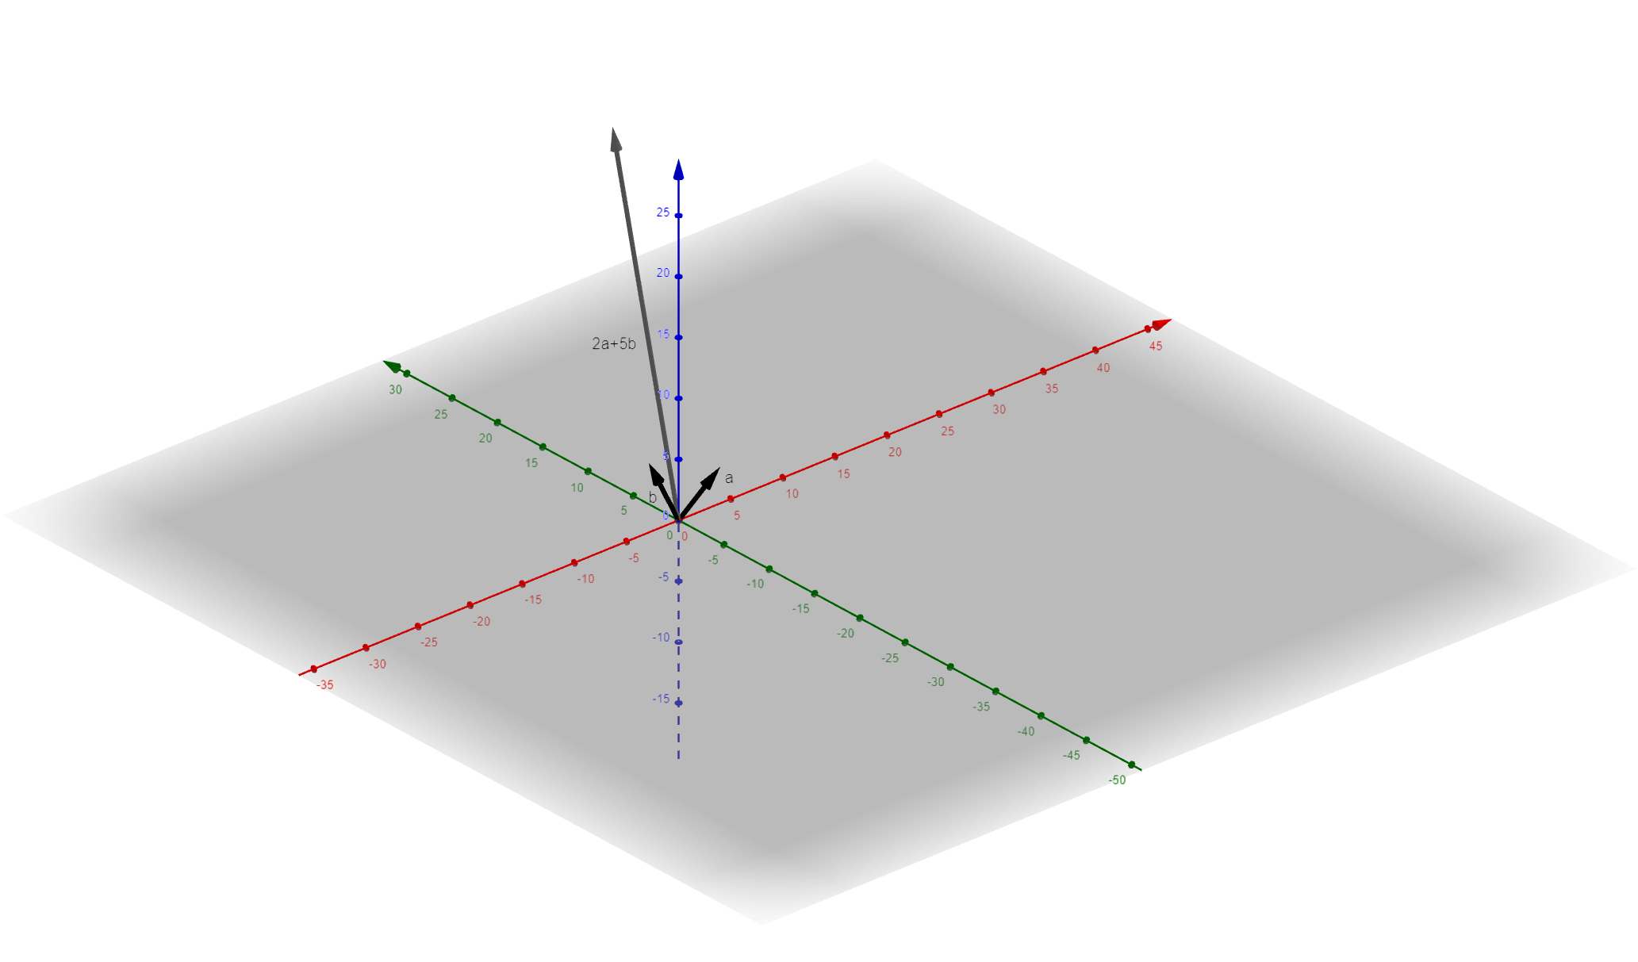
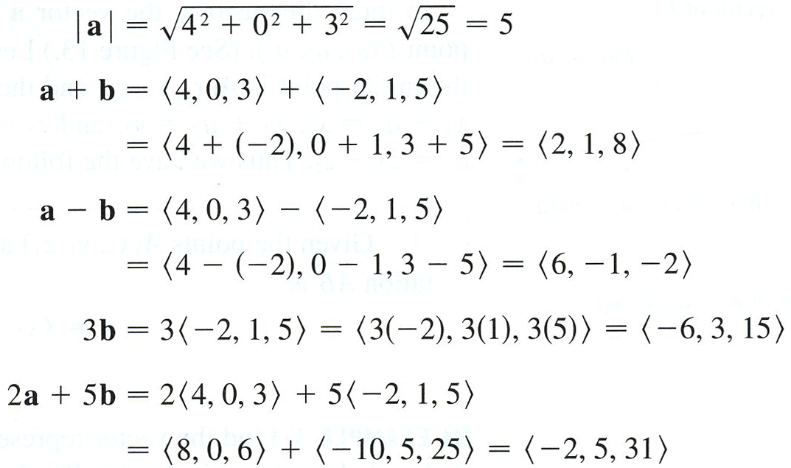
Example

Slide 10
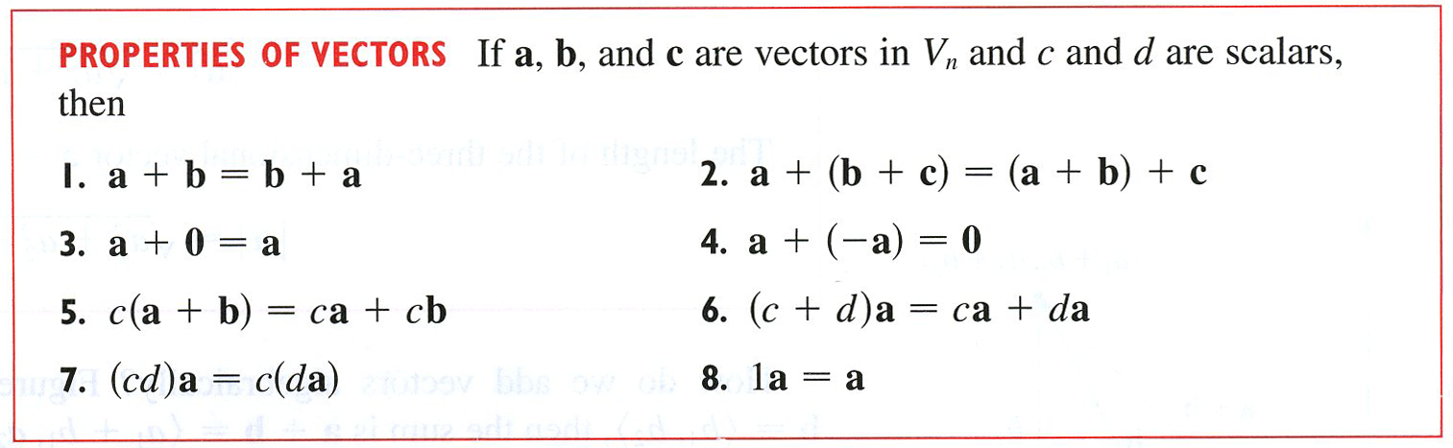

Slide 11

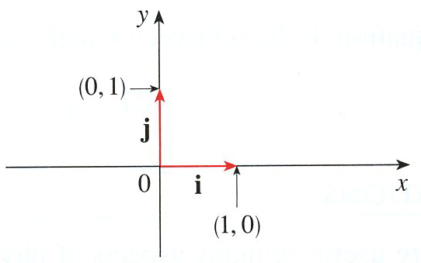
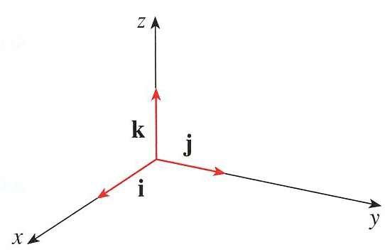
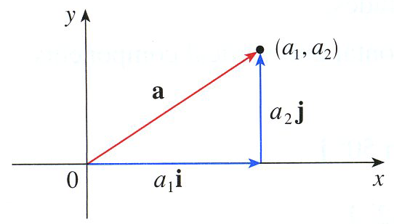
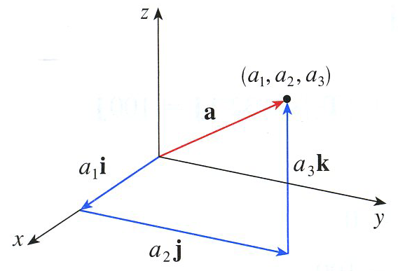



Slide 12
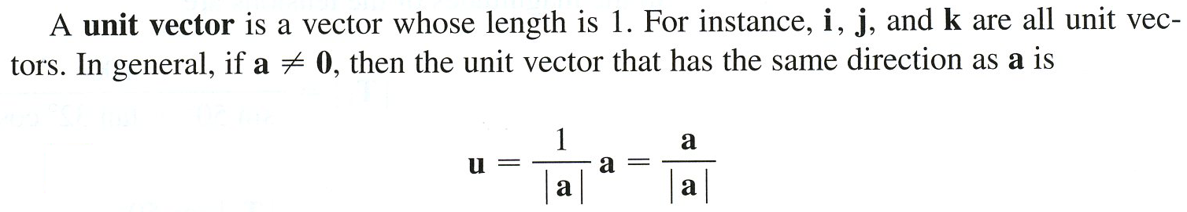
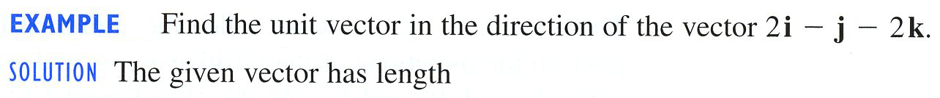
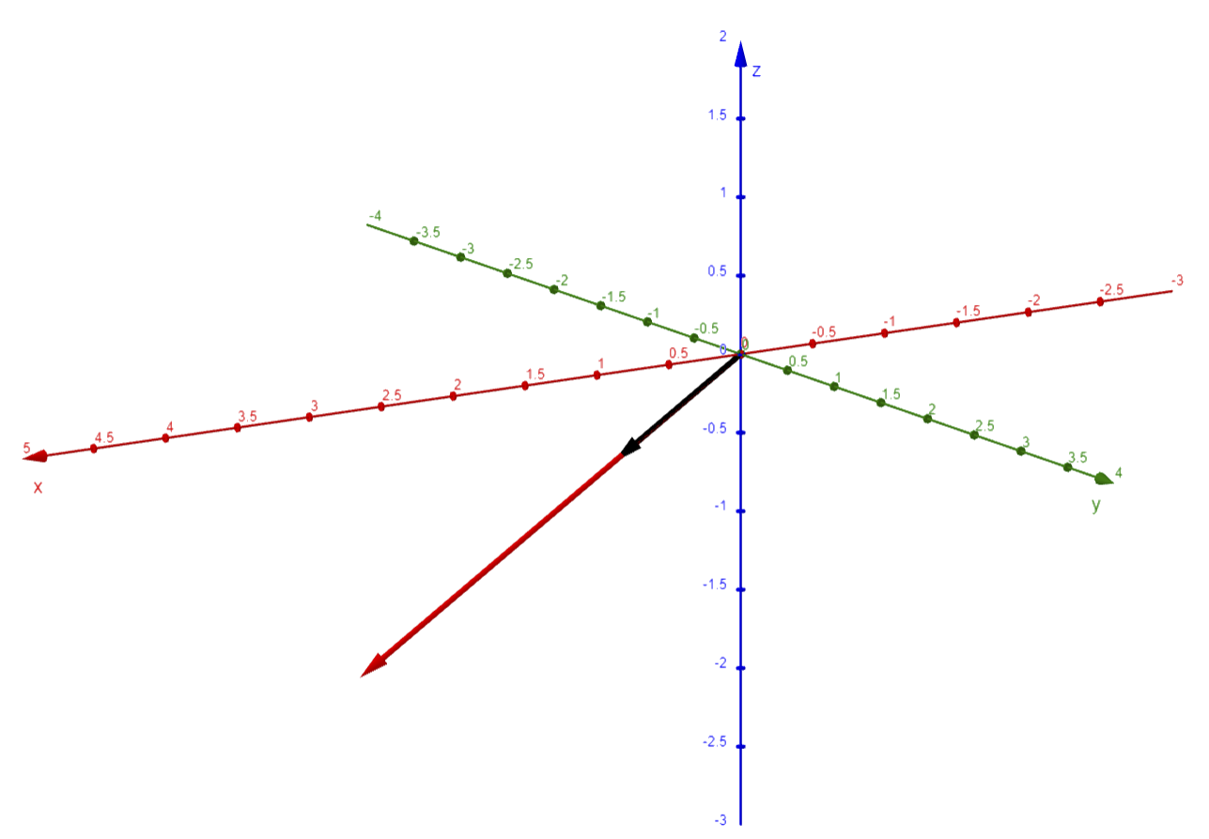
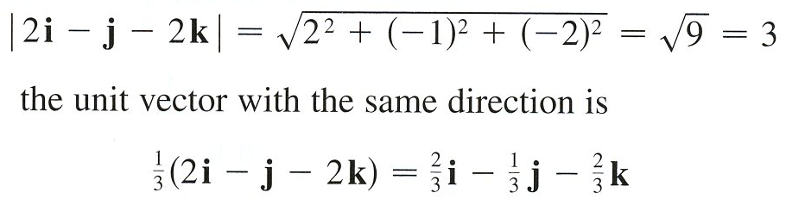
Example

Slide 13

Example

Slide 14
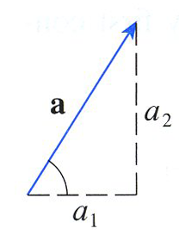
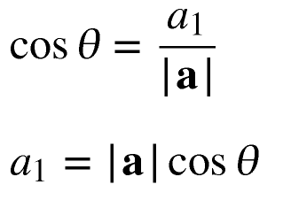
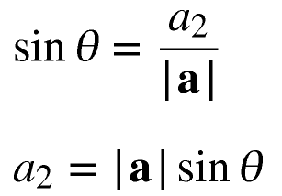

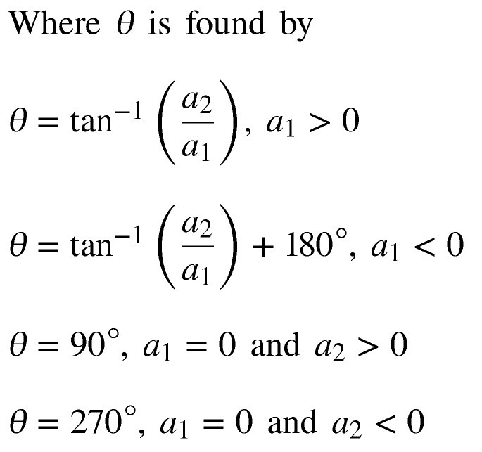

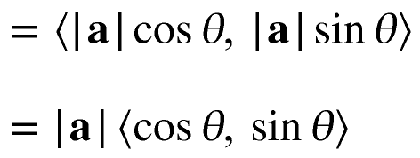
Trigonometric Form for a Vector
Vector is in Q1 or Q4
Vector is in Q2 or Q3
Vector on Positive y-axis
Vector on Negative y-axis

Slide 15
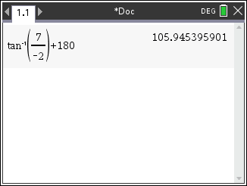


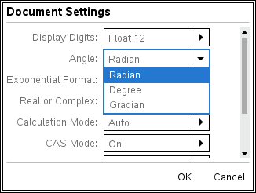
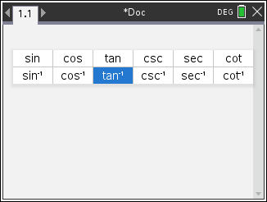

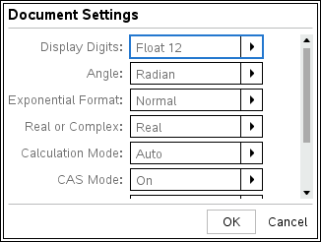
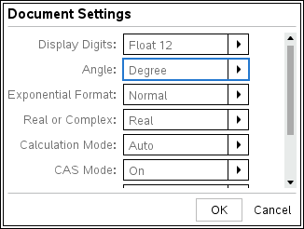
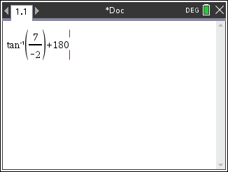

Example
Vector v is in Q2 so,

Slide 16
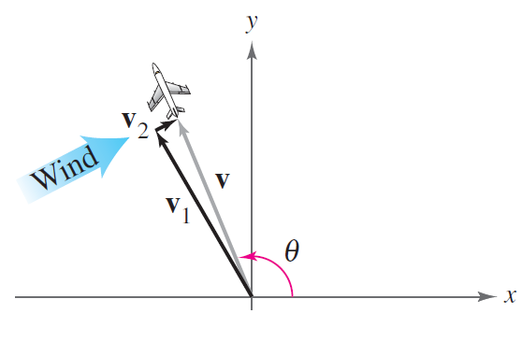
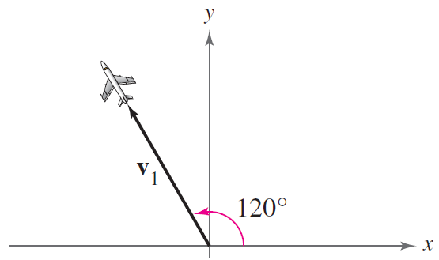

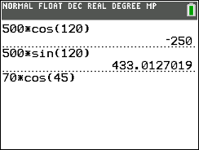
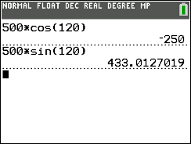
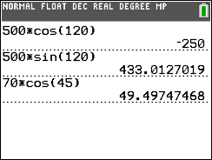
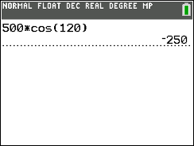
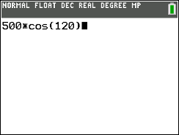
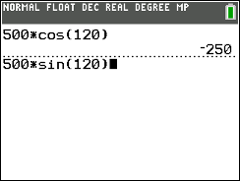
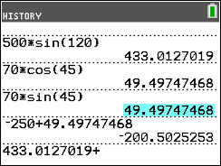








Example
An airplane is traveling at a speed of 500 miles per hour with a bearing of 330° at a fixed altitude with a negligible wind velocity, as shown in the figure. (Note that a bearing of 330° corresponds to a direction angle of 120°, since bearing is measured in degrees clockwise from north.) The airplane encounters a wind blowing with a velocity of 70 miles per hour in the direction N 45° E. What are the resultant speed and the true direction of the airplane?
The velocity of the airplane (alone) is
and the velocity of the wind is
y
330°
Wind Vector
N 45° E
So, the resultant vector v of the airplane (in the wind) is
45°
45°
x

Slide 17









Example
An airplane is traveling at a speed of 500 miles per hour with a bearing of 330° at a fixed altitude with a negligible wind velocity, as shown in the figure. (Note that a bearing of 330° corresponds to a direction angle of 120°, since bearing is measured in degrees clockwise from north.) The airplane encounters a wind blowing with a velocity of 70 miles per hour in the direction N 45° E. What are the resultant speed and the true direction of the airplane?
The resultant speed of the airplane is
miles per hour
To find $θ_{v }$, the direction angle of the
flight path, note that
330°
The flight path lies in Quadrant II, so $θ_{v }$ lies in Quadrant II and ${180}^{∘}$ must be added to the inverse tangent.

Slide 18















Example
An airplane is traveling at a speed of 500 miles per hour with a bearing of 330° at a fixed altitude with a negligible wind velocity, as shown in the figure. (Note that a bearing of 330° corresponds to a direction angle of 120°, since bearing is measured in degrees clockwise from north.) The airplane encounters a wind blowing with a velocity of 70 miles per hour in the direction N 45° E. What are the resultant speed and the true direction of the airplane?
Reference angle
So, the true bearing of the airplane is
330°
The forms of vector v
Component
miles per hour
Linear Combination
Trigonometric

