Slide 1
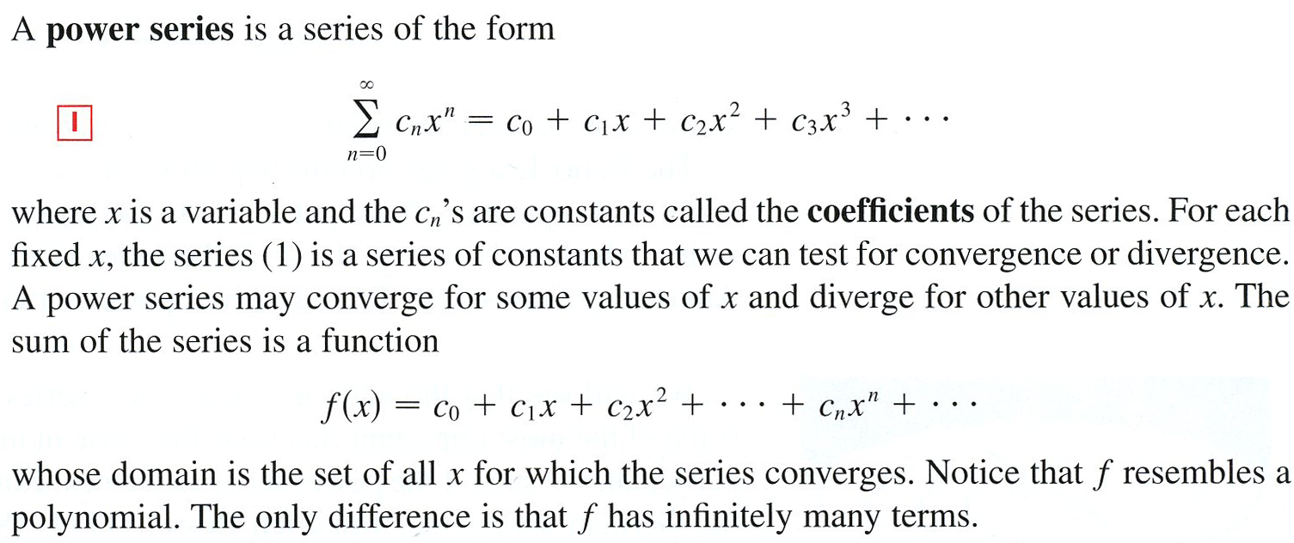

Slide 2
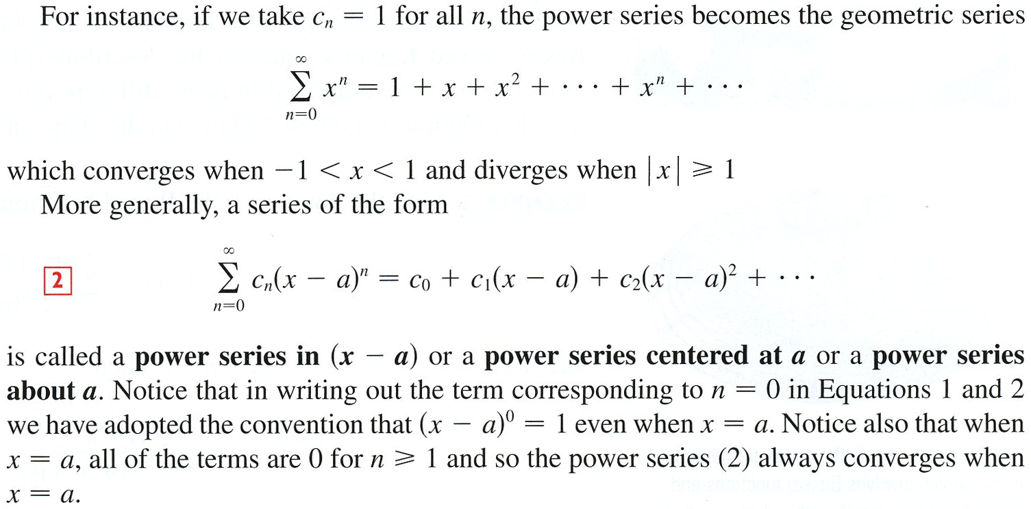
Common ratio is r = x

Slide 3
Geometric Series
Once again, in a geometric series each term is found by multiplying the preceding term by the same number, r.
This converges to if , and diverges if .
is called the interval of convergence. In interval notation $x∈\left(−1,1\right).$

Slide 4
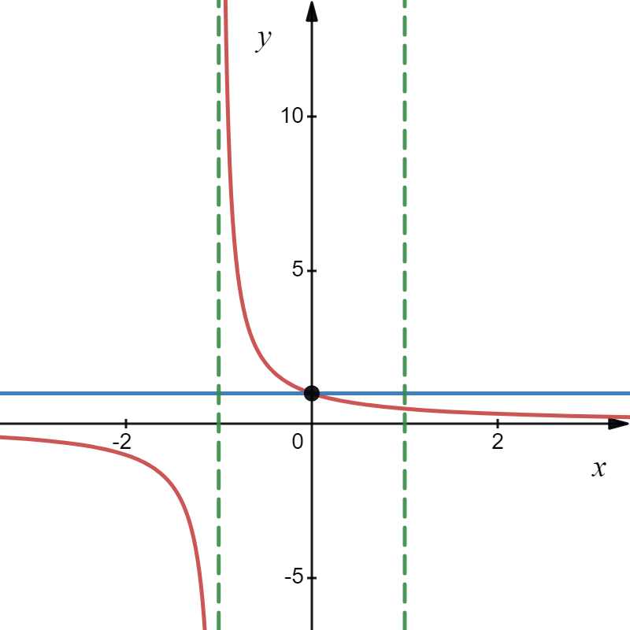
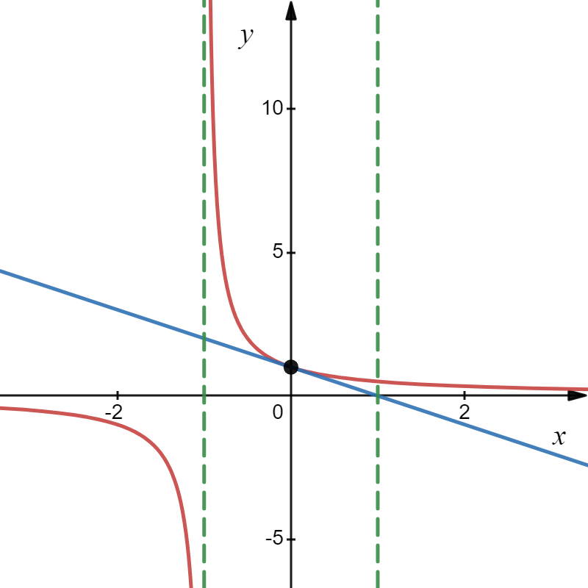
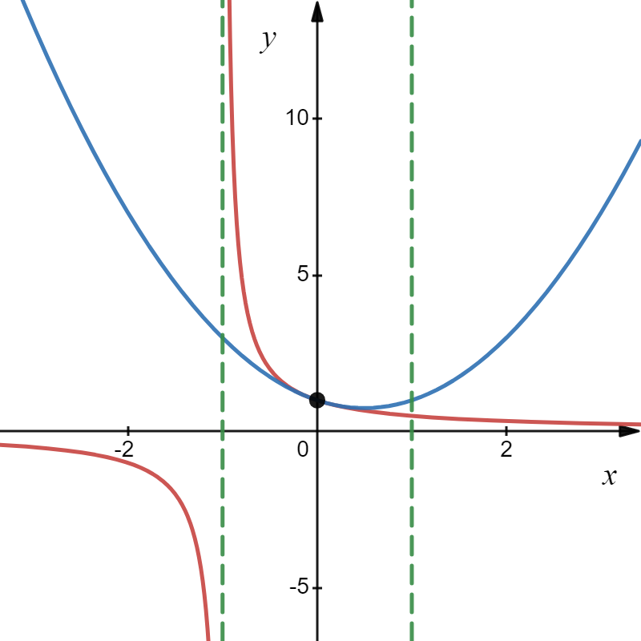
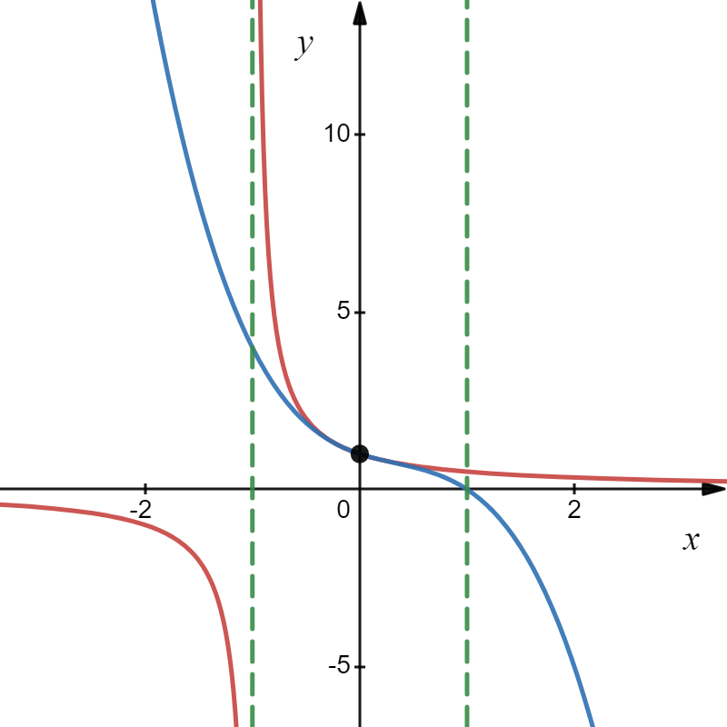
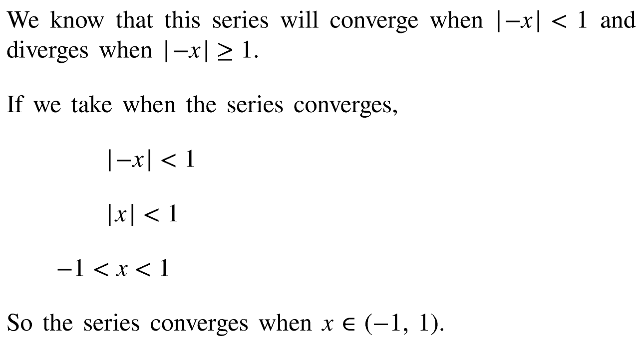
Example
this is a geometric series, , where a = 1 and r = − x, so we get,
Power Series 1
This is called the interval of convergence.

Slide 5
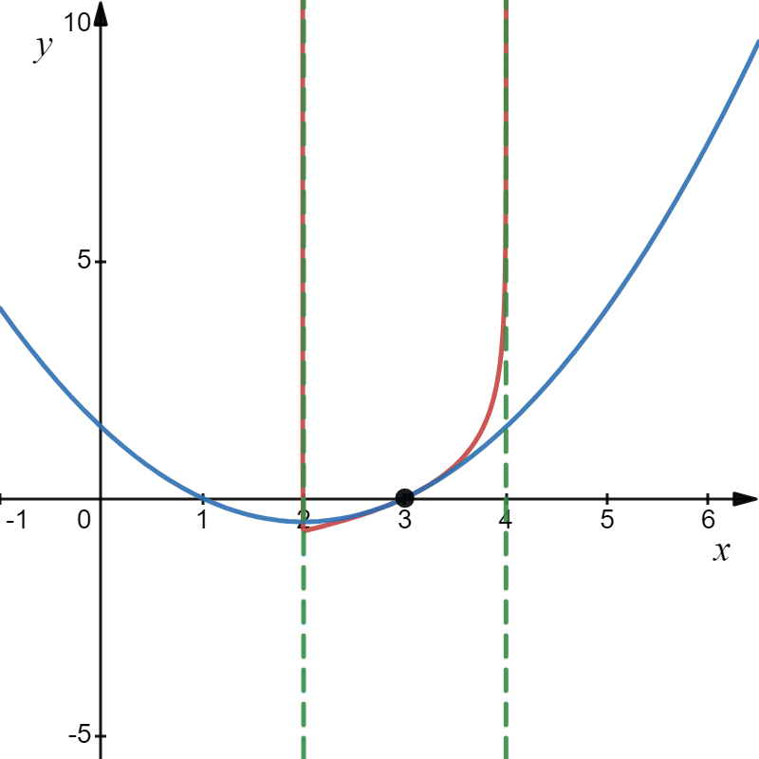
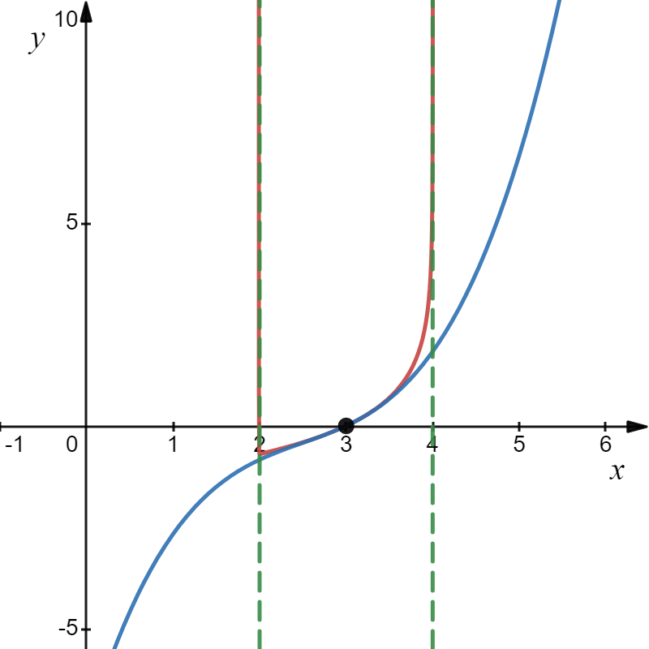
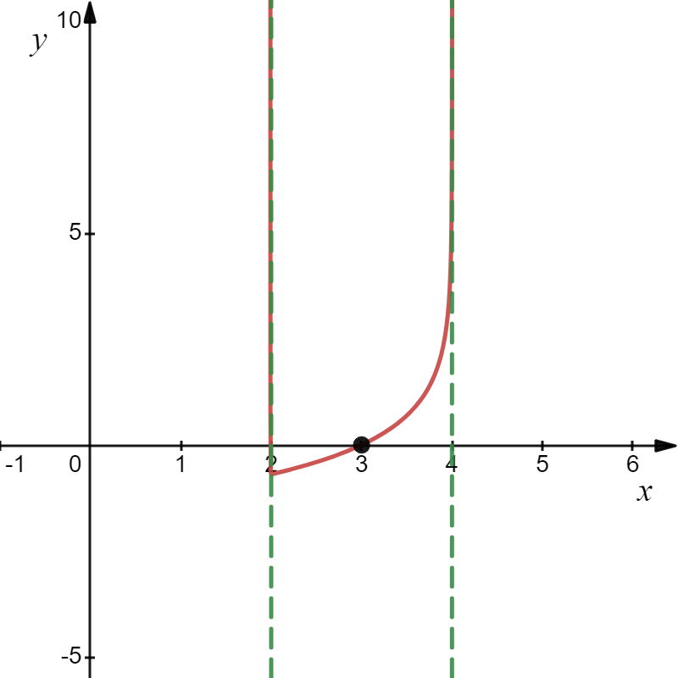
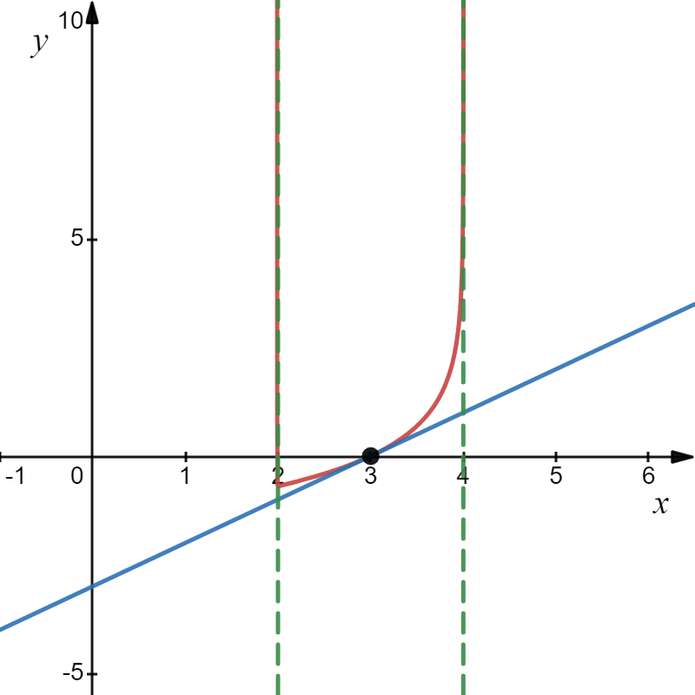
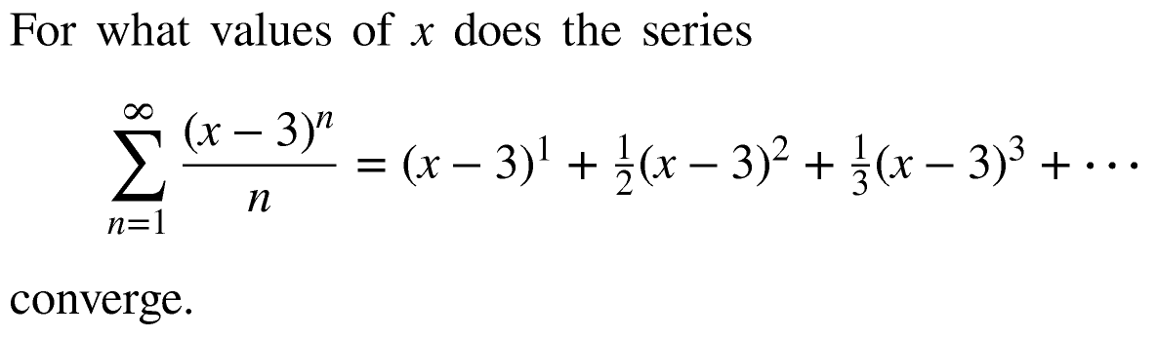



Example
So, we get
Does the series converge at x = 2 or x = 4?
That is, find the interval of convergence.
When x = 2 we get the series
Converges by
Alternating Series Test, “AST”
Not geometric! What do we do?
The Ratio Test!
When x = 4 we get the series
Diverges by
p - Series Test, “PST”
(Harmonic Series)
Hence, the series converges when $x∈\left[2,4\right).$
This is the interval of convergence$.$
The series will converge by the Ratio Test when
Power Series 2

Slide 6
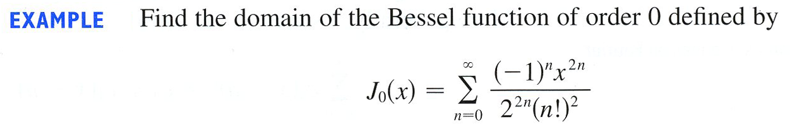
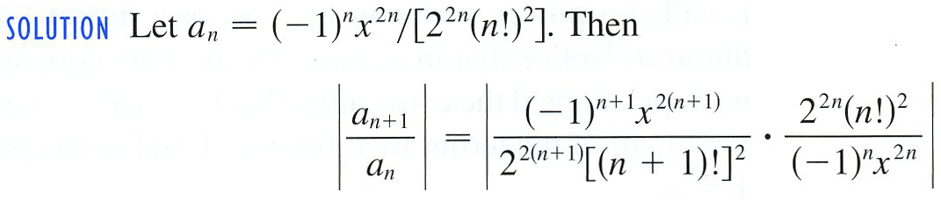
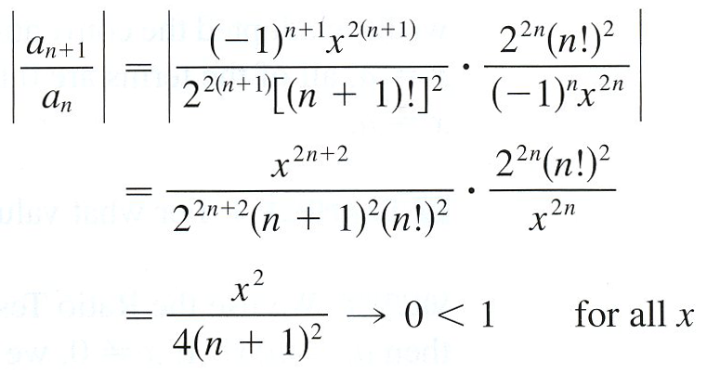

Example

Slide 7
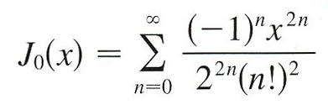
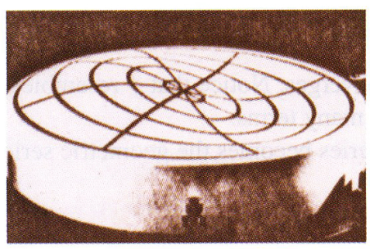
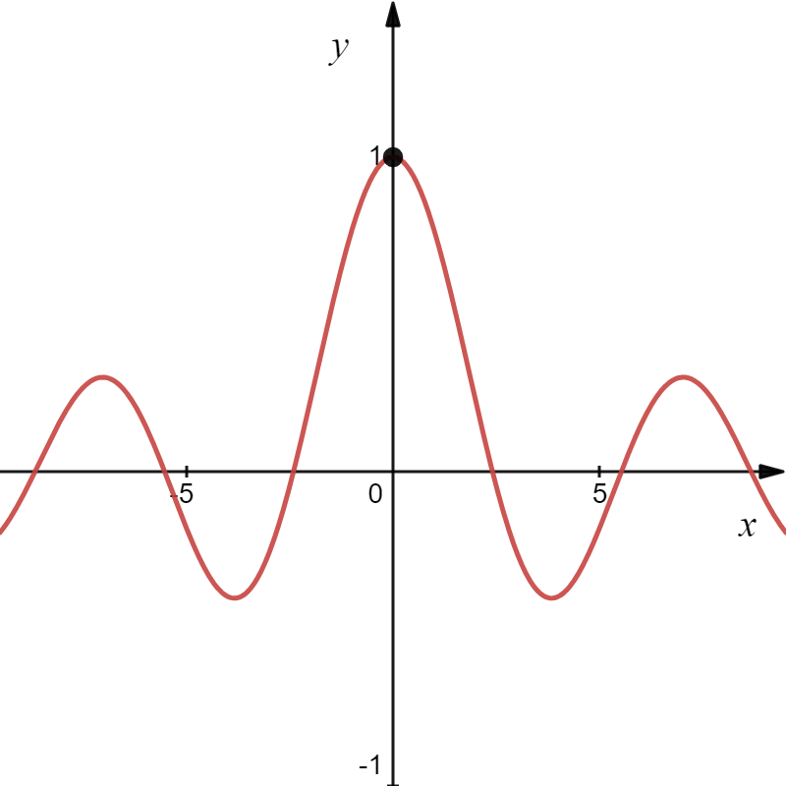
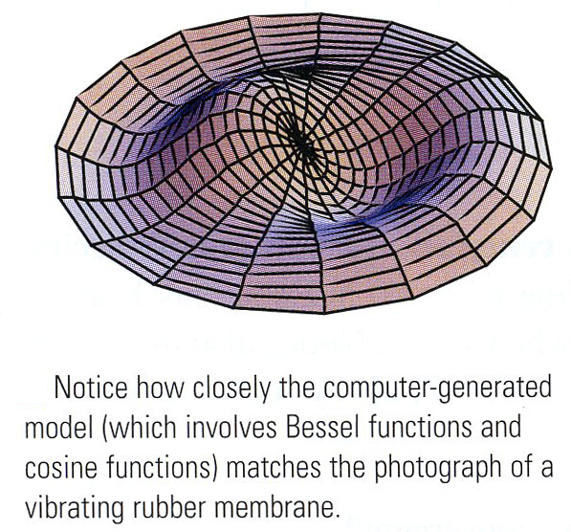
Bessel Function
Power Series 3
http://www.2dcurves.com/gamma/gammabs.html#Besselfunction1

Slide 8
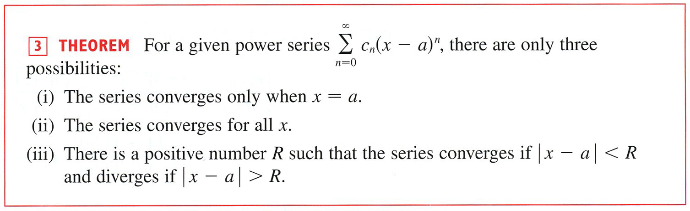


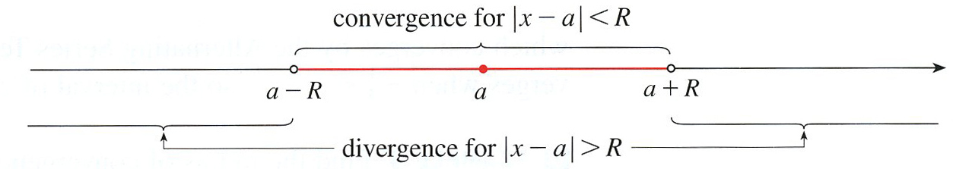

Slide 9





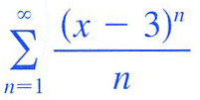

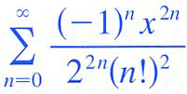



Slide 10

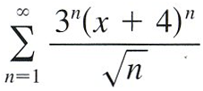
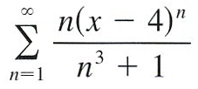



Example
a)
b)
Next, we find the interval of convergence, we get
a) By the Ratio Test we get
We must check the endpoint at $x=−\frac{13}{3}$and $x=−\frac{11}{3}$
When $x=−\frac{13}{3}$ we get the series
Converges by
Alternating Series Test
When $x=−\frac{11}{3}$we get the series
Diverges by
p - Series Test
The series will converge by the Ratio Test when
Hence, the interval of convergence is $x∈\left[−\frac{13}{3},−\frac{11}{3}\right).$

Slide 11

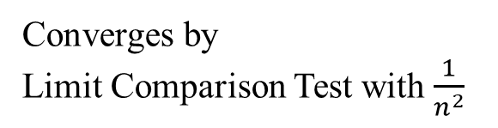



Example
b)
Next, we find the interval of convergence, we get
b) By the Ratio Test we get
We must check the endpoint at $x=3$ and $x=5$
When $x=3$ we get the series
Converges by
Alternating Series Test
When $x=5$we get the series
Converges by
Limit Comparison Test with $\frac{1}{n^{2}}$
The series will converge by the Ratio Test when
Hence, the interval of convergence is $x∈[3,5].$

