Slide 1
What’s your strategy?

Slide 2
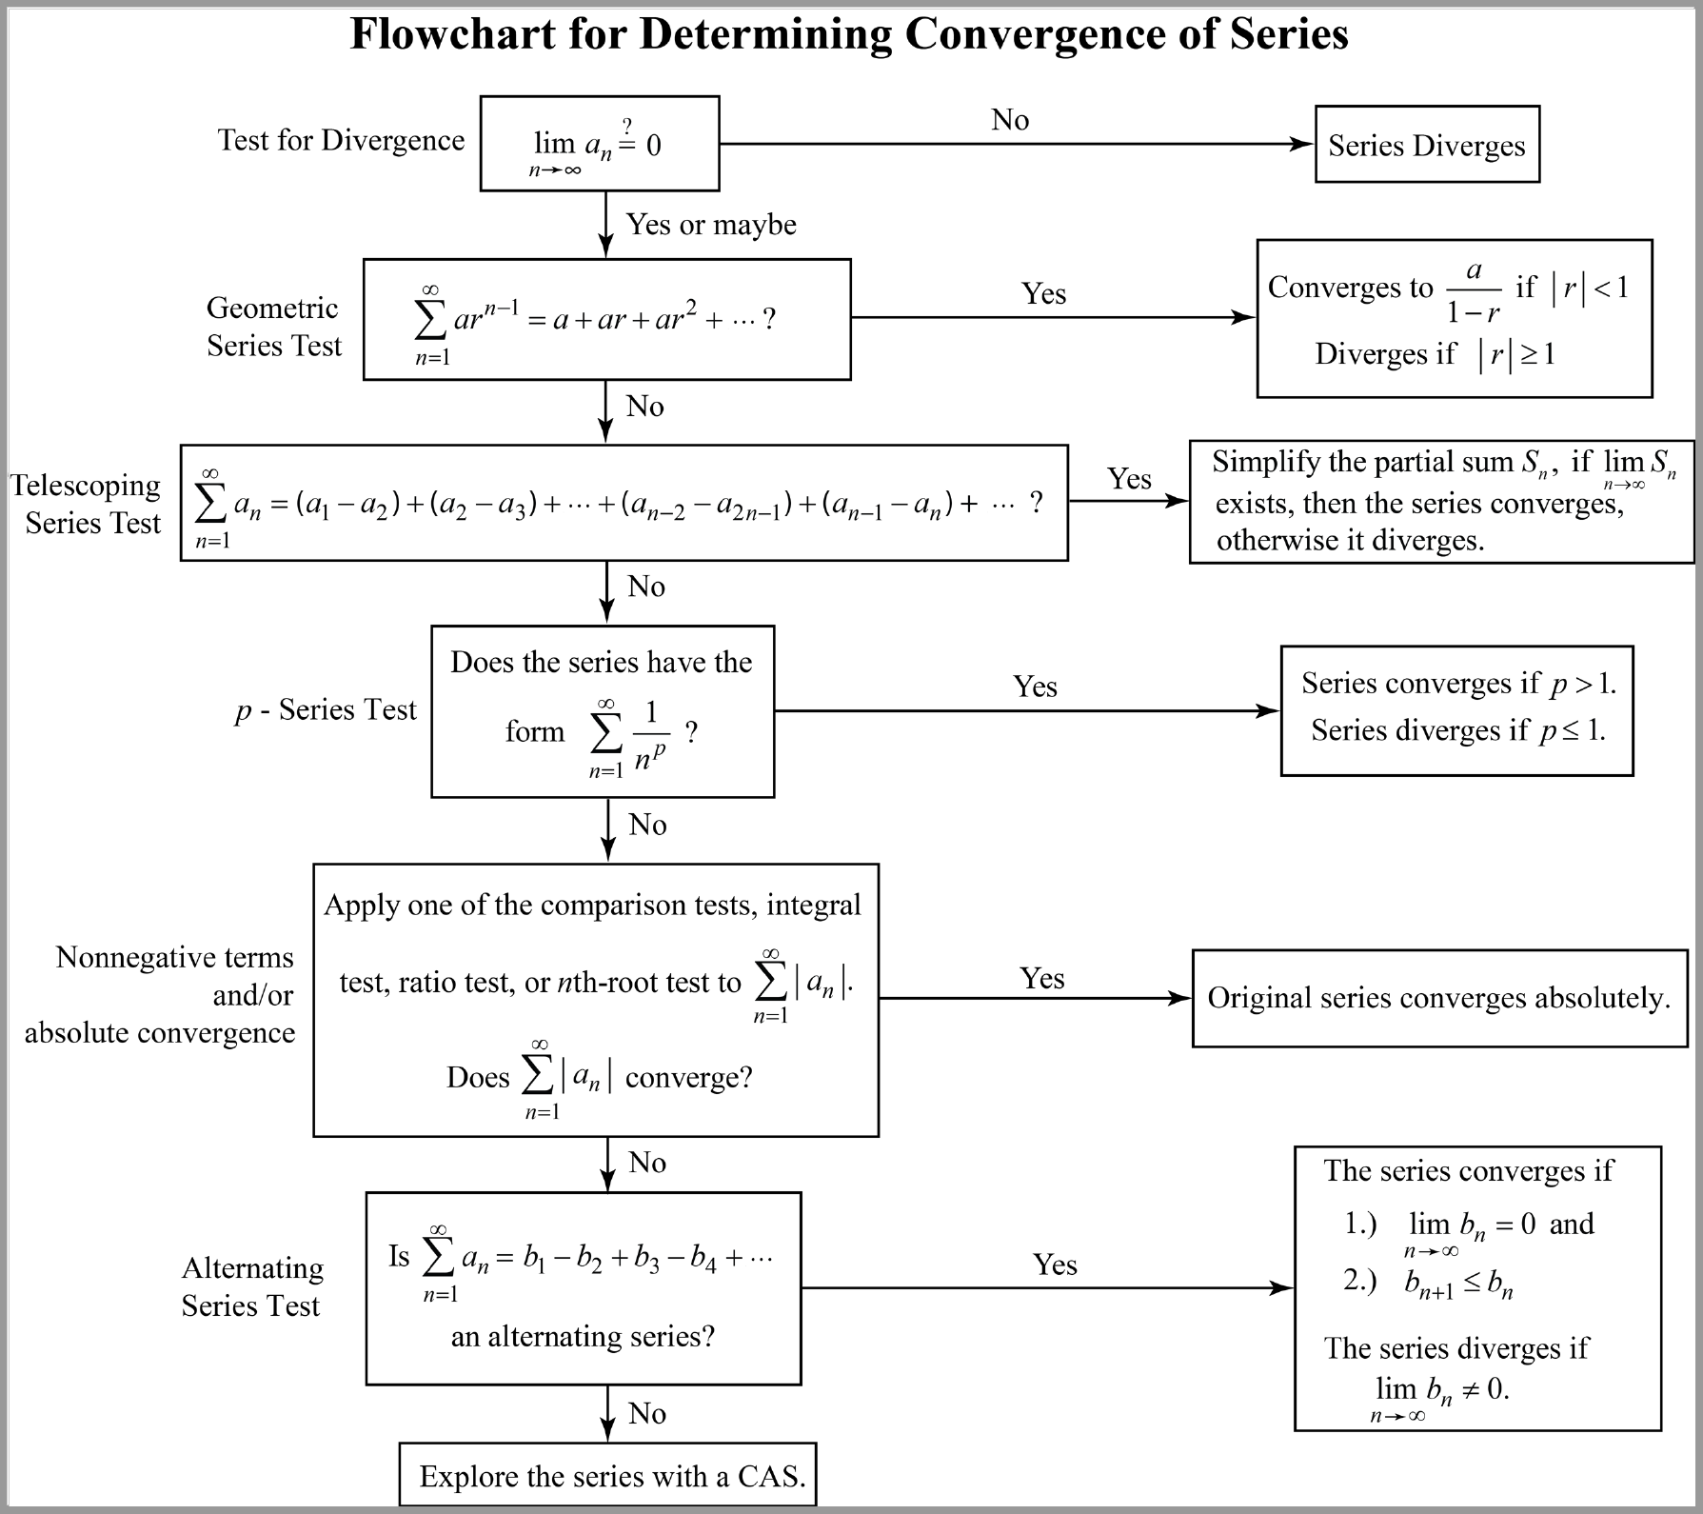

Slide 3
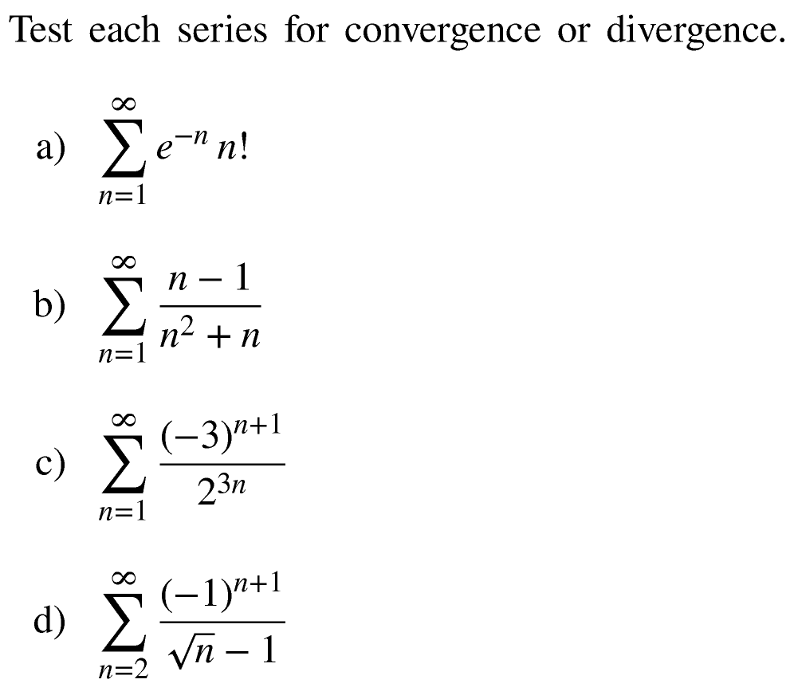
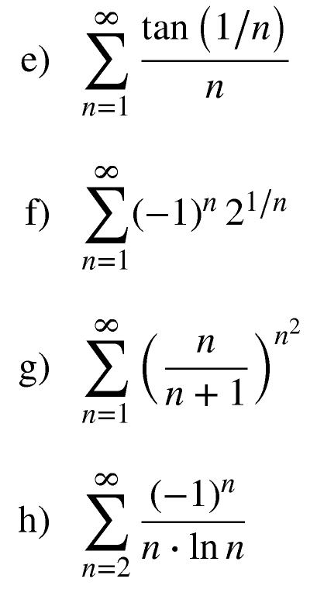
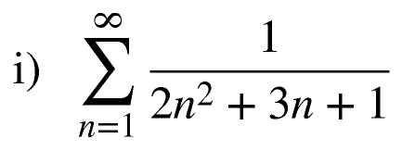
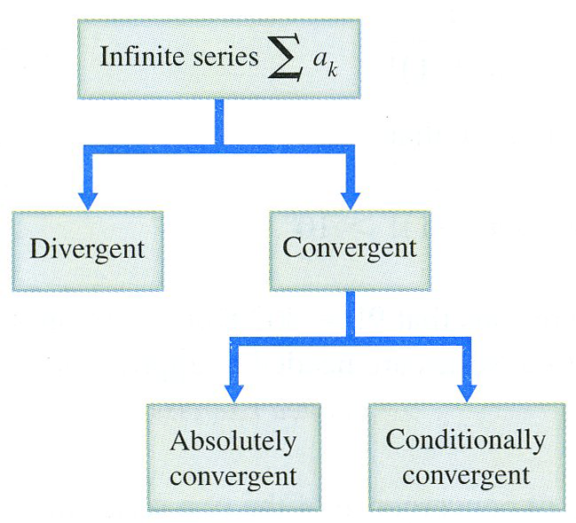

Slide 4

Alternating Series
Maybe
Let’s use the Ratio Test by first simplifying
Therefore, by the Ratio Test, the given series is
absolutely convergent and therefore convergent by ACT.

Slide 5
Series with positive terms.
Looks like it will.

Slide 6
Series with positive terms.
Maybe.
Let’s use the Root Test by first simplifying
Therefore, by the Root Test, the given series is convergent.

Slide 7
Alternating Series
Thus, the original series converges conditionally.

Slide 8
Series with positive terms.
True!

