Slide 1
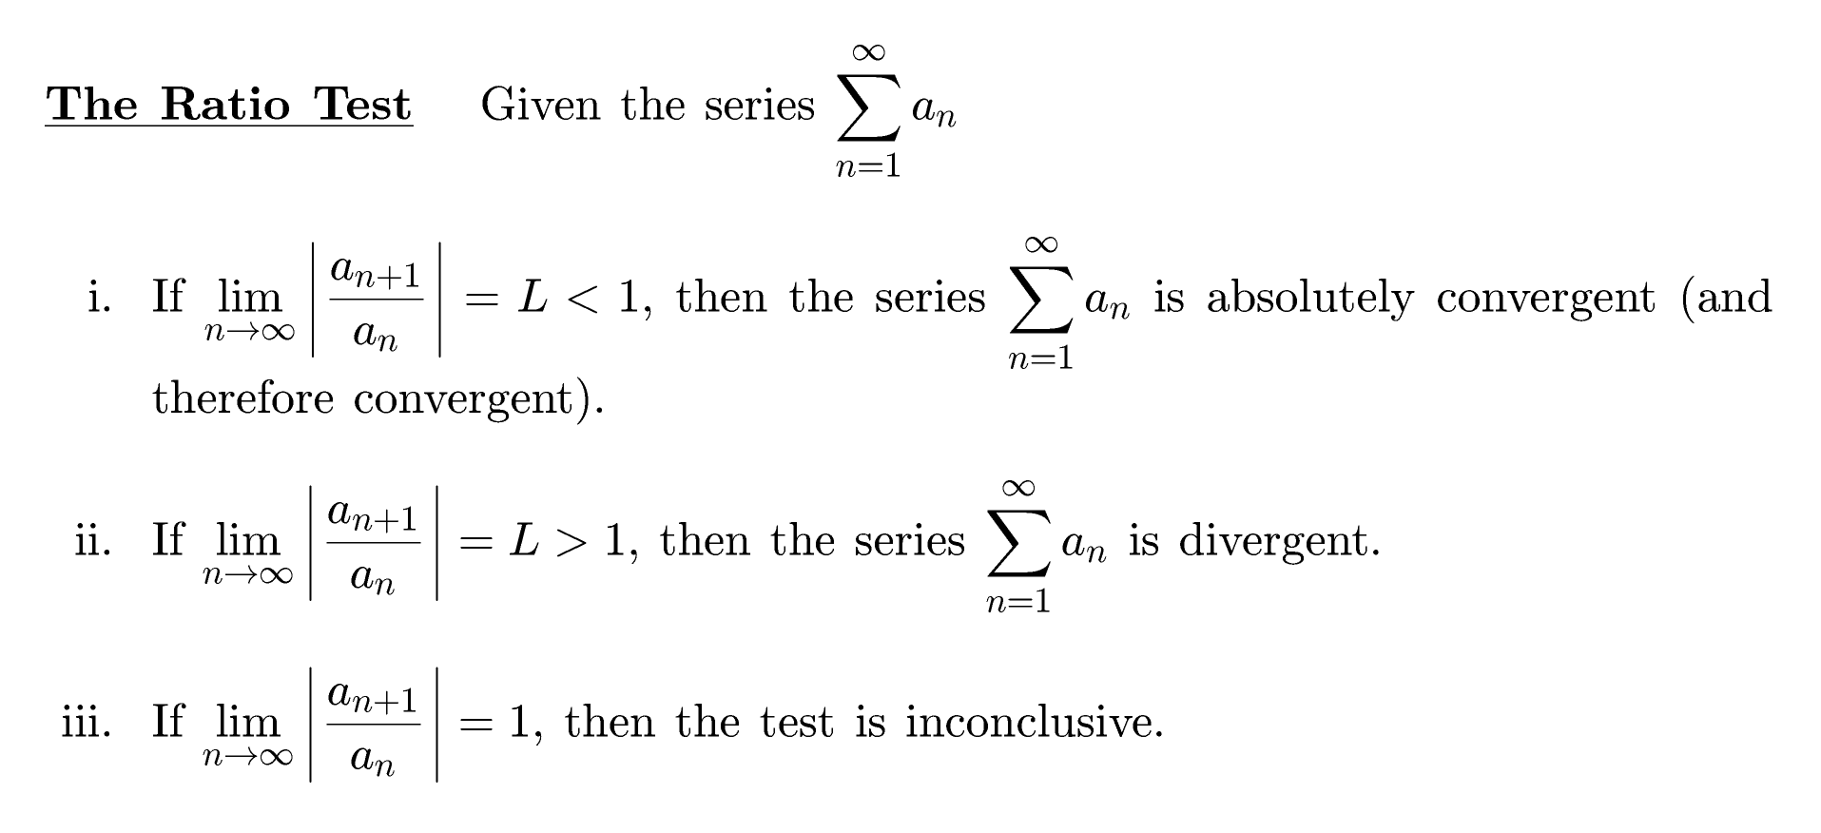


Slide 2
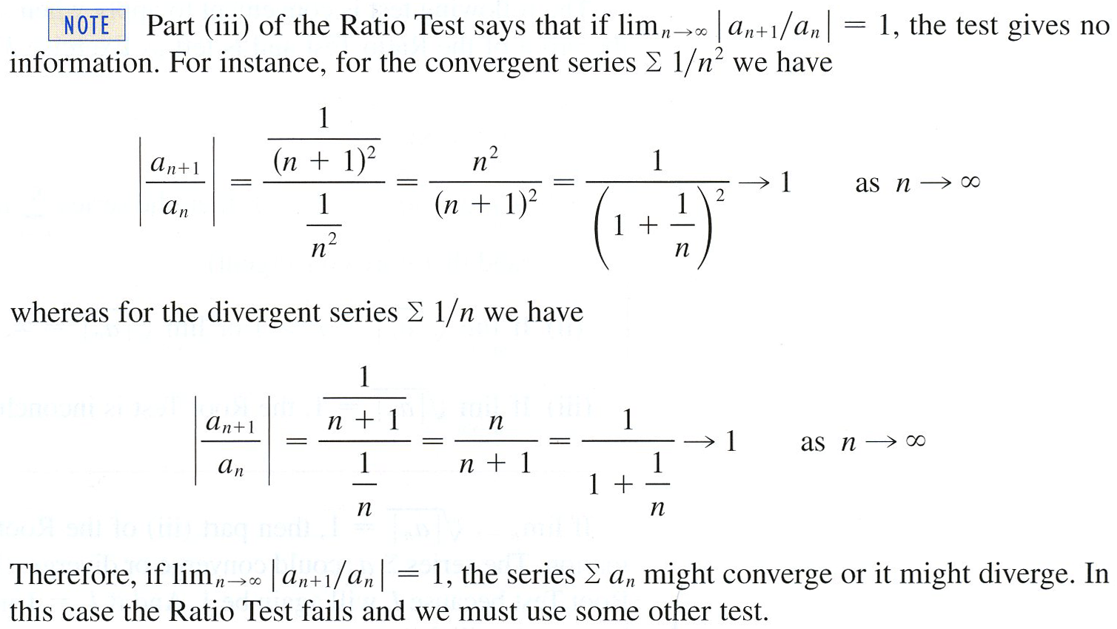

Slide 3

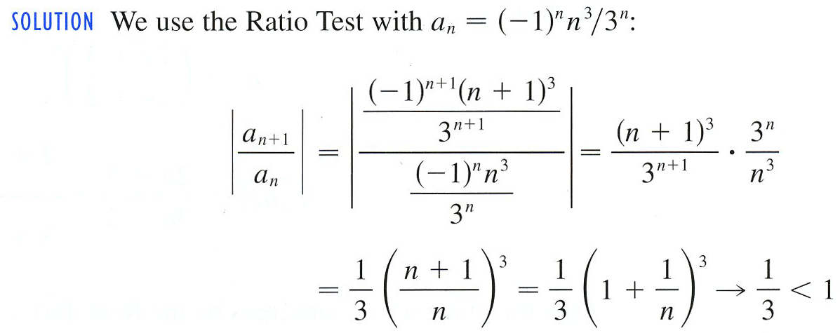
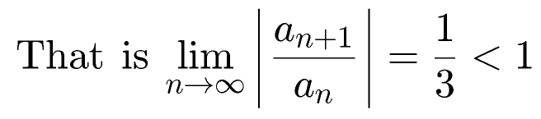
Example
Looks like it will.
Thus, by the Ratio Test, the given series is absolutely convergent and therefore convergent by ACT.

Slide 4
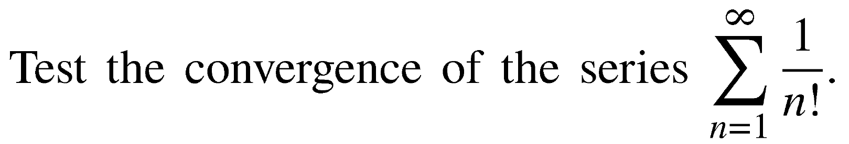
Example
What do you think?
Let’s use the Ratio Test by first simplifying
Thus, by the Ratio Test, the given series is
absolutely convergent and therefore convergent by ACT.

Slide 5
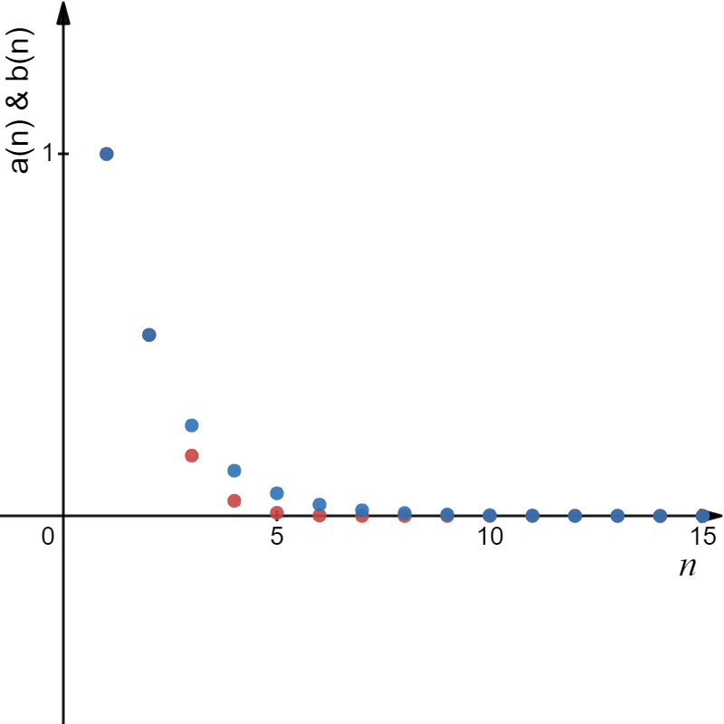
Example
Here’s another solution.
So, we get

Slide 6

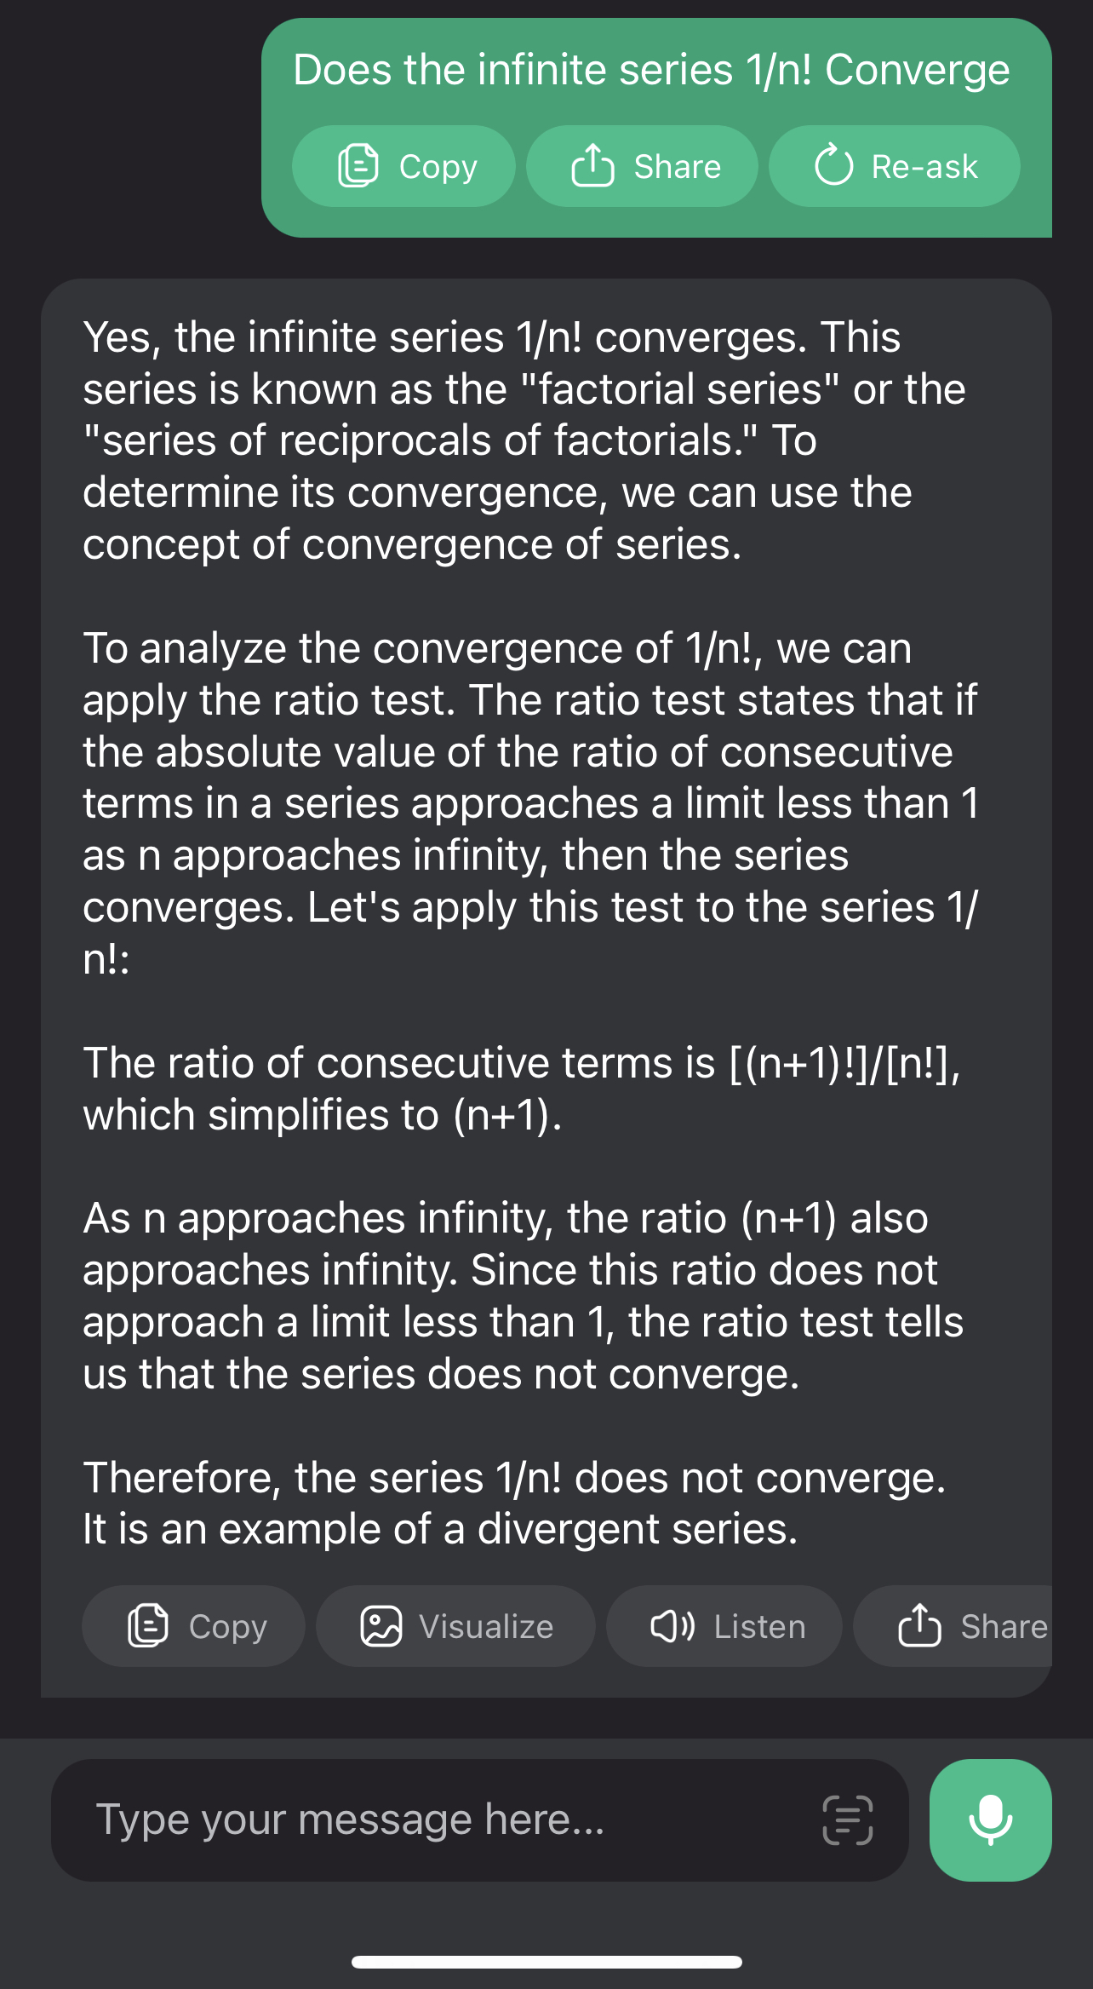


Let’s ask AI.

Slide 7
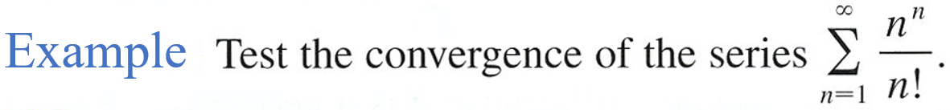
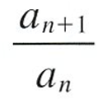
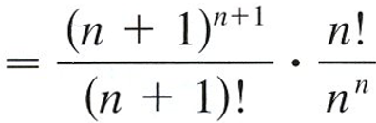
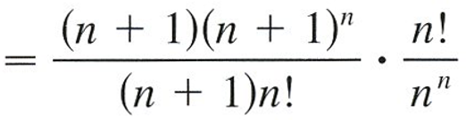
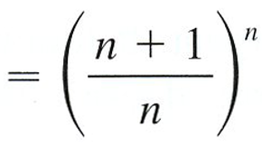
Maybe

Slide 8
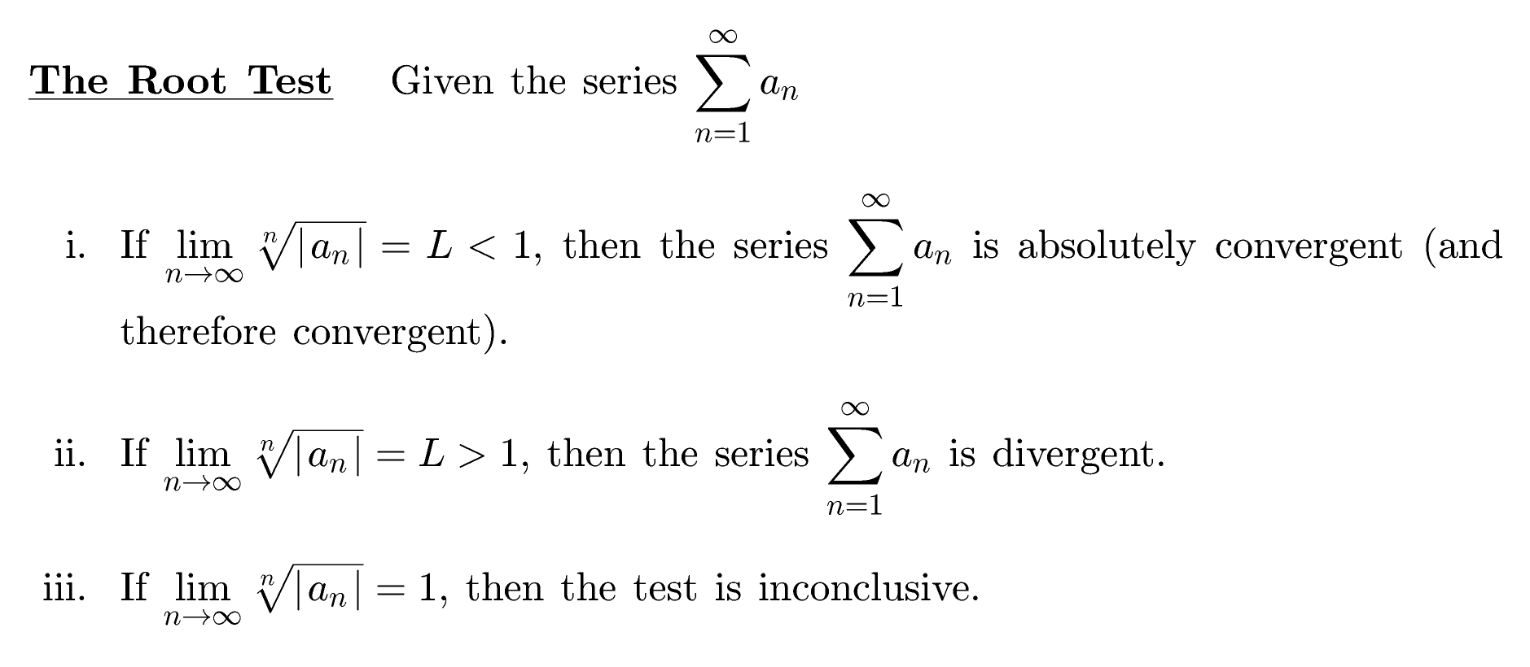
This is the last test!!

Slide 9
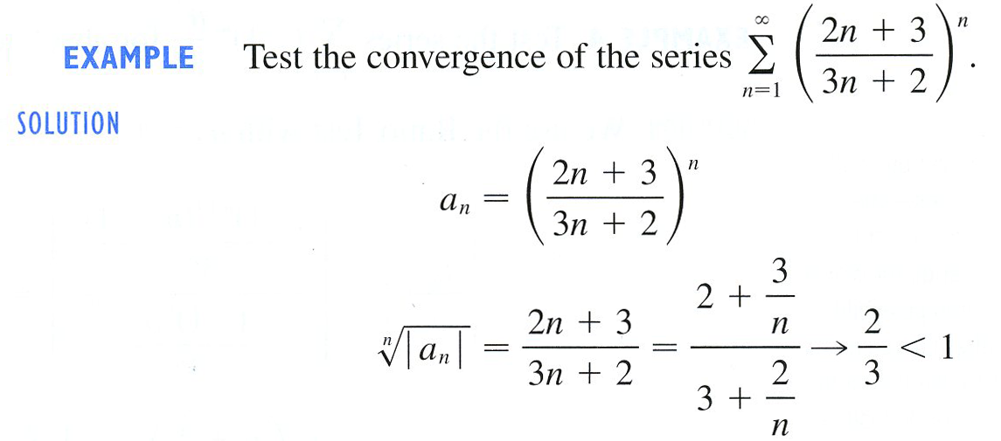
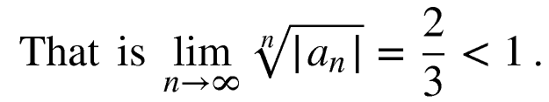
Example
?
Maybe
By the Root Test

Slide 10
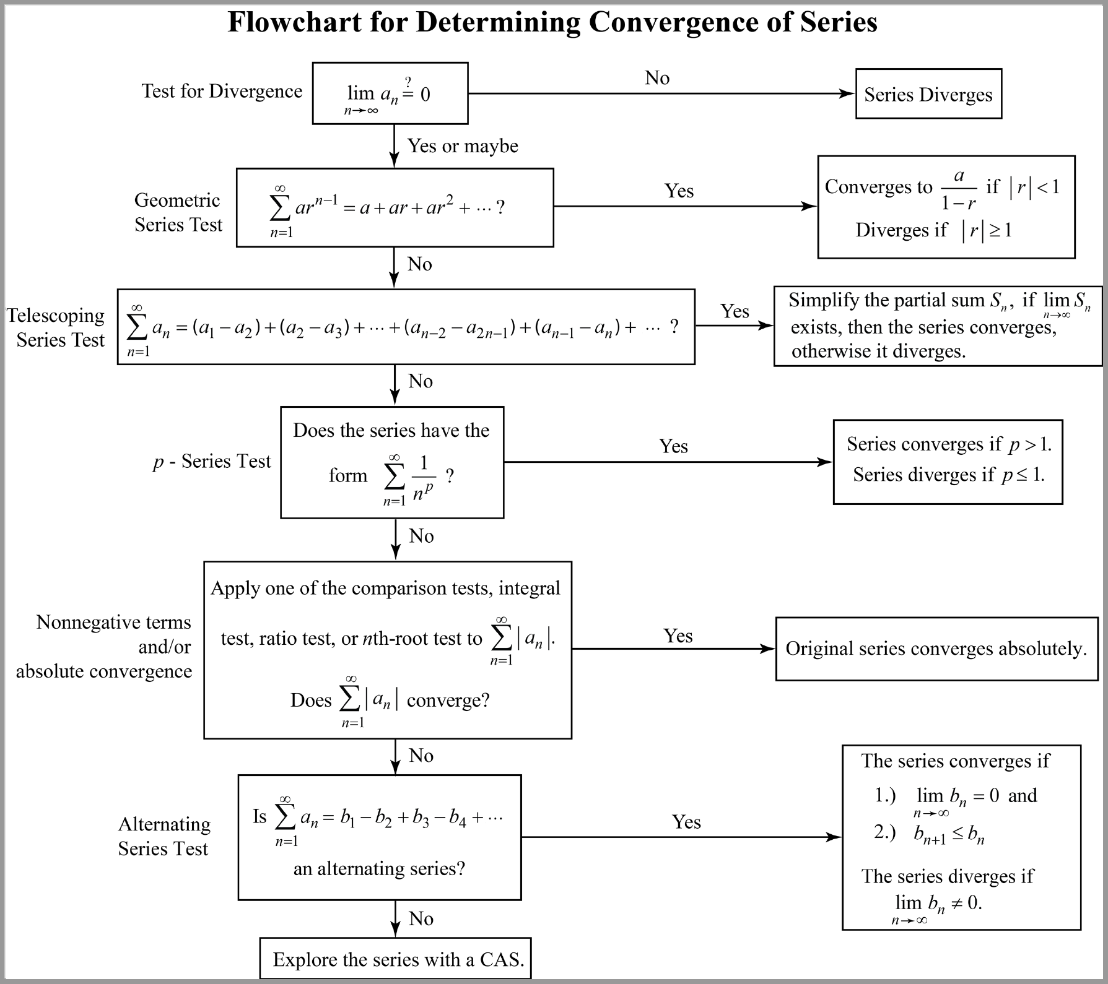

Slide 11
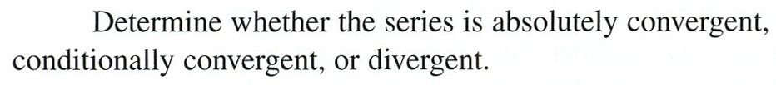
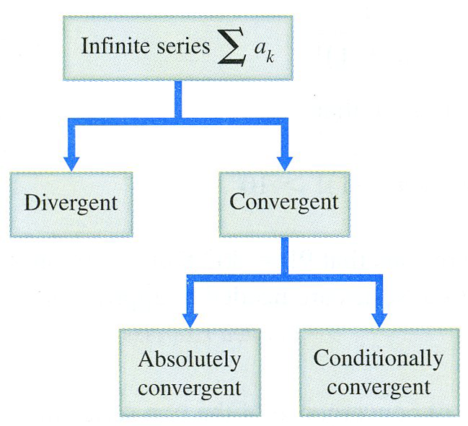
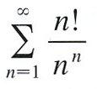

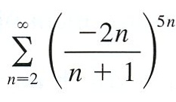
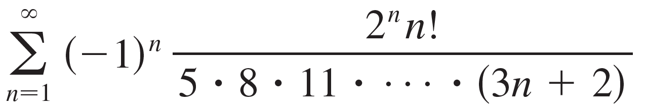
Example
a)
b)
c)
d)
Alternating Series or
Terms with Positive
and Negative Terms

Slide 12
a)
This looks familiar.
Yeah, maybe.
Let’s use the Ratio Test by first simplifying
Therefore, by the Ratio Test, the given series is
absolutely convergent and therefore convergent.

Slide 13
b)
Maybe
So, what test should we use?

Slide 15
b)
Maybe
So, what test should we use?
By the Integral Test we let

Slide 16
Hence, the series diverges absolutely.
Does it converge conditional?
Let’s check it out!

Slide 18
Hence by IT, the series diverges absolutely.
Does it converge conditional?
Let’s check it out!

Slide 19
c)
Alternating
Series
Maybe.
Let’s use the Root Test by first simplifying
Therefore, by the Root Test, the given series diverges absolutely.
Since the given series is alternating, does it converge conditional?
Thus, the original series diverge by TD or AST.

Slide 20
c)
No.
Therefore, by the TD, the given series diverges.

Slide 21

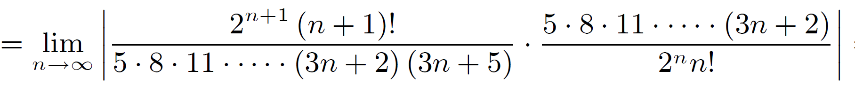
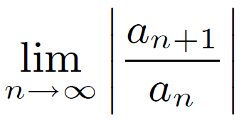
d)
Maybe.
Let’s use the Ratio Test.

Slide 22
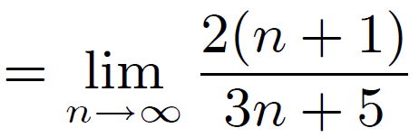
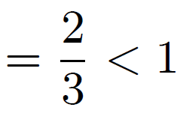
d)
Maybe.
Let’s use the Ratio Test.
2
(n + 1)
DTE
Therefore, by the Ratio Test, the given series converges absolutely and thus converges by ACT.

