Slide 1

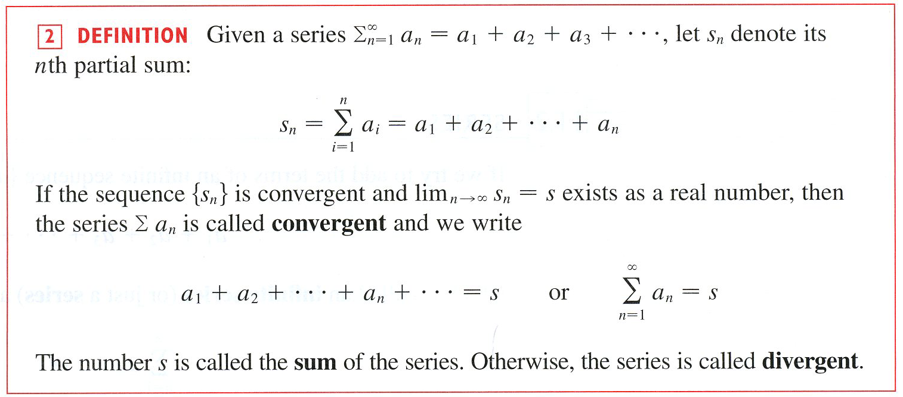

Slide 2
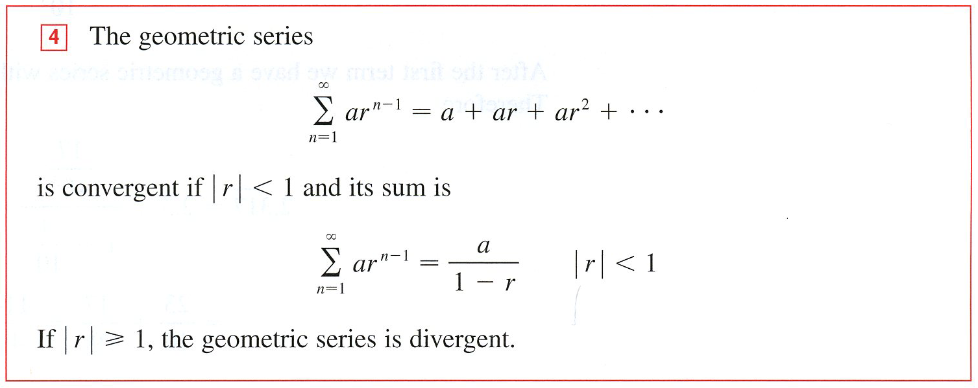

“GST”

Slide 3


“TD”
“IT”

Slide 4


THE p-SERIES TEST
“PST”
“DCT”
The Direct Comparison Test

Slide 5

“LCT”

Slide 6



Slide 7

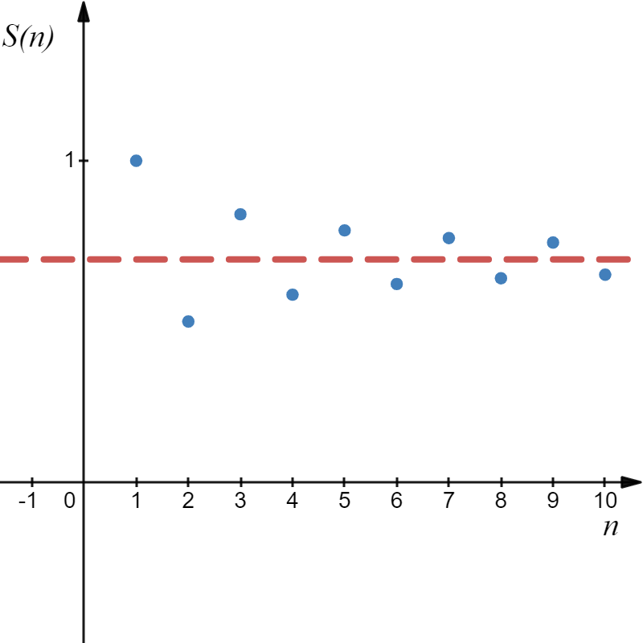
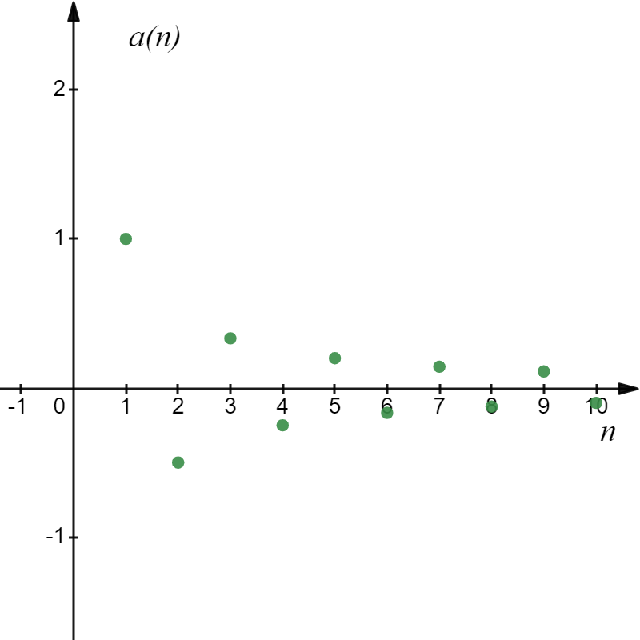
Alternating Harmonic Series

Slide 8
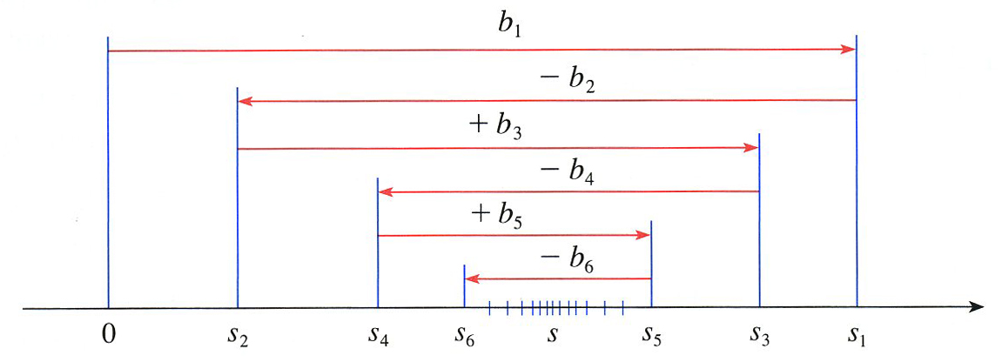
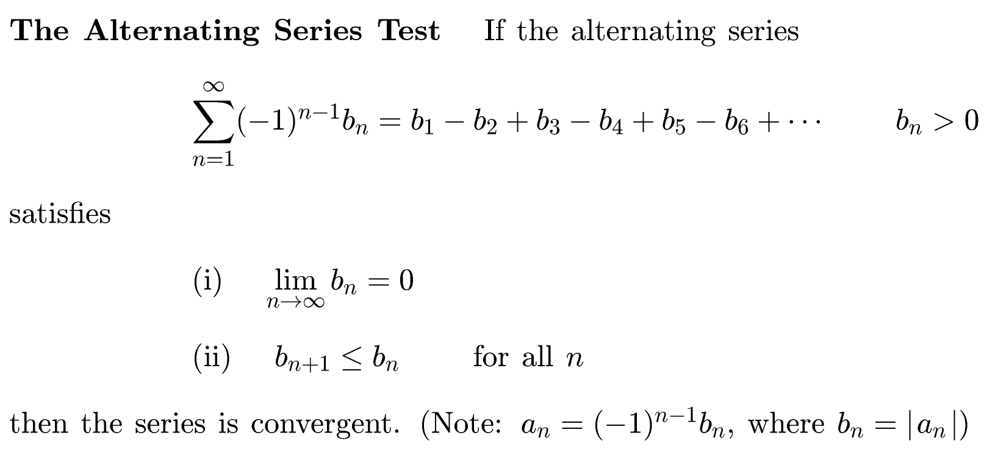


Slide 9
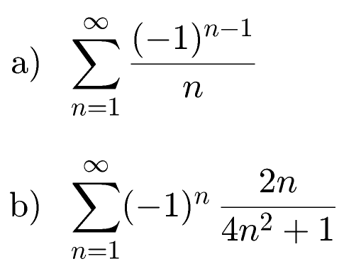
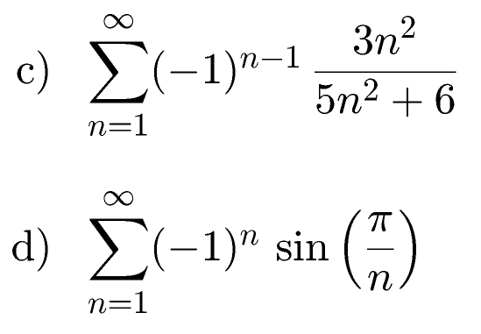

Example

Slide 13



Absolute Convergence Theorem, “ACT”

Slide 14



Example

Slide 15




Example

Slide 16

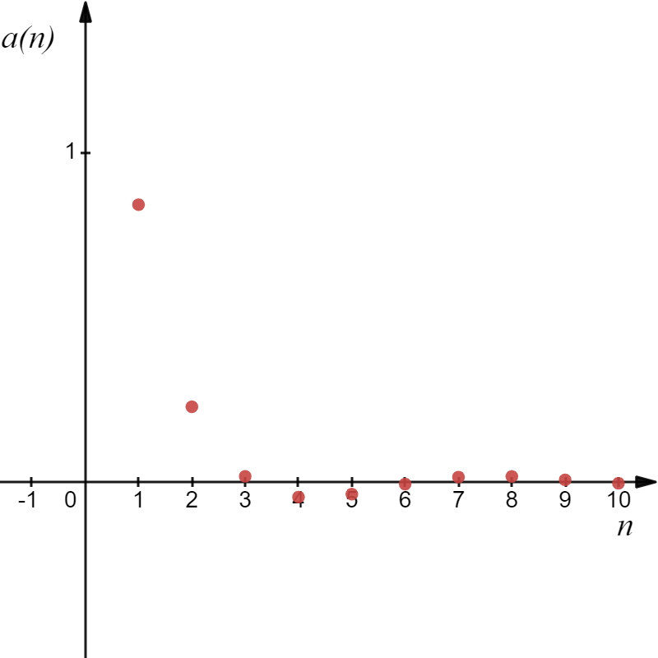

“ACT”
Example
Looks like it will.

Slide 17
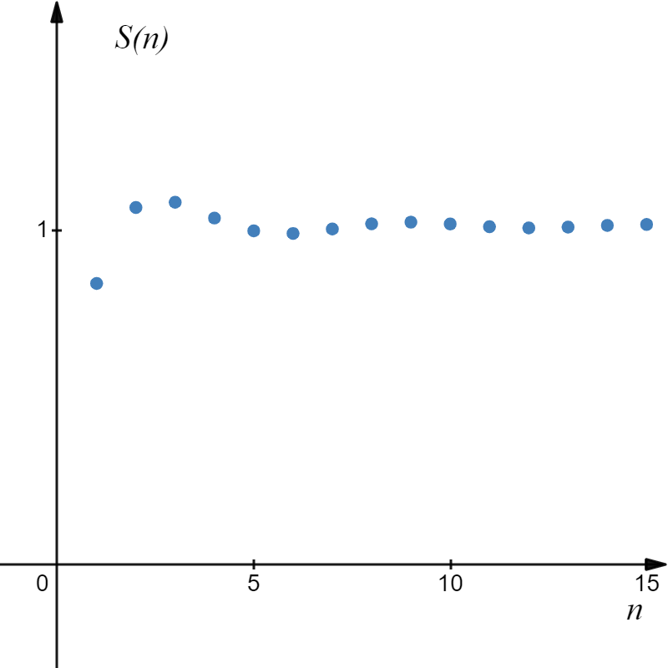
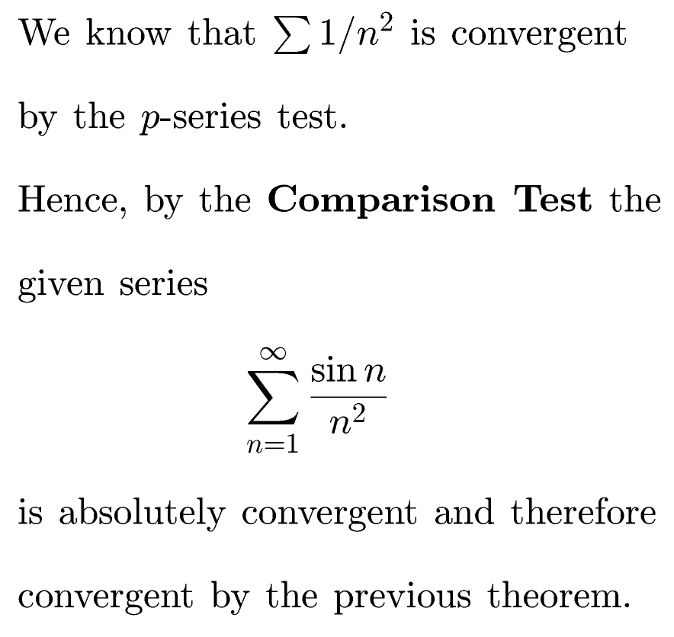
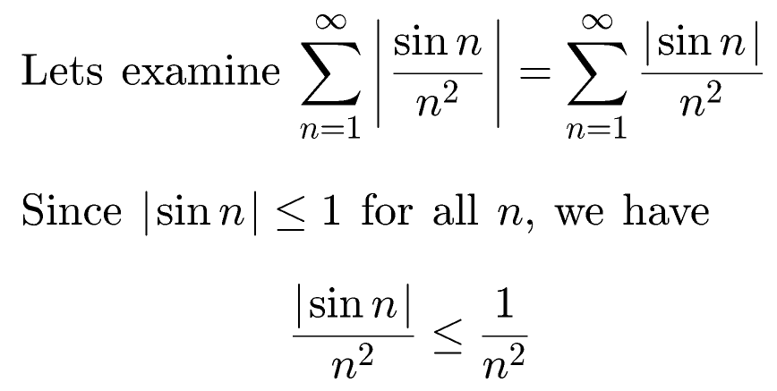
If we examine the sequence of partial sums it appears the series converges, but now we must prove it.
Hence, by DCT the given series

Slide 18


Example
Determine whether the series is absolutely convergent, conditionally convergent, or divergent.
converges ( p-series with p = 3), the given series is absolutely convergent. Therefore, the original series converges by the Absolute Convergence Theorem, “ACT”.

Slide 19




Example
Determine whether the series is absolutely convergent, conditionally convergent, or divergent.
The given series converges by the Alternating Series Test, since
Let $b_{n}=\left|a_{n}\right|=\frac{1}{\sqrt[3]{n}}$
(i)
(ii)
Thus, the series converges but is not absolutely convergent, hence it is conditionally convergent.

Slide 20



Example
Determine whether the series is absolutely convergent, conditionally convergent, or divergent.
Let $b_{n}=\left|a_{n}\right|=\frac{n}{2n+1}$
(i)
1/2
Hence, the series diverges by the Test for Divergence or by the Alternating series Test.

Slide 21
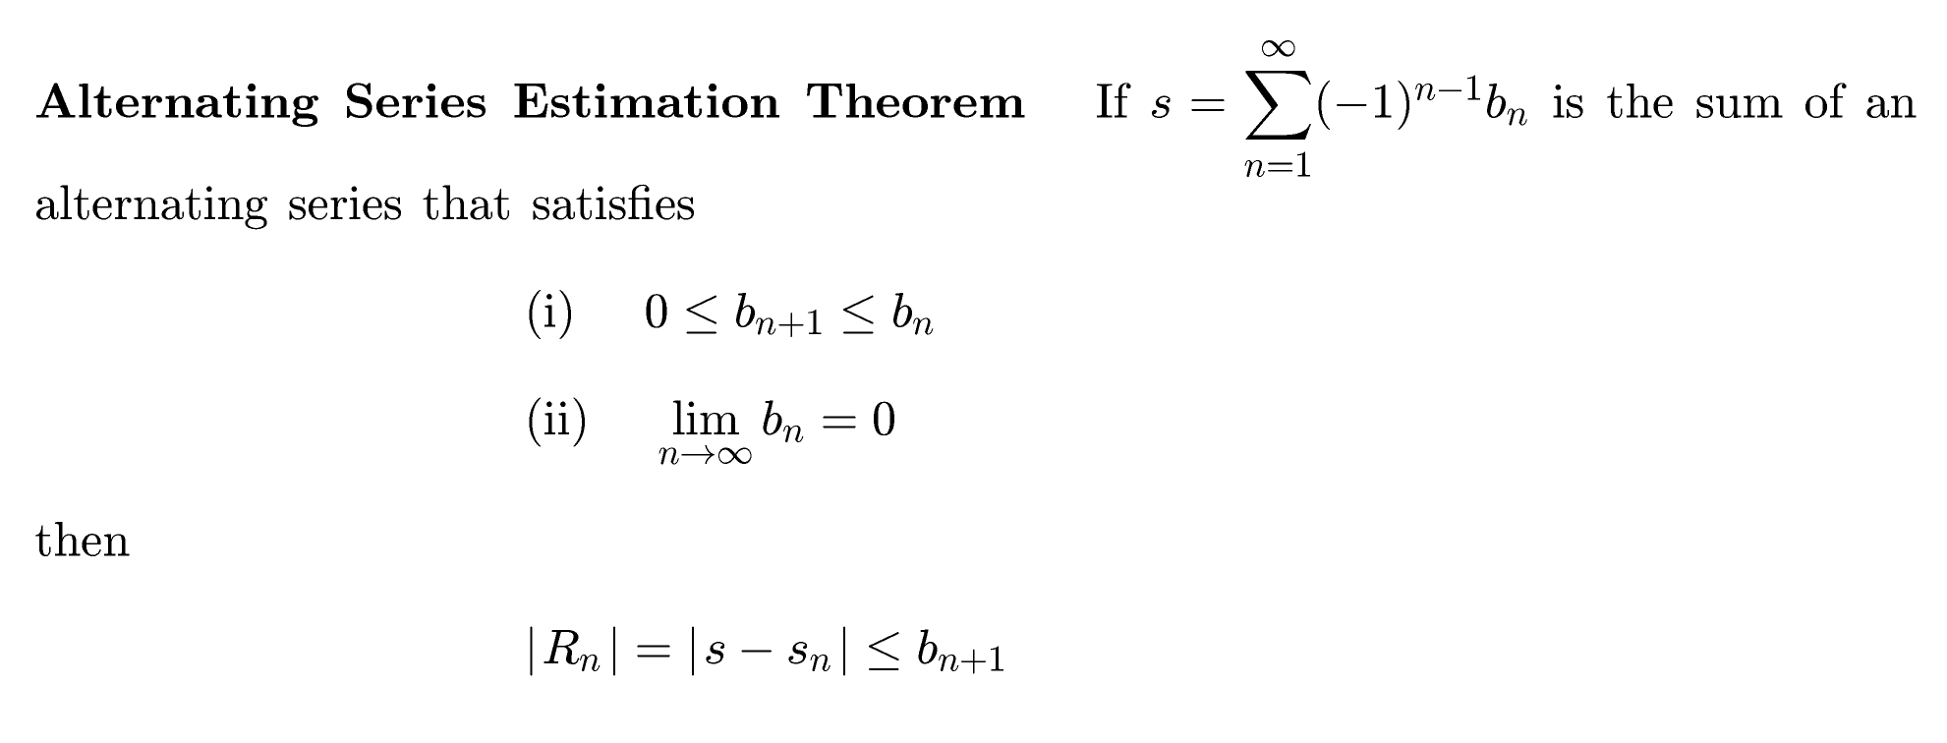


b_{n+1} is the largest error for the partial series S_{n}.

Slide 22

Example

Slide 23


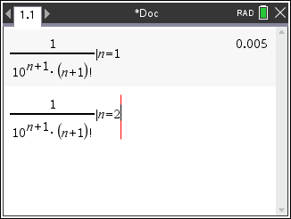
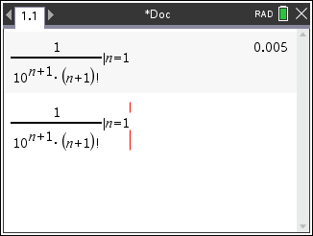
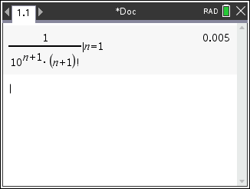
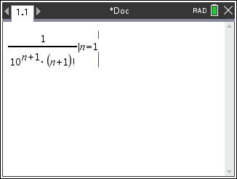
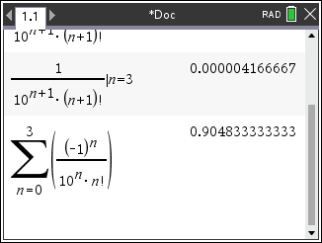
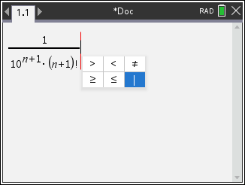
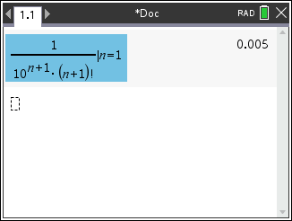
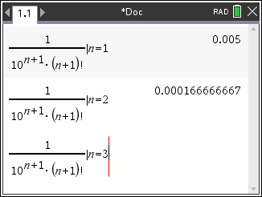
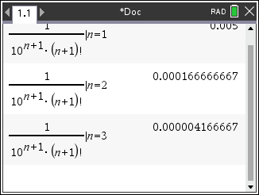
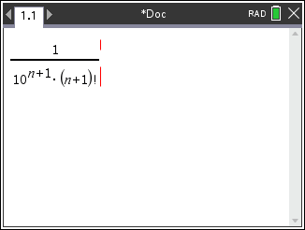
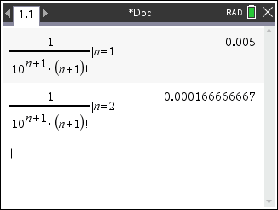
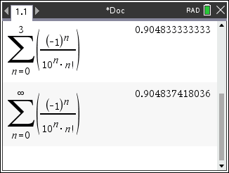
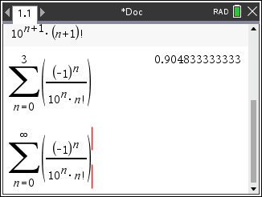
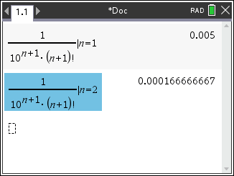
Example

Slide 24



Slide 25




