Slide 1

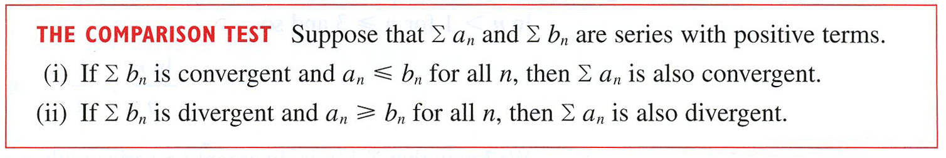

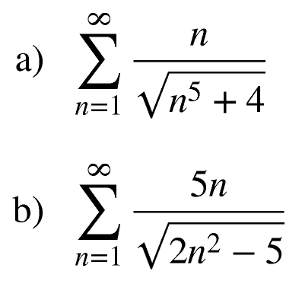
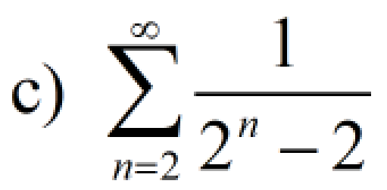
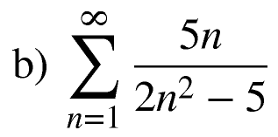
The Direct Comparison Test – “DCT”
Example

Slide 2

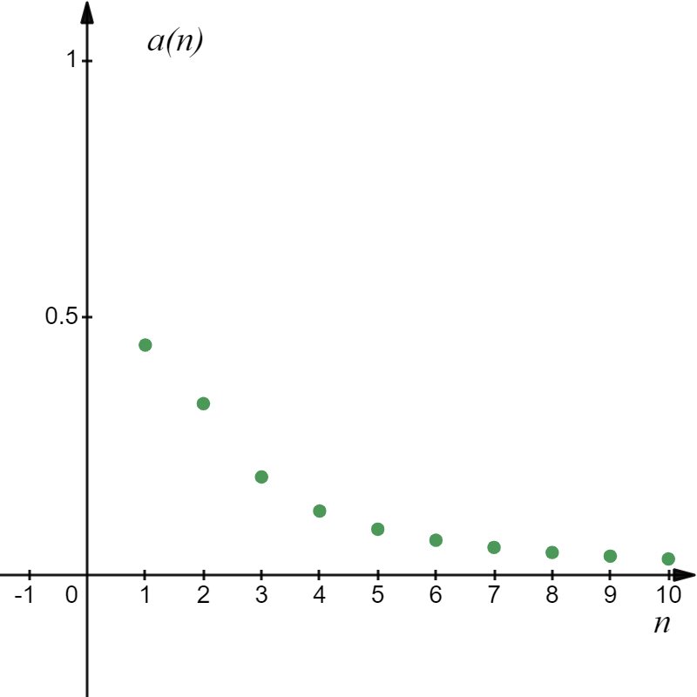
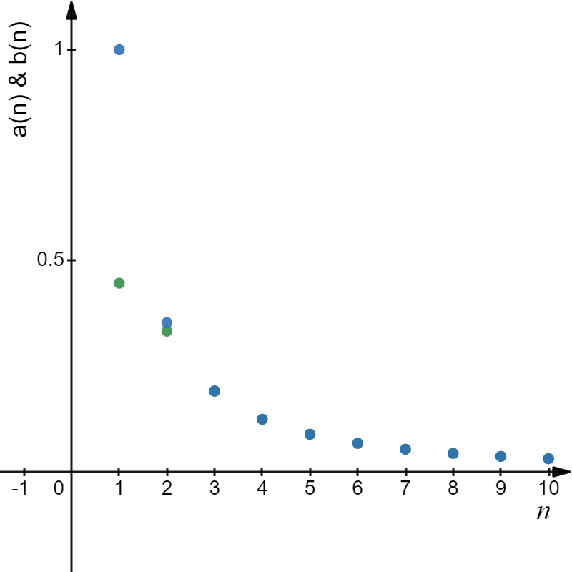
Series with positive terms.
Smaller Denominator Larger Fraction

Slide 3
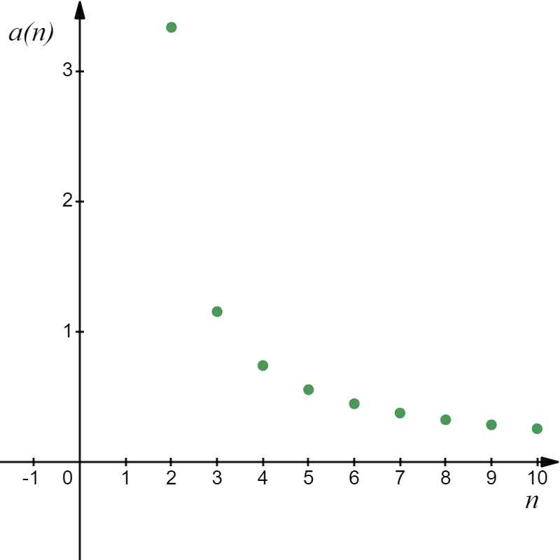
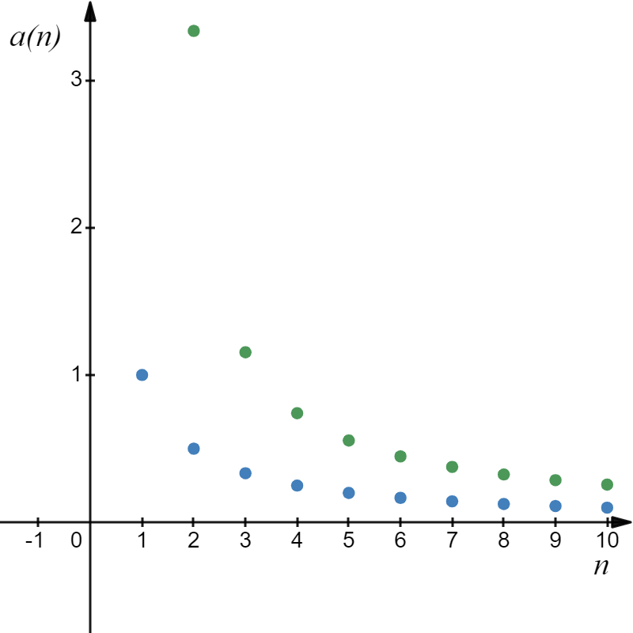
Series with positive terms.
Larger Denominator Smaller Fraction

Slide 4
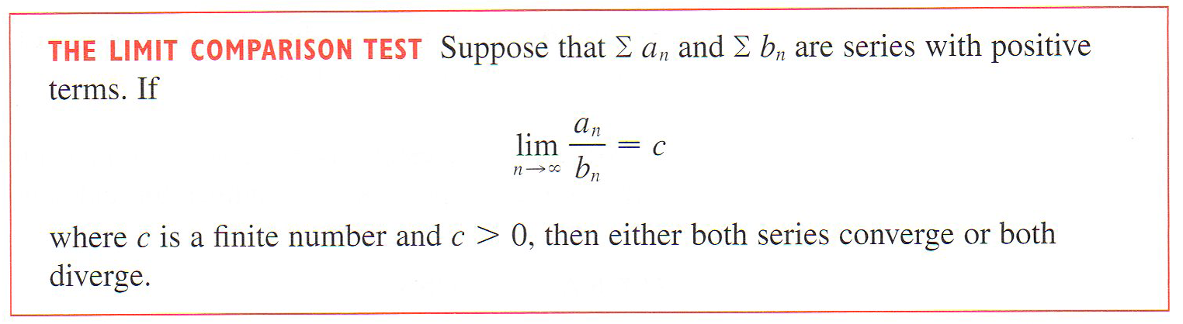
Series with positive terms.
The Limit Comparison Test – “LCT”

Slide 5
Series with positive terms.

Slide 6
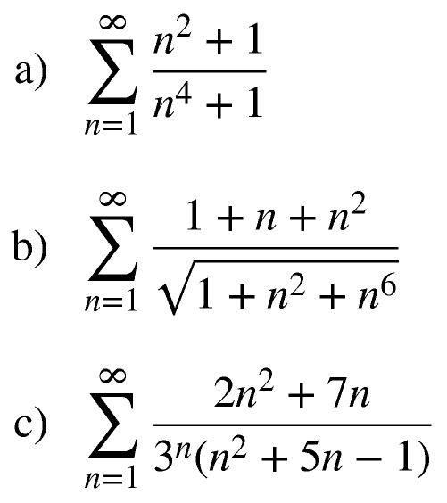
Example

Slide 7
Series with positive terms.

Slide 8
Series with positive terms.

Slide 9
Series with positive terms.

