Slide 1













11.2 Summation Notation and Series
$a_{1},a_{2},a_{3},a_{4},a_{5},a_{6},a_{7},a_{8},a_{9},a_{10}$ is a ten-term sequence, example
$$a_{1}=$$
$$a_{6}=$$
$$a_{2}=$$
$$a_{7}=$$
$$a_{3}=$$
$$a_{8}=$$
$$a_{4}=$$
S1 E4 $∙$ Cripples, Bastards, and Broken Things
60 min $∙$ May 8, 2011
$$a_{9}=$$
$$a_{5}=$$
$$a_{10}=$$
${S1=a}_{1}+a_{2}+a_{3}+a_{4}+a_{5}+a_{6}+a_{7}+a_{8}+a_{9}+a_{10}=\sum_{n=1}^{10}{a_{n}}=$ Game of Thrones Series

Slide 2



Slide 3

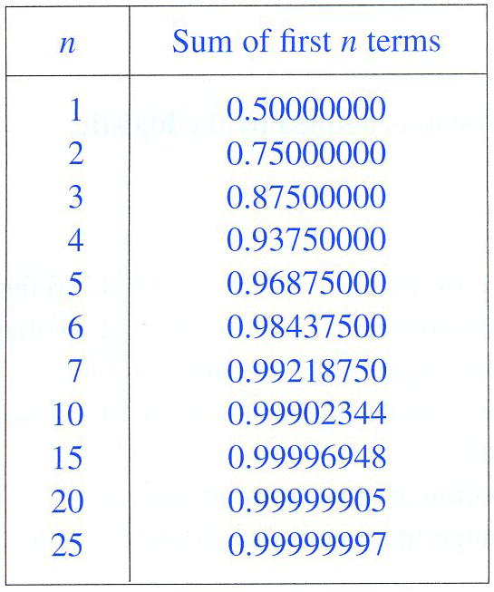

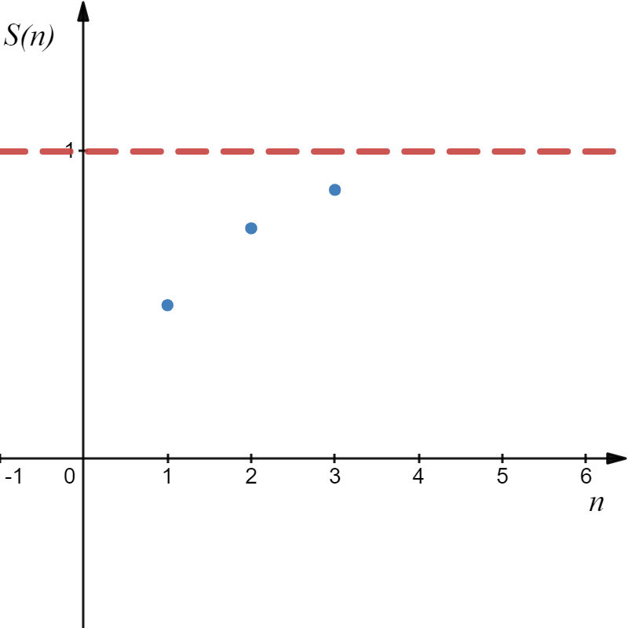
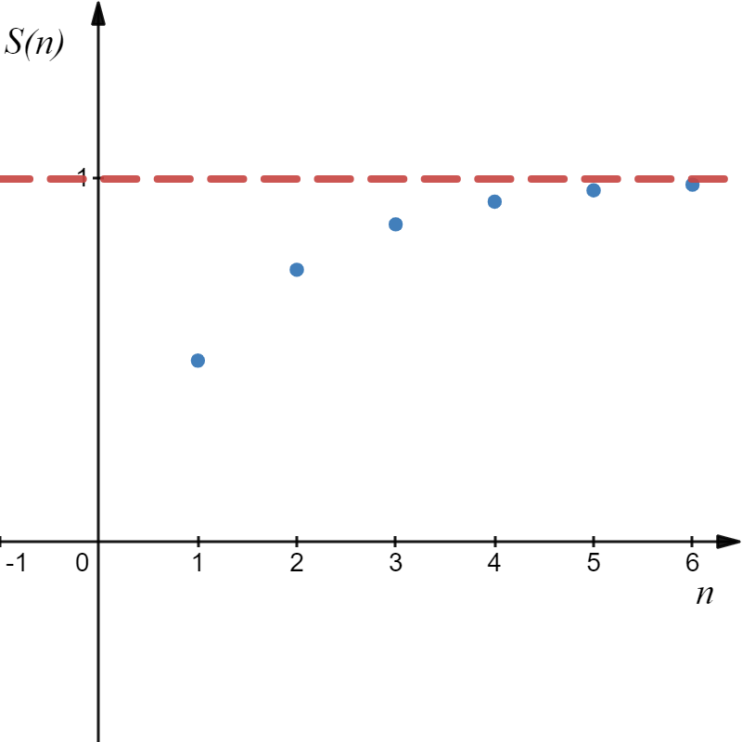
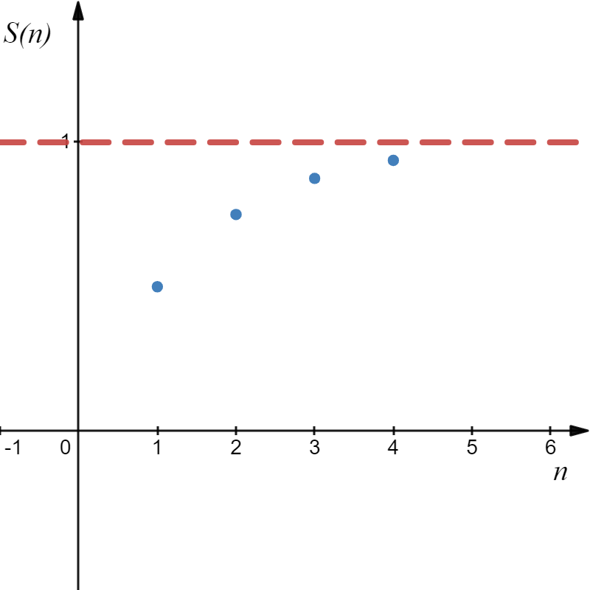
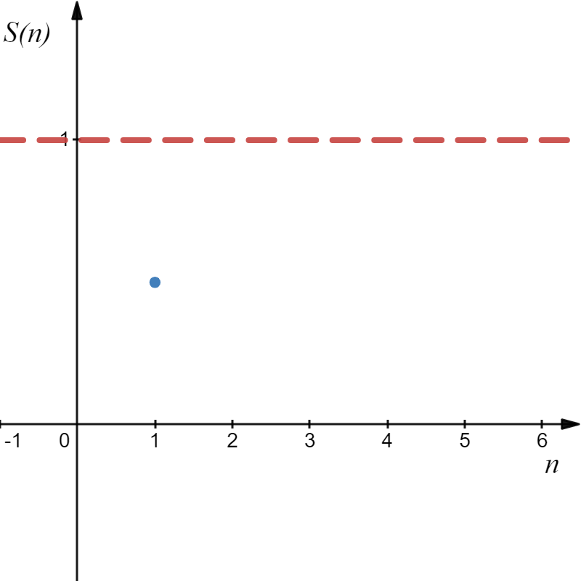
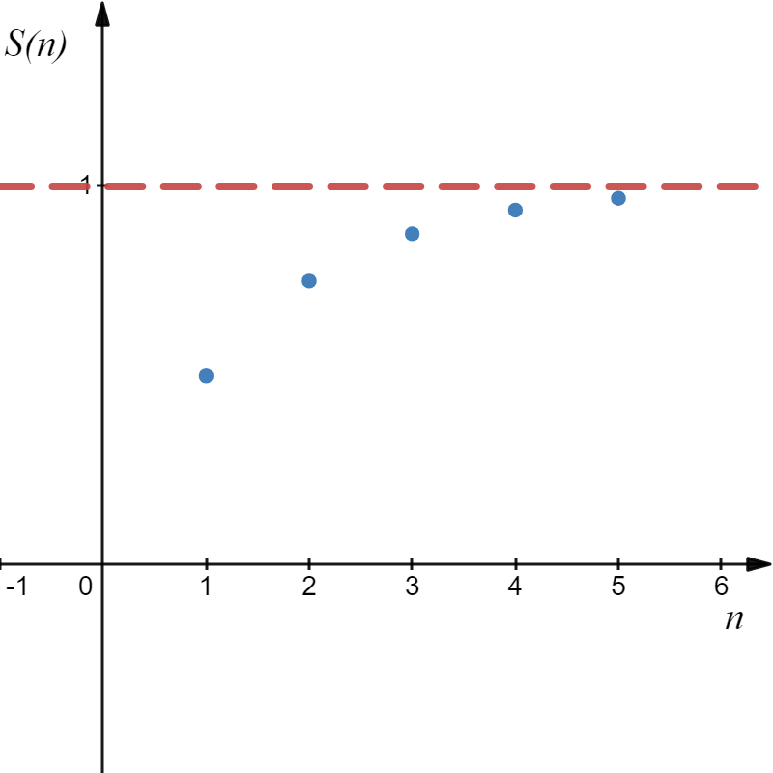
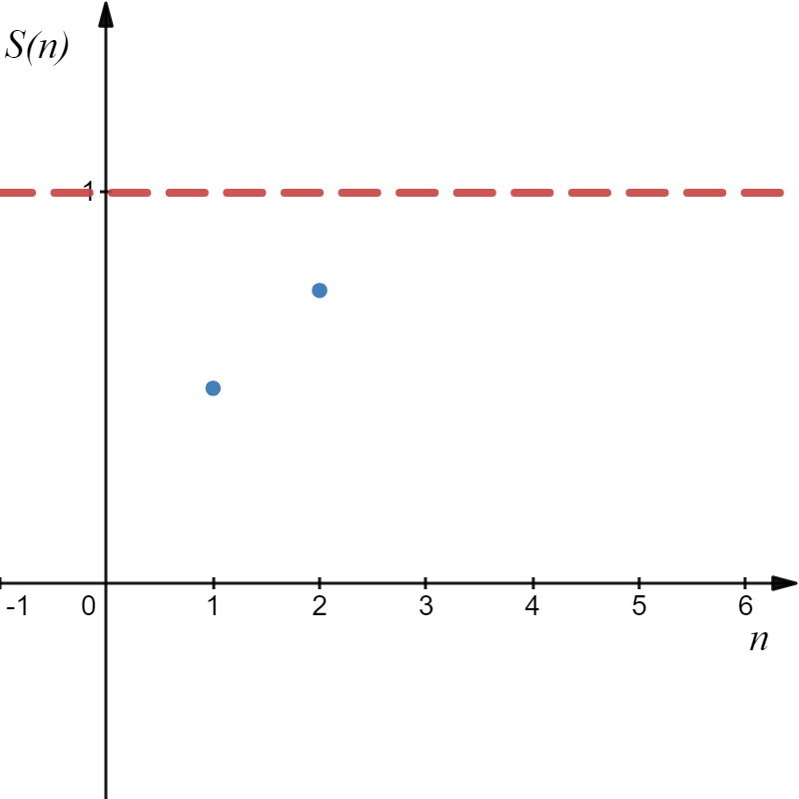


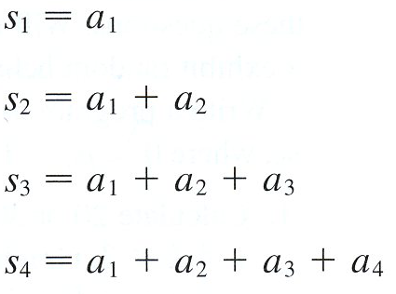



Slide 4
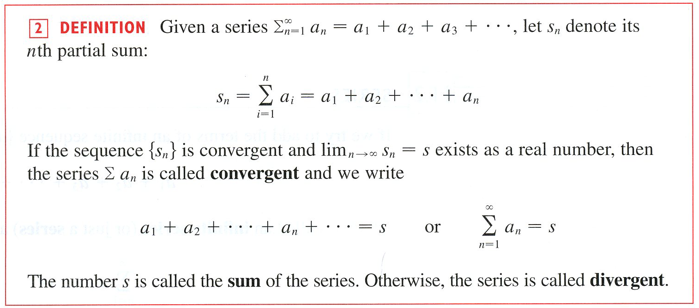

Slide 5

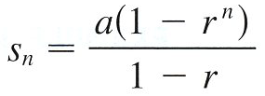


When does this sum converge?
If $r≠1$
_
_
( )

Slide 6
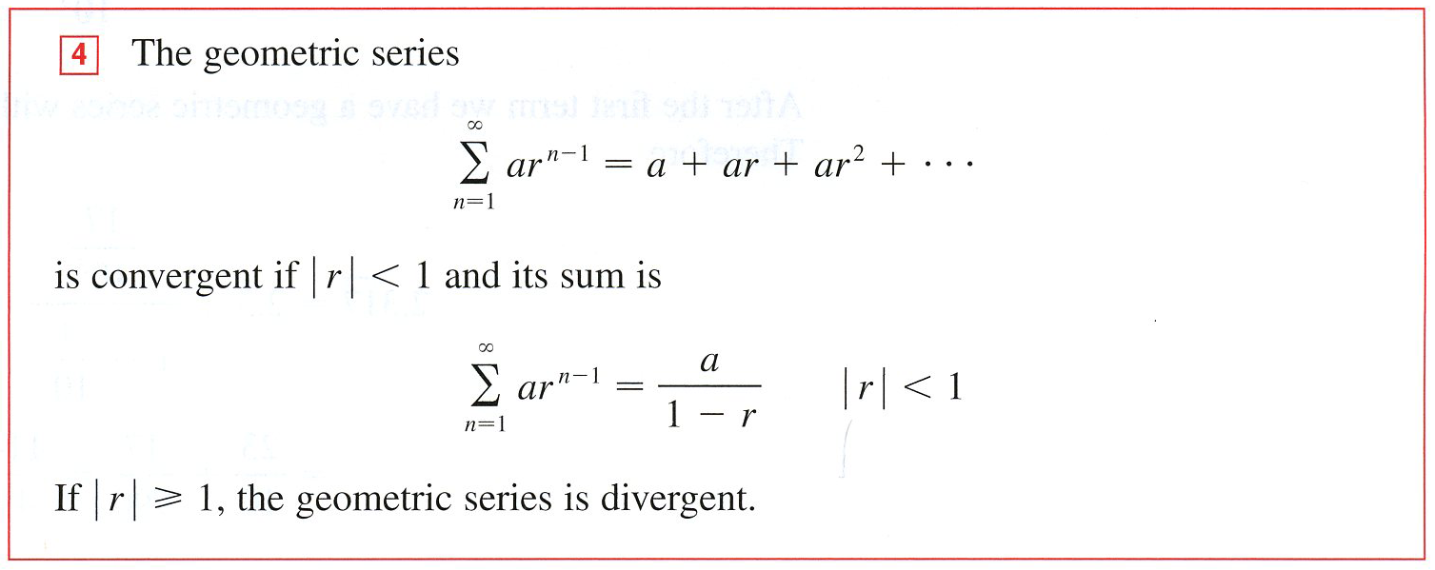

Slide 7

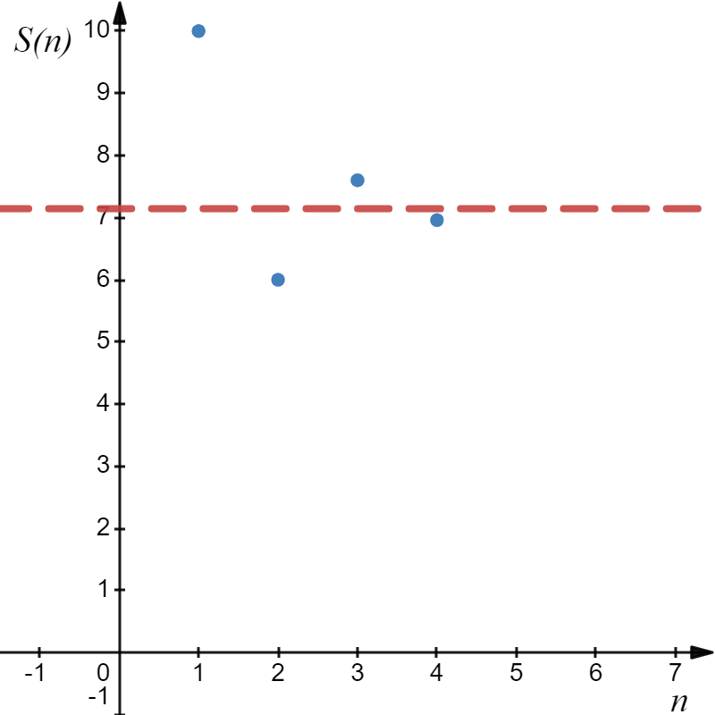

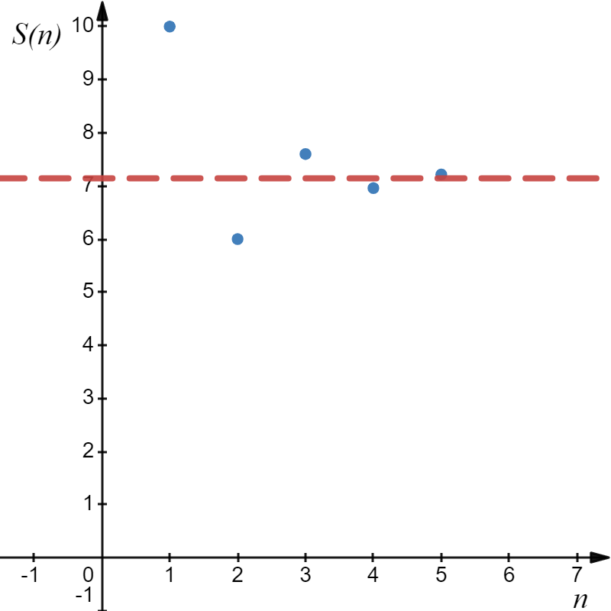
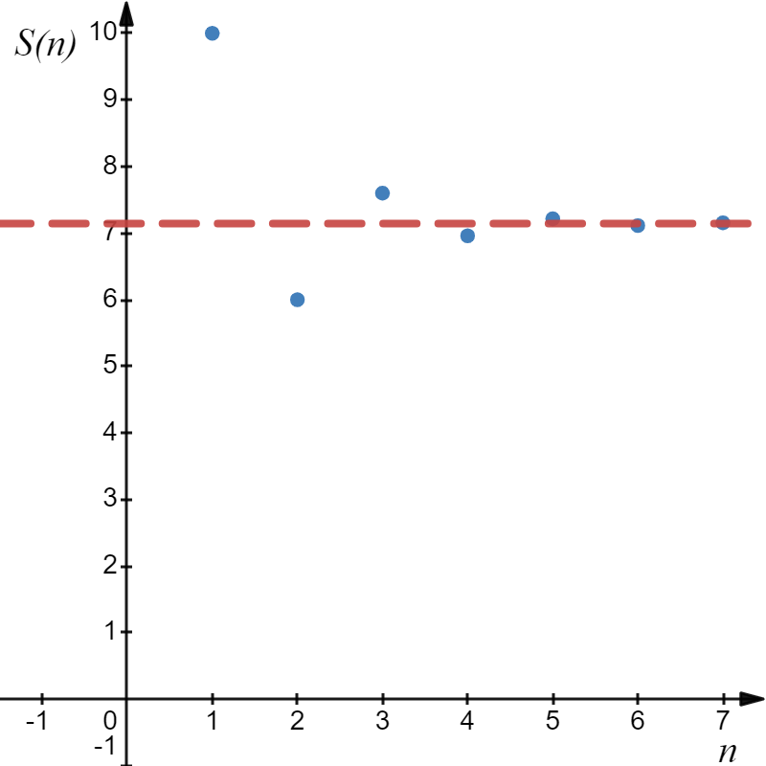
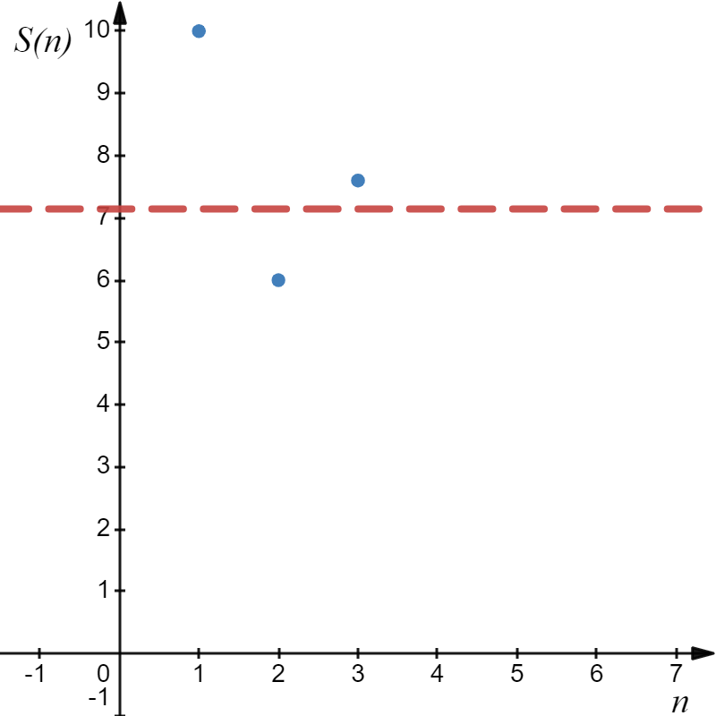
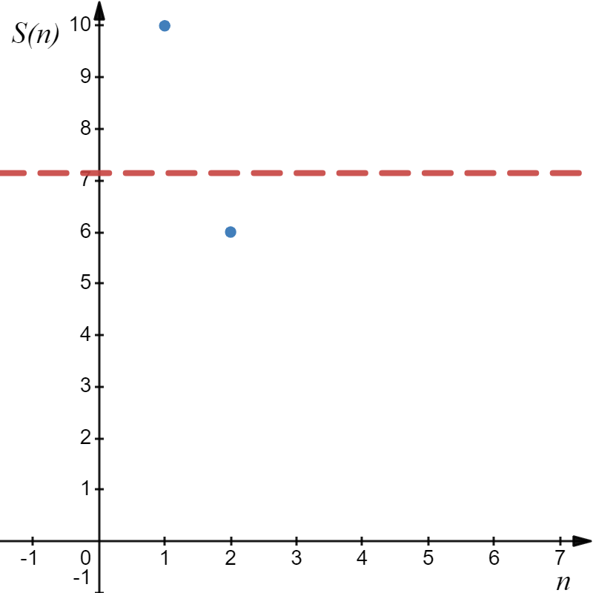
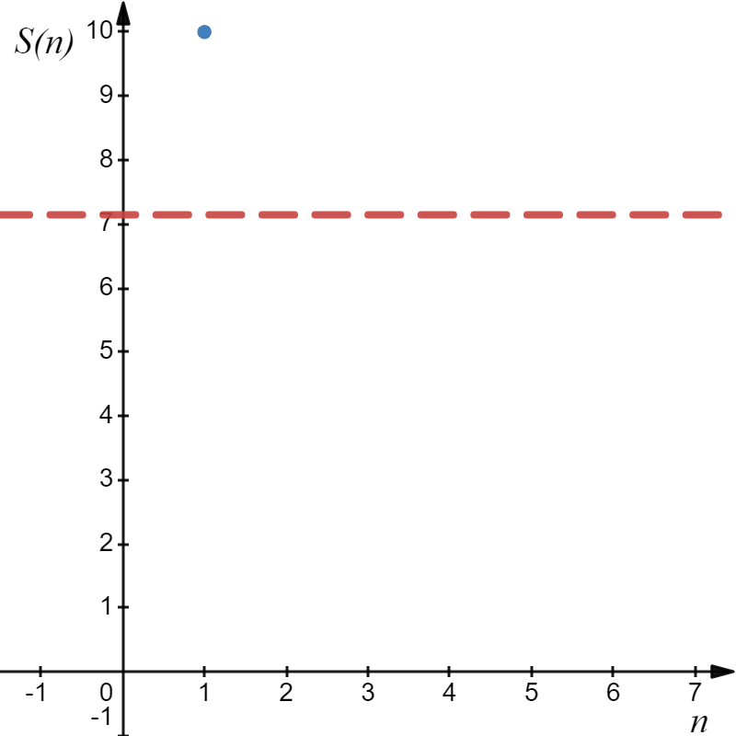

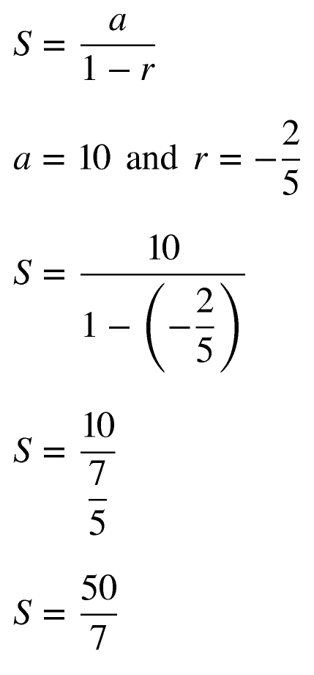
Example

Slide 8

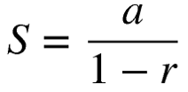
Example
Not Geometric
Geometric Series
Convergent

Slide 9
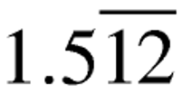
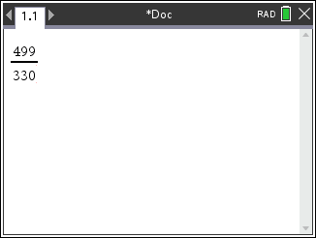
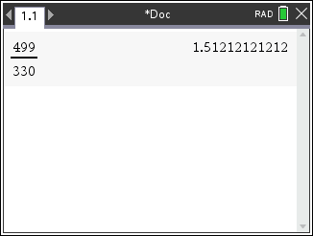
Example
Geometric Series

Slide 10

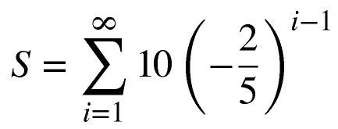
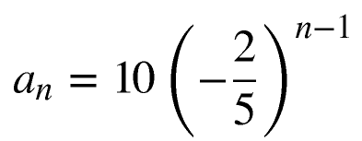
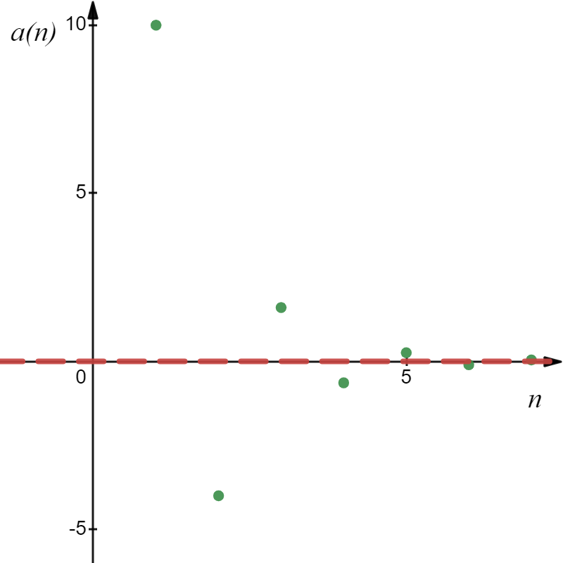
Converges
The converse of this theorem is false.

Slide 11




Slide 12

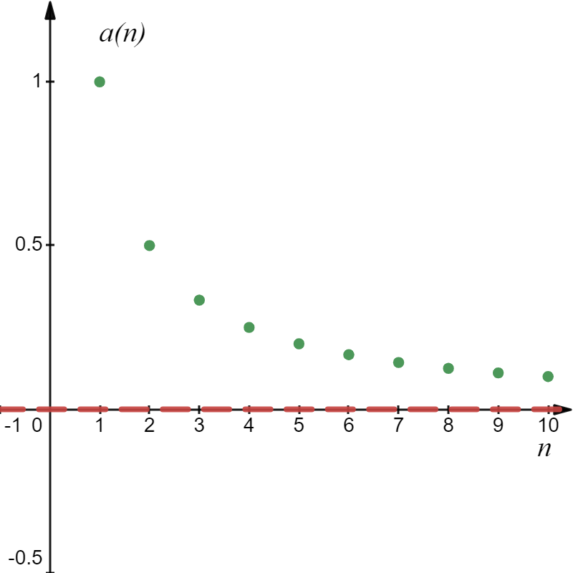
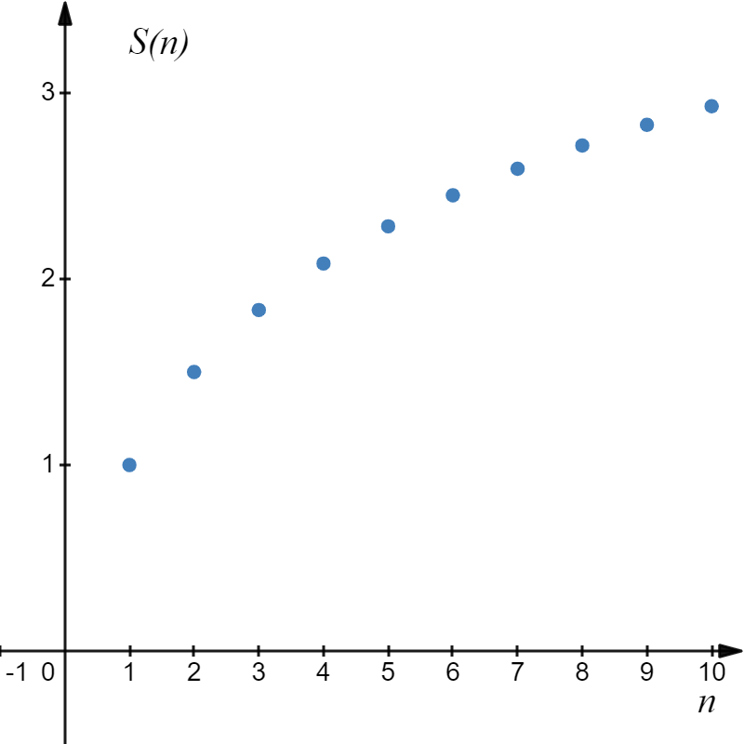
The Harmonic Series
The Harmonic Series Diverges, since the sequence of partial sums diverges.

Slide 13
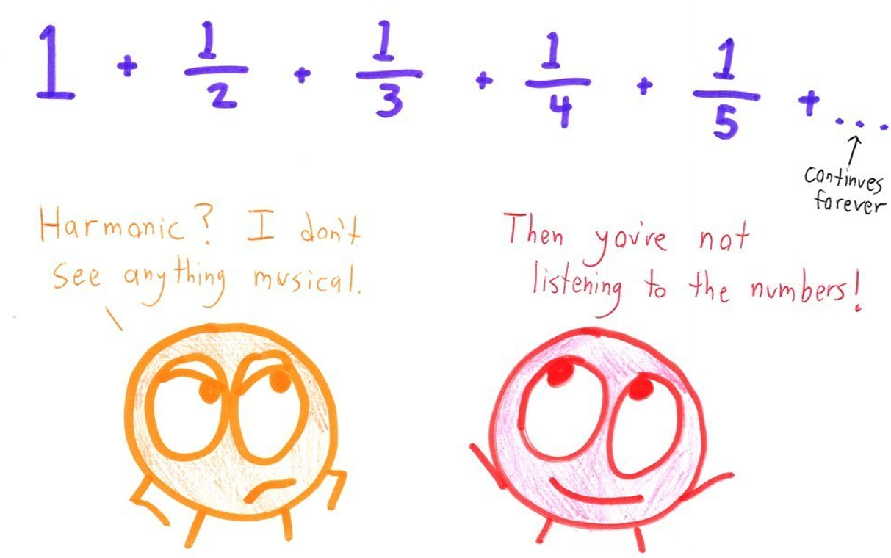

Slide 14



The contrapositive of the previous theorem is:
“TD”
Example
SOLUTION

Slide 15
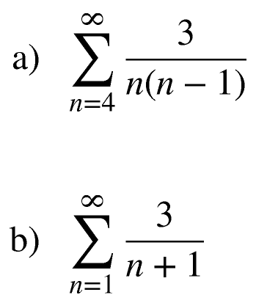
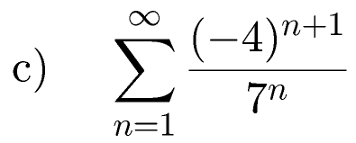
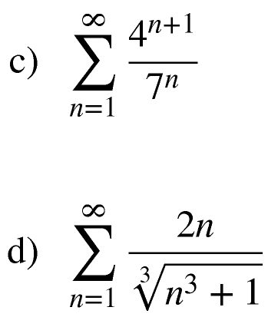
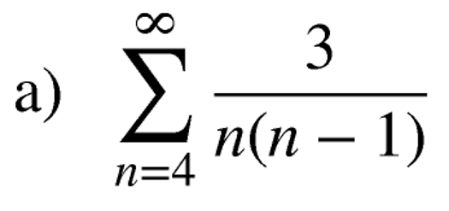
Not Geometric
Series my converge
We analyze the partial sum.
Telescoping Series

Slide 16
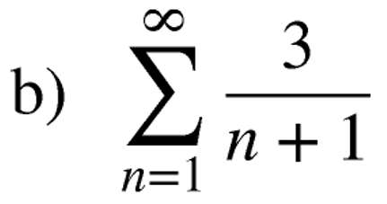
Harmonic Series
Divergent by Harmonic Series Test (HST)
Convergent by Telescoping Series Test (TST)
Geometric
Not Geometric
Series may converge

Slide 17
Not Geometric
0
“TD”

Slide 18
Example
Geometric
The Geometric series will converge when
This is called the interval
of convergence.

