Slide 1
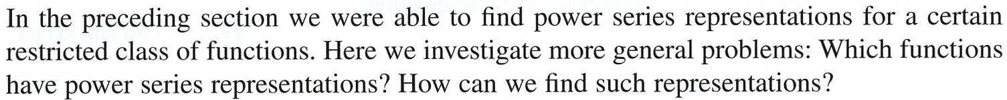

y
y = f (x)
(0, f (0))
x

Slide 2
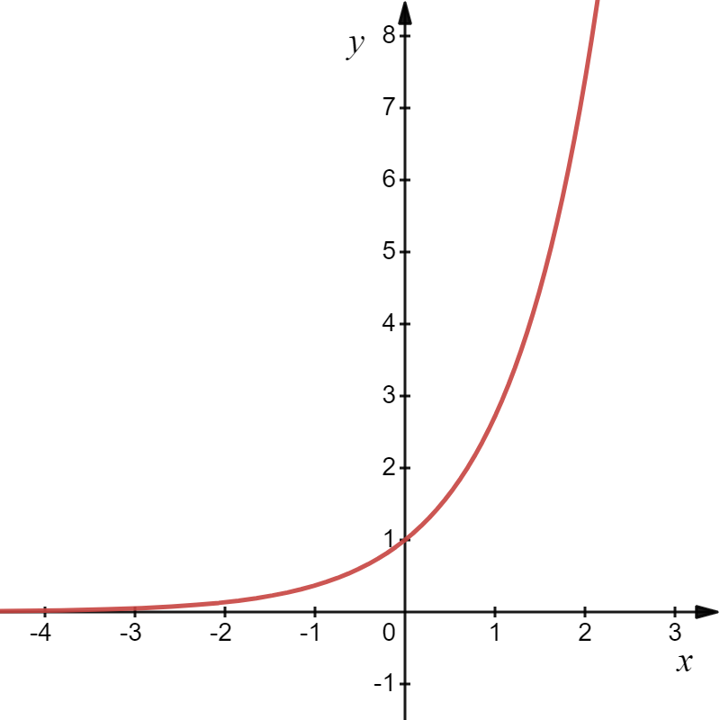
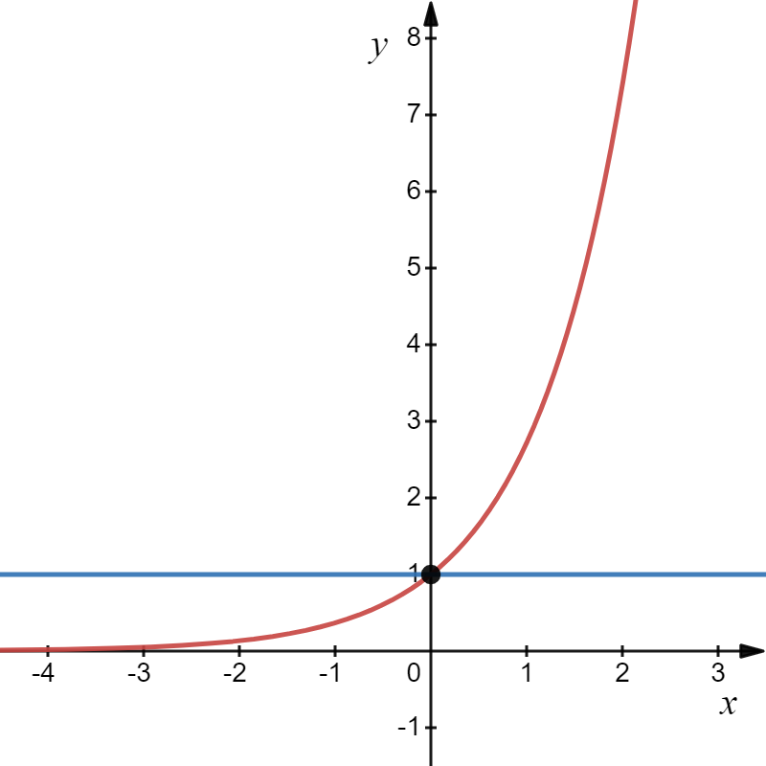
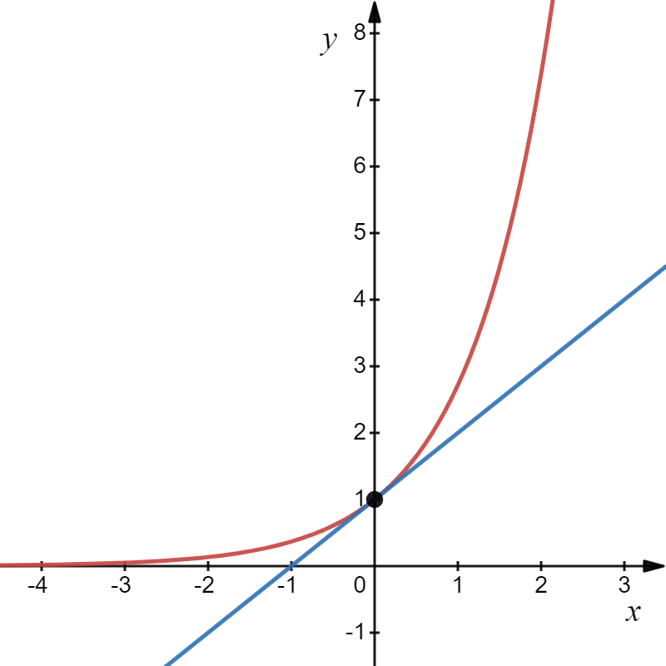
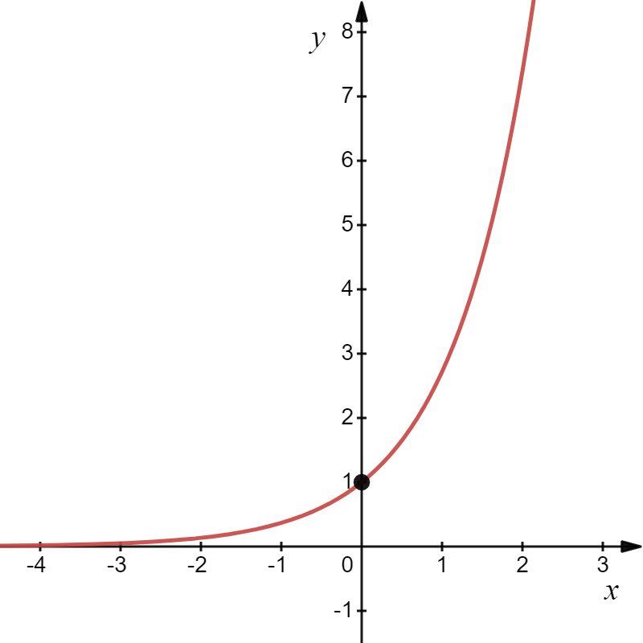
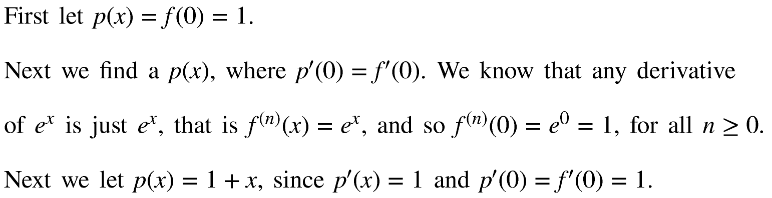

Slide 3

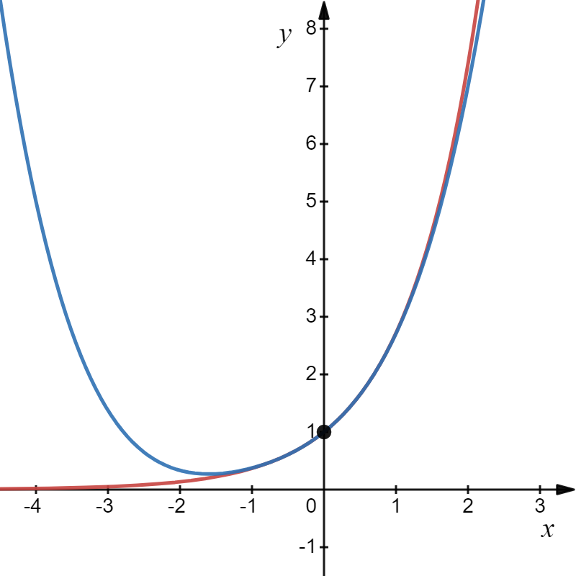
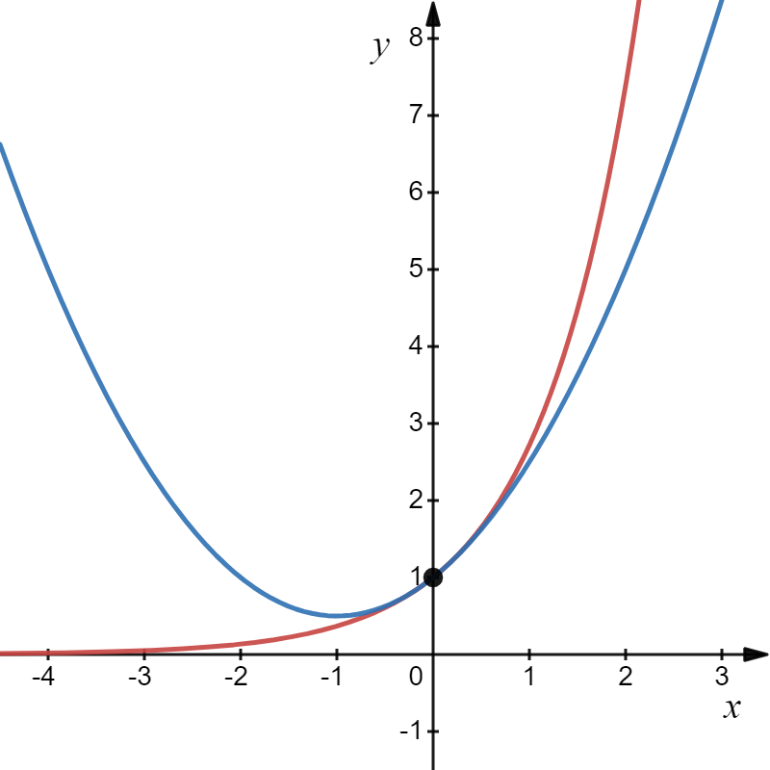
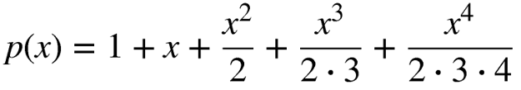
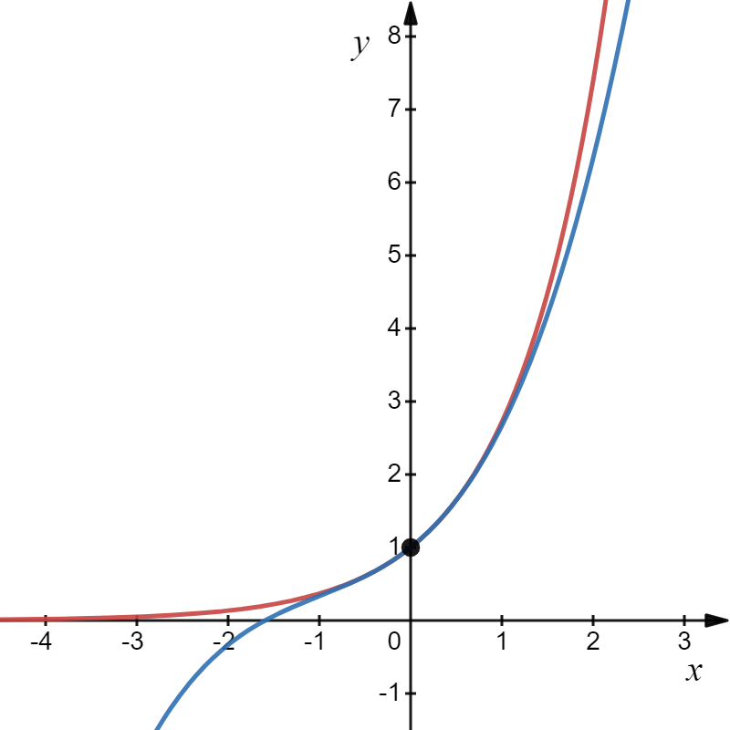

Slide 4
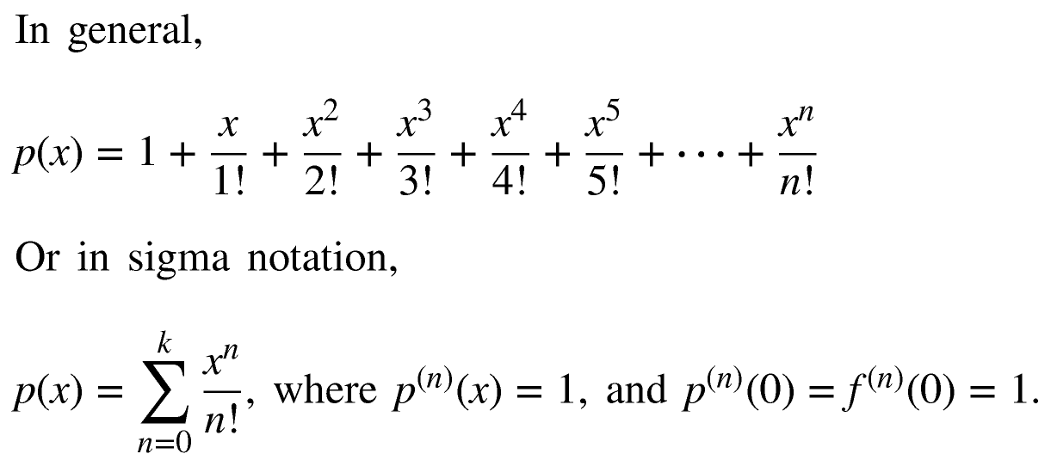
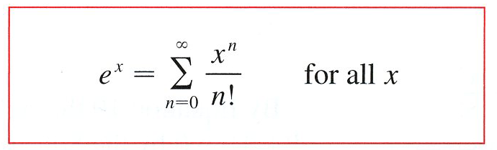
y = e^{x}
But this series is finite, so letting n go to infinity it appears that
To show this we will first find the interval of convergence using the Ratio Test.

Slide 5
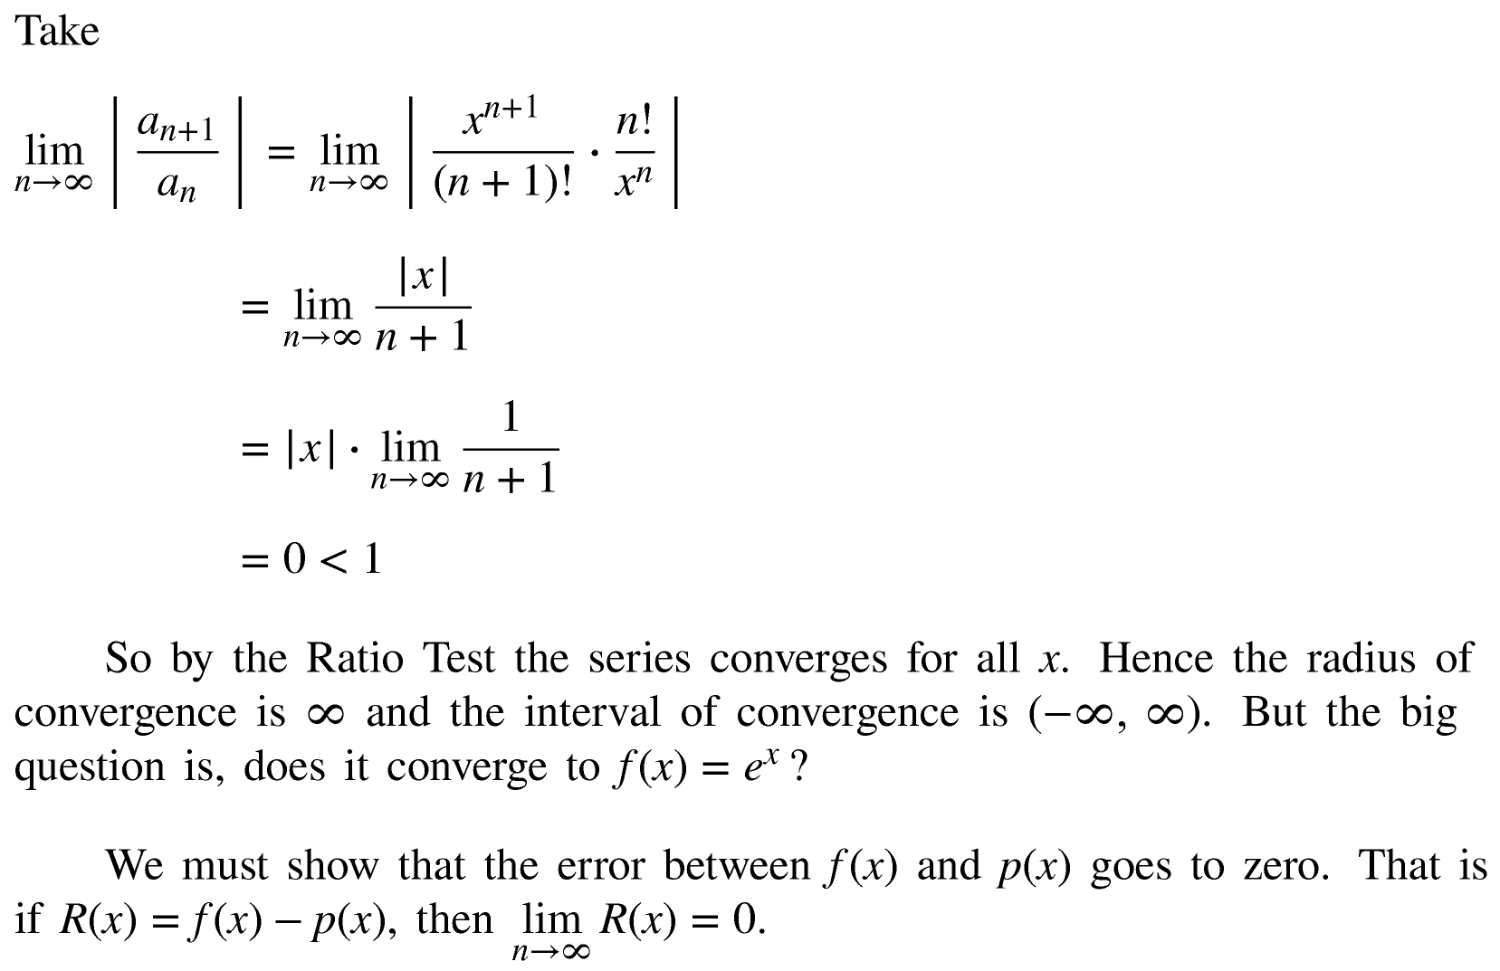

Slide 6
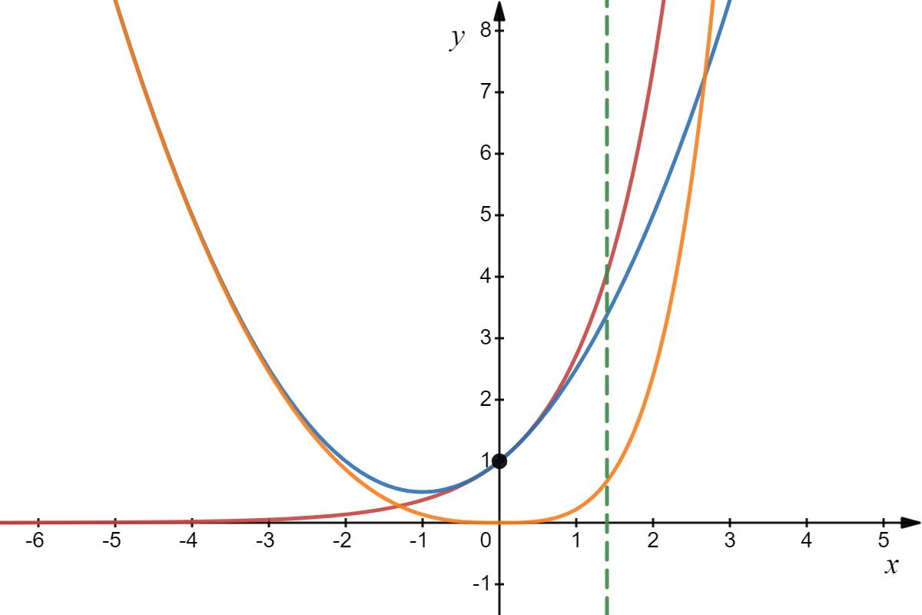



R(x)

Slide 7


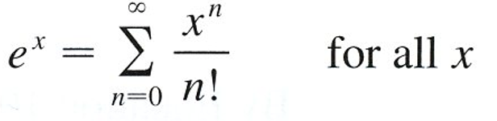

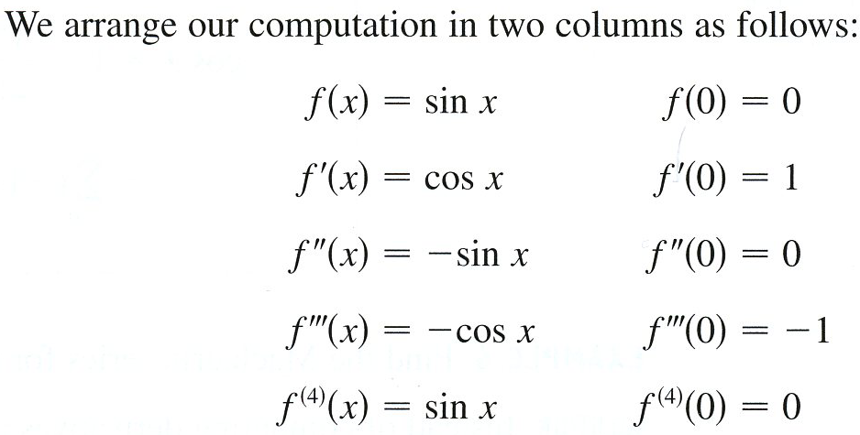

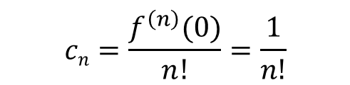
Generalizing this process, we get the following series.
$$cn=\frac{f^{\left(n\right)}(0)}{n!}=\frac{1}{n!}$$
c_{n}
This looks like fun! What function would you like to write as a Maclaurin series next?
to calculate the coefficients $cn=\frac{f^{\left(n\right)}(x)}{n!}$
n = 0, no derivative
n = 1, first derivative
n = 2, second derivative
n = 3, third derivative
n = 4, fourth derivative

Slide 8
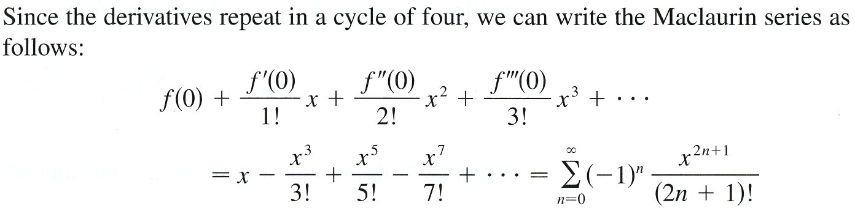

n = 0
n = 1
n = 2
n = 3

Slide 9
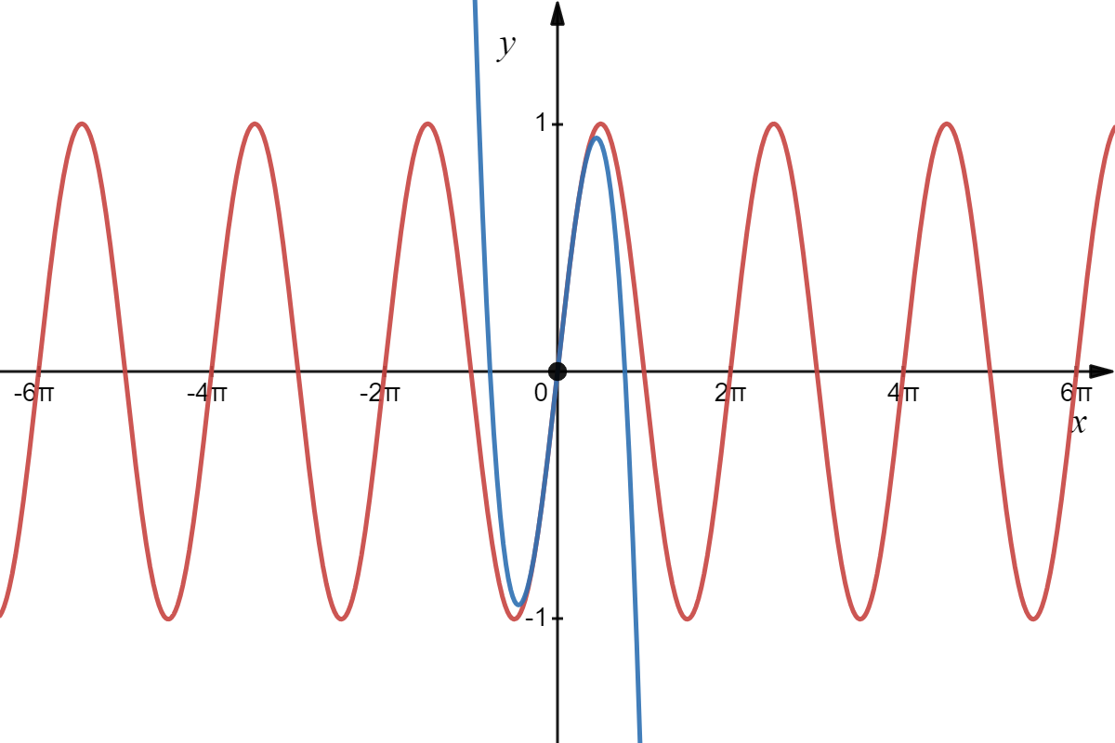
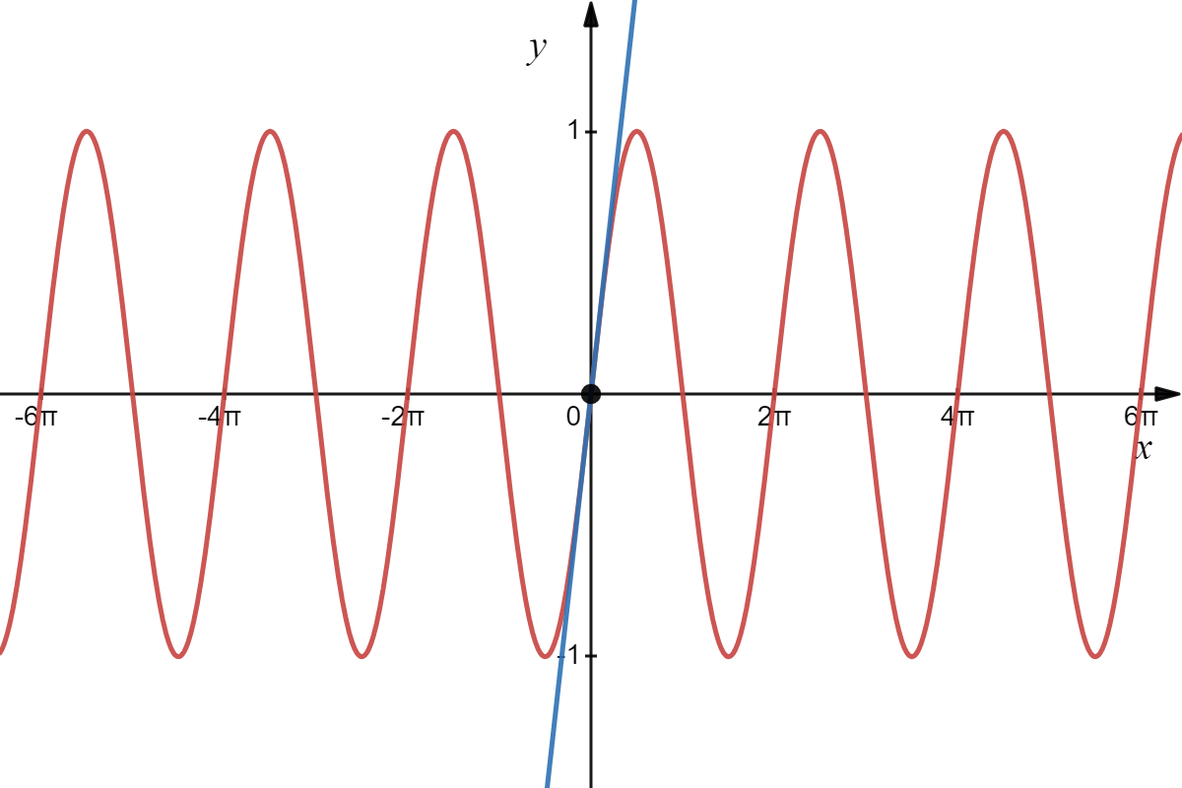
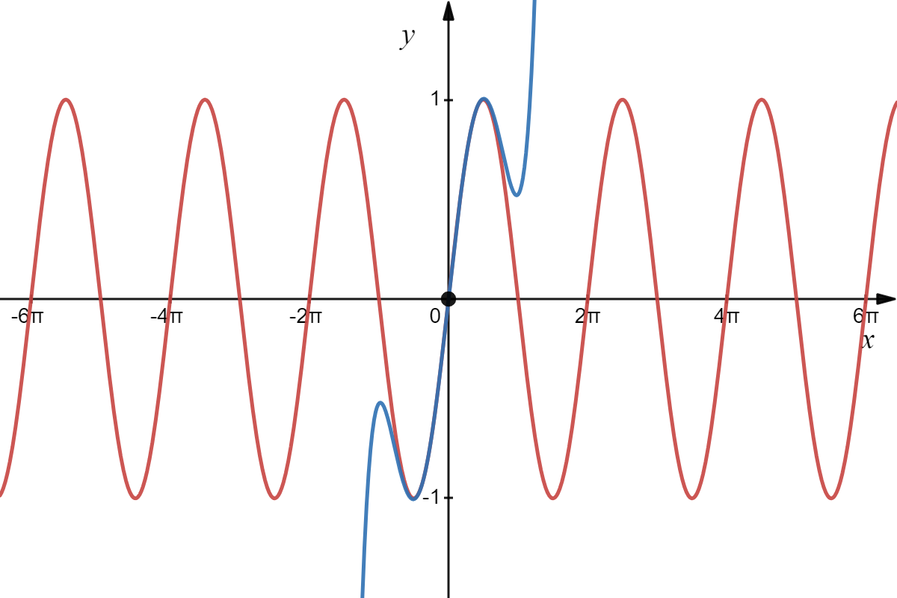
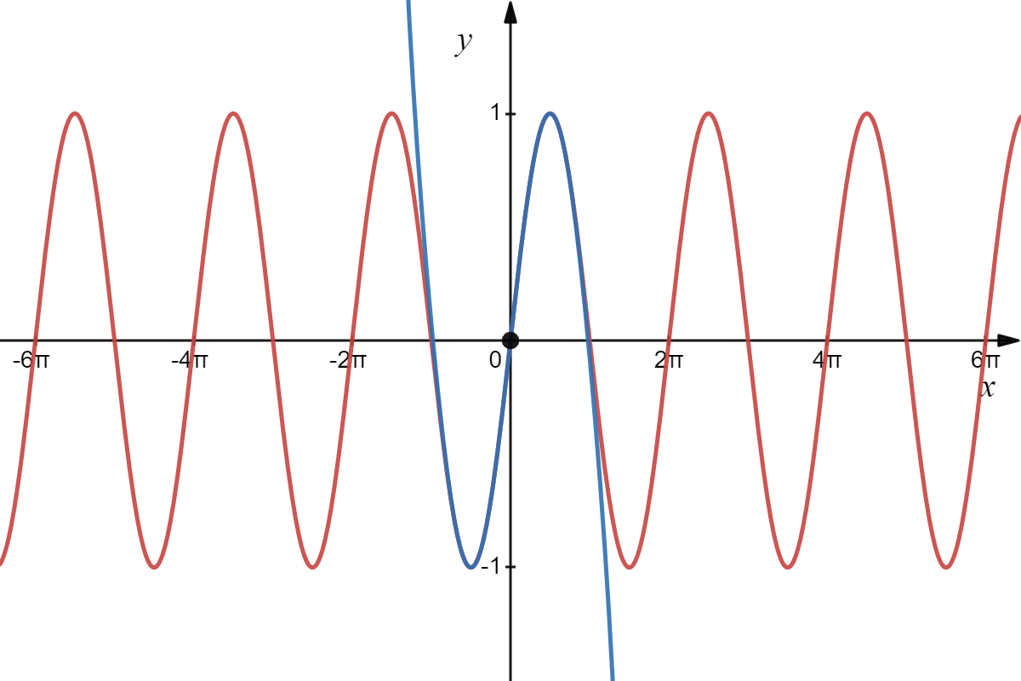
y =sin x

Slide 10
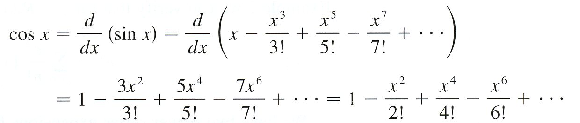

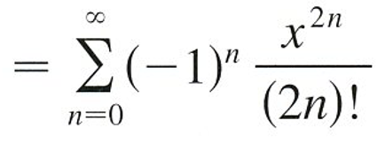
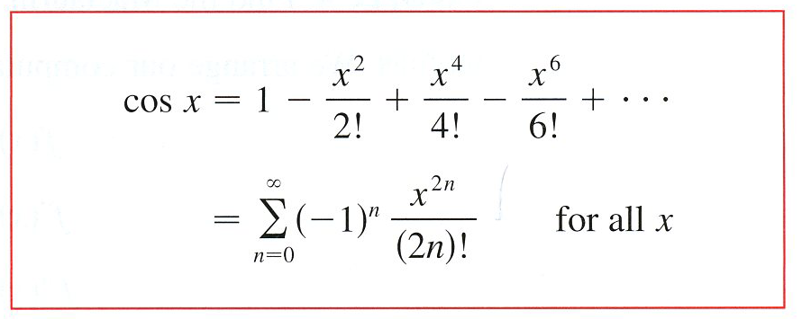
y =cos x

Slide 11
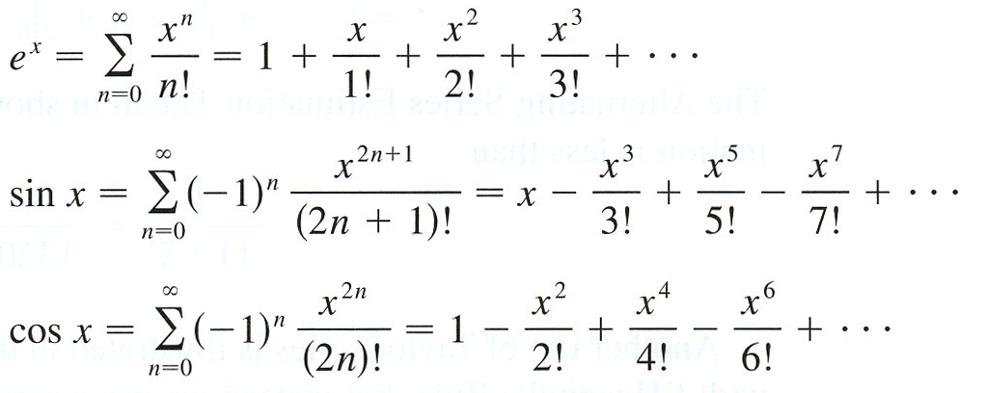
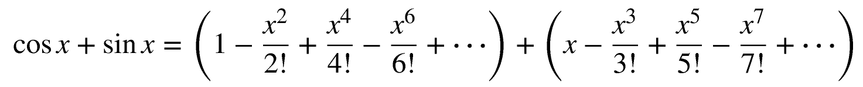
In conclusion, here are the Maclaurin series for e^{x}, sin x, and cos x :
If you look closely at the Maclaurin series for e^{x}, sin x has the odd degree terms, and cos x has the even degree terms. In fact, it looks like if we take cos x + sin x we almost get e^{x}. Let’s take a look.

Slide 12
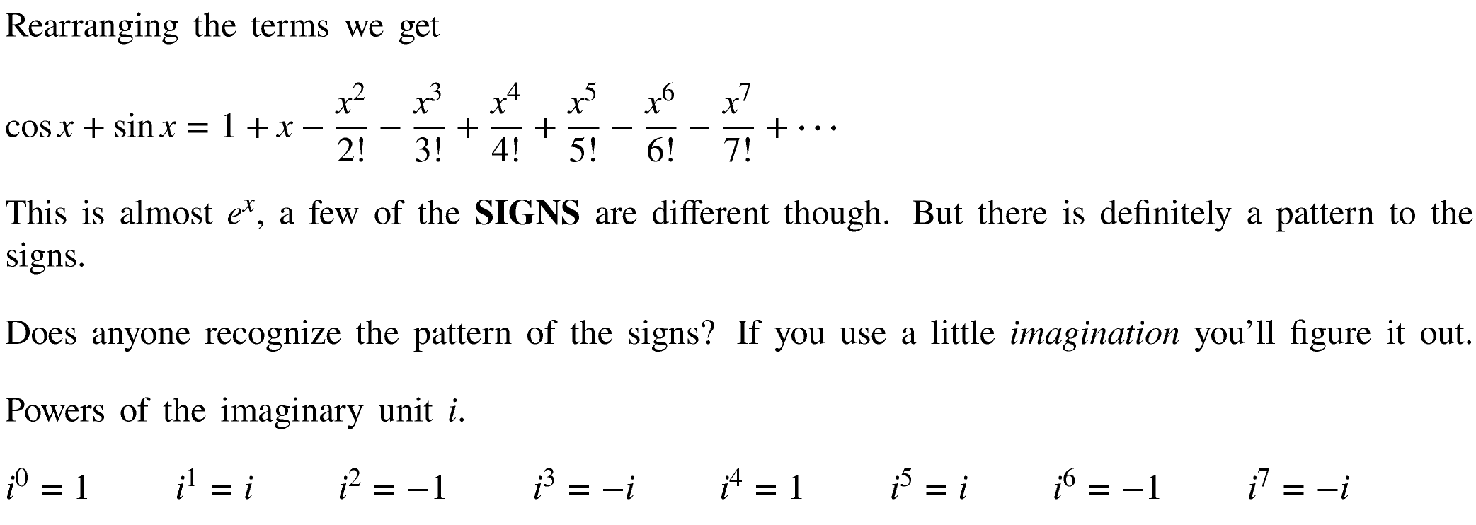
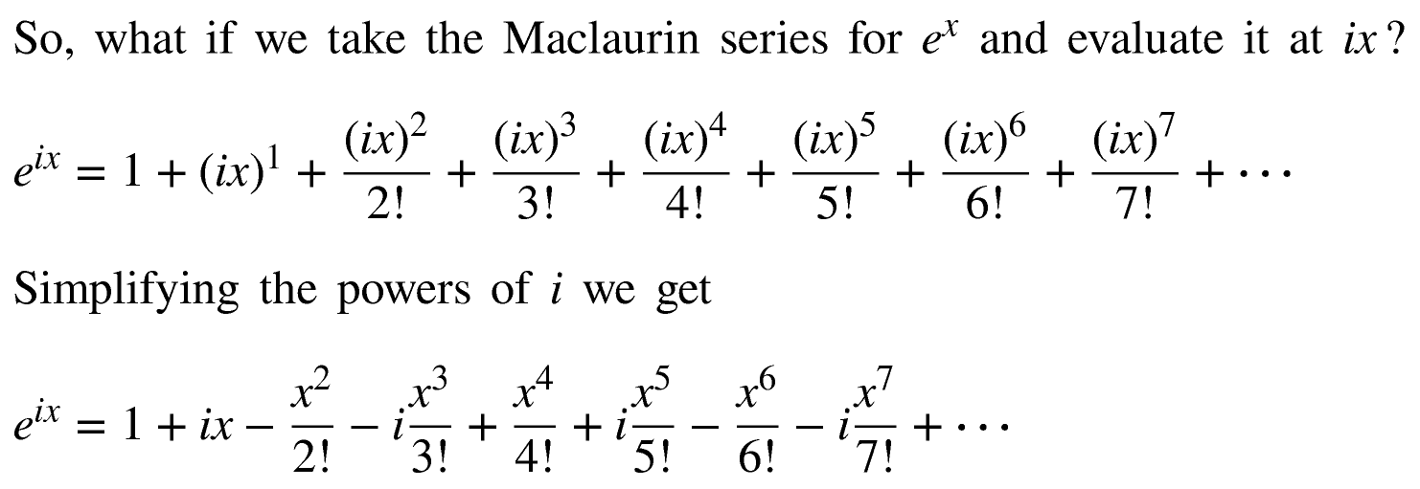

Slide 13
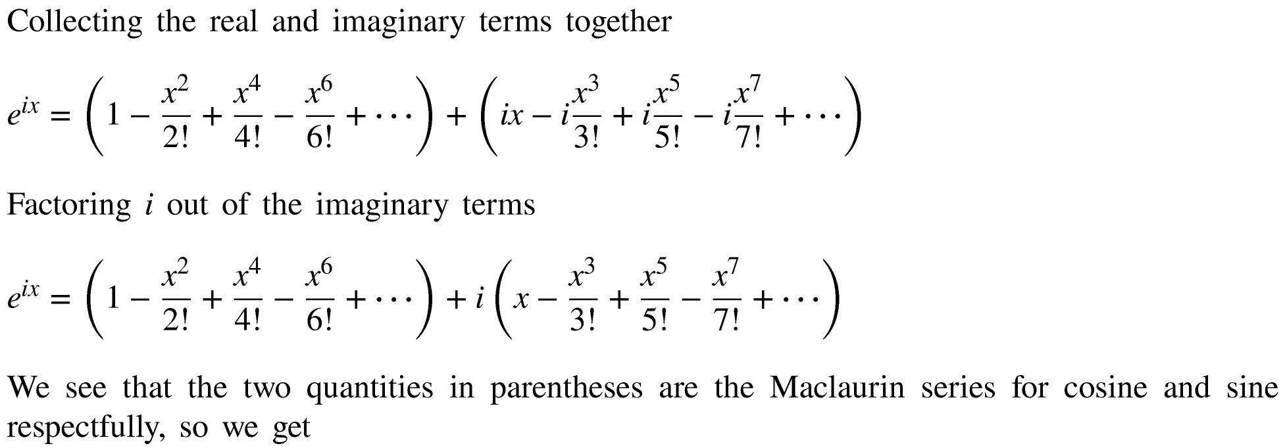
WOW!!

Slide 14
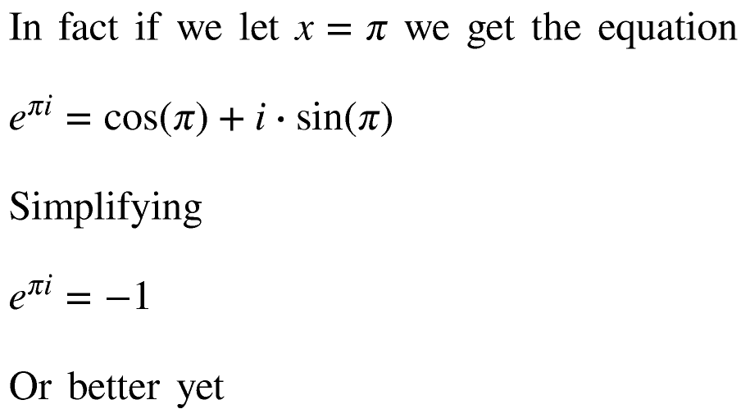

WOW¹⁰⁰!!

Slide 15
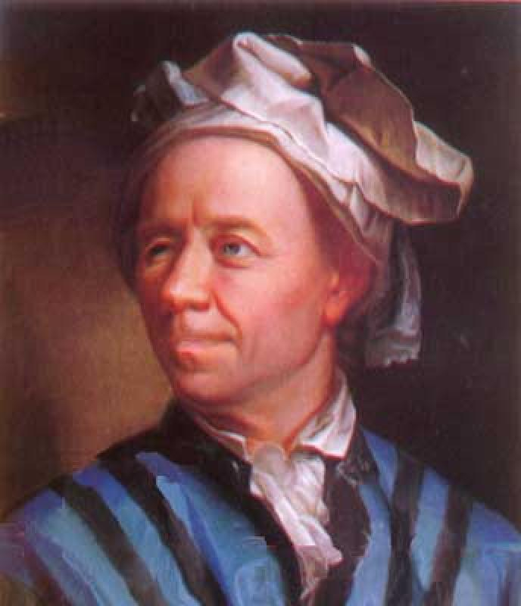
A little maths history!
Leonhard Euler
1707 - 1783

Slide 16
Leonhard Euler’s Work
Quantity:
Euler’s collected works, the Opera Omnia,
run to over 25,000 pages.
In 1910 Gustav Eneström catalogued Euler’s
866 books and papers in a document that itself
ran to 388 pages.
After his death, Euler published …
… 228 papers.

Slide 17
Quality:
Mathematical terms (from MATHWORLD Wolfram):
Euler – 96 entries
Gauss – 70 entries
Cauchy – 33 entries
Bach – 0 entries

Slide 18
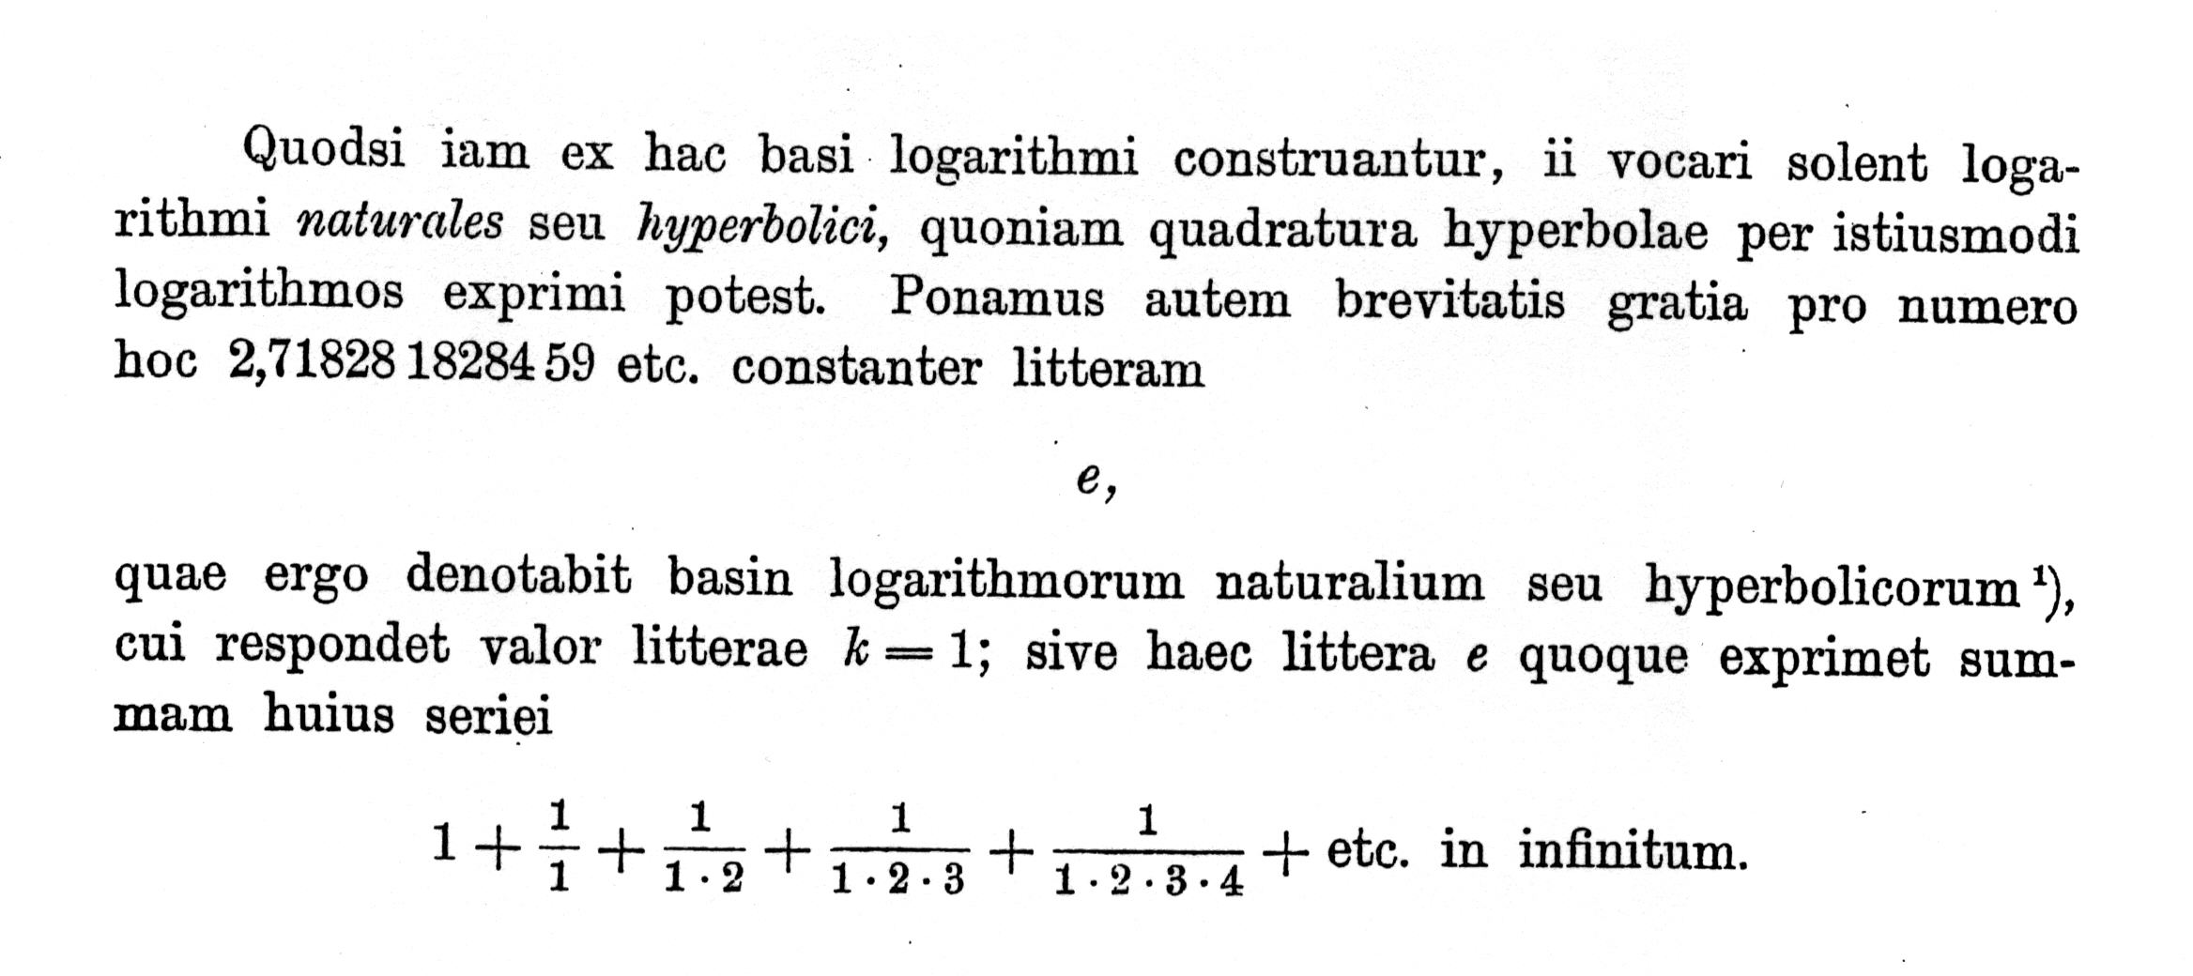
The number e (1748)

Slide 19
Euler’s Identity (1748)

Slide 20

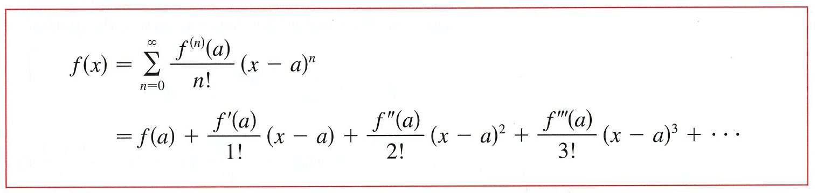

Back to work!
y
y = f (x)
(a, f (a))
x
a
When a = 0, the series is a Maclaurin series.

Slide 21
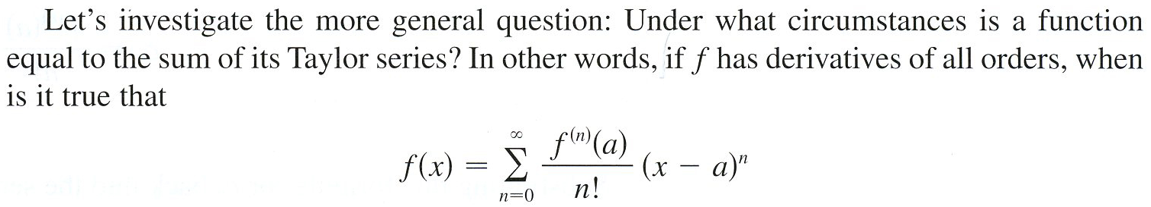
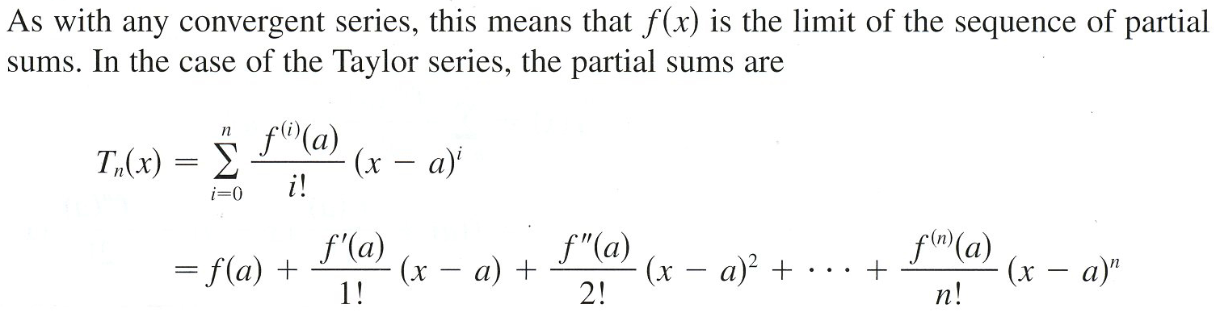

Slide 22
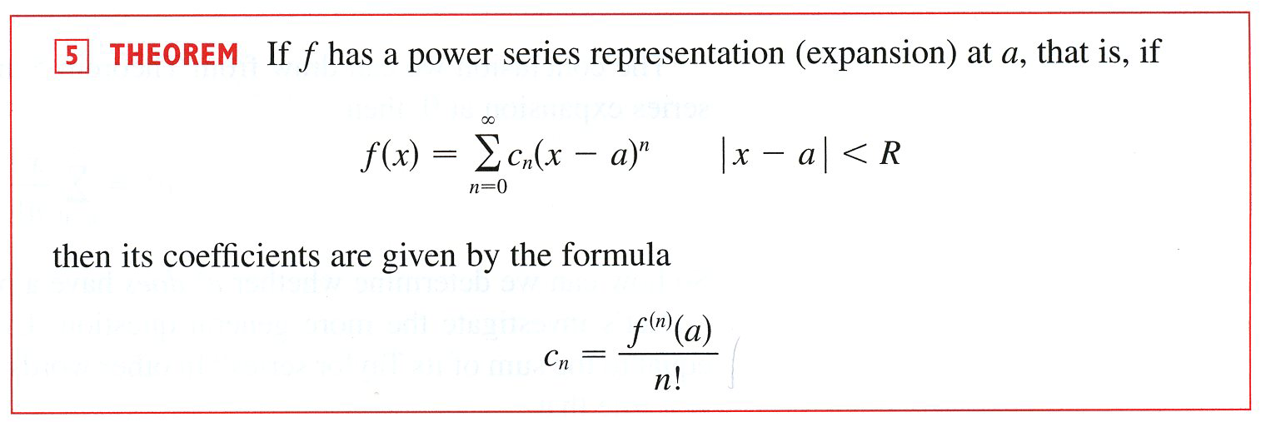

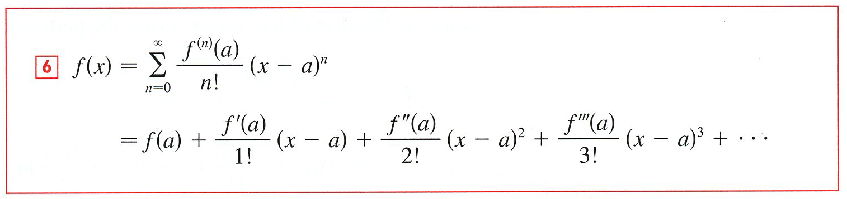
In summary, we have the Taylor Series expansion for a function f (x).

Slide 23
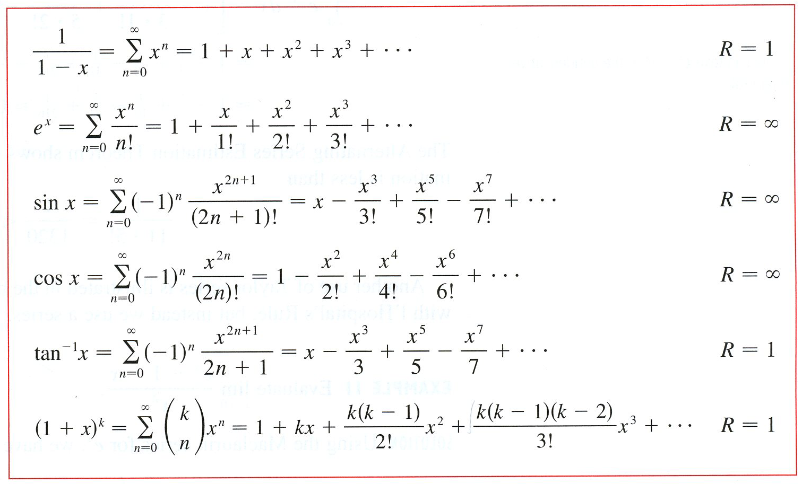

Slide 24
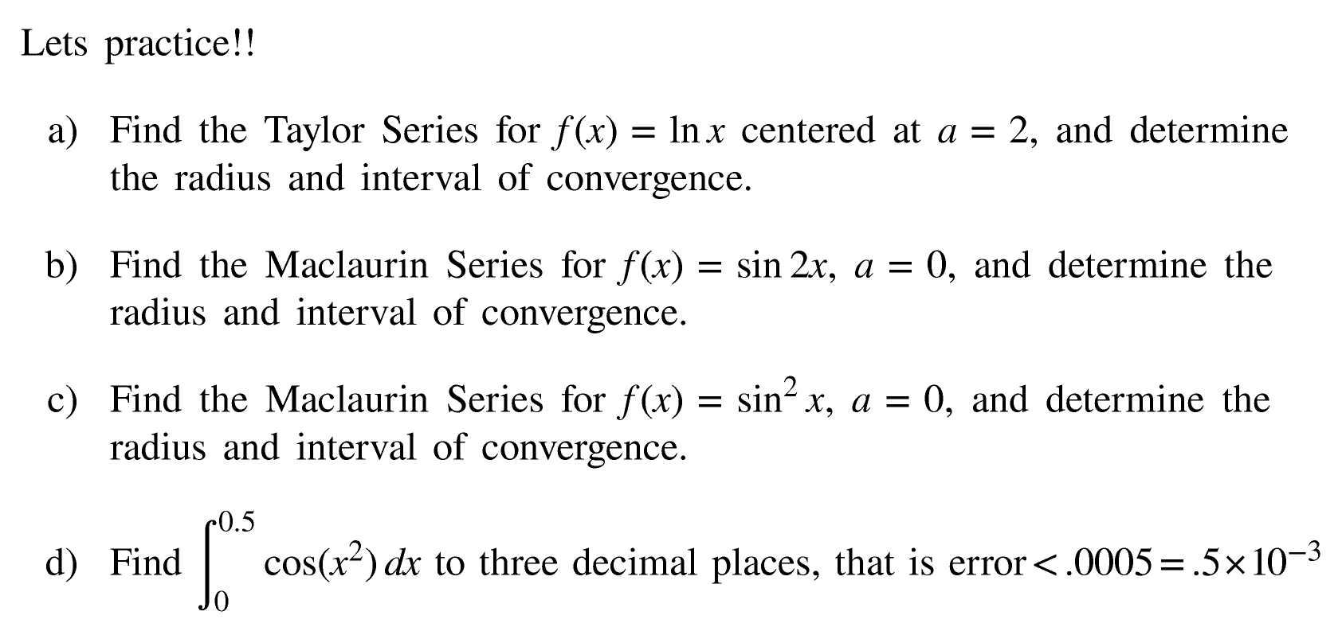
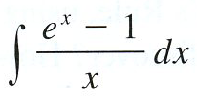
e)

Slide 25
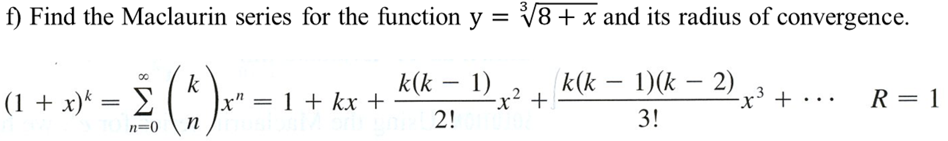

Slide 26



Example
coefficients
n
0
1
2
3
4
5
$$f^{\left(n\right)}(x)$$
$$f^{\left(n\right)}(2)$$
First, we will find the coefficients by constructing a table.
Coefficients
What’s
the
Pattern
What’s the Radius of Convergence?
Let’s go to the next slid and find out!

Slide 27




Let’s use the Ratio Test by first simplifying, and then find the interval of convergence
We must check the endpoint at $x=0$and $x=4$ with the series.
When $x=0$ we get the series
Diverges by the
p-Series Test
When $x=4$we get the series
Converges by the
Alternating Series Test
Radius of convergence is R = 2
Hence, the interval of convergence is $x∈(0,4].$
$$y =ln⁡x$$

Slide 28

Example
b) Derive
n
0
1
2
3
4
5
$$f^{\left(n\right)}(x)$$
$$f^{\left(n\right)}(0)$$
First, we will find the coefficients by constructing a table.
Coefficients
Odd
2n + 1
What’s the Radius of Convergence?
Next slide please!

Slide 29

Let’s use the Ratio Test to find the interval of convergence.
Hence, the interval of convergence is $x∈\left(−∞,∞\right).$
Radius of convergence is R = $∞.$
y =sin (2x)

Slide 30

Example
Let’s use the Ratio Test to find the interval of convergence.
Hence, the interval of convergence is $x∈\left(−∞,∞\right).$
Radius of convergence is R = $∞.$
y =sin² (x)

Slide 31
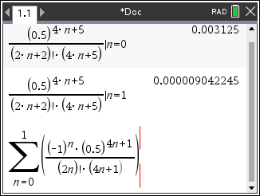
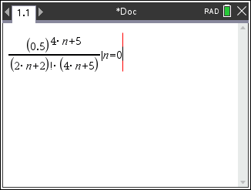
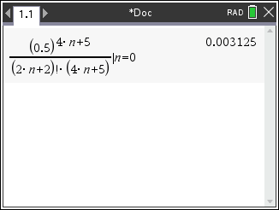
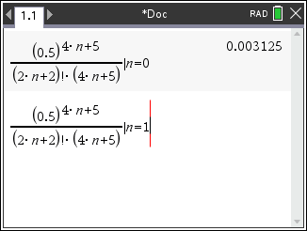
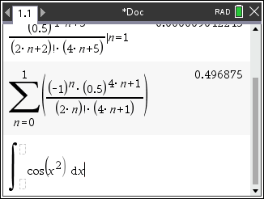
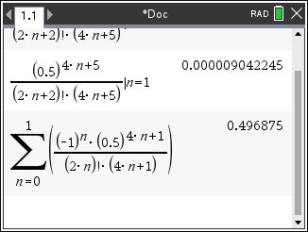
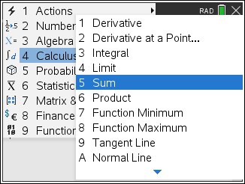
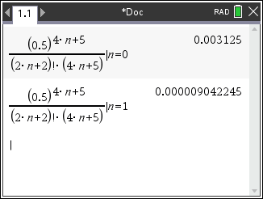



Example

Slide 32



Example
Antiderivative is not an elementary function.
What can we do?
Clever math!

Slide 33

Example
The Binomial Series
$$=2∙\sum_{n=0}^{∞}{\left({1/3 \atop n}\right){\left(\frac{x}{8}\right)}^{n}}$$

Slide 34


Slide 35


Find the function represented by the given power series.

Slide 36


Slide 37














Find the function represented by the given power series.
Find the error.

Slide 38



Slide 39


























Using CAS, find a Taylor polynomial of order 5 centered at a = 1 for the function
taylor(function, independent variable, order, centered)

