Slide 1
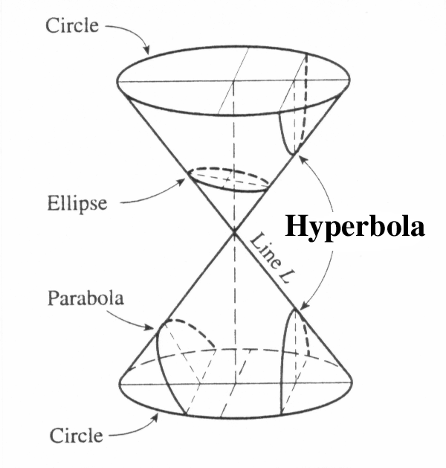
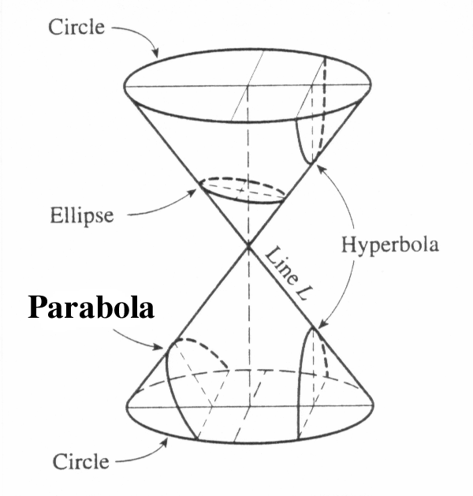
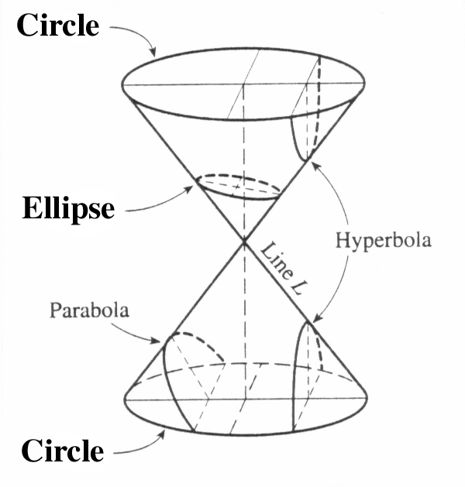

Slide 2
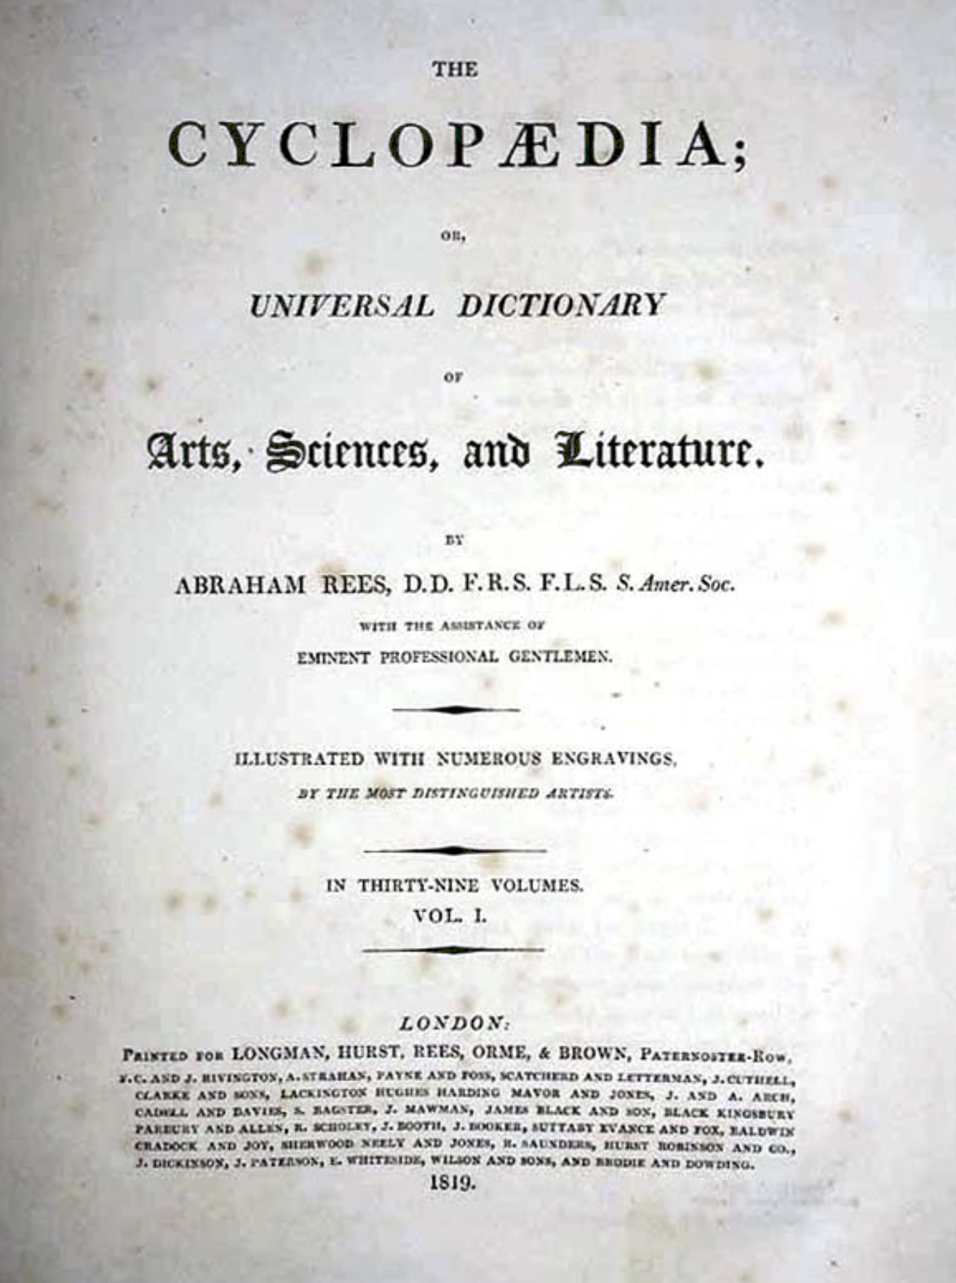
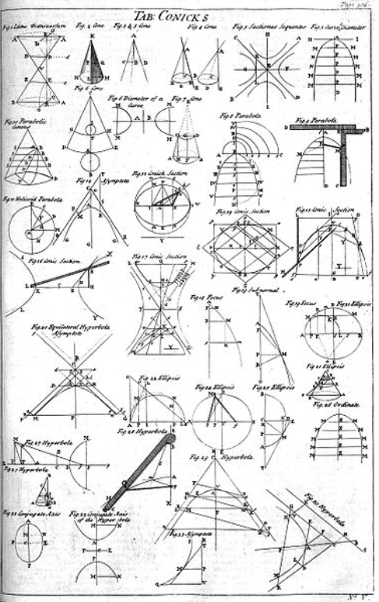
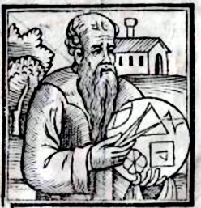
A Little History
Apollonius of Perga
240 BC - 190 BC
Apollonius, a Greek mathematician, is often referred to as the “Great Geometer” for his extensive work on conic sections. He made significant contributions to the study and classification of conics and his treatise “Conics” is consider a fundamental work in the field.

Slide 3
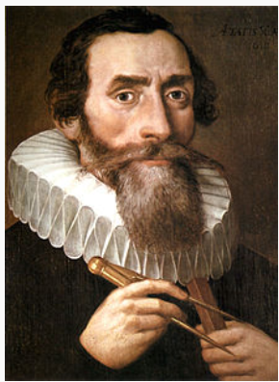
A Little History
Johannes Kepler
December 27, 1572 – November 15, 1630
Kepler’s discoveries had profound impact on the development of physics and astronomy, and his contributions to the study of conics played a crucial role in advancing our understanding of the universe. Today, his laws of planetary motion and his insights into conics continue to be fundamental in the field of astronomy.

Slide 4
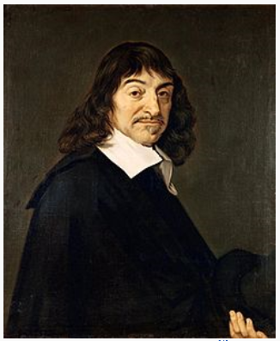
A Little History
René Descartes
March 31, 1596 – February 11, 1650
René Descartes introduced the concept of the Cartesian coordinate system, which allows geometric figures, including conics, to be represented algebraically. By assigning coordinates to points on a plane, Descartes was able to describe conics using equations, which revolutionized the study of conic sections.

Slide 5
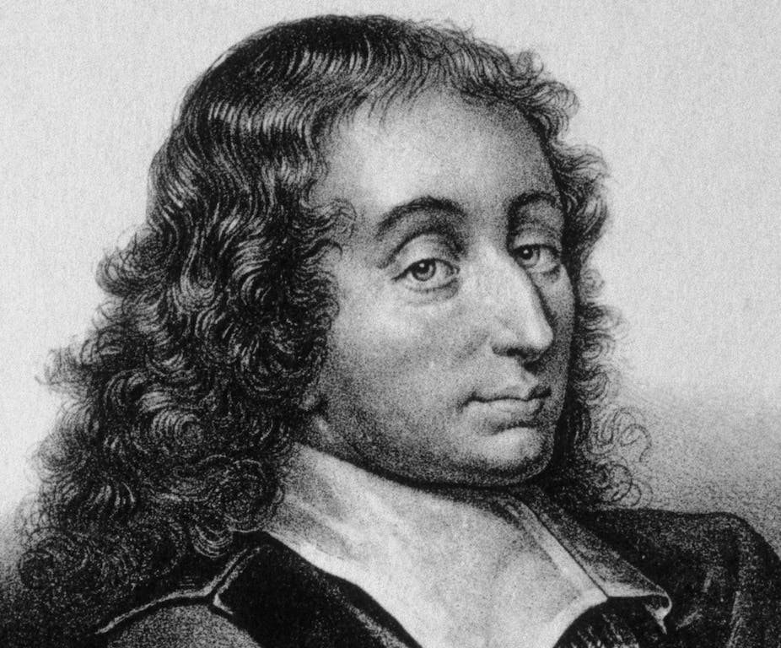
A Little History
Blaise Pascal
June 19, 1623 – August 11, 1662
Pascal’s use of conic sections primarily involving exploring their geometric properties and developing theorems related to them. His contributions have had a lasting impact on the field mathematics and continue to be studied and applied today.

Slide 6
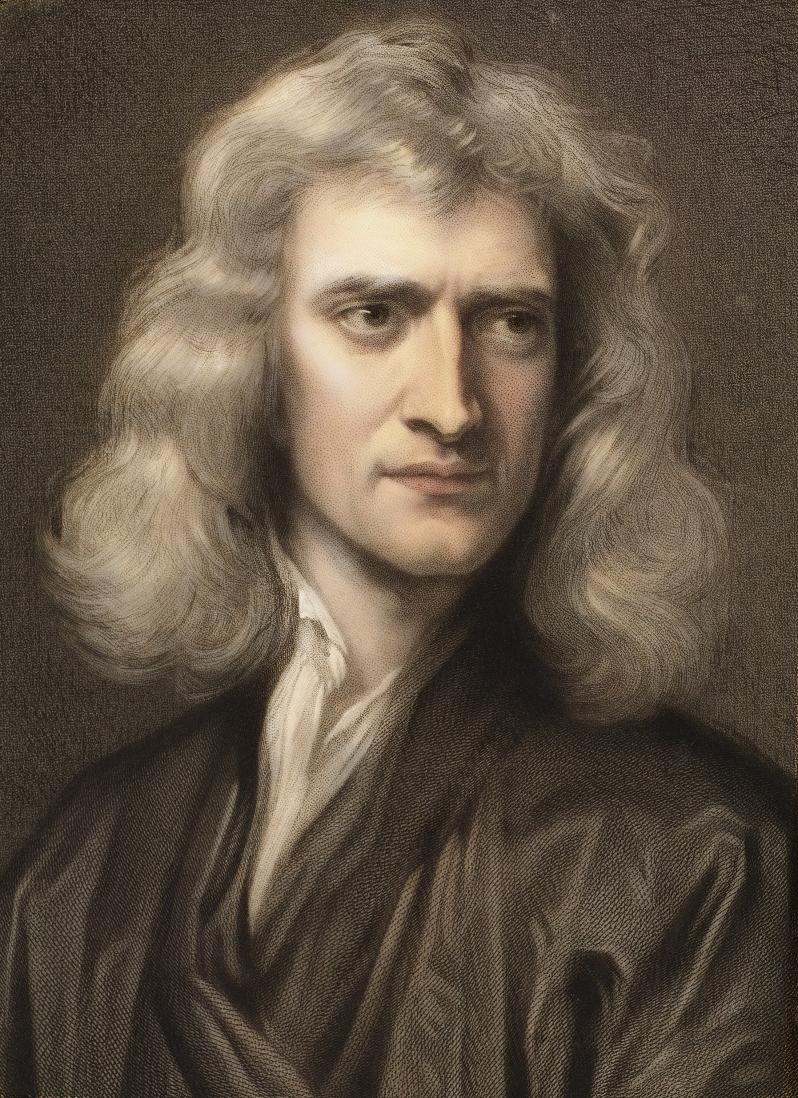
A Little History
Sir Isaac Newton
December 25, 1642 – March 20, 1727
Newton’s use of conic sections allowed him to explain planetary motion and develop his theory of optics, thus revolutionizing our understanding of the natural world.

Slide 7
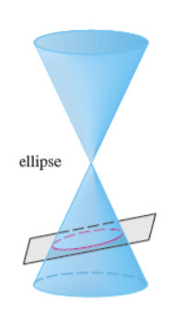
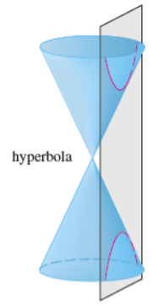
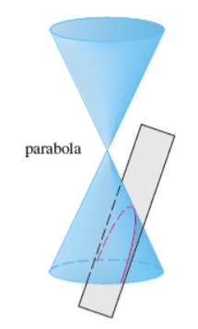
So, in this section we give geometric definitions of parabolas, ellipses, and hyperbolas and derive their standard equations. They are called conic sections, or conics, because they result from intersecting a cone with a plane as shown below.

Slide 8
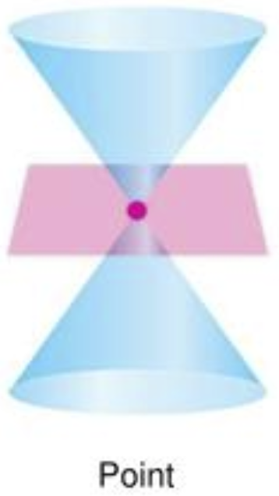
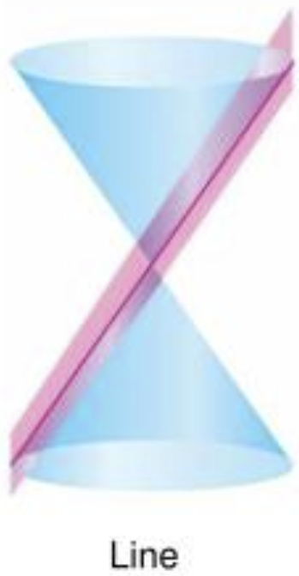
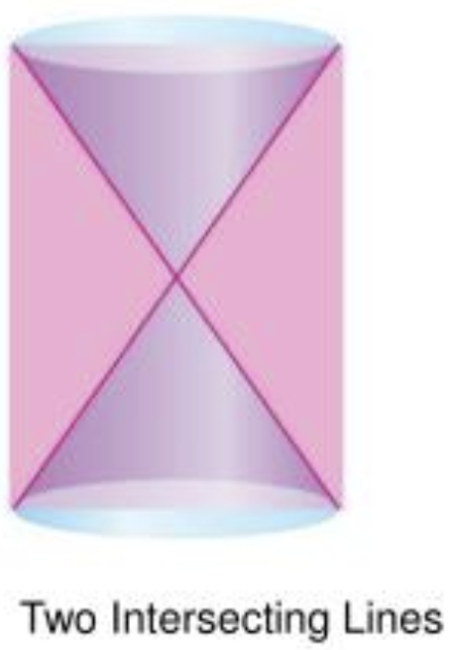
Special cases occur when the plane touches the vertex: a point, line or 2 intersecting lines.
These are called the “Degenerate Conic Sections”

Slide 9
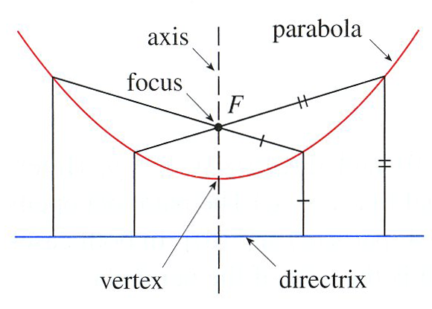
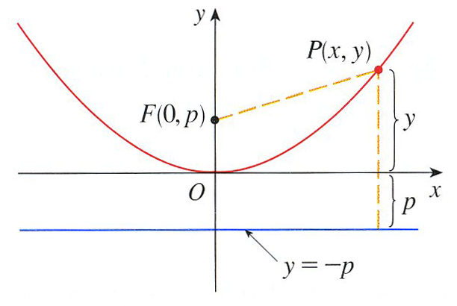
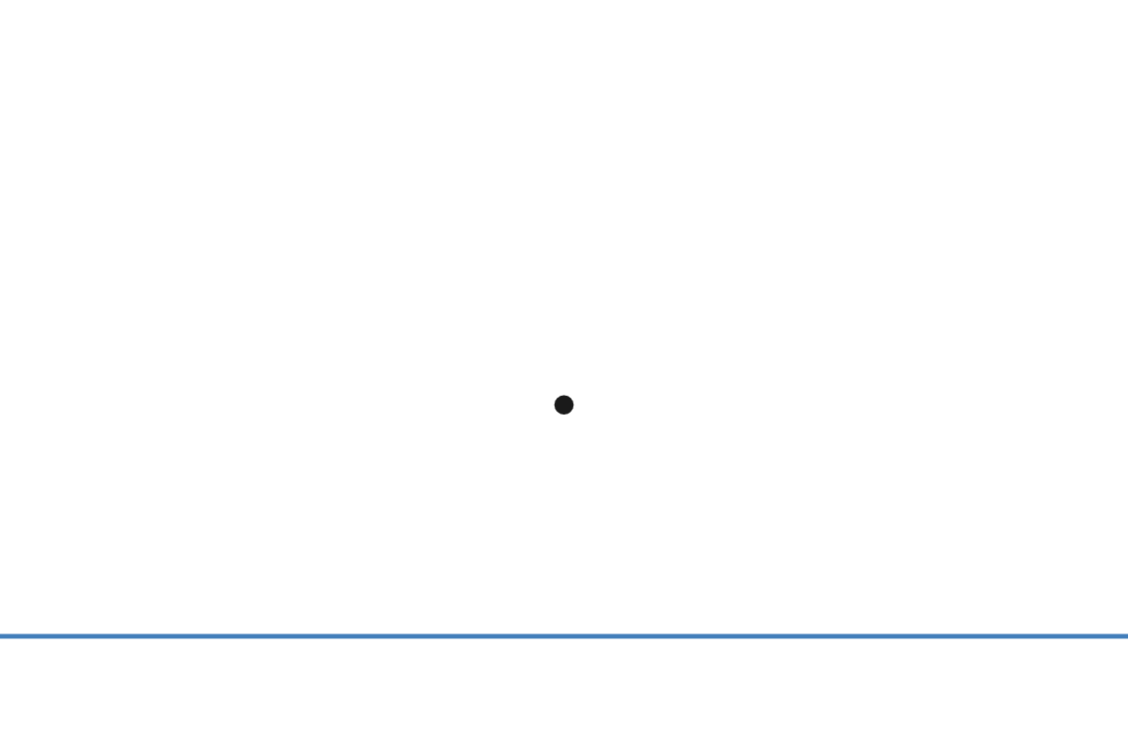





Geometric Definition of a Parabola
A parabola is the set of all points in a plane that are equidistant from a given line
and a given point not on the line.
F
$$l$$

Slide 10
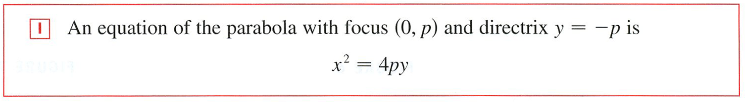

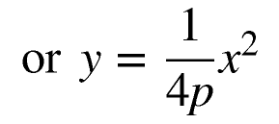
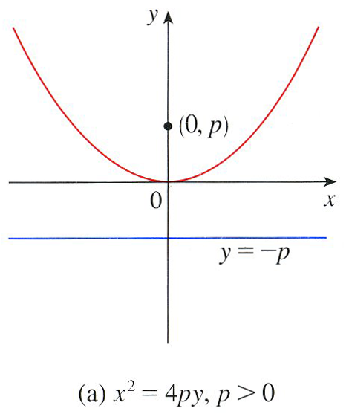
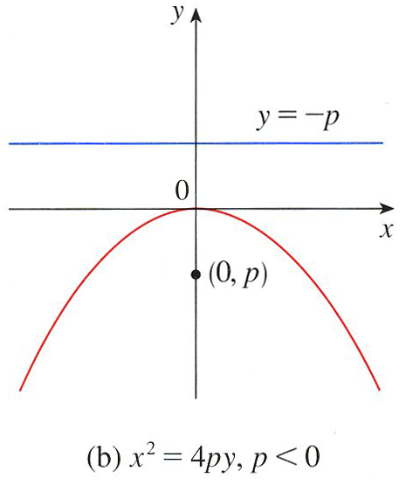

Slide 11



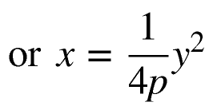
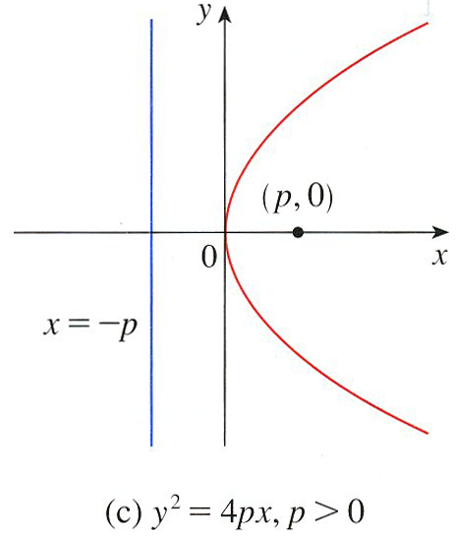
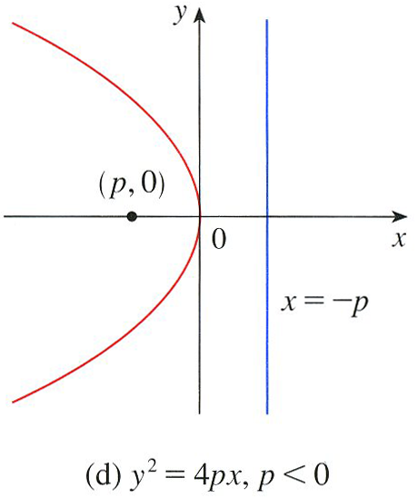

Slide 12
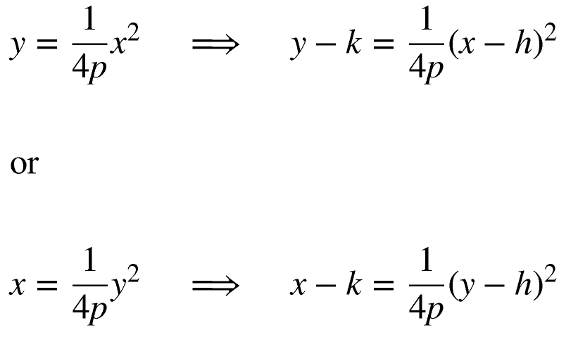
Let’s check it out!

Slide 13

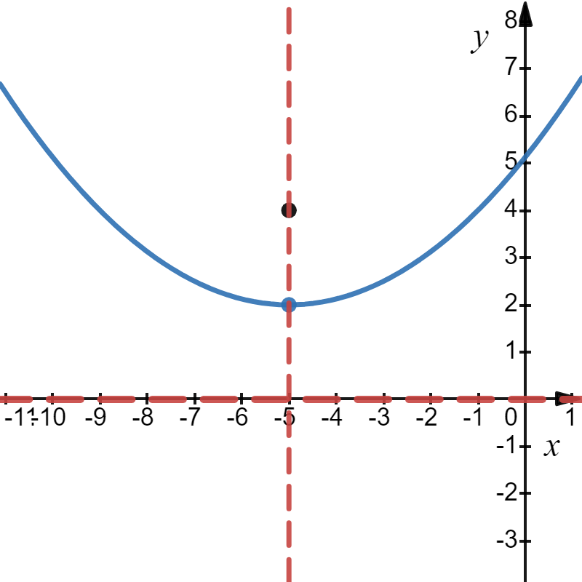
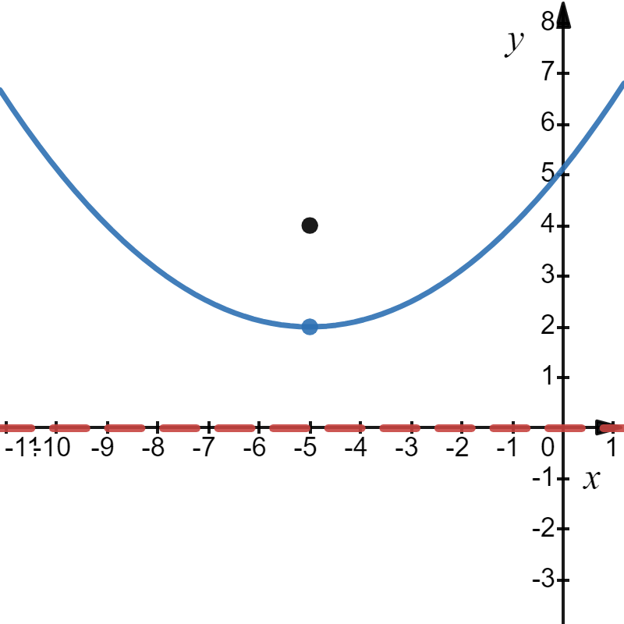
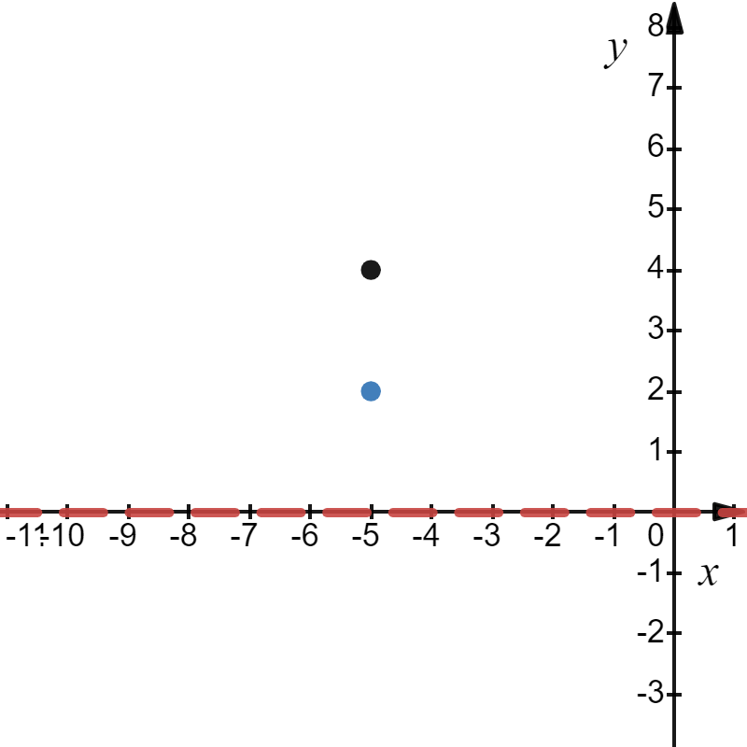
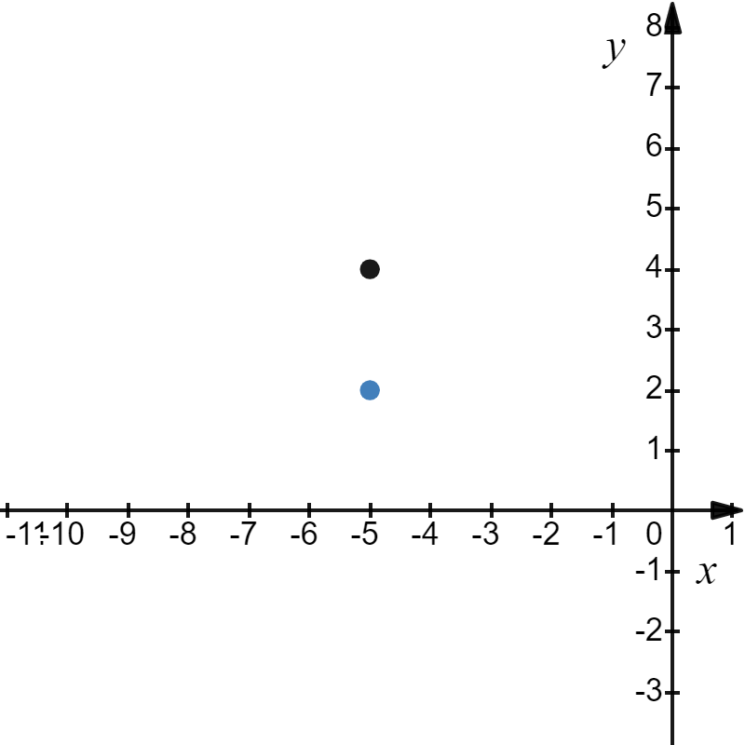
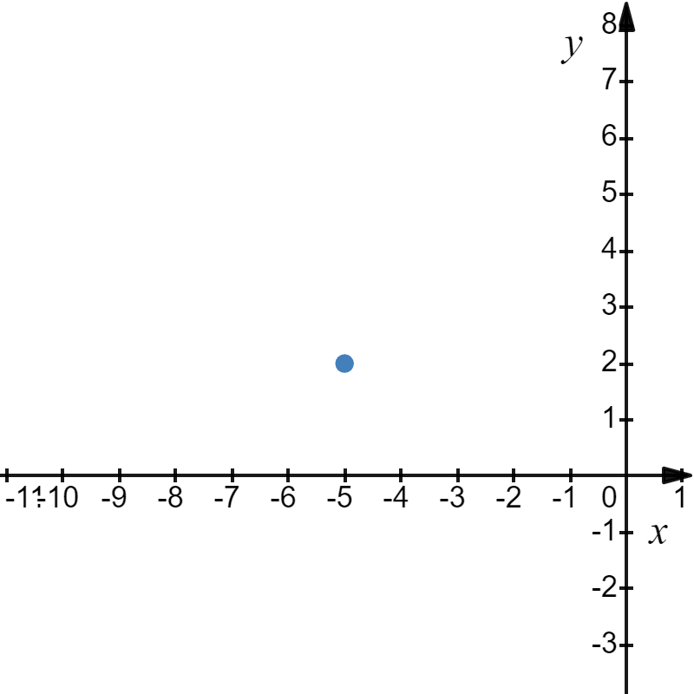
Example

Slide 14
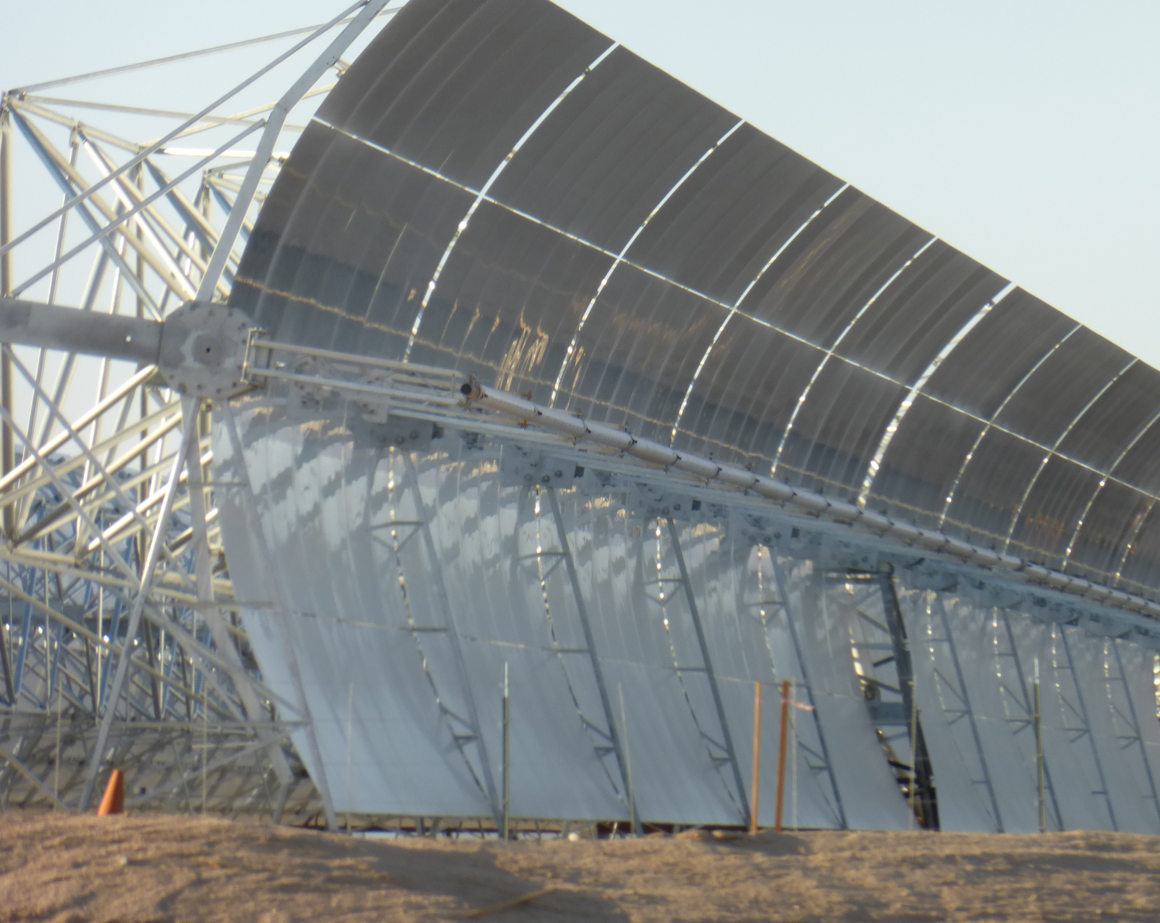
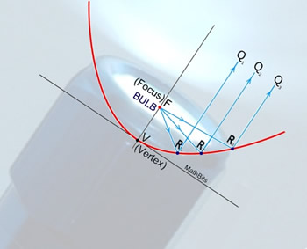
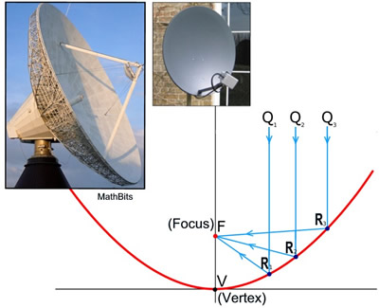
In addition to mathematics, the parabolic curve is present in physics, astronomy, wireless communications, industry, solar energy, and engineering. Applications of parabolic curves often require specific information about the curve including the focal point.

Slide 15
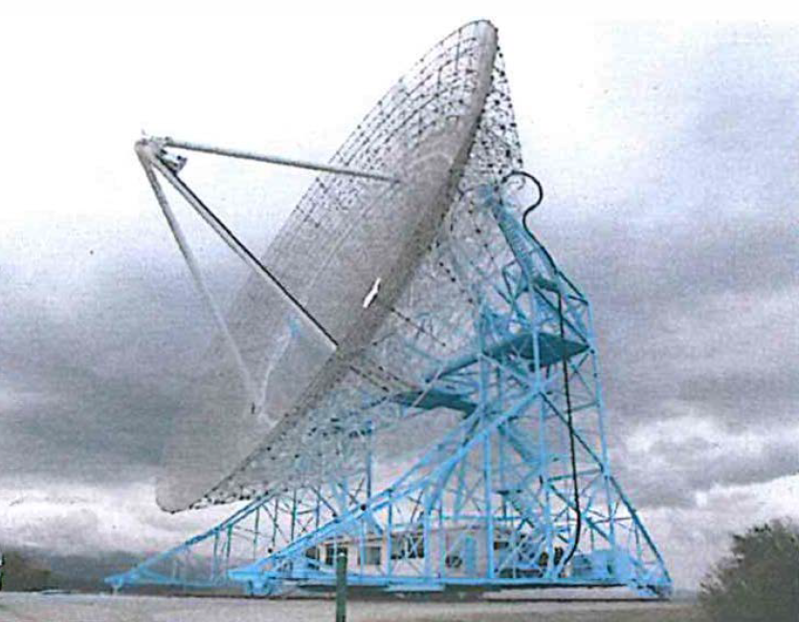
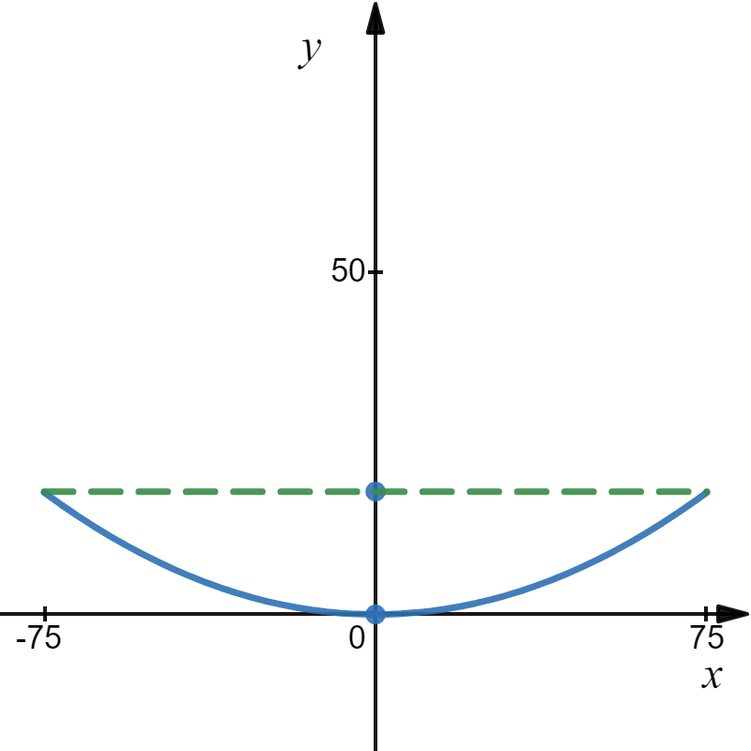
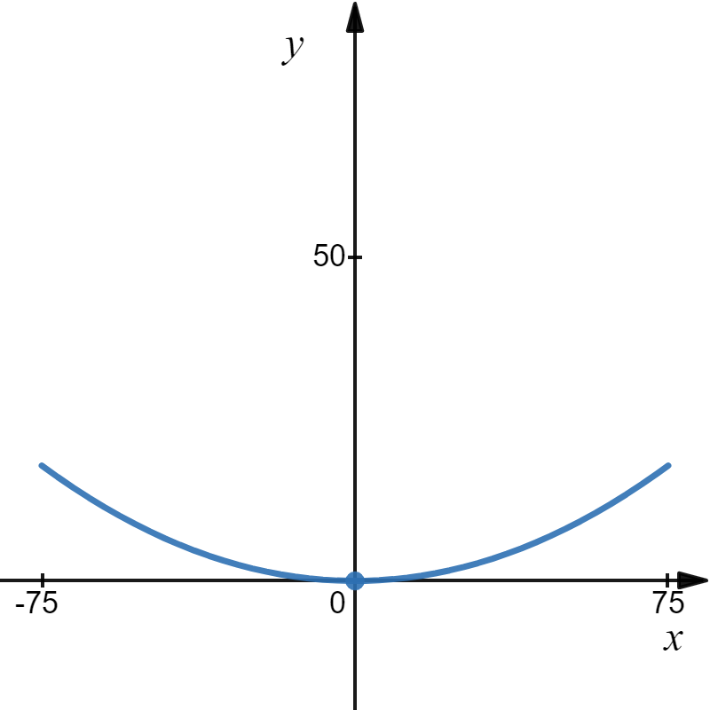

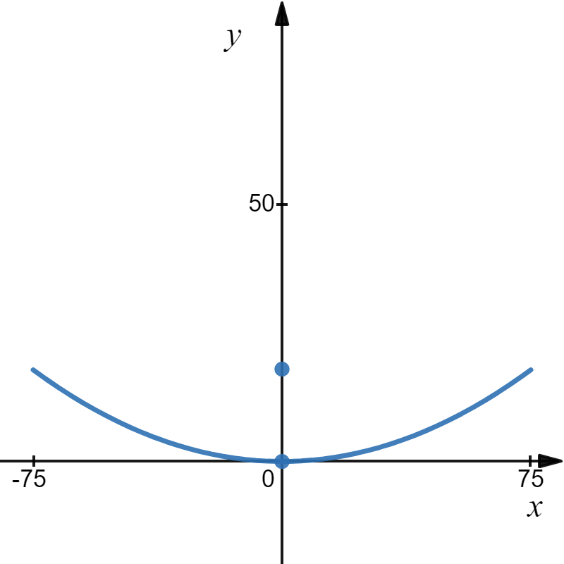
Example
A satellite communications antenna has the shape of a parabola that is 150 feet across at the open end and 18 feet deep. At what distance from the center of the dish should the receiver be placed?
Let’s place the vertex at the origin and the parabola opening up.
150 feet
The receiver should be placed 78.125 feet above the vertex.

Slide 16
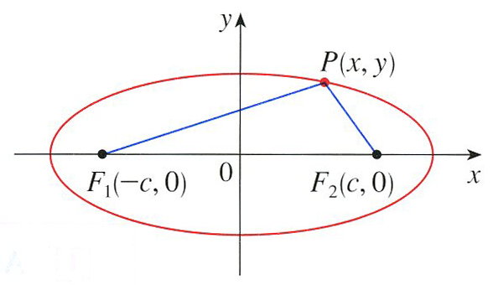
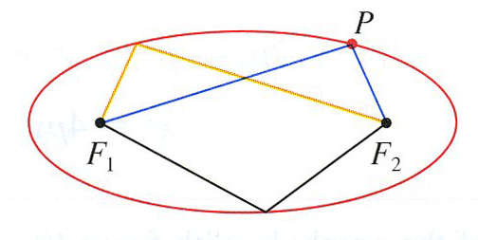




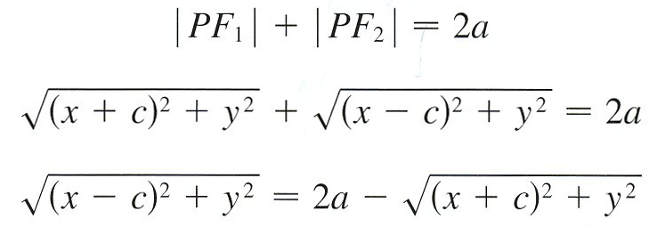
Geometric Definition of An Ellipse
An ellipse is the set of all points in a plane, the sum of whose distances from two given points (called the foci) is a constant.
2a is called the focal radii.

Slide 17
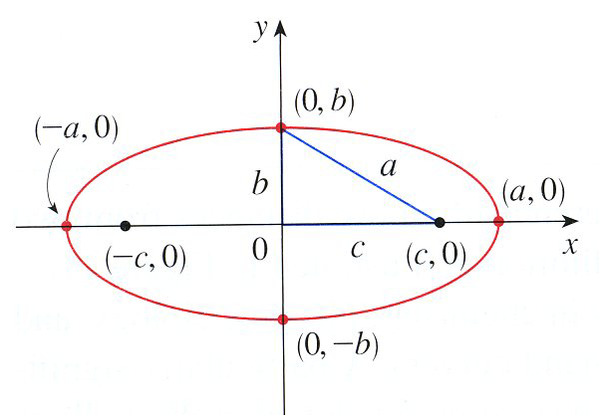



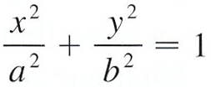
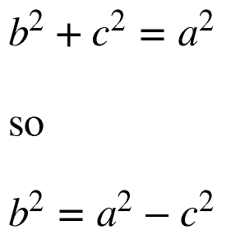

Slide 18
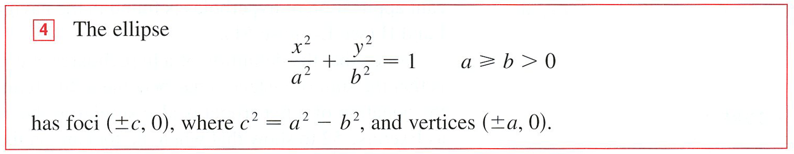

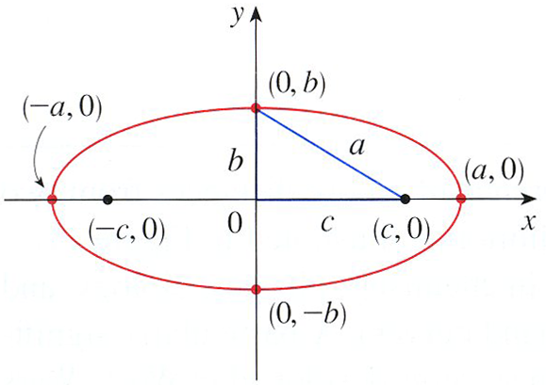



Slide 19
minor axis
co-vertices

Slide 20
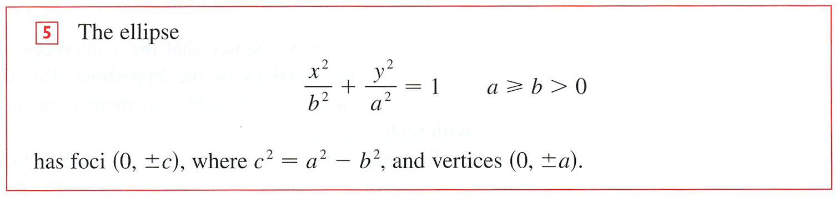
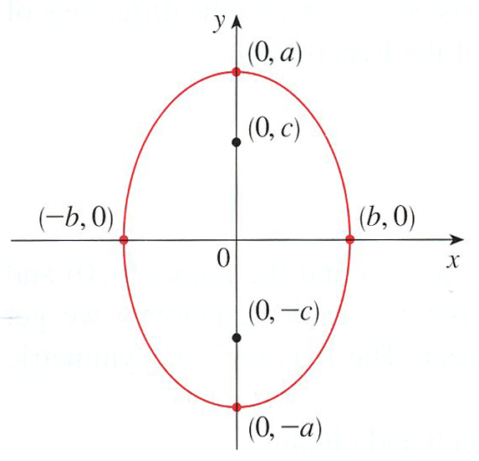

Slide 21
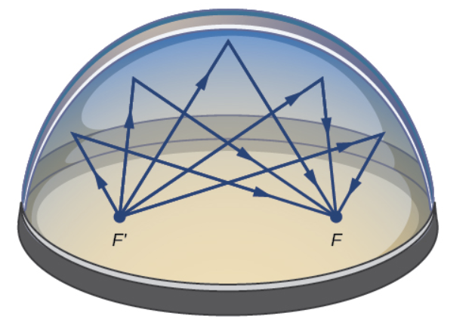

The Statuary Hall in the Capitol Building in Washington, D.C. is an elliptical dome.
Sound waves are reflected between foci in an elliptical room, called a whispering chamber.

Slide 22


If a source of light or sound is placed at one focus of a surface with elliptical cross-sections, then all the light or sound is reflected off the surface to the other focus.
This principle is used in lithotripsy, a treatment for kidney stones.
A reflector with elliptical cross-section is placed in such a way that the kidney stone is at one focus.
High-intensity sound waves generated at the other focus are reflected to the stone.
The waves destroy the stone without damaging other tissue.
Thus, the patient is spared the trauma of surgery, and recovers within a few days.

Slide 23



Example

Slide 24



We shift the Ellipse by taking the standard equations replacing x with x – h and y with y – k.
Ellipse with horizontal major axis.
Center is (h, k). Length of major axis is 2a. Length of minor axis is 2b. Distance between center and either focus is c with c² = a² − b², a > b > 0

Slide 25


Ellipse with vertical major axis.
Center is (h, k). Length of major axis is 2a. Length of minor axis is 2b. Distance between center and either focus is c with c² = a² − b², a > b > 0

Slide 26
Example: Find the center, vertices and foci for the ellipse
25x² + 4y² + 50x − 16y = 59
and sketch its graph.
a > b > 0

Slide 27





Example: Find the center, vertices and foci for the ellipse
25x² + 4y² + 50x − 16y = 59
and sketch its graph.

Slide 28





Example: Find an equation of the ellipse with foci (2, –2), (4, –2), and vertices (1, –2), (5, –2).
First let’s graph the points.
We see that the major axis is horizontal, so we will use the equation below.
The center is
From the graph we see that a = 2 and c = 1.
Substituting we get

Slide 29

Example:
An elliptical tabletop is cut from a piece of glass that measures 6 feet by 16 feet.
a) Assuming that the major axis is on the x-axis, what is the equation of the ellipse?
b) Find the coordinates of the foci.
c) If a closed loop string is wrapped around the two foci to draw the ellipse, how long is the loop.

Slide 30
a) Assuming that the major axis is on the x-axis, what is the equation of the ellipse?
y
x
b) Find the coordinates of the foci.

Slide 31
c) If a closed loop string is wrapped around the two foci to draw the ellipse, how long is the loop.
y
x

Slide 32





Geometric Definition of A Hyperbola
A hyperbola is the set of all those points in a plane such that the difference in their distances from two fixed points (foci) in the plane is a constant.
.

Slide 33

After a little algebra and some clever math, we clearly get

Slide 34





Horizontal Hyperbola

Slide 35


Horizontal Hyperbola
(−c, 0)
(0, b)
(a, 0)
(−a, 0)
(0, −b)
(c, 0)

Slide 36



Vertical Hyperbola

Slide 37








Example: Find the center, vertices, foci, and asymptotes for the hyperbola
9y² − 25x² = 225
and sketch its graph.
Vertical Hyperbola

Slide 38


We shift the Hyperbola by taking the standard equations replacing x with x – h and y with y – k.
Hyperbola with horizontal transverse axis
Center is (h, k). Distance between vertices is 2a, transverse axis. Distance between the co-vertices is 2b,conjugate axis. Distance between center and either focus is c with c² = a² + b²
Asymptotes:

Slide 39


We shift the Hyperbola by taking the standard equations replacing x with x – h and y with y – k.
Hyperbola with vertical transverse axis is
Center is (h, k). Distance between vertices is 2a, transverse axis. Distance between the co-vertices is 2b,conjugate axis. Distance between center and either focus is c with c² = a² + b²
Asymptotes:

Slide 40
Example: Find the center, vertices, foci and asymptotes for the hyperbola
and sketch its graph.

Slide 41








Example: Find the center, vertices, foci and asymptotes for the hyperbola
and sketch its graph.

Slide 42


Example What is the standard form equation of the hyperbola that has vertices at (0,−2) and (6,−2) and foci at (−2,−2) and (8,−2)? Sketch the hyperbola.
Let’s first graph the vertices (0,−2) and (6,−2) and the foci (−2,−2) and (8,−2)?
Since the vertices line on a horizontal line, we will use the equation
Now we will identify the center. The center is halfway between the vertices, so
(−2,−2)
(0,−2)
(6,−2)
(8,−2)
(−2,−2)
(0,−2)
(6,−2)
(8,−2)
So far, we get
Next, we will find a².

Slide 43





Example What is the standard form equation of the hyperbola that has vertices at (0,−2) and (6,−2) and foci at (−2,−2) and (8,−2)? Sketch the hyperbola.
The length of the transverse axis, 2a, is the distance between the vertices.
Since we are given the foci, we can find c and use the equation $c^{2}=a^{2}+b^{2}$, to find $b^{2}$.
(−2,−2)
(0,−2)
(6,−2)
(8,−2)
(−2,−2)
(0,−2)
(6,−2)
(8,−2)
(−2,−2)
(8,−2)
(−2,−2)
(−2,−2)
(6,−2)
(−2,−2)
(0,−2)
(6,−2)
(8,−2)
(0,−2)
(0,−2)
(6,−2)
(6,−2)
(8,−2)
(−2,−2)
(0,−2)
(8,−2)
(0,−2)
(6,−2)
(8,−2)

