Slide 1

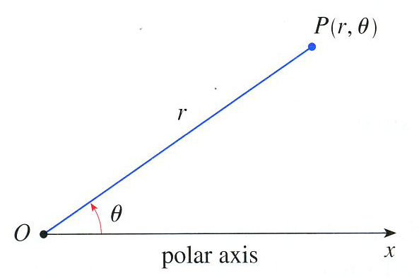


One way to give someone directions is to tell them to go three blocks East and five blocks South.
Another way to give directions is to point and say, “Go a half mile in that direction.”
Polar graphing is like the second method of giving directions. Each point is determined by a distance r and a directed angle rotation $θ$.

Slide 2


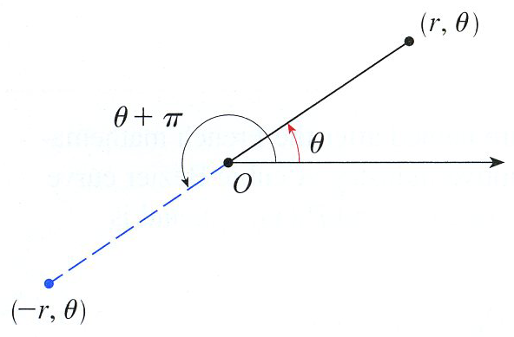

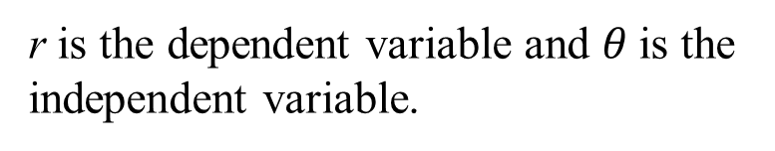
A polar coordinate pair
determines the location of a point.
r is the dependent variable and $θ$is the independent variable.
Pole
Polar axis

Slide 3
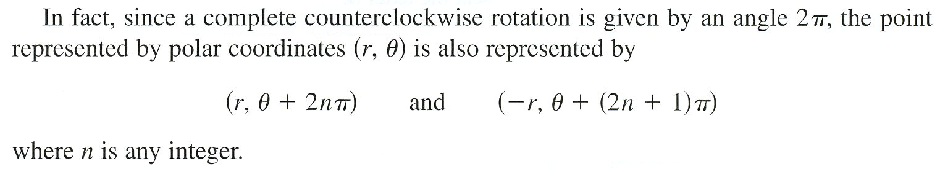
More than one coordinate pair can refer to the same point.

Slide 4
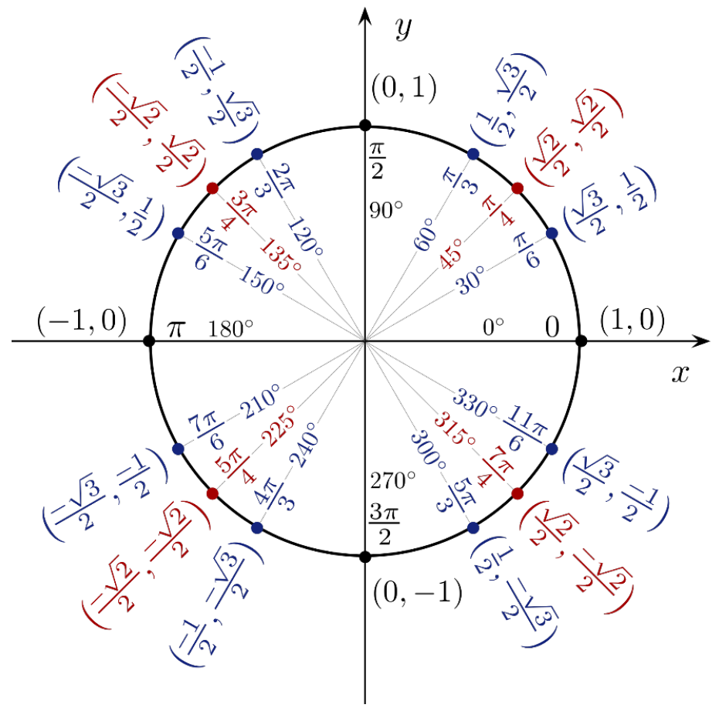
Unit Circle
Know It!!

Slide 5



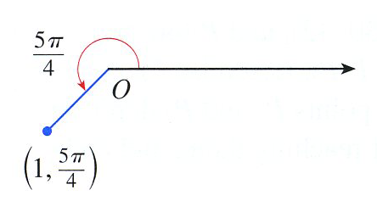
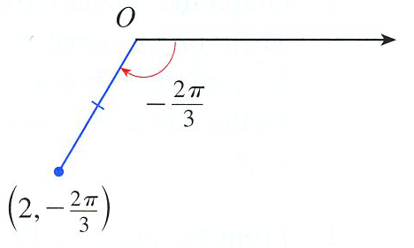


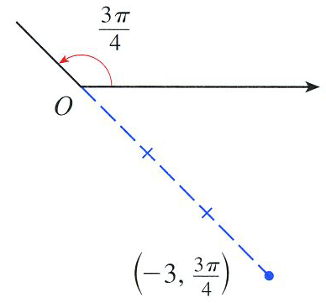
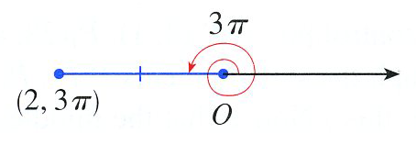
Desmos

Slide 6
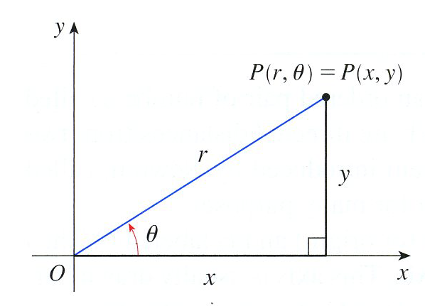
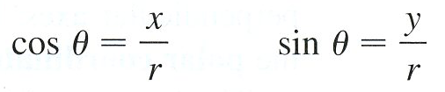
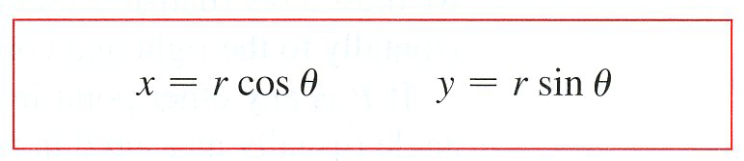
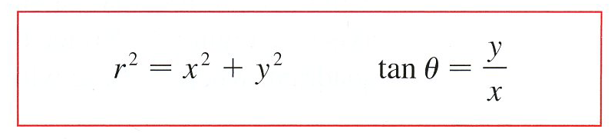
Recall from trigonometry
Equations 1
Equations 2

Slide 7
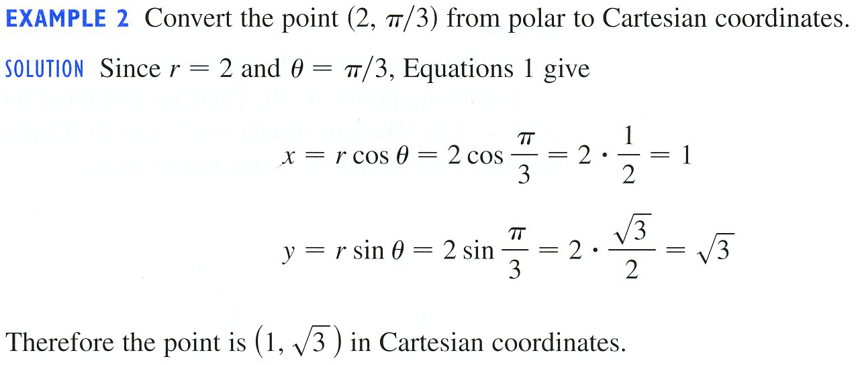
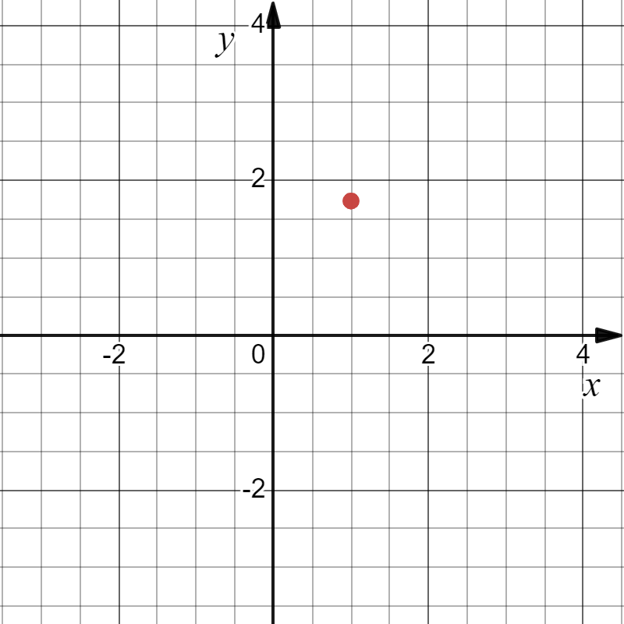
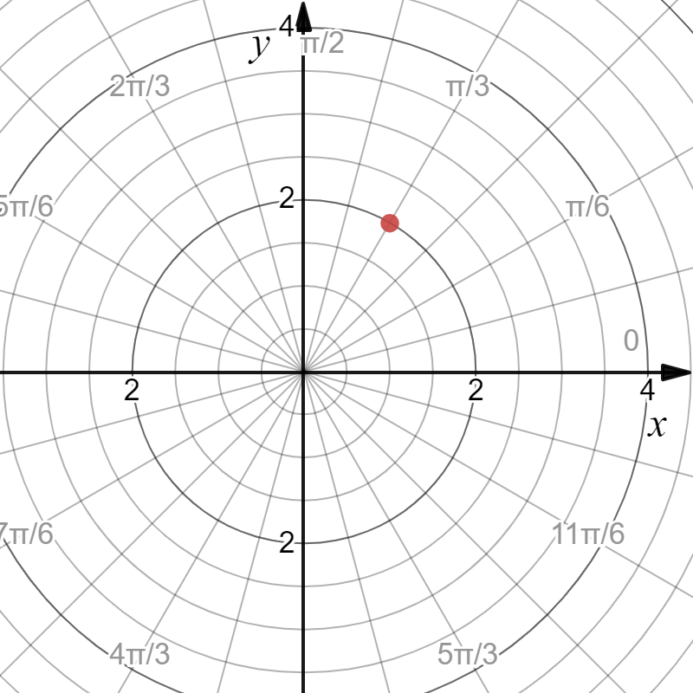


Example

Slide 8
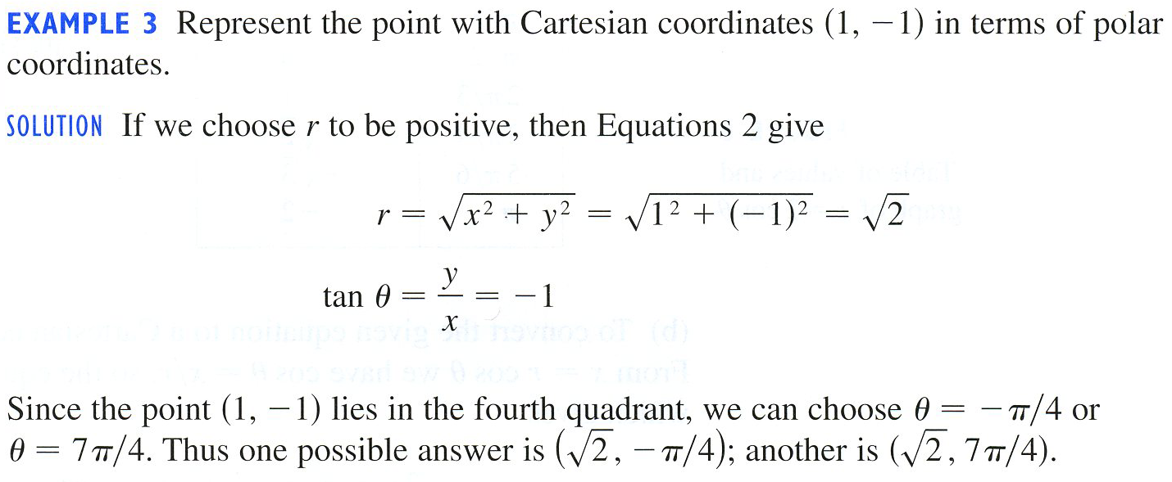
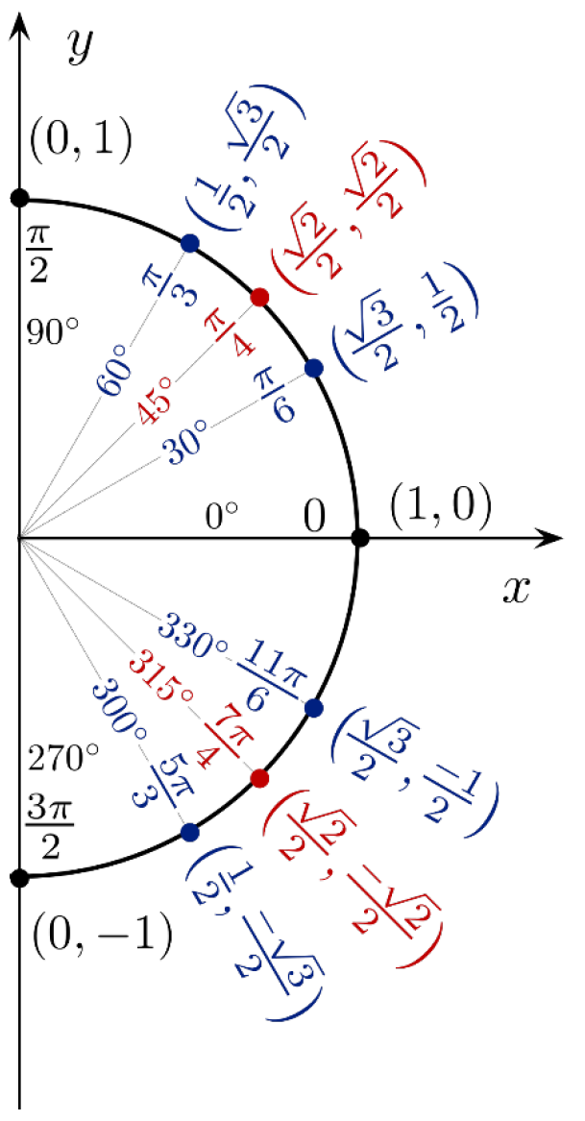
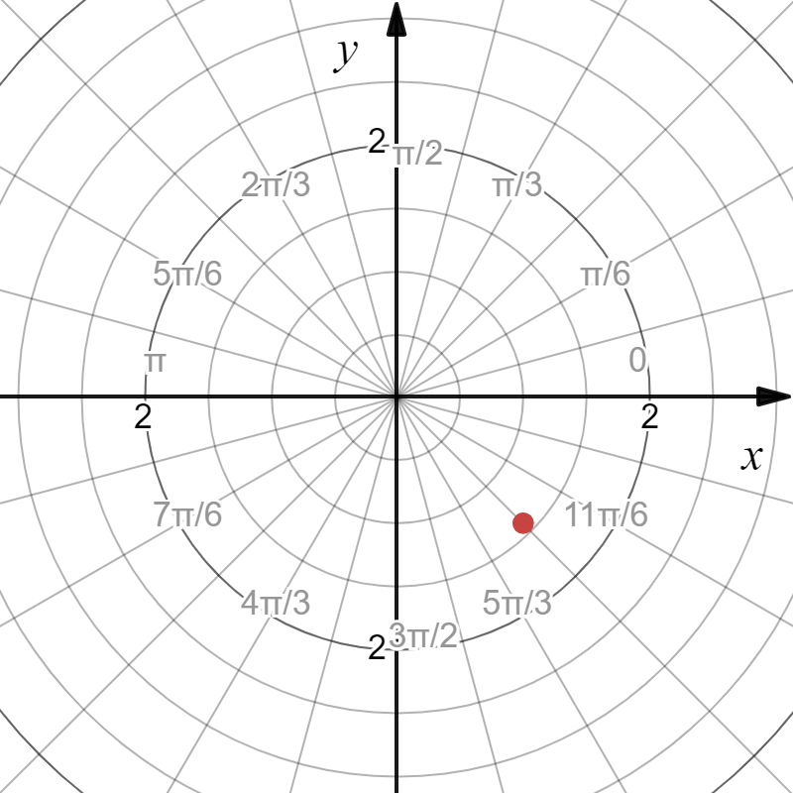
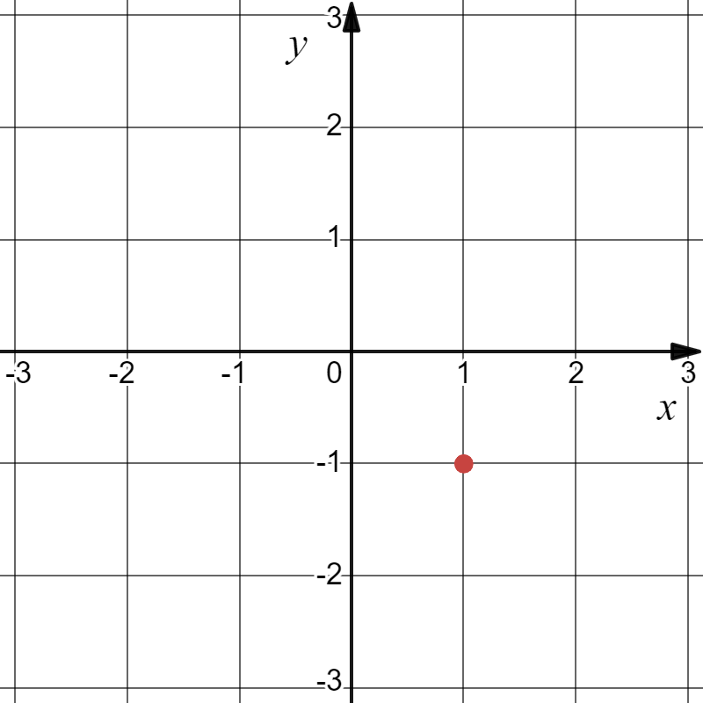



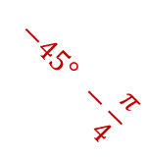
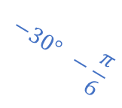

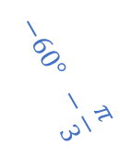
Example
$$−30° −\frac{π}{6}$$
$$−45° −\frac{π}{4}$$
$$−60° −\frac{π}{3}$$
$$−90$$
$$−\frac{π}{2}$$

Slide 9

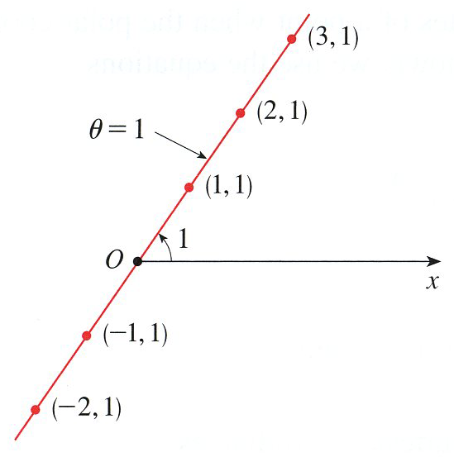
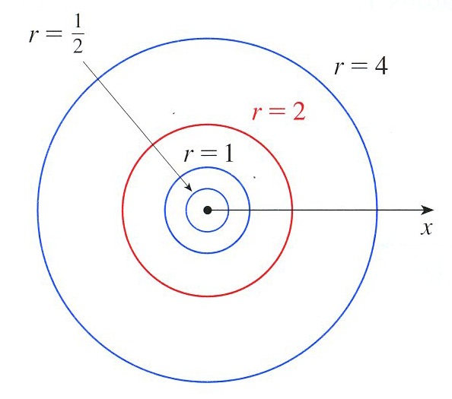

Slide 10

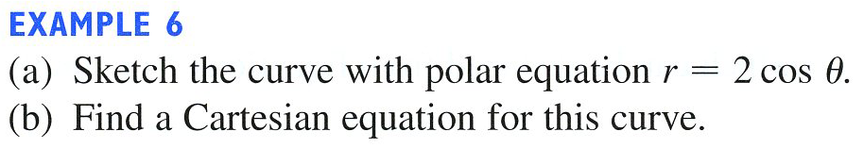

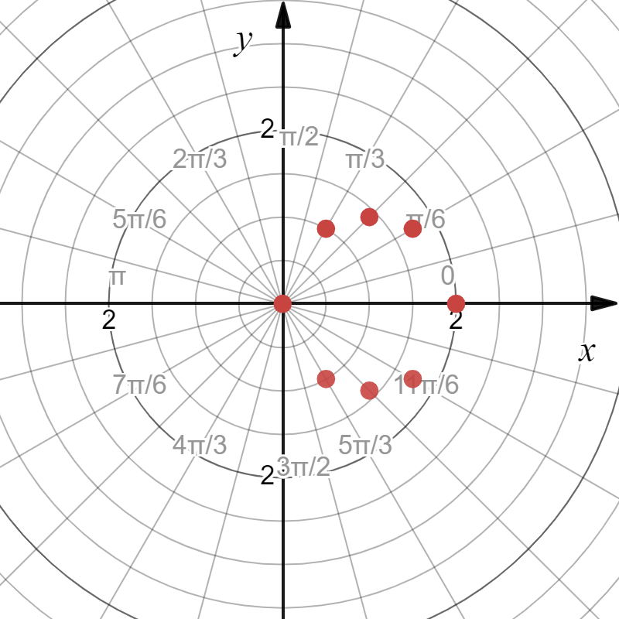
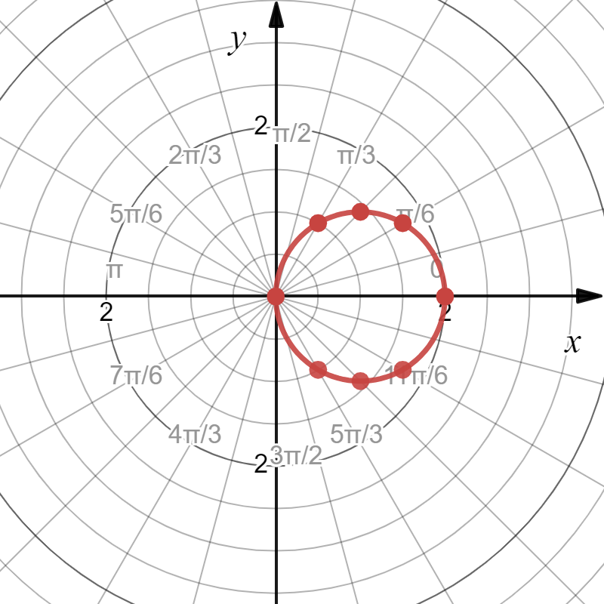
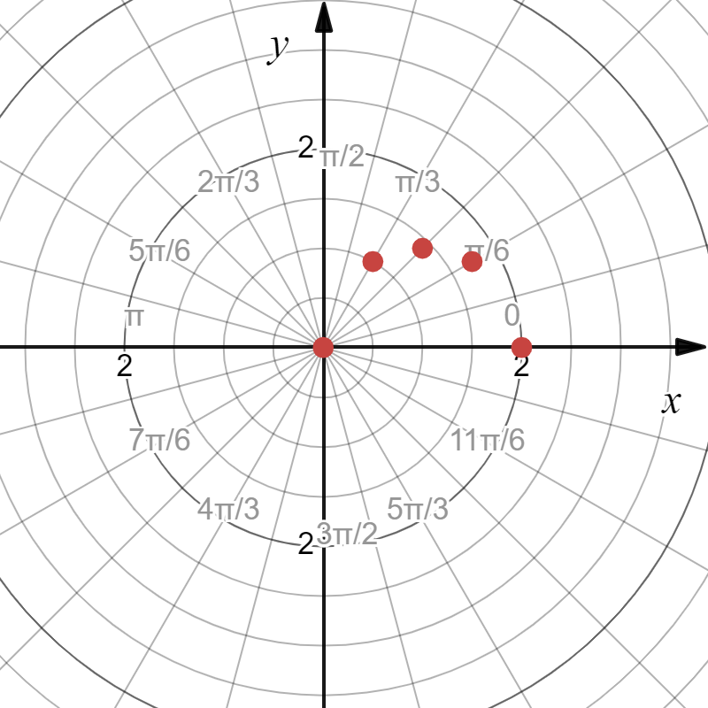

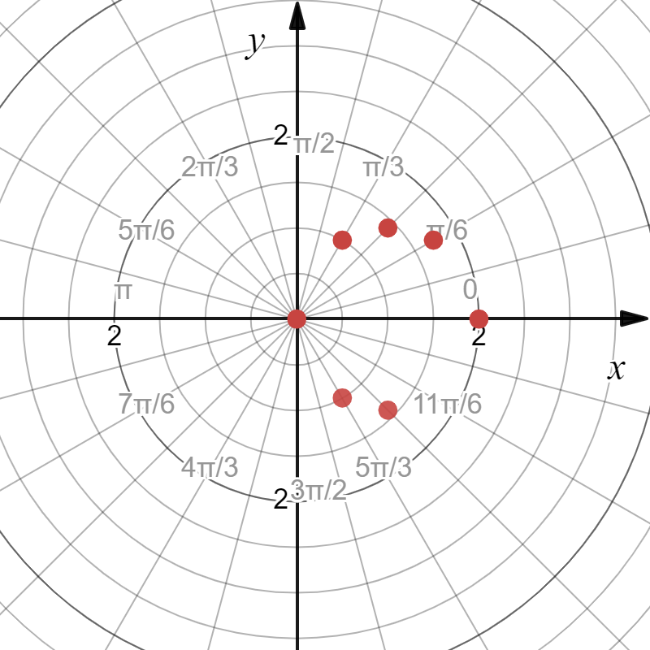
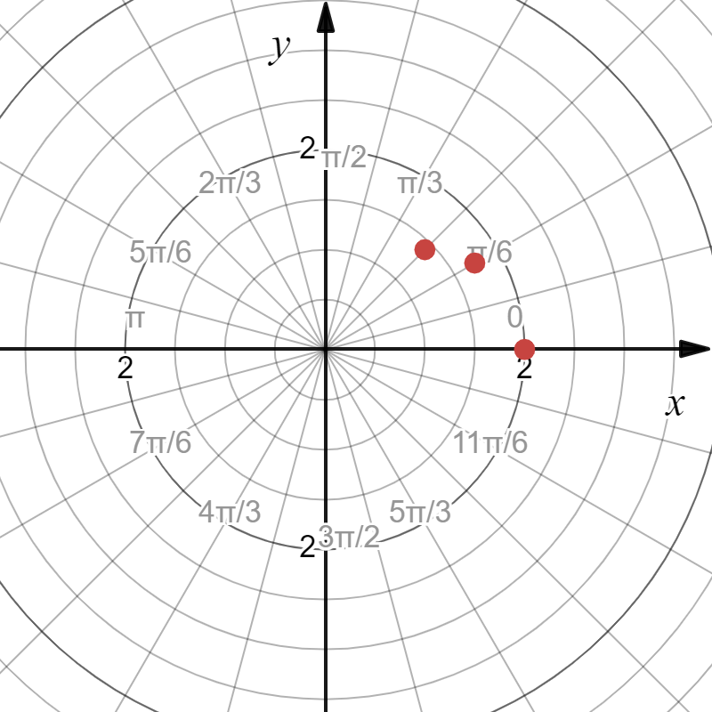
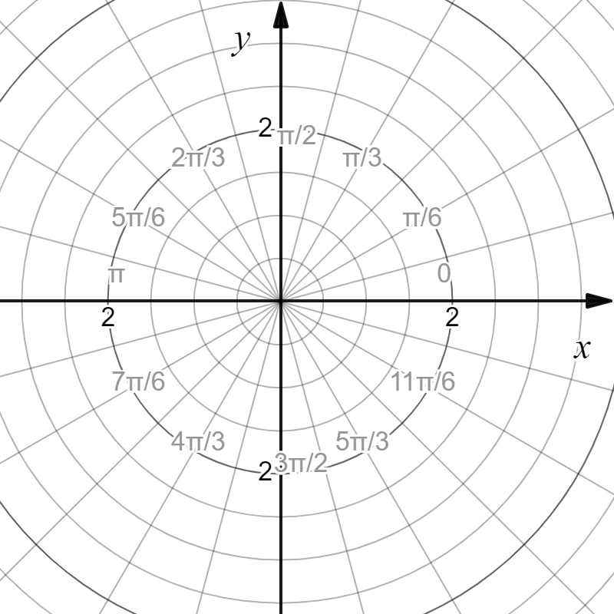
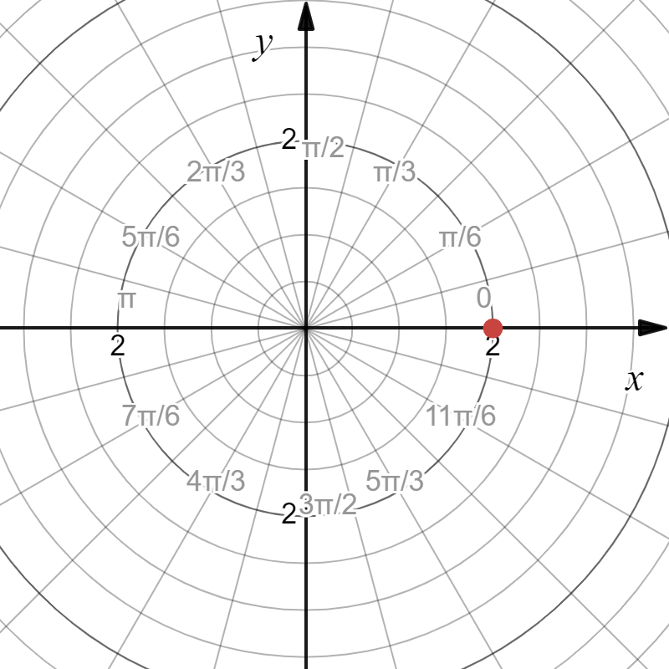
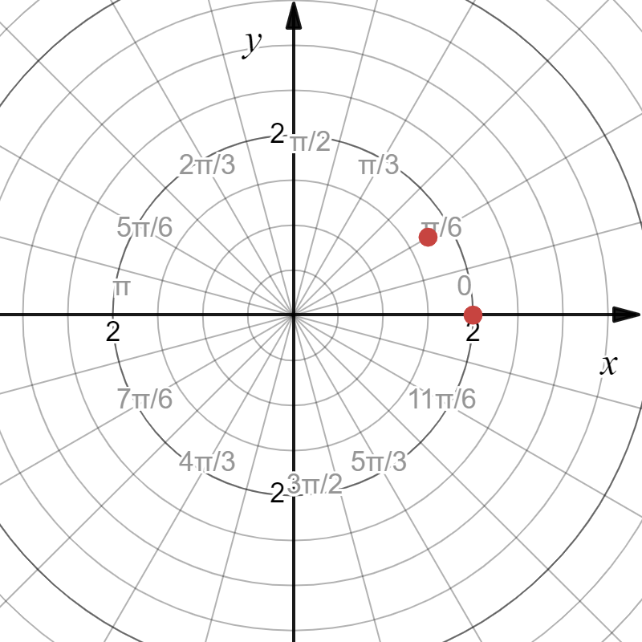
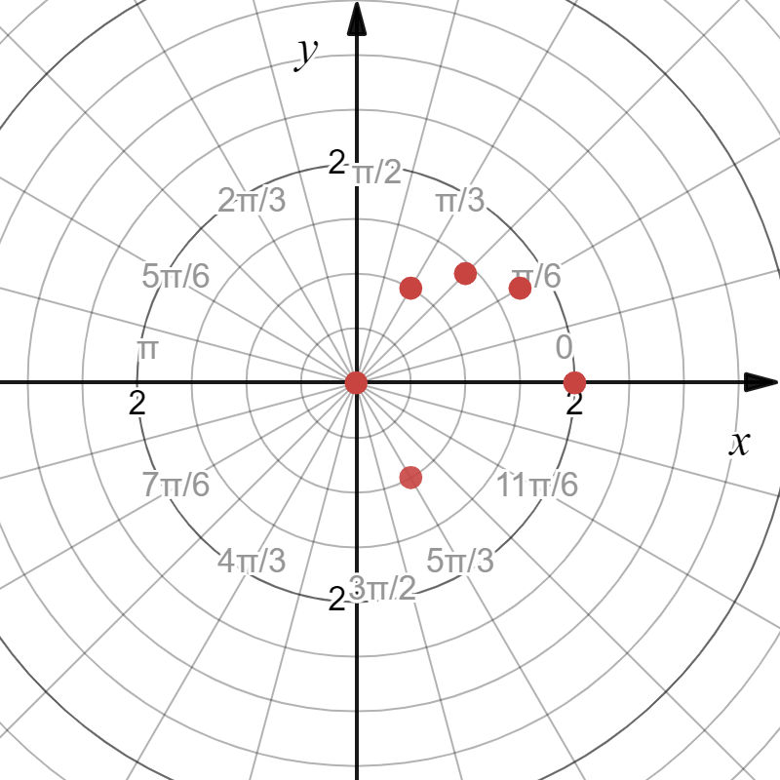
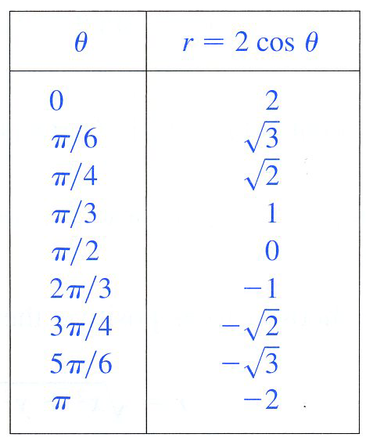









Example
$$\left(\sqrt{2},\frac{π}{4}\right)$$
$$\left(1,\frac{π}{3}\right)$$
$$\left(\sqrt{3},\frac{π}{6}\right)$$
$$\left(0,\frac{π}{2}\right)$$
$$\left(2,0\right)$$
$$\left(−2,π\right)$$
$$\left(−\sqrt{3},\frac{5π}{6}\right)$$
$$\left(−1,\frac{2π}{3}\right)$$
$$\left(−\sqrt{2},\frac{3π}{4}\right)$$
We will get back to graphing later.

Slide 11
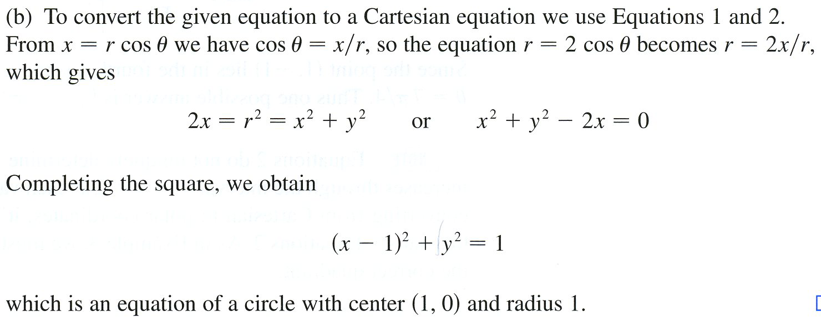
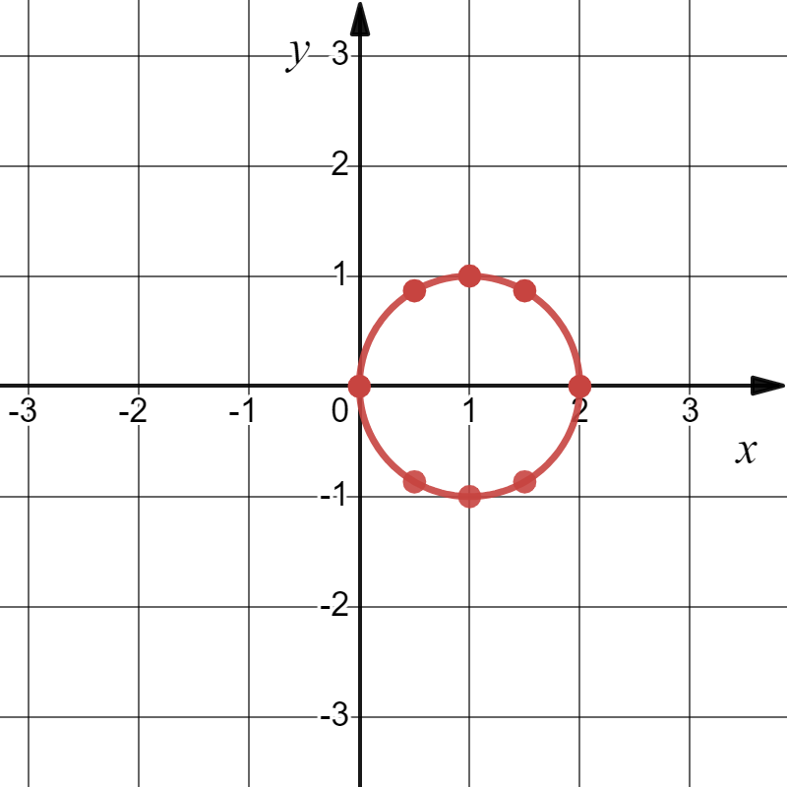
Example

Slide 12
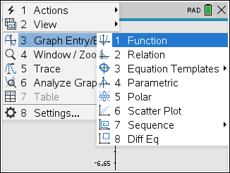




So, a summary of the different forms of equation are:
1.) Functions $y=f(x)$
2.) Parametric $(f\left(t\right),g\left(t\right))$
3.) Polar $r=f\left(θ\right)$
4.) Sequence $a_{n}=f\left(n\right), n∈ℤ$
More to come!

Slide 13
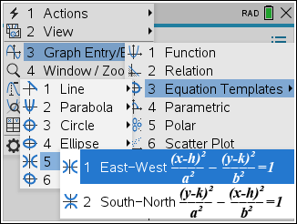
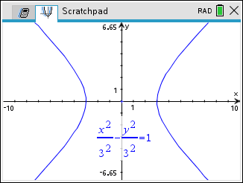
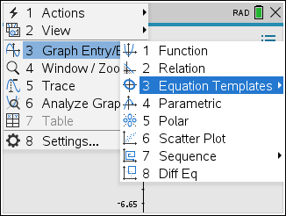
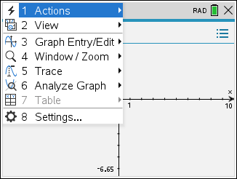
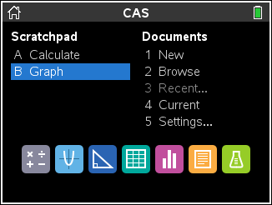
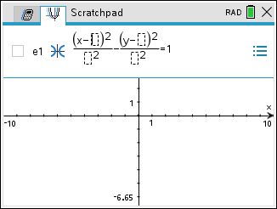
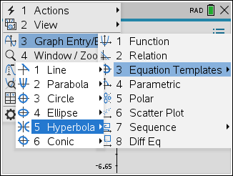
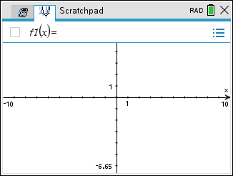
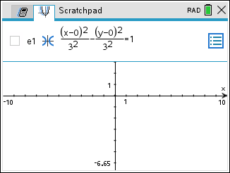
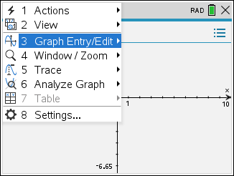










Example

Slide 14










Slide 15









Slide 16








Slide 17




Slide 18



We use the product rule here.

Slide 19

Example

Slide 20

$$∙\frac{2}{2}$$

Slide 21





Slide 22
Example

Slide 23
Example
sin(α − β)=sinαcosβ − cosαsinβ

Slide 24









Example

