Slide 1


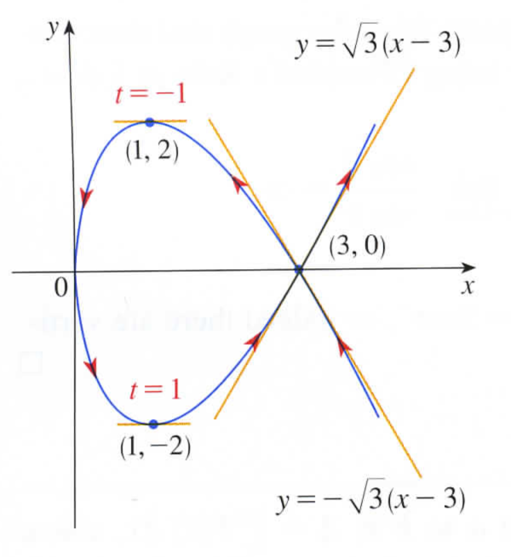

Find

Slide 2
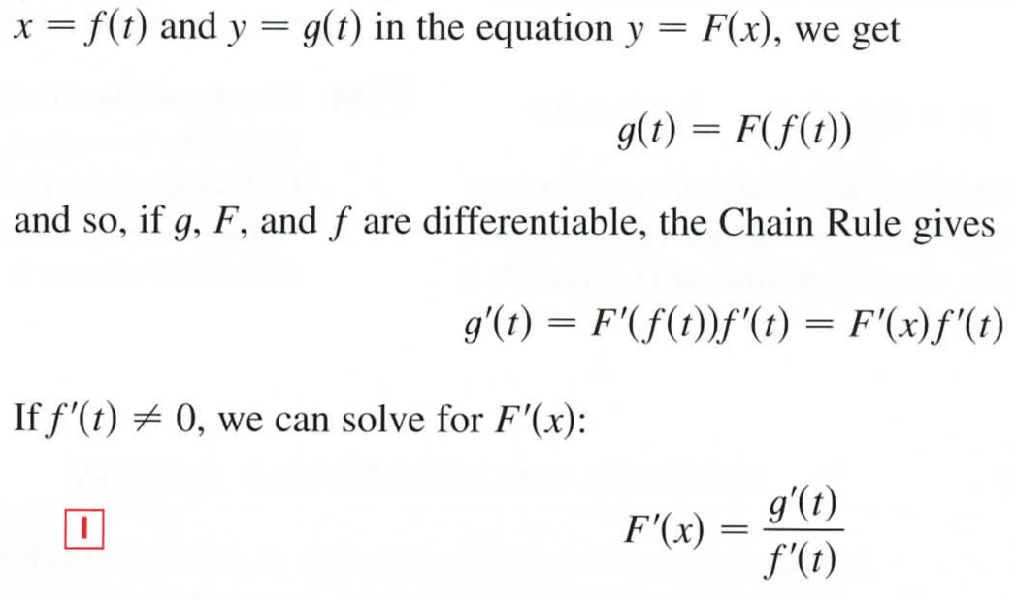

Slide 3
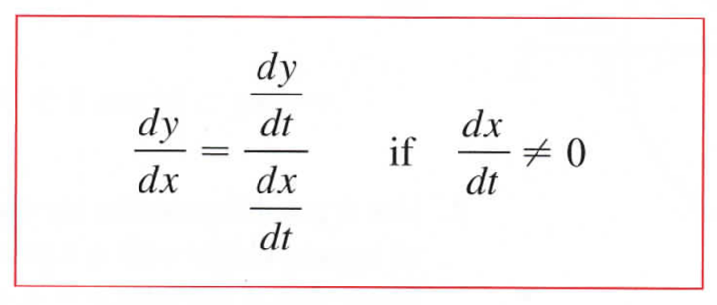
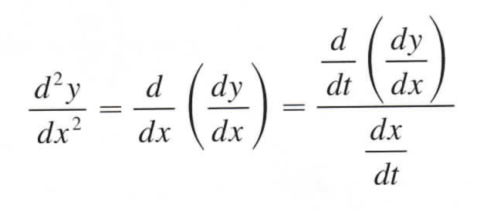
The formula for finding the slope of a parametrized curve is:
How about the second derivative?
In terms of t

Slide 4
Find the first derivative (dy/dx) in terms of t.
2. Find the derivative of dy/dx with respect to t.
3. Divide by dx/dt.

Slide 5
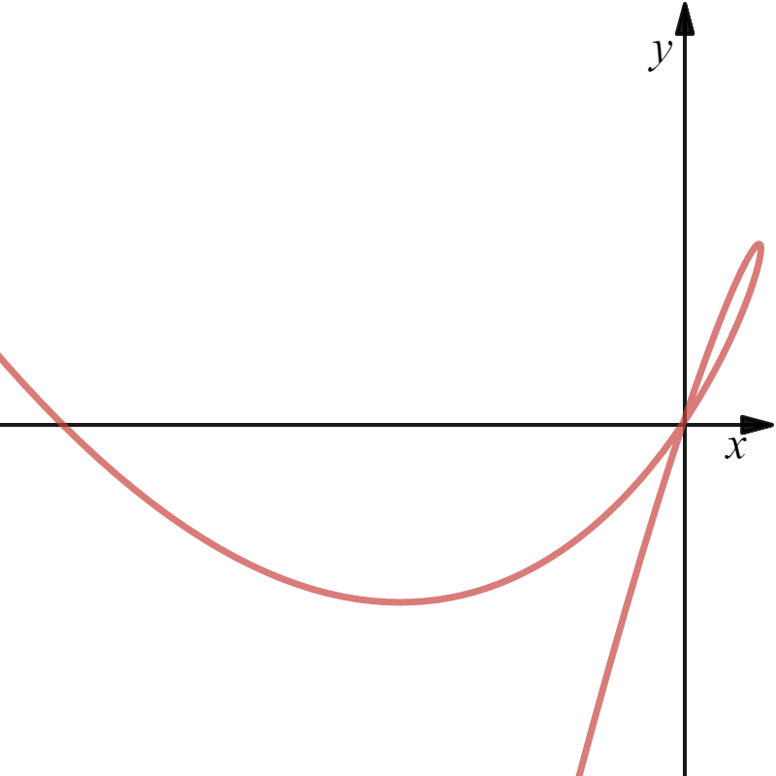
Example

Slide 6

3. Divide by dx/dt.
Find the first derivative (dy/dx) in terms of t.
2. Find the derivative of dy/dx with respect to t.
Quotient Rule

Slide 7
We need to find when dy/dx is either zero (horizontal tangent) or undefined (vertical tangent).

Slide 8
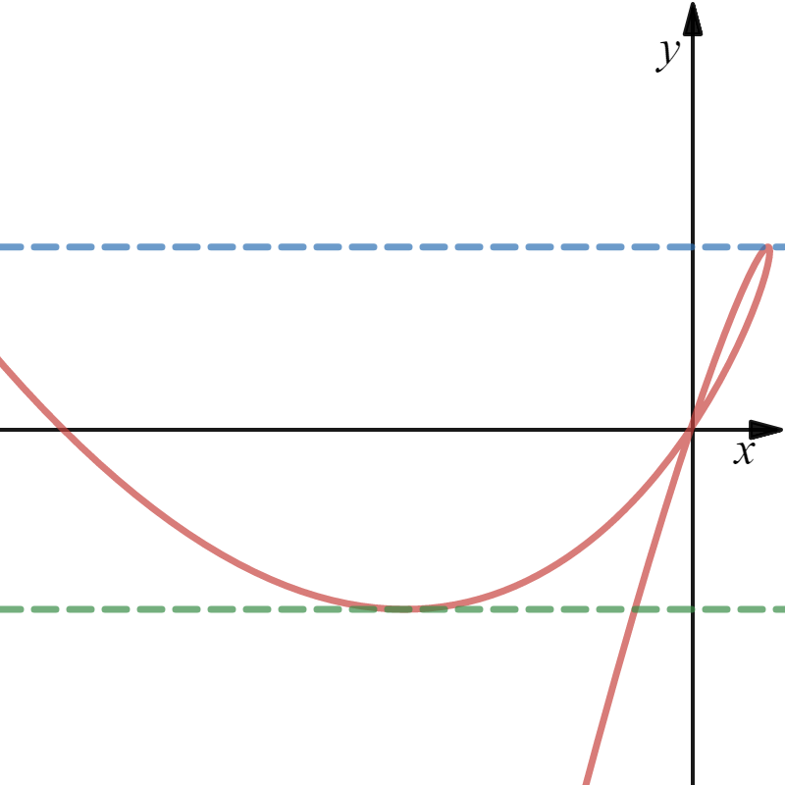

Slide 9
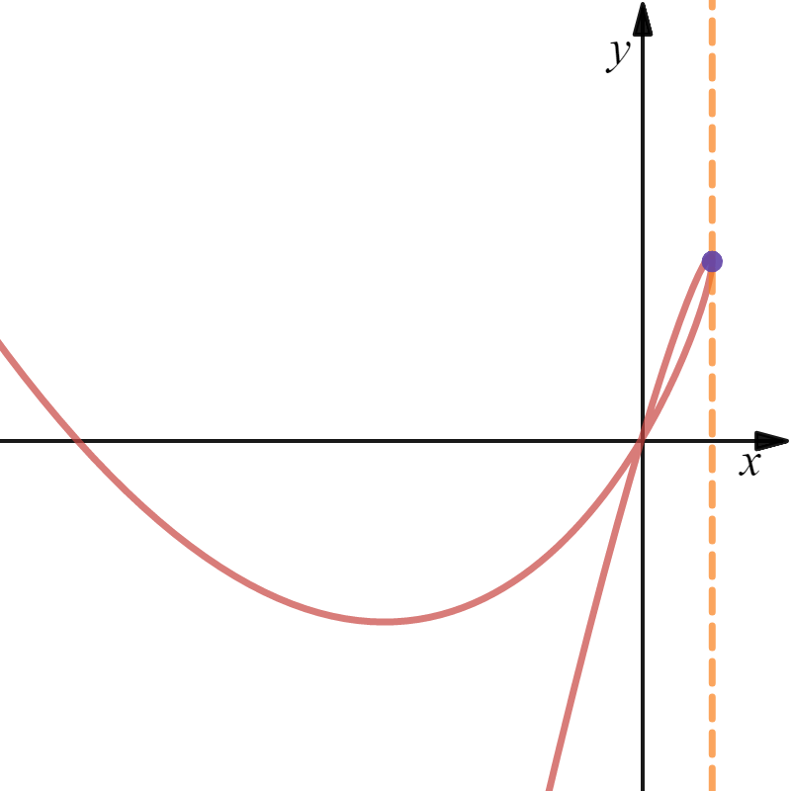

Slide 10
Recall that the second derivative determines concavity:
is positive
Curve is concave up.
is negative
Curve is concave down.
is zero or und.
Possible inflection point
(where concavity changes).

Slide 11
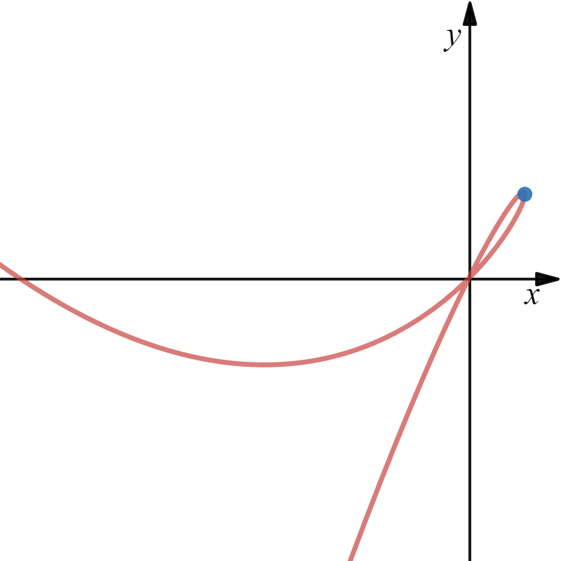
Possible inflection point at .
t

Slide 12
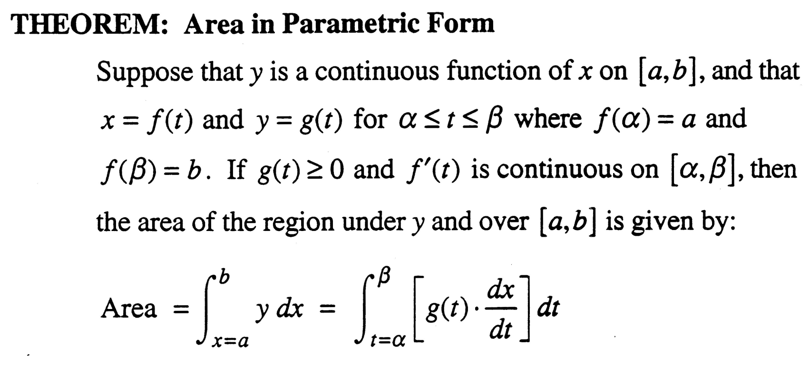
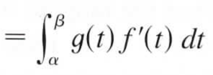

Slide 13
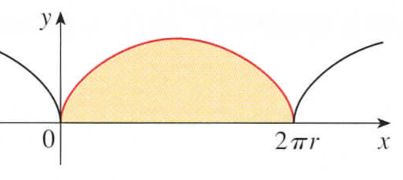











Example
y
dx
Let

Slide 14
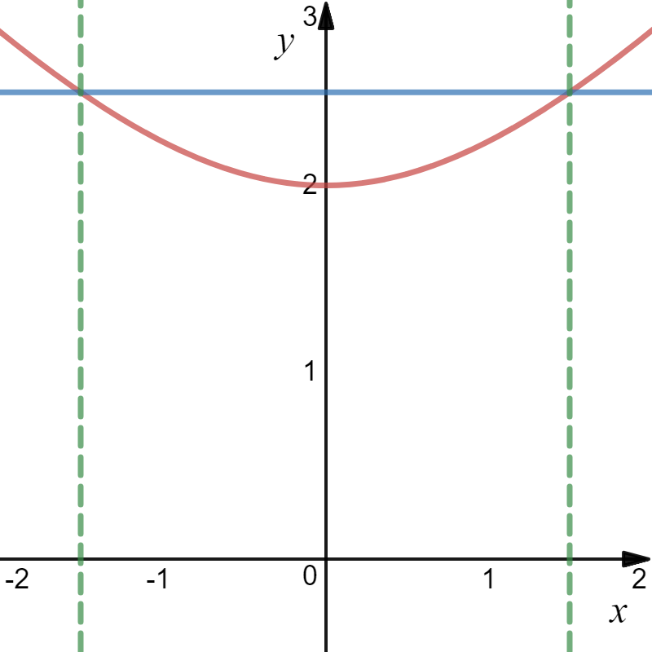
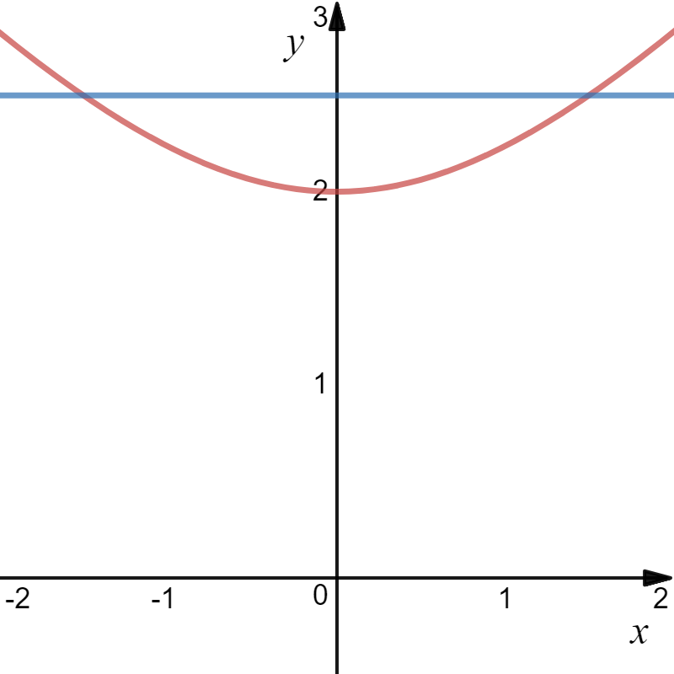
Example
5/2 − y

Slide 15
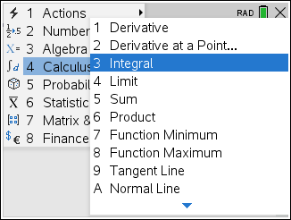
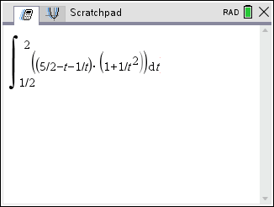
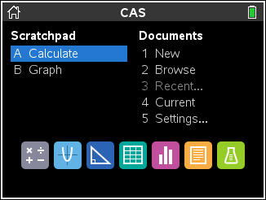

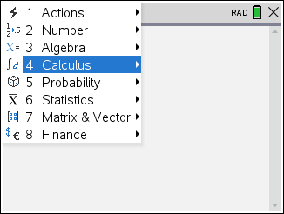
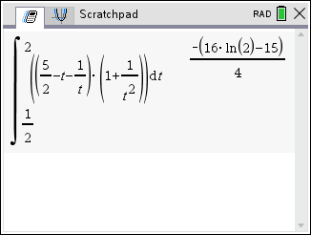
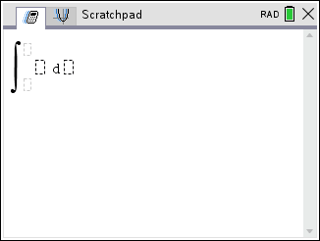
Example
5/2 − y

Slide 16



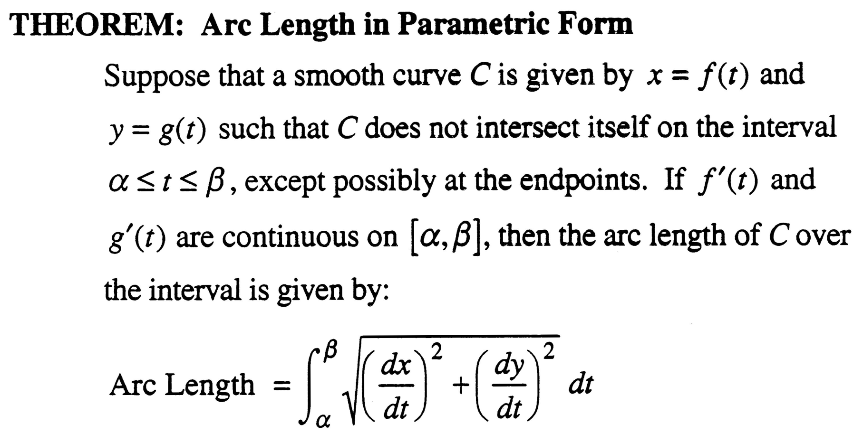

Slide 17
Example

Slide 18
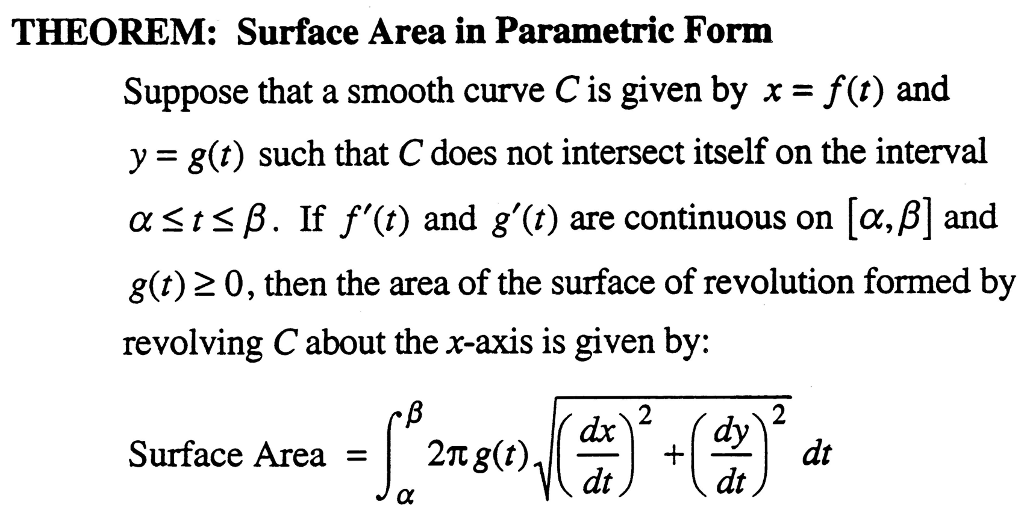


Slide 19
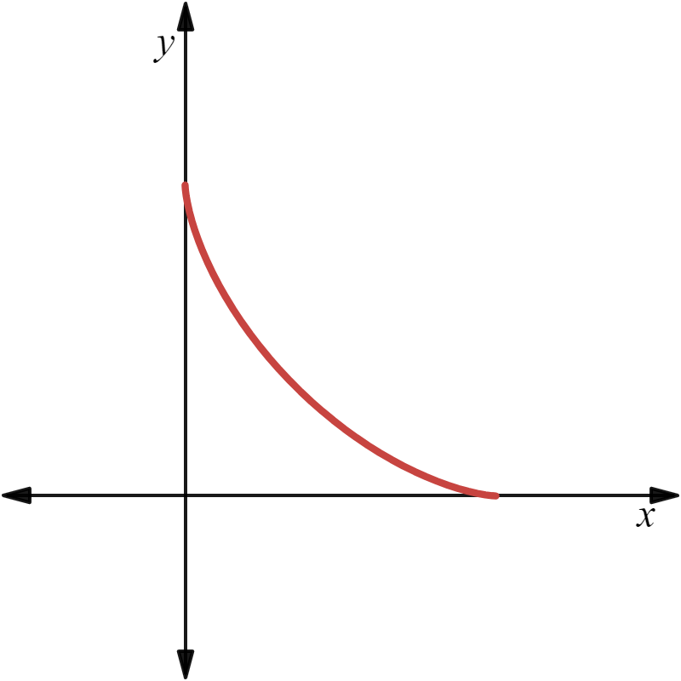
Example

Slide 20
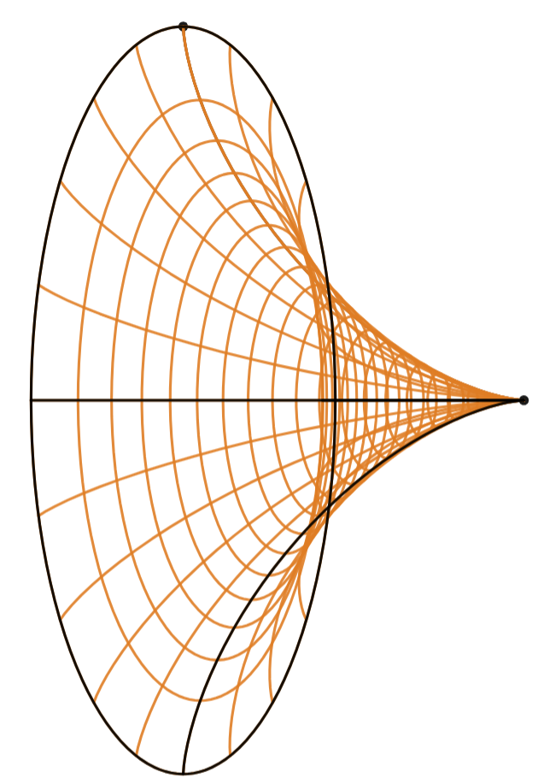
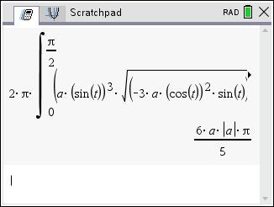
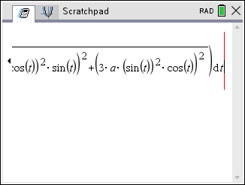
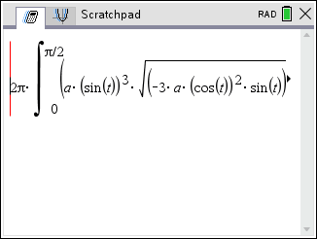
Example

