Slide 1
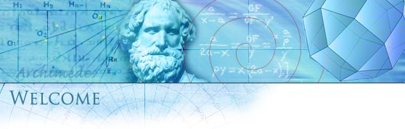
Santa Rosa Junior College
Mathematics
Gale Bach
Second Course in Calculus
Math 1B – Section 8131
Summer 2026
https://profiles.santarosa.edu/gale-w-bach

Slide 2

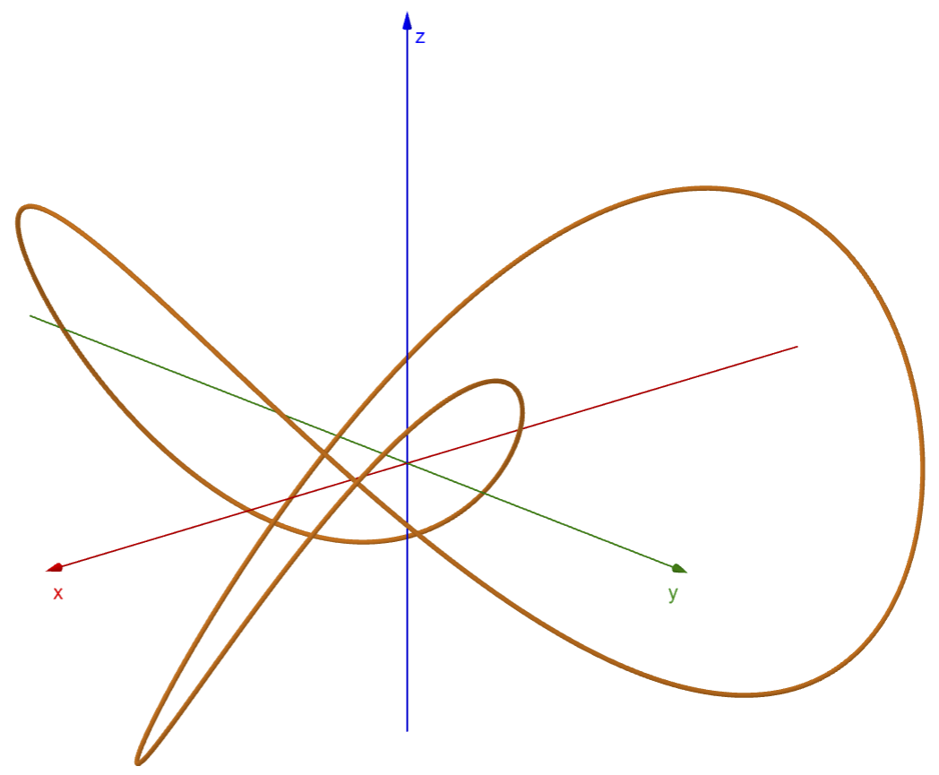
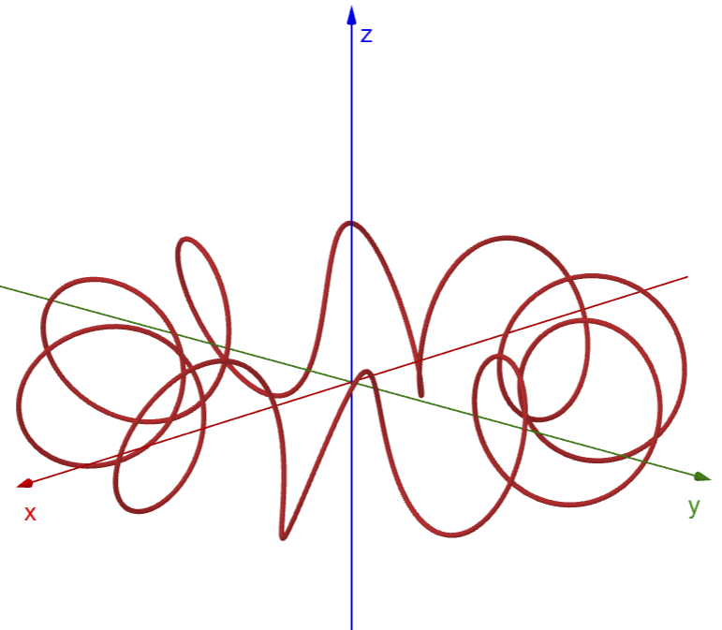

Space Curves
Trefoil Knot
Toroidal Spiral

Slide 3
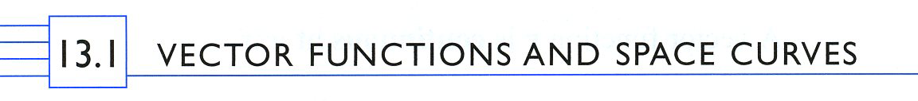
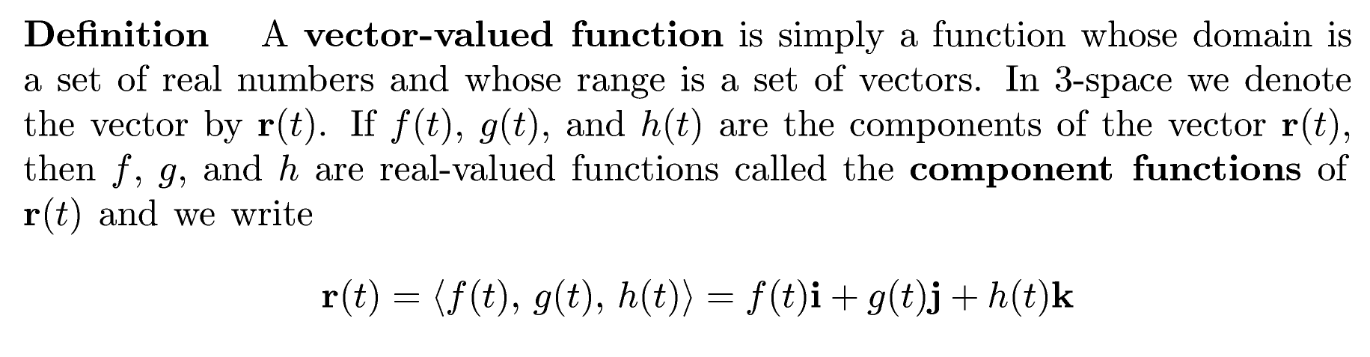
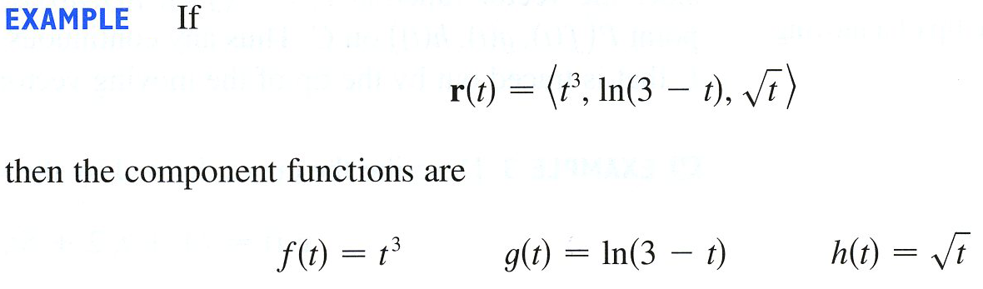

Example
Space Curve 1

Slide 4


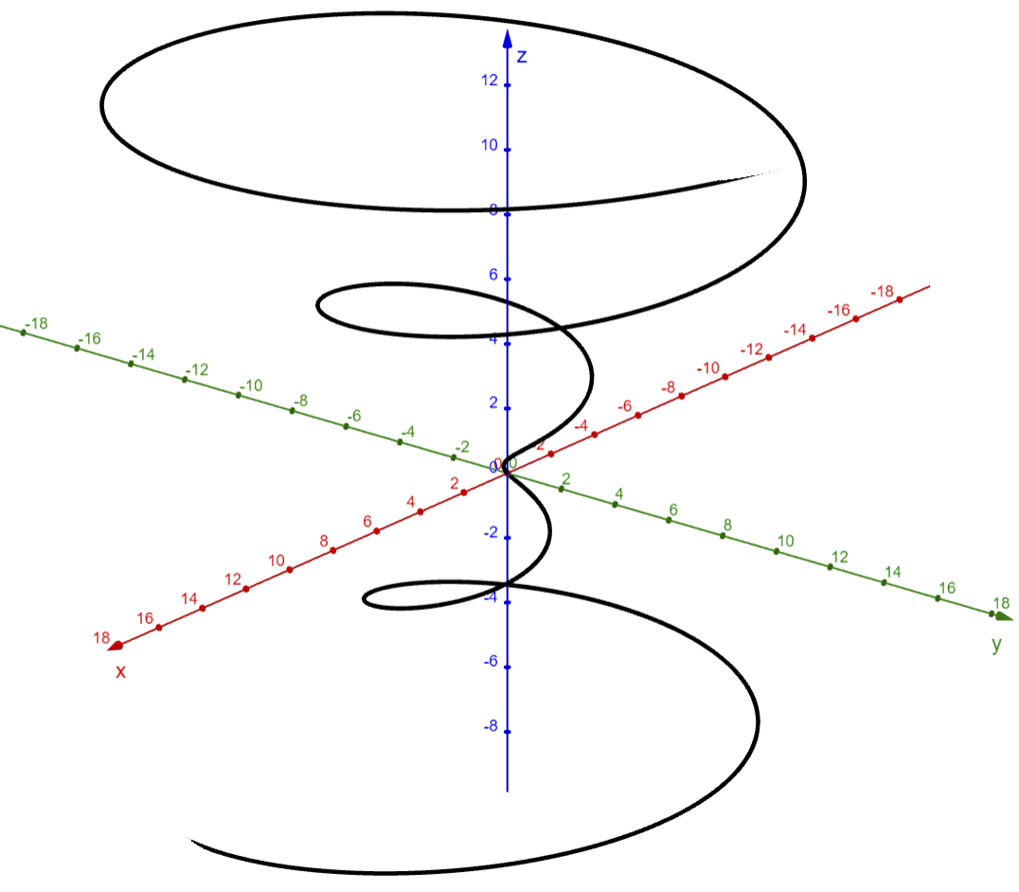
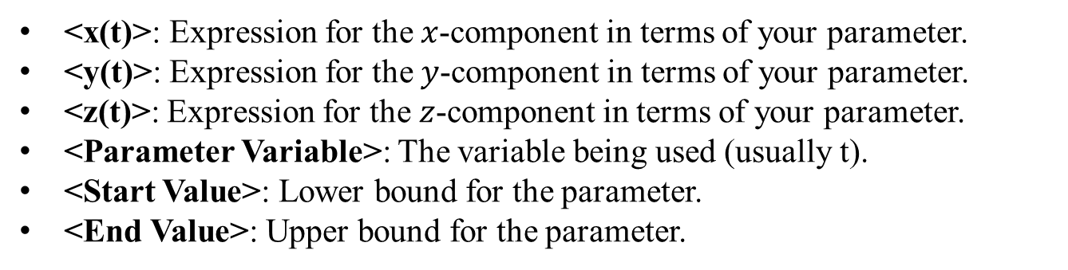
Space Curves
Here is the code:
Curve( <x(t)>, <y(t)>, <z(t)>, <Parameter Variable>, <Start Value>, <End Value> )
<x(t)>: Expression for the $x$-component in terms of your parameter.
<y(t)>: Expression for the $y$-component in terms of your parameter.
<z(t)>: Expression for the $z$-component in terms of your parameter.
<Parameter Variable>: The variable being used (usually t).
<Start Value>: Lower bound for the parameter.
<End Value>: Upper bound for the parameter.
How to Enter It in GeoGebra 3D
1. Click on the Input bar in the left panel.
2. Type Curve(...) command.
3. Press Enter.
Example
Conical Spiral
Curve(t*cos(t), t*sin(t), t, t, -6pi, 6pi)

Slide 5

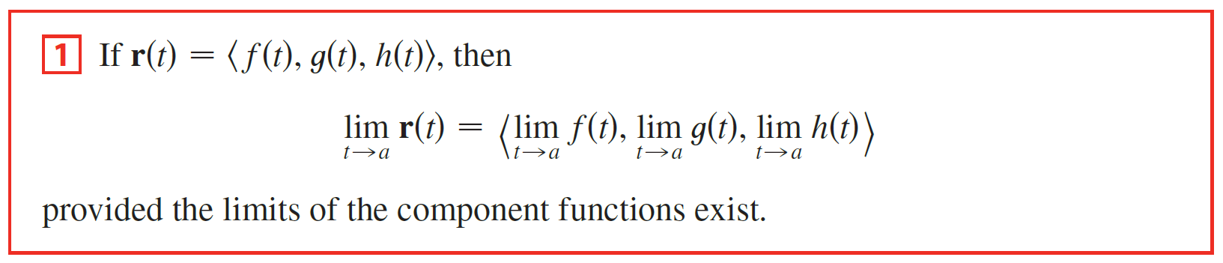
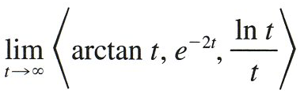


Example
Limit of r(t)

Slide 6
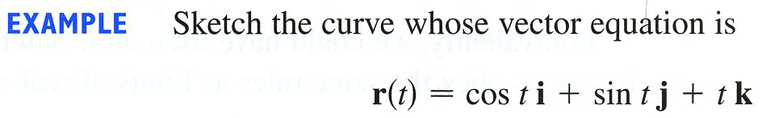
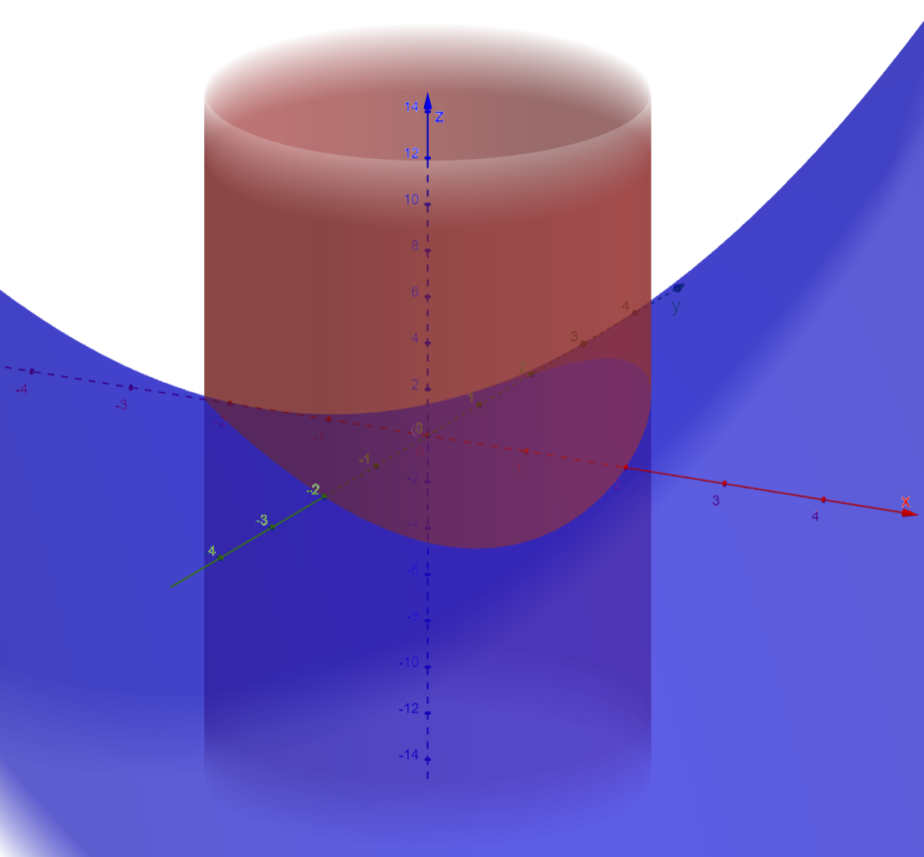
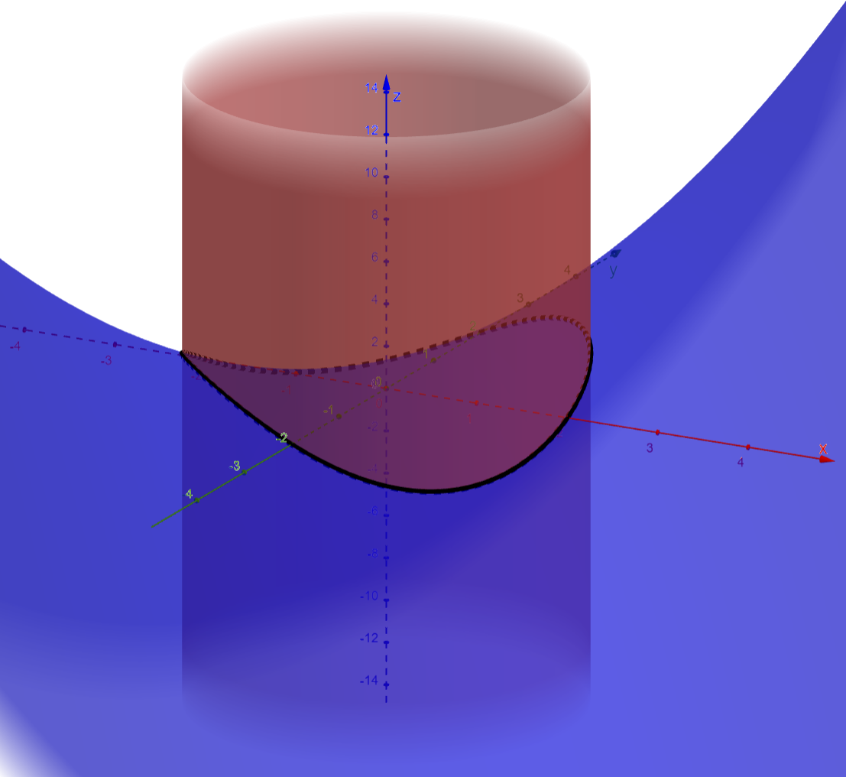
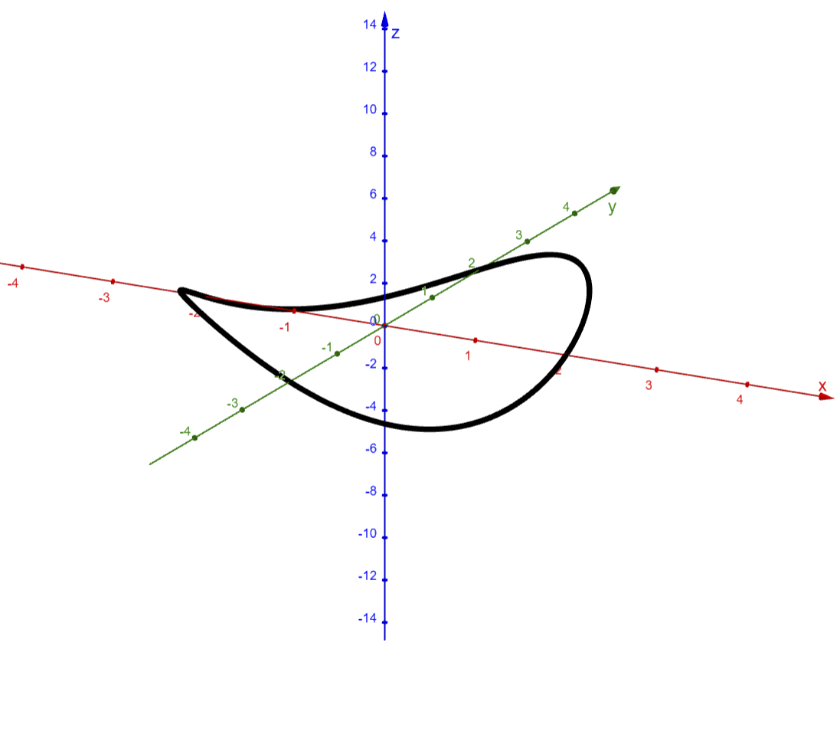

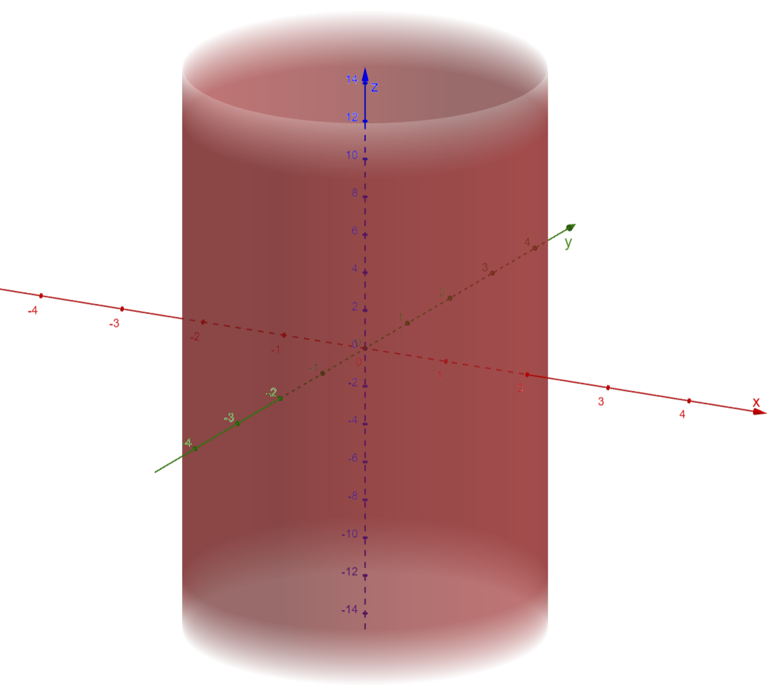
Example
Helix
Example
Intersection

Slide 7

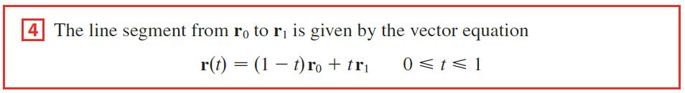


Example
Find a vector equation and parametric equations for the line segment that joins P to Q.
Then, by Equation 12.5.4
we have a vector equation for the line segment:
with corresponding parametric equations

Slide 8

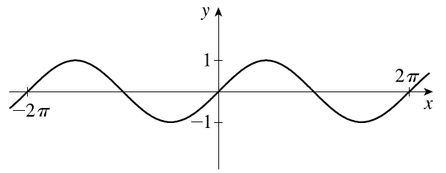


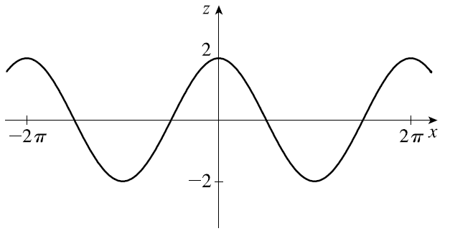

Example
Draw the projections of the curve onto the three coordinate planes.

Slide 9
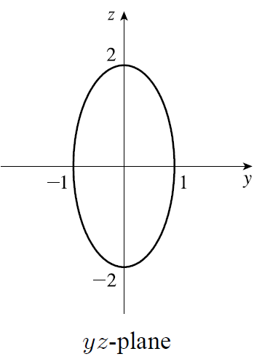
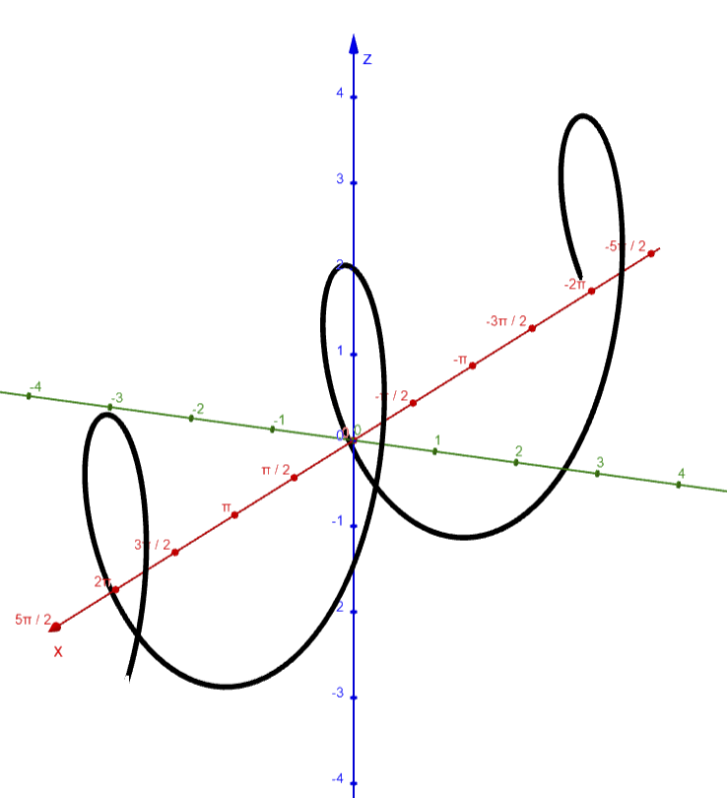

Example
Draw the projections of the curve onto the three coordinate planes.
Finally the projection onto the

