Slide 1

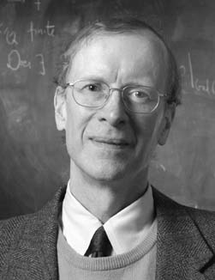
Andrew John Wiles
1953 – Present
Sir Andrew John Wiles, is a British mathematician and a Royal Society Research Professor at Oxford University, specializing in number theory. He is most notable for proving Fermat's Last Theorem.

Slide 2
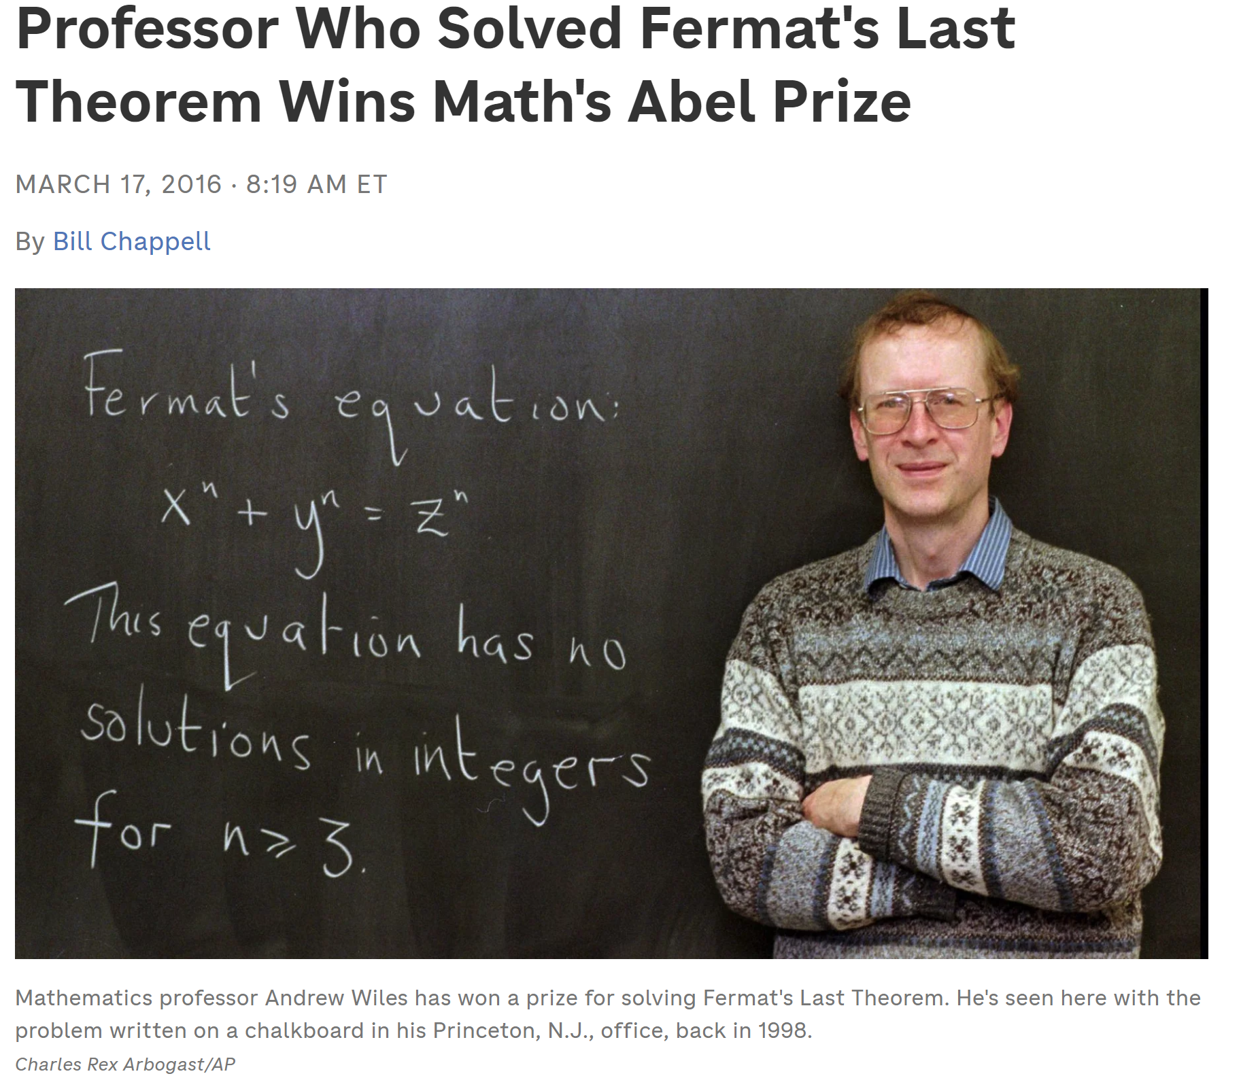

Slide 3
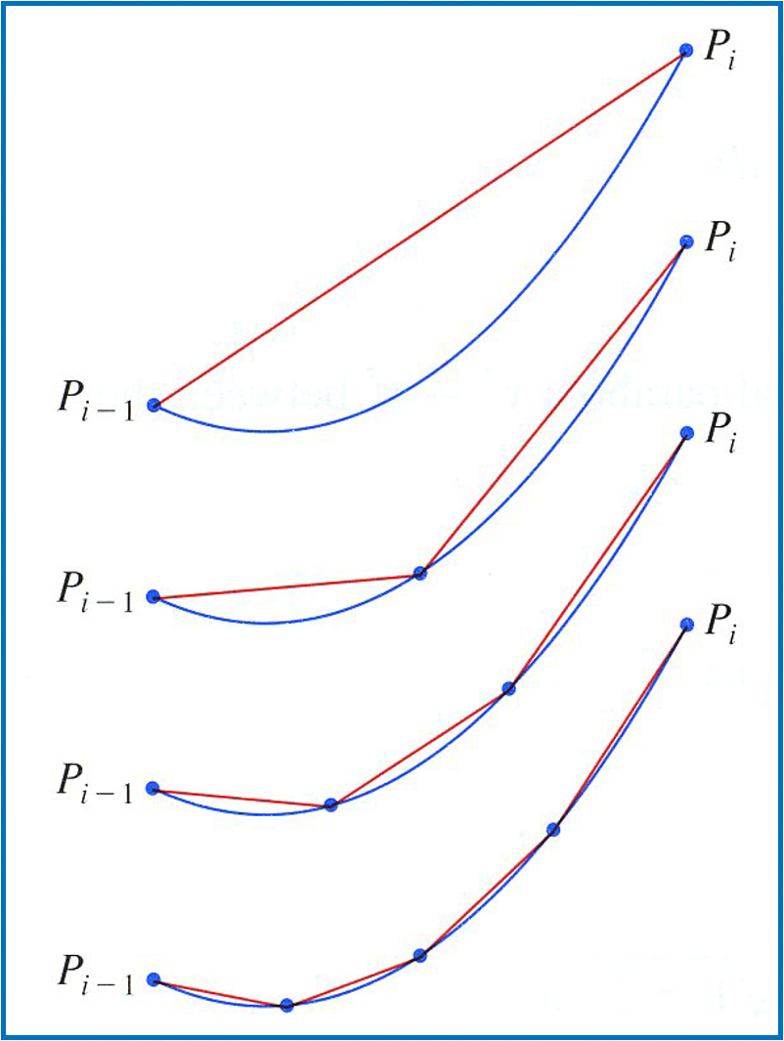
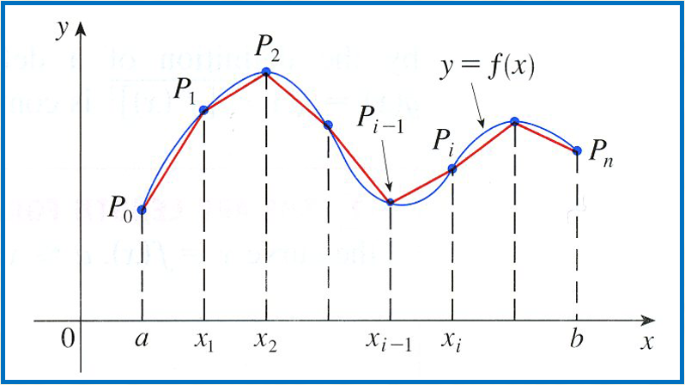
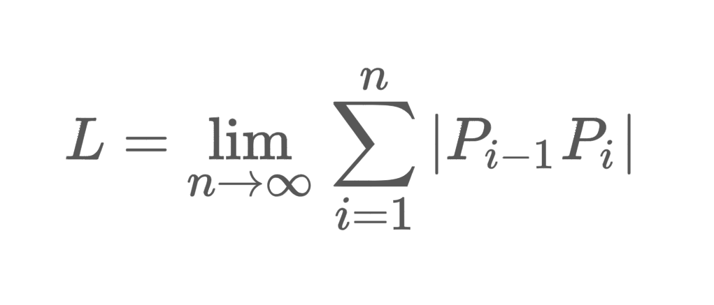

Slide 4
Lengths of Curves:
If we want to approximate the length of a curve, over a short distance we could measure a straight line.
By the pythagorean theorem:
Length of Curve (Cartesian)

Slide 5
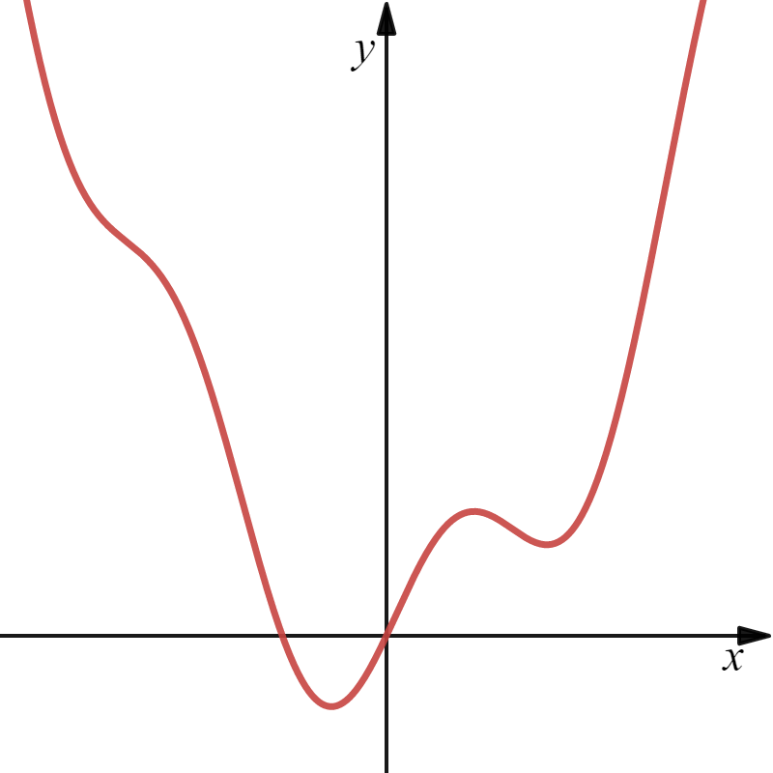
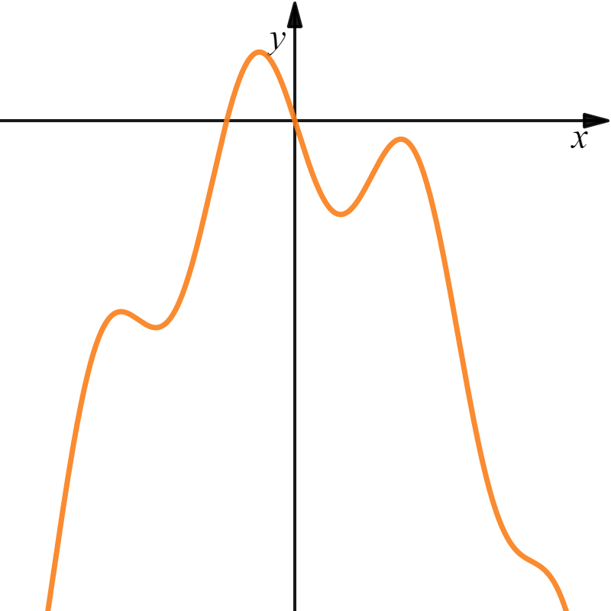
Arc Length Formula

Slide 6
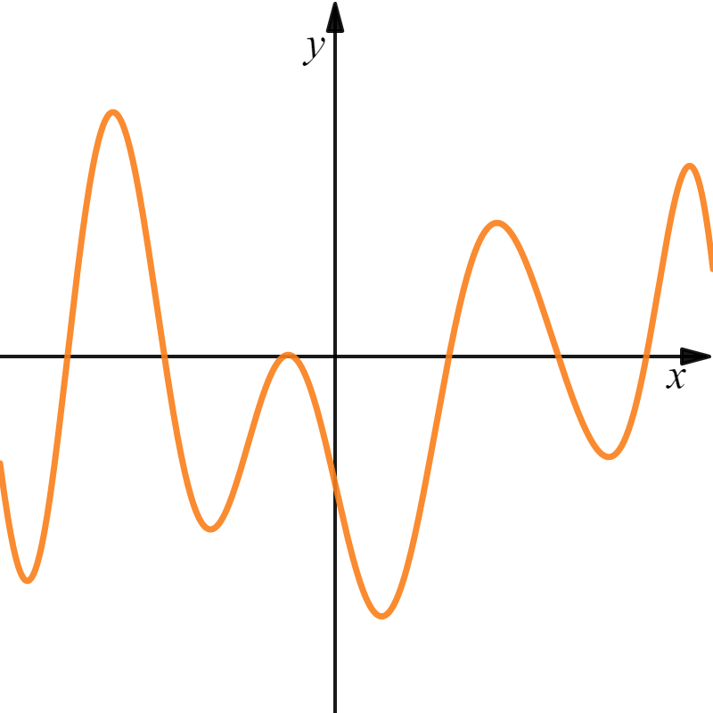



Slide 7
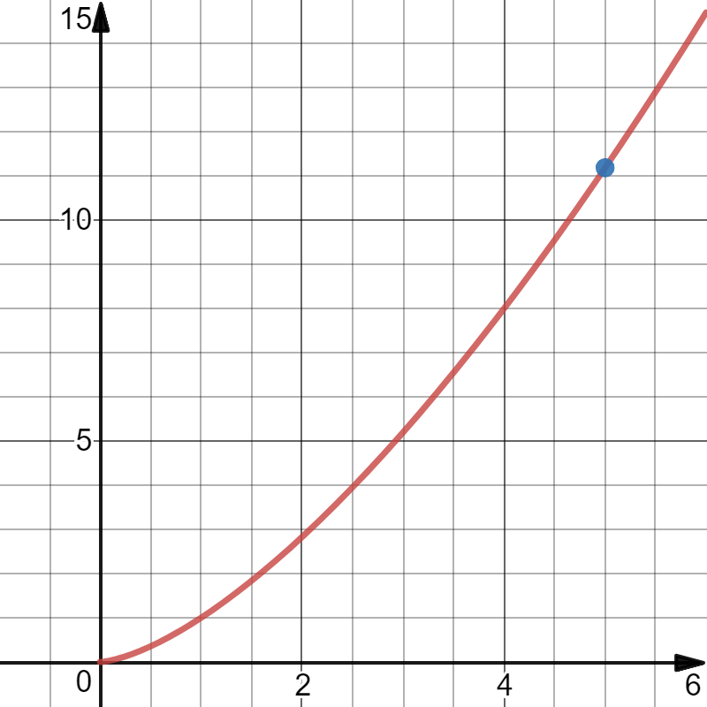

Example: Find the arc length for the function over the specified interval.

Slide 9
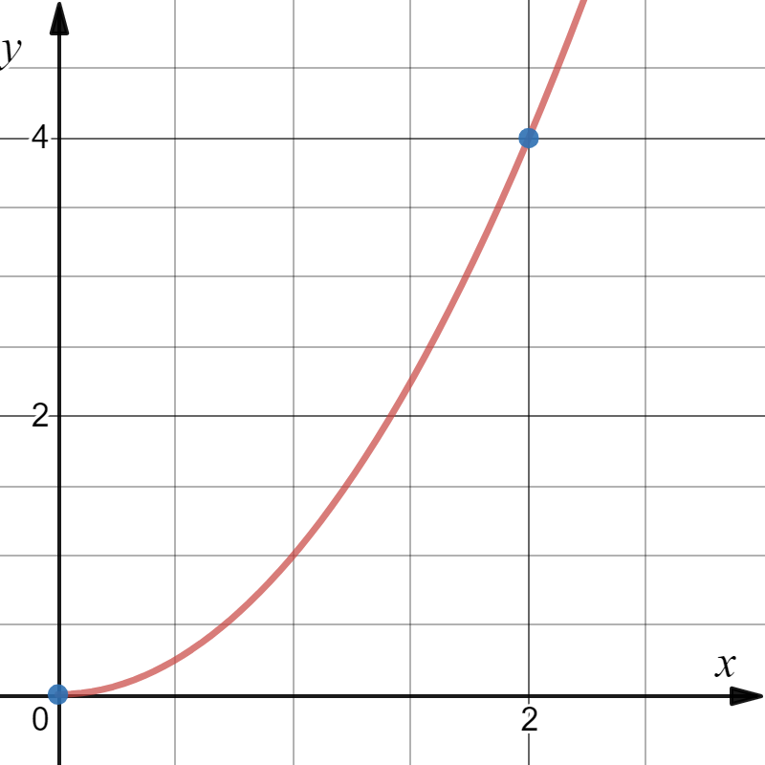
Example: Find the arc length for the function over the specified interval.

Slide 10

Now what?
Math 1B!!

Slide 11
Wow!!
This is called Trigonometric Substitution!!

Slide 12

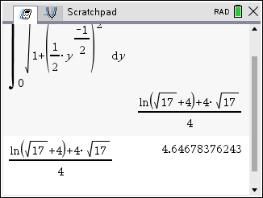
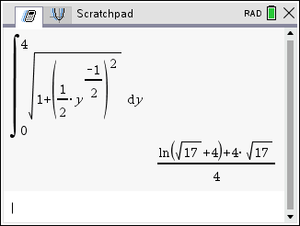

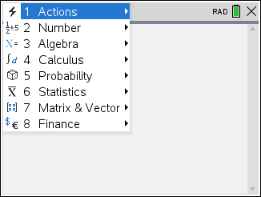
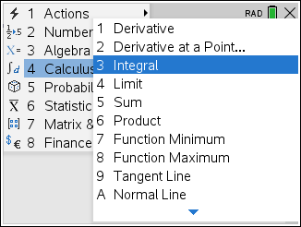
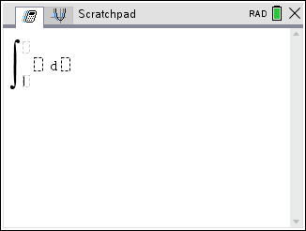
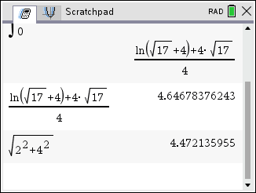
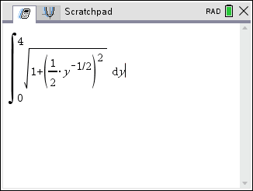
Computer Algebra Systems

Slide 13
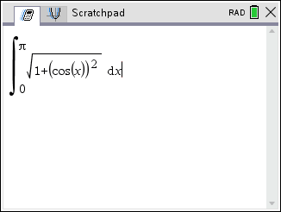
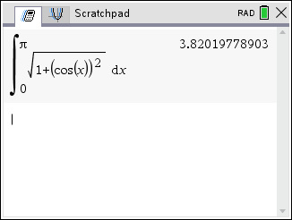
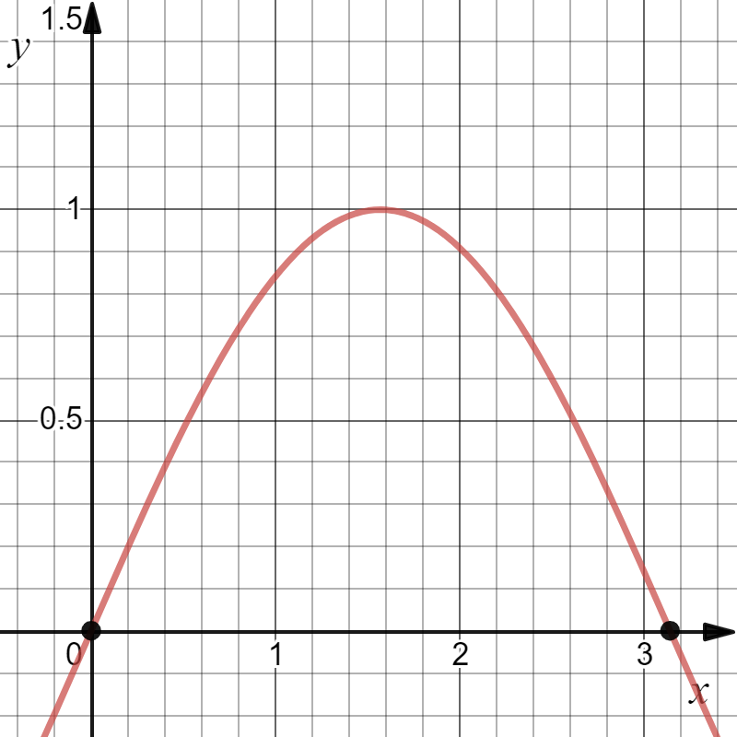
Example: Find the arc length for the function over the specified interval.
s
No exact answer, just an approximation.
F, the antiderivative, is not an elementary function.

Slide 14
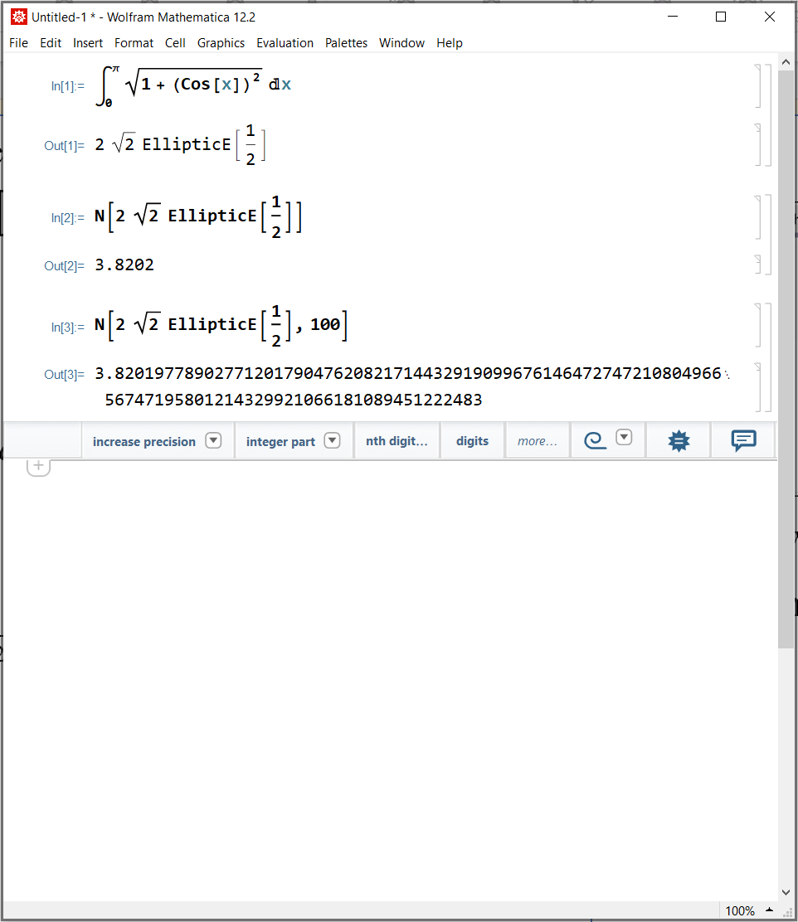
Example: Find the arc length for the function over the specified interval.
s
F, the antiderivative, is not an elementary function.

Slide 15

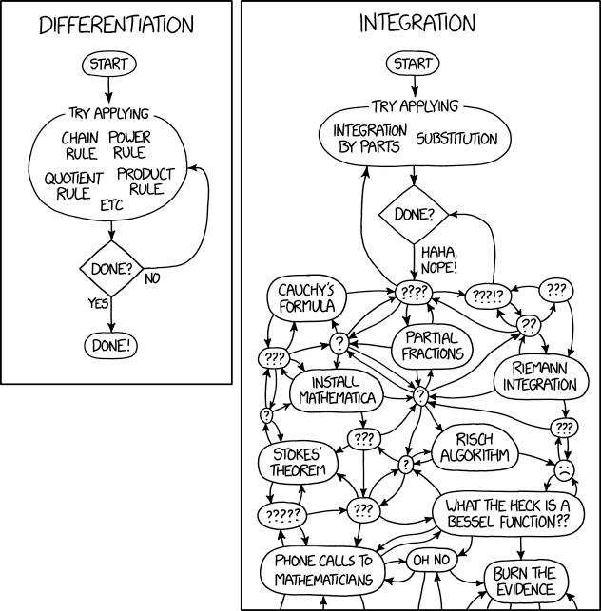

So much more great Maths
to learn!

