Slide 1

Srinivasa Ramanujan
1887 - 1920
Ramanujan made substantial contributions to the analytical theory of numbers and worked on elliptic functions, continued fractions, and infinite series.

Slide 2


Using integrals to find area works extremely well as long as we can find the antiderivative of the function.
Sometimes it is impossible to find the antiderivative of a function. For example, it is impossible to evaluate the following integrals exactly:
At other times, we don’t even have a function, but only measurements taken from real life.
What we need is an efficient method to estimate area when we can not find the antiderivative.
In this section, we will introduce three numerical techniques for calculation the definite integral.

Slide 3
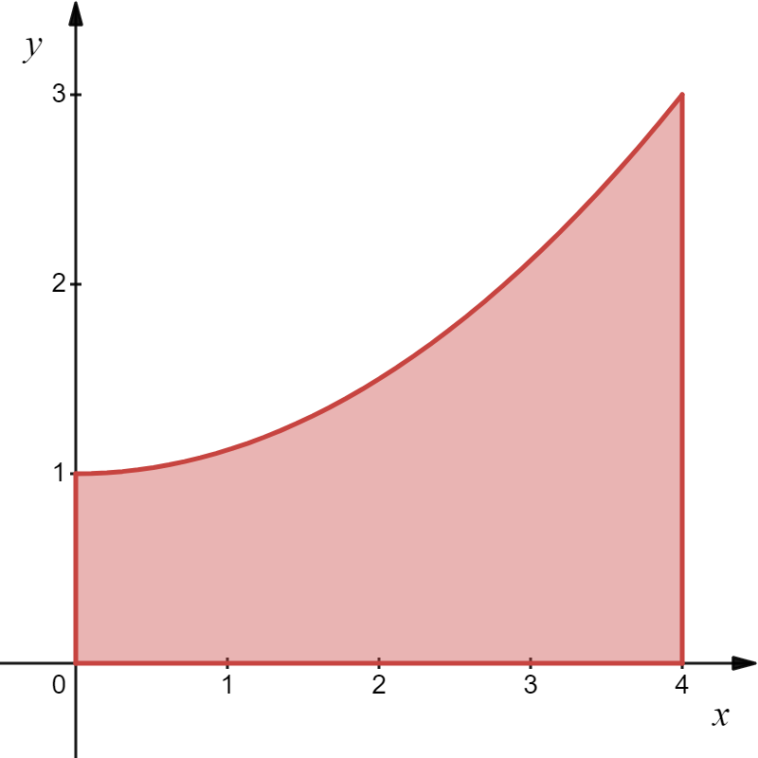
Example
Find the area under the curve
Solution
Actual area under curve:

Slide 4
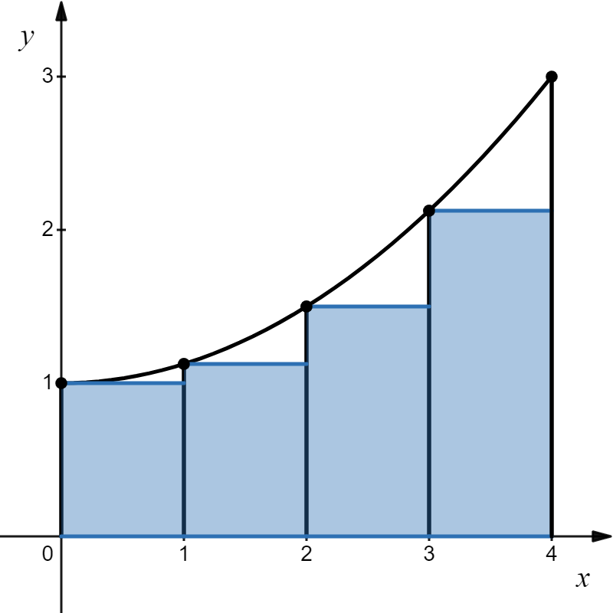
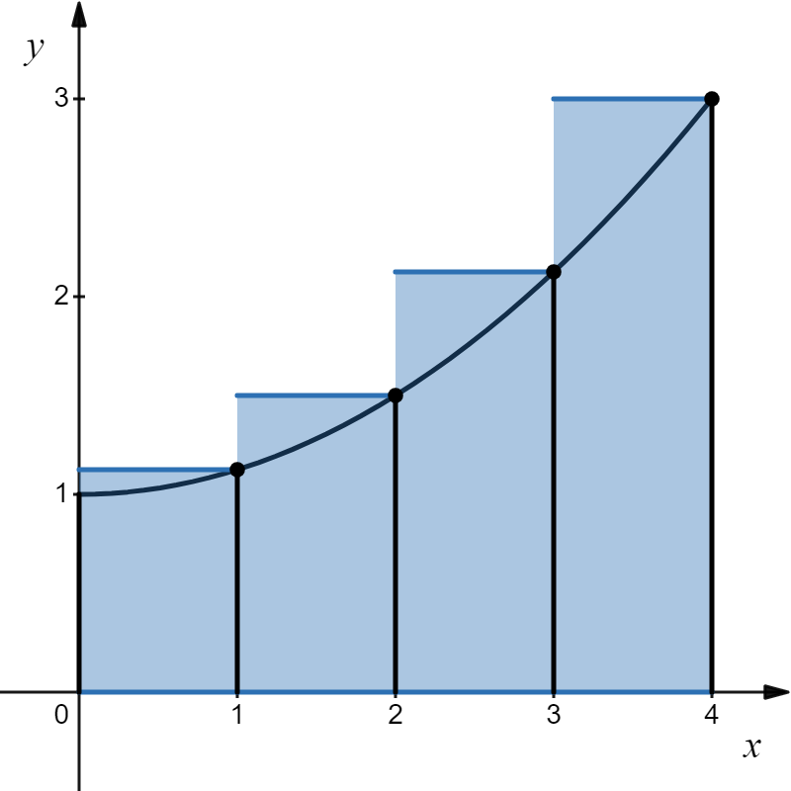
Example
Find the area under the curve
Solution
Left-hand rectangular approximation:
Right-hand rectangular approximation:
Approximate area:
Approximate area:
(too low)
(too high)

Slide 5

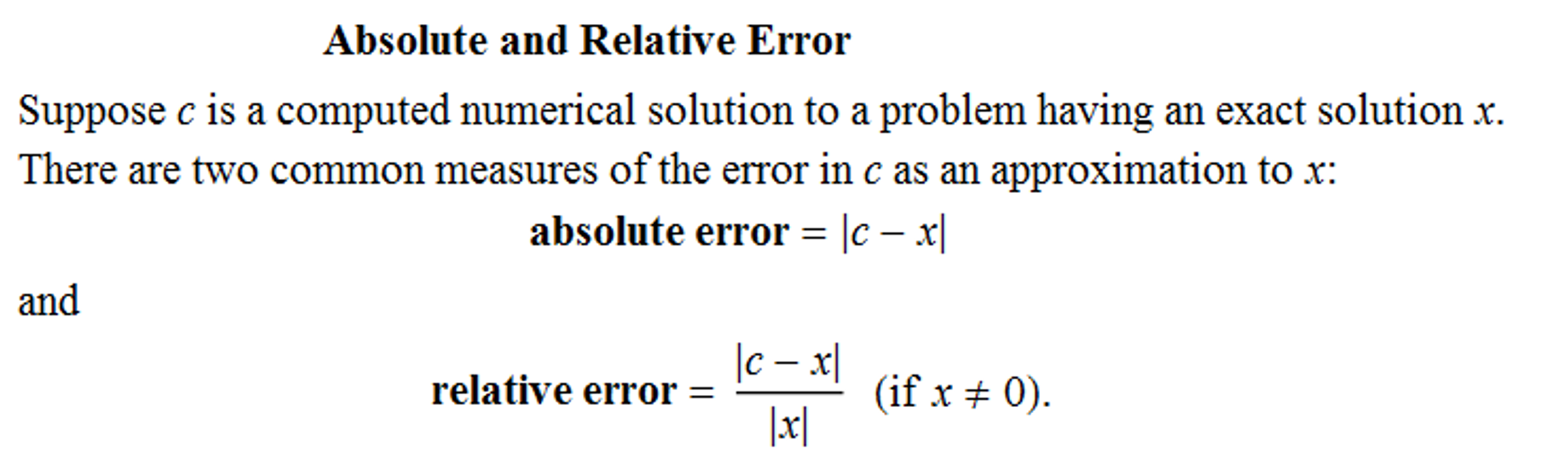
Averaging the two:
What’s the error?
Definitions
So, 1.25% error
(too high)
What is the visual calculus of averaging right and left sums?

Slide 6
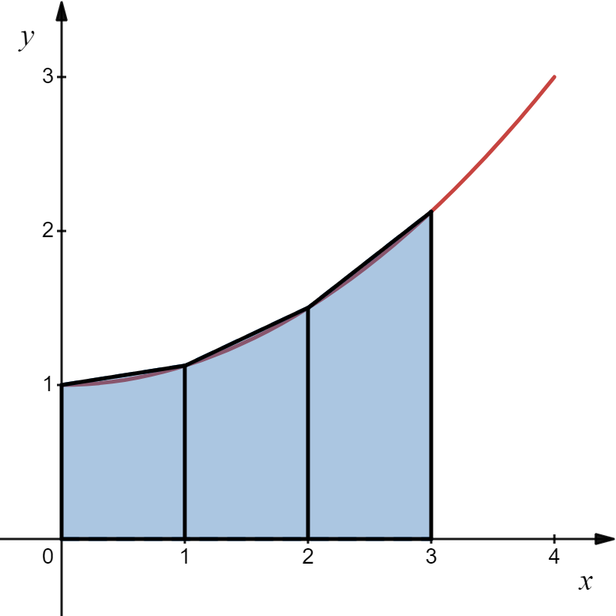
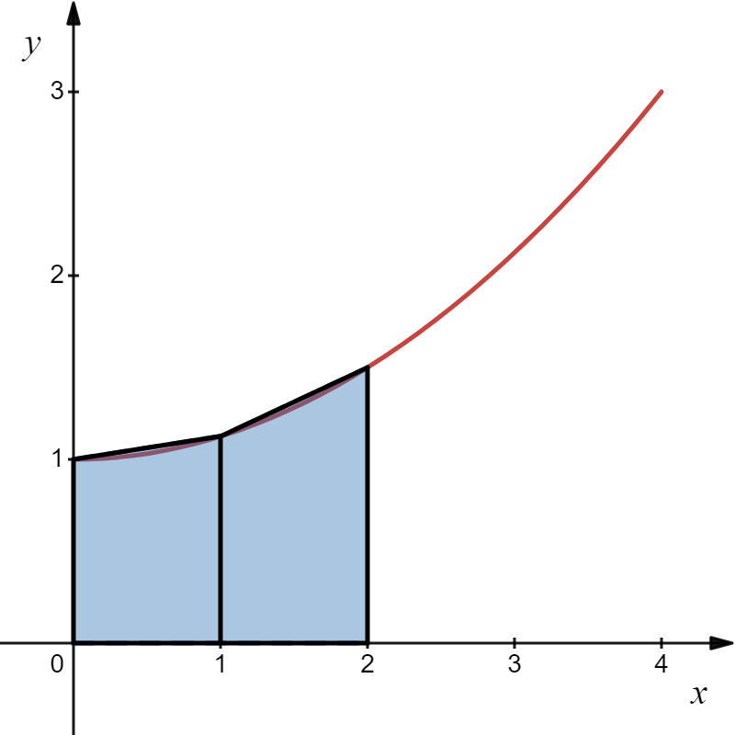
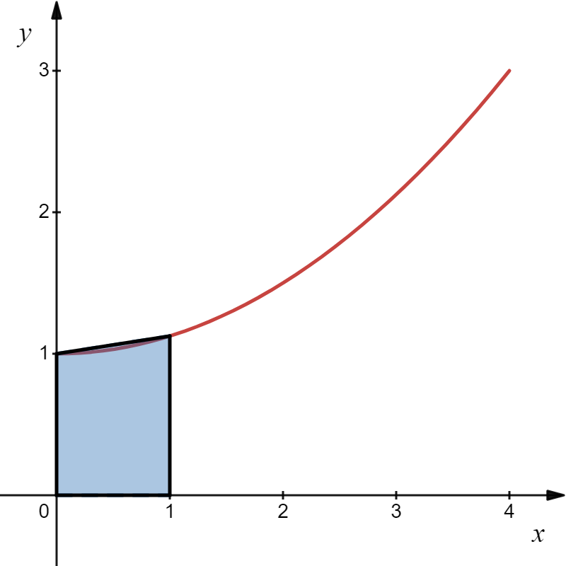
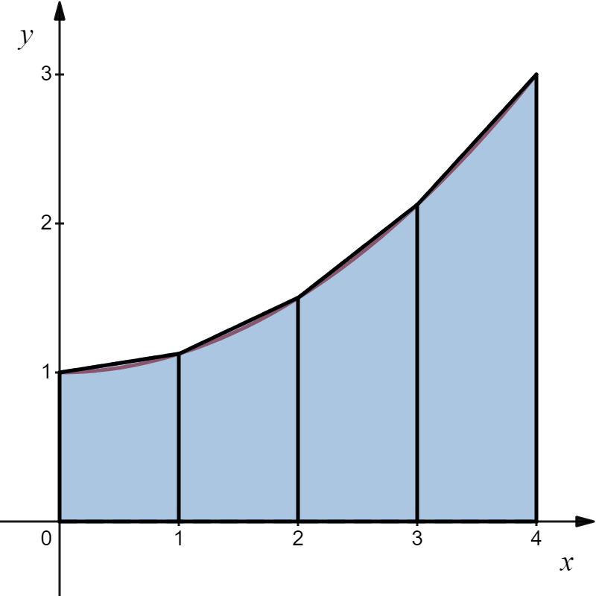

Averaging right and left sums gives us trapezoids!

Slide 7

As we calculated before.

Slide 8
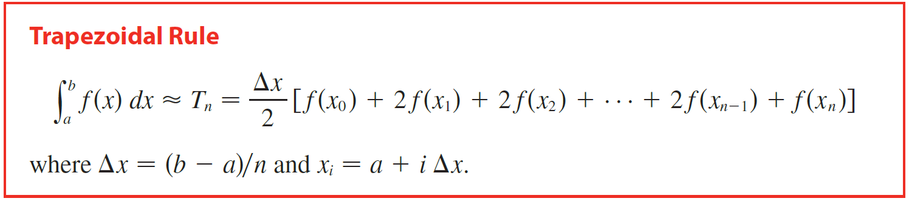

Slide 9
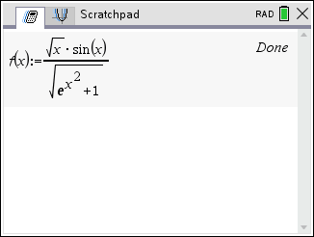
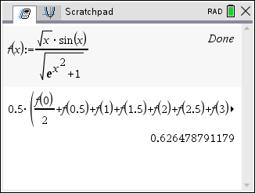
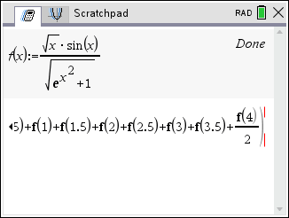
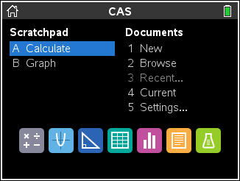
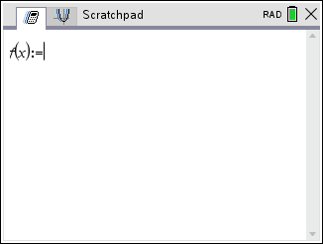
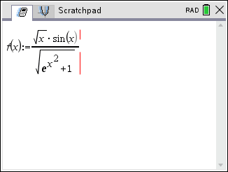
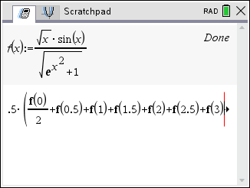

Example
Solution

Slide 10
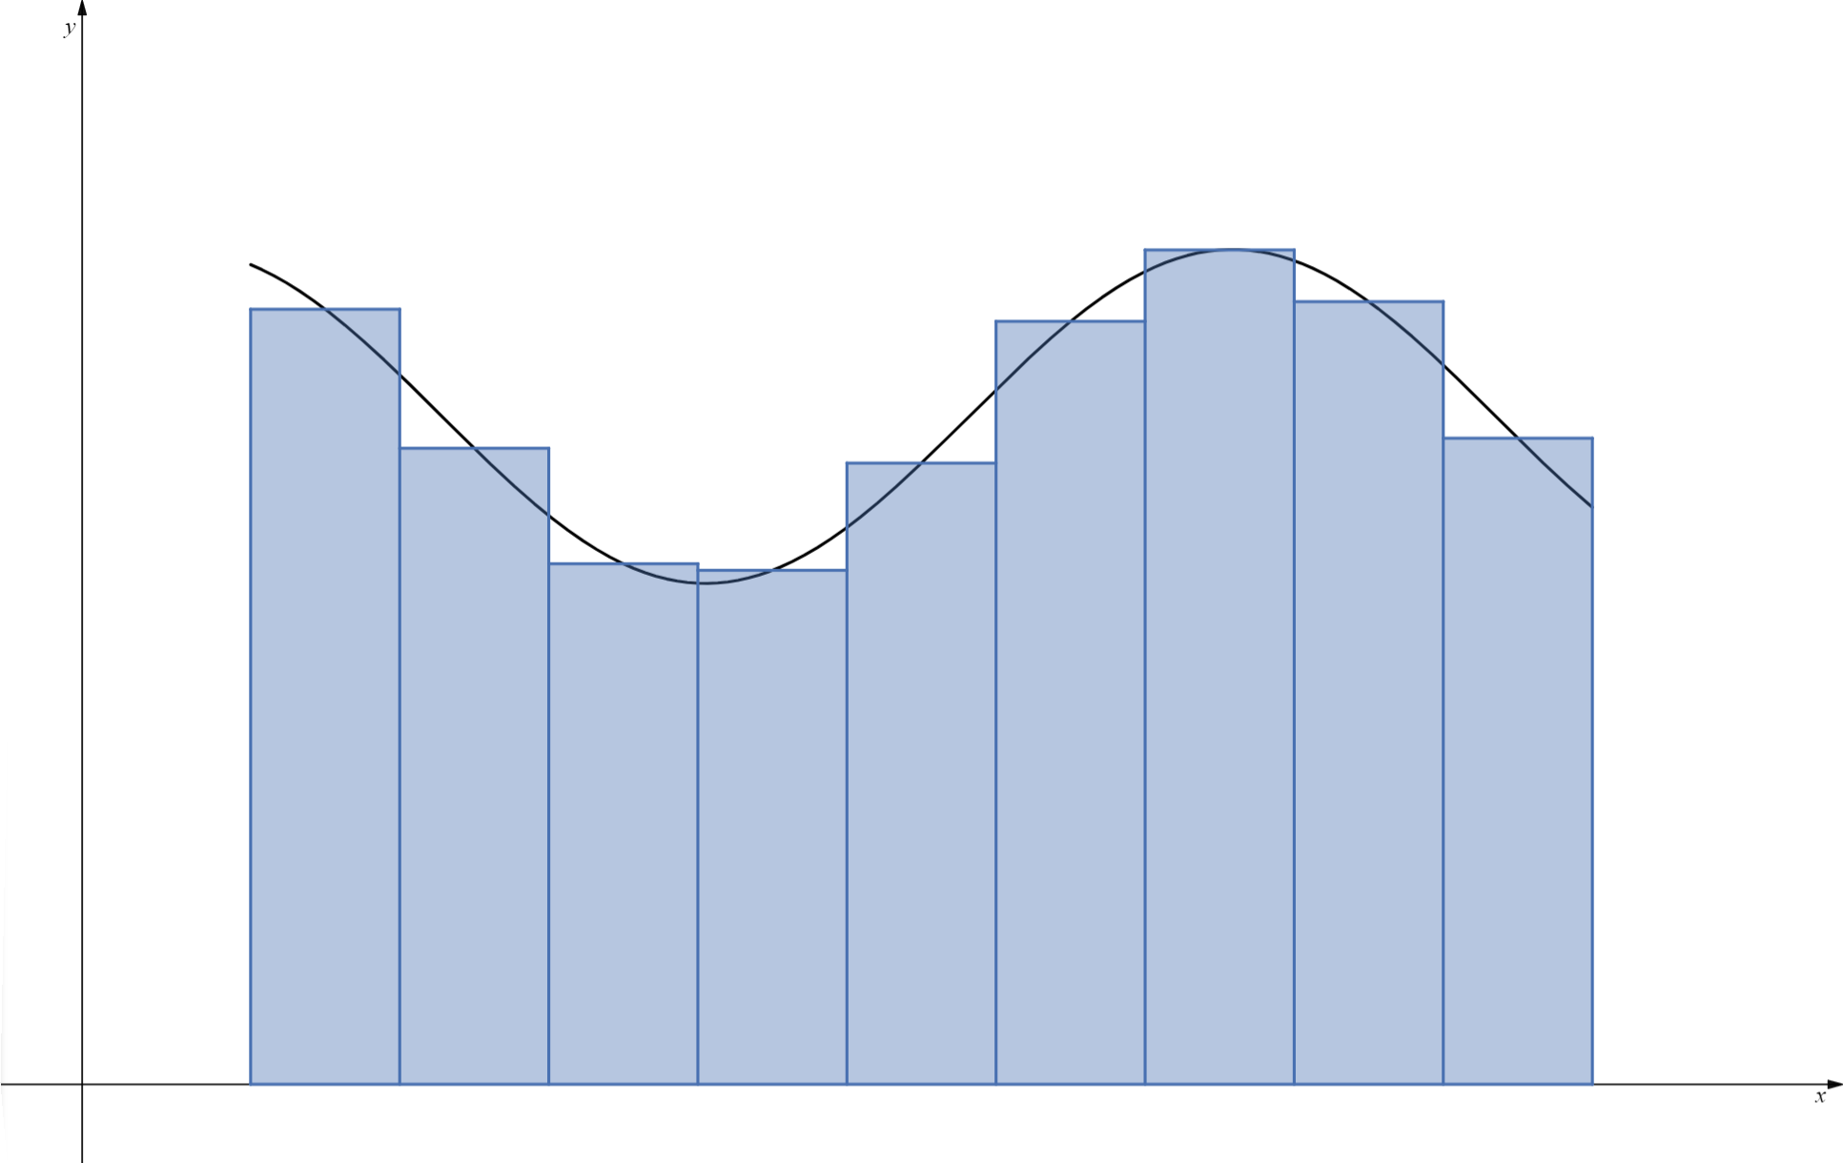



Slide 11
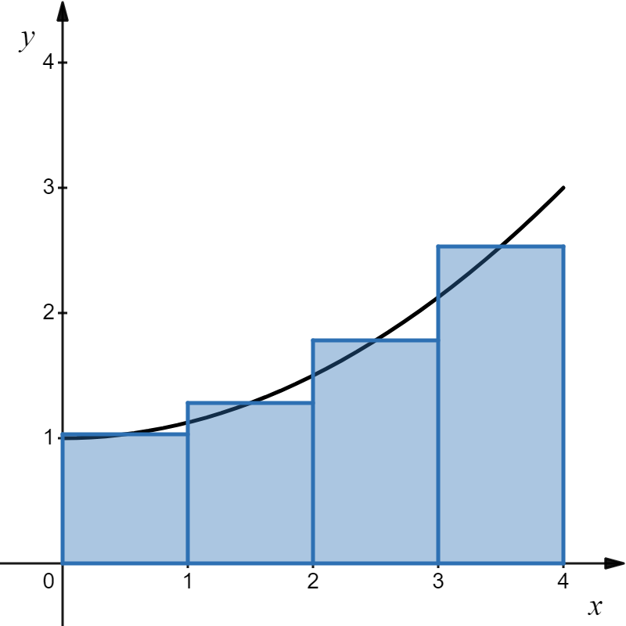
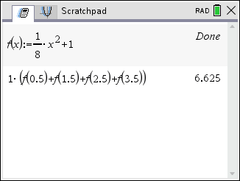
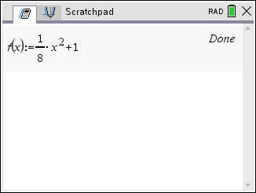
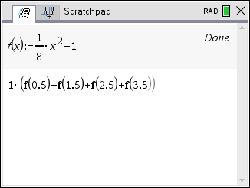
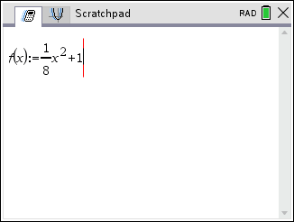
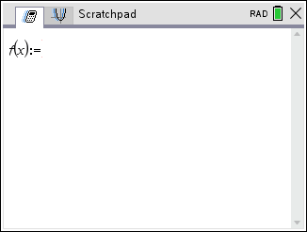
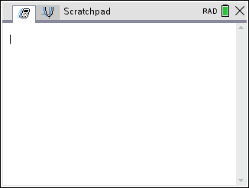
Example
Find the area under the curve with 4 rectangles.
Solution
0.625% error
(too low)
The midpoint rule gives a closer approximation than the trapezoidal rule, but in the opposite direction.

Slide 12
Trapezoidal Rule:
1.25% error
(too high)
Midpoint Rule:
0.625% error
(too low)
Notice that the trapezoidal rule gives us an answer that has twice as much error as the midpoint rule, but in the opposite direction.
Ahhh!
If we use a weighted average:
This is the exact answer!
Oooh!
Wow!

Slide 13
This weighted approximation gives us a closer approximation than the midpoint or trapezoidal rules.
twice midpoint
trapezoidal
Simpson’s Rule
Midpoint:
Trapezoidal:

Slide 14
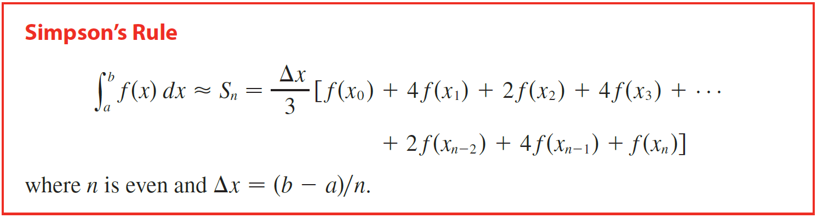


Slide 15
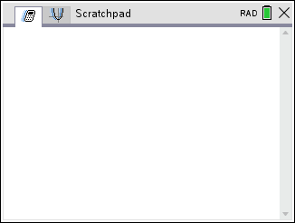
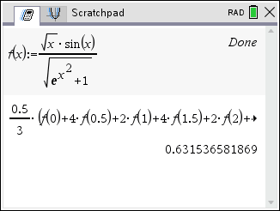
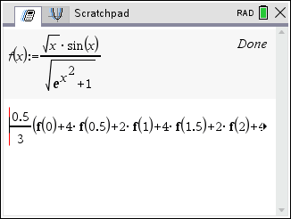
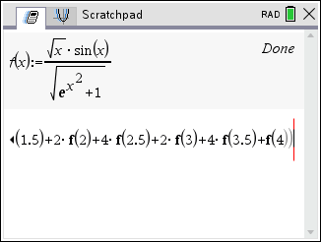
Example
Solution

Slide 16
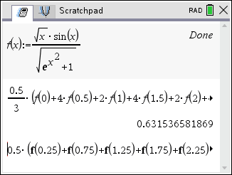
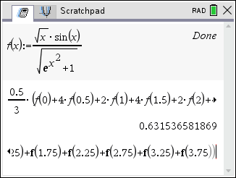
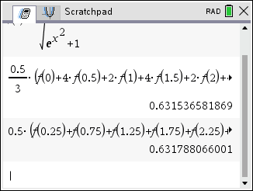
Example
Solution

Slide 17
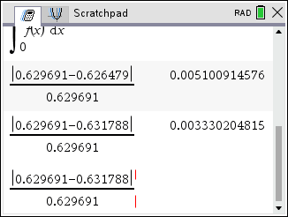
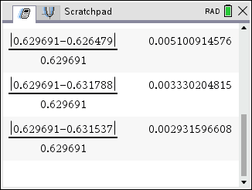
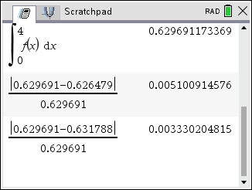
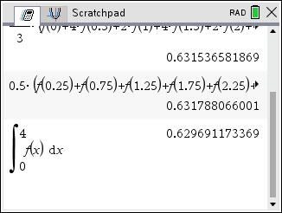
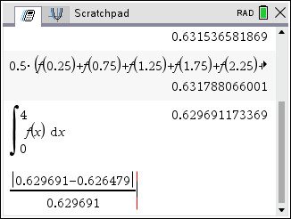
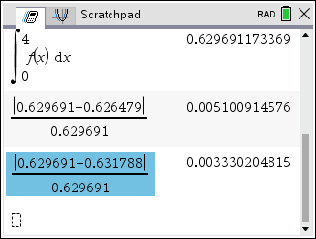
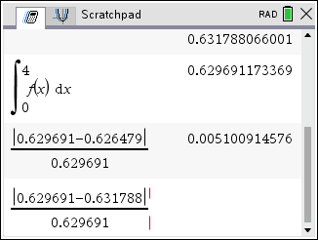
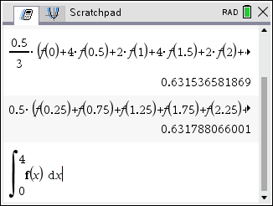
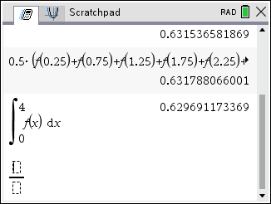
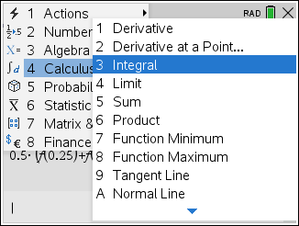
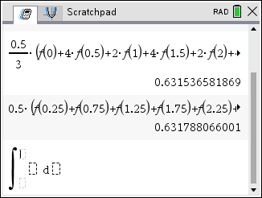

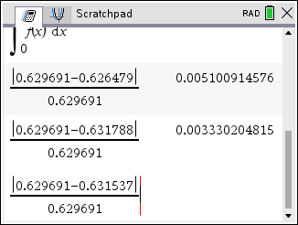
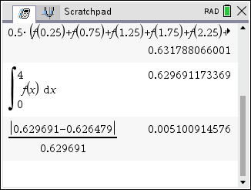
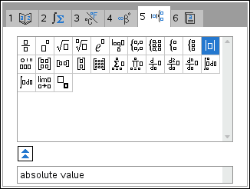
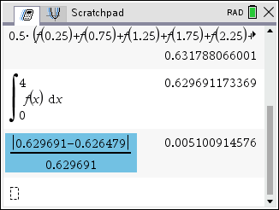
Example
Solution
Simpson’s Rule Wins

Slide 18
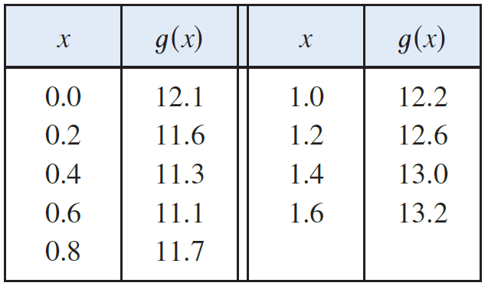


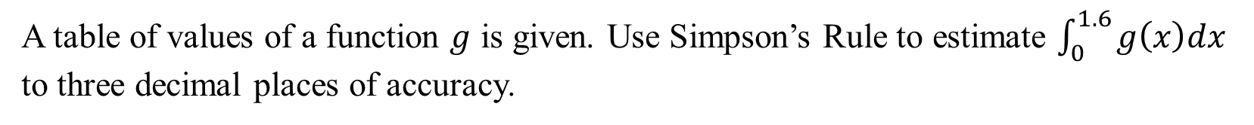
Example
A table of values of a function $g$ is given. Use Simpson’s Rule to estimate $\int_{0}^{1.6}{g\left(x\right)dx}$ to three decimal places of accuracy.
Solution

Slide 19
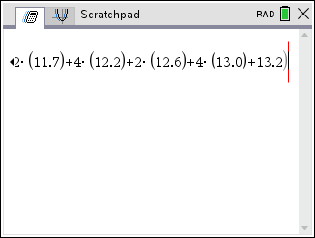


Example
A table of values of a function $g$ is given. Use Simpson’s Rule to estimate $\int_{0}^{1.6}{g\left(x\right)dx}$ to three decimal places of accuracy.
Solution

