Slide 1
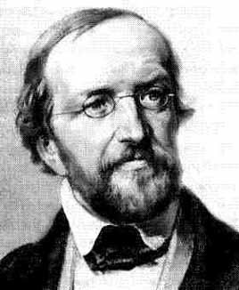
Johann Peter Gustav Lejeune Dirichlet
1805 – 1859
Dirichlet proved the convergence of Fourier series, as well as developed the modern definition of a function, also he contributed to analytic number theory.

Slide 2
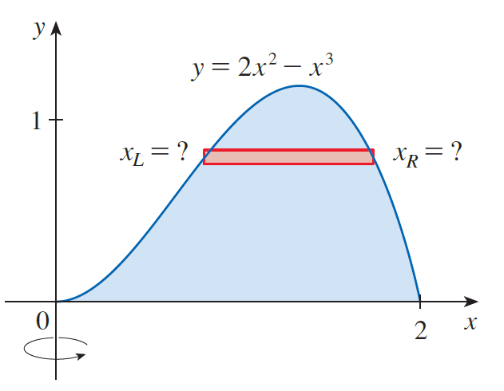
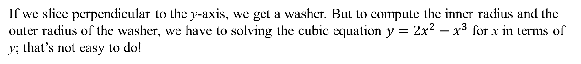
If we slice perpendicular to the y-axis, we get a washer. But to compute the inner radius and the outer radius of the washer, we have to solving the cubic equation $y={2x}^{2}−x^{3}$ for x in terms of y; that’s not easy to do!
What if we take parallel cross-sections to the y-axis? What’s the cross-section?

Slide 3
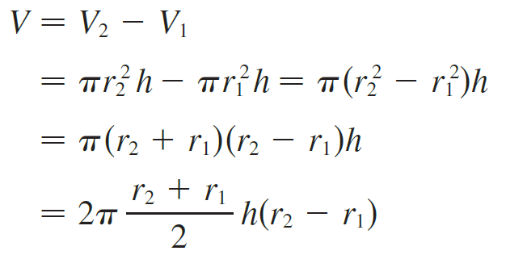

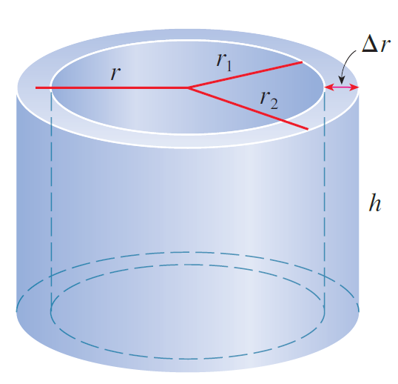




There is a method, called the method of cylindrical shells, that is easier to use in a case like the one shown in the previous slide.
Its volume V is calculated by subtracting the volume V₁ of the inner cylinder from the volume V₂ of the outer cylinder:
If we let
(the average radius of the shell)
then this formula for the volume of a cylindrical shell becomes

Slide 4
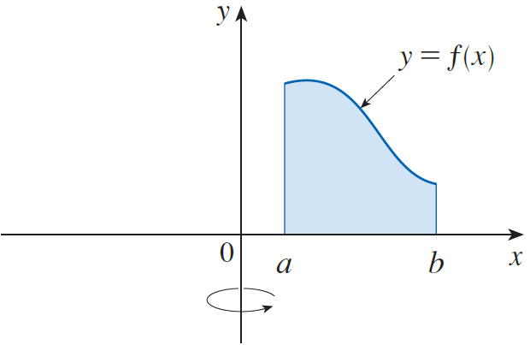
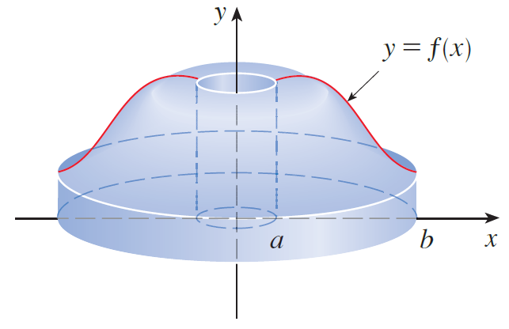
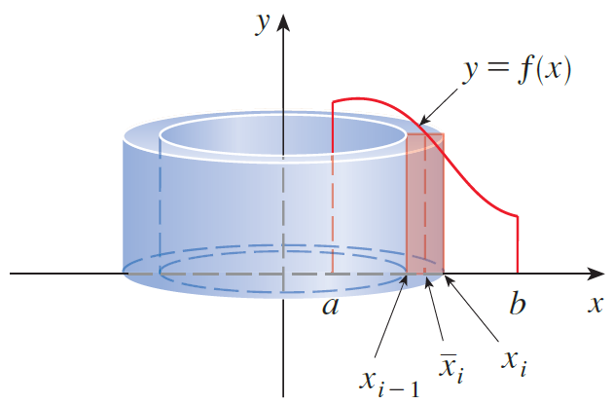
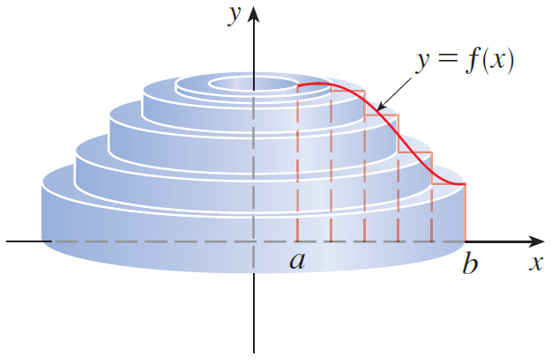
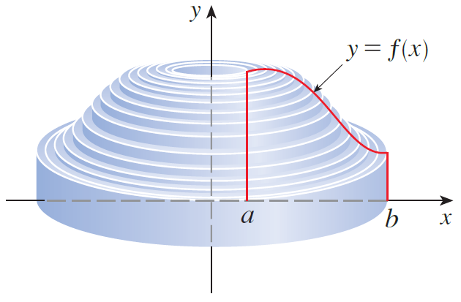


Slide 5
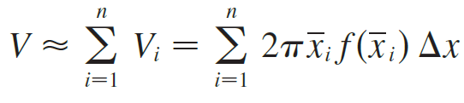


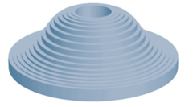
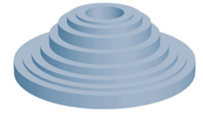

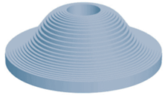
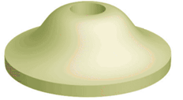

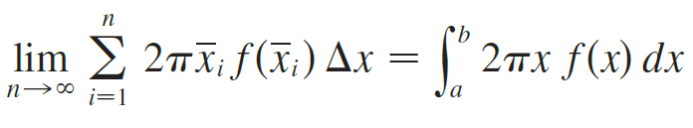
Therefore an approximation to the volume V of S is given by the sum of the volumes of these shells:
This approximation appears to become better as $n→∞$.But, from the definition of an integral, we know that

Slide 6
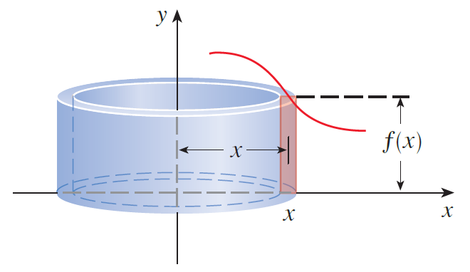
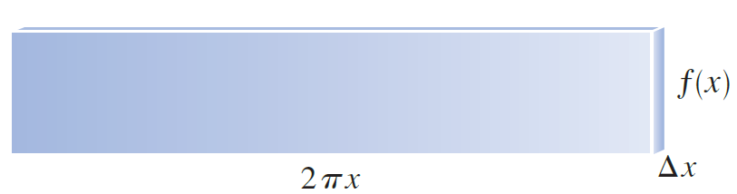
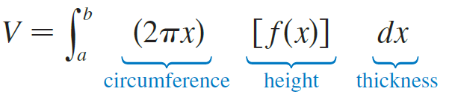
Area of Face

Slide 7
Example
y
x
cross section
Solution
x
The volume of the shell is given by:
r is the x value of the function.
h is the y value of the function.
thickness is dx.

Slide 8
Example
y
This is called the Shell method because we use cylindrical shells.
x
cross section
Solution
x
The volume of the shell is given by:
Now we bring out the Super Sum, the Great Accumulator

Slide 9
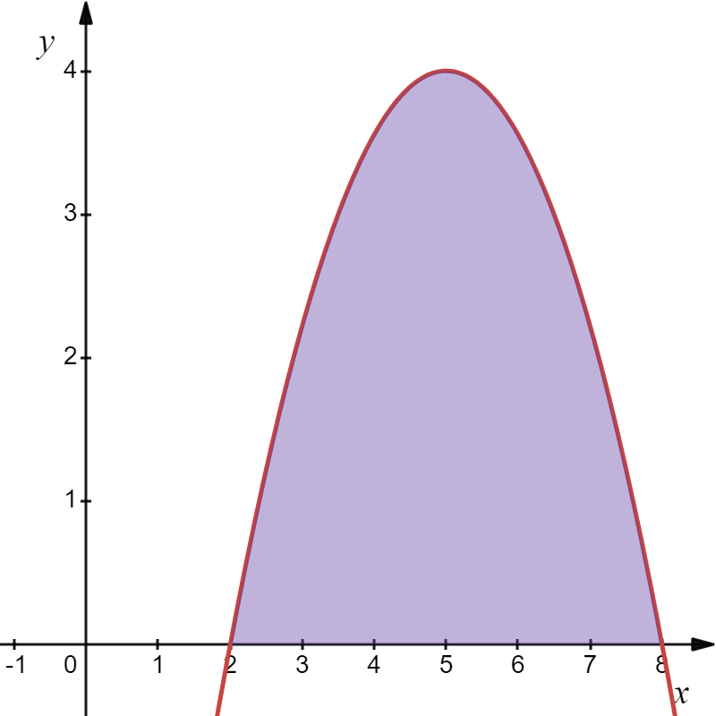
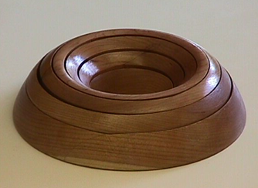
Example
Find the volume generated when this shape is revolved about the y-axis.
Solution
Washers?
It’s not easy to solve for x, so we do not want to use a washers to find the volume.

Slide 10
Example
Find the volume generated when this shape is revolved about the y-axis.
Shell method:
A(x)
Solution
If we take a vertical rectangle and revolve it about the y-axis we get a cylindrical shell.

Slide 11


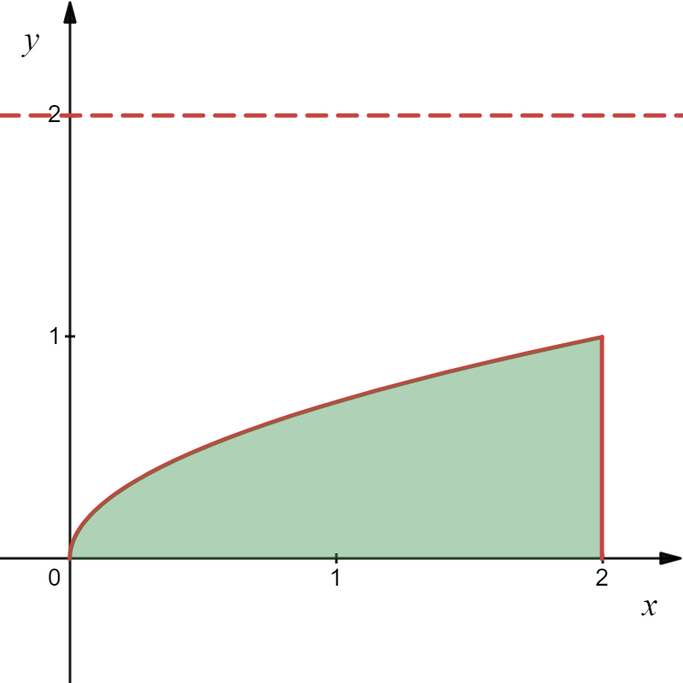
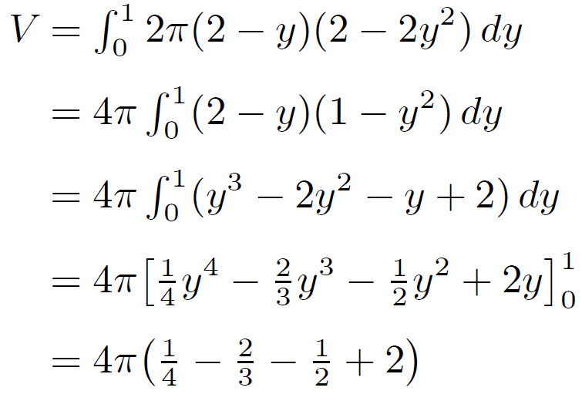
Example
Use the method of cylindrical shells to find the volume generated by rotating the region bounded by the given curves about the specified axis.
Solution

Slide 12

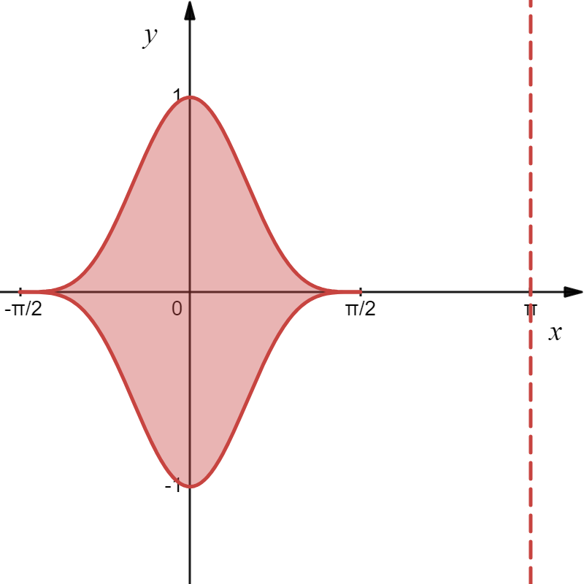
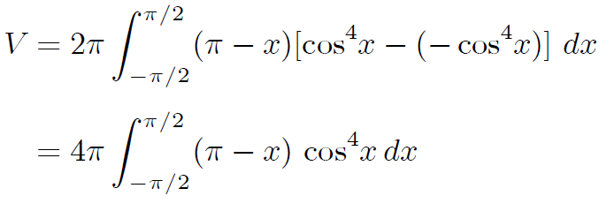
Example
(a) Set up an integral for the volume of the solid obtained by rotating the region bounded by the given curve about the specified axis.
(b) Use a calculator or computer to evaluate the integral correct to three decimal places.
Solution
(a)

Slide 13
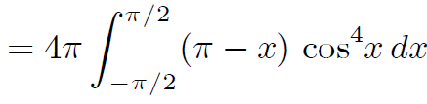
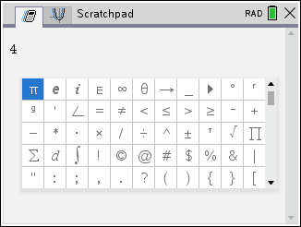
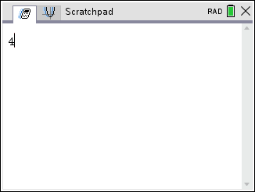
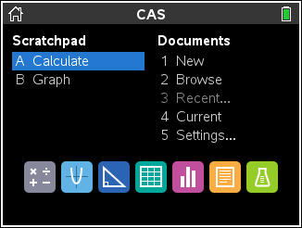
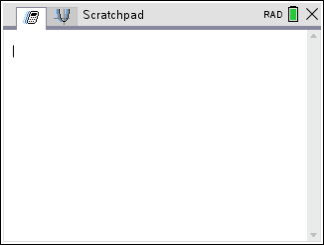
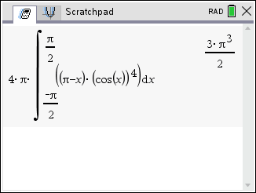
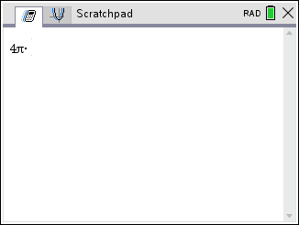
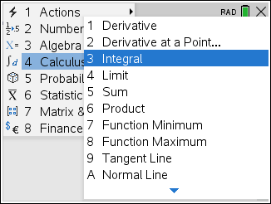
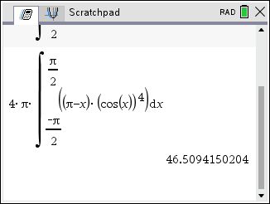
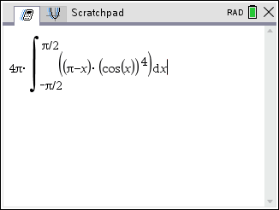
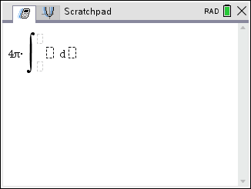
Example
(a) Set up an integral for the volume of the solid obtained by rotating the region bounded by the given curve about the specified axis.
(b) Use a calculator to evaluate the integral correct to three decimal places.
Solution
(b)
V

