Slide 1

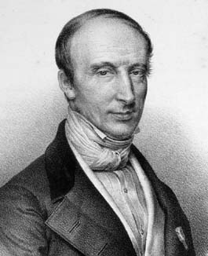
Augustin Louis Cauchy
1789 – 1857
Cauchy pioneered the study of analysis, both real and complex, and the theory of permutation groups. He also researched in convergence and divergence of infinite series, differential equations, determinants, probability and mathematical physics.

Slide 2


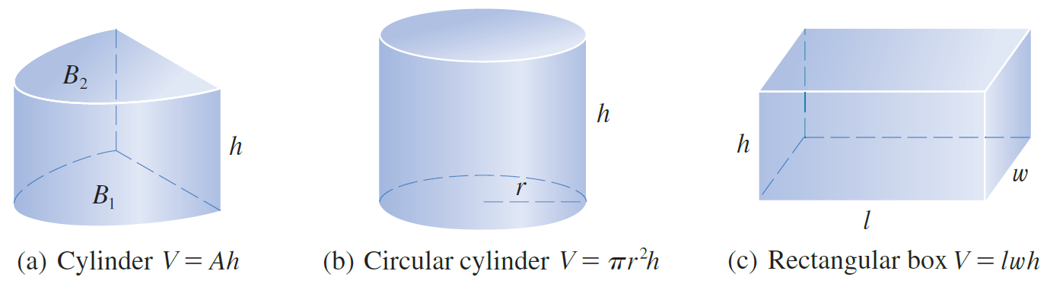

Slide 3
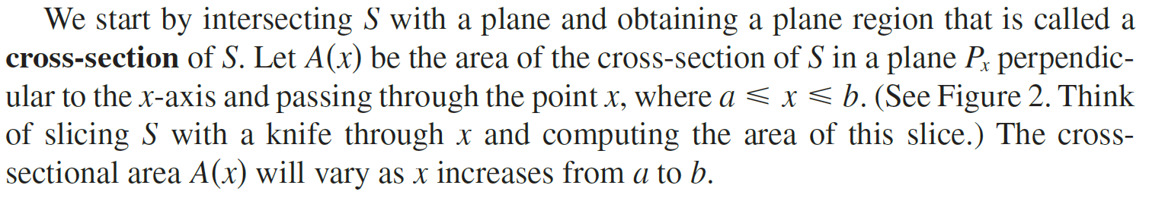
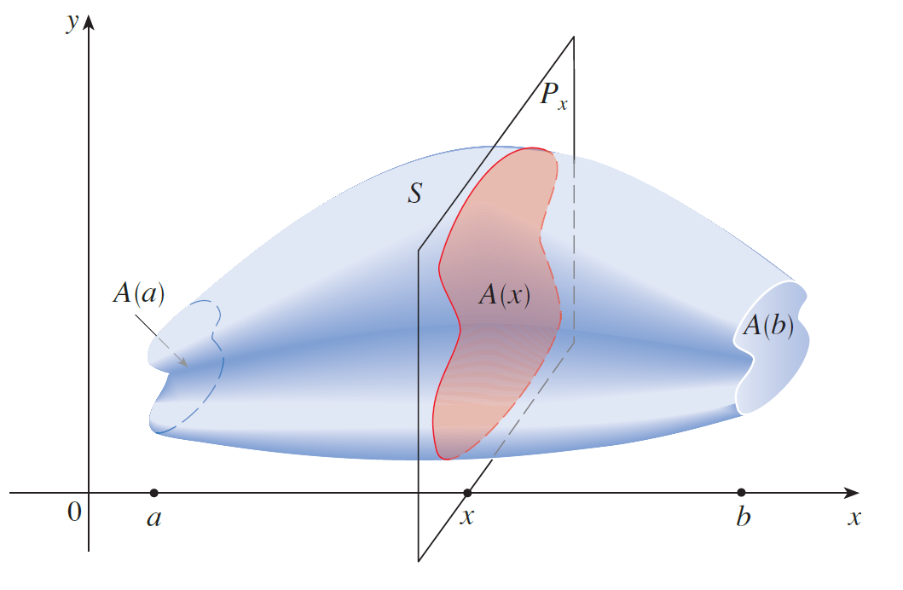


Slide 4

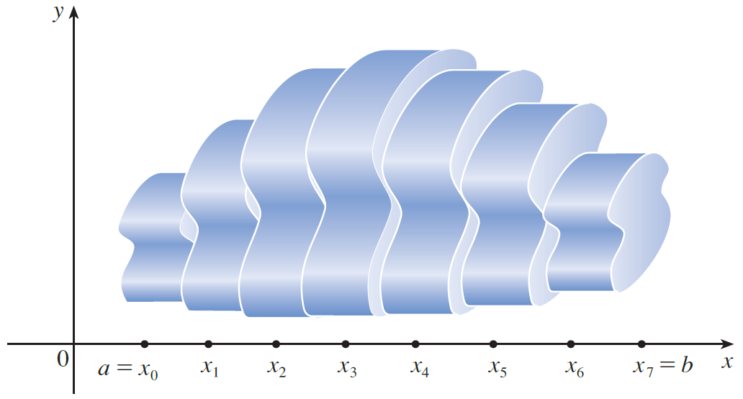
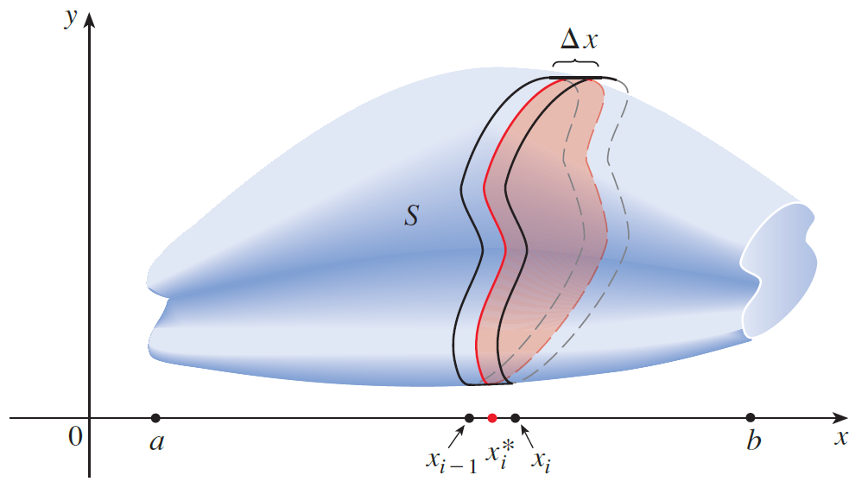

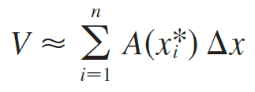
Adding the volumes of these slabs, we get an approximation to the total volume (that is, what we think of intuitively as the volume):

Slide 5
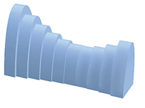

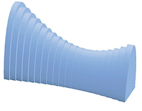

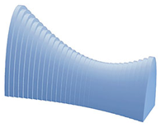
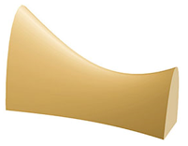


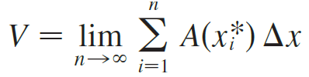
Increase the number of slabs.
We recognize the limit of a Riemann sum

Slide 6
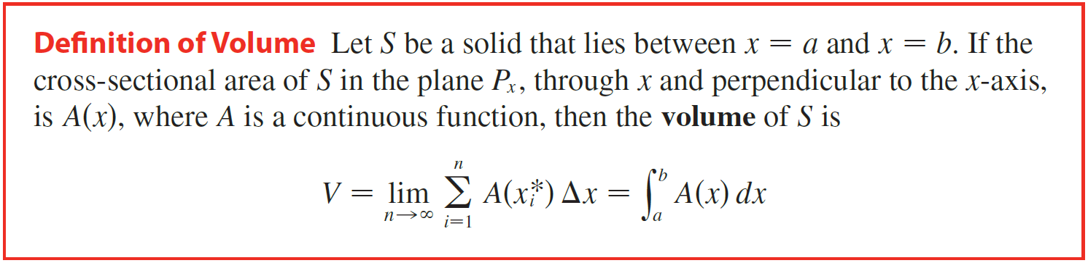

Slide 7
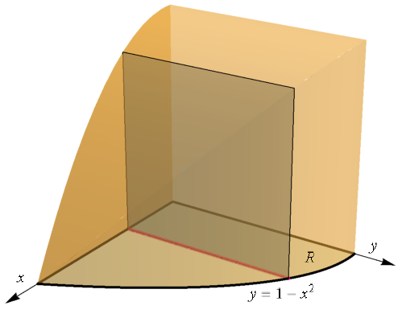
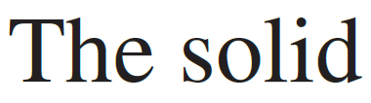
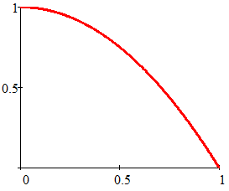

Example
Volume of a Parabolic Cube
Square Cross-section
Solution
The base
y
R
x
Base of Solid
$$1−x^{2}$$
x
x
(1,0)

Slide 8
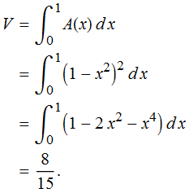
Example
Volume of a Parabolic Cube
Square Cross-section
Solution
x
Base of Solid
+
$$1−x^{2}$$
(1,0)
units³

Slide 9
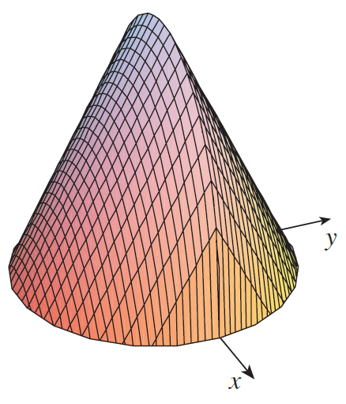
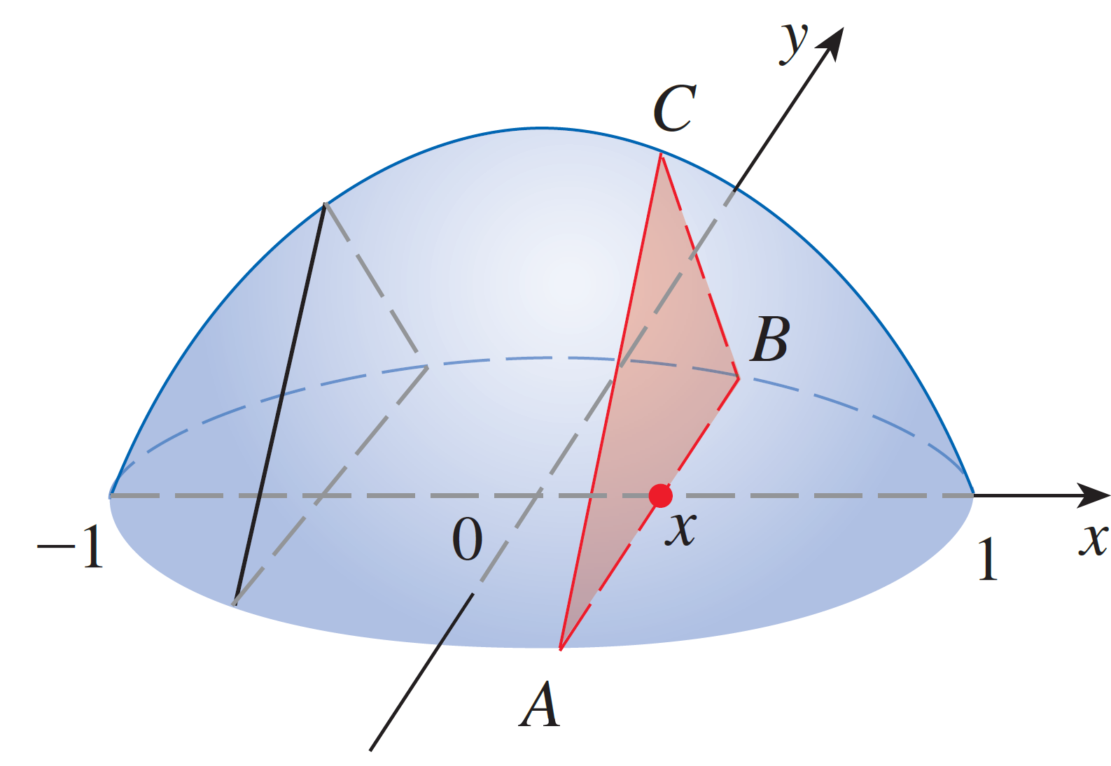
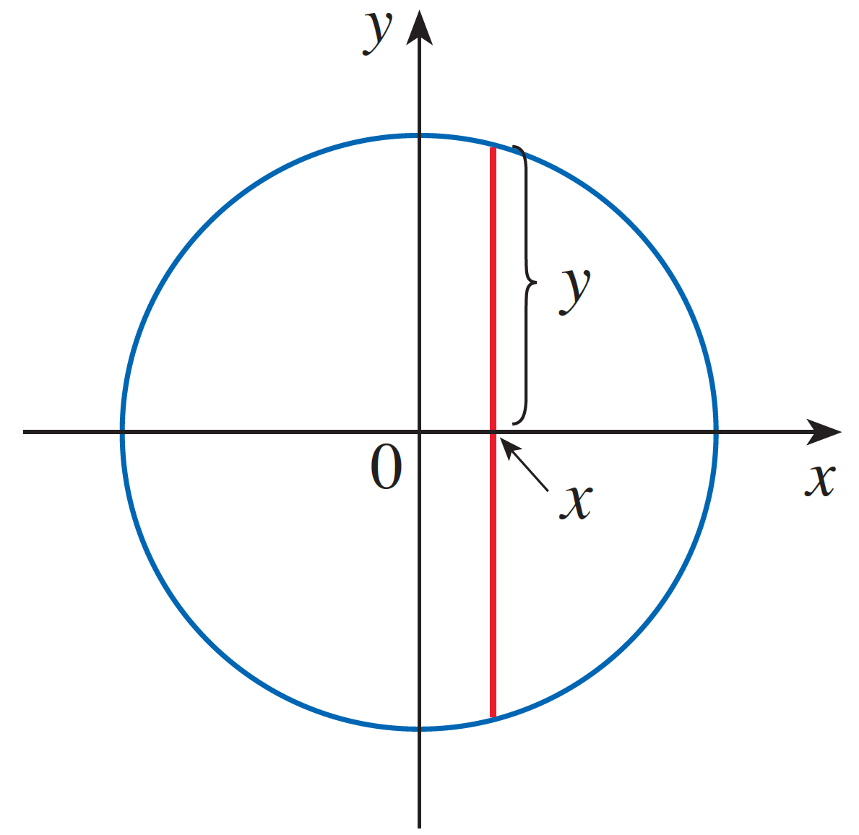
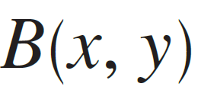

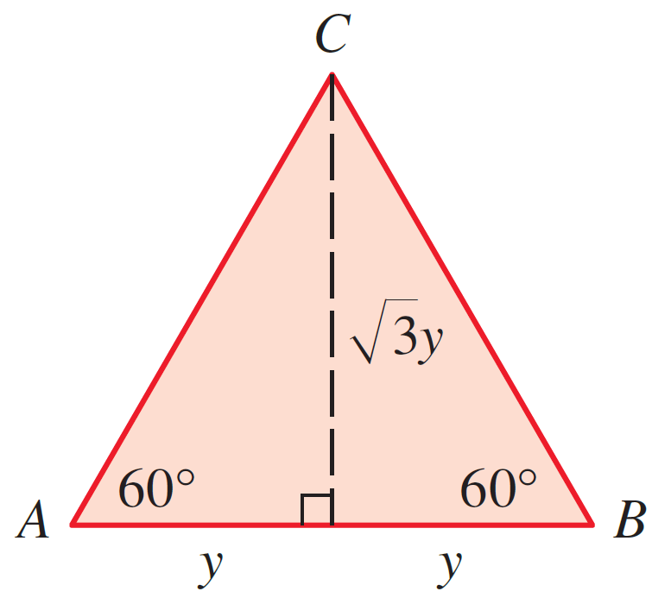


Example
Find the volume of the solid below with a circular base or radius r. For this solid, each cross section made with a plane P_{x} perpendicular to the x-axis is an equilateral triangle.
Solution
The base

Slide 10
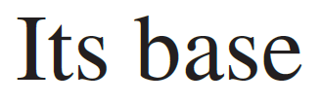
Example
Find the volume of the solid below with a circular base or radius r. For this solid, each cross section made with a plane P_{x} perpendicular to the x-axis is an equilateral triangle.
Solution
(Symmetry)

Slide 11


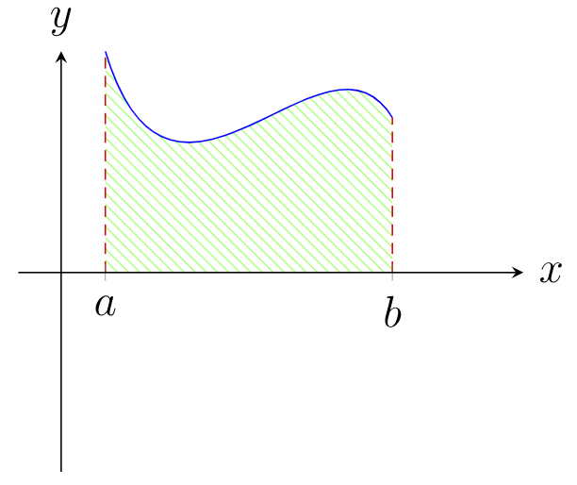
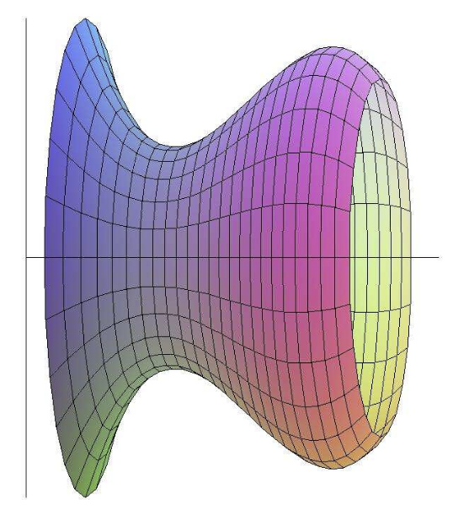
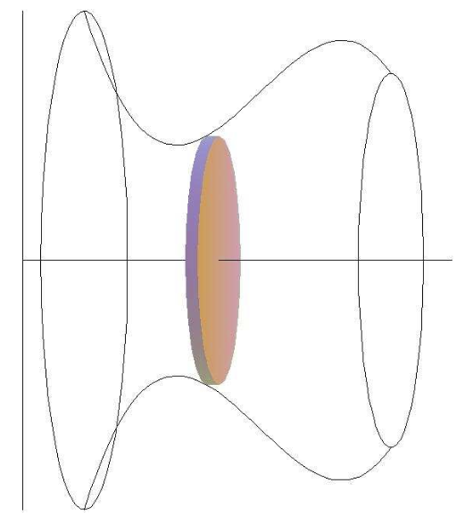

If we revolve a region about a line, we obtain a solid of revolution. In the following examples we see that for such a solid, cross-sections perpendicular to the axis of rotation are circular.
Disk Method
The base
x
x
“The Disk”

Slide 12
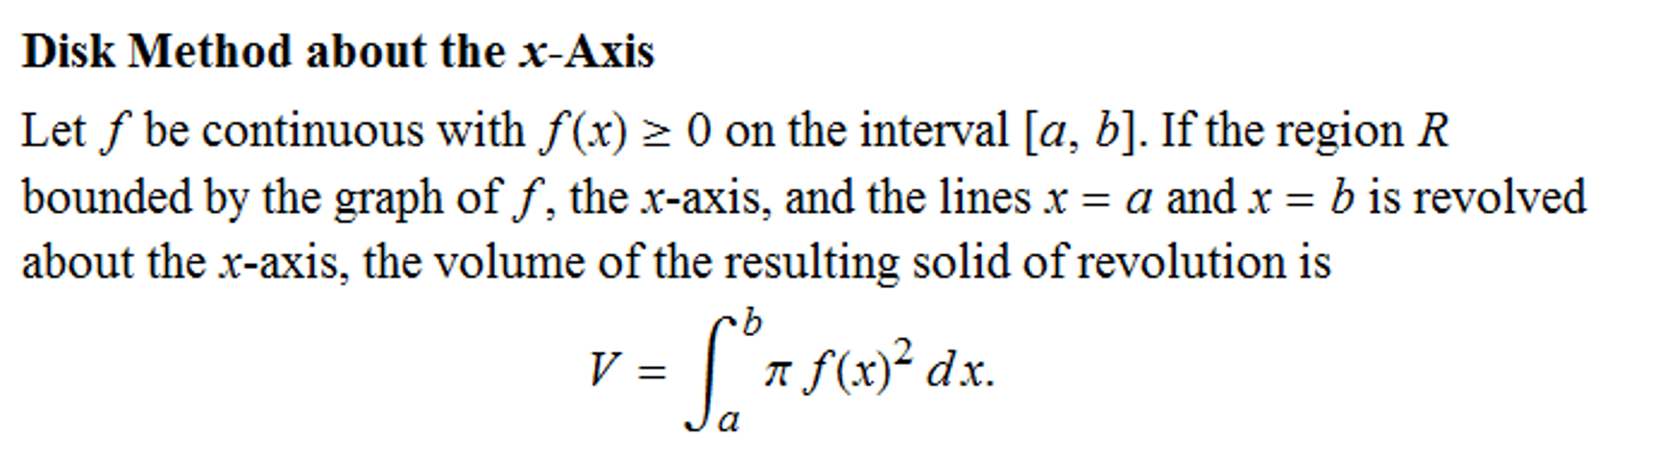
x

Slide 13
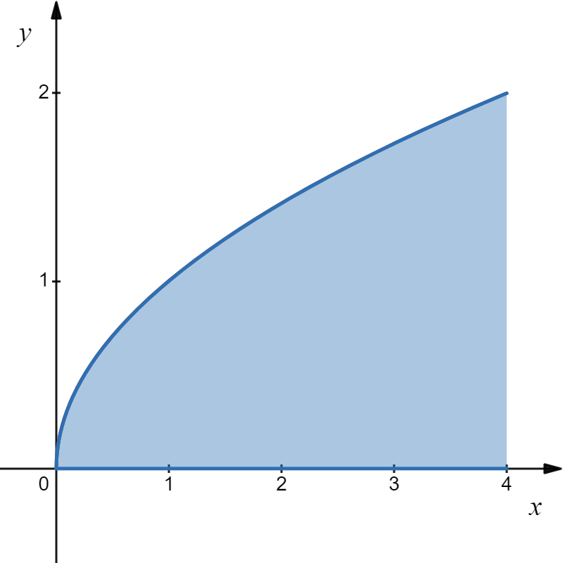
Example
The base
Suppose I start with this curve.
My boss at the ACME Rocket Company has assigned me to build a nose cone in this shape.
I revolve the curve about x-axis.
So, what is the volume of the nose cone?

Slide 14
`
Solution
How could we find the volume of the cone? Disk Method!
Draw the radius of the disk, a very thin rectangle.
Rotate about the x-axis.
A cross-section is a disk.
The volume of this disk is the area the face times thickness:
x
In this case:
r = the y value of the function
thickness = a small change in x = dx

Slide 15
`
Solution
If we add the volumes, we get:
x

Slide 16
In summary, if the bounded region is rotated about the x-axis, and the plane perpendicular to the x-axis intersects the region with circular disks, then the formula is:
.
Area of Face
Thickness
Volume of the Disk
A shape rotated about the y-axis would be:

Slide 17
The region between the curve , and the y-axis is revolved about the y-axis. Find the volume.
Example
Solution
We use a horizontal disk.
The thickness is dy.
y
The radius is the x value of the function .
x
volume of disk

Slide 18
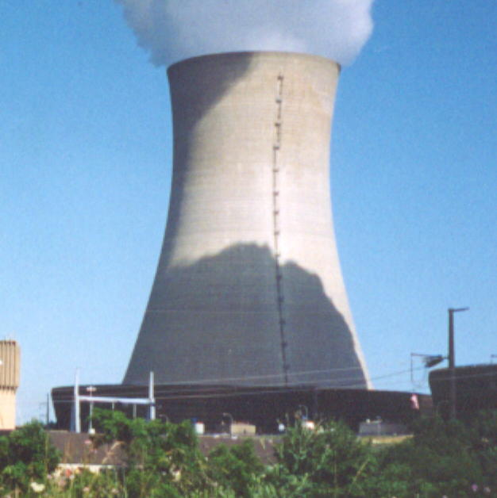
Example
The natural draft cooling tower shown at left is about 500 feet high and its shape can be approximated by the graph of this equation revolved about the y-axis:
Find the total of the cooling tower.
Solution
The volume can be calculated using the disk method with a horizontal disk.

Slide 19
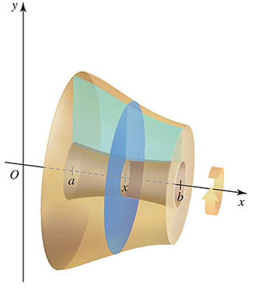
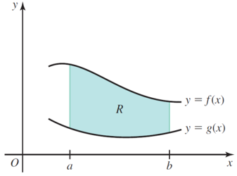
Washer Method
In the following examples we see that some solids of revolution have a hollow core surrounding the axis of revolution.
The Base
x
A disk with a hole in it, we will call
the cross-section a washer.

Slide 20
Washer Method
Area of Face A(x)

Slide 21
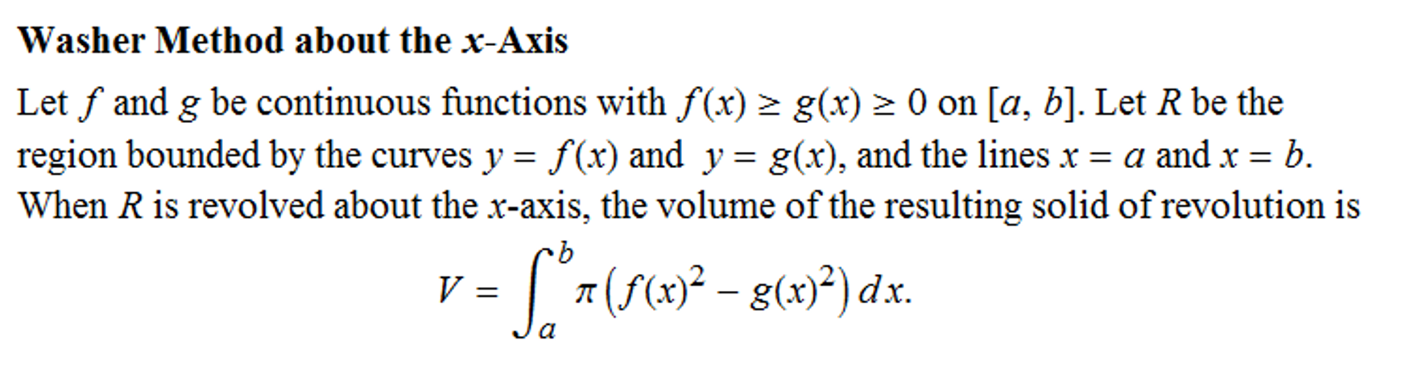
x

Slide 22

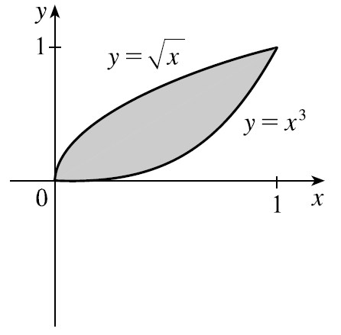

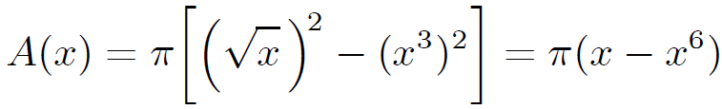
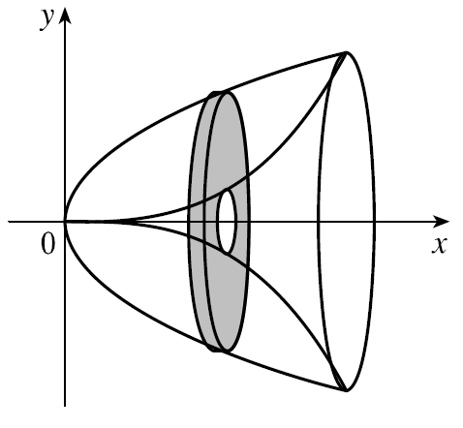




Example
Write an and evaluate an integral for the volume of the solid obtained by rotating the region bounded by the given curves about the specified line.
Solution
A cross-section is a washer with inner radius
x

Slide 23
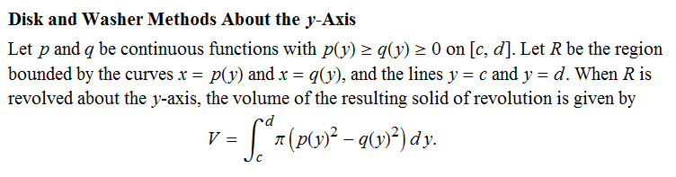
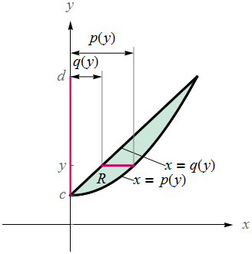

Slide 24
Example
The region bounded by and is revolved about the line x = 2. Find the volume.
y
The outer radius is:
The inner radius is:
x
r_{i}
r_{O}
x = 2

Slide 25
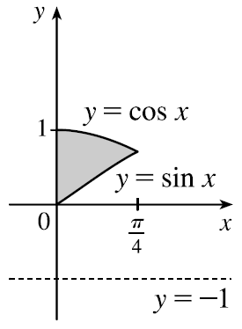






Example
Write an and evaluate an integral for the volume of the solid obtained by rotating the region bounded by the given curves about the specified line.
Solution
x

Slide 26

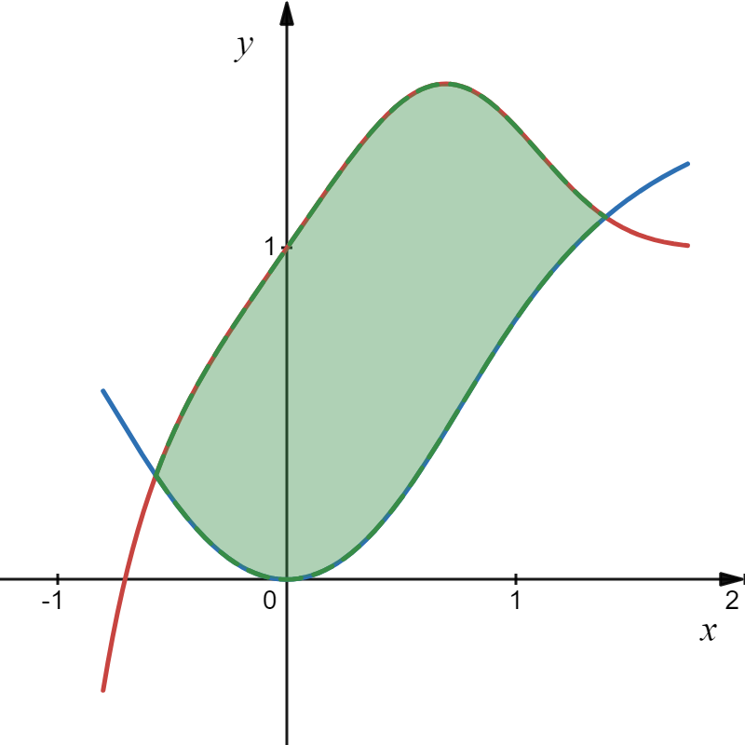



use a calculator
or computer to find (approximately)
Example
Let R be the region bounded by the curves,
use a calculator to approximate the following.
Find approximate x-coordinates of the points of intersection
of the given curves.
R
(b) Find the area of the region R.
Find the volume of the solid obtained by rotating the region R
about the x-axis.
Find the volume of the solid obtained by rotating the region R
about the line y = −2.
Find the volume of the solid obtained by using the region R as a base of a solid where each cross
section perpendicular to the x-axis is an equilateral triangle.

Slide 27

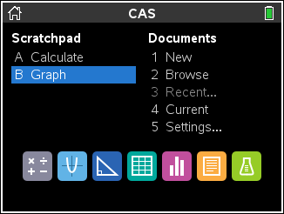
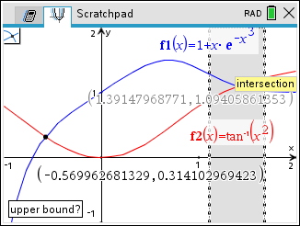
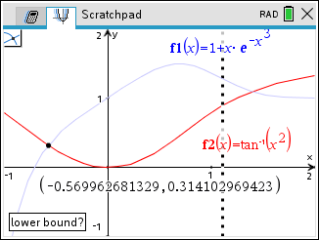
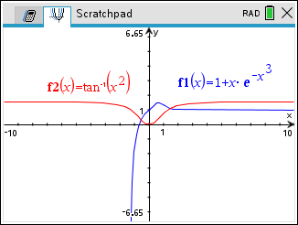
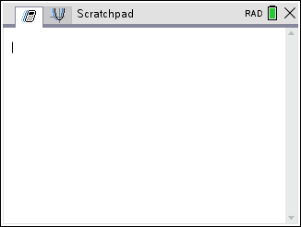
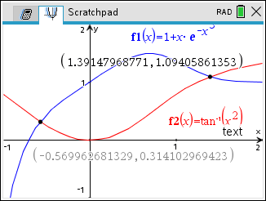
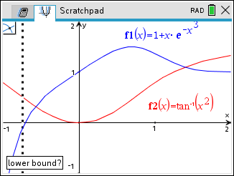
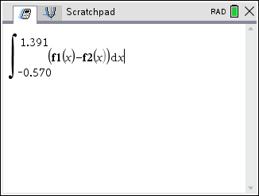

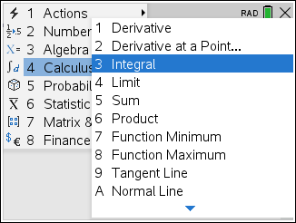
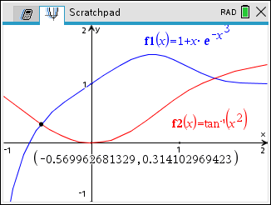
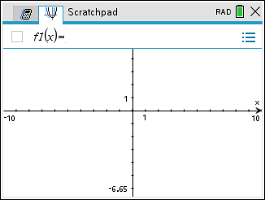












use a calculator
or computer to find (approximately)
Solution
Find approximate x-coordinates of the points of intersection
of the given curves.
(1.391, 1.094)
The points of intersection are
(−0.570, 0.314) and (1.391, 1.094).
R
(−0.570, 0.314)
(b) Find the area of the region R.
x

Slide 28






use a calculator
or computer to find (approximately)
Solution
Find the volume of the solid obtained by rotating the region R
about the x-axis.
(1.391, 1.094)
R
(−0.570, 0.314)
x

Slide 29







use a calculator
or computer to find (approximately)
Solution
Find the volume of the solid obtained by rotating the region R
about the line y = −2.
(1.391, 1.094)
R
(−0.570, 0.314)
x
y = −2

Slide 30
use a calculator
or computer to find (approximately)
Solution
B
Find the volume of the solid obtained by using the region R as
a base of a solid where each cross section perpendicular to
the x-axis is an equilateral triangle.
(1.391, 1.094)
R
(−0.570, 0.314)
A
x
C
A
B

Slide 31





use a calculator
or computer to find (approximately)
Solution
B
Find the volume of the solid obtained by using the region R as
a base of a solid where each cross section perpendicular to
the x-axis is an equilateral triangle.
(1.391, 1.094)
R
(−0.570, 0.314)
A
x
C
A
B

