Slide 1

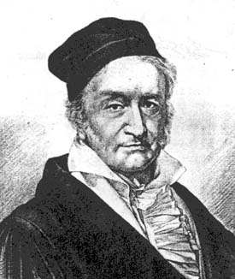
Johann Carl Friedrich Gauss
1777 – 1855
Gauss worked in a wide variety of fields in both mathematics and physics including number theory, analysis, differential geometry, geodesy, magnetism, astronomy and optics. His work has had an immense influence in many areas.

Slide 2
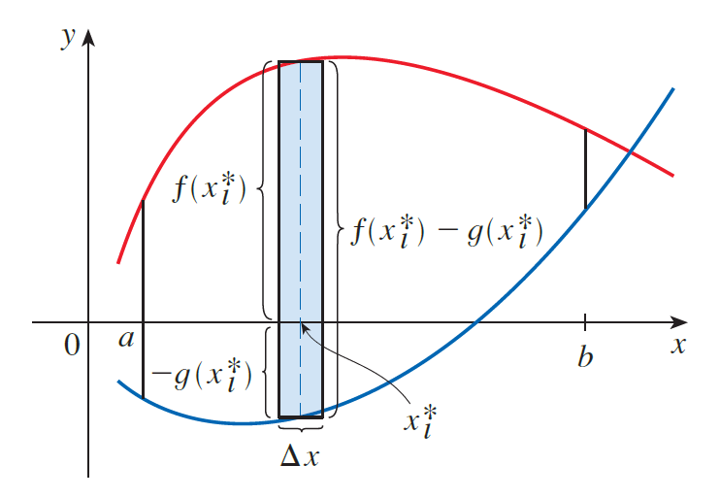
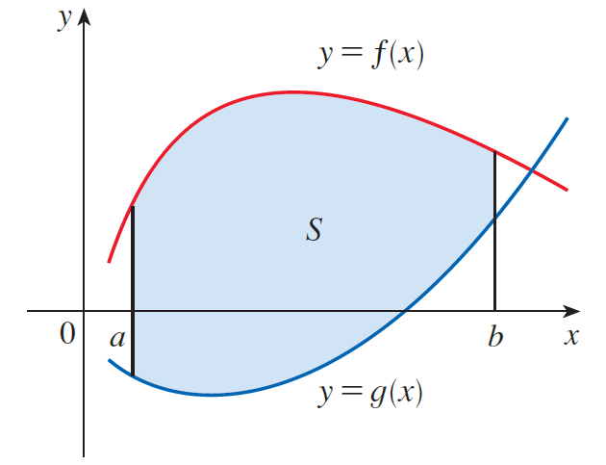
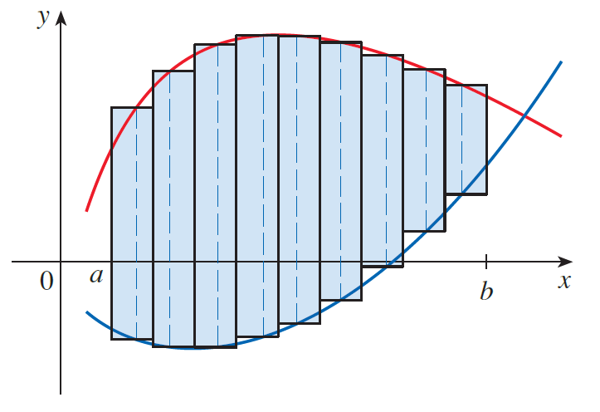


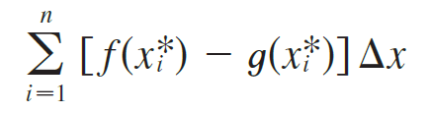

The Riemann sum
$$S≈$$

Slide 3
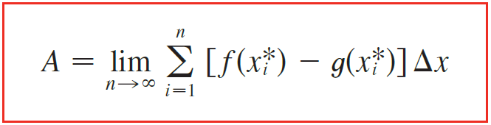
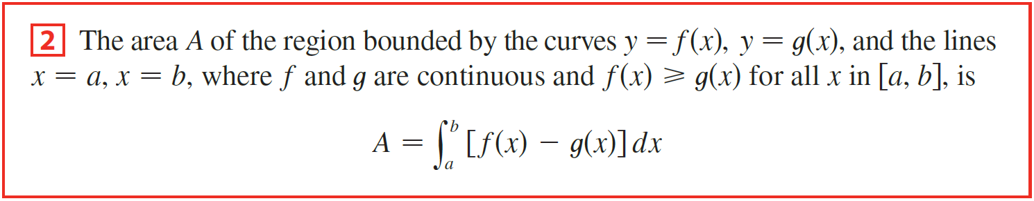
we have the
following
formula for area.
2
This approximation appears to become better and better as $n→∞.$Therefore, we define the area A of the region S as the limiting value of the sum of the areas of these approximating rectangles.
Therefore, we have the following formula for area.

Slide 4
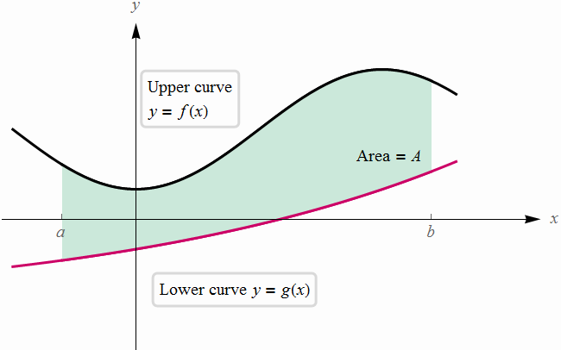



Top Curve
dx
x
Bottom Curve

Slide 5
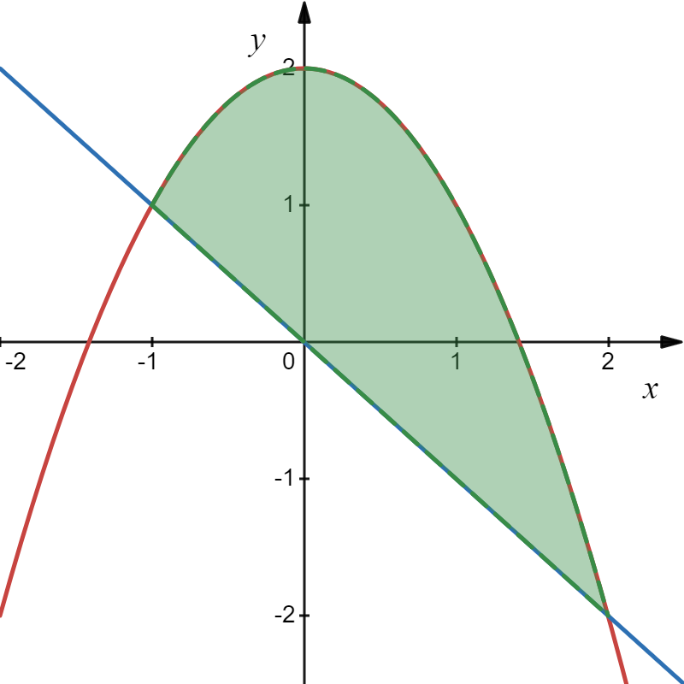
Example
Find the area of the region bounded between the two curves.
Since this strip is a long thin rectangle, the area is:
If we add all the rectangles, we get:

Slide 6
Example
Find the area of the region bounded between the two curves.
Solution

Slide 7
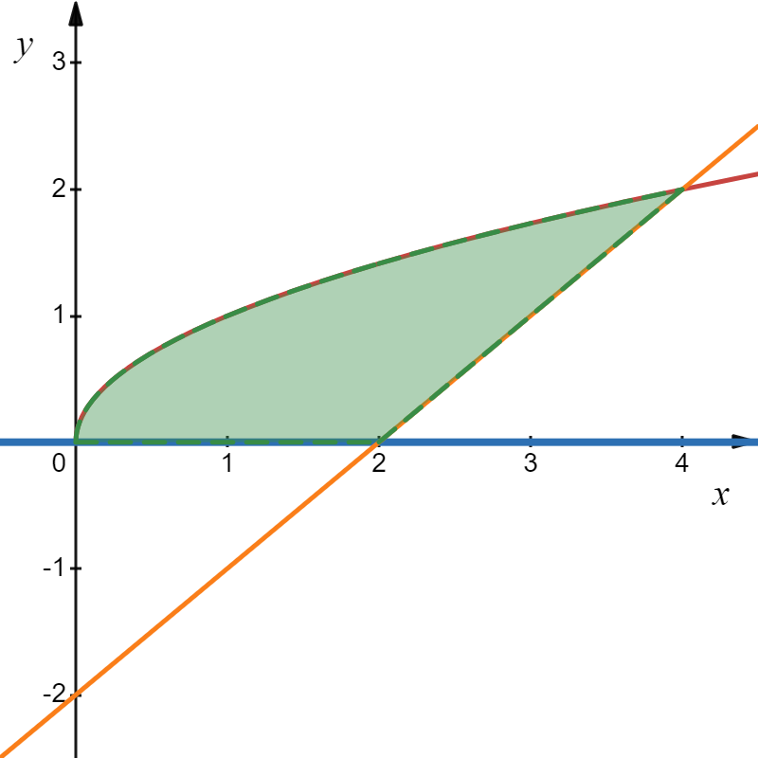
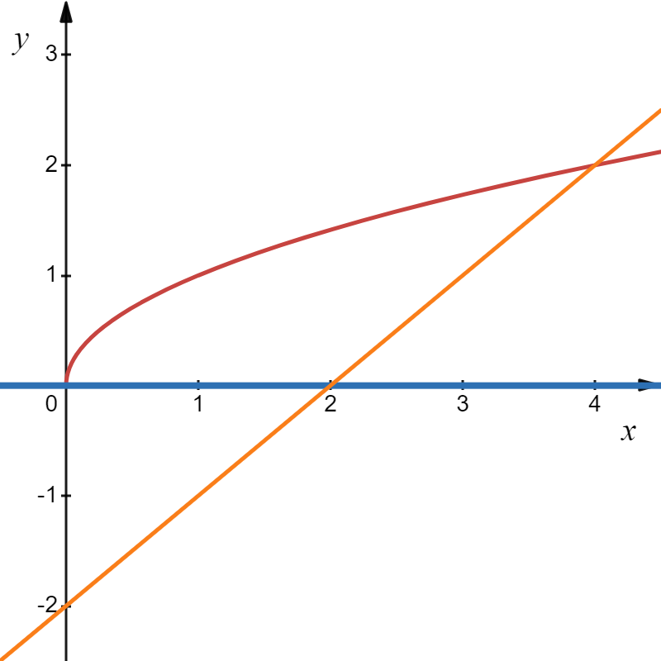
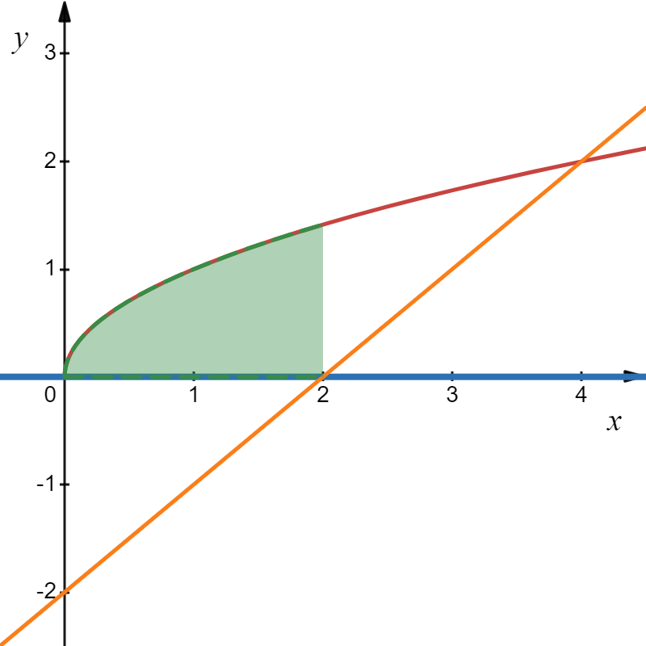

Example
Solution
We must integrate in two separate regions:
Is there an easier way?

Slide 8
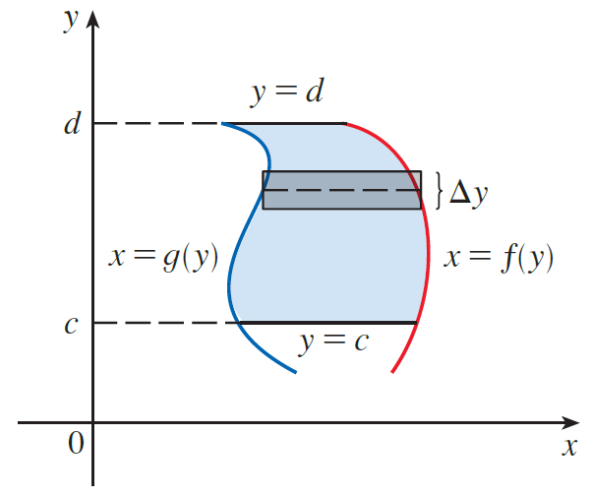



Example
We can find the same area using a horizontal rectangle.
Since the width of the rectangle is dy, we find the length of the rectangle by solving for x in terms of y.

Slide 9
Example
Solution
What are the limits?
length of
rectangle
width of strip
That was a lot easier!

Slide 10
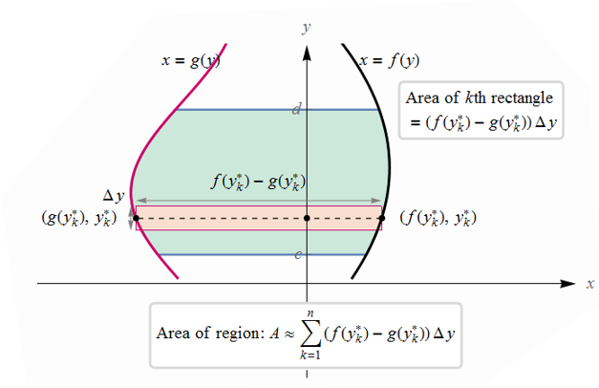

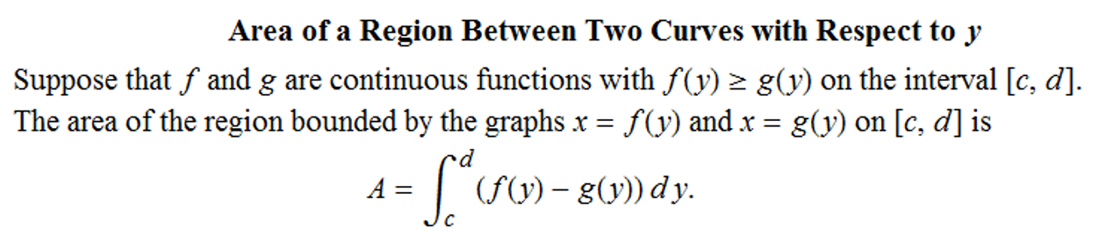
Definition

Slide 11
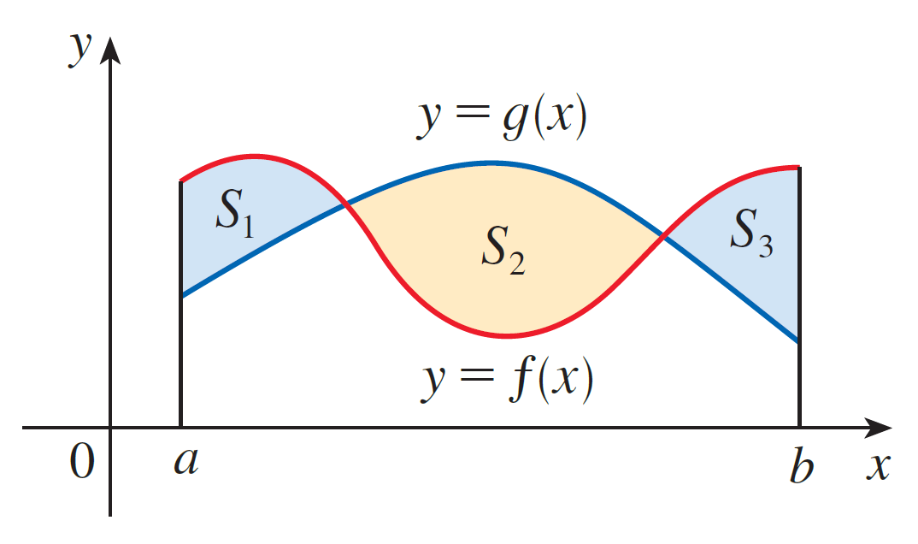
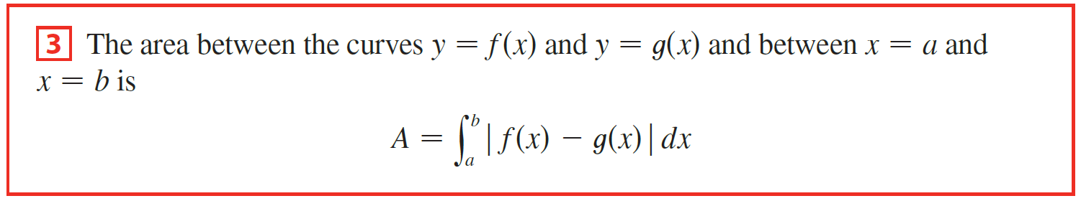
If we are asked to find the area between the curves y = f (x) and y = g(x) where f (x) > g(x) for some values of x but g(x) > f (x) for other values of x, then we split the given region S into several regions S₁, S₂, . . . with areas A₁, A₂, . . . as shown in the figure.

Slide 12
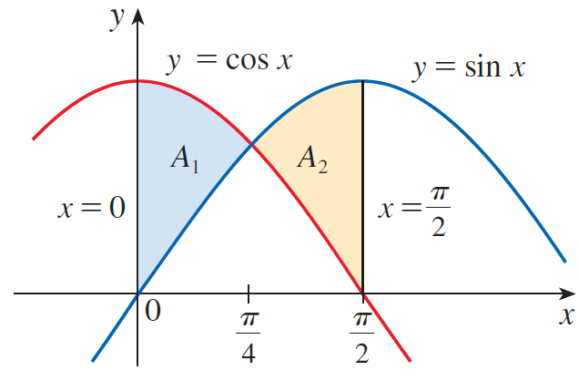
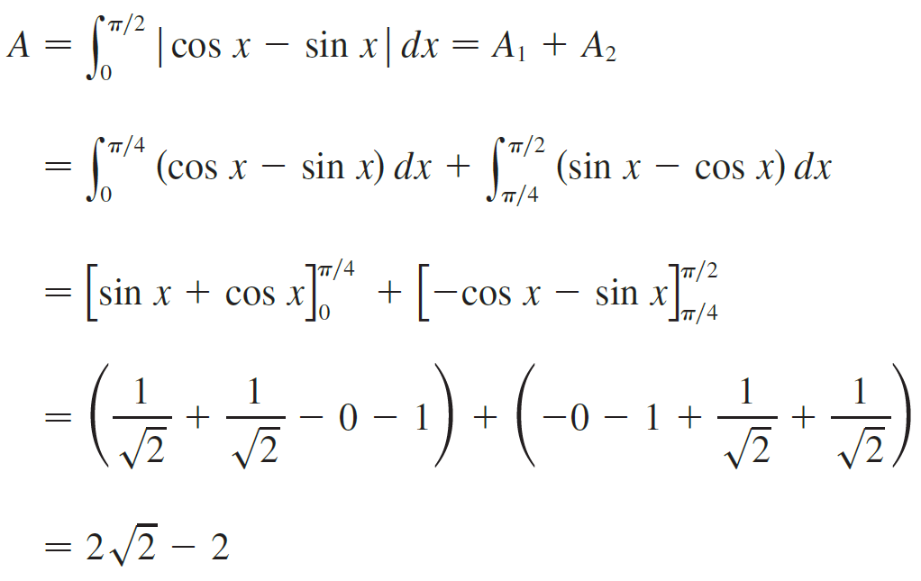
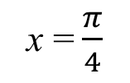
Example
Find the area of the region bounded by the curves y = sin x, y = cos x, x = 0, and x = $π/$2.
Solution
What’s the point of intersection?
sin x = cos x
units²
x = $\frac{π}{4}$

Slide 13
General Strategy for Area Between Curves:
1
Sketch the curves.
2
Decide on vertical or horizontal rectangle connecting the boundary curves. (Pick whichever is easier to write formulas for the length of the rectangle, and/or whichever will let you integrate fewer times.)
3
Write an expression for the area of the rectangle.
(If the width is dx, the length must be in terms of x.
If the width is dy, the length must be in terms of y.
4
Find the limits of integration. (If using dx, the limits are x values; if using dy, the limits are y values.)
5
Integrate to find area.

Slide 14
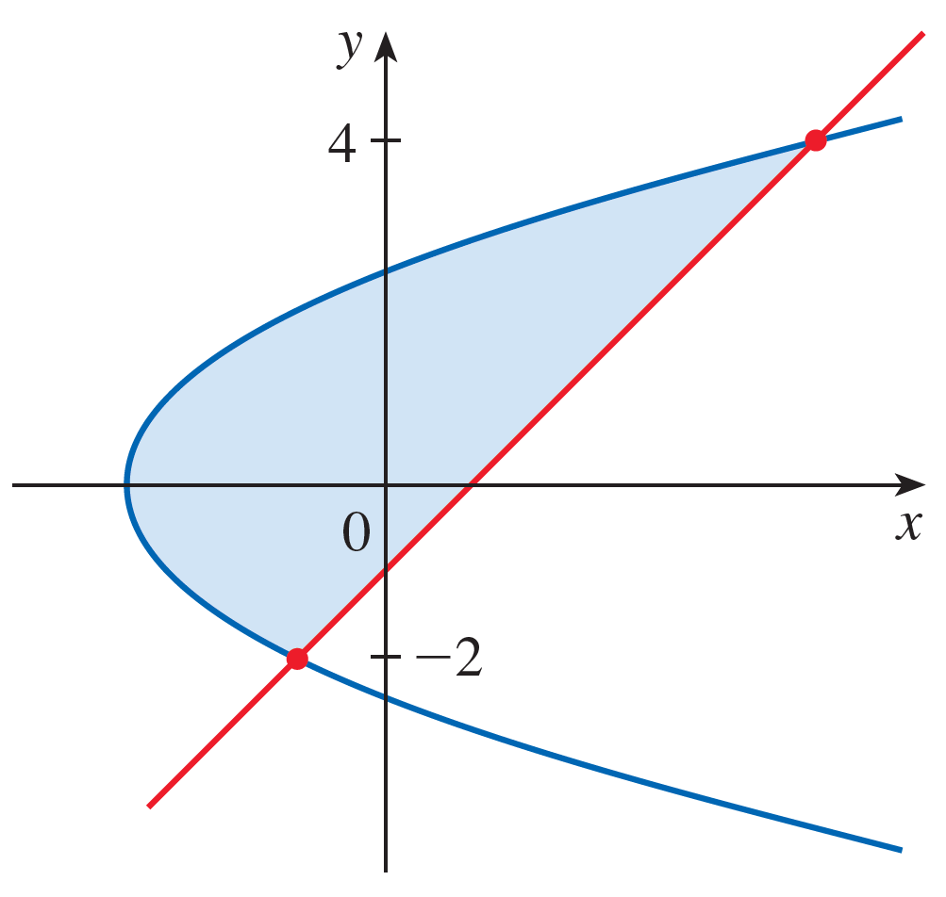


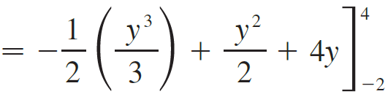

Example
Find the area enclosed by the line $y=x−1$ and the parabola $y^{2}=2x+6$.
Solution
By solving the two equations simultaneously we find the points of intersection are
Vertical or horizontal rectangles?
We solve the equations for x
units²

Slide 15
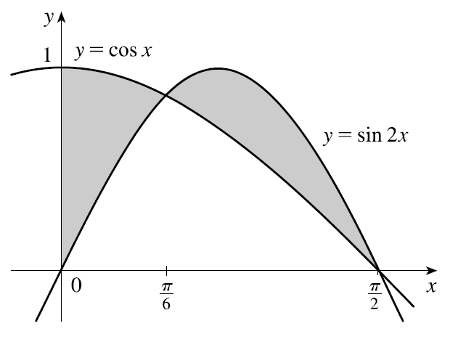








Example
Sketch the region enclosed by the given curves and find its area.
Solution
By solving the two equations simultaneously we find the point of intersection is
Horizontal or vertical rectangles?

Slide 16
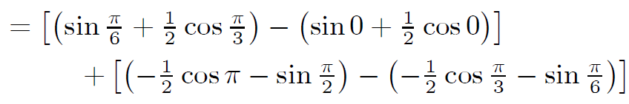
Example
Sketch the region enclosed by the given curves and find its area.
Solution

Slide 17
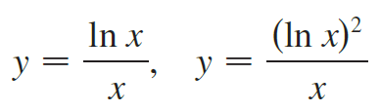

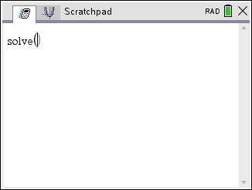
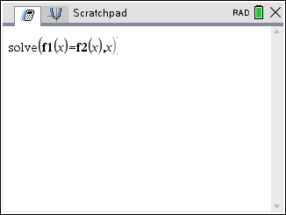
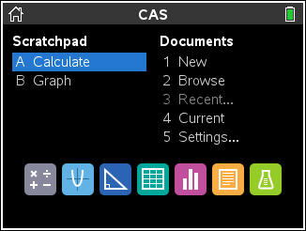
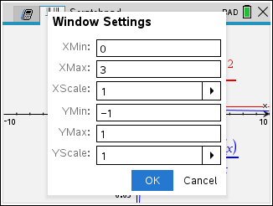
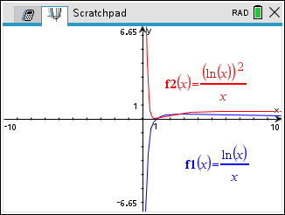
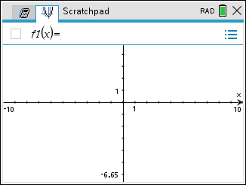
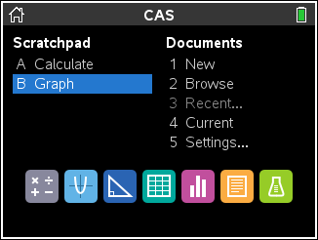
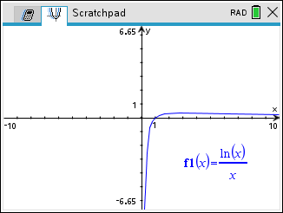
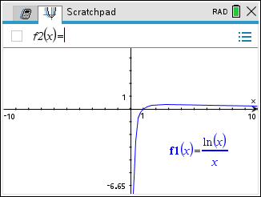
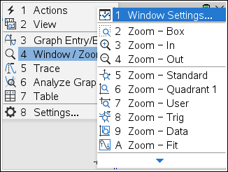
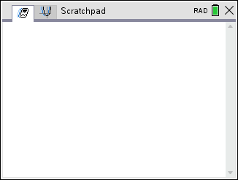
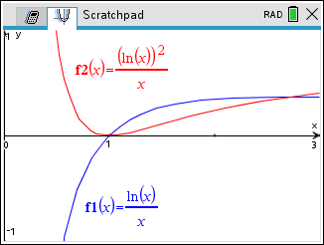
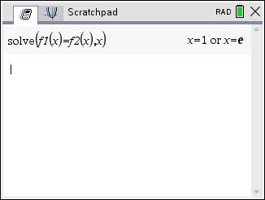
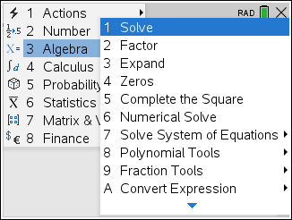
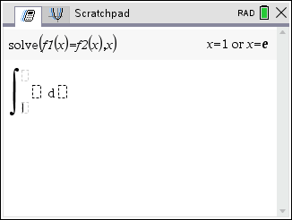
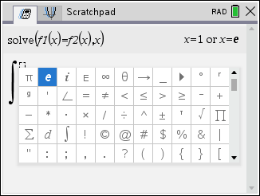
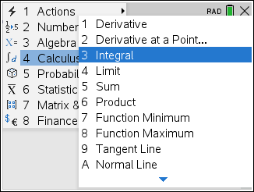
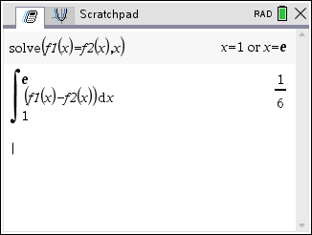
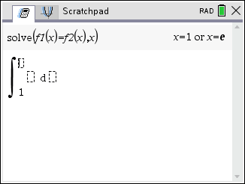
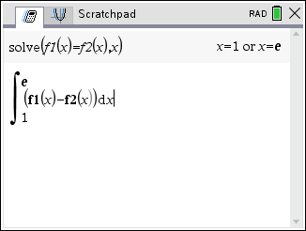
Example
Sketch the region enclosed by the given curves and find its area.
Solution
By solving the two equations simultaneously with CAS we get
We will use vertical rectangles.

