Slide 1

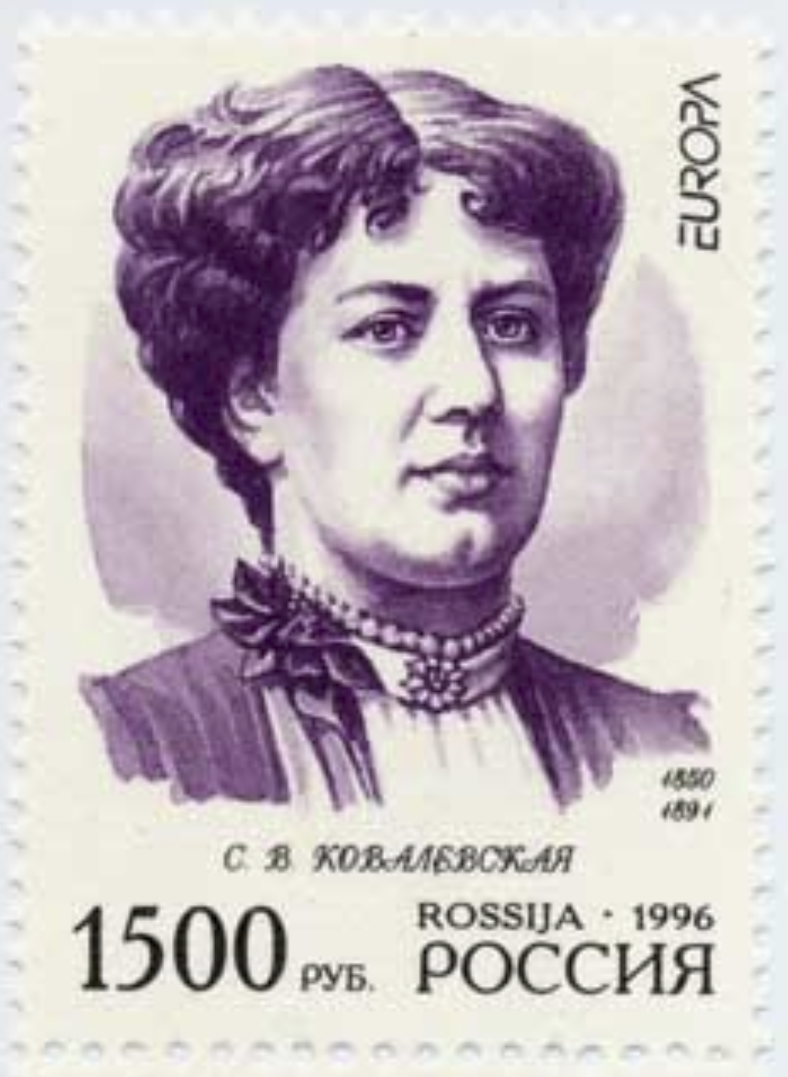
Sofia Kovalevskaya 1850 – 1891
Kovalevskaya was a Russian mathematician who made noteworthy contributions to analysis, partial differential equations and mechanics. She was a pioneer for women in mathematics around the world -- the first woman to obtain a doctorate (in the modern sense) in mathematics.

Slide 2

Because of the Fundamental Theorem, it’s important to be able to find antiderivatives. But our antidifferentiation formulas don’t tell us how to evaluate integrals such as
To find this integral we use the problem-solving strategy of introducing something extra. Here the “something extra” is a new variable; we change from the variable x to a new variable u. Making the integrand an obvious derivative.
Let’s see how it works!

Slide 3


Example
Evaluate the indefinite integral.
Solution
The variable of integration must match the variable in the integrand.
Don’t forget to substitute the value for u back into the problem!
This technique is called the “Substitute Rule.” It transforms the integrand into an obvious derivative.

Slide 4

Example
Evaluate the indefinite integral.
Solution
One of the clues that we look for is if we can find a function and its derivative in the integrand.
The derivative of is .
Differentiate
Separation of variables
Note that this only worked because of the factor 2x in the original integrand. Many integrals can not be done by substitution.

Slide 5
Example
Evaluate the indefinite integral.
Solution
Solve for dx.

Slide 6
Example
Evaluate the indefinite integral.
Solution

Slide 7
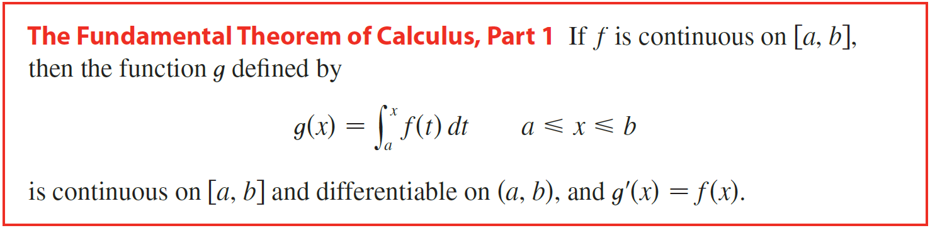

Slide 8
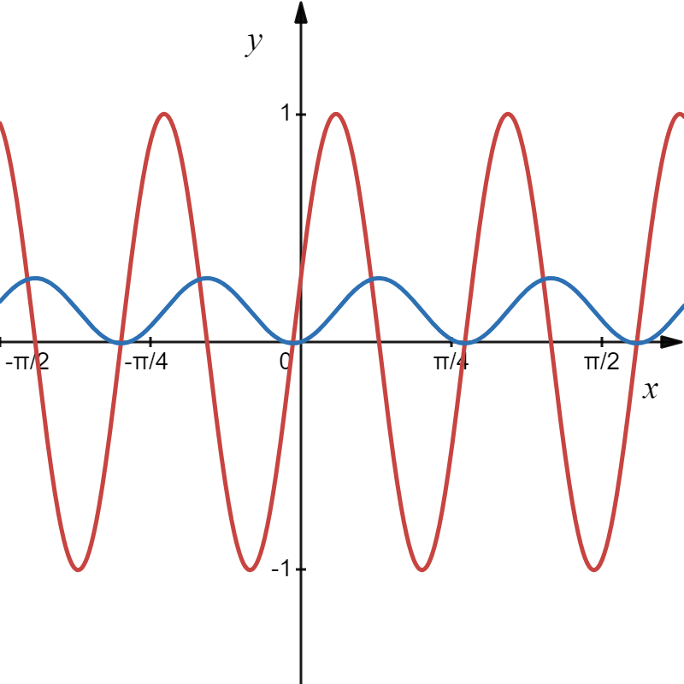
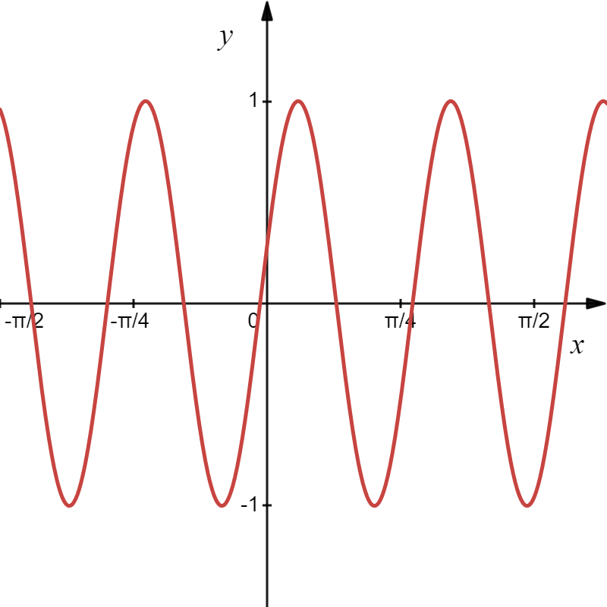
By FTC part 1
Since the integrand has a symbolic antiderivative, previous example, we can write g(x) as
Letting C = 0 we get

Slide 9
Example
Evaluate the indefinite integral.
Solution
We solve for because we can find it in the integrand.

Slide 10
Example
Evaluate the indefinite integral.
Solution

Slide 11


Example
Evaluate the definite integral.
FTC Part 2
Solution
new upper limit
Must Change the original limits!
new lower limit

Slide 12
Example
Evaluate the definite integral.
Solution
New Limits
Don’t forget to use the new limits.
7th grade math

Slide 13
Example
Evaluate the definite integral.
Solution
New Limits

Slide 14
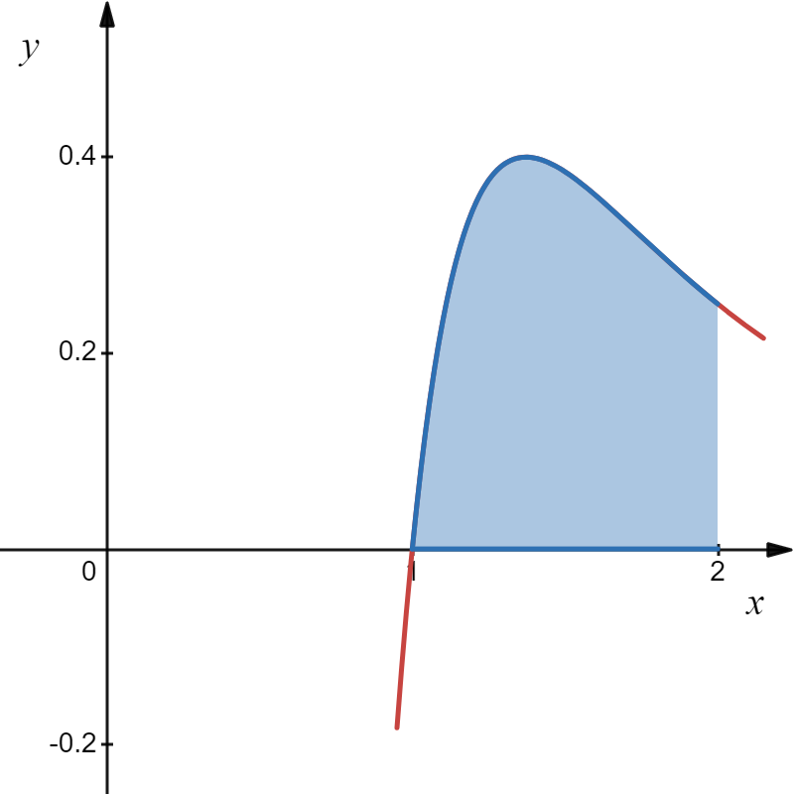
Example
Evaluate the definite integral.
Solution
New Limits

Slide 15
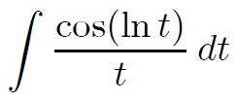
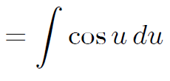




Example
Evaluate the indefinite integral.
Solution

Slide 16
Example
Evaluate the indefinite integral.
Solution

