Slide 1
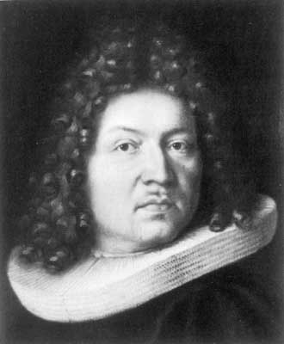
Jacob Bernoulli
1654 – 1705
Jacob Bernoulli was a Swiss mathematician who became familiar with calculus through a correspondence with Gottfried Leibniz, then collaborated with his brother Johann on various applications, notably publishing papers on transcendental curves.

Slide 2
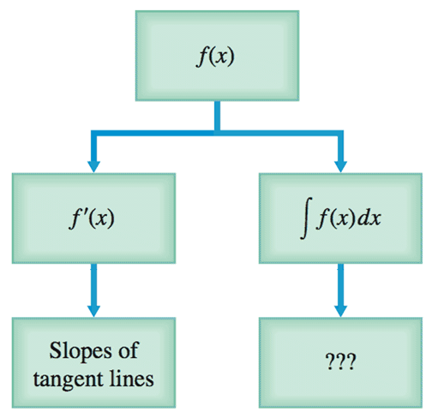

Slide 3

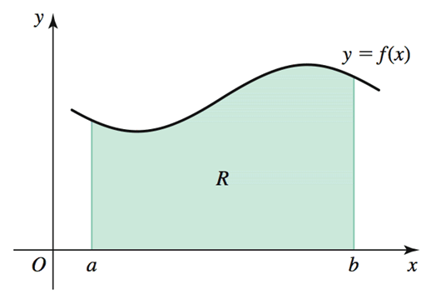

Slide 4
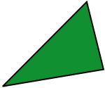


Slide 5
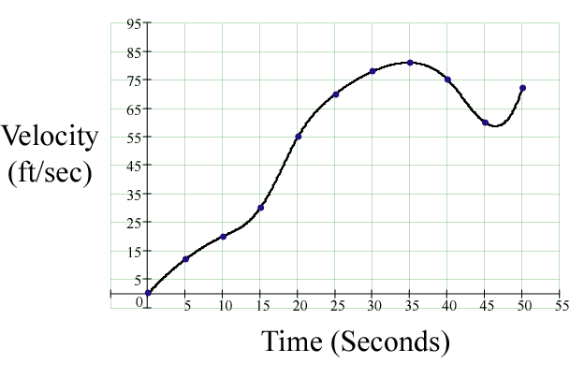
How about the area under the curve and above the x-axis? What does that area represent?
Distance
Traveled
t = 0
t = 50

Slide 6
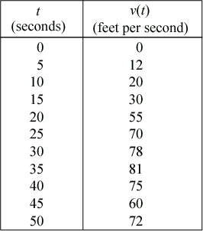

Right-Hand Rectangles

Slide 7
Right-Hand Rectangles
Left-Hand Rectangles

Slide 8
Right-Hand Rectangles
Left-Hand Rectangles
Midpoint Rectangles

Slide 9
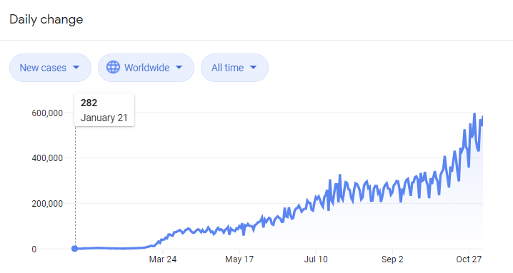
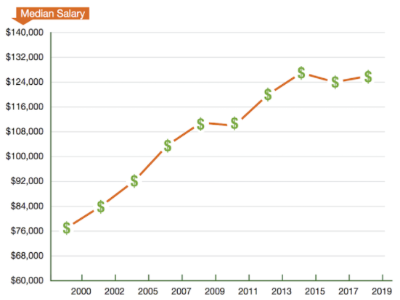
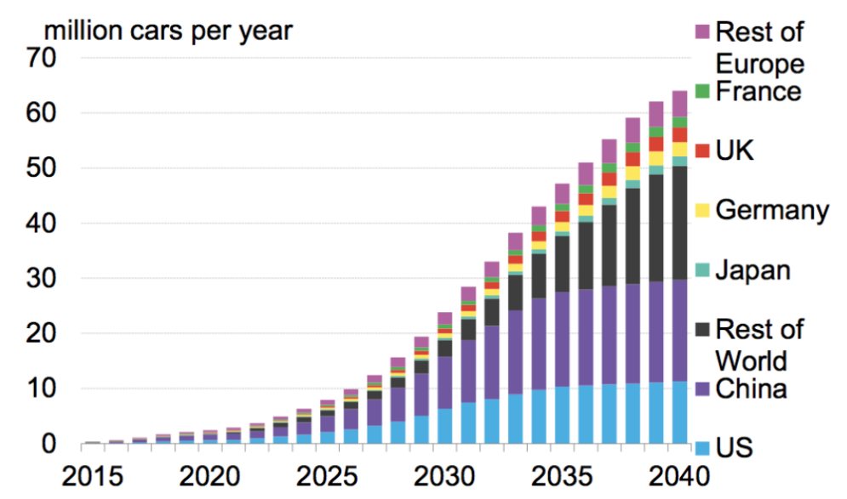
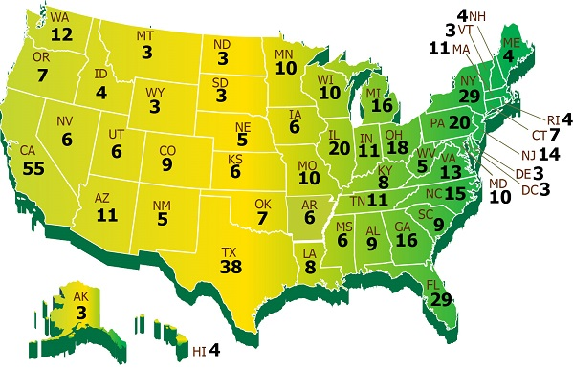
“Area” Under the Curve
Covid-19
STEM Salaries
Total Salary
Total Cases
Electric Cars
Total Electoral College
Total Electric
Cars

Slide 10
Example
Find the area under the curve using the left endpoint of four subintervals over the interval [0, 4]. Left-hand Rectangles
Solution
Approximate area:

Slide 11
Example
Find the area under the curve using the right endpoint of four subintervals over the interval [0, 4]. Right-hand Rectangles
Solution
Approximate area:

Slide 12
Example
Use rectangles generated from the midpoint of each subinterval to find the area under the curve . Midpoint Rectangles.
Solution
Approximate area:
In this example there are four subintervals. As the number of subintervals increases, so does the accuracy.

Slide 13
With 8 subintervals:
Approximate area:
What is the exact area?
We need more rectangles!
width of subinterval

Slide 14
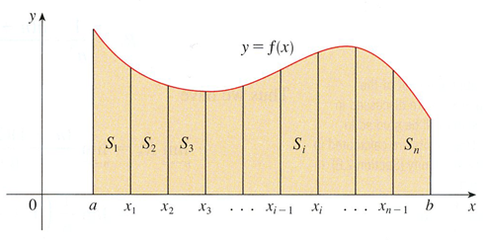




Slide 15
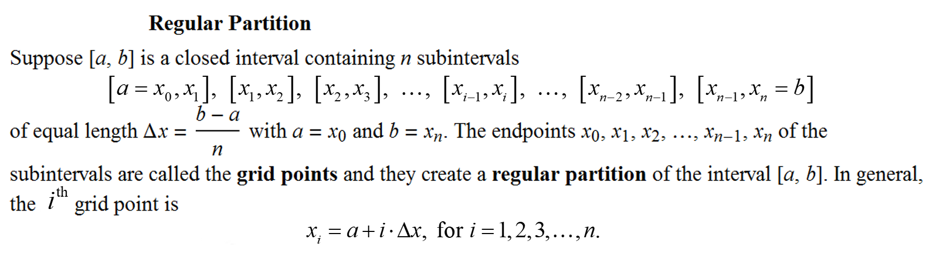
Definition

Slide 16
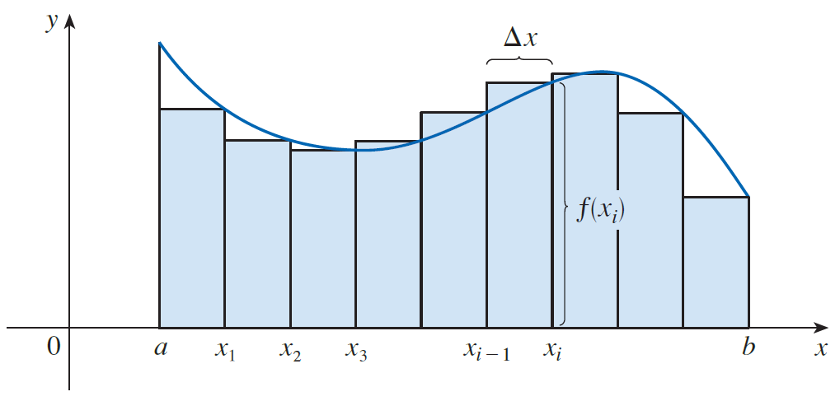
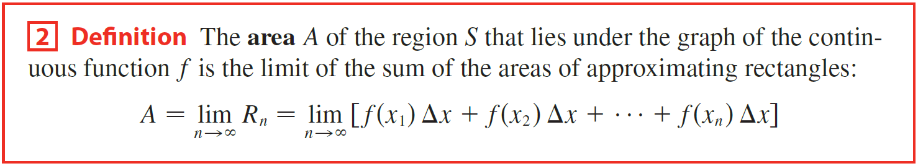
This summation is called a Right Riemann Sum, it calculates the area under the curve.

Slide 17
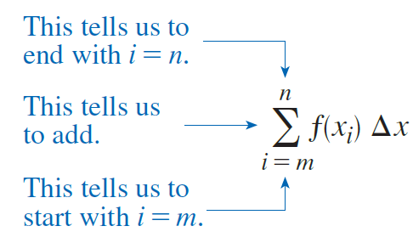
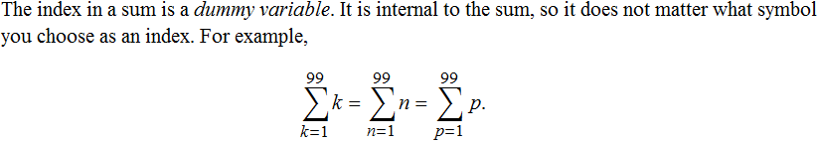



Riemann Sum
Condensed Sum
Expanded Sum
Heights of Rectangles
Width

Slide 18

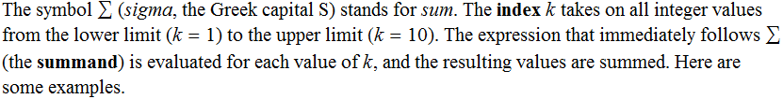





Slide 19
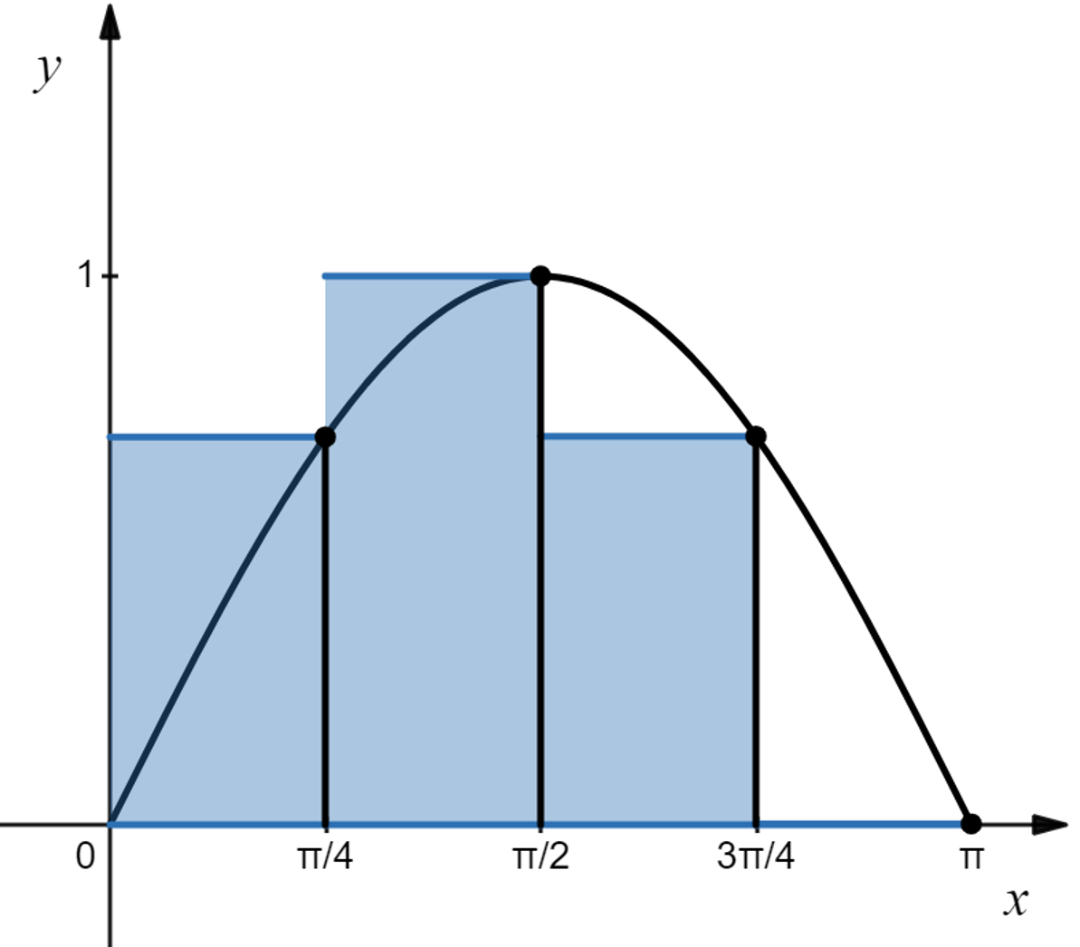
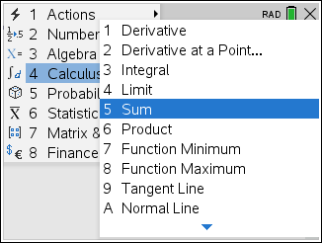
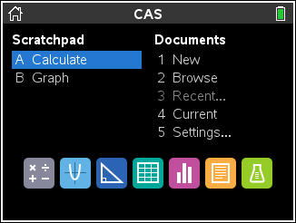
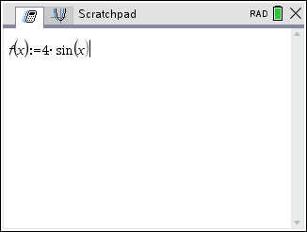
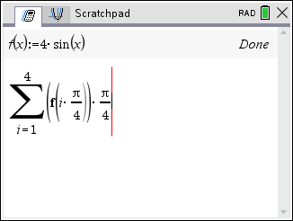
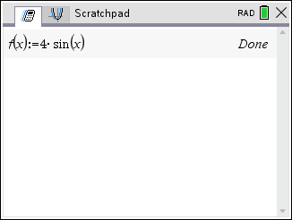
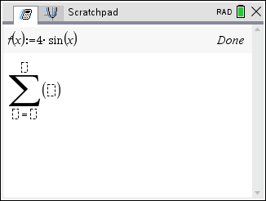
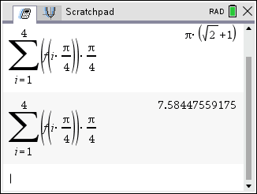
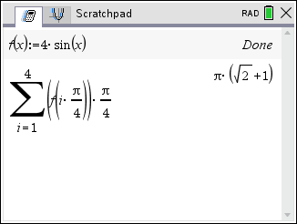

Example
Find the area under the curve using a Right Riemann sum,
over the interval [0, π] with 4 subintervals.
Solution
Height of Rectangles
Base Width of Rectangles
$≈$7.584

Slide 20
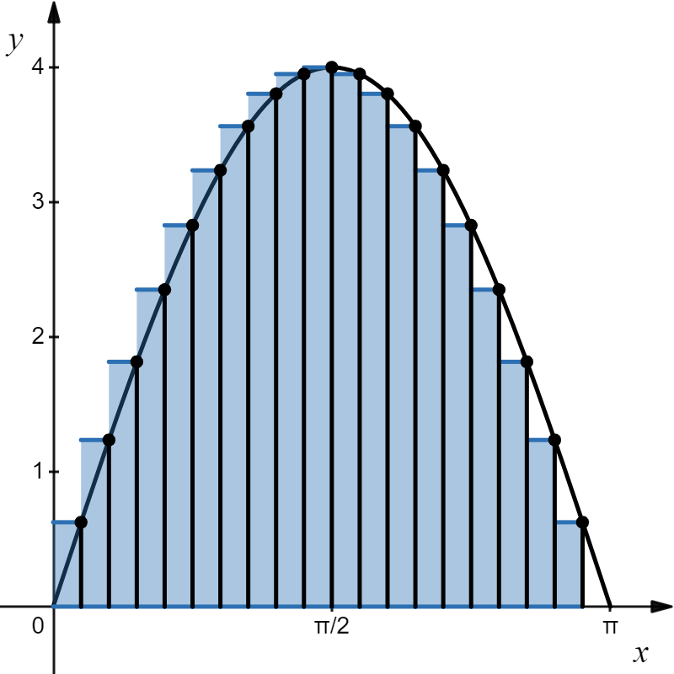
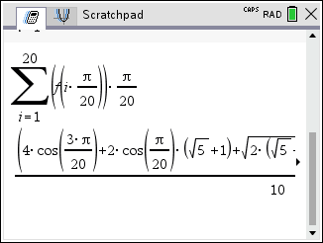
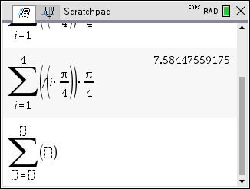
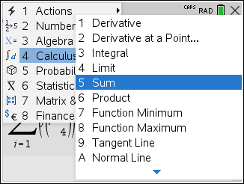
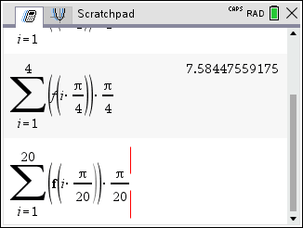
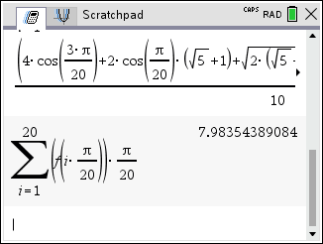

Example
Find the area under the curve using a Right Riemann sum,
over the interval [0, π] with 20 subintervals.
Solution
$≈$7.984
Height of Rectangles
Base Width of Rectangles

Slide 21
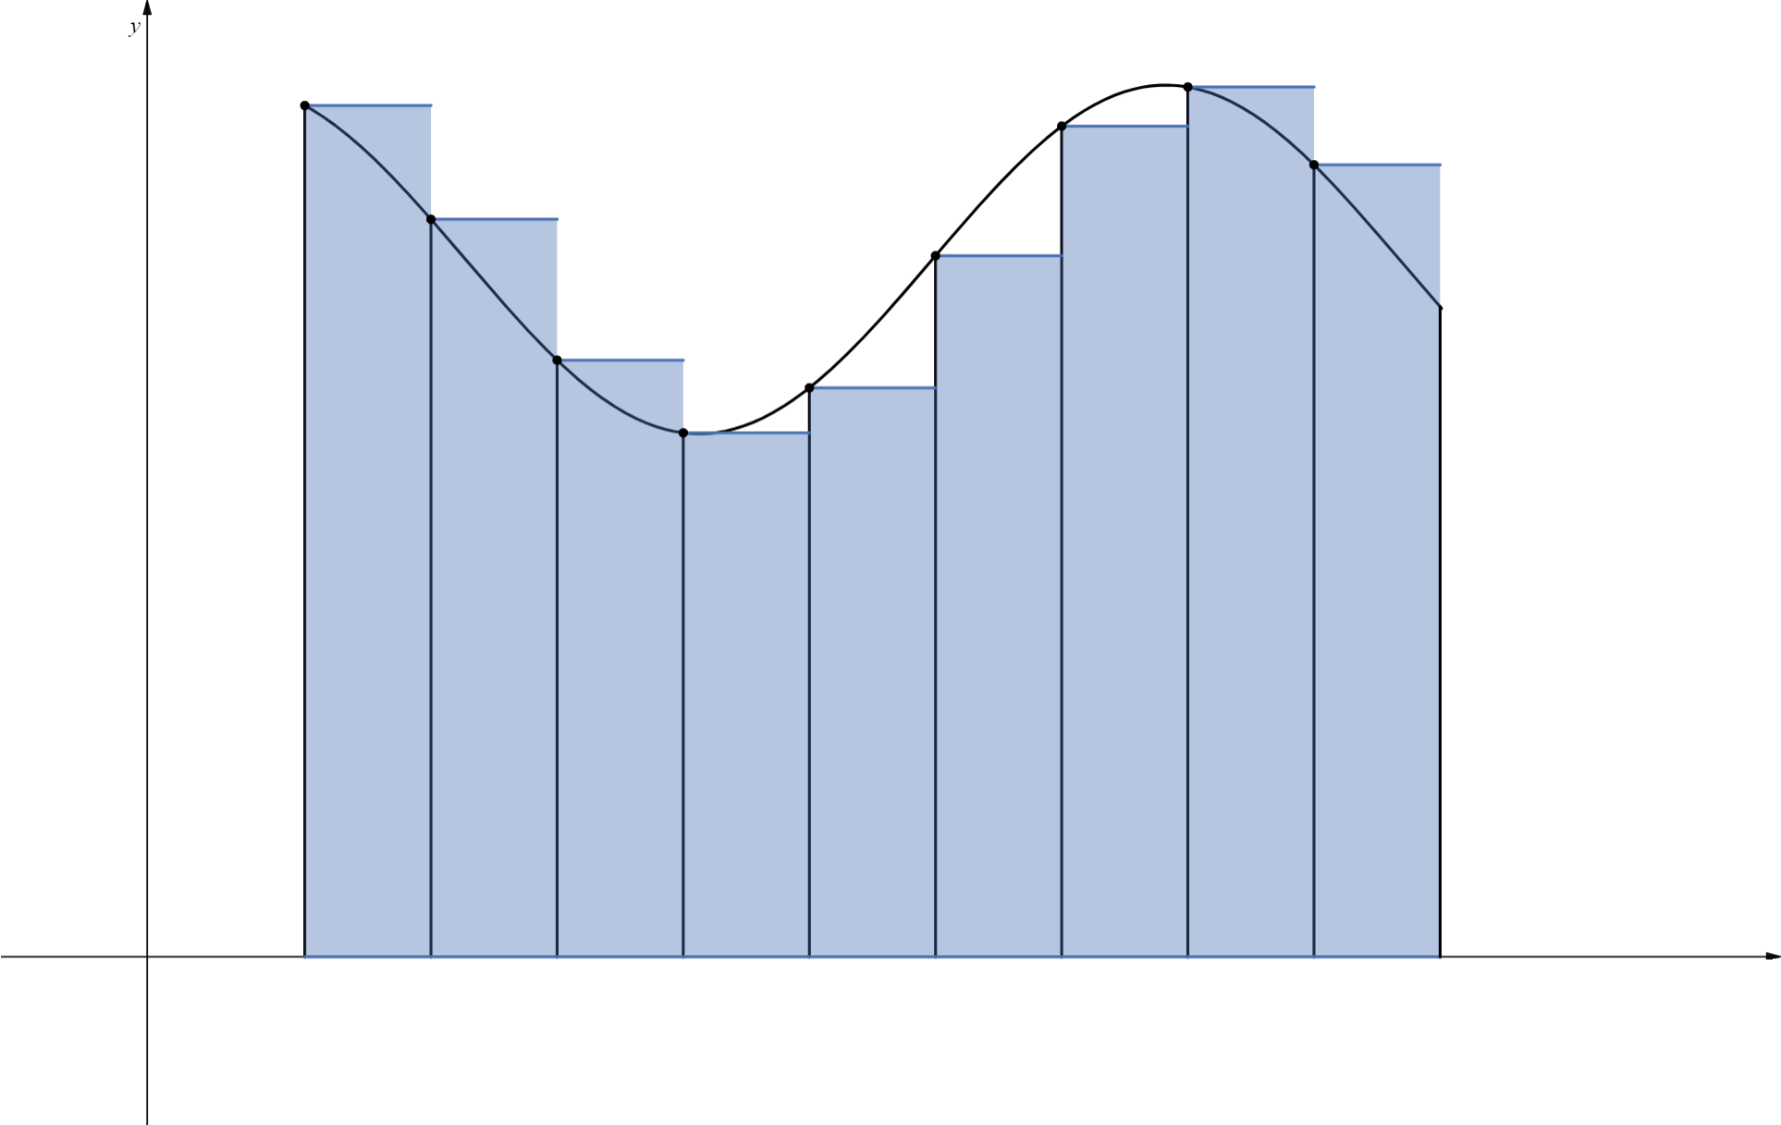


This summation is called a Left Riemann Sum, it calculates the area under the curve.

Slide 22
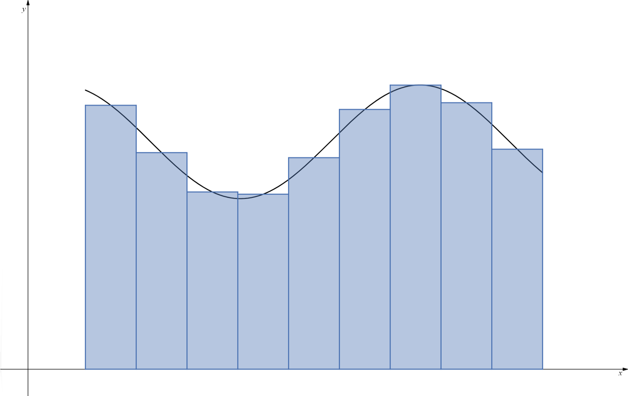

This summation is called a Midpoint Riemann Sum, it calculates the area under the curve.

Slide 23
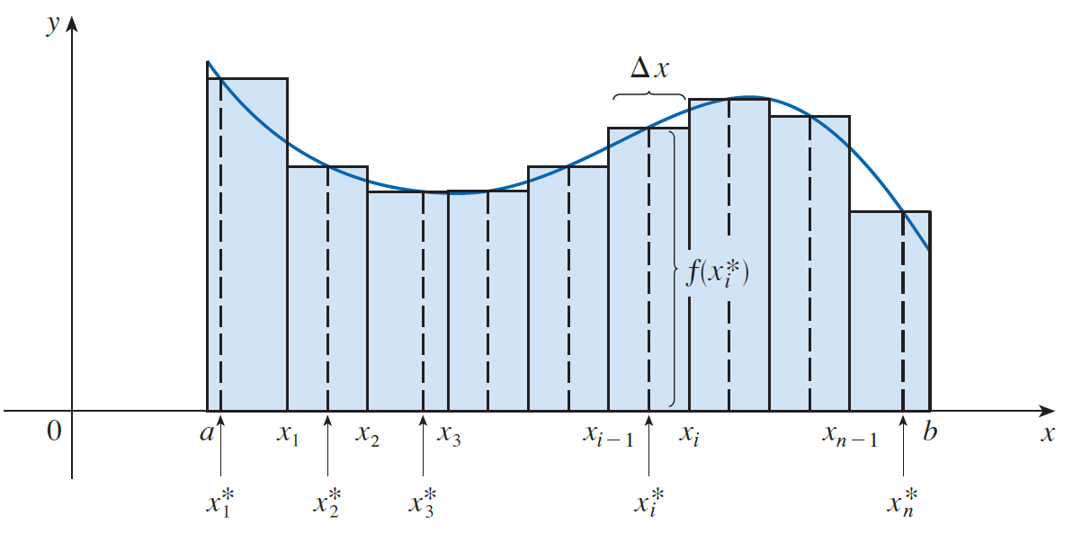
This summation is called a Riemann Sum, it calculates the area under the curve.

Slide 24
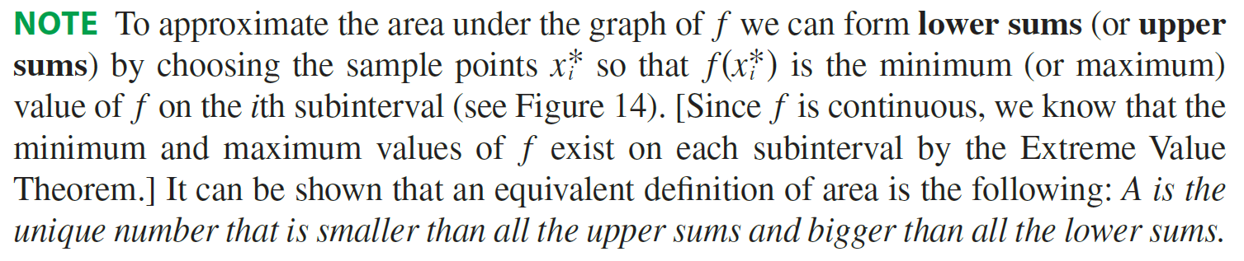
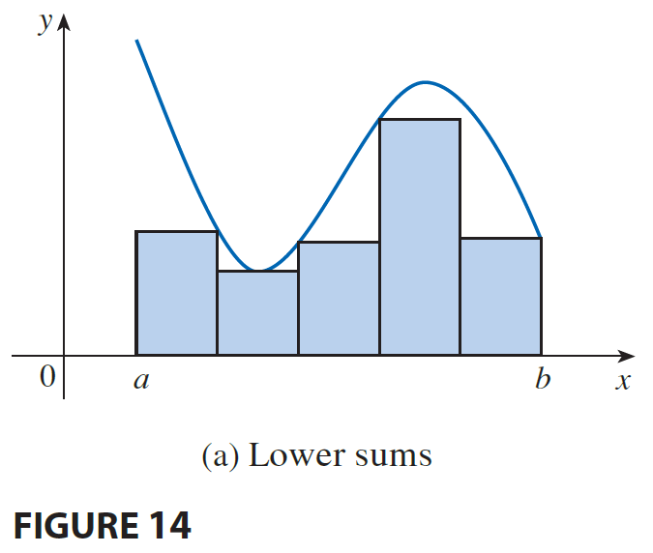
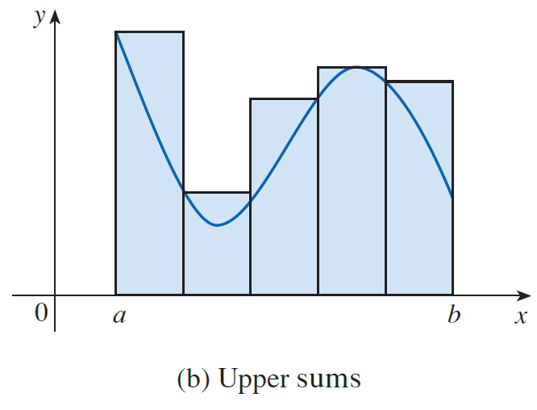
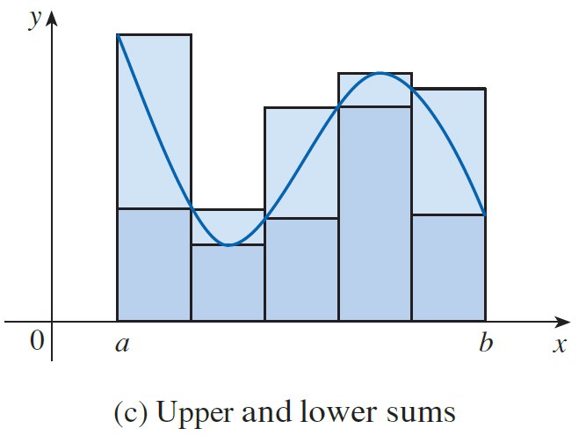

Slide 25
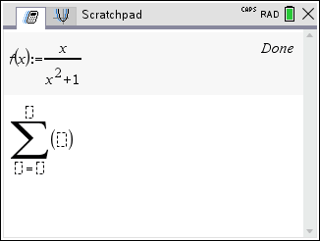
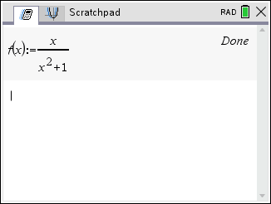
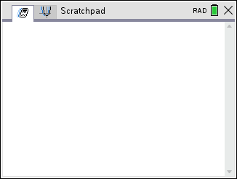
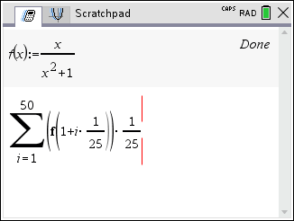
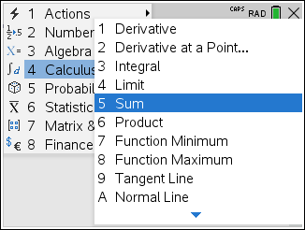
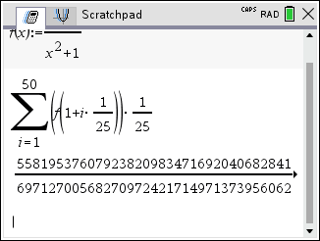
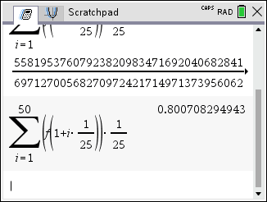

Example
Solution
$≈0$.801
Height of Rectangles
Base Width of Rectangles

Slide 26
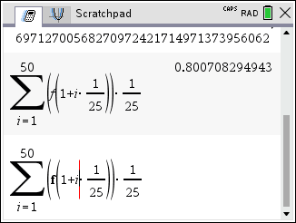
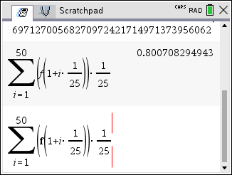
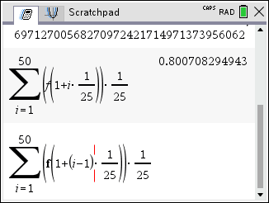
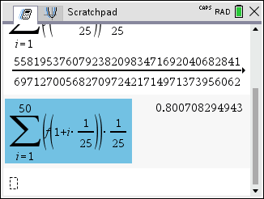



Example
Solution
$≈0$.809
Height of Rectangles
Base Width of Rectangles

Slide 27






Example
Solution
$≈0$.805
Height of Rectangles
Base Width of Rectangles

Slide 28






Example
Use Definition 2 to find an expression for the area under the graph of f as a limit. Do not evaluate the limit.
Solution
How do we compute this limit?
Section 5.2!

