Slide 1

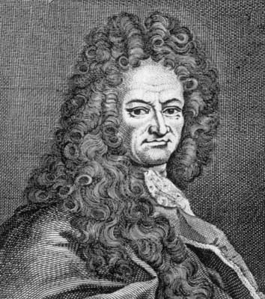
Gottfried Wilhelm von Leibniz
1646 – 1716
Gottfried Leibniz was a German mathematician who developed the present-day notation for the differential and integral calculus though he never thought of the derivative as a limit. With Newton, he was known to be one of the inventors of calculus, he also invented an early calculating machine.

Slide 2
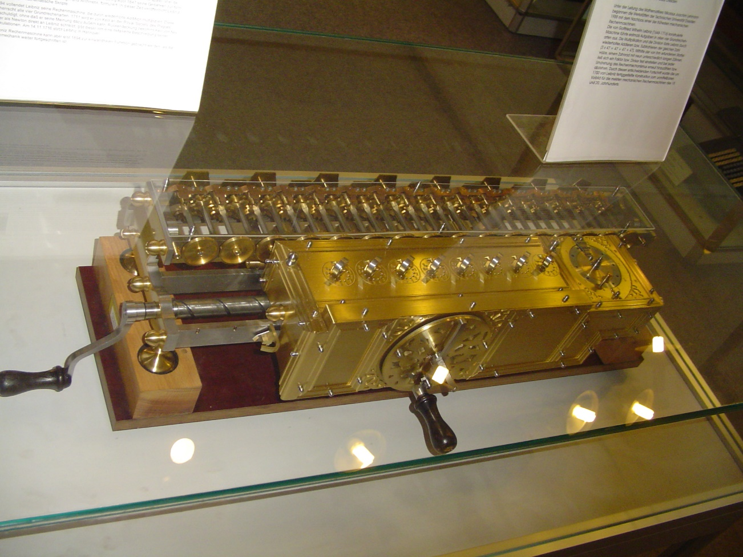
Leibniz Stepped Reckoner Calculator
In 1673, Leibniz built the first true four-function calculator. His unique, drum-shaped gears formed the basis of many successful calculator designs for the next 275 years, an unbroken record for a single underlying calculator mechanism. Leibniz built several versions of the Stepped Reckoner over about 45 years. Only one survives today.

Slide 3
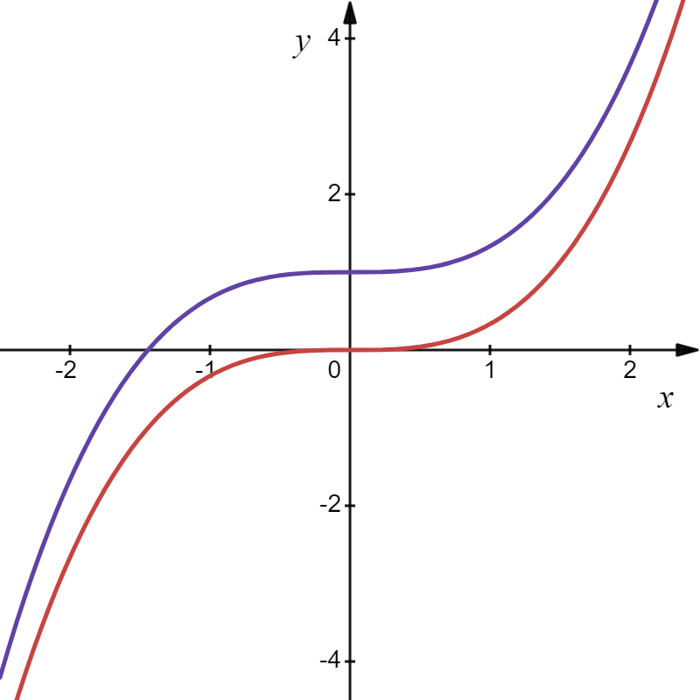
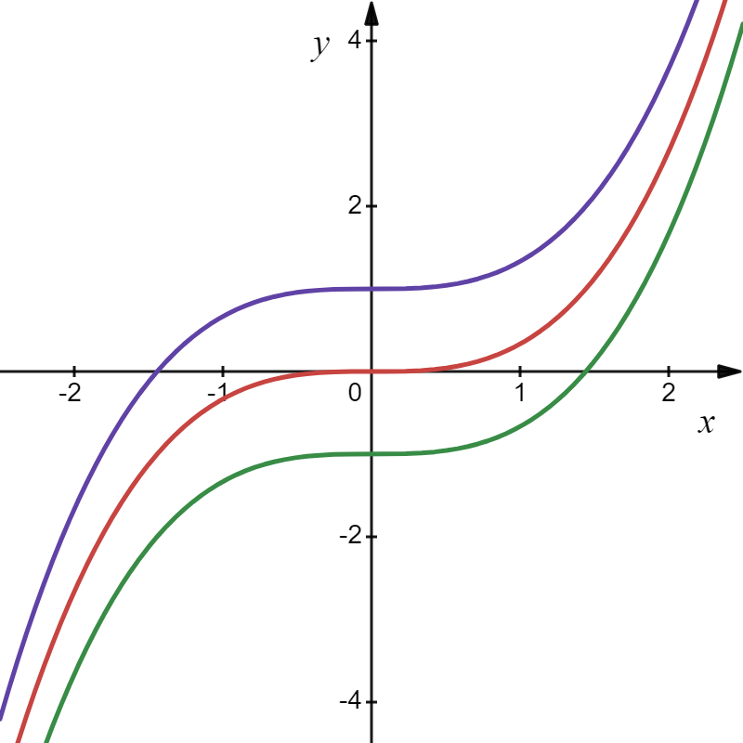
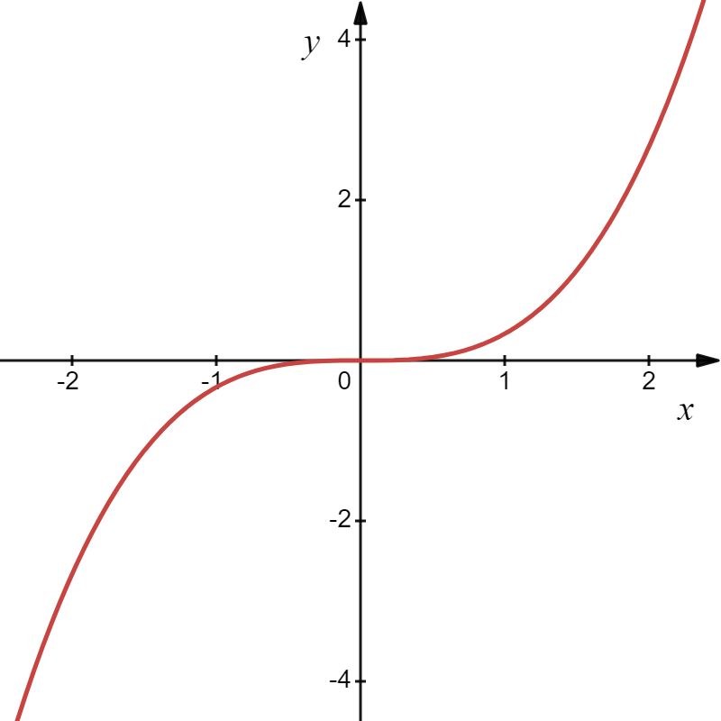

Slide 4
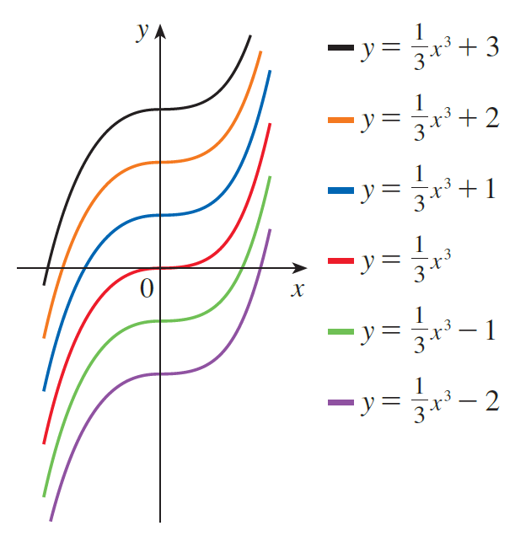
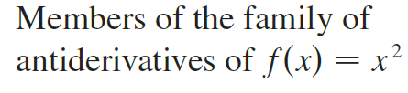

Slide 5
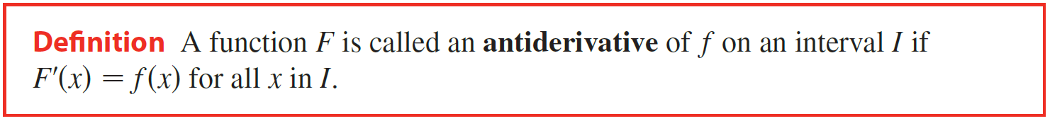
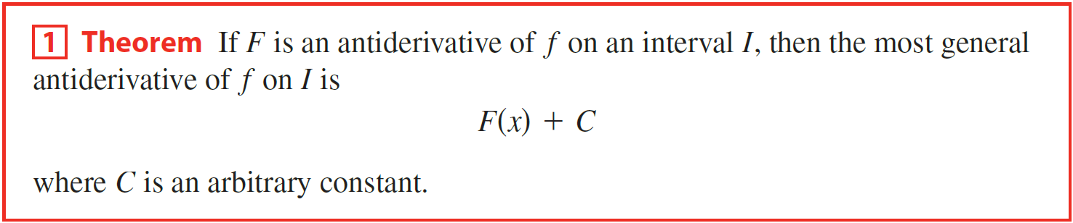
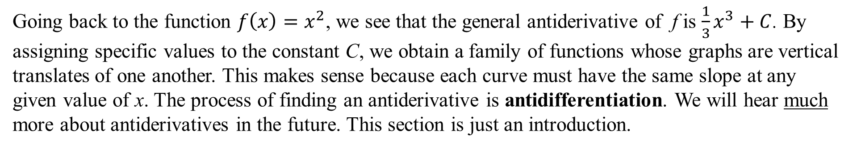
The process of finding the original function from the derivative is so important that it has a name:
Going back to the function $f\left(x\right)=x^{2}$, we see that the general antiderivative of f is $\frac{1}{3}x^{3}+C$. By assigning specific values to the constant C, we obtain a family of functions whose graphs are vertical translates of one another. This makes sense because each curve must have the same slope at any given value of x. The process of finding an antiderivative is antidifferentiation. We will hear much more about antiderivatives in the future. This section is just an introduction.

Slide 6
Example
Find the function whose derivative is and whose graph passes through .
Solution
General Solution.
Notice that we have the initial conditions (0, 2) to determine the value of C.
Particular Solution.

Slide 7
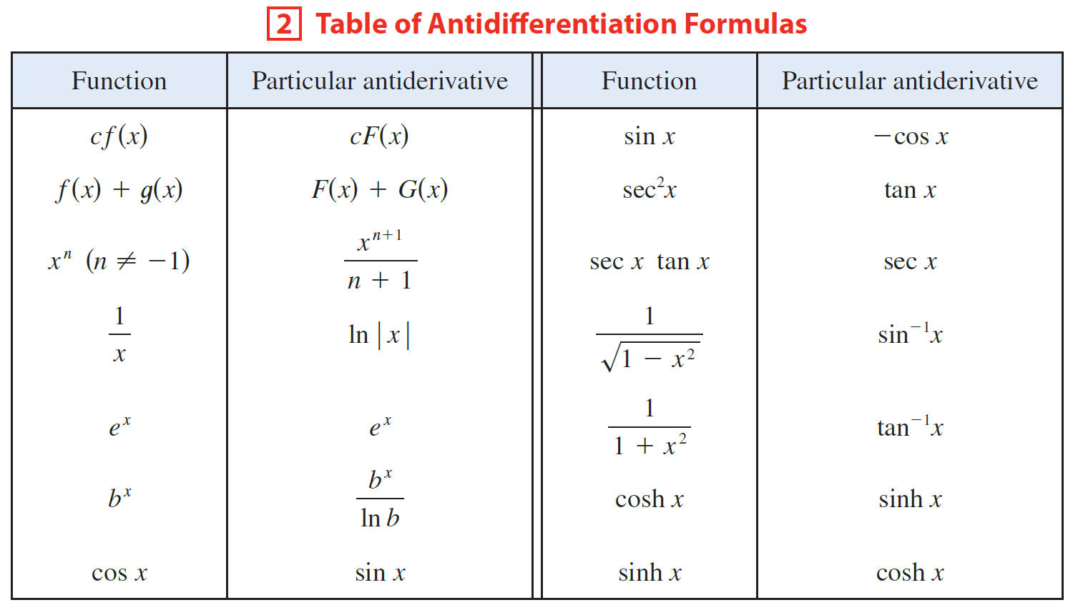

To obtain the most general antiderivative from the particular ones in Table 2, we must add an arbitrary constant C, as we did in the previous example.

Slide 8

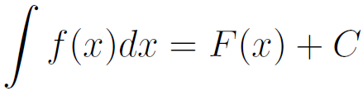

Variable of integration
(dummy variable)
Constant of Integration or
Arbitrary Constant
Integration
Symbol
Integrand
Antiderivative
This is read “The antiderivative of f of x dx” or “The indefinite integral of f of x dx.”

Slide 9
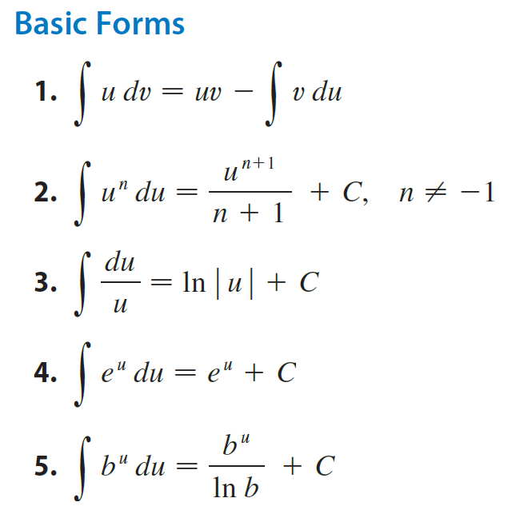
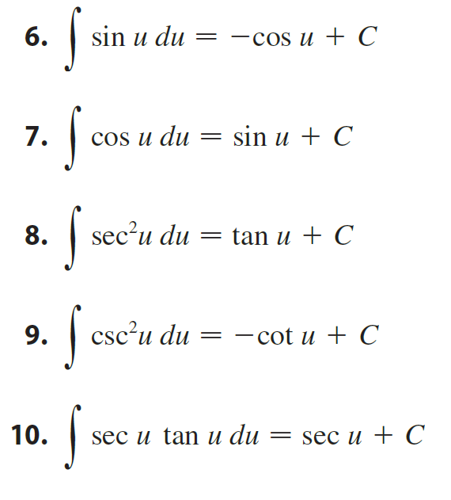
More to come!

Slide 10
Example
Find the velocity v(t) and position s(t) equations for a downward acceleration (gravity) of a m/sec², an initial velocity of v₀ m/sec, and initial of position of s₀ m.
Solution
Since acceleration is the derivative of velocity, velocity must be the antiderivative of acceleration.
The power rule in reverse: Increase the exponent by one and multiply by the reciprocal of the new exponent.
Since velocity is the derivative
of position, position must be the
antiderivative of velocity.

Slide 11
Example
Find the velocity v(t) and position s(t) equations for a downward acceleration (gravity) of a m/sec², an initial velocity of v₀ m/sec, and initial of position of s₀ m.
Solution
Since acceleration is the derivative of velocity, velocity must be the antiderivative of acceleration.
The initial position is s(0) = s₀.
Since velocity is the derivative
of position, position must be the
antiderivative of velocity.

Slide 12
It is important to understand the relationship between velocity, acceleration and the behavior of the particle.
Velocity | Acceleration | Behavior of Particle
Positive | Positive | Speeding Up
Positive | Negative | Slowing Down
Negative | Positive | Slowing Down
Negative | Negative | Speeding Up
Zero | Positive or Negative | Stopped
Positive or Negative | Zero | Constant Speed
The particle speeds up when the velocity is positive and increasing (v and a are both positive) and also when the velocity is negative and decreasing (v and a are both negative). In other words, the particle speeds up when the velocity and acceleration have the same sign. The particle is slowing down when velocity and acceleration have opposite sign.

Slide 13
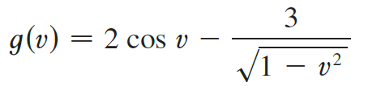
Example
Find the most general antiderivative of the function. (Check your answer by differentiation.)
(c)
Solution
Most General Antiderivative

Slide 14
Example
Find the most general antiderivative of the function. (Check your answer by differentiation.)
(c)
Solution
(c)

Slide 15

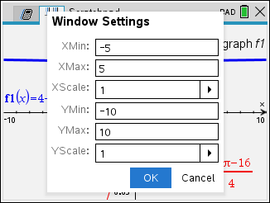
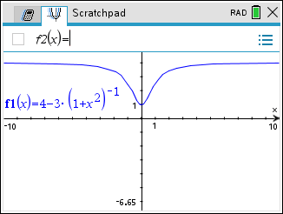

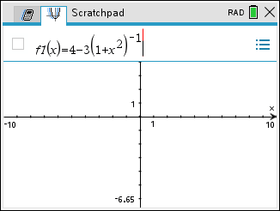
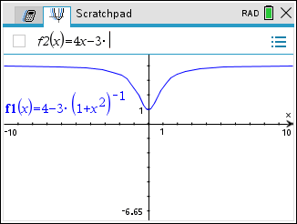
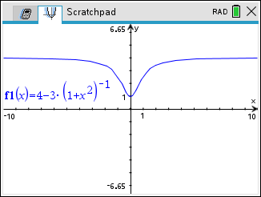
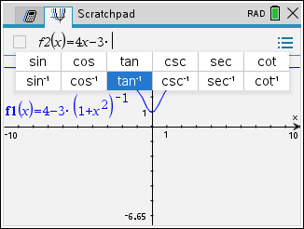
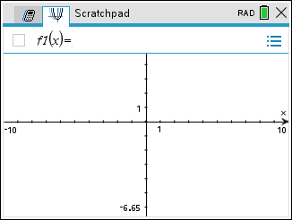
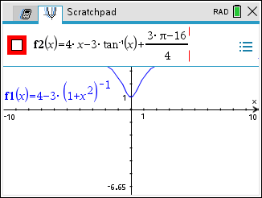
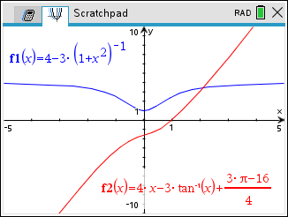
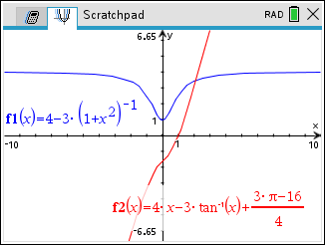
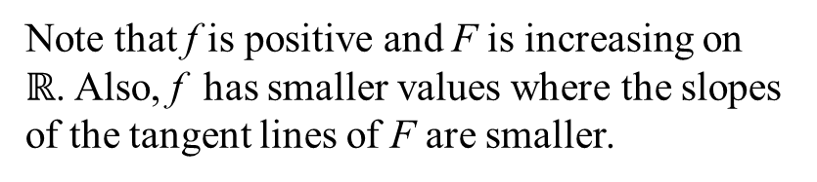
Example
Find the antiderivative F of f that satisfies the given condition. Check your answer by comparing the graphs of f and F.
Solution
Particular Solution.
Most General Antiderivative
f
F
Note that f is positive and F is increasing on $ℝ$. Also, f has smaller values where the slopes of the tangent lines of F are smaller.

Slide 16
Example
Find f .
Solution
General Solution.
Particular Solution.

Slide 17
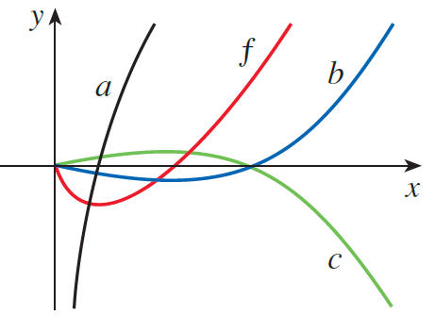


Example
The graph of a function f is shown. Which graph is an antiderivative of f and why?
Solution
Also, f is positive where b is increasing, which supports our conclusion.

Slide 18
Example
A particle is moving with the given data. Find the position of the particle.
Solution

Slide 19
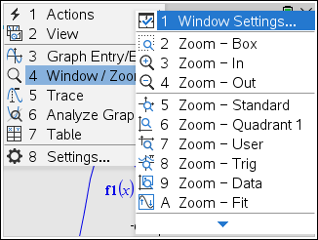
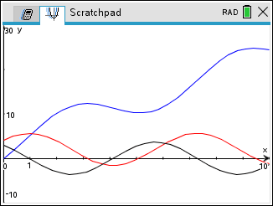
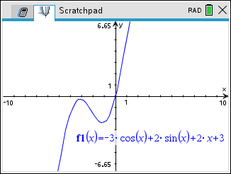
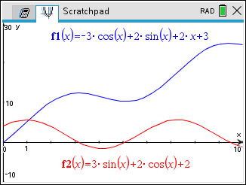
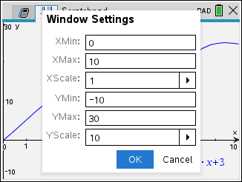
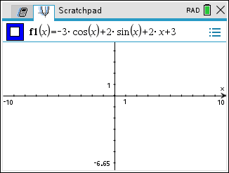
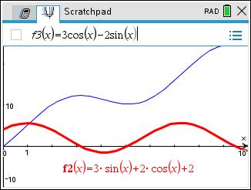
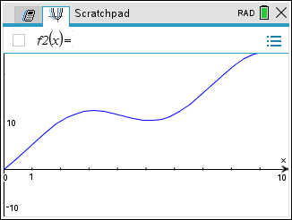
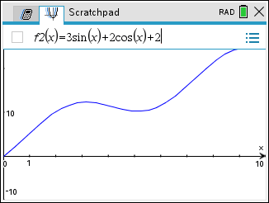
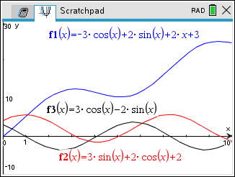
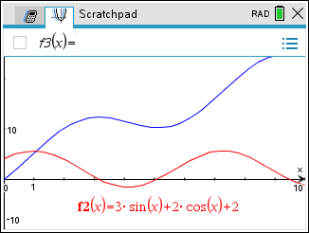
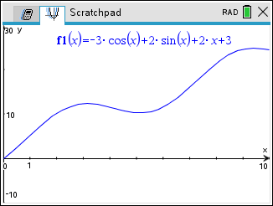
Example
A particle is moving with the given data. Find the position of the particle.
Solution

