Slide 1
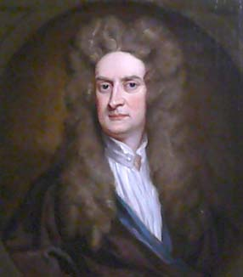
Sir Isaac Newton
1643 – 1727
Isaac Newton was the greatest English mathematician of his generation. He laid the foundation for differential and integral calculus. His work on optics and gravitation make him one of the greatest scientists the world has known.

Slide 2
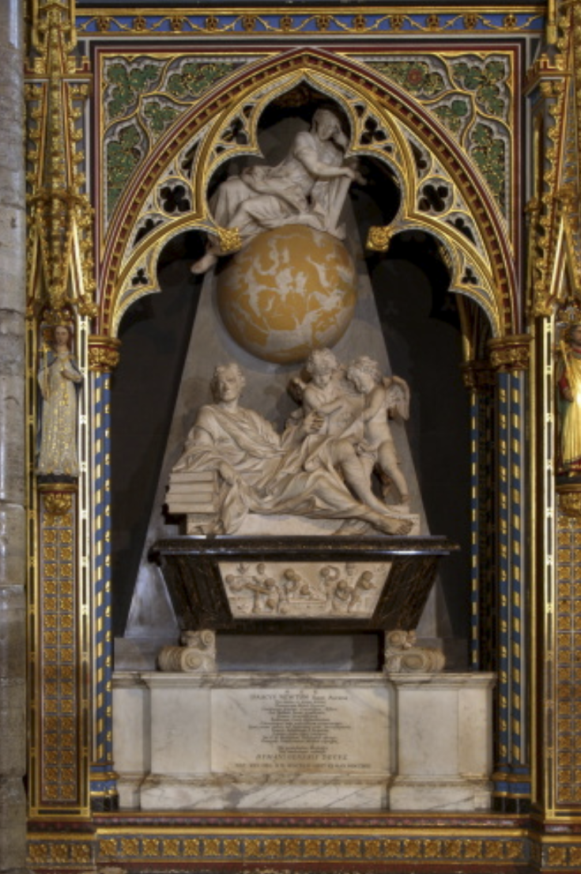
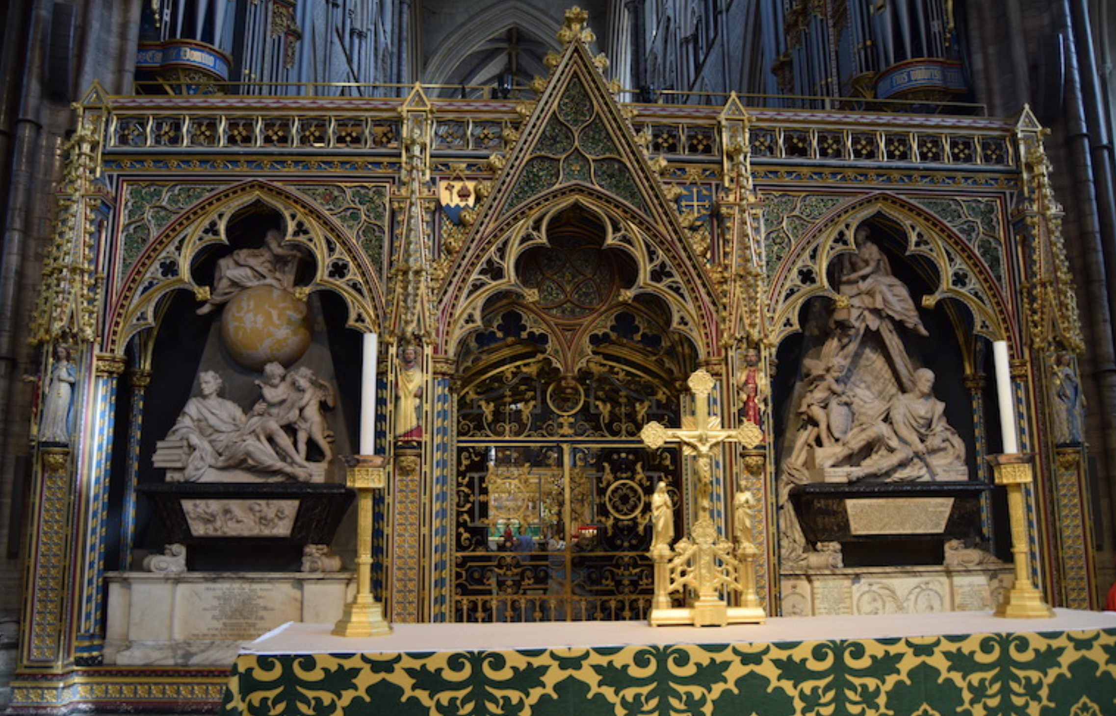
Westminster Abbey

Slide 3
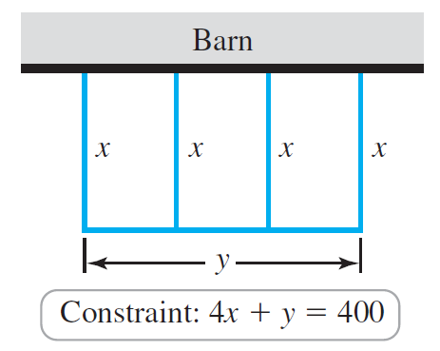

Example
A Classic Problem
You have 400 feet of fence to enclose a rectangular corral along the side of a barn to house some chickens. Three exterior fences and two interior fences partition the corral into three rectangular regions. What dimensions of the corral maximize the enclosed area? What is the area of that corral?
Solution
II Objective Function
I Objective: Maximize Area of corral
III Domain
IV “Calculus Time”

Slide 4
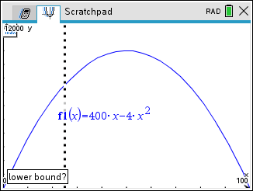
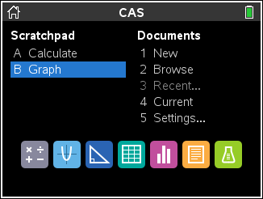
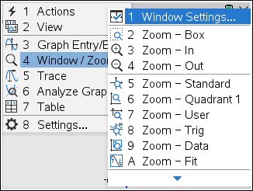
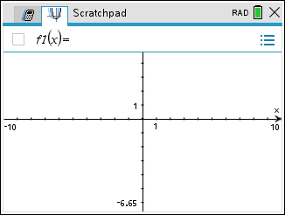
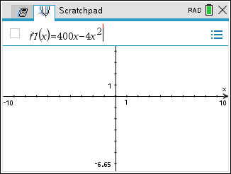
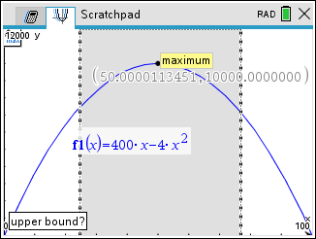
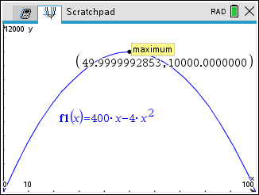
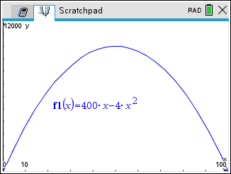
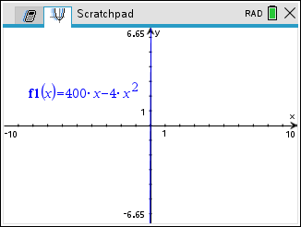
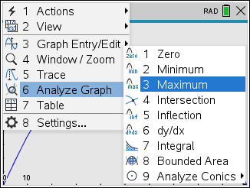
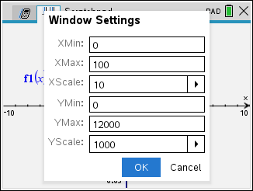
Solution
IV “Calculus Time” (continued)
By The Extreme Value Theorem, the absolute maximum occurs here, since the endpoints give zero area.
V Conclusion: By EVT, the dimensions of the corral are 50ft by 200ft with an absolute maximum area of 10,000 ft².

Slide 5
Optimization Problems
Mini/Max Problems
Optimization concerns the minimization or maximization of functions. It is used to solve complex design problems to improve cost, reliability, and performance in a wide range of applications.
I Introduction The first step is to read the problem carefully until it is clearly understood. Ask yourself: What is the objective? What are the constraints? Identify the given quantities, and conditions?
Draw a Diagram In most problems it is useful to draw and identify the given and required quantities on the diagram.
Introduce Notation Assign a symbol to the quantity that is to be maximized or minimized (let’s call it Q for now). Also select symbols (a, b, c, …, x, y, z) for other unknown quantities and label the diagram with these symbols. It may help to use initials as suggestive symbols – for example, A for area, h for height, t for time.

Slide 6
II Write an Objective Function Express Q in terms of the variables introduced in part I.
Express Your Objective Function in One Variable If Q has been expressed as a function of more than one variable, use the given information to find relationships (in the form of equations) among these variables. Then use these equations to eliminate all but one of the variables in the objective equation for Q. Thus , Q will be expressed as a function of one variable, say x, Q = f(x).
III Write the domain of this function!!
IV Find the Extrema of Q(x) Find the absolute maximum or minimum value for your objective function Q. In particular, if the domain of Q is a closed interval use the Extreme Value Theorem, if an open interval use OLE. Be a name dropper!
V Conclusion State your results.

Slide 7
Extreme Value Theorem (EVT)
Increasing/Decreasing Test (IDT)
First Derivative Test (FDT)
And
One Local Extremum Theorem(OLE)
Let’s recall.

Slide 8
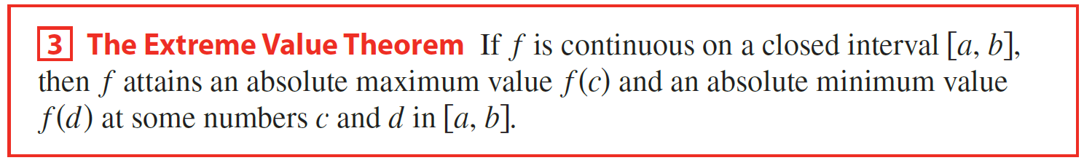
(EVT)
(c, f (c))
(c, f (c))
(c, f (c))
(c, f (c))
(d, f (d))
(d, f (d))
(d, f (d))
(d, f (d))
Absolute Maximum point is an interior point and Absolute Minimum point is an endpoint
Absolute Minimum point is an interior point and Absolute Maximum point is an endpoint
Absolute Maximum and Minimum points are endpoints
Absolute Maximum and Minimum points are interior points

Slide 9
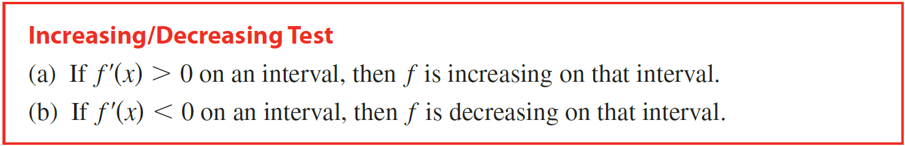

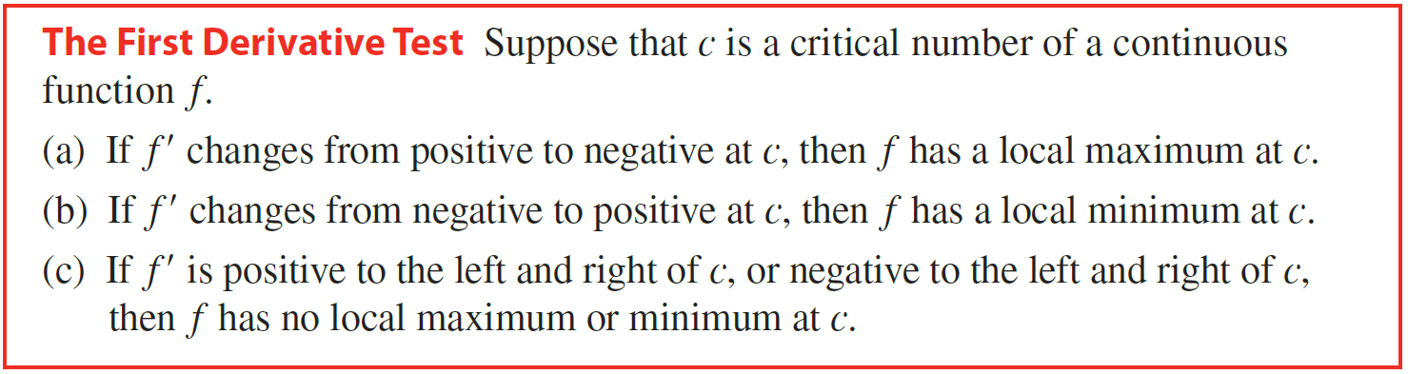
(IDT)
(FDT)

Slide 10
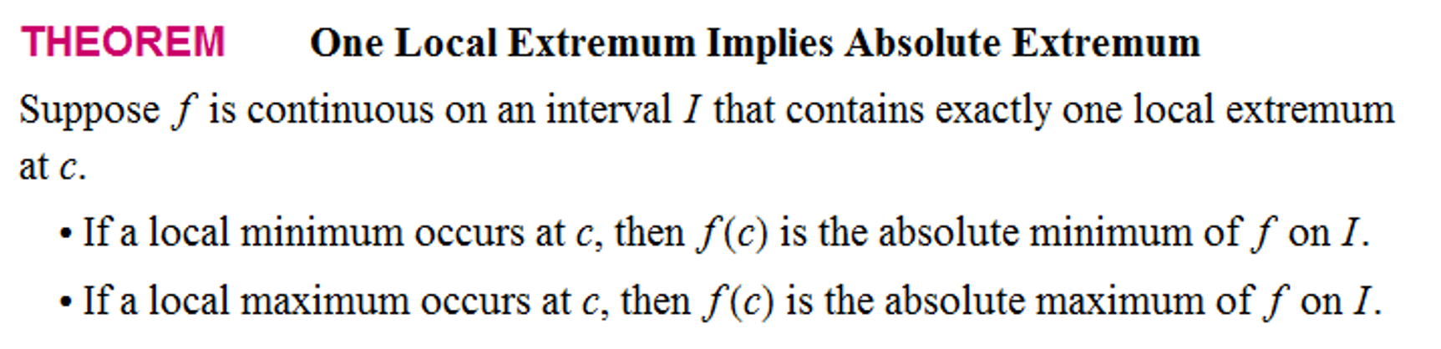
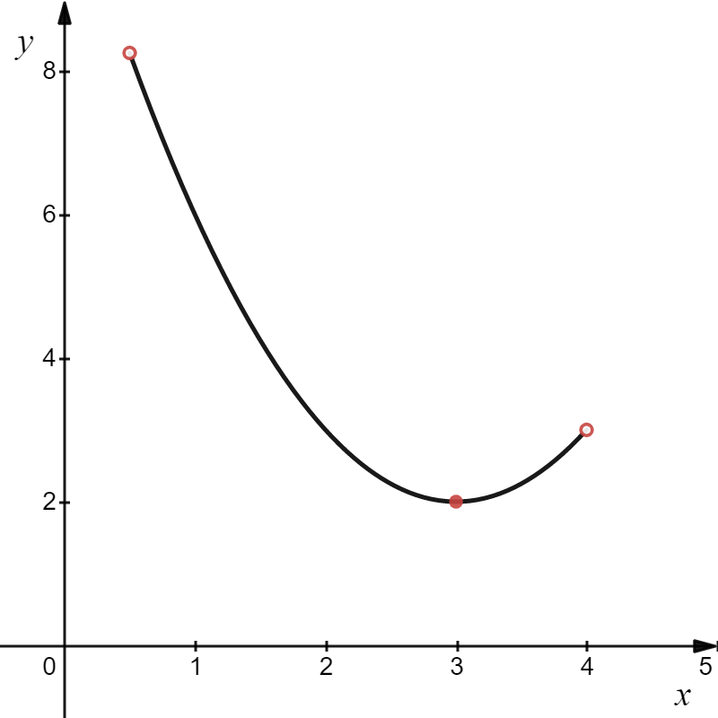
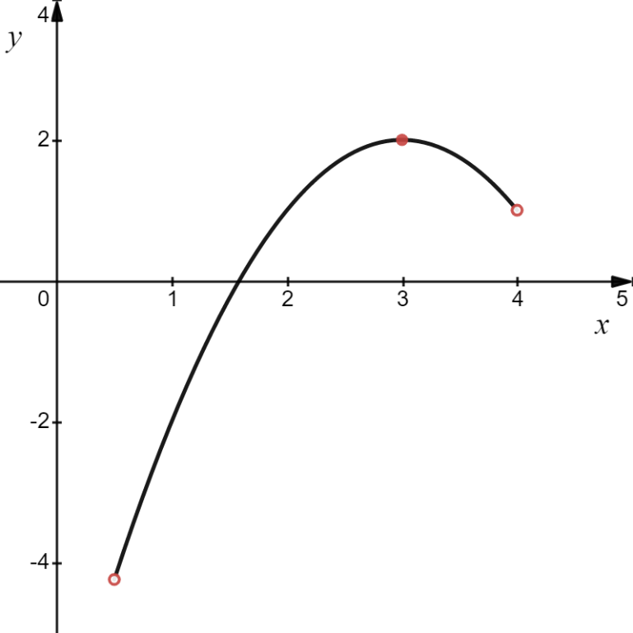
(OLE)
Absolute Maximum
Absolute Minimum

Slide 11
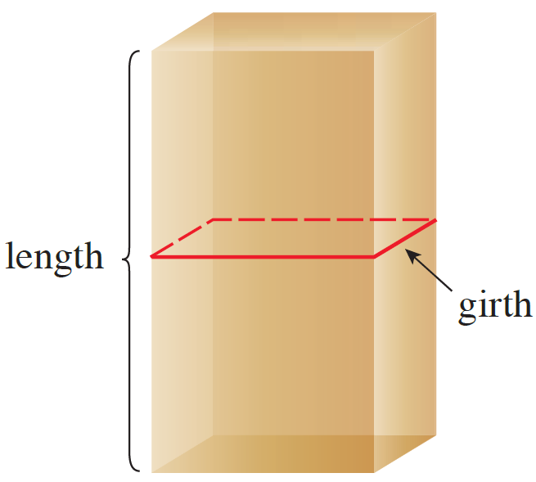
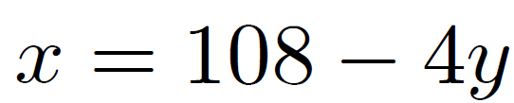
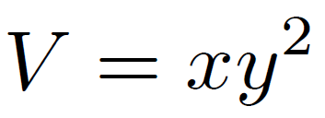
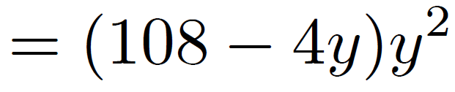
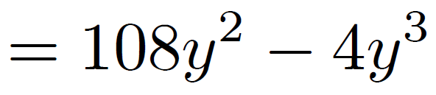
Example
A package to be mailed using the US postal service may not measure more than 108 inches in length plus girth. (Length is the longest dimension and girth is the largest distance around the package, perpendicular to the length.) Find the dimensions of the rectangular box with square base of greatest volume that may be mailed.
Solution
I Objective: Maximize Volume of Box
Let x > 0 be the length of the package (in)
y > 0 be the length of the sides of the square base (in)
We have the constraint equation x + 4y = 108
x
y
II Objective Function
III Domain
y
y
y

Slide 12
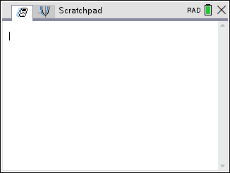
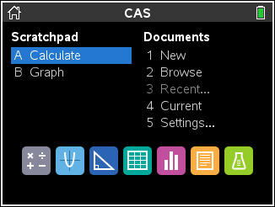
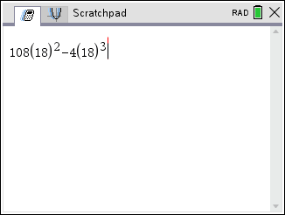
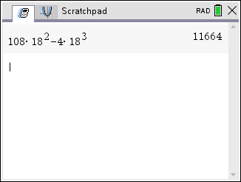
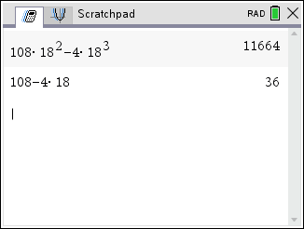
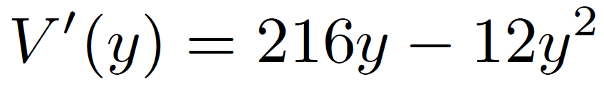
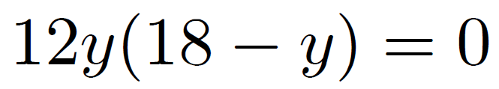

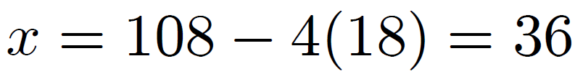
Solution
IV “Calculus Time”
V Conclusion: Thus, the dimensions that give the greatest volume are 18in × 18in × 36in, giving a greatest possible volume of 11,664 in³.
y
By OLE, there is an absolute maximum when y = 18.

Slide 13
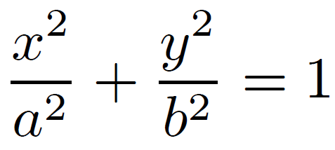
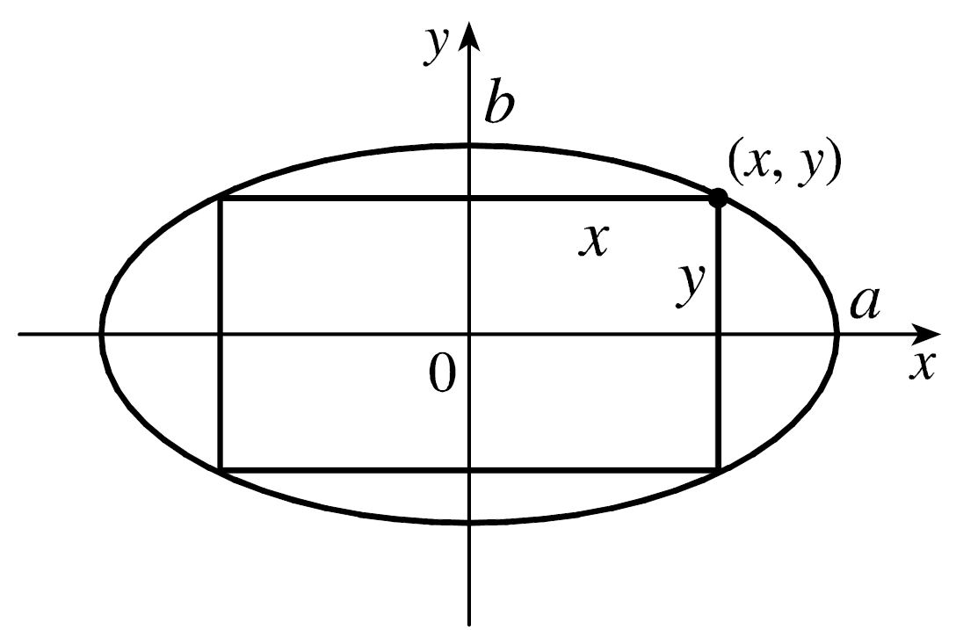


Example
Find the area of the largest rectangle that can be inscribed in the ellipse $\frac{x^{2}}{a^{2}}+\frac{y^{2}}{b^{2}}=1$.
Solution
I Objective: Maximize the area of the inscribe rectangle.
Let x > 0
y > 0
II Objective Function
The area of the rectangle is
A = (2x)(2y) = 4xy

Slide 14
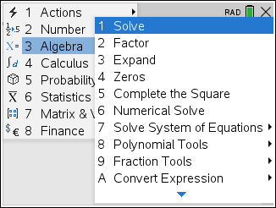
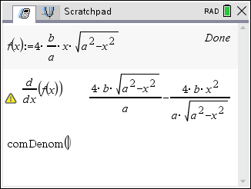
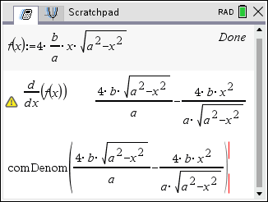
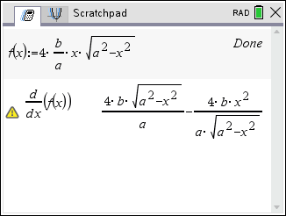
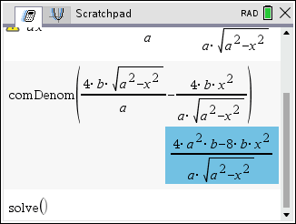
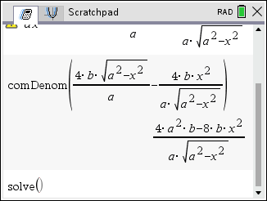
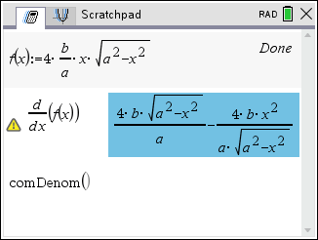
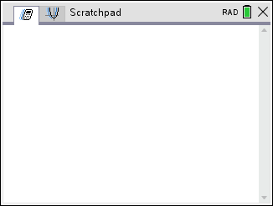
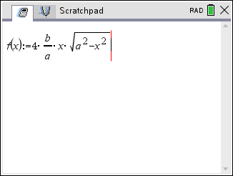
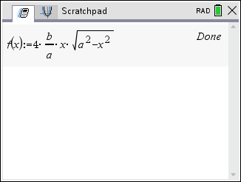
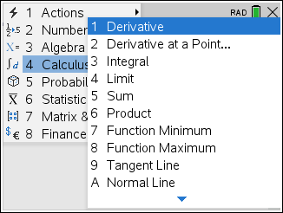
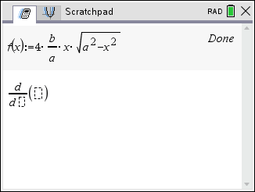
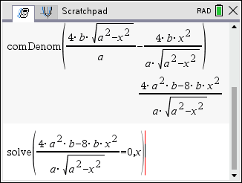
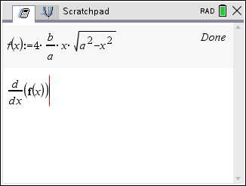









Solution
III Domain
IV “Calculus Time”
V Conclusion: By EVT, the absolute maximum area of the inscribed rectangle is 2ab units².
So, the critical number is $x=\frac{a\sqrt{2}}{2}$ .

Slide 15



Example
A manufacturer wants to construct cylindrical aluminum cans for a new energy drink with volume 2000 cm³ (2 liters). What radius and height will minimize the amount of aluminum used? What will be the surface area?
Solution
I Objective: Minimize the of aluminum used, minimize surface area.
Let x = radius (cm) and h = height (cm).
Volume V is 2000 cm³, so you have
Blast 2000
Total Surface Area S = 2πxh + 2πx²

Slide 16
Solution
II Objective Function
Surface area S = 2πxh + 2πx², x > 0 (since x is the radius), can now be written as a function of x.
Blast 2000
III Domain

Slide 17




















Solution
IV “Calculus Time”
Blast 2000
So, the critical number is $x=\frac{10}{π^{1/3}}≅6.828$ .
V Conclusion: The absolute minimum surface area is $600π^{1/3}$ cm² when the radius is $\frac{10}{π^{1/3}}$ cm and the height is $\frac{20}{π^{1/3}}$ cm.
x
By OLE, there is an absolute minimum when x = $\frac{10}{π^{1/3}}$.

Slide 18

Example
The figure below shows an offshore oil well located at a point W that is 5 miles from the closest point A on a straight shoreline. Oil is to be piped from W to a shore point B that is 8 miles from point A by piping it on a straight line under water from W to some point P between A and B and then on to B via pipe along the shoreline. If the cost of laying pipe is $1,500,000 per mile under water and $650,000 over land, where should the point P be located to minimize the cost of laying the pipe?
Solution
I Objective: Minimize the of cost of the construction of the pipeline.
Let x = distance from point A to P (miles)
II Objective Function
III Domain

Slide 19























Solution
IV “Calculus Time”
So, the critical number is $x≅2.404$ .
V Conclusion: By EVT, the absolute minimum cost of building the pipeline is $11,959,000.
absolute minimum cost

Slide 20

Example
A right circular cylinder is inscribed in a cone with height h and base radius r. Find the largest possible volume of such a cylinder.
Solution
I Objective: Maximize the volume of the inscribed cylinder.
Let x = radius of inscribed cylinder (units)
II Objective Function
y
x
h
III Domain
r

Slide 21


















Solution
IV “Calculus Time”
So, the critical number is $x=\frac{2r}{3}$.
V Conclusion: By EVT, the absolute minimum volume of the inscribed right circular cylinder is $\frac{4hπr^{2}}{27}$ units².
absolute maximum volume

