Slide 1
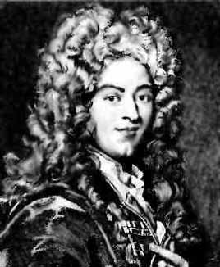
Marquis de L'Hospital
1661 - 1704
de L'Hospital was a French mathematician who wrote the first textbook on calculus, which consisted of the lectures of his teacher Johann Bernoulli.

Slide 2

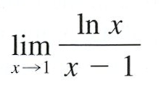
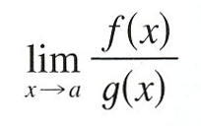
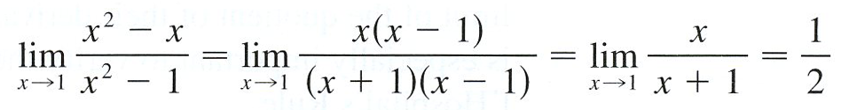

Slide 3
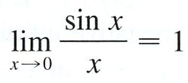

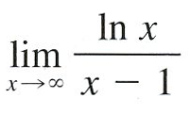
So, in this section we introduce a systematic method, know as l’Hospital’s Rule, for the evaluation of indeterminate forms.

Slide 4

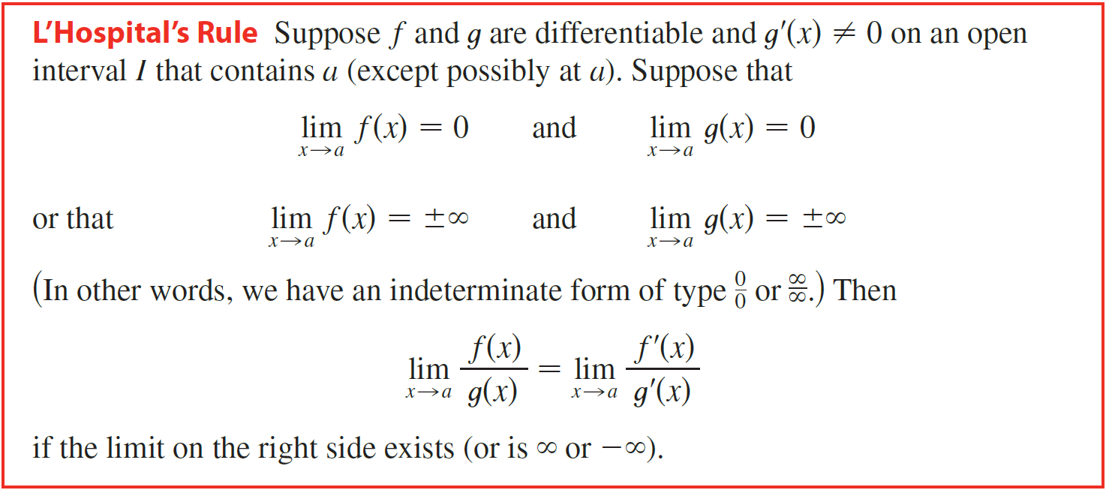

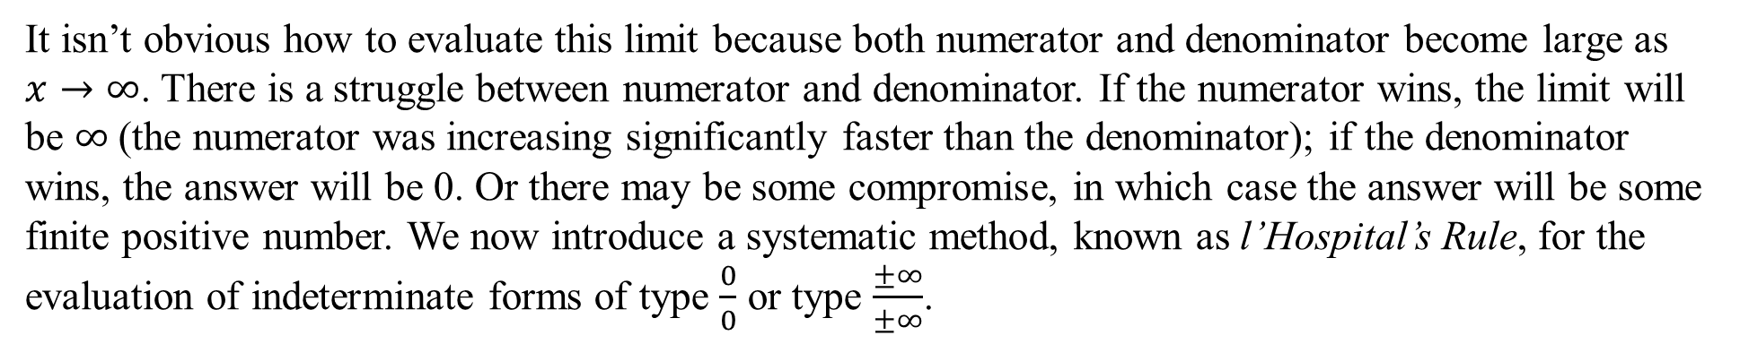
It isn’t obvious how to evaluate this limit because both numerator and denominator become large as $x→∞$. There is a struggle between numerator and denominator. If the numerator wins, the limit will be $∞$ (the numerator was increasing significantly faster than the denominator); if the denominator wins, the answer will be 0. Or there may be some compromise, in which case the answer will be some finite positive number. We now introduce a systematic method, known as l’Hospital’s Rule, for the evaluation of indeterminate forms of type $\frac{0}{0}$ or type $\frac{±∞}{±∞}$.

Slide 5
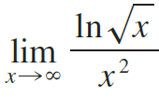
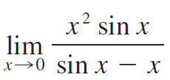


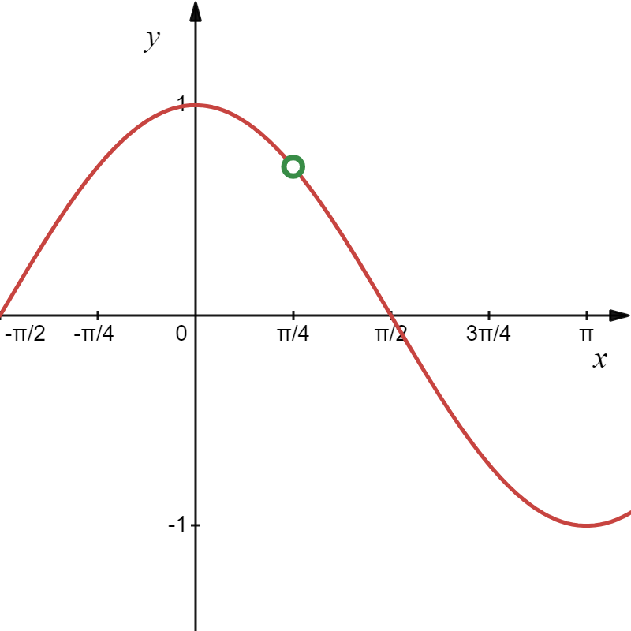


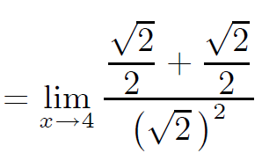
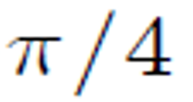

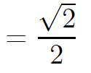
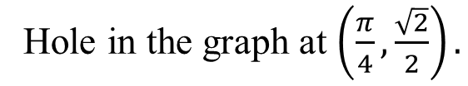

$$\left(\left(kdck\right)\right)$$
Example
Find the limit. Use l’Hospital’s Rule where appropriate.
(a)
(b)
(c)
Solution
(a)
Hole in the graph at $\left(\frac{π}{4},\frac{\sqrt{2}}{2}\right).$

Slide 6
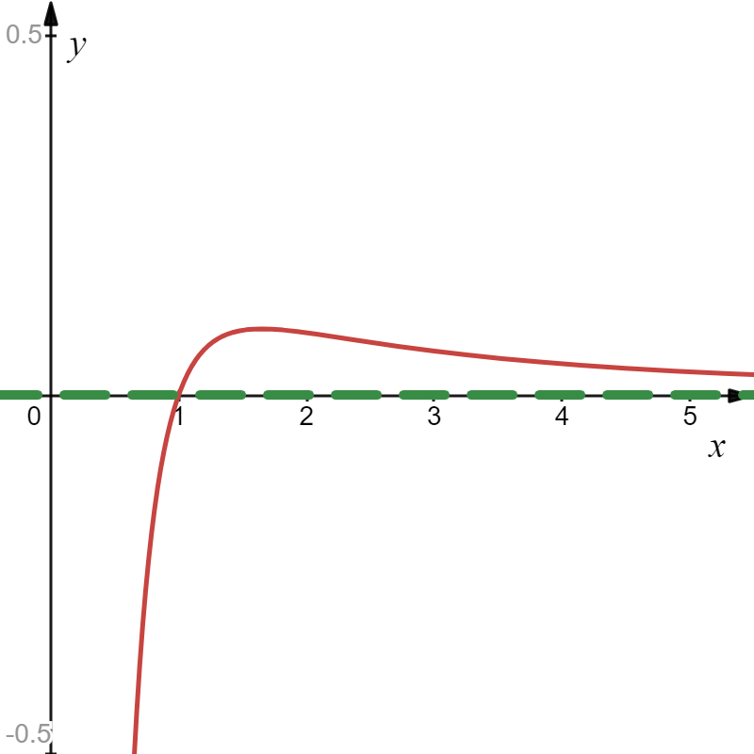

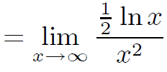
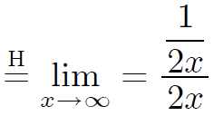




Example
Find the limit. Use l’Hospital’s Rule where appropriate.
(a)
(b)
(c)
Solution
(b)
$$\frac{∞}{∞}$$
y = 0
Horizontal asymptote at y = 0.

Slide 7
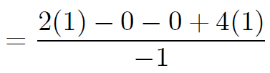
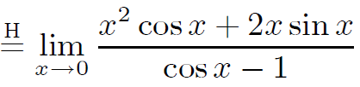
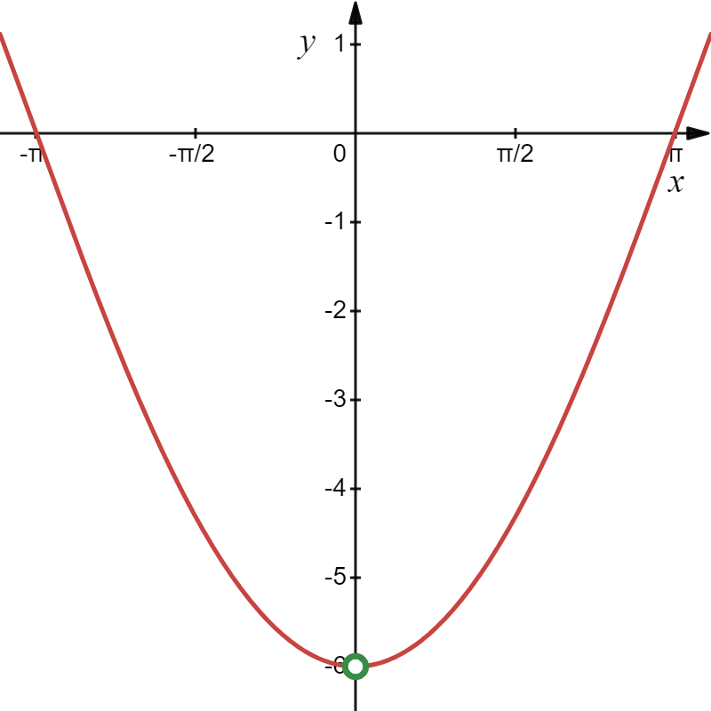


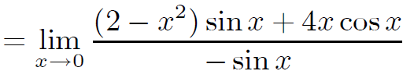




Example
Find the limit. Use l’Hospital’s Rule where appropriate.
(a)
(b)
(c)
Solution
(c)
$$\frac{0}{0}$$
$$\left(0−6\right)$$
Hole in the graph at $\left(0−6\right).$

Slide 8
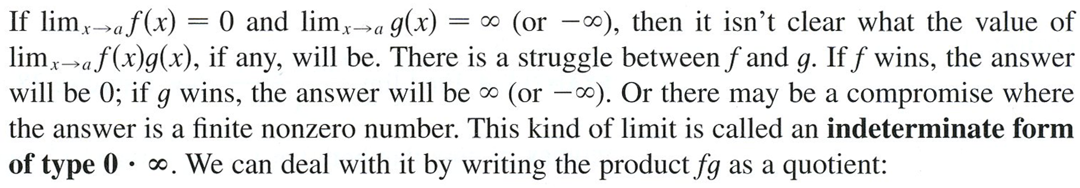

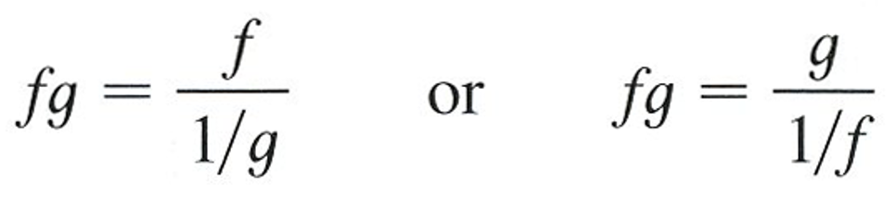

Slide 9
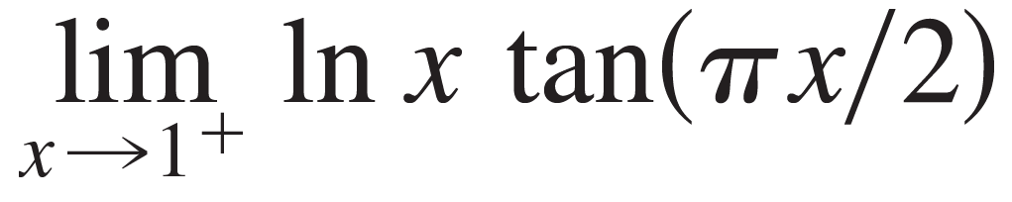
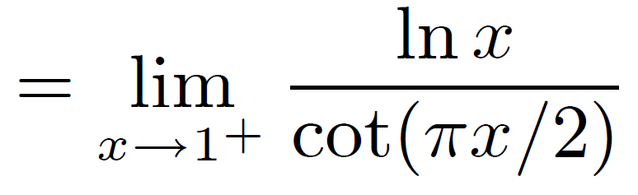
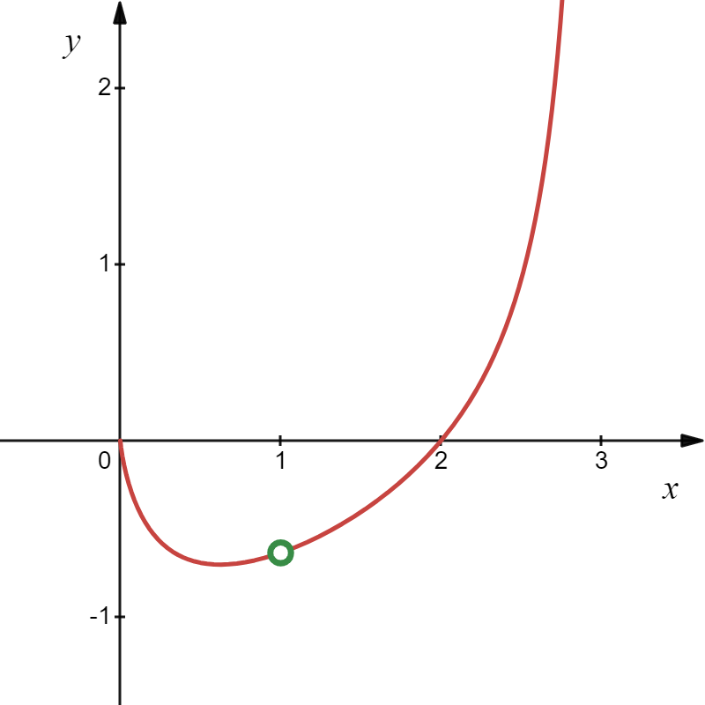
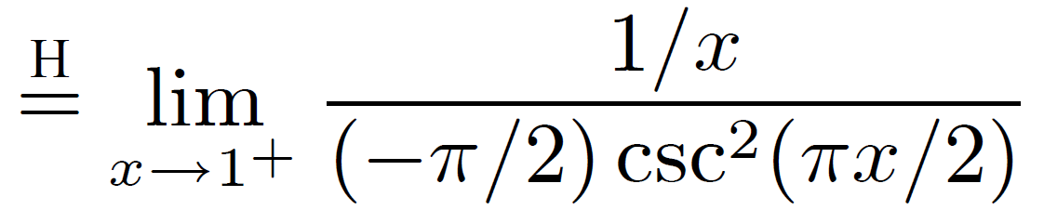
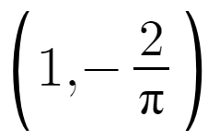

Example
Find the limit. Use l’Hospital’s Rule where appropriate.
.
Solution
.
Hole in the graph at $\left(1,−\frac{2}{π}\right).$

Slide 10
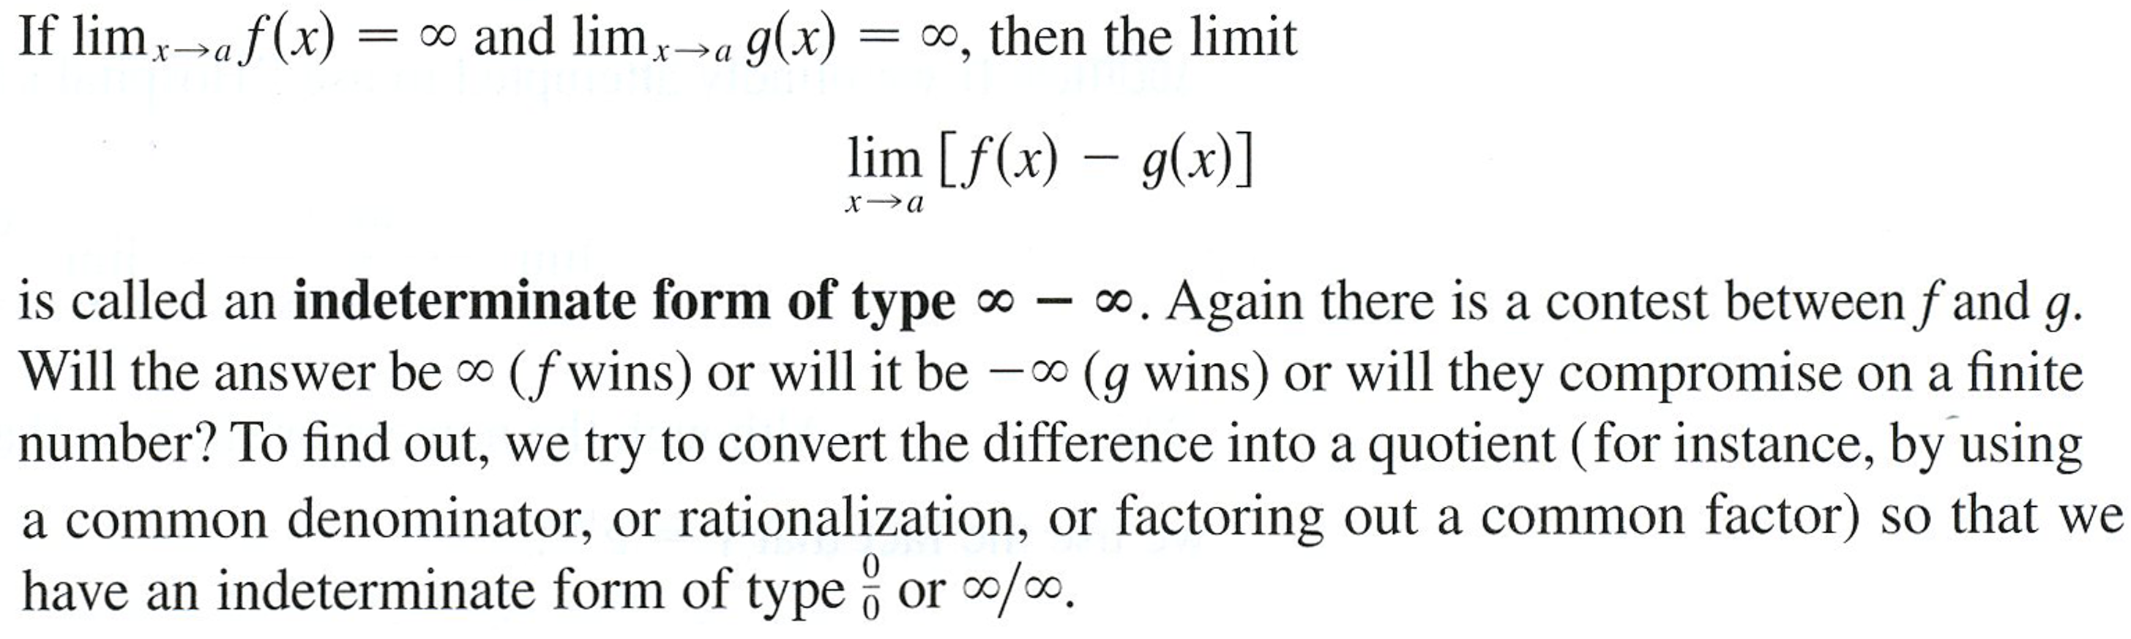

Slide 11
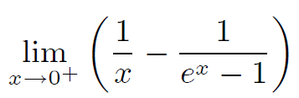
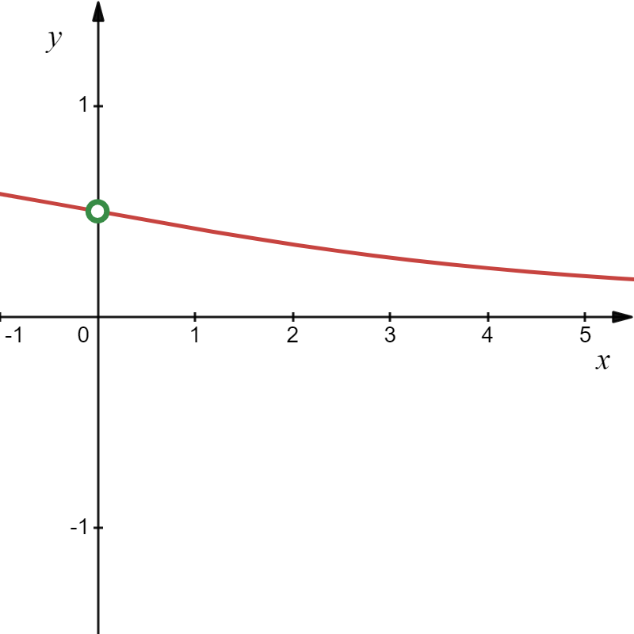

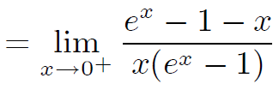






Example
Find the limit. Use l’Hospital’s Rule where appropriate.
Solution
$$\left(0,\frac{1}{2}\right)$$
Hole in the graph at $\left(0,\frac{1}{2}\right).$

Slide 12
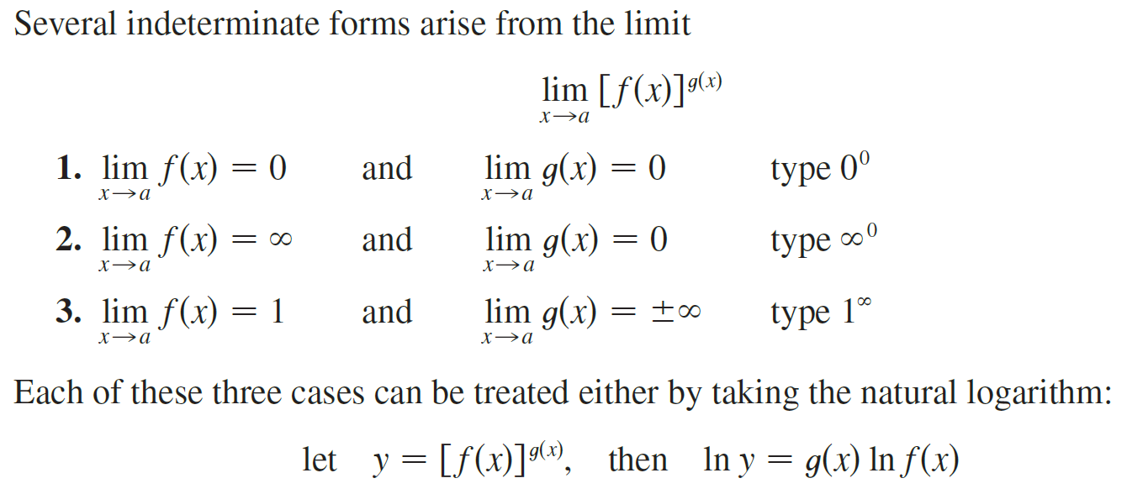

Slide 13






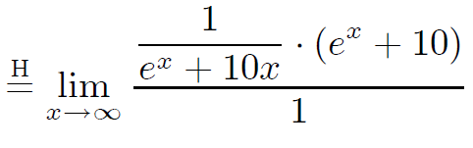
Example
Find the limit. Use l’Hospital’s Rule where appropriate.
(a)
(b)
Solution
(a)
Let

Slide 14






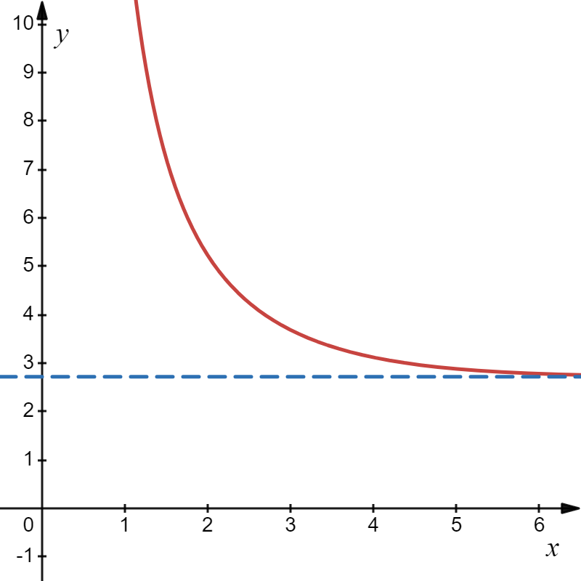






Solution
Using the fact that $y=e^{\ln{y}}$ we get
Horizontal asymptote at $y=e.$
$$y=e$$

Slide 15
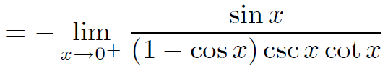
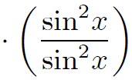


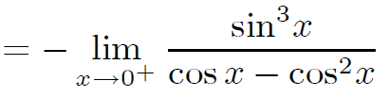



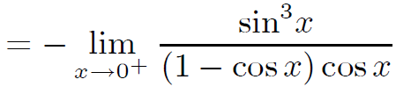

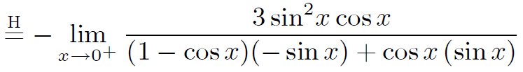
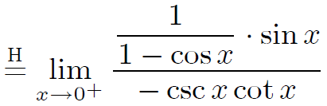
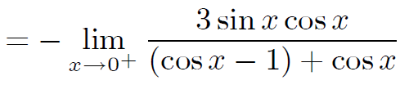
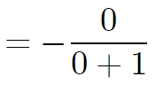
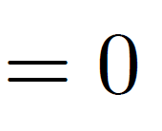
Example
Find the limit. Use l’Hospital’s Rule where appropriate.
(a)
(b)
Solution
(b)
Let

Slide 16
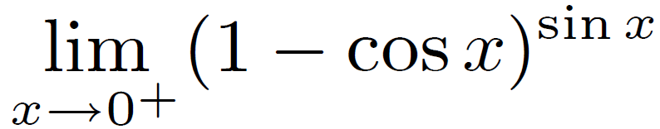
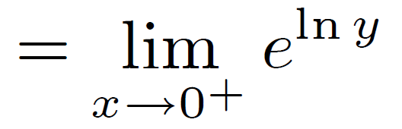
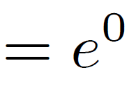
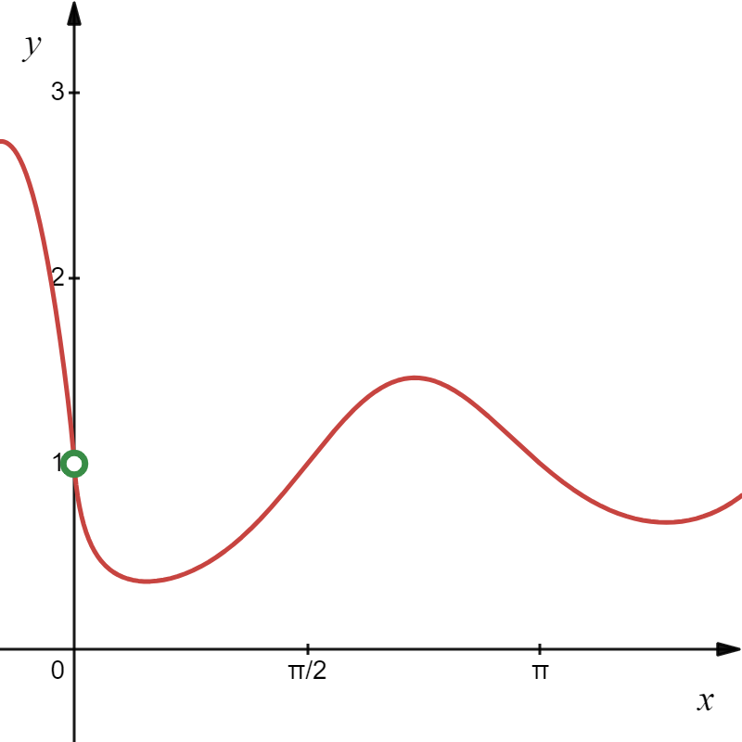



Solution
Using the fact that $y=e^{\ln{y}}$ we get
Hole in the graph at $\left(0,1 \right).$

Slide 17

In summary,

