Slide 1
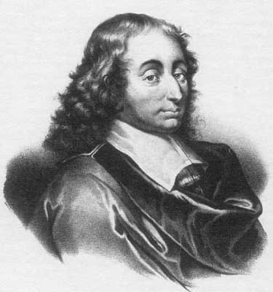
Blaise Pascal
1623 – 1662
Blaise Pascal was a very influential French mathematician and philosopher who contributed to many areas of mathematics. He worked on conic sections and projective geometry and in correspondence with Fermat he laid the foundations for the theory of probability.

Slide 2
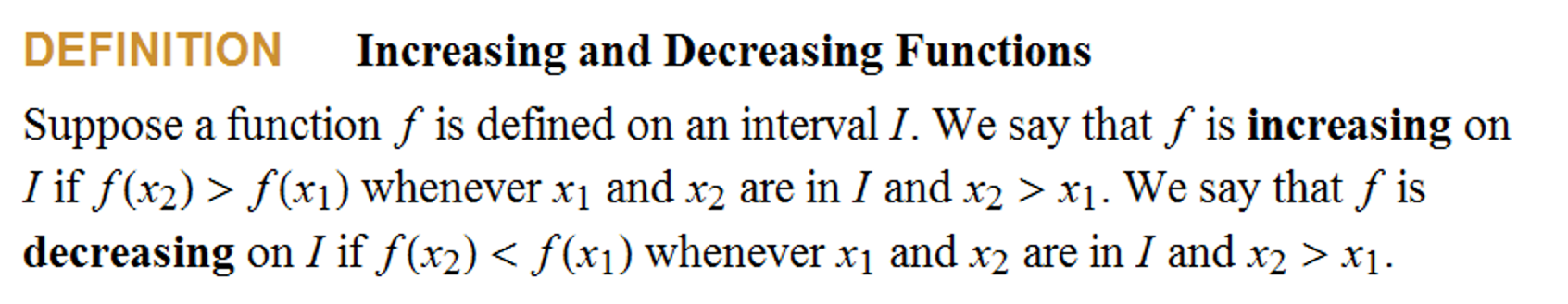


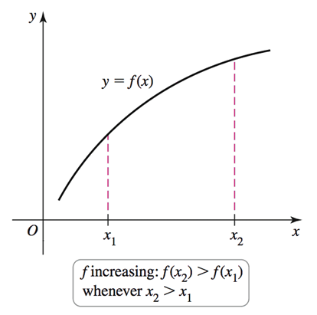
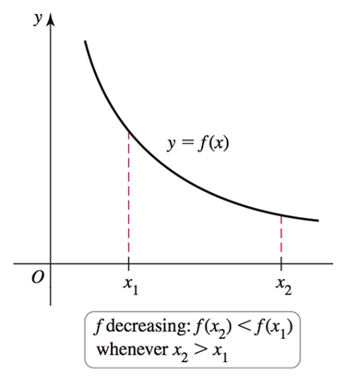

Slide 3

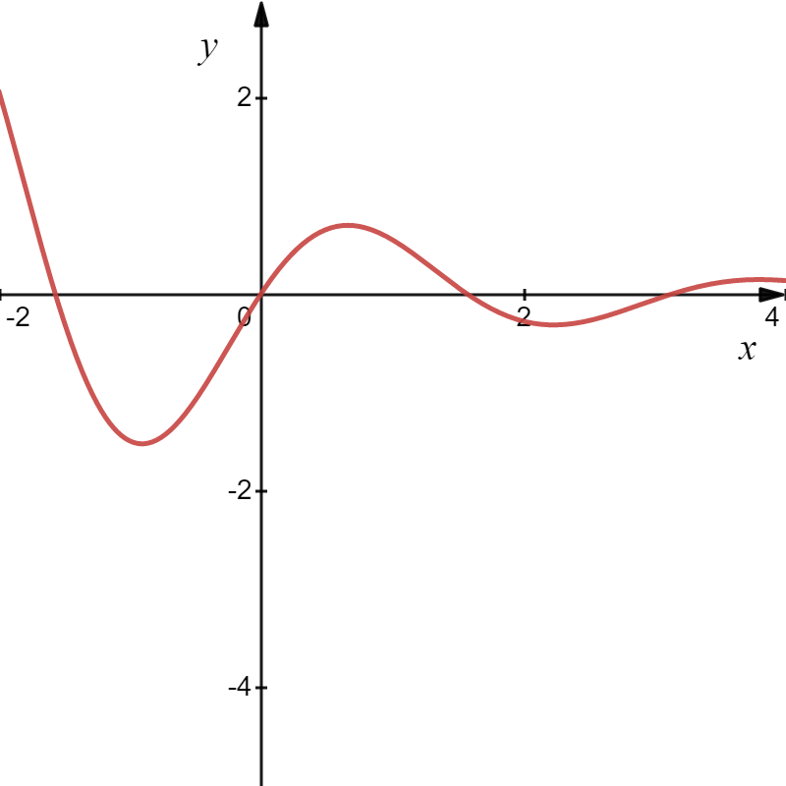
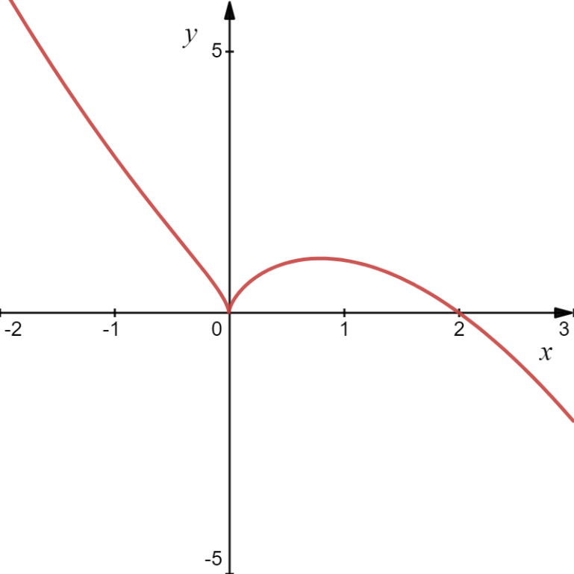
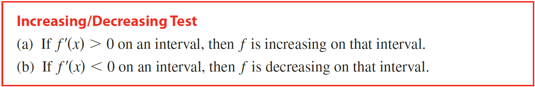
Thus, it appears that f increases when $f′(x)$ is positive and decreases when $f′(x)$ is negative. We get the following theorem.
(IDT)

Slide 4

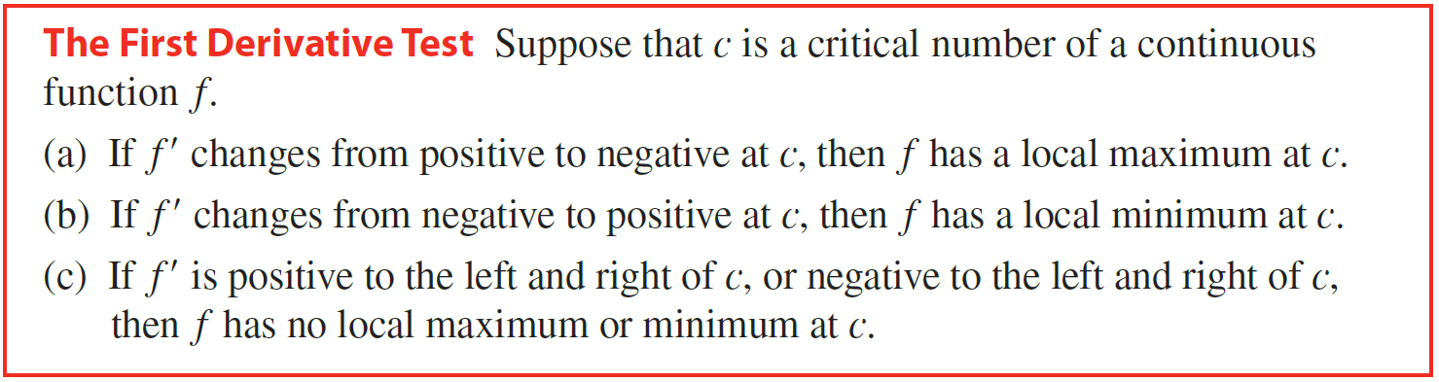
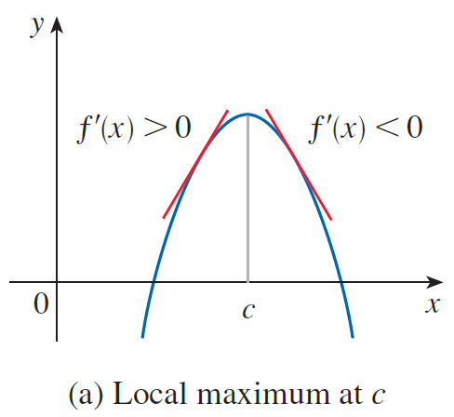
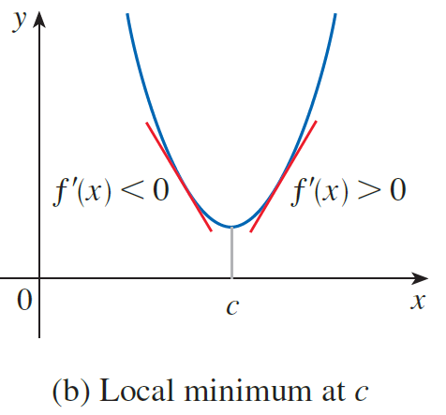
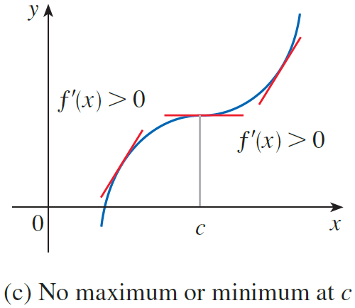
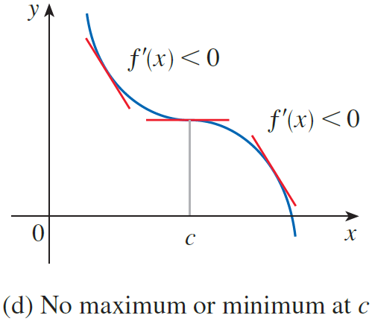
Recall from Section 4.1 that if f has a local maximum or minimum at c, then c must be a critical number of f (by Fermat’s Theorem), but not every critical number gives rise to a maximum or a minimum. We therefore need a test that will tell us whether or not f has a local maximum or minimum at a critical number.
(FDT)

Slide 5
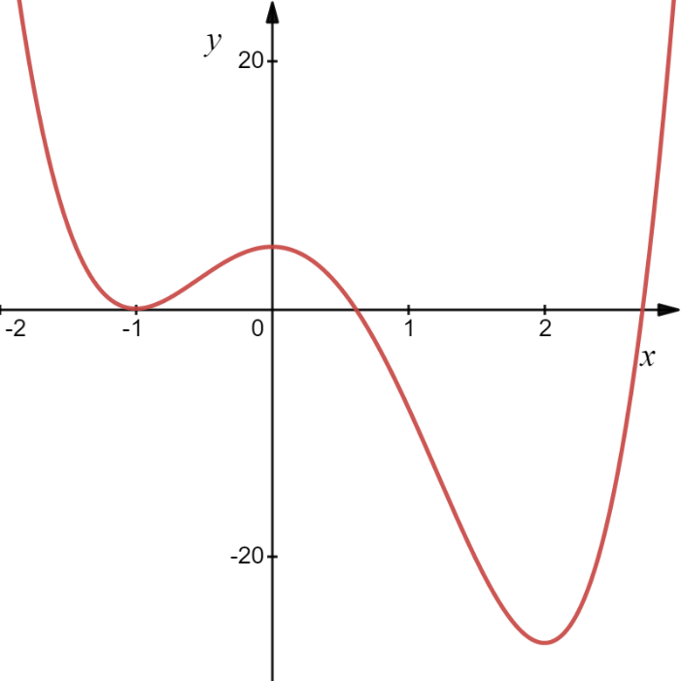
Example
Solution
x
−1

Slide 6

Solution
x
−1

Slide 7
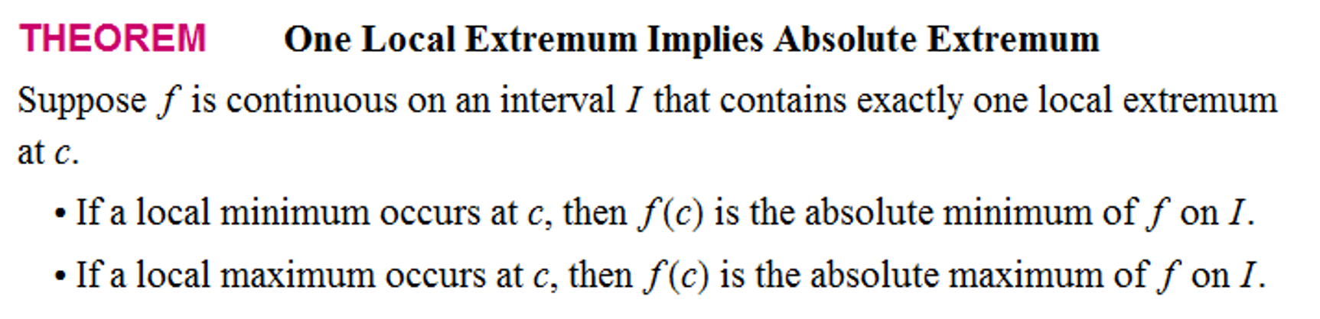
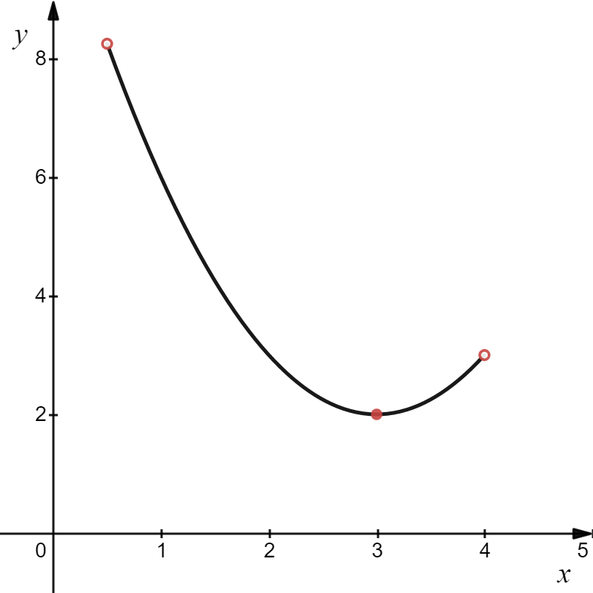
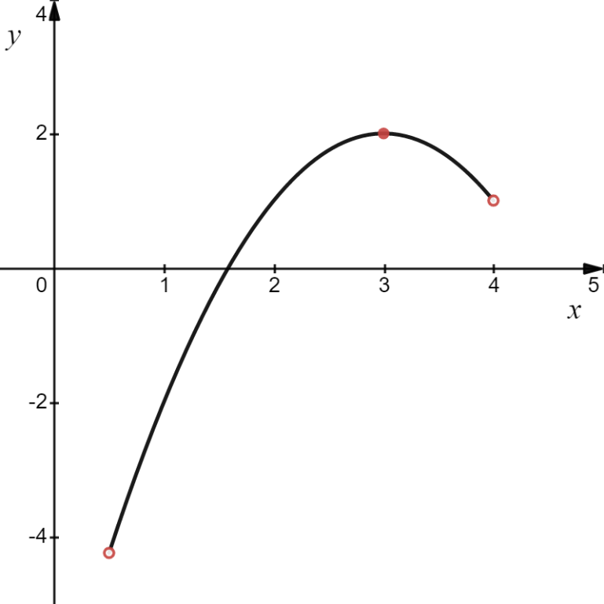
(OLE)

Slide 8





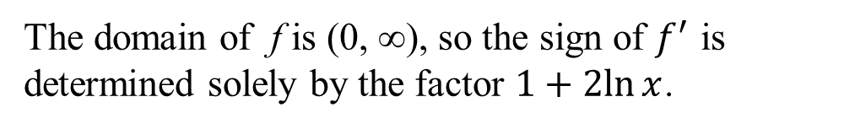
maximum and
Example
Consider the function .
(a) Find the intervals on which f is increasing or decreasing.
(b) Find the local maximum and minimum values of f , determine if they are absolute.
Solution
(a) Find the intervals on which f is increasing or decreasing.
x
The domain of f is (0, ∞), so the sign of $f^{′}$ is determined solely by the factor $1+2ln{x}$.

Slide 9
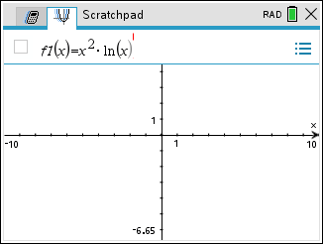
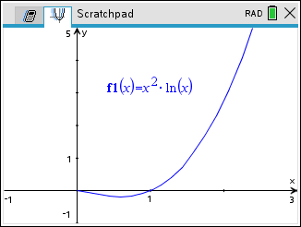
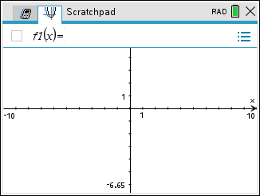
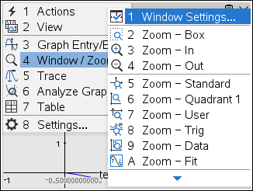
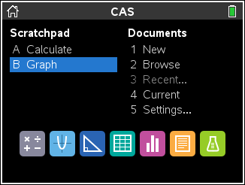
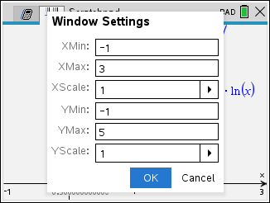
Example
Consider the function .
(a) Find the intervals on which f is increasing or decreasing.
(b) Find the local maximum and minimum values of f , determine if they are absolute.
Solution
(b) Find the local maximum and minimum values of f , determine if they are absolute.
x
Hence, by FDT f has a local minimum value at $x=e^{−1/2}.$
Absolute Minimum Point
is a local minimum value.
But wait! By OLE $y=−\frac{1}{2e}$ is the absolute minimum value for f $.$

Slide 10

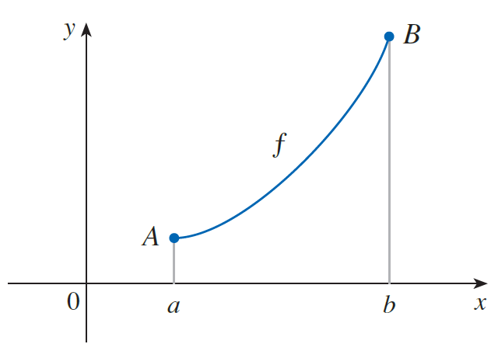
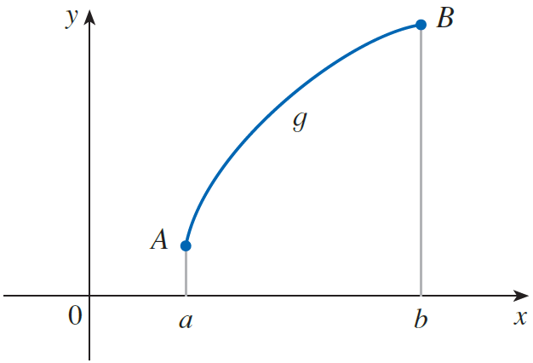
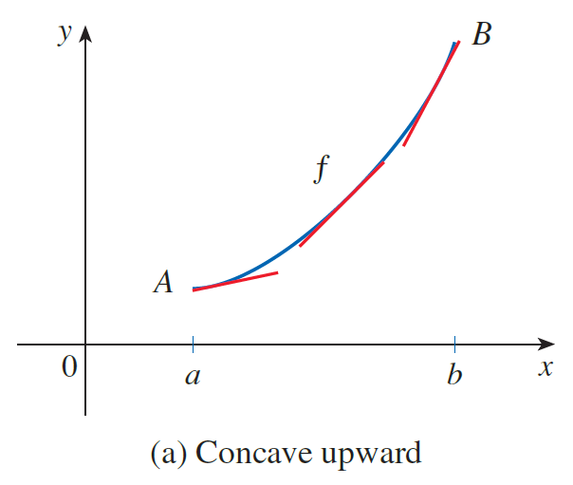
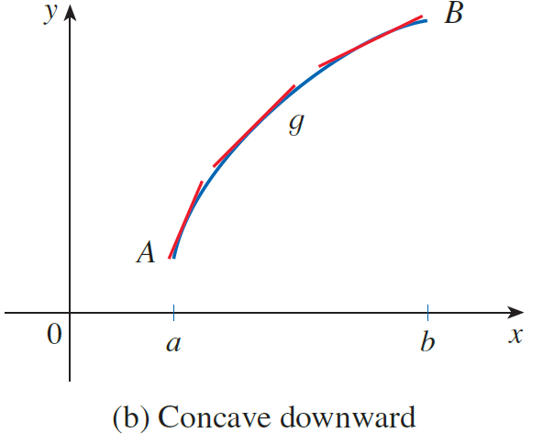
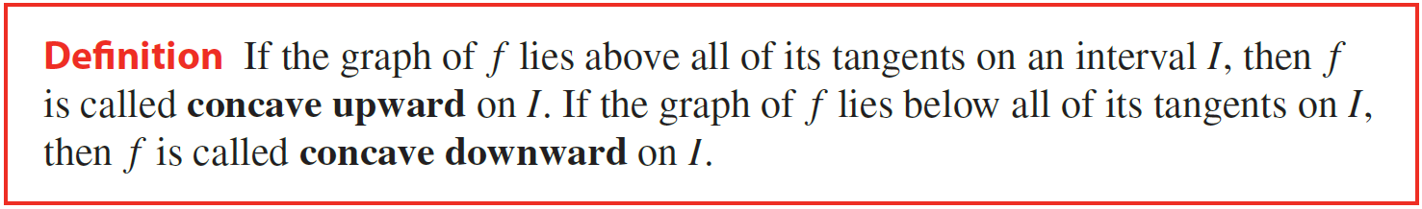

Slide 11
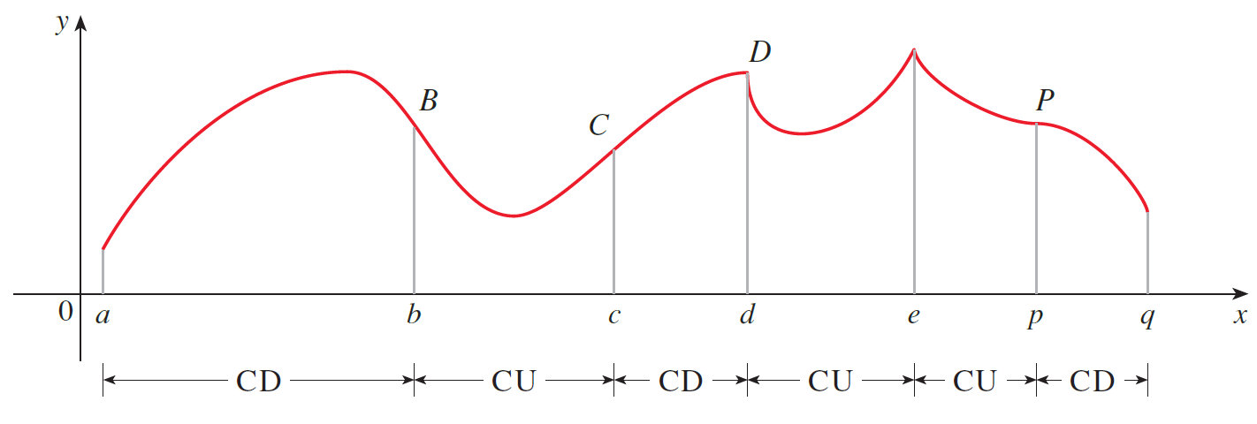

Slide 12
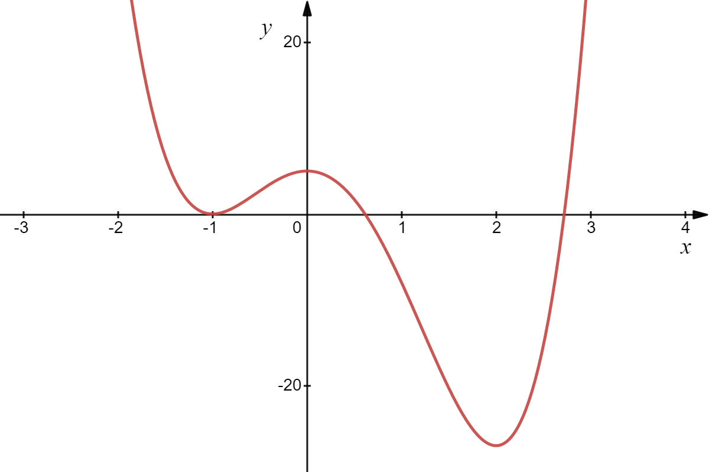
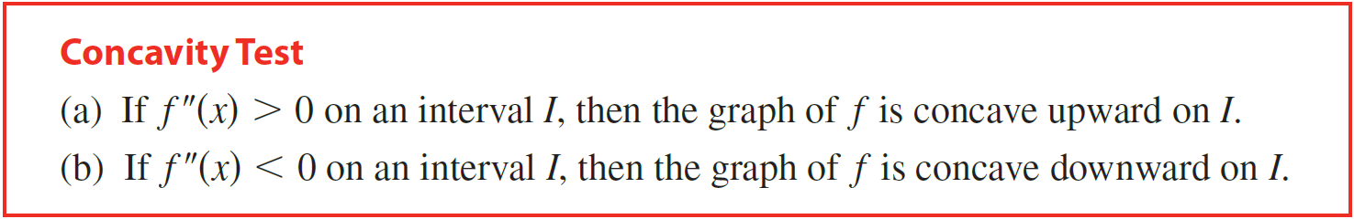
Let’s take the second derivative of y.
Concave up
Concave Down
(CT)

Slide 13
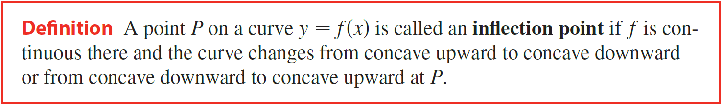
(DIP)

Slide 14
Example
(a) Find the intervals on which f is increasing or decreasing.
(b) Find the local maximum and minimum points of f .
(c) Find the intervals of concavity and the inflection points.
Solution
(a) Find the intervals on which f is increasing or decreasing.
(b) Find the local maximum and minimum points of f .
Possible extrema at .
Set
x

Slide 15
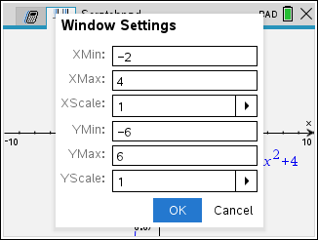
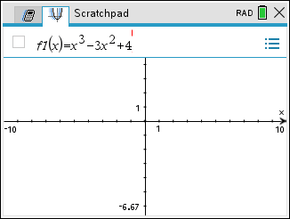
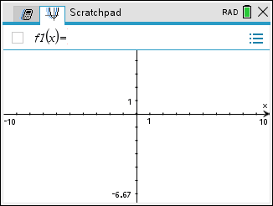
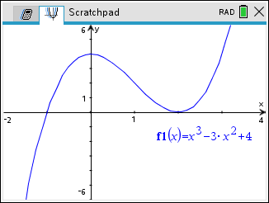
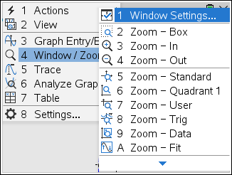
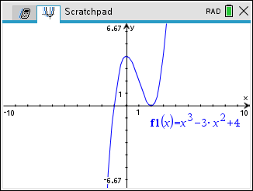
Solution
(c) Find the intervals of concavity and the inflection points.
Now let’s examine concavity and look for inflection points by setting the second derivative equal to zero.
Possible inflection point at .
negative
x
positive
By DIP, there is an inflection point at (1, 2) since the second derivative changes from negative to positive.

Slide 16





Example
Consider the function .
(a) Find the intervals of increase or decrease.
(b) Find the local maximum and minimum values.
(c) Find the intervals of concavity and the inflection points.
Solution
(a) Find the intervals of increase or decrease.
$$θ$$
Let

Slide 17


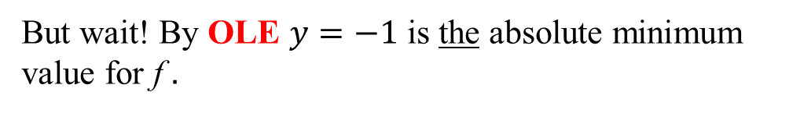
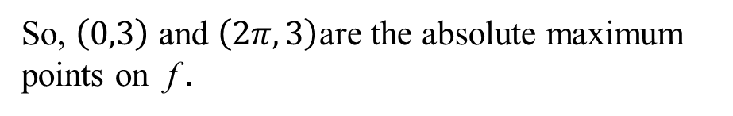
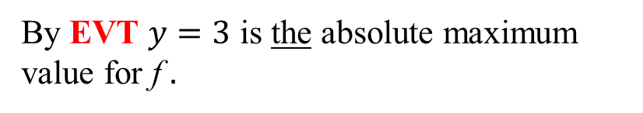
Solution
(b) Find the local maximum and minimum values.
By EVT $y=3$ is the absolute maximum value for f $.$
So, $\left(0,3\right)$ and $\left(2π,3\right)$are the absolute maximum points on f $.$
Hence, by FDT f has a local minimum value at $x=π.$
But wait! By OLE $y=−1$ is the absolute minimum value for f $.$
So, $\left(π,−1\right)$ is the absolute minimum point on f $.$
Since f is defined on a closed interval there must be an absolute maximum value for f by EVT. Let’s check the endpoints.

Slide 18








Solution
(c) Find the intervals of concavity and the inflection points.
$$θ$$

Slide 19
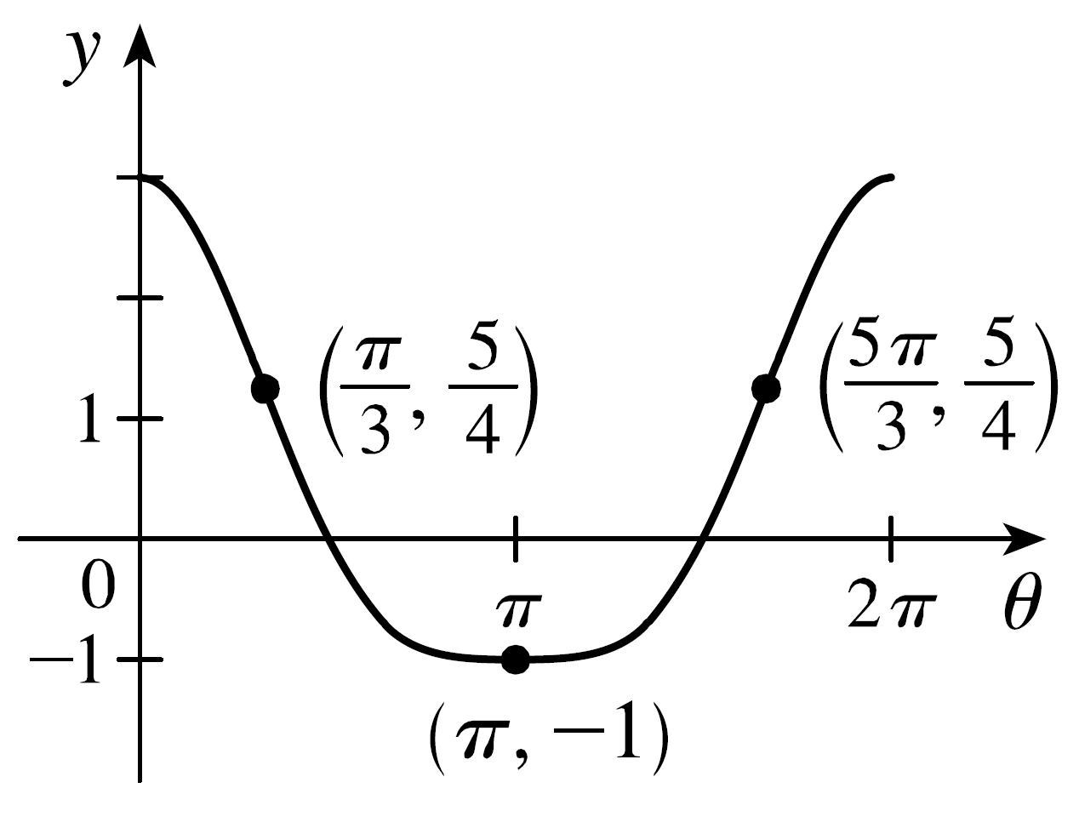
Solution
(c) Find the intervals of concavity and the inflection points.
$$θ$$

Slide 20
In summary, given a real number c in the domain of a continuous function y = f (x),
First derivative:
is positive
Curve is increasing.
IDT
is negative
Curve is decreasing.
is zero or
undefined
Possible local maximum or minimum points.
FDT
Second derivative:
is positive
Curve is concave up.
CT
is negative
Curve is concave down.
is zero or
undefined
Possible inflection point
(where concavity changes).
DIP

Slide 21

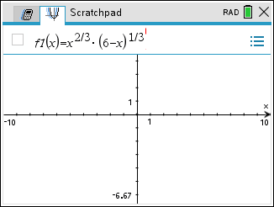
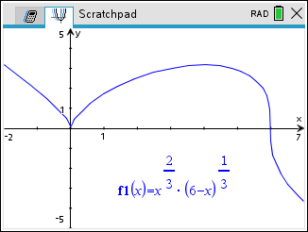
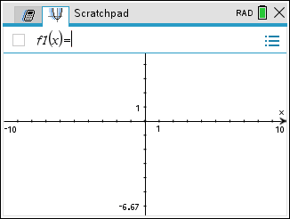
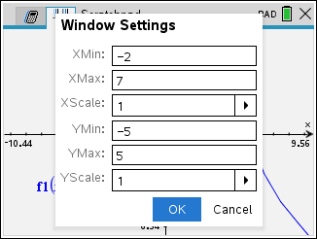
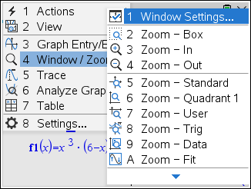
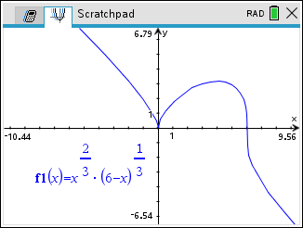
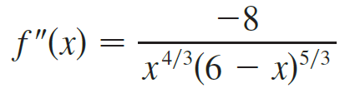
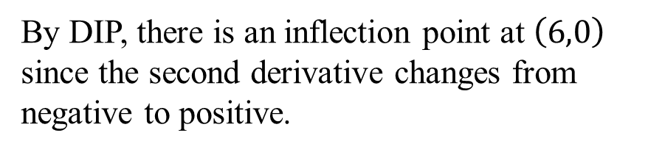
Example
Consider the function If the function below is it’s second derivative, find intervals of concavity and inflection point(s).
Solution
By DIP, there is an inflection point at $\left(6,0\right)$ since the second derivative changes from negative to positive.
x

Slide 22




Example
In each part state the x-coordinates of the inflection points
of f. Give reasons for your answers.
(a) The curve is the graph of $f$.
(b) The curve is the graph of $f′$.
(c) The curve is the graph of $f′′$.
Solution
There is an IP at x = 3 because the graph of f changes from CD to CU there. There is an IP at x = 5 because the graph of $f(x)$ changes from CU to CD there.
(b) There is an IP at x = 2 and at x = 6 because $f′(x)$ has a maximum value there, and so $f′′$ changes from positive to negative there. There is an IP at x = 4 because $f′(x)$ has a minimum value there and so $f′′(x)$ changes from negative to positive there.
(c) There is an inflection point at x = 1 because $f′′(x)$ changes from negative to positive there, and so the graph of $f(x)$ changes from concave downward to concave upward. There is an inflection point at x = 7 because $f′′(x)$ changes from positive to negative there, and so the graph of $f(x)$ changes from concave upward to concave downward.

Slide 23



(SDT)

Slide 24






Example
Solution
Possible local extrema at x = 0, 2.
We can use the Second Derivative Test:
Because the second derivative at x = 0 is negative and $y^{′}\left(0\right)=0$, the graph is concave down and therefore (0,4) is a local maximum point.
Because the second derivative at x = 2 is positive and $y^{′}\left(2\right)=0$, the graph is concave up and therefore (2,0) is a local minimum point.

Slide 25





Example
Consider the function .
(a) Find the vertical and horizontal asymptotes.
(b) Find the intervals of increase or decrease.
(c) Find the local maximum and minimum values.
(d) Find the intervals of concavity and the inflection points.
(e) Use the information from parts (a) – (d) to sketch the graph of f.
Solution
0
0
(a) Find the vertical and horizontal asymptotes.
0
0
A similar argument can be made for $x→0^{−}.$
So, x = 0 is a VA.
So, y = 1 is a HA.

Slide 26





Solution
(b) Find the intervals of increase or decrease.
x
Let
x = 2 is a critical number.
How about x = 0?
0 is not a critical number but we will check it out since it’s a V.A..

Slide 27

Solution
(c) Find the local maximum and minimum values.
x
f (x) changes from increasing to decreasing at x = 2, so f (2) is a local maximum value. There is no local minimum value.
In other words, f (x) is below y = 1 as $x→−∞$ and above y = 1 as $x→+∞$.

Slide 28



Solution
(d) Find the intervals of concavity and the inflection points.
x
By DIP, there is an inflection point at $\left(3,\frac{11}{9} \right)$ since the second derivative changes from negative to positive.

Slide 29








Solution
(e) Use the information from parts (a) – (d) to sketch the graph of f.
y = 1 is a HA.
x = 0 is a VA.
f (x) is below y = 1 as $x→−∞$ and above y =1 as $x→+∞$
2
3
Inflection point at $\left(3,\frac{11}{9} \right)$

