Slide 1
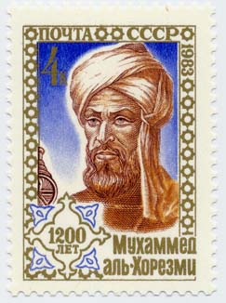
Abu Ja'far Muhammad ibn Musa Al-Khwarizmi
About 790 - About 850
Al'Khwarizmi was an Islamic mathematician who wrote on Hindu-Arabic numerals and was among the first to use zero as a place holder in positional base notation. The word algorithm derives from his name. His algebra treatise Hisab al-jabr gives us the word algebra and can be considered as the first book to be written on algebra.

Slide 2

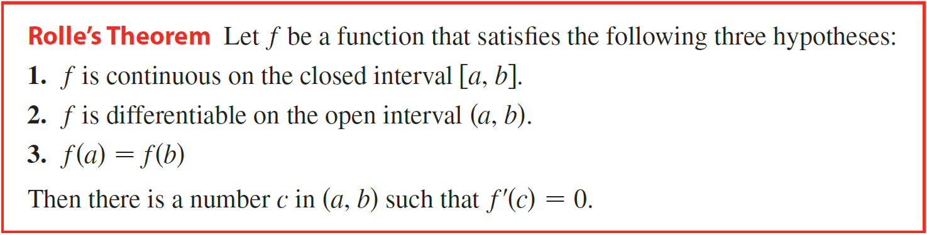

To arrive at the Mean Value Theorem, we first need the following result.

Slide 3
Horizontal Tangent Line
O

Slide 4
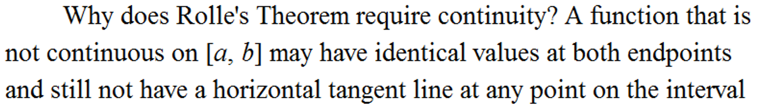


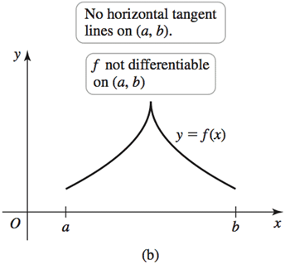
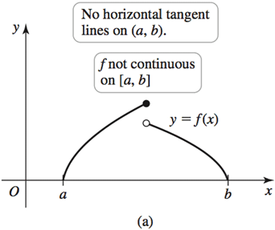
.
.

Slide 5


Example
Verify that the function satisfies the three hypotheses of Rolle’s Theorem on the given interval. Then find all numbers c that satisfy the conclusion of Rolle’s Theorem.
Solution
1. f is a rational function that is continuous on its domain, (−∞, 0) ∪ (0, ∞), so it is continuous on $\left[\frac{1}{2},2\right]$.
2.

Slide 6




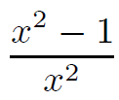

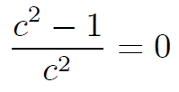
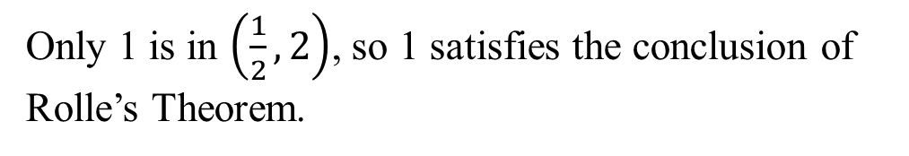
Solution
3.
Only 1 is in $\left(\frac{1}{2},2\right)$, so 1 satisfies the conclusion of
Rolle’s Theorem.
By Rolle’s Theorem we let

Slide 7
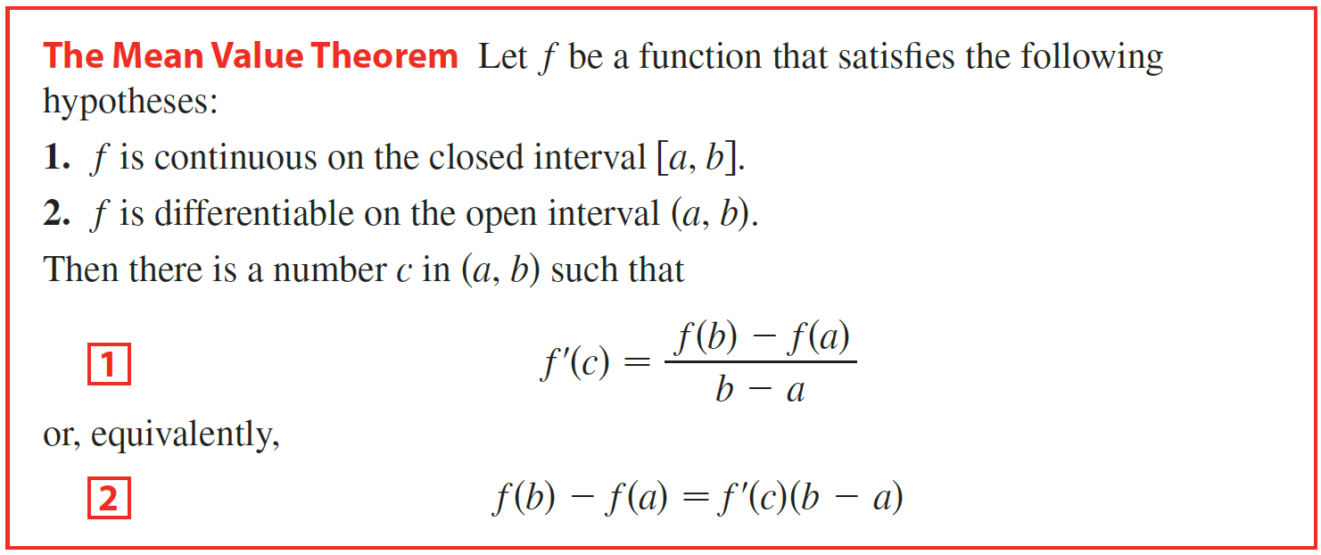
The Mean Value Theorem says that at some point in the open interval, the slope of the secant line equals the slope of the tangent line.

Slide 8



Slope of tangent:
Tangent parallel to secant.
Slope of secant:
O

Slide 9
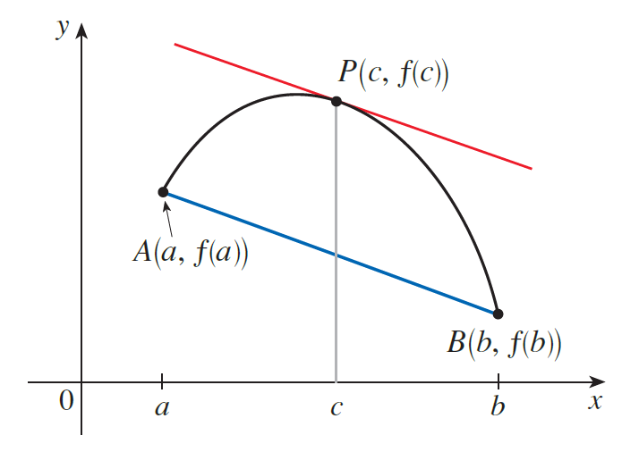
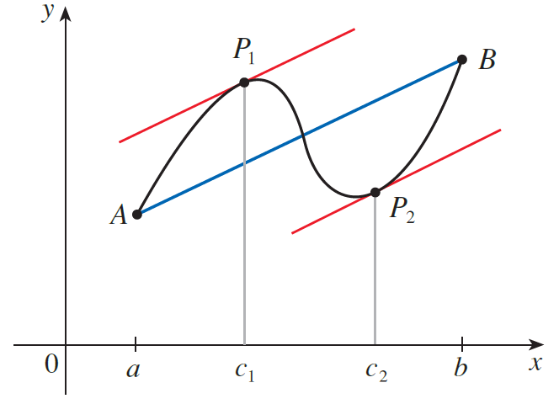
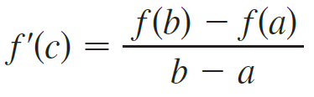

Slide 10

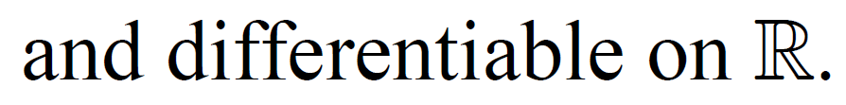
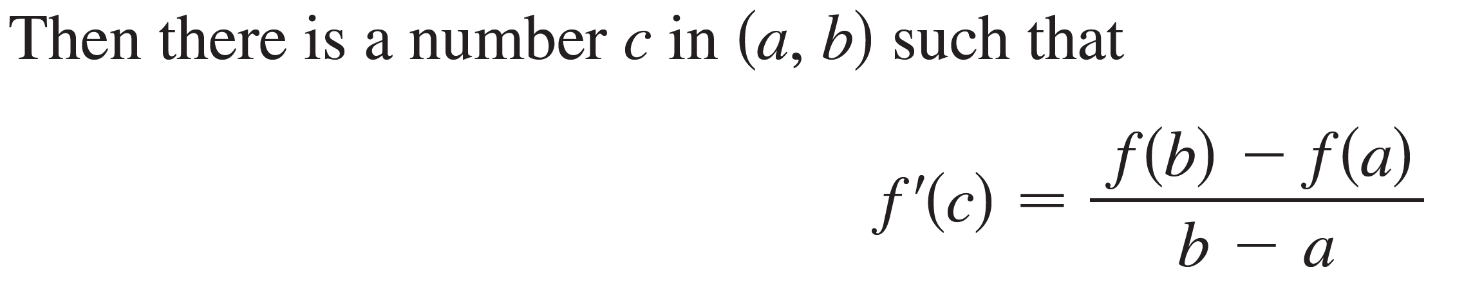

Example
Verify that the function satisfies the hypotheses of the Mean Value Theorem on the given interval. Then find all numbers c that satisfy the conclusion of the Mean Value Theorem.
Solution

Slide 11
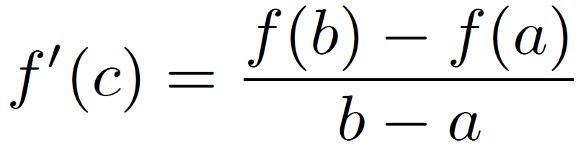
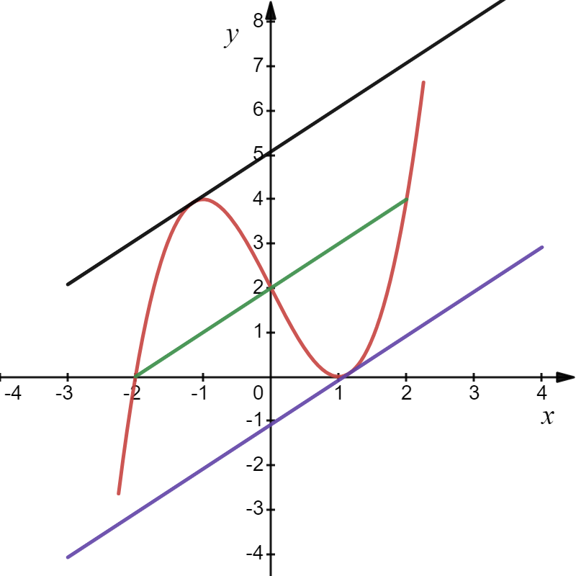
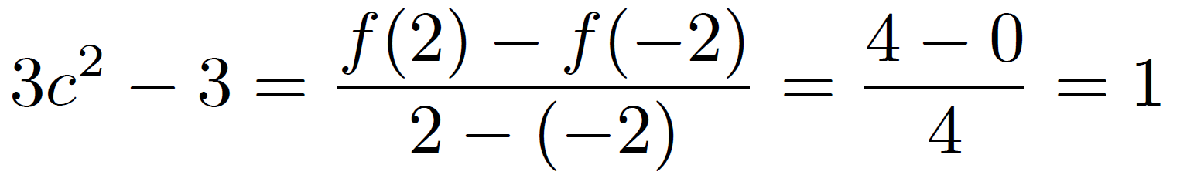
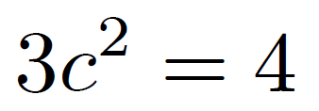
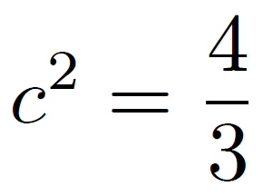
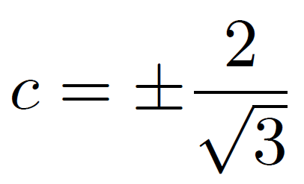

Solution
$$f^{′}\left(x\right)=3x^{2}−3$$
The slope of the secant line equals the slope of the tangent line.

