Slide 1
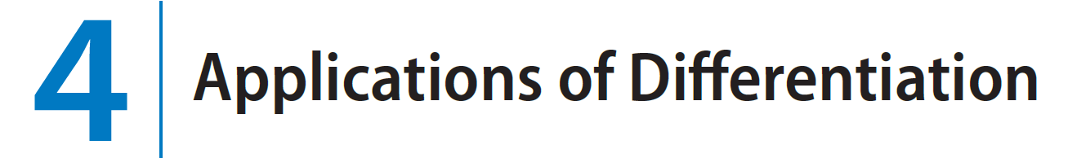
WE HAVE ALREADY INVESTIGATED SOME of the applications of derivatives, but now that we know the differentiation rules, we are in a better position to pursue the applications of differentiation in greater depth. Here we learn what derivatives tell us about the shape of a graph of a function and, in particular, how they help us locate maximum and minimum values of functions. Many practical problems require us to minimize a cost or maximize an area or somehow find the best possible outcome of a situation. In particular, we will be able to investigate the optimal shape of a
can and to explain the location of rainbows in the sky.

Slide 2
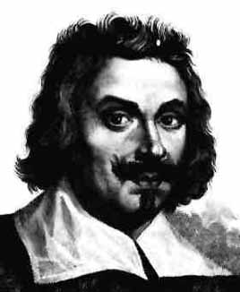
Evangelista Torricelli
1608 – 1647
Evangelista Torricelli was an Italian scientist who was the first man to create a sustained vacuum and to discover the principle of a barometer. He also achieved some important results in the development of the calculus.

Slide 3
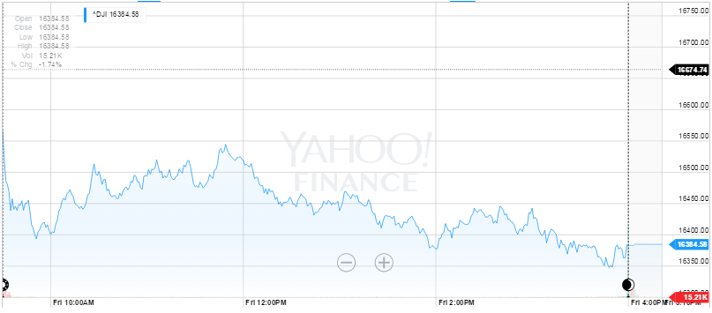
How do we describe high and low points on a graph?

Slide 4
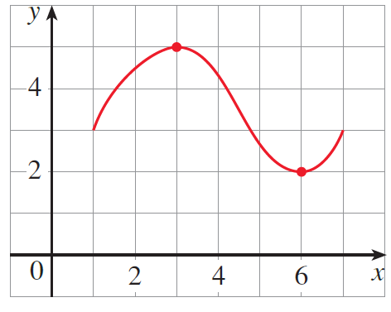
Even though the graphing calculator and the computer have eliminated the need to routinely use calculus to graph by hand and to find maximum and minimum values of functions, we still study the methods to increase our understanding of functions and the mathematics involved.
Absolute extreme values occur either at maximum or minimum points on a curve.
An absolute maximum or minimum is sometimes called a global maximum or minimum. The maximum and minimum values of f are called extreme values of f.
They are also sometimes called absolute extrema.
(Extrema is the plural of the Latin extremum.)

Slide 5


Slide 6
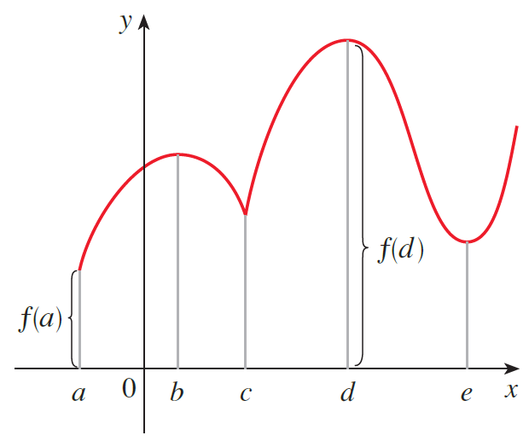
If we say that something is near c, we mean that it is true on some open interval containing c. (Thus, a local maximum or minimum can’t occur at an endpoint.)

Slide 7

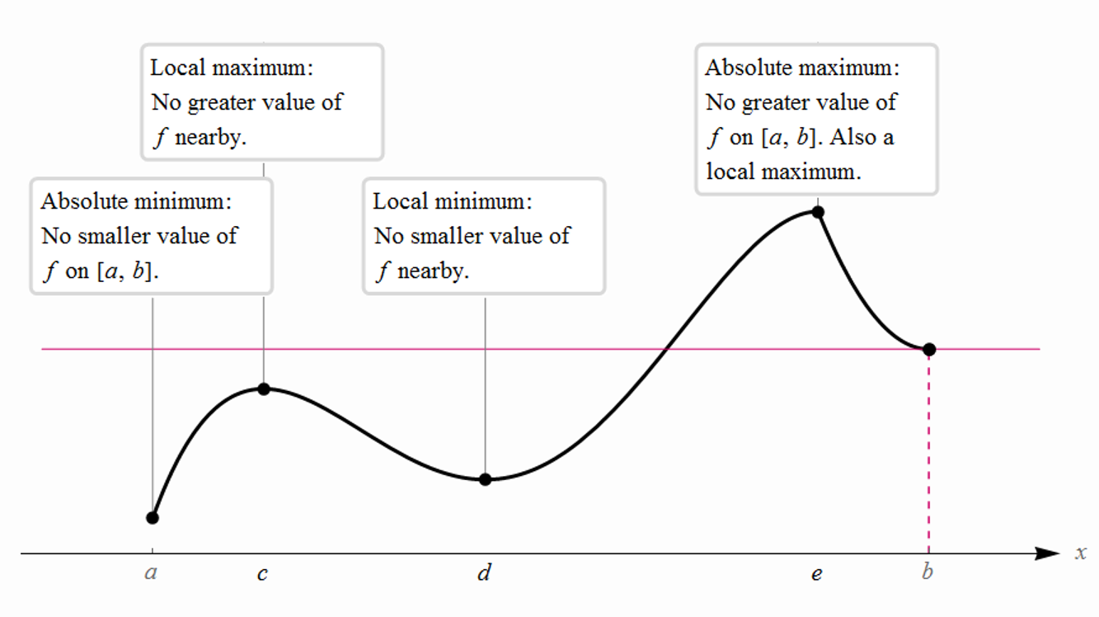

Slide 8
Extrema Terminology and Definitions
Maxima: absolute or local (relative)
The ordered pair (a, b) is an absolute maximum point if and only if y = b is an absolute maximum value and x = a is a maximizer.
The ordered pair (a, b) is a local maximum point if and only if y = b is a local maximum value and x = a is a maximizer.
Minima: absolute or local (relative)
The ordered pair (a, b) is an absolute minimum point if and only if y = b is an absolute minimum value, x = a is a minimizer.
The ordered pair (a, b) is a local minimum point if and only if y = b is a local minimum value, x = a is a minimizer.

Slide 9
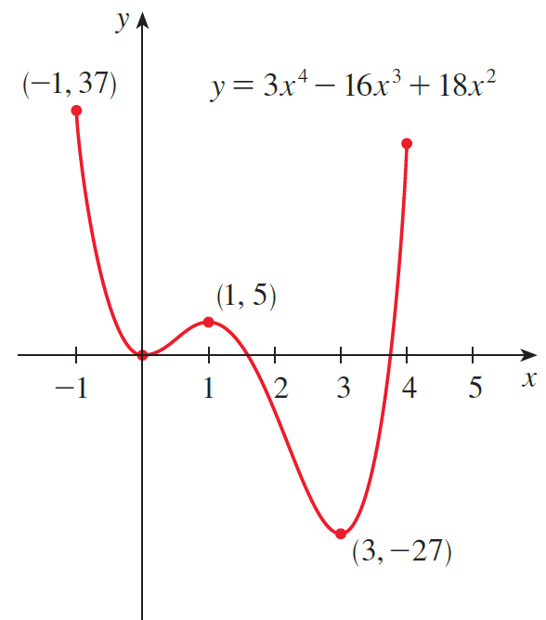
Example
The graph of the function
is shown in the figure below.
Solution
You can see that f (1) = 5 is a local maximum value, whereas the absolute maximum value is f (−1) = 37.
(This absolute maximum is not a local maximum
because it occurs at an endpoint.)
Also, f (0) = 0 is a local minimum value and f (3) = −27
is both a local and an absolute minimum.
(0,0)
Note that f has neither a local nor an absolute
maximum value at x = 4.

Slide 10

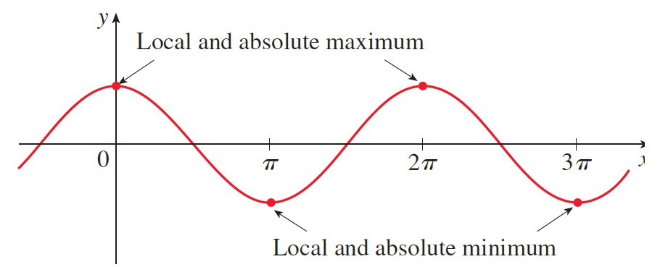


Example
Consider
Solution
Cosine takes on its (local and absolute) maximum and minimum values of 1 and −1, respectfully, infinitely many times. So, extreme values are not unique.

Slide 11

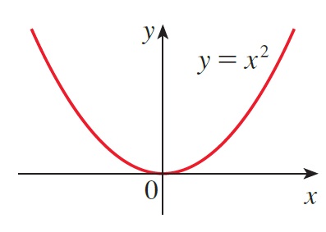
Example
Consider
Solution
Therefore, f (0) = 0 is the absolute (and local) minimum value of f .
This corresponds to the fact that the origin is the lowest point on the parabola y = x².
However, there is no highest point on the parabola and so this function has no maximum value.

Slide 12

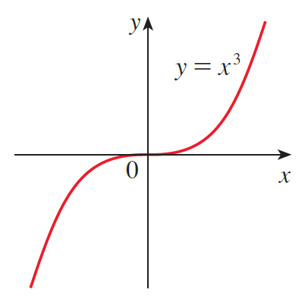
Example
Consider
Solution
From the graph of the function f (x) = x³, shown in the figure, we see that this function has neither an absolute maximum value nor an absolute minimum value. In fact, it has no local extreme values either.

Slide 13
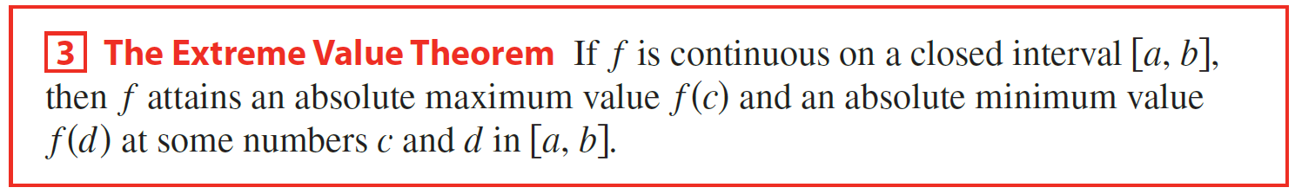
We have seen that some functions have extreme values, whereas others do not. The following theorem gives conditions under which a function is guaranteed to possess extreme values.
EVT
(c, f (c))
(c, f (c))
(c, f (c))
(c, f (c))
(d, f (d))
(d, f (d))
(d, f (d))
(d, f (d))
Absolute Maximum point is an interior point and Absolute Minimum point is an endpoint
Absolute Minimum point is an interior point and Absolute Maximum point is an endpoint
Absolute Maximum and Minimum points are endpoints
Absolute Maximum and Minimum points are interior points

Slide 14
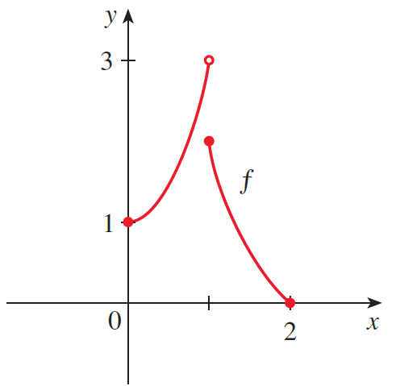
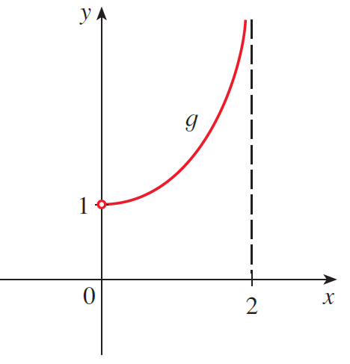

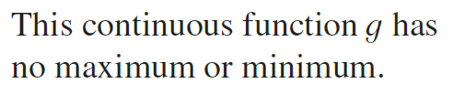
The figures below show that a function need not possess extreme values if either hypothesis (continuity or closed interval) is omitted from the Extreme Value Theorem.

Slide 15
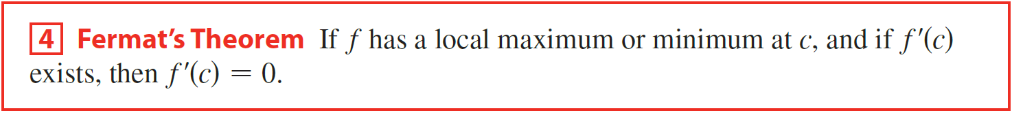
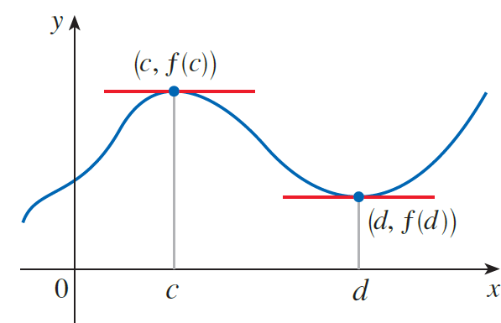
The Extreme Value Theorem says that a continuous function on a closed interval has a maximum value and a minimum value, but it does not tell us how to find these extreme values.

Slide 16
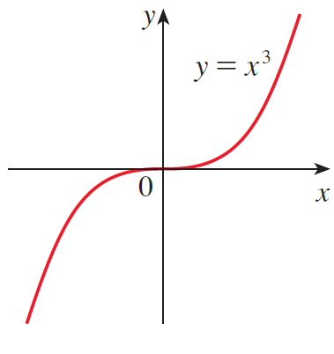
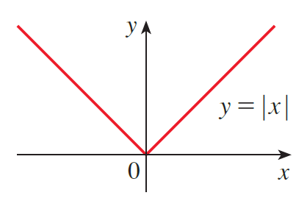

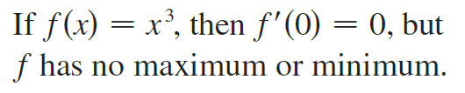
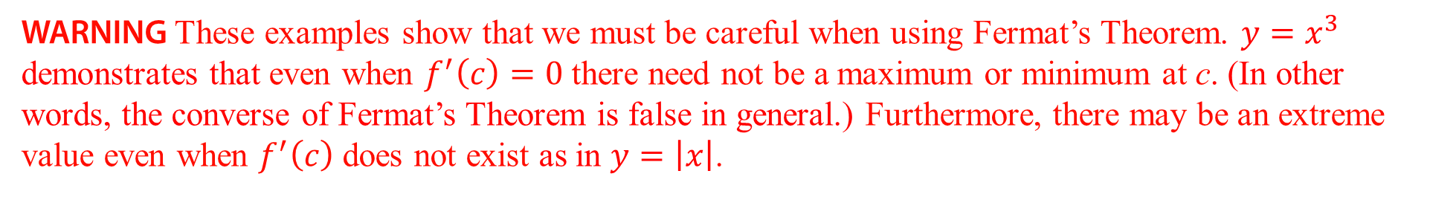
WARNING These examples show that we must be careful when using Fermat’s Theorem. $y=x^{3}$ demonstrates that even when $f^{′}\left(c\right)=0$there need not be a maximum or minimum at c. (In other words, the converse of Fermat’s Theorem is false in general.) Furthermore, there may be an extreme value even when $f^{′}\left(c\right)$does not exist as in $y=\left|x\right|$.

Slide 17
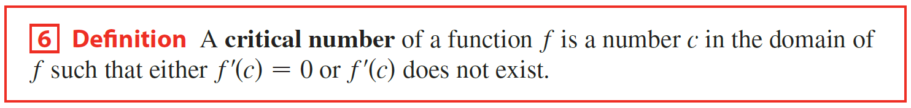
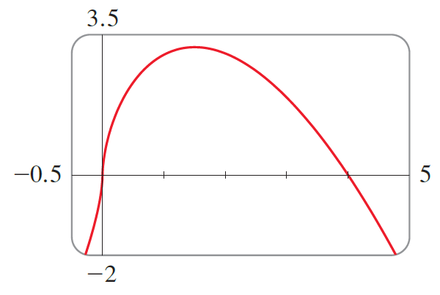


Fermat’s Theorem does suggest that we should at least start looking for extreme values of f at the numbers c where $f^{′}\left(c\right)=0$or where $f^{′}\left(c\right)$does not exist. Such numbers are given a special name.

Slide 18



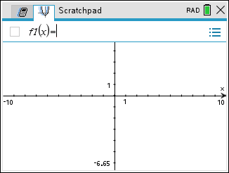

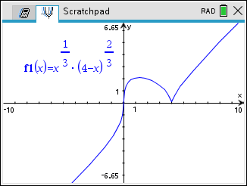
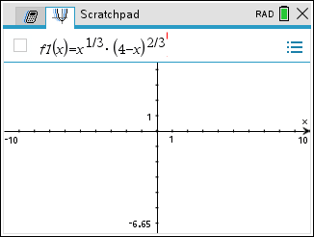

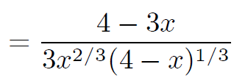



Example
Find the critical numbers of the function.
Solution
x =
Let

Slide 19
x =
We see that at x = 4/3 and x = 4 we have extreme points.

Slide 20
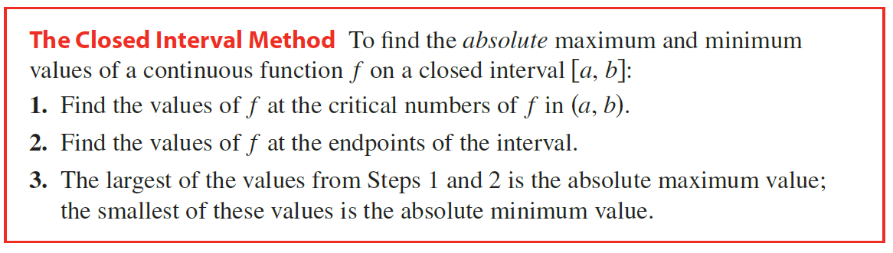
To find an absolute maximum or minimum of a continuous function on a closed interval, we note that either it is local [in which case it occurs at a critical number] or it occurs at an endpoint of the interval. Thus, the following three-step procedure always works.

Slide 21

Z
Example
Find the absolute maximum and absolute minimum values of f on the given interval.
Endpoint
(b)
(c)
Interior point (Critical Point)
Solution
Endpoint
There are no values of x that will make
the first derivative equal to zero.
Absolute Minimum Value
The first derivative is undefined at x = 0,
0 is in the closed interval, so (0,0)
is a critical point.
Absolute Maximum Value
By The Extreme Value Theorem
2. Find the values of f at the endpoints of the interval.
Absolute
Minimum Point:
3. The largest of the values from Steps 1 and 2 is the absolute maximum value; the smallest of these values is the absolute minimum value.
Absolute
Maximum Point:

Slide 22











(b)
Endpoint
Absolute Maximum Value
Solution
Interior points (Critical Points)
Absolute Minimum Value
Endpoint
By The Extreme Value Theorem
Critical numbers are
Absolute
Minimum Point:
Absolute
Maximum Point:

Slide 23











(c)
Endpoint
Solution
Interior point (Critical Point)
Absolute Maximum Value
Endpoint
Absolute Minimum Value
By The Extreme Value Theorem
Absolute
Minimum Point:
Absolute
Maximum Point:
Critical number is

Slide 24

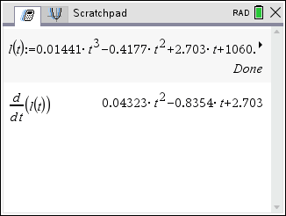

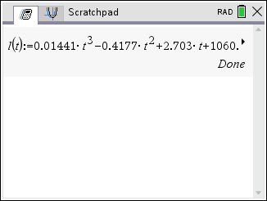

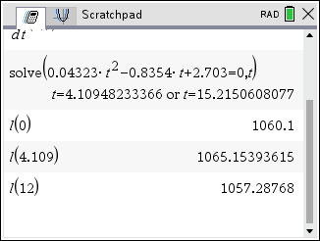
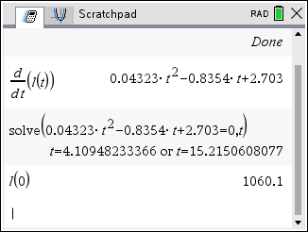
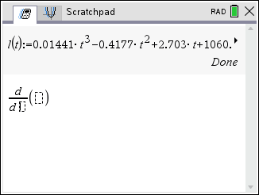
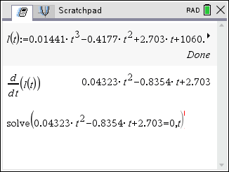
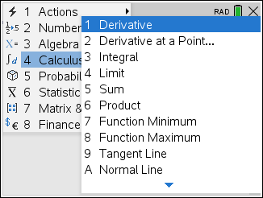
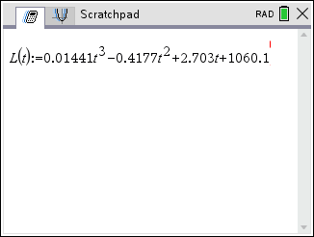
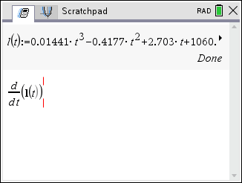
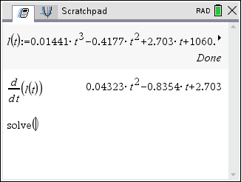
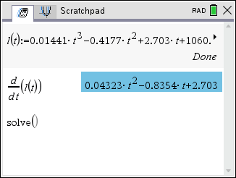
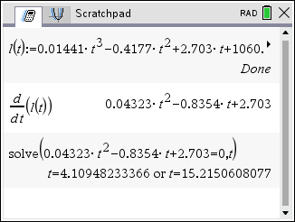
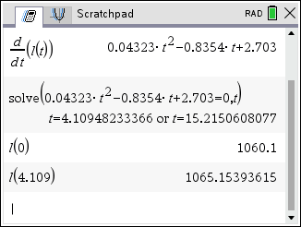
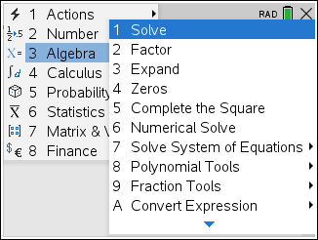

Example
The water level, measured in feet above mean sea level, of Lake Lanier in Georgia, USA, during 2012 can be modeled by the function
where t is measured in months since January 1, 2012. Estimate when the water level was highest during 2012.
Solution
Let
Endpoint
Interior point (Critical Point)
Endpoint
Absolute Maximum Value
Thus, by the Extreme Value Theorem, the water level was highest during 2012 at about 4.109 months after January 1.

