Slide 1

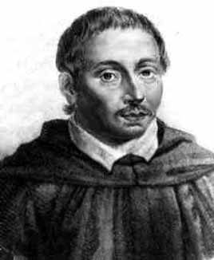
Bonaventura Francesco Cavalieri
1598 – 1647
Bonaventura Cavalieri was an Italian mathematician who developed a method of indivisibles which became a factor in the development of the integral calculus.

Slide 2

In a related rates problem, the idea is to compute the rate of change of one quantity in terms of the rate of change of another quantity (which may be more easily measured). The procedure is to find an equation that relates the two quantities and then use the Chain Rule to differentiate both sides with respect to time. A related rate problem is analyzing a problem over time.
Example
Air is being pumped into a spherical balloon so that its volume increases at a rate of 100 cm³/s. How fast is the radius of the balloon increasing when the diameter is 50 cm?
Solution
I Introduction
Assign symbols to all quantities that are functions of time.
r
V
Let
r = radius of the sphere (cm)
V = volume of the sphere (cm³)
r and V are functions of time.

Slide 3
Solution
II Known Derivative
Express the given rate(s) in terms of derivatives.
r
V
The volume of air is increase at a rate of 100 cm³/s
III Unknown Derivative
Express the unknown rate(s) in terms of derivatives.
What rate is the radius increase when the diameter is 50 cm?

Slide 4


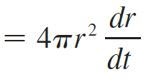
Solution
IV Equation
Write an equation that relates the various quantities of the problem that are functions of time. If
necessary, use geometry of the situation to eliminate one of the variables by substitution.
r
V
V Differential Equation
Use the Chain Rule to differentiate both sides of the equation with respect to t, also known as implicit differentiation, to find a differential equation.
This differential equation relates r and V over time, thus a related rate!

Slide 5
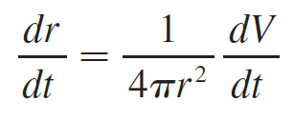

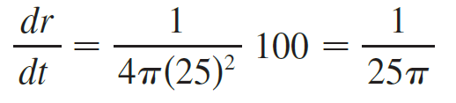

Solution
VI Snapshot
Substitute the given information into the resulting equation and solve for the unknown derivative.
Now we solve for the unknown quantity:
r
V
VII Conclusion
State your conclusion to the problem.

Slide 6
Steps for Related Rates Problems:
I Introduction
-Read the problem carefully.
-Draw a picture (sketch), if possible.
-Introduce notation. Assign symbols to all quantities
that are functions of time.
II Known Derivative
Express the given rates in terms of derivatives.
III Unknown Derivative
Express the unknown rates in terms of derivatives.
IV Equation
Write an equation that relates the various quantities
of the problem that are functions of time. If
necessary, use geometry of the situation to eliminate
one of the variables by substitution.

Slide 7
Steps for Related Rates Problems:
V Differential Equation
Use the Chain Rule to differentiate both sides of the
equation with respect to t, also known as implicit
differentiation, to find a differential equation.
VI Snap Shot
Substitute the given information into the resulting
equation and solve for the unknown derivative.
VII Conclusion
State your conclusion to the problem.

Slide 8
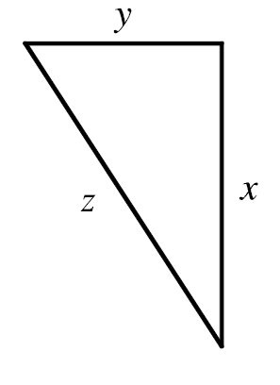
Example
Two cars start moving from the same point. One travels south at 60 mi/h and the other travels west at 25 mi/h. At what rate is the distance between the cars increasing two hours later?
Solution
I Introduction
Let
x = car traveling south (mi)
y = car traveling west (mi)
z = distance between cars (mi)
Start
West
x, y and z are functions of time.
South

Slide 9
Example
Two cars start moving from the same point. One travels south at 60 mi/h and the other travels west at 25 mi/h. At what rate is the distance between the cars increasing two hours later?
Solution
II Known Derivative
One travels south at 60 mi/h and the other travels west at 25 mi/h.
Start
West
III Unknown Derivative
At what rate is the distance between the cars increasing two hours later?
South

Slide 10



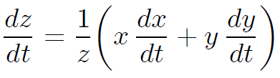
Example
Two cars start moving from the same point. One travels south at 60 mi/h and the other travels west at 25 mi/h. At what rate is the distance between the cars increasing two hours later?
Solution
IV Equation
Start
West
V Differential Equation
Use the Chain Rule to differentiate both sides of the equation with respect to t.
South
Differential Equation

Slide 11
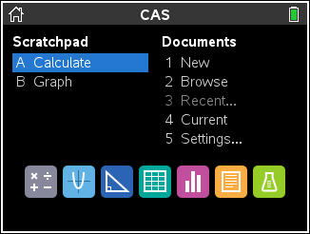
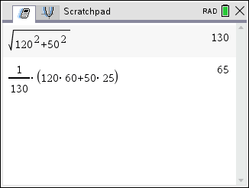
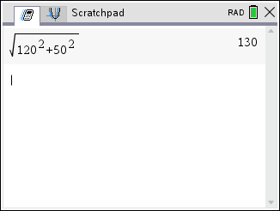
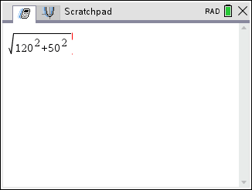

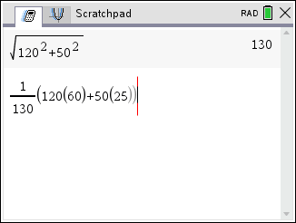

Solution
VI Snapshot
Substitute the given information into the resulting equation.
Start
West
VII Conclusion
South
The distance between the cars after two hours is increasing at a rate of 65 mi/h.

Slide 12
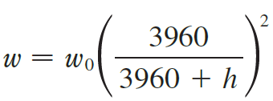
Example
The weight w of an astronaut (in pounds) is related to her height h above the surface of the earth (in miles) by
where w₀ is the weight of the astronaut on the surface of the earth. If the astronaut weighs 130 pounds on earth and is in a rocket, being propelled upward at a speed of 12 mi/s, find the rate at which her weight is changing (in lb/s) when she is 40 miles above the earth’s surface.
Solution
I Introduction
Let
w = weight of astronaut (lb)
h = height above the surface of the earth (mi)
w, and h are functions of time.

Slide 13
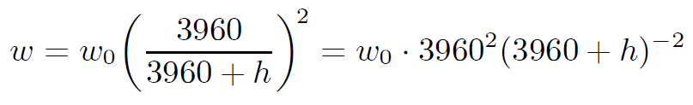
Solution
II Known Derivative
Being propelled upward at a speed of 12 mi/s.
III Unknown Derivative
Find the rate at which her weight is changing she is 40 miles above the earth’s surface.
IV Equation

Slide 14
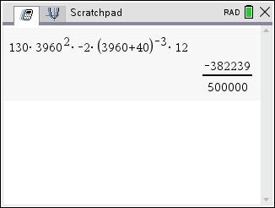
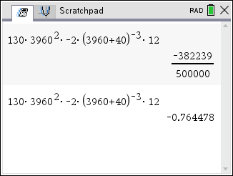
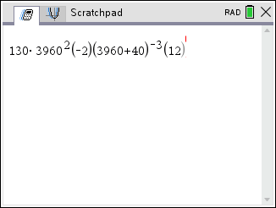




Solution
V Differential Equation
Use the Chain Rule to differentiate both sides of the equation with respect to t.
Differential Equation
VI Snapshot
Substitute the given information into the differential equation above.
VII Conclusion
Her weight is decreasing at a rate of 0.7645 lb/s when she is 40 miles above the earth’s surface.

Slide 15
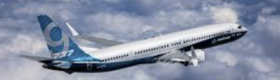
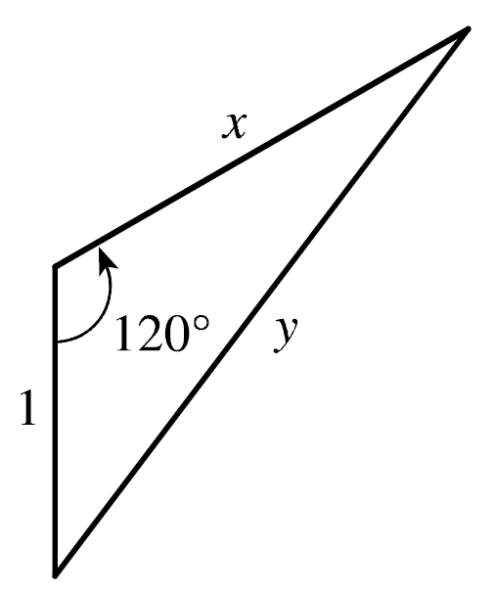
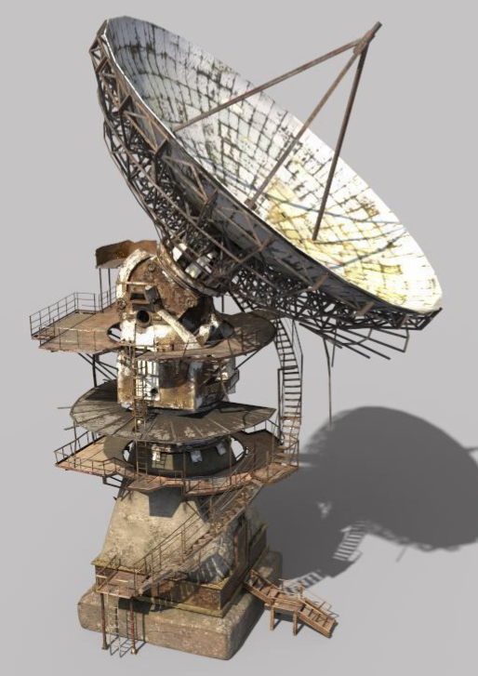
Example
A plane flying with a constant speed of 300 km/h passes over a ground radar station at an altitude of 1 km and climbs at an angle of 30º. At what rate is the distance from the plane to the radar station increasing a minute later?
Solution
I Introduction
Let
x = distance plane traveled (km)
y = distance plane is from radar station (km)
x, and y are functions of time.

Slide 16


Solution
II Known Derivative
Plane flying with a constant speed of 300 km/h
III Unknown Derivative
Find the rate that the distance from the plane to the radar station increasing a minute later.
IV Equation
By the Law of Cosines,

Slide 17




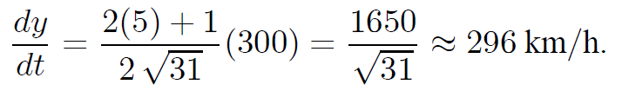
Solution
V Differential Equation
Use the Chain Rule to differentiate both sides of the equation with respect to t.
Differential Equation
VI Snapshot
Substitute the given information into the resulting equation.
VII Conclusion
The distance from the plane to the radar station is increasing at a rate of 296 km/h after 1 minute.

Slide 18
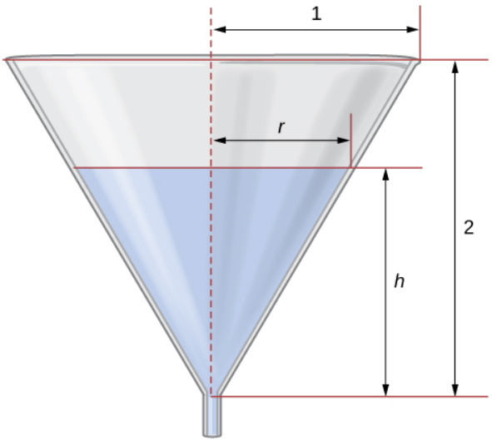
Example
Water is draining from the bottom of a cone-shaped funnel at the rate 2 in³/min. The height of the funnel is 16 inches and the radius at the top of the funnel is 4 in. At what rate is the height of the water in the funnel changing when the height of the water is 8 in?
Solution
4 in
I Introduction
Let
V = volume of water (in³)
r = radius of water level (in)
h = height of water level (in)
r
V
16 in
V, r, and h are functions of time.
h

Slide 19
4 in
Solution
II Known Derivative
Water is draining out at the rate of 2 in³/min
r
V
16 in
h
III Unknown Derivative
Find the rate that the height of the water is changing when the water level is 8 in.
Therefore, the ratio of the sides in the two triangles is the same.
4 in
IV Equation
r
16 in
h
We see that we have similar triangles.

Slide 20

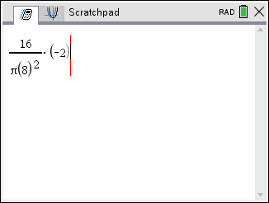
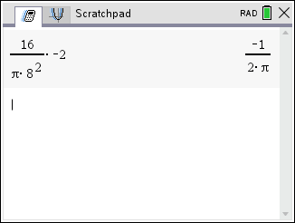
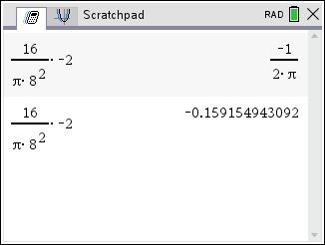
Solution
V Differential Equation
Use the Chain Rule to differentiate both sides of the equation with respect to t.
4 in
r
V
16 in
Differential Equation
h
VI Snapshot
Substitute the given information into the resulting equation.
VII Conclusion
The height of the water is decreasing at a rate of 0.159 in/min when the water level is 8 in.

Slide 21
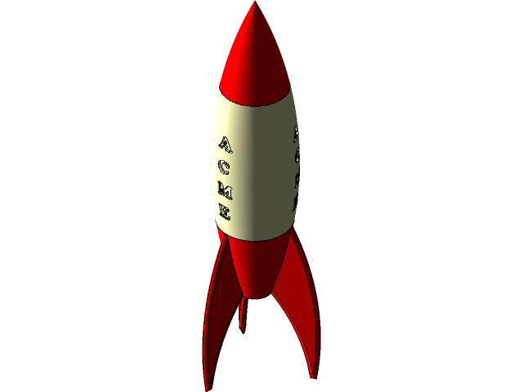
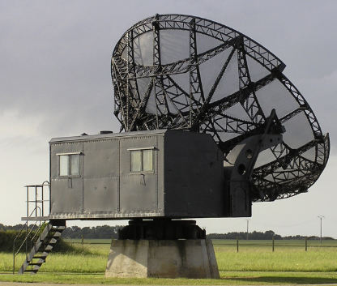
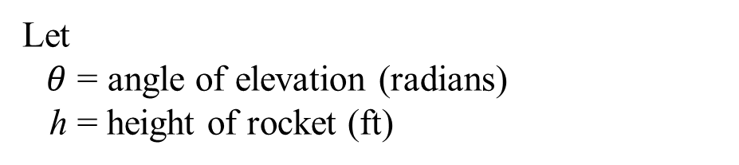


Example
A television camera is positioned horizontally 4,000 feet from the base of a rocket launching pad. The angle of elevation of the camera has to change at the correct rate in
order to keep the rocket in sight. Let’s assume the rocket rises vertically and its speed is 600 ft/sec when it has risen 3,000 ft. If the television camera is always kept aimed at the rocket, how fast is the camera’s angle of elevation changing at that same moment?
Solution
I Introduction
Let
$θ$ = angle of elevation (radians)
h = height of rocket (ft)
$θ$ and h are functions of time.
h
$$θ$$
4,000 feet

Slide 22

Solution
II Known Derivative
Rocket rises vertically and its speed is 600 ft/sec when it has risen 3,000 ft.
h
$$θ$$
4,000 feet
III Unknown Derivative
Find how fast is the camera’s angle of elevation changing at that same moment.
IV Equation

Slide 23
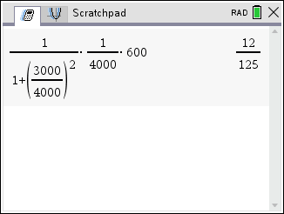
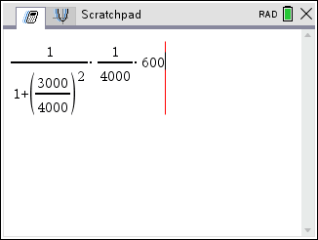
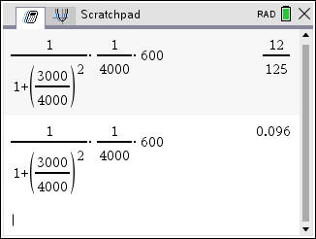
Solution
V Differential Equation
Use the Chain Rule to differentiate both sides of the equation with respect to t.
Differential Equation
VI Snapshot
Substitute the given information into the resulting equation.
VII Conclusion
The angle of elevation of the rocket is increasing at a rate of $\frac{12}{125}$ rad/sec when the rocket is 3000 feet high.

