Slide 1
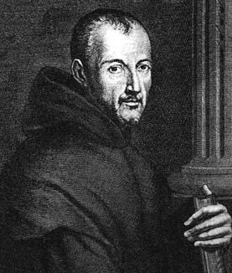
Marin Mersenne
1588 – 1648
Marin Mersenne was a French monk who is best known for his role as a clearing house for correspondence between eminent philosophers and scientists and for his work in number theory.

Slide 2

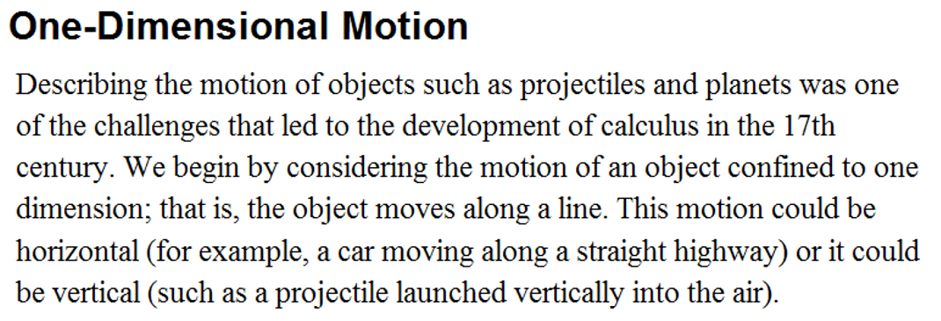
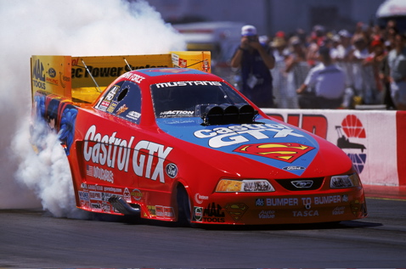

Slide 3
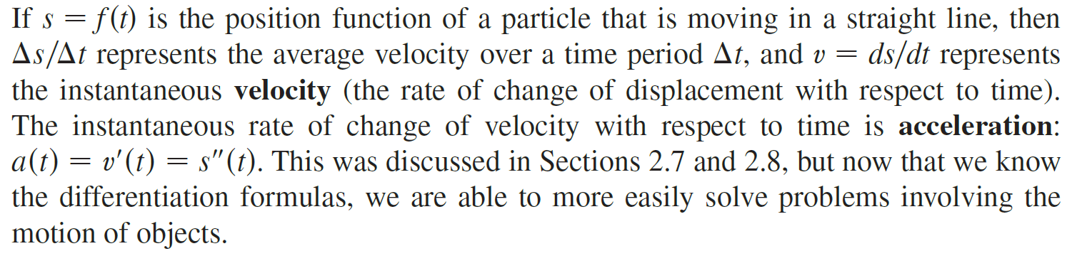
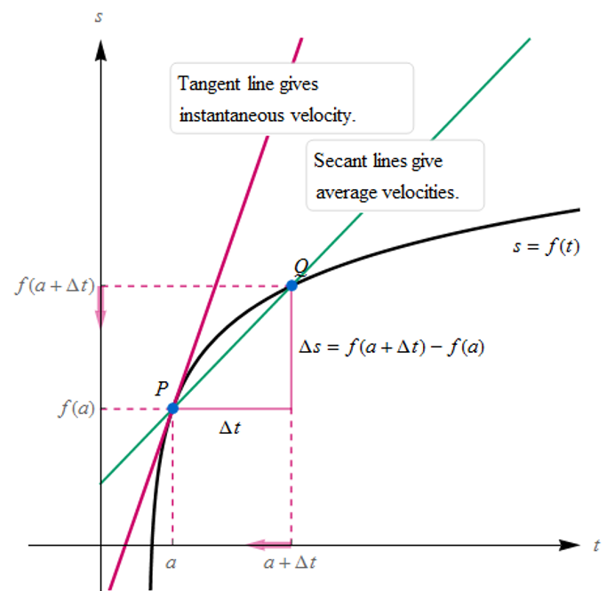


Velocity is the first derivative of position.

Slide 4
Free Fall Equation
Gravitational
Constants on Earth
Speed is the absolute value of velocity.
Velocity is speed with direction.

Slide 5
Acceleration is the derivative of velocity.
If displacement, s(t), is in:
Velocity would be in:
Acceleration would be in:

Slide 6
It is important to understand the relationship between velocity, acceleration and the behavior of the particle.
Velocity | Acceleration | Behavior of Particle
Positive | Positive | Speeding Up
Positive | Negative | Slowing Down
Negative | Positive | Slowing Down
Negative | Negative | Speeding Up
Zero | Positive or Negative | Stopped
Positive or Negative | Zero | Constant Speed
The particle speeds up when the velocity is positive and increasing (v and a are both positive) and also when the velocity is negative and decreasing (v and a are both negative). In other words, the particle speeds up when the velocity and acceleration have the same sign. The particle is slowing down when velocity and acceleration have opposite sign.

Slide 7
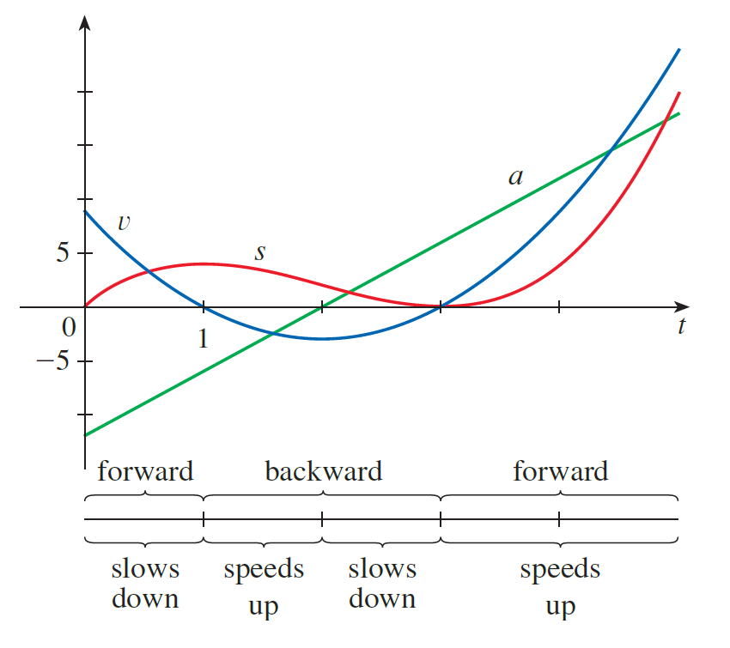
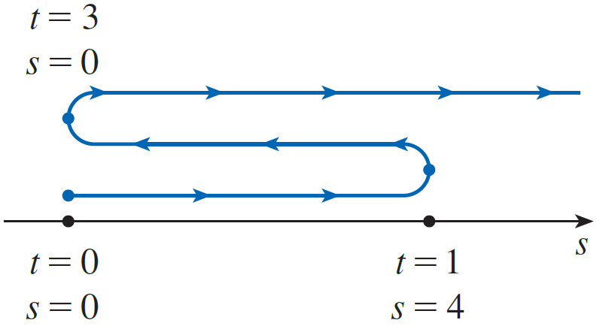
The figure below summarizes the motion of a particle moving horizontally.
v > 0 forward
v = 0 stopped
v < 0 backward
v > 0 forward
v = 0 stopped
t
How about acceleration?
v > 0
a < 0
v < 0
a < 0
v < 0
a > 0
v > 0
a > 0

Slide 8
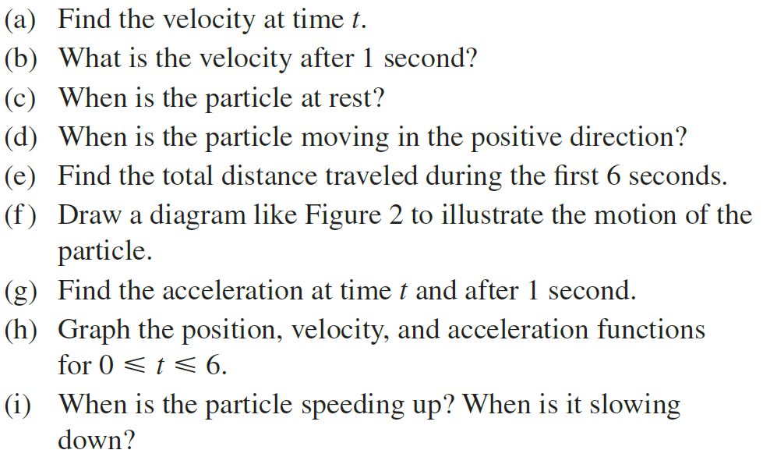


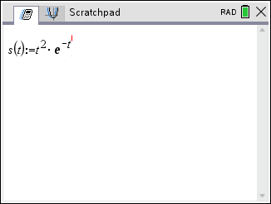

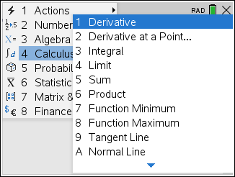
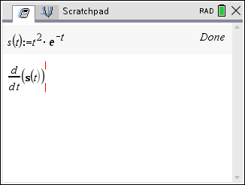
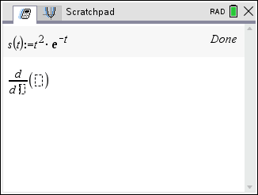
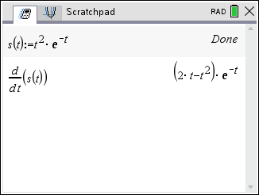
Example
A particle moves according to a law of motion $s\left(t\right)=t^{2}e^{−t}$, t $≥$0, where t is measured in seconds and s in feet.
Solution
(a) Find the velocity at time t.

Slide 9
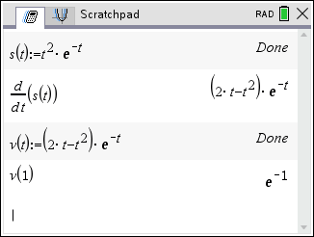
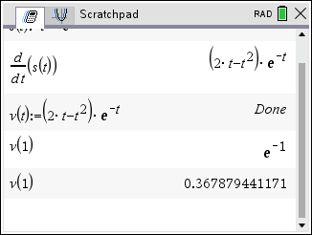
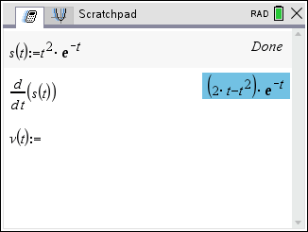
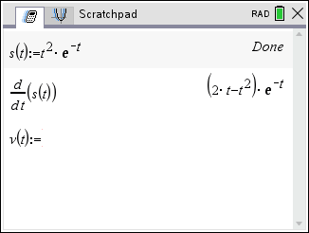
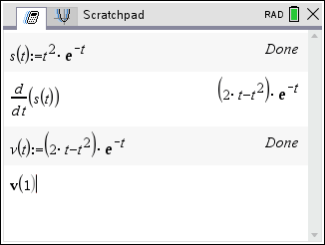
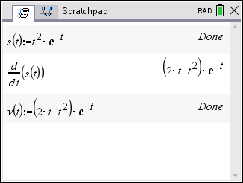
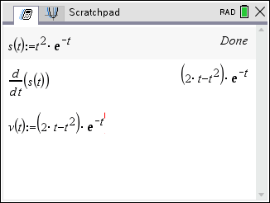
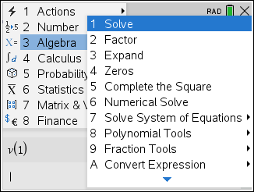
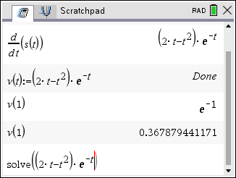
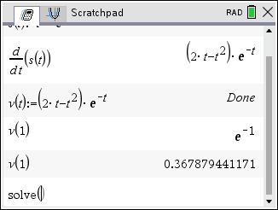
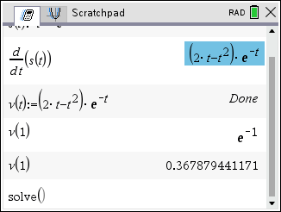
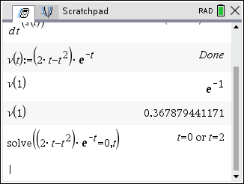
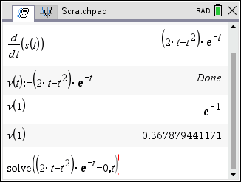
Solution
(b) What is the velocity after 1 second?
(c) When is the particle at rest, stopped?

Slide 10
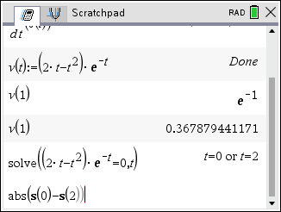
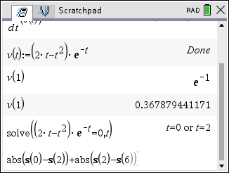
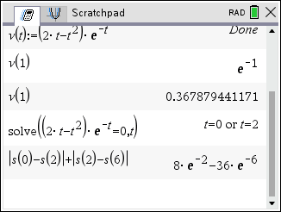
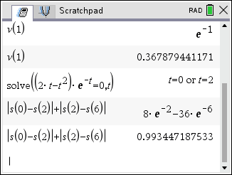
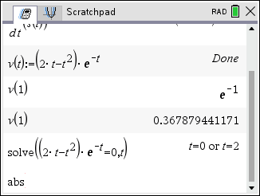
Solution
(d) When is the particle moving in the positive direction, forward?
The particle is moving in the positive direction (forward) when
(e) Find the total distance traveled during the first 6 seconds.
The total distance traveled during the first 6 seconds is

Slide 11
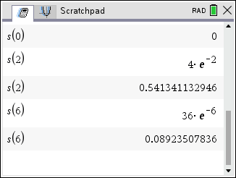
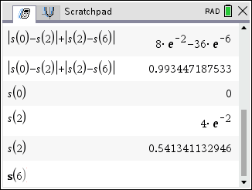
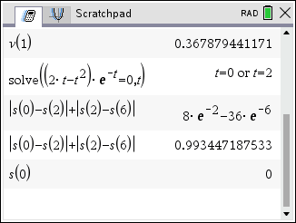
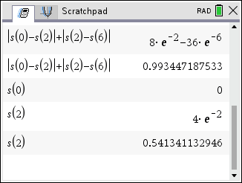
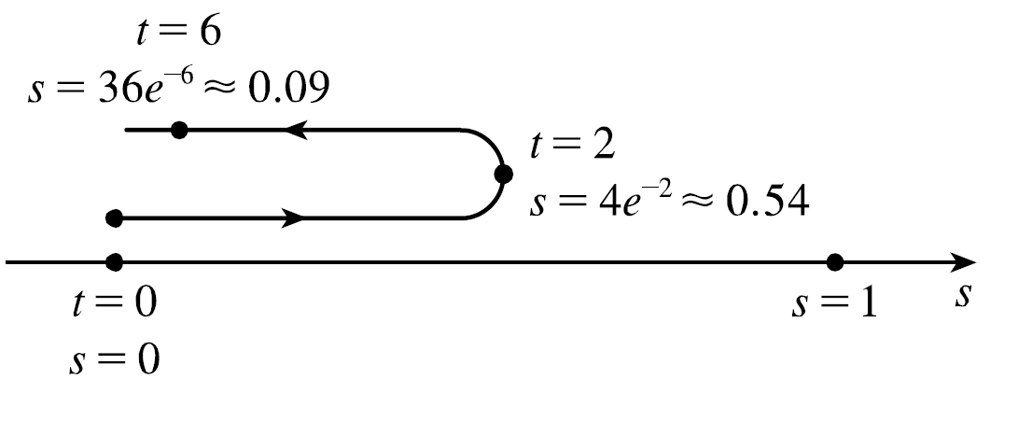
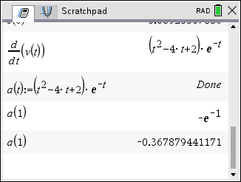
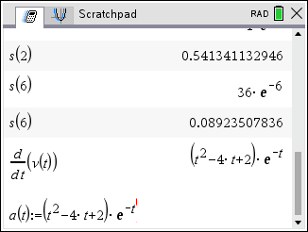
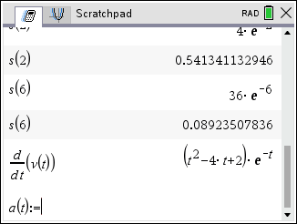
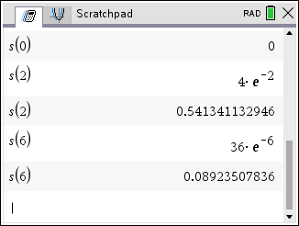
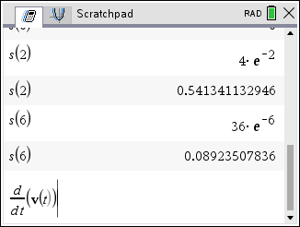
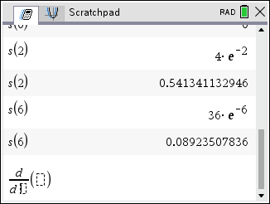
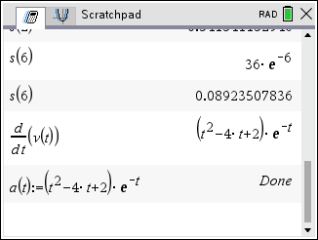

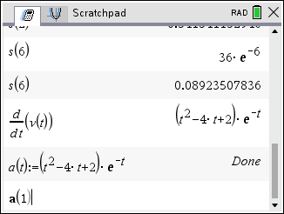
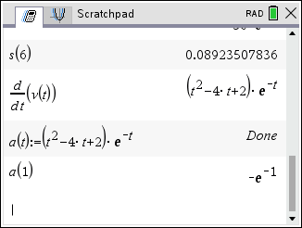
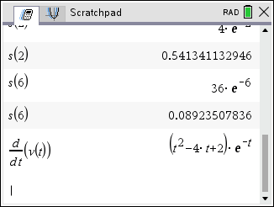
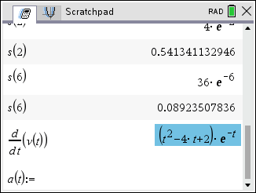
Solution
(f ) Draw a diagram to illustrate the motion of the particle.
(g) Find the acceleration at time t and after 1 second.

Slide 12
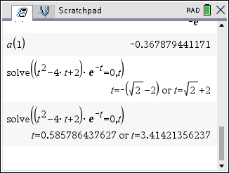
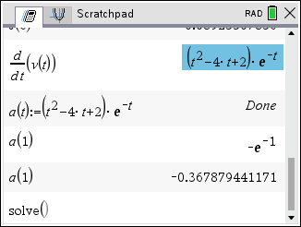
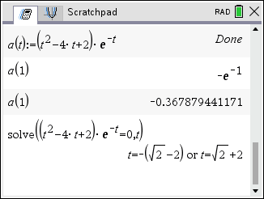




















Solution
(h) Graph the position, velocity, and acceleration functions for 0 < t < 6.
When is the particle speeding up?
When is it slowing down?
Using the previous information and the figure in part (h), we see that v and a are both positive when
both negative when
The particle is slowing down when v and a
have the same sign. This occurs when
The particle is speeding up when v and a
have the same sign.

Slide 13











Example
Solution
(a) What is the maximum height reached by the ball?
At maximum height the velocity of the ball is v = 0 ft/sec.
= 2.5 sec
is the maximum height reached by the ball.

Slide 14











Solution
(b) What is the velocity of the ball when it is 96 ft above the ground on its way up? On its way down?
We let
So the ball has a height of 96 ft on the way up at t = 2 and on the way down at t = 3.

