Slide 1


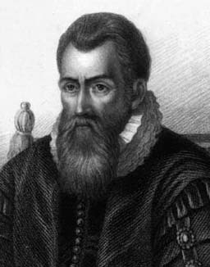
Derivatives of Logarithmic and Inverse Trigonometric Functions
John Napier
1550 to 1617
John Napier was a Scottish scholar who is best known for his invention of logarithms, but other mathematical contributions include a mnemonic for formulas used in solving spherical triangles and two formulas known as Napier's analogies.

Slide 2
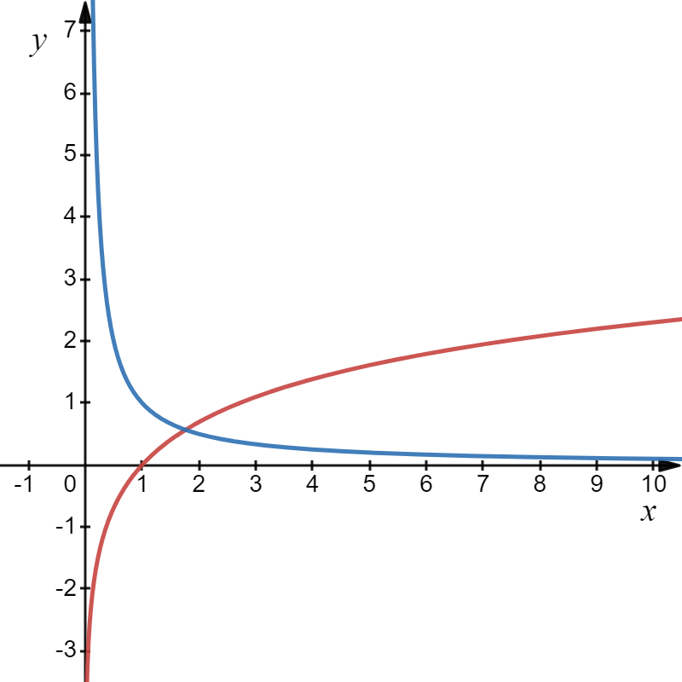
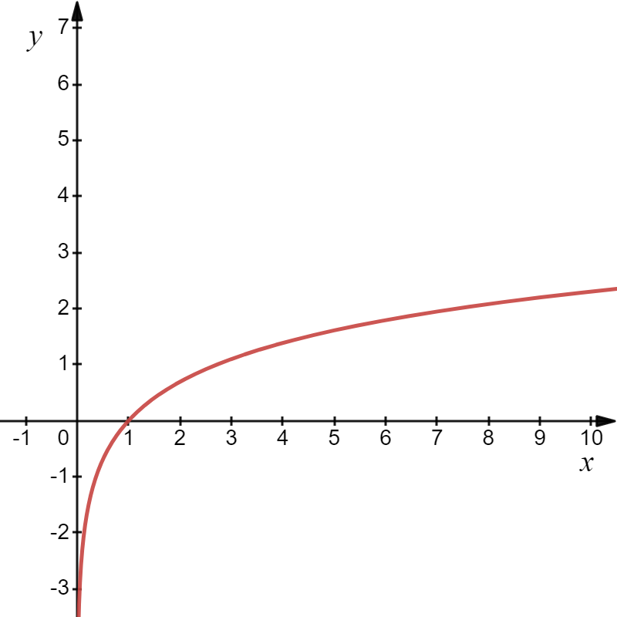
Now we want to find the derivative of logarithmic functions.
The generalized derivative is:

Slide 3
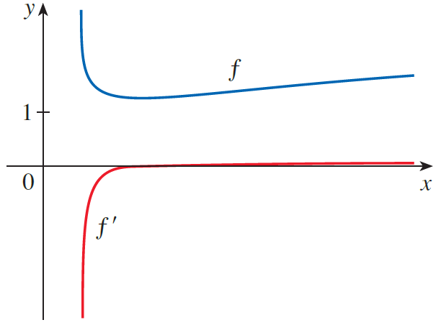
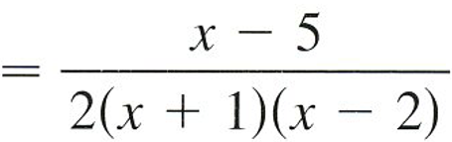

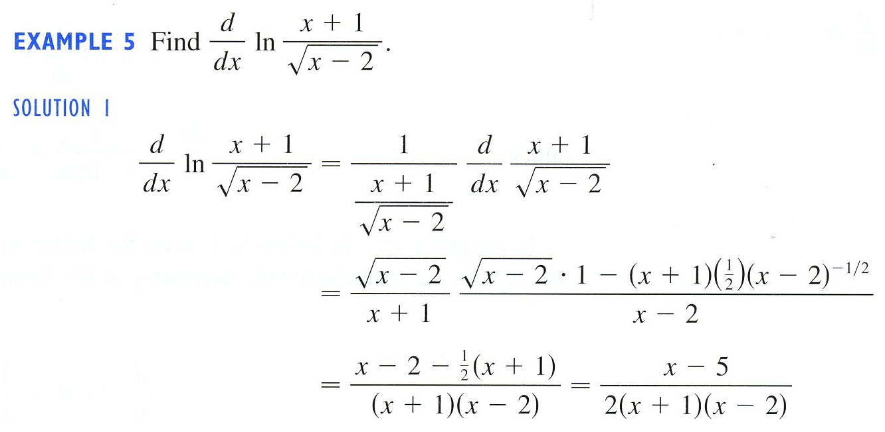
Example
Solution
$$∙\frac{2}{2}$$

Slide 4



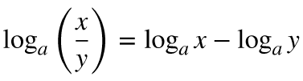



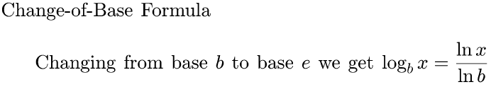

Slide 5
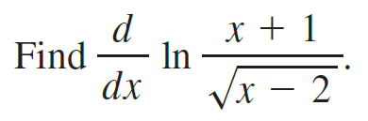


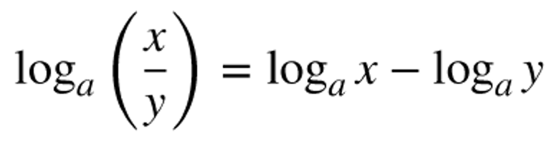
Example
Solution
A lot easier!

Slide 6
To find the derivative of any logarithmic function of any base, you can use the change of base rule for logs:
Change of Base to e
The generalized derivative formula of the log of any base and the natural logarithm is:

Slide 7
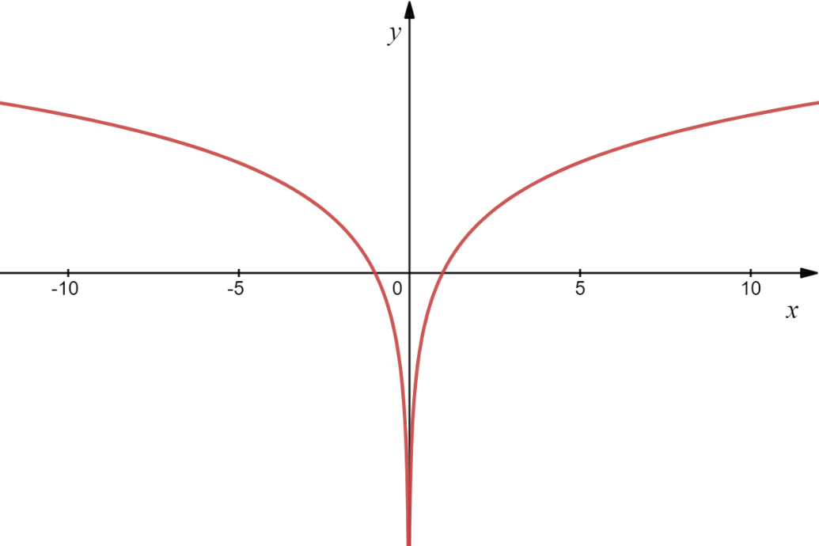
To expand the domain of logarithmic functions we take the absolute value of the argument. So, let’s examine
It can be shown that,
The derivative is the same!!

Slide 8
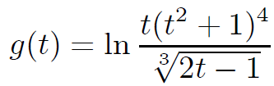

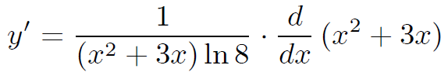

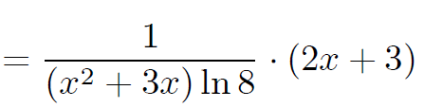
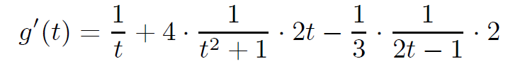
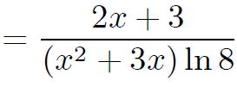
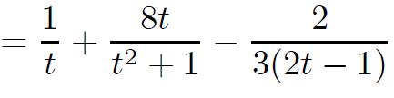

Example
Differentiate the function.
(a)
(b)
Solution
(a)
(b)
$$∙ 1$$

Slide 9

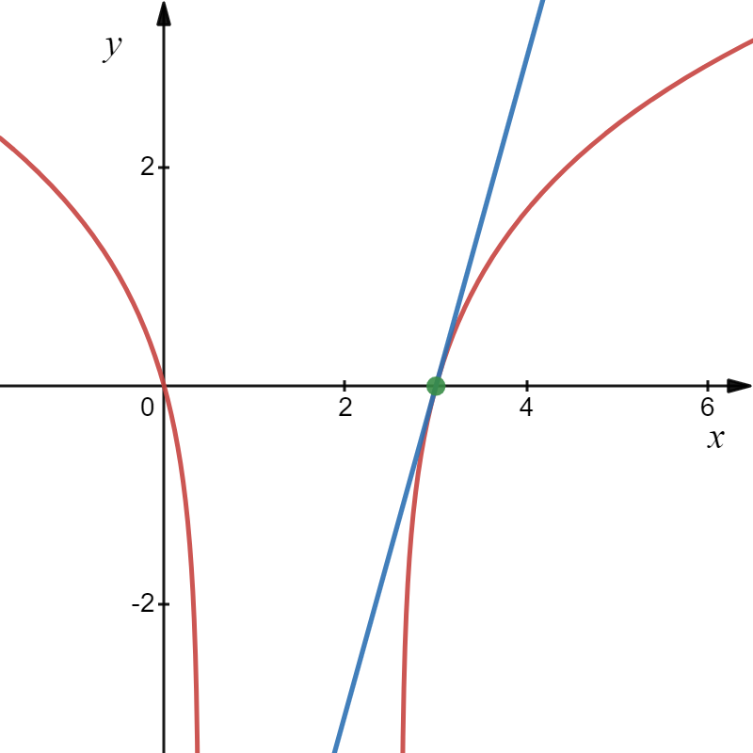





e
Example
Find an equation of the tangent line to the curve at the given point.
Solution
(3,0)
So, the slope of tangent line to the curve at (3,0) is
m =
An equation of the tangent line is

Slide 10
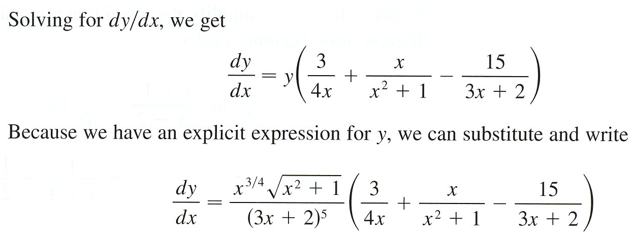
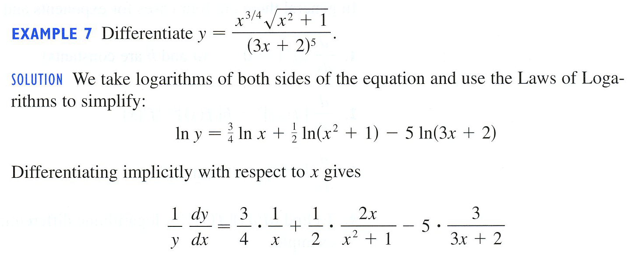
Example
Quotient Rule?
Solution

Slide 11
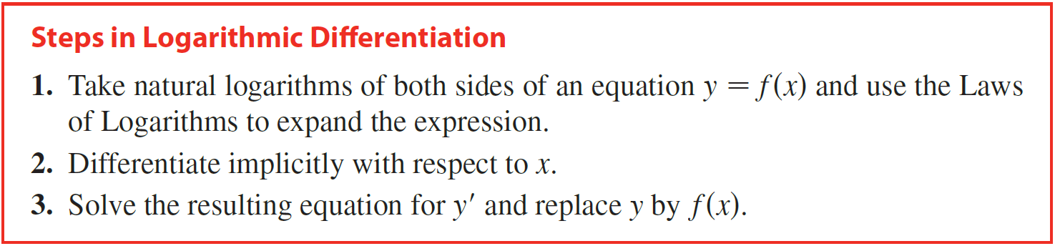
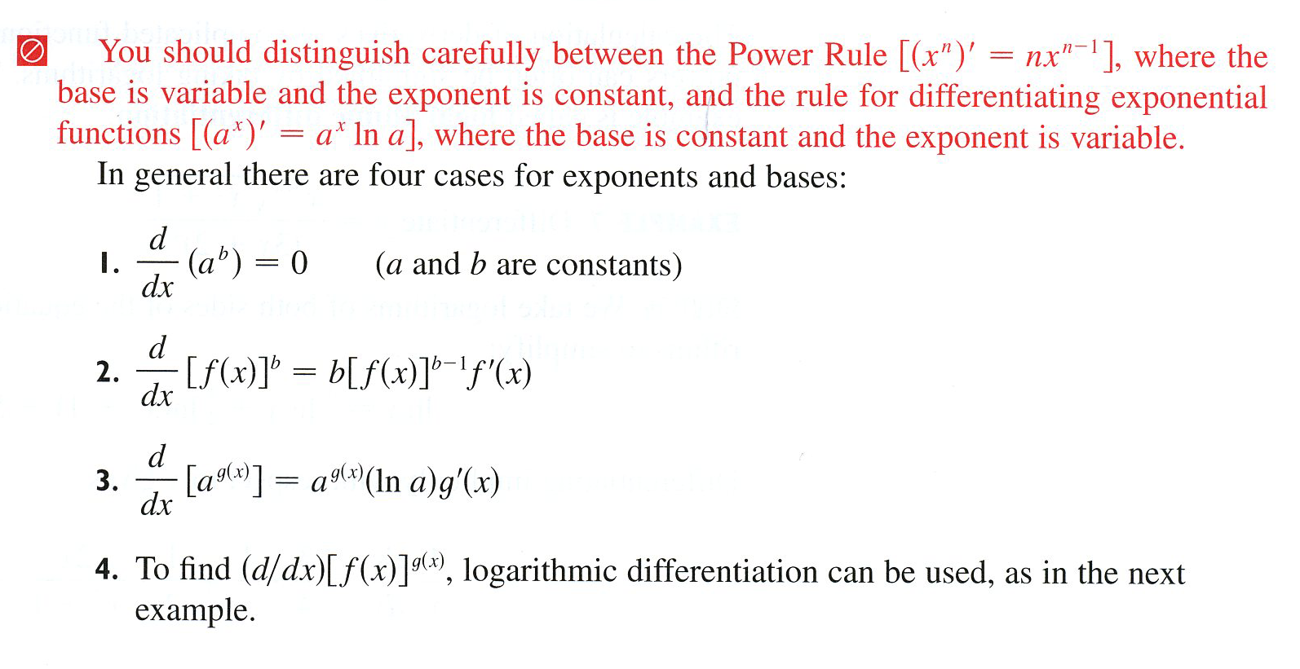

Slide 12



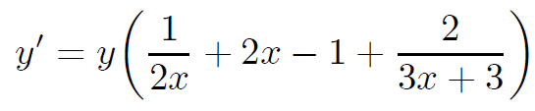
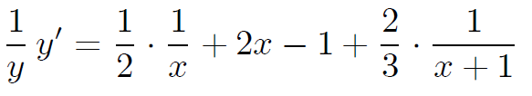
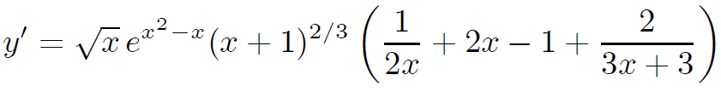
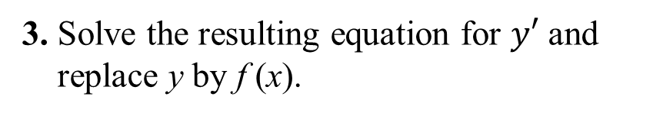
Example
Use logarithmic differentiation to find the derivative of the function.
(a)
(b)
Solution
(a)
3. Solve the resulting equation for $y′$ and
replace y by f (x).

Slide 13


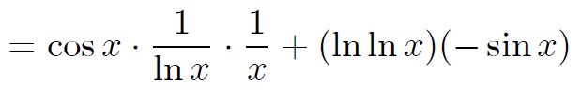




Example
Use logarithmic differentiation to find the derivative of the function.
(a)
(b)
Solution
NO!!!
Logarithmic Differentiation
(b)
$$∙$$
$$∙$$
$$∙$$

Slide 14
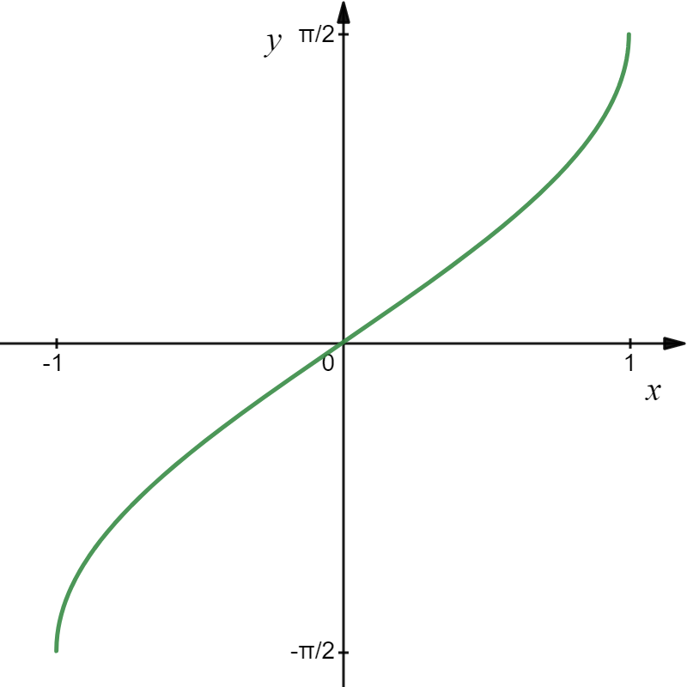
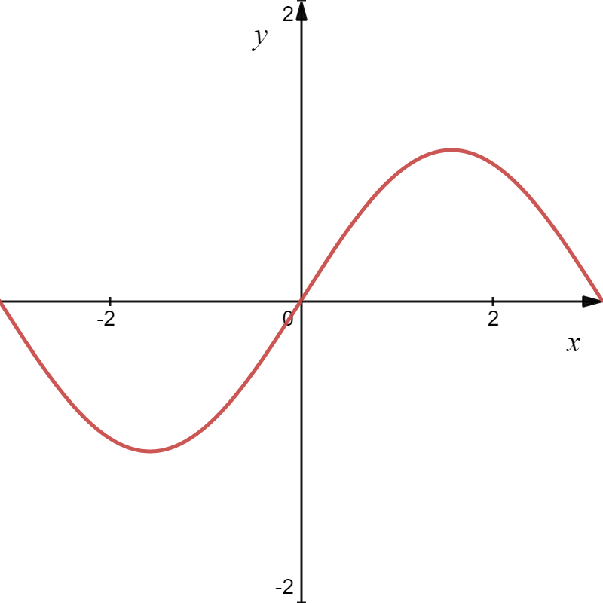

Slide 15
We can use implicit differentiation to find
But
so is positive.

Slide 16
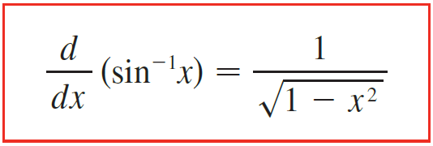
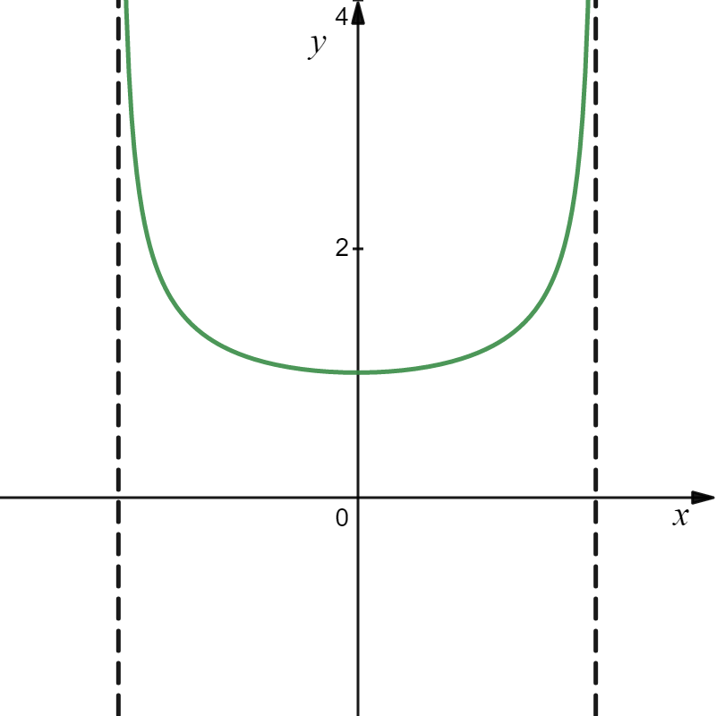

Slide 17
We could use the same technique to find and .

Slide 18
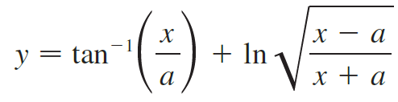

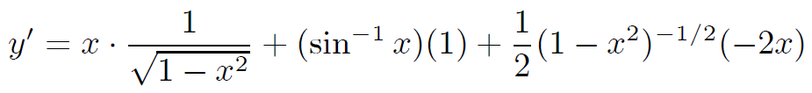
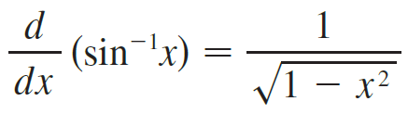
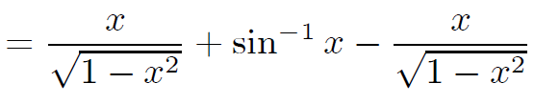

Example
Find the derivative of the function. Simplify where possible.
(a)
$$∙$$
(b)
Solution
(a)
$$∙$$

Slide 19
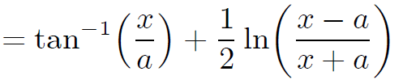
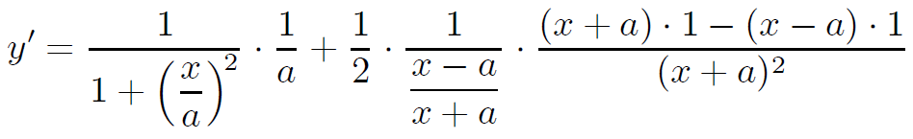
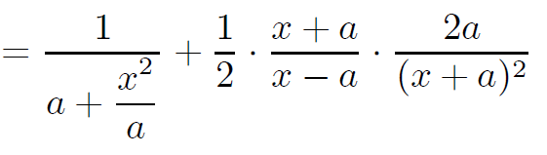
Example
Find the derivative of the function. Simplify where possible.
(a)
$$∙$$
(b)
Solution
(b)

Slide 20
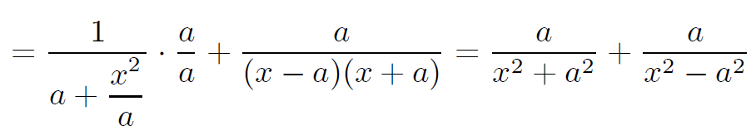

Example
Find the derivative of the function. Simplify where possible.
(a)
$$∙$$
(b)
Solution
That was fun!! I can’t wait to do my homework!!

