Slide 1
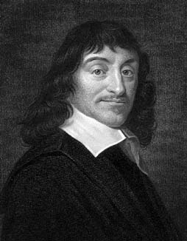
René Descartes
1596 – 1650
René Descartes was a French philosopher whose work, La géométrie, includes his application of algebra to geometry from which we now have Cartesian geometry. His work had a great influence on both mathematicians and philosophers.

Slide 2

Implicit Equation
y = f (x)
This is not a function, but it would still be nice to be able to find the slope of tangents line to the circle.
x
Do the same thing to both sides.
Note use of chain rule, and f (x) is a
function of x.
Solving for dy/dx.
Remember y = f (x).
Implicit Differentiation

Slide 3
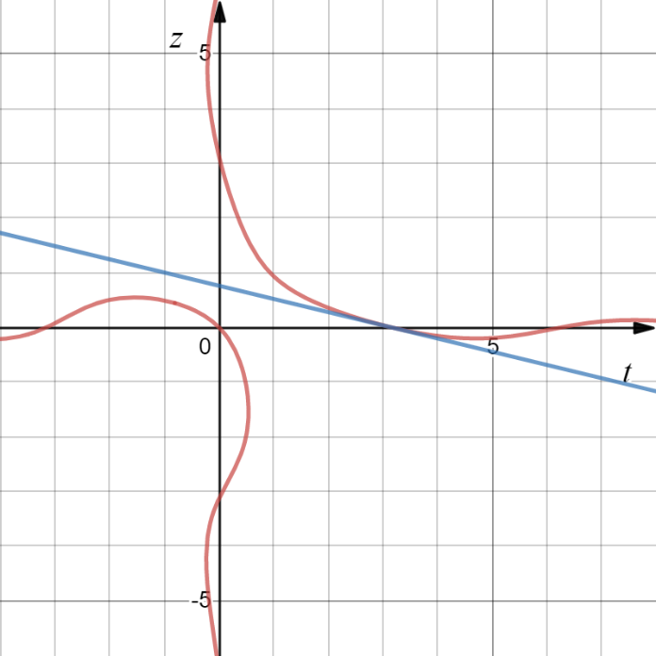

z is a function of t.
p is a function of v.
Examples
Examples
Chain Rule
Chain Rule
Chain Rule
Chain Rule

Slide 4

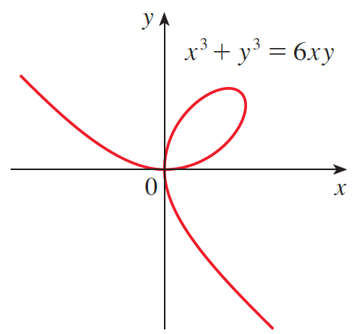
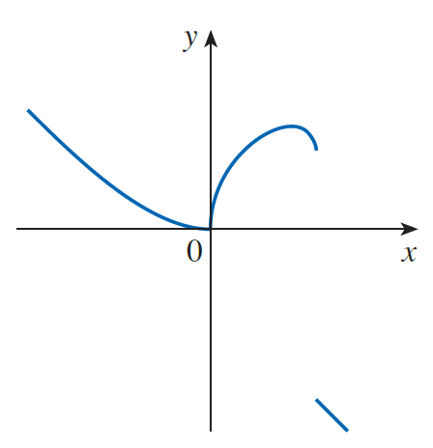
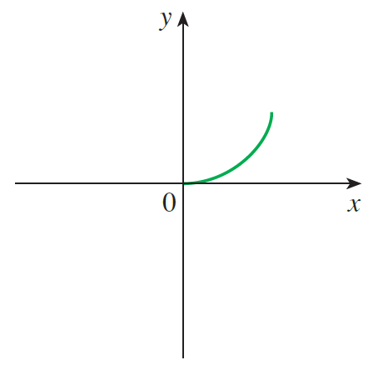
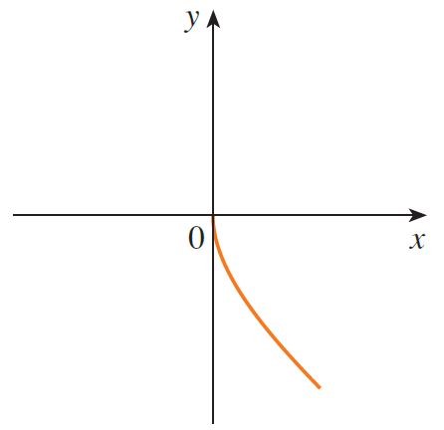
Graphs of three functions defined implicitly by the folium of Descartes

Slide 5

Fortunately, we don’t need to solve an equation for y in terms of x in order to find the derivative of y. Instead, we can use the method of implicit differentiation. This consists of differentiating both sides of the equation with respect to x and then solving the resulting equation for dy/dx. In the examples and exercises of this section it is always assumed that the given equation determines y implicitly as a differentiable function of x so that the method of implicit differentiation can be applied.
Example
Solution
Differentiate both sides with respect to x.

Slide 6
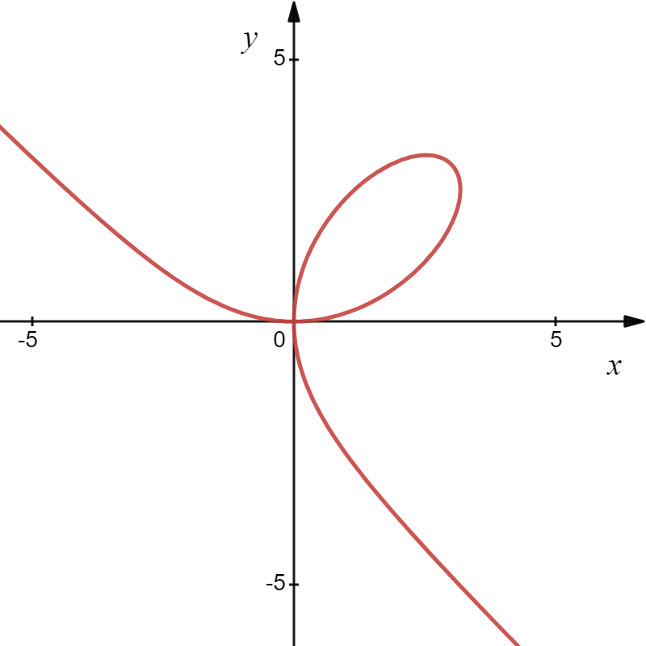
Prime Notation
Differentiate both sides with respect to x.
Prime Notation
Leibniz Notation

Slide 7
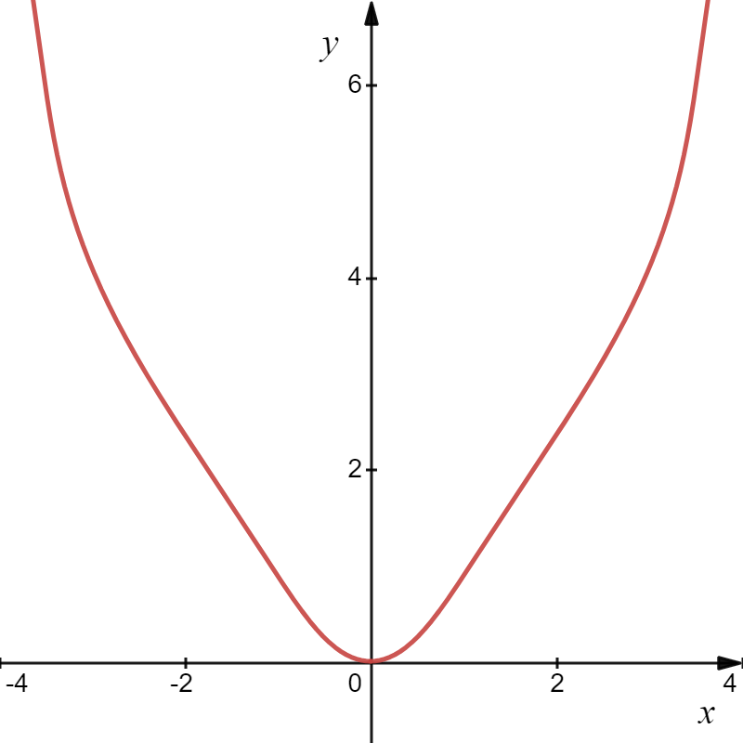
Example
Solution
This can’t be solved for y.
The graph of the curve is:
Again, this technique is called Implicit Differentiation.
Differentiate both sides of the
equation with respect to x
using the Chain Rule.
2 Solve for .

Slide 8



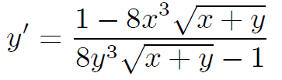
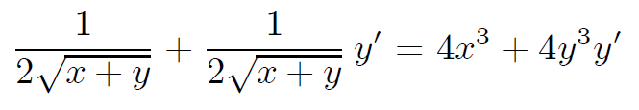
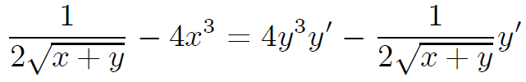
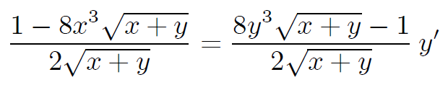
Example
Find dy/dx by implicit differentiation.
Solution

Slide 9
Example
Solution
We need the slope. Since it’s not easy to solve for y, we’ll use implicit differentiation to solve for .
Note product rule.
Tangent Line:
Normal Line:

Slide 10
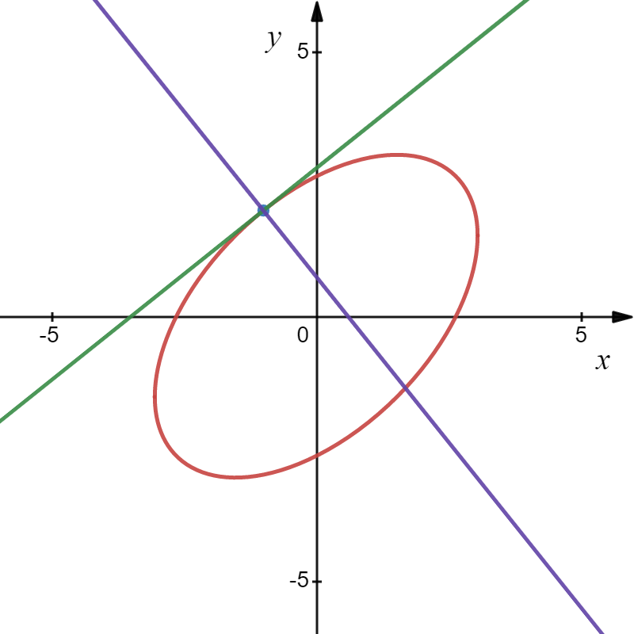


Here is the graph!

Slide 11
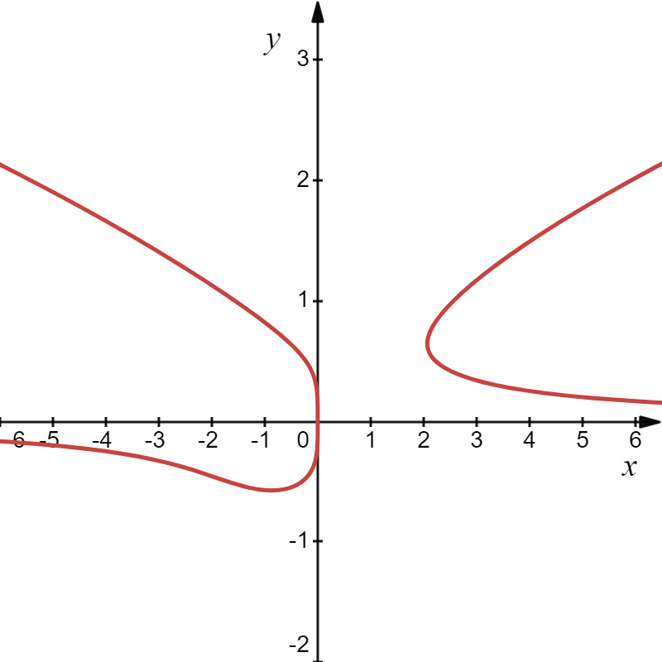


Example
Solution
Solve for y ?
No!
The graph of the curve is:
We use the technique called Implicit Differentiation.
Differentiate both sides of the
equation with respect to x
using the Chain Rule.
2 Solve for .
Solve for $y′$

Slide 12

Example
Solution
Solve for y ?
No!
The graph of the curve is:
We use the technique called Implicit Differentiation.
Differentiate both sides of the
equation with respect to x
using the Chain Rule.
Factor out $y′$
2 Solve for .

Slide 13
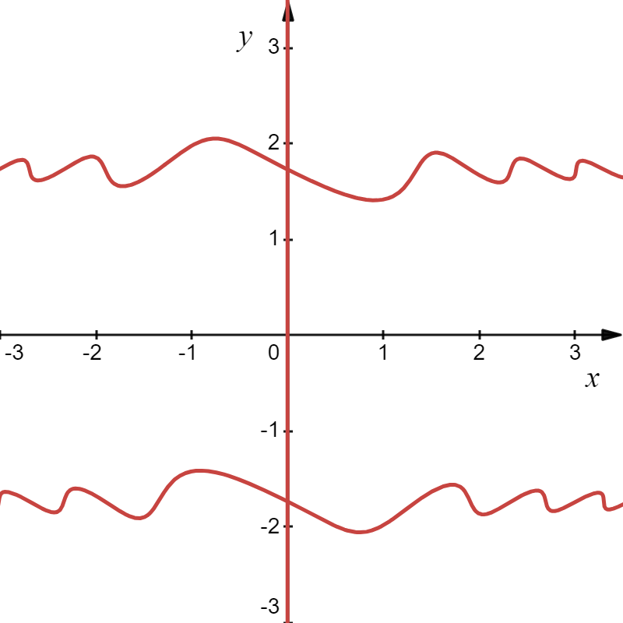
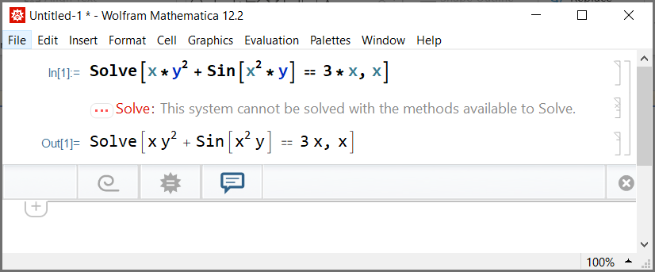
Example
Find dy/dx by implicit differentiation.
Solution
Solve for y ?
Impossible!

Slide 14
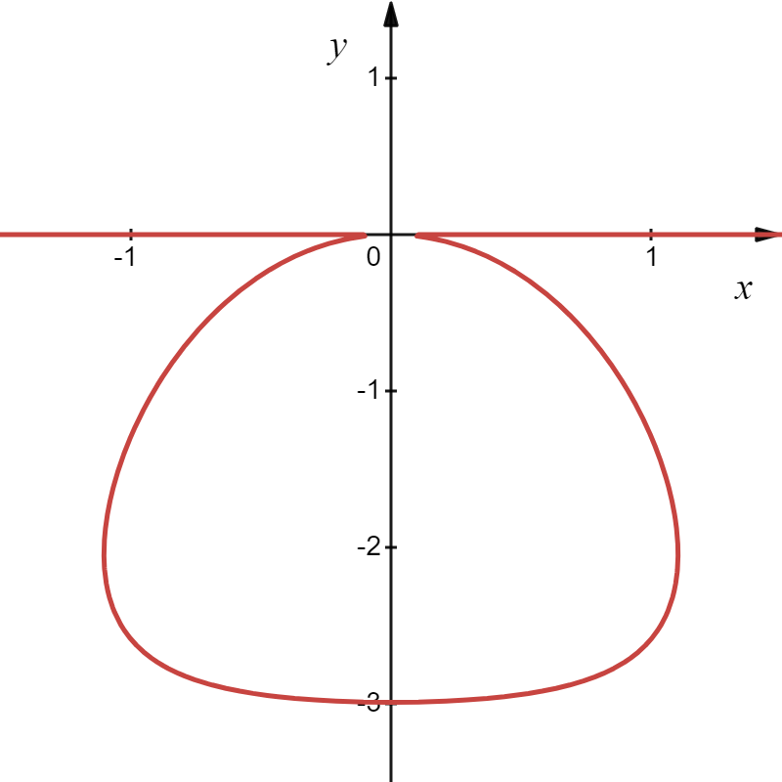
Example
Solution
Now that’s a derivative!

