Slide 1

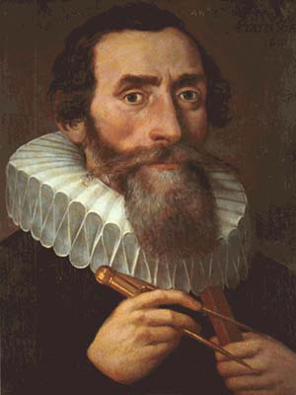
Johannes Kepler
1571 – 1630
Johannes Kepler was a German mathematician and astronomer who discovered that the Earth and planets travel about the sun in elliptical orbits. He gave three fundamental laws of planetary motion. He also did important work in optics and geometry.

Slide 2



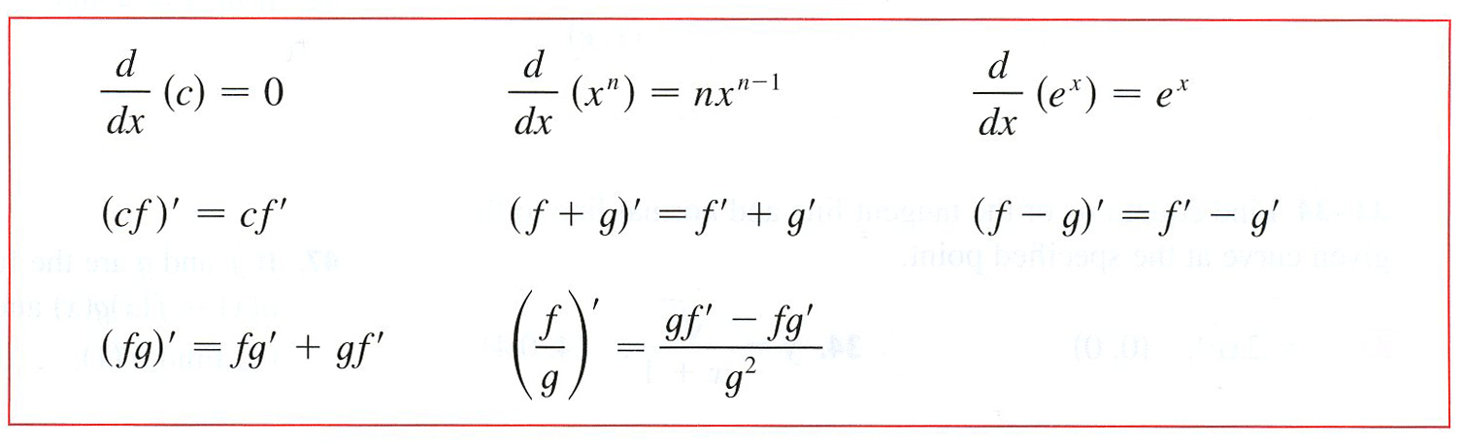
We now have a pretty good list of “shortcuts” to find derivatives of simple functions.
Of course, many of the functions that we will encounter are not so simple. What is needed is a way to combine derivative rules to evaluate more complicated combinations of functions. Functions that include addition, subtraction, multiplication, division, and composition.

Slide 3
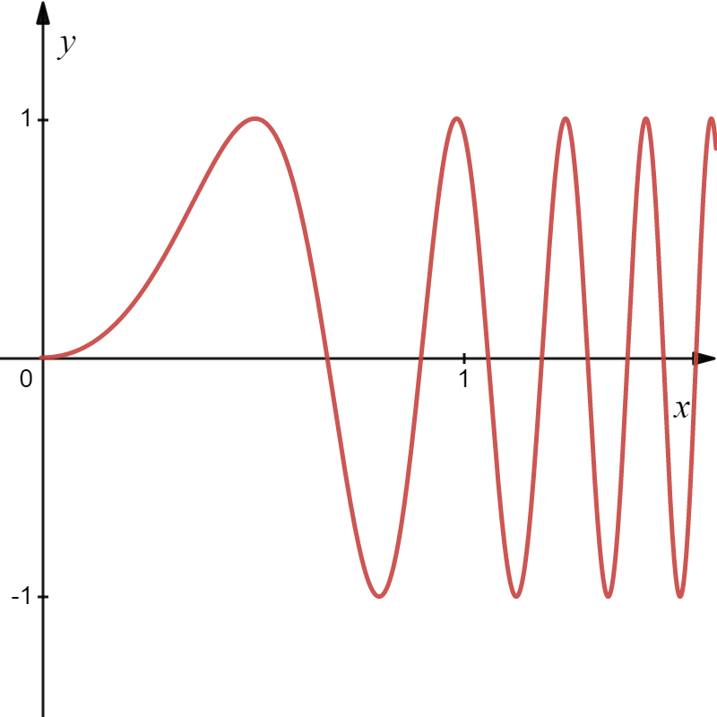
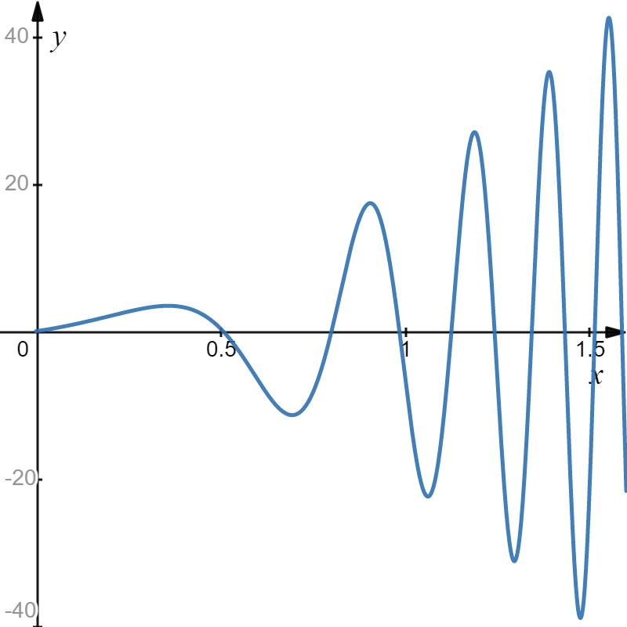
We’ll do this derivative later!

Slide 4
Consider a simple composite function:

Slide 5
Consider:
This pattern is called the Chain Rule!

Slide 6

Chain Rule
Leibniz Notation
Differentiate the outside function
evaluate at the inside function…
Times the derivative of the
inside function.
Hence,
If is the composite of and , then
Chain Rule
Prime Notation

Slide 7
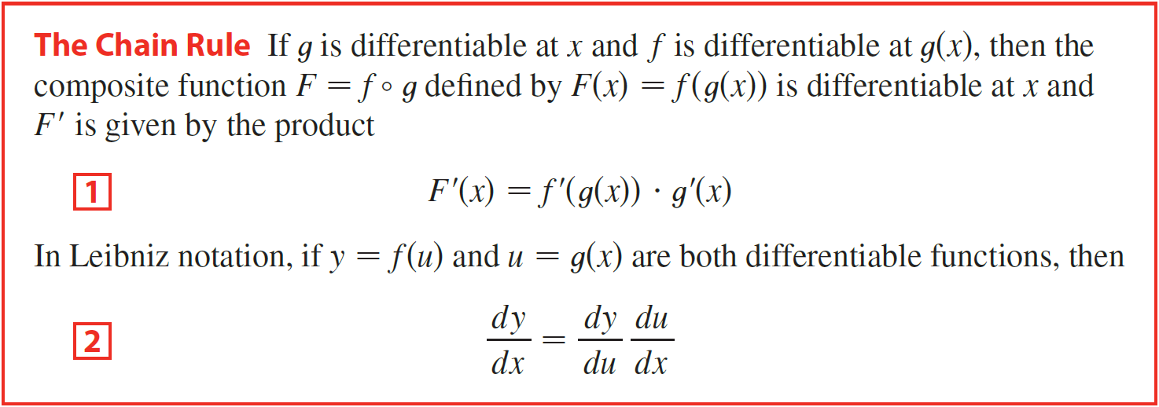

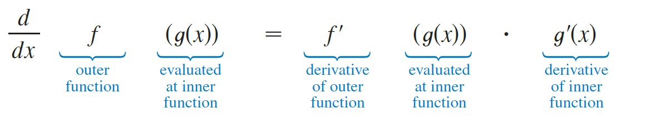

Slide 8
Example
For the function below, write the composite function in the form $f(g\left(x)\right)$. [Identify the inner function $u=g(x)$ and the outer function $y=f(u)$.] Then find the derivative dy/dx.
Solution
Inner Function
Outer Function
Chain Rule

Slide 9
Example
Find the derivative of the function.
Solution
Here is a faster way to find the derivative:
Differentiate the outside function
evaluate at the inside function…
Times the derivative of the
inside function.
Simplifying

Slide 10

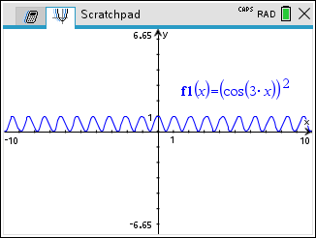
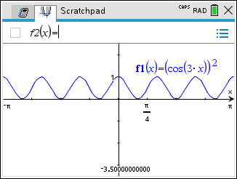
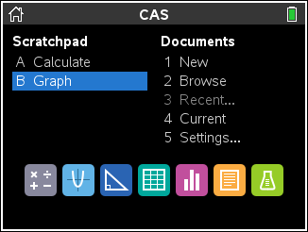
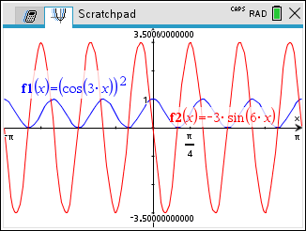
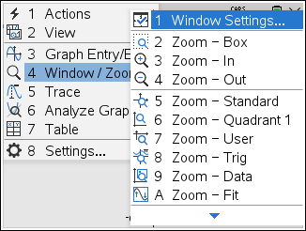
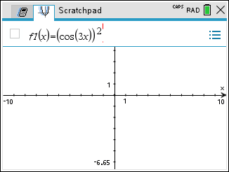
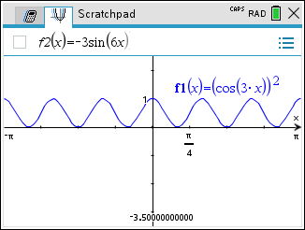
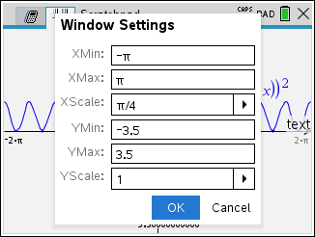
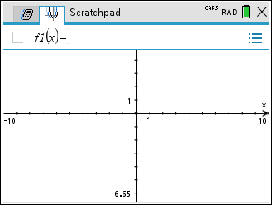
Example
Find the derivative of the function.
The chain rule can be used more than once.
Solution
(That’s what makes the “chain” in the “chain rule”!)
It looks like we need to use the chain rule again!
WHAT!!
derivative of the
outside function
evaluate at the
inside function
derivative of the
inside function

Slide 11
Every derivative problem could be thought of as a chain-rule problem:
derivative of outside function
evaluated at the
inside function
The derivative of x is one.
derivative of inside function

Slide 12
Generalized Derivative formulas include the chain rule!
and the list continues…
Remember that u is a function of x!

Slide 13
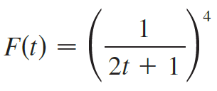




Example
Find the derivative of the function.
(a)
(b)
(c)
Solution
(a)
derivative of outside function
evaluated at the
inside function
derivative of the
inside function

Slide 14





Example
Find the derivative of the function.
(a)
(b)
(c)
Solution
(b)

Slide 15


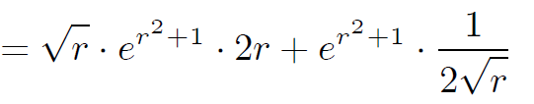
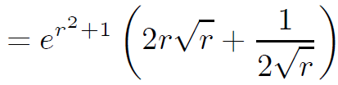
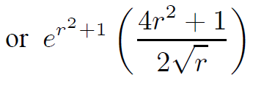
Example
Find the derivative of the function.
(a)
(b)
(c)
Solution
(c)
Product Rule

Slide 16
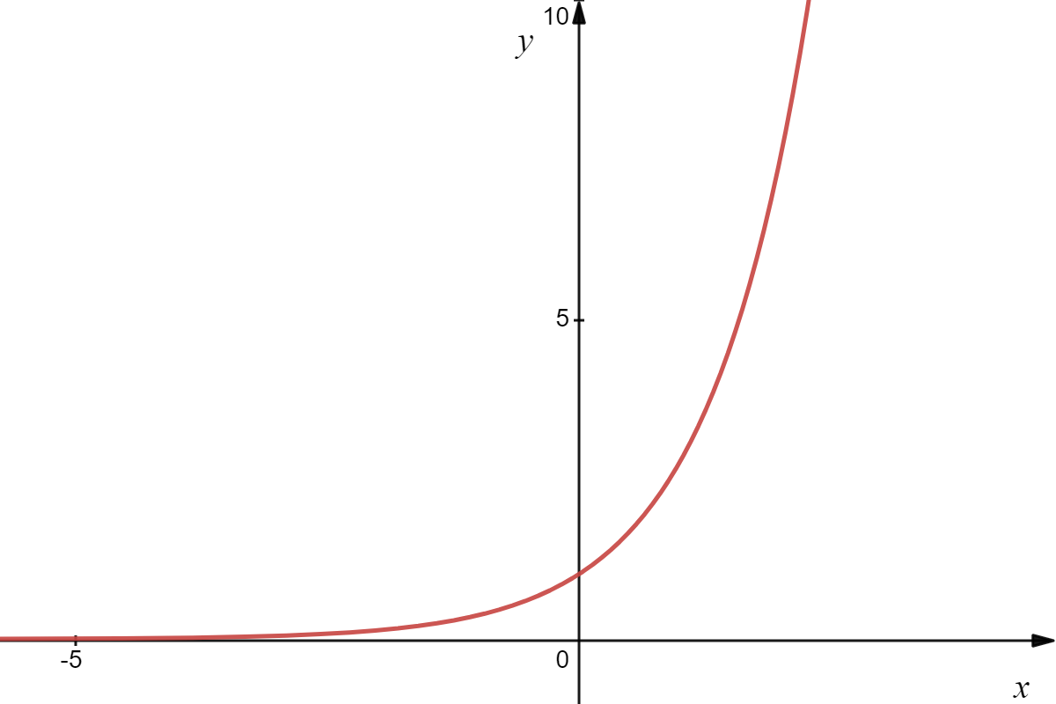

Slide 17

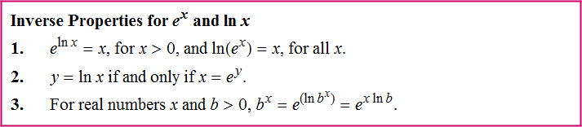
We would like to find its derivative.

Slide 18
Using the chain rule, we get

Slide 19





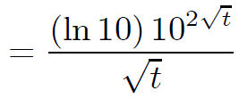
Example
Find the derivative of the function.
(a)
(b)
(c)
Solution
(a)

Slide 20



Example
Find the derivative of the function.
(a)
(b)
(c)
Solution
(b)

Slide 21
Example
Find the derivative of the function.
(a)
(b)
(c)
Solution
(c)

Slide 22



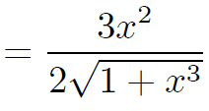
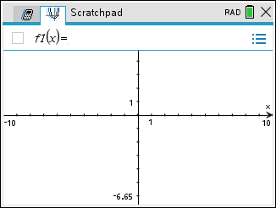
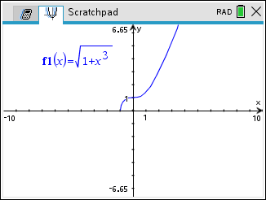
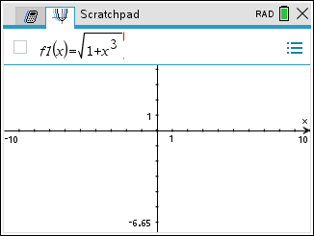
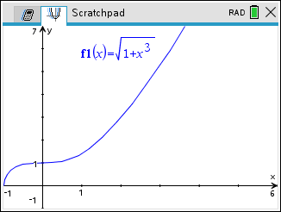
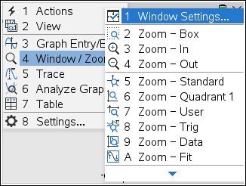
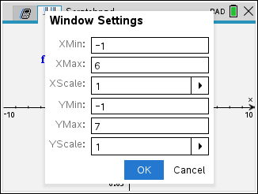
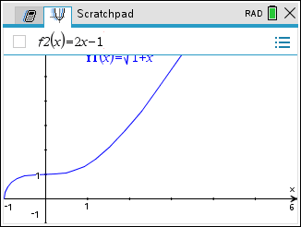
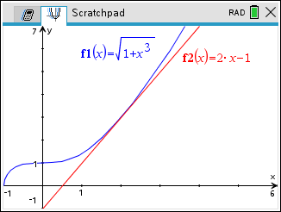

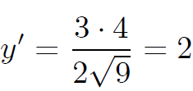


(2,3)
Example
Find an equation of the tangent line to the curve at the given point.
Solution
At the point of tangency (2,3) the slope is
m =
and an equation of the tangent line is
(2,3)

Slide 23
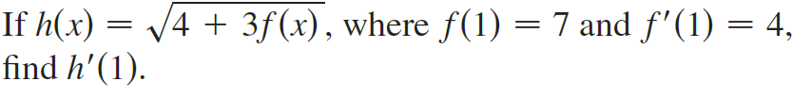






Example
Solution
$$=\frac{6}{\sqrt{25}}$$
$$=\frac{6}{5}$$

Slide 24
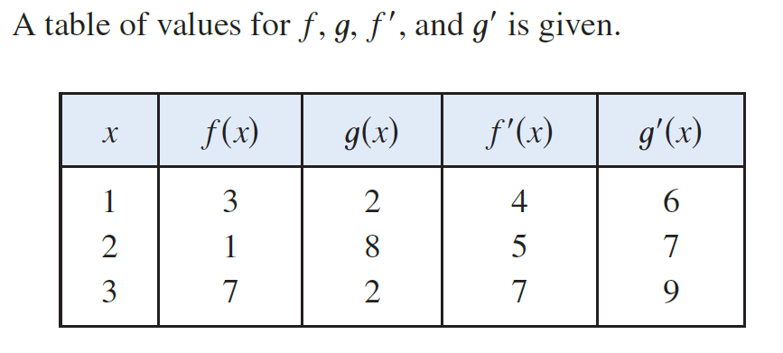
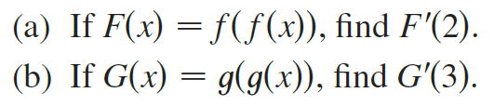






Example
Solution

Slide 25






Example
Solution

Slide 26
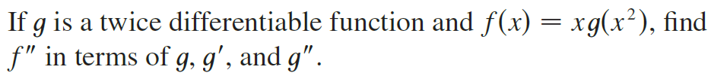




Example
Solution

