Slide 1
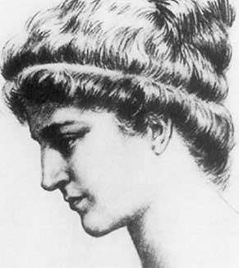
Hypatia of Alexandria
370 – 415
Hypatia was an Alexandrine Greek Neoplatonist philosopher in Egypt who was one of the earliest mothers of mathematics. As head of the Platonist school at Alexandria, she also taught philosophy
and astronomy.

Slide 2
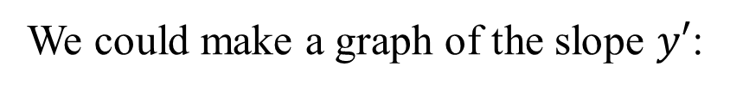
Consider the function
We could make a graph of the slope $y′$:
slope
Now we connect the dots!
The resulting curve is a cosine curve.

Slide 3
We can do the same thing for
slope
The resulting curve is a sine curve that has been reflected about the x-axis.

Slide 4
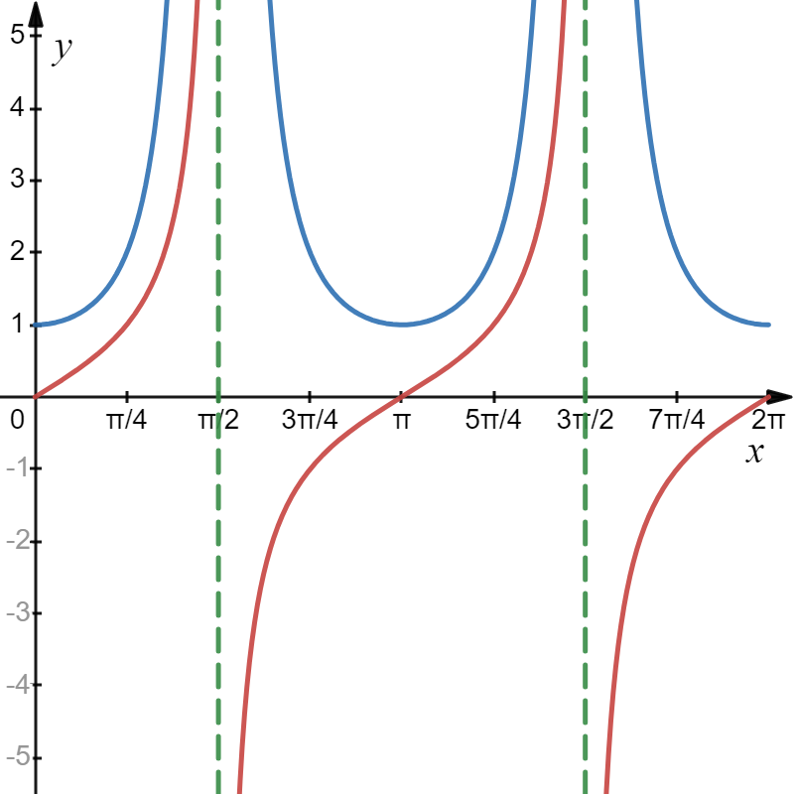
We can find the derivative of tangent x by using the quotient rule.

Slide 5
Derivatives of the remaining trigonometric functions can be determined the same way.

Slide 6
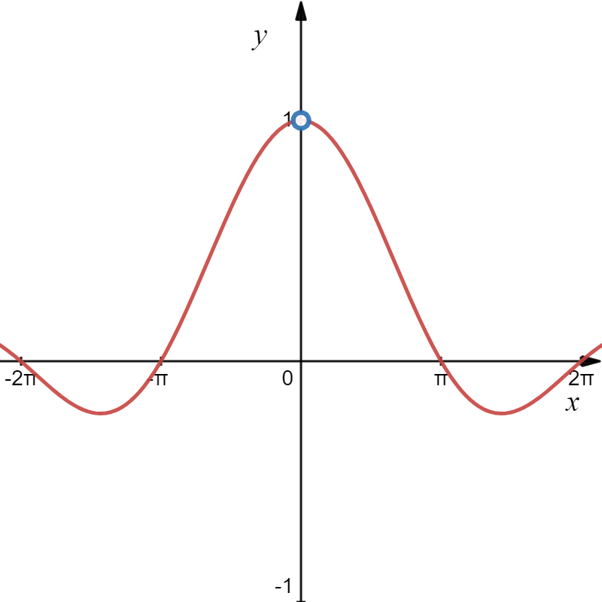
Fundamental Limits with Sine and Cosine
Consider:
Hence:

Slide 7
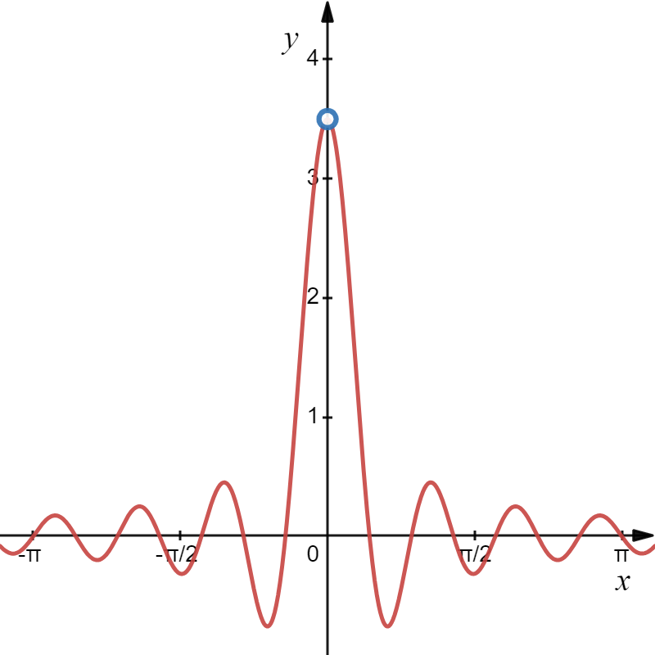
Fundamental Limits with Sine and Cosine
Consider:
So
Hence:

Slide 8
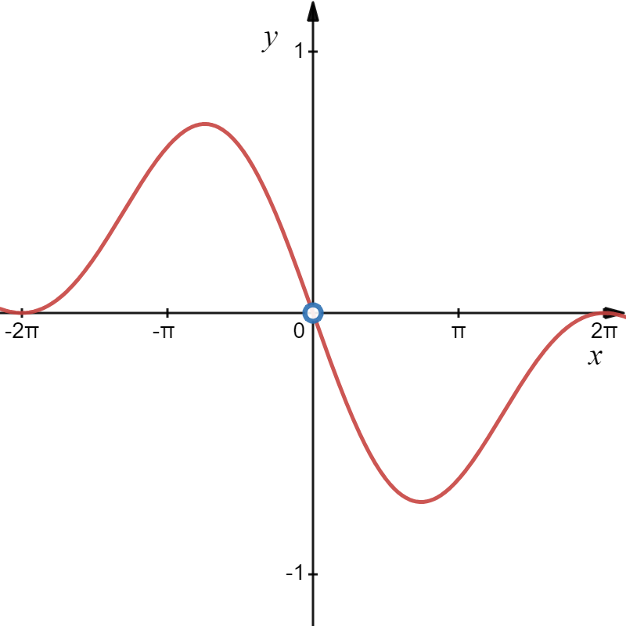
Fundamental Limits with Sine and Cosine
Consider:
Hence:

Slide 9
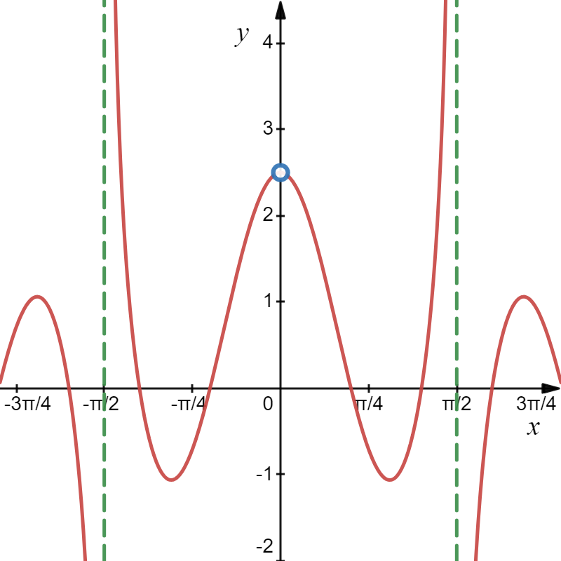
Fundamental Limits with Sine and Cosine
Consider:
So
Hence:

Slide 10

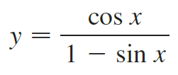

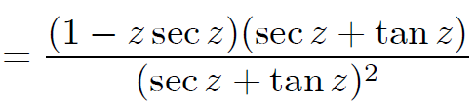




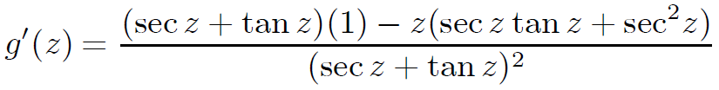

Example
Differentiate.
(a)
(b)
(c)
Solution
(a)
(b)

Slide 11
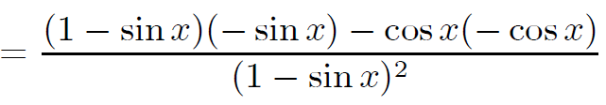
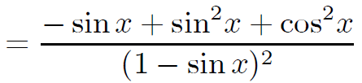

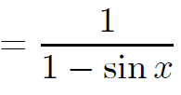
Example
Differentiate.
(a)
(b)
(c)
Solution
(c)

Slide 12
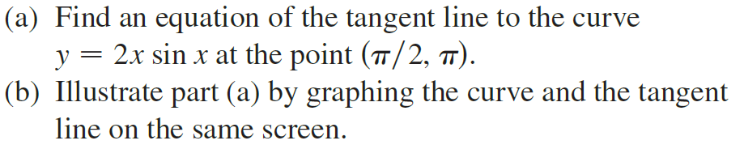


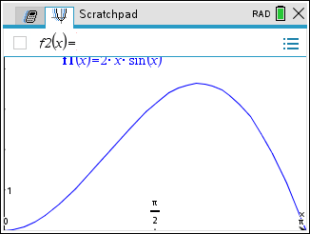

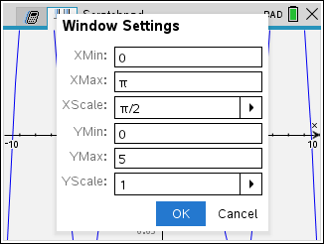
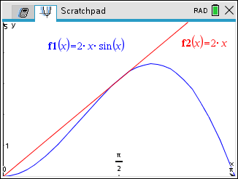

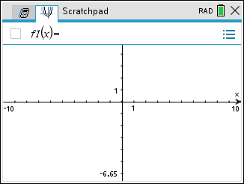
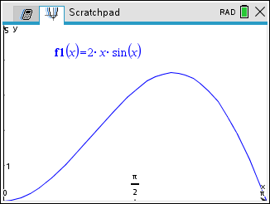
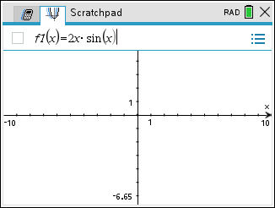
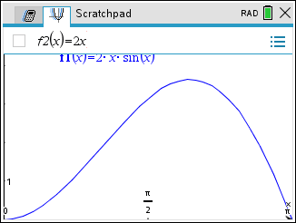








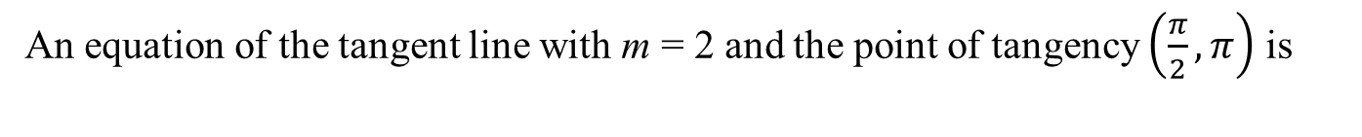

Example
Solution
$$\left(\frac{π}{2},π\right)$$
An equation of the tangent line with m = 2 and the point of tangency $\left(\frac{π}{2},π\right)$ is

Slide 13
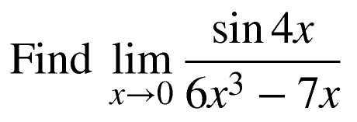
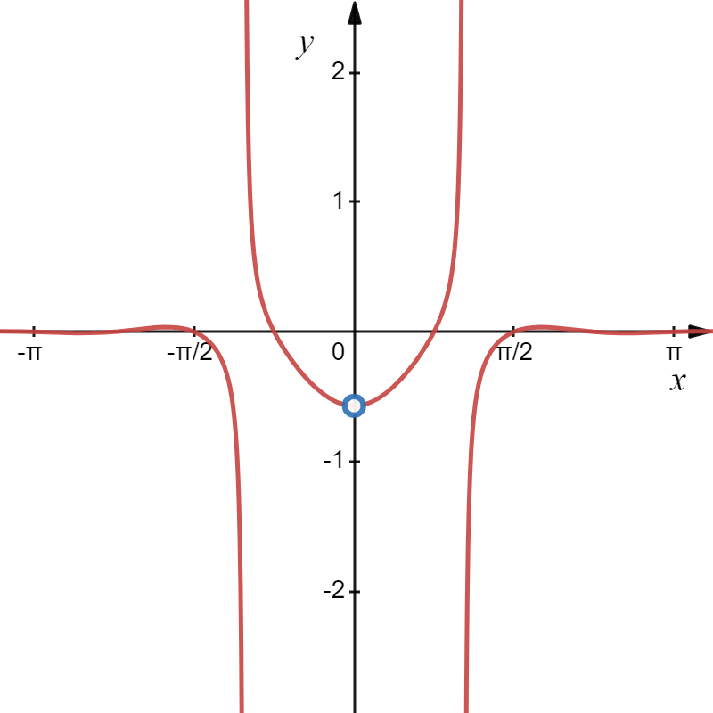
Example
Solution

