Slide 1
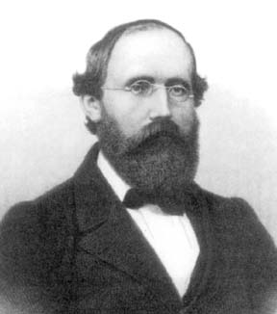
Georg Friedrich Bernhard Riemann
1826 – 1866
Riemann's ideas concerning geometry of space had a profound effect on the development of modern theoretical physics. He clarified the notion of integral by defining what we now call the Riemann integral.

Slide 2
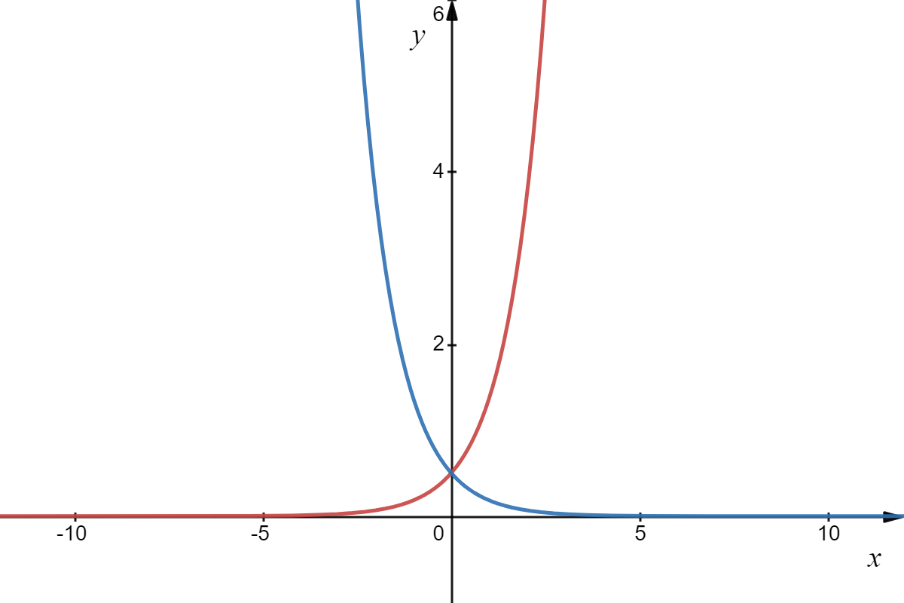
Let’s examine the exponential functions:

Slide 3
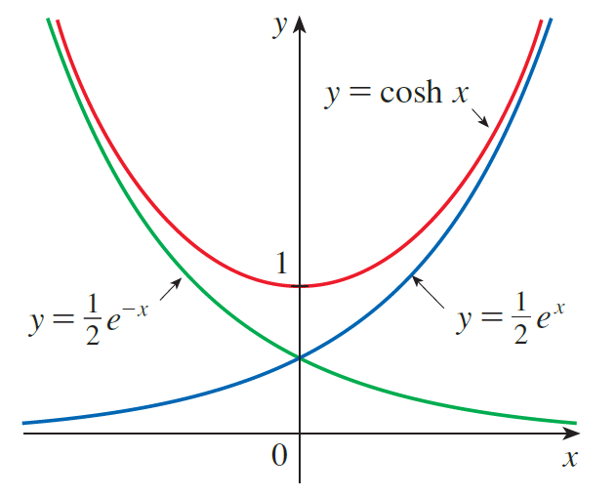
Now, lets look at the combination of these two functions with addition.
We call this function hyperbolic cosine.
Any curve of the form
(Note: x is not an angle!)

Slide 4
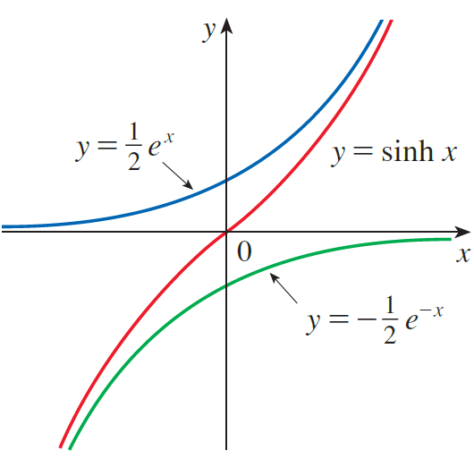
Next, lets look at the combination of these two functions with subtraction.
We call this function hyperbolic sine.

Slide 5
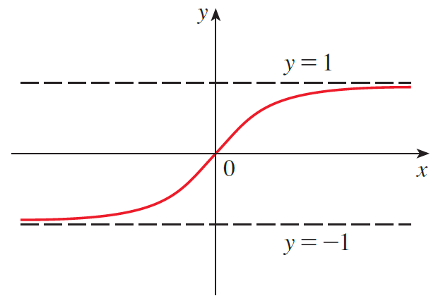


Slide 6
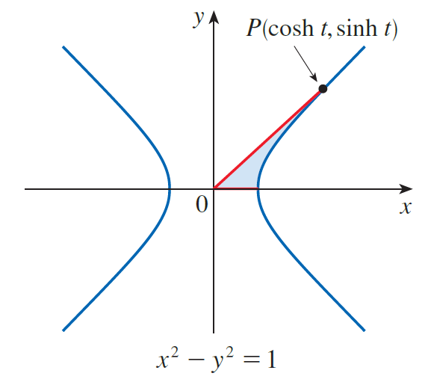


Why hyperbolic, you ask? Watch this…
Take the unit hyperbola
Substituting into the unit hyperbola we get

Slide 7
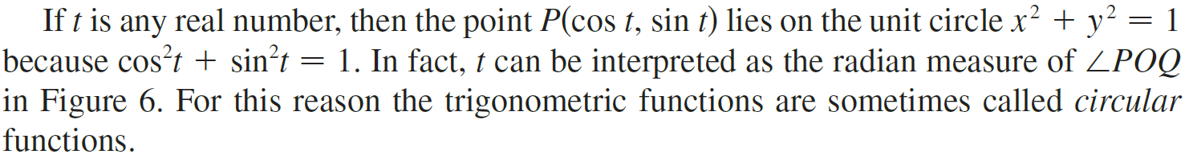
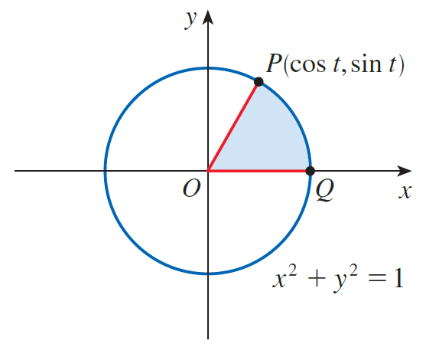

Slide 8
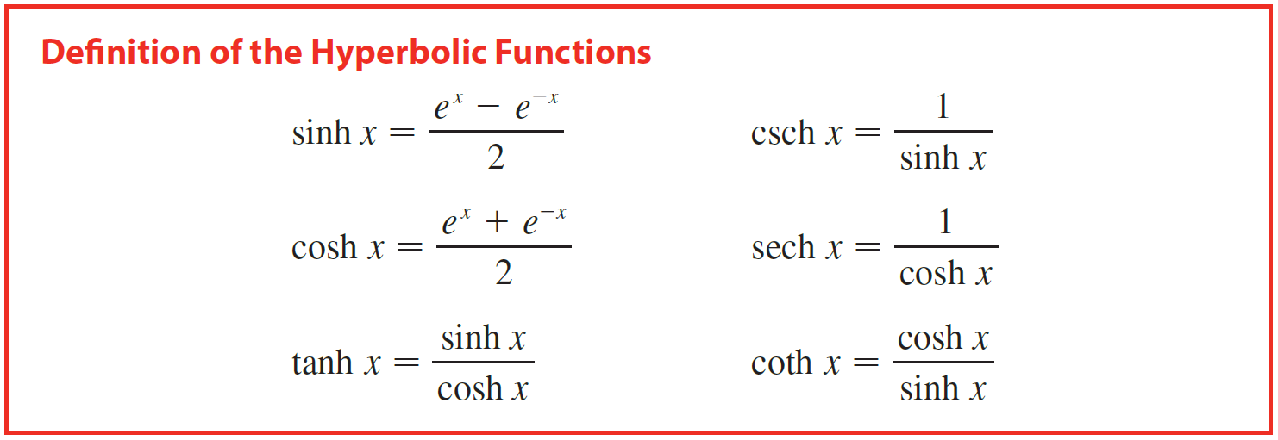


Slide 9

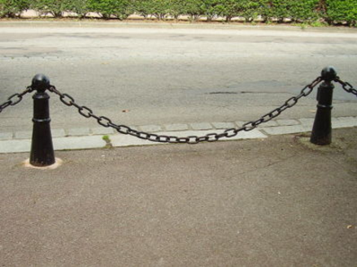
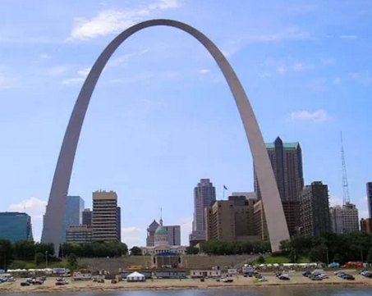

Some of the mathematical uses of hyperbolic functions will be seen in Chapter 7. Applications to science and engineering occur whenever an entity such as light, velocity, electricity, or radioactivity is gradually absorbed or extinguished because the decay can be represented by hyperbolic functions. The most famous application is the use of hyperbolic cosine to describe the shape of a hanging wire. It can be proved that if a heavy flexible cable (such as an overhead power line) is suspended between two points at the same height, then it takes the shape of a curve with equation
called a catenary (The Latin word catena means “chain.”)

Slide 10
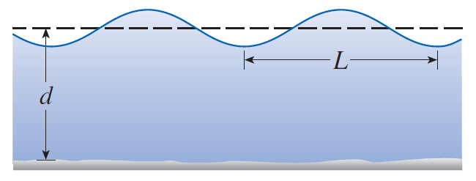
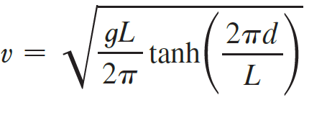
Idealized Ocean Wave
Another application of hyperbolic functions occurs in the description of ocean waves: the velocity of a water wave with length L moving across a body of water with depth d is modeled by the function
where g is the acceleration due to gravity.

Slide 11
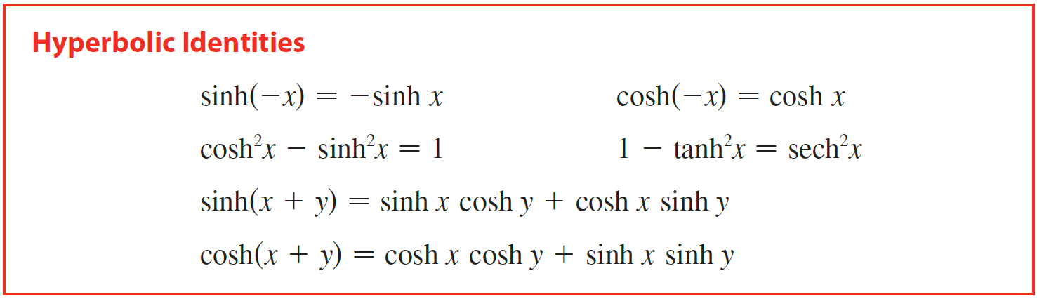
The hyperbolic functions satisfy a number of identities that are similar to well-known trigonometric identities.

Slide 12
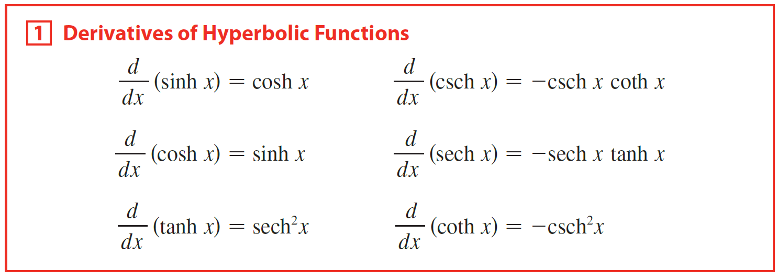
I can read your minds, what are their derivatives?
Note the analogy with the differentiation formulas for trigonometric functions, but note that the signs are different in some cases.

Slide 13
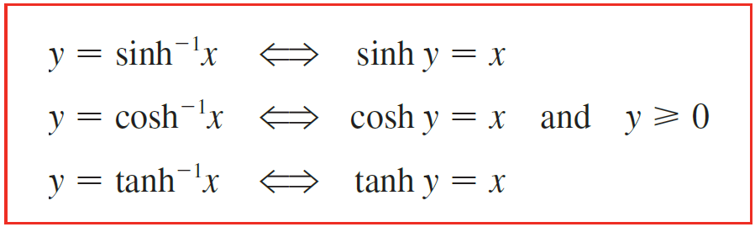
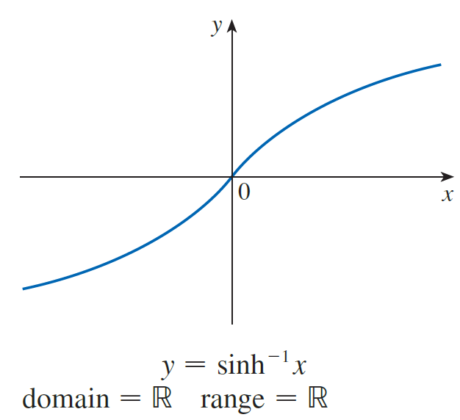
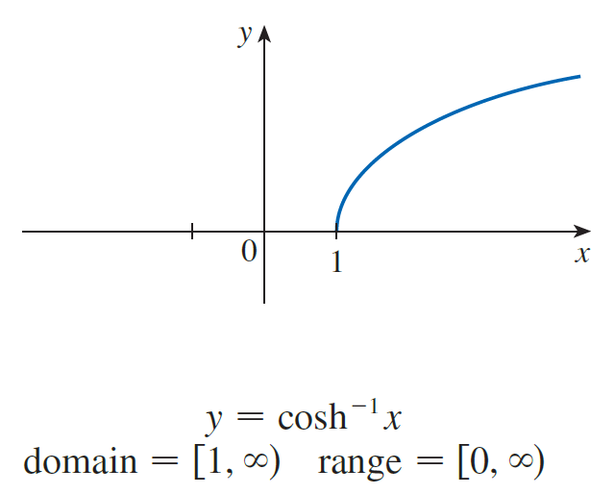
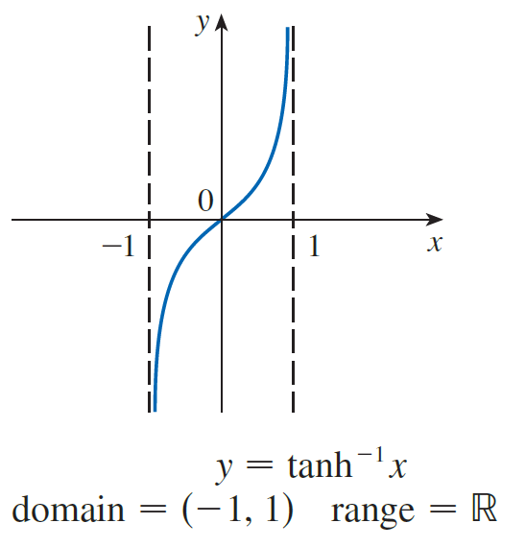

Slide 14

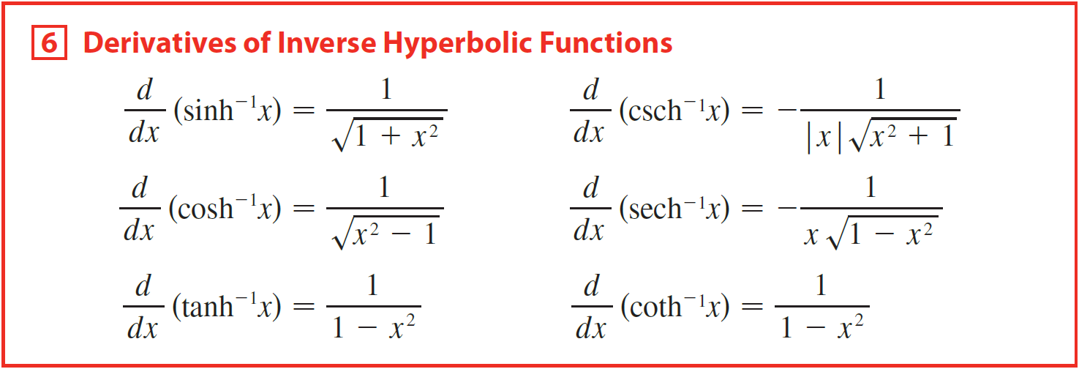
Since the hyperbolic functions are defined in terms of exponential functions, it’s not surprising to learn that the inverse hyperbolic functions can be expressed in terms of logarithms. In particular, we have:

Slide 15
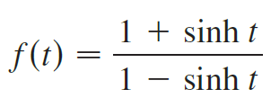




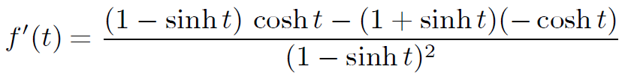



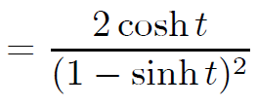
Example
Find the derivative. Simplify where possible.
(a)
(b)
(c)
Solution
(a)
(b)
.

Slide 16
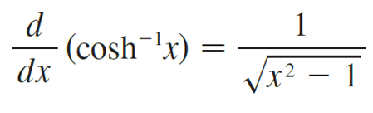
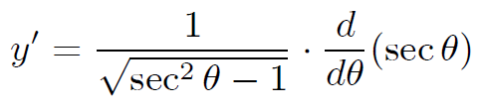
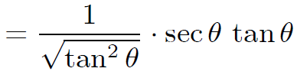


Example
Find the derivative. Simplify where possible.
(a)
(b)
(c)
Solution
(c)

Slide 17

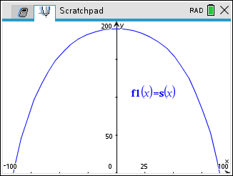
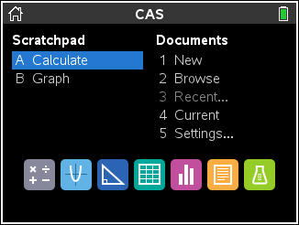

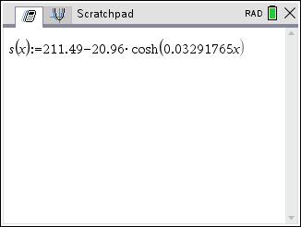
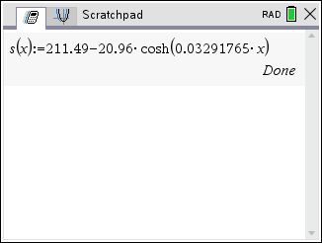
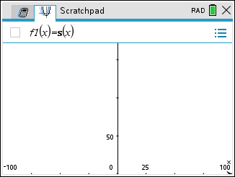
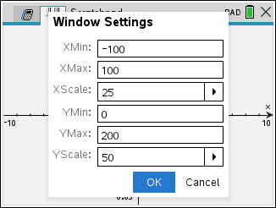
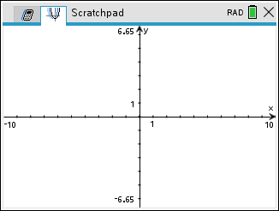
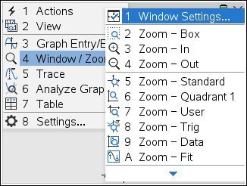
Example
The Gateway Arch The Gateway Arch in St. Louis was designed by Eero Saarinen and was constructed using the equation
for the central curve of the arch, where x and y are measured in meters and $\left|x\right|≤91.20.$
(a) Graph the central curve.
(b) What is the height of the arch at its center?
(c) At what points is the height 100 m?
(d) What is the slope of the arch at the points in part (c)?
Solution
(a) Graph the central curve.

Slide 18
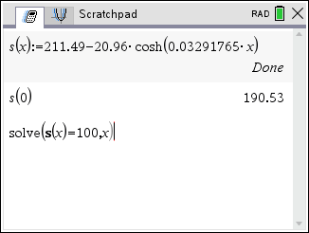
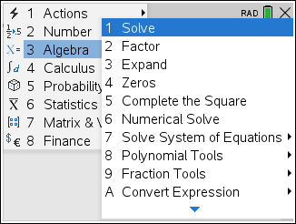
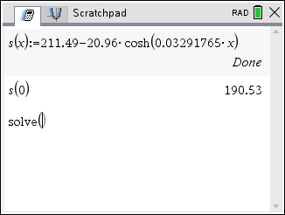
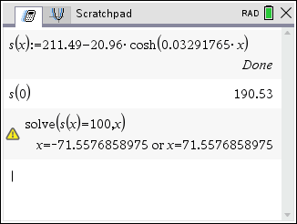

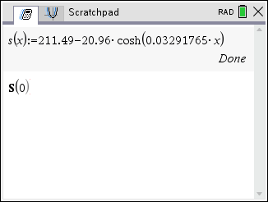
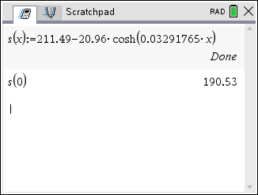
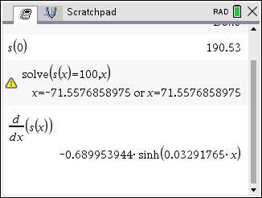
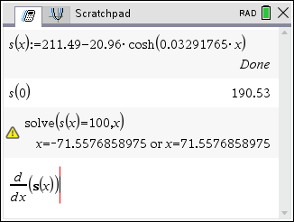
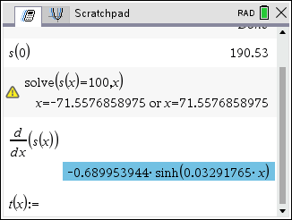
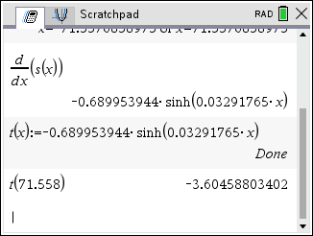
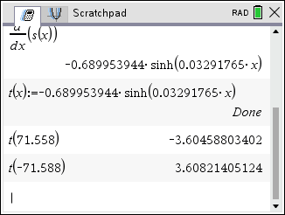
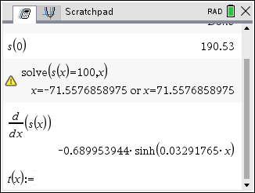
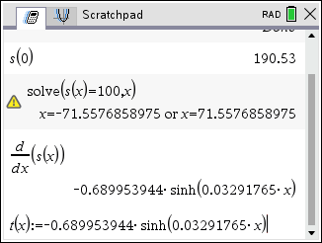
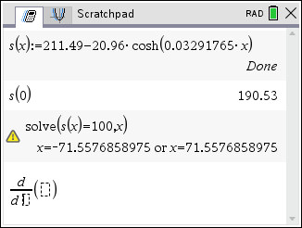
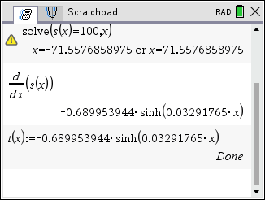
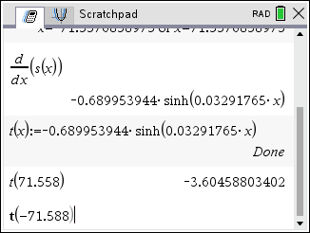




Solution
(b) What is the height of the arch at its center?
Height of the arch at its center in when x = 0.
The height of the arch at its center is 190.53 m.
$$\left(−71.558, 100\right)$$
$$\left(71.558, 100\right)$$
(c) At what points is the height 100 m?
The points are approximately $\left(±71.558, 100\right).$
(d) What is the slope of the arch at the points in part (c)?
So, the slope at (71.558, 100) is about −3.605 and the slope at (−71.558, 100) is about 3.605.

