Slide 1


WE HAVE SEEN HOW TO INTERPRET derivatives as slopes and rates of change. We have used the definition of a derivative to calculate the derivatives of functions defined by formulas. But it would be tedious if we always had to use the definition, so in this chapter we develop rules for finding derivatives without having to use the definition directly. These differentiation rules enable us to calculate with relative ease the derivatives of polynomials, rational functions, algebraic functions, exponential and logarithmic functions, and trigonometric and inverse trigonometric functions. We then use these rules to solve problems involving rates of change and the approximation of functions.

Slide 2
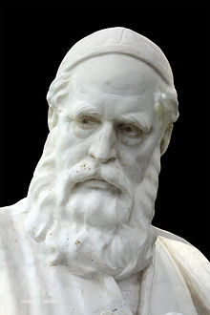
Omar Khayyam
1048 – 1131
Omar Khayyam was a Persian mathematician, astronomer, philosopher, and poet, who is widely considered to be one of the most influential scientists of the middle ages. He wrote numerous treatises on mechanics, geography, mineralogy, and astronomy.

Slide 3
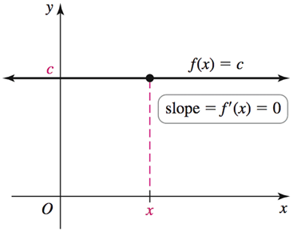
If the derivative of a function is its slope, then for a constant function, the derivative must be zero.
The derivative of a constant is zero.
Example
Differentiate:

Slide 4
We saw that if , then .
This is part of a pattern.
Power Rule
Example
Differentiate:
Solution

Slide 5

Constant Multiple Rule
The derivative of a constant times a function is the constant time the derivative of the function.
Example
Differentiate:
The Power Rule (General Version)

Slide 6
Sum and Difference Rules
Example
Differentiate:
Solution

Slide 7


Product Rule
Notice that this is not just the product of two derivatives.
Example
Differentiate:

Slide 8

Quotient Rule
“Low dee high minus high dee low draw the line and denominator squared we go.”
Example
Differentiate:

Slide 9
Derivative of the Natural Exponential Function

Slide 10

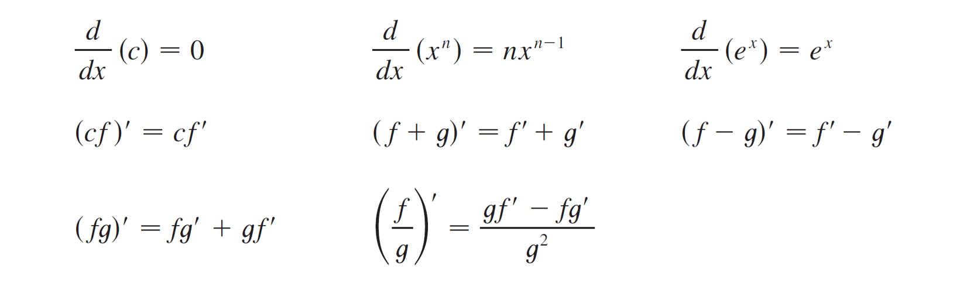
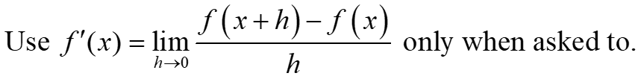
Shortcut Formulas

Slide 11








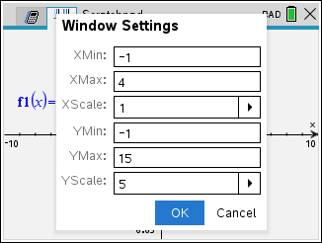
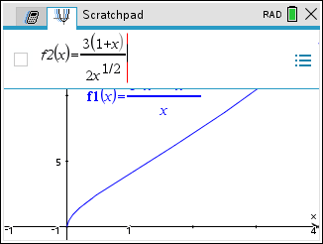

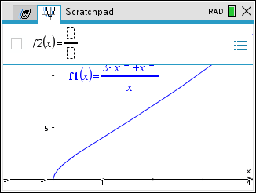
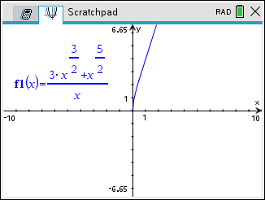
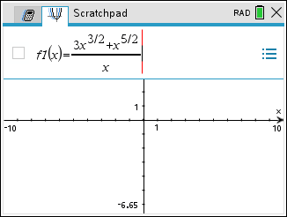

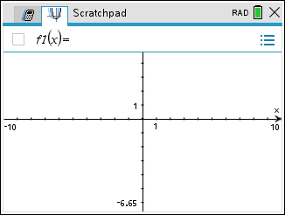
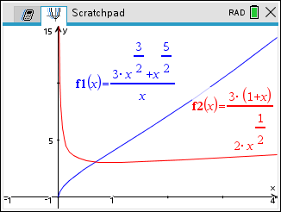


Example
Differentiate the function.
(a)
(b)
(c)
(d)
(e)
Solution
Power Rule
(a)
Power Functions

Slide 12







Example
Differentiate the function.
(b)
(c)
Solution
(c)
(b)
Product Rule
Power Rule

Slide 13
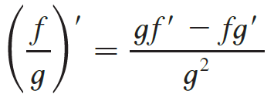
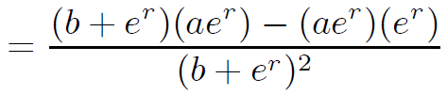
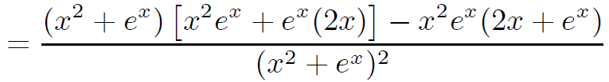
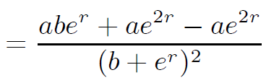
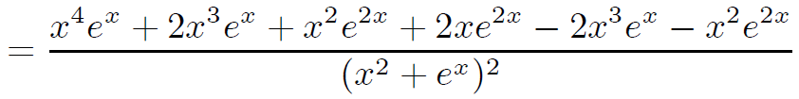

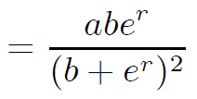
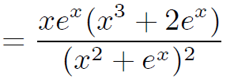
Example
Differentiate the function.
Quotient Rule
(d)
(e)
Solution
(d)
(e)

Slide 14
Example
Find the horizontal tangent lines of
Solution
Horizontal tangent lines occur when slope is zero.
Plugging the x-values into the original equation, we get the points of tangency to be:
Hence, the horizontal tangent lines are:
Why do we get the same tangent line?
Let’s look at the graph.

Slide 18
The function is even, that is why we get the same horizontal tangent at y = 1.

Slide 19
First derivative (slope) is zero at x = 0, −1, 1. The x-intercepts of the graph of the derivative.

Slide 20
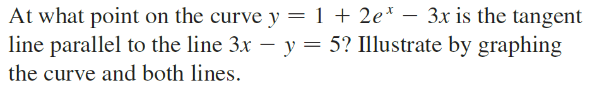




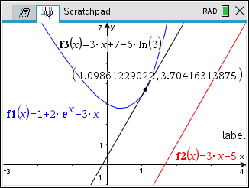
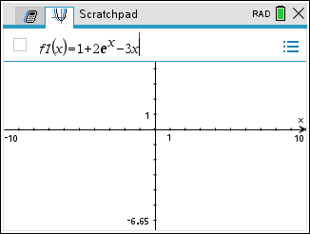
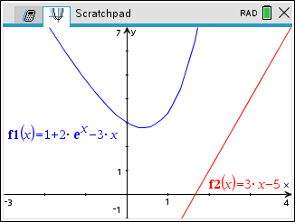

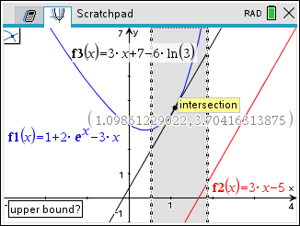
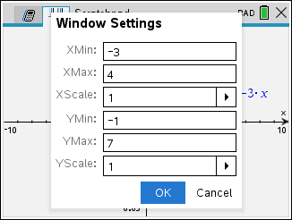
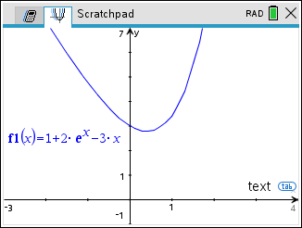
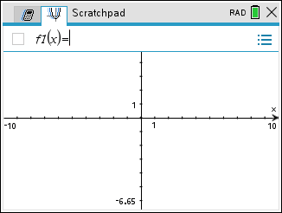
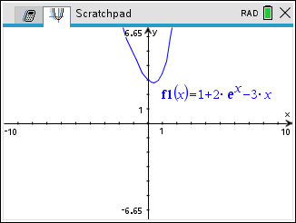
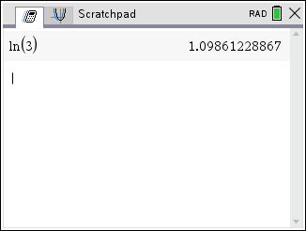
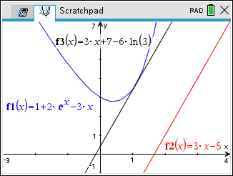
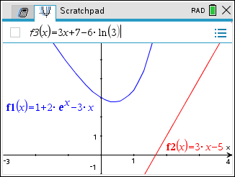
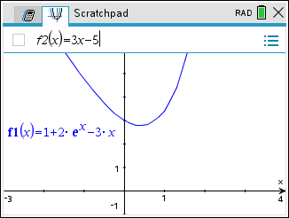
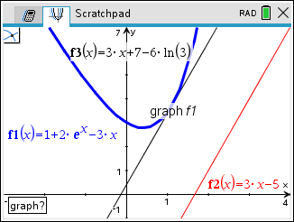
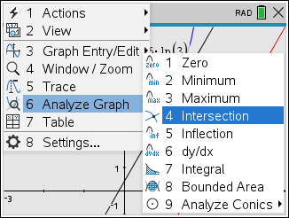
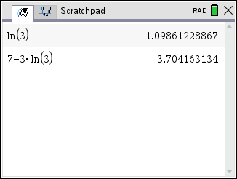
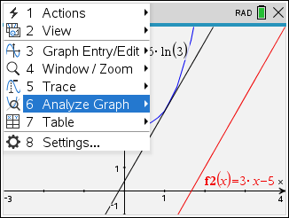
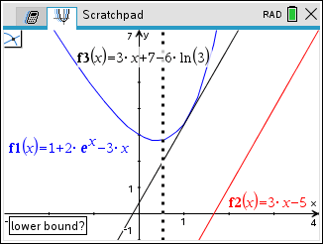

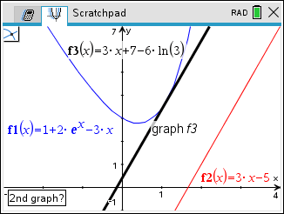


Example
Solution
The equation of the tangent line is
The point of tangency occurs at

Slide 21

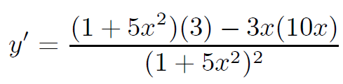


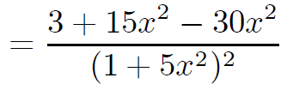
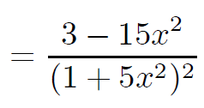

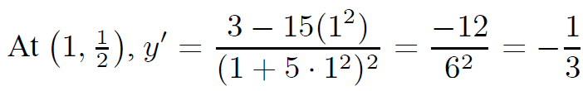

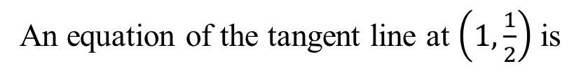

Example
Find equations of the tangent line and normal line to the given curve at the specified point.
An equation of the tangent line at $\left(1,\frac{1}{2}\right)$ is
Solution
The slope of the normal line is 3, so an equation of the normal line is
The slope at $\left(1,\frac{1}{2}\right)$ is $m=−\frac{1}{3}$

Slide 22
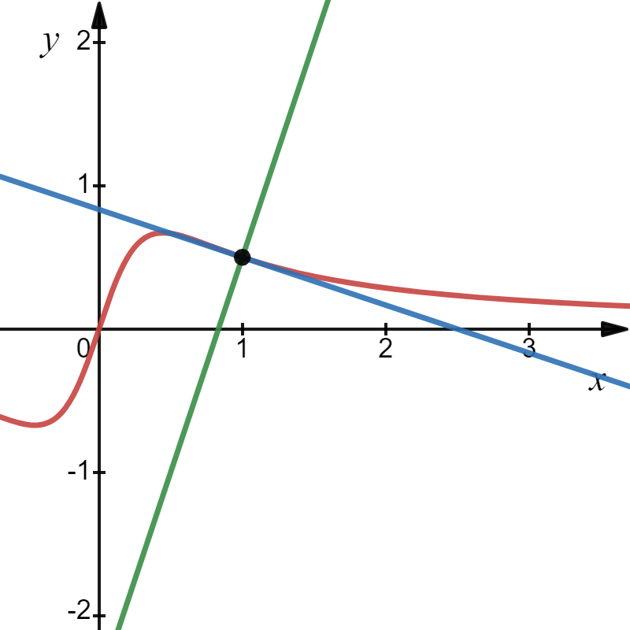

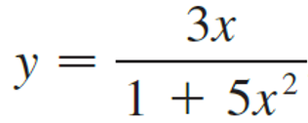

Slide 23
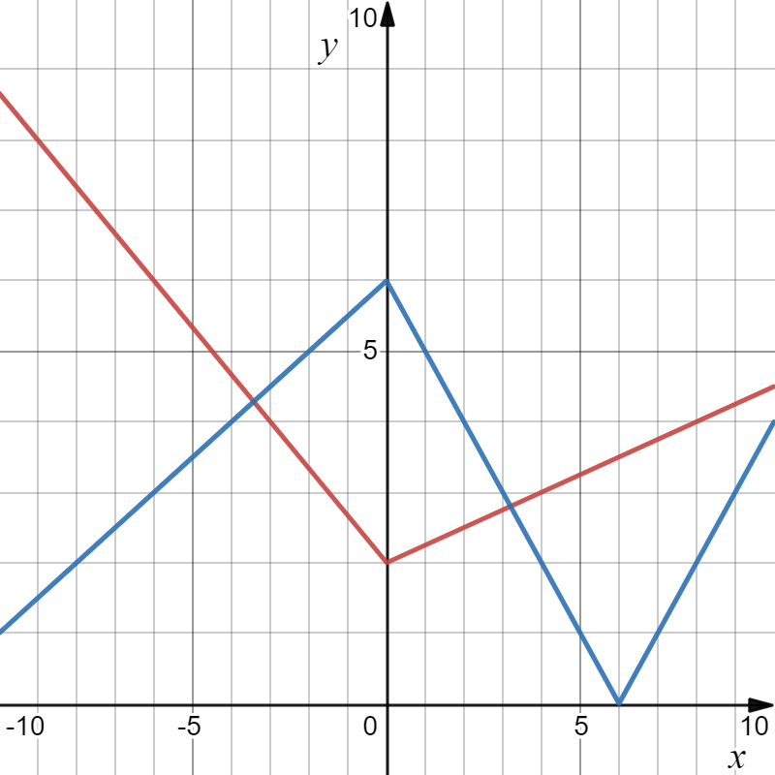
Example
Solution

Slide 24
Example
Solution

Slide 25

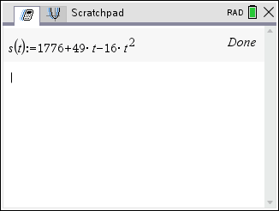
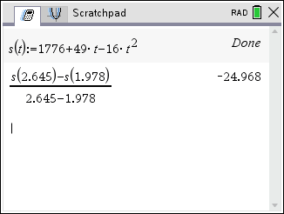
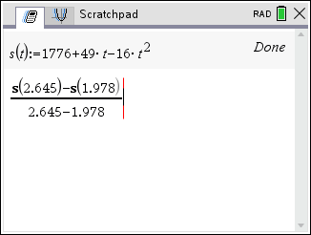
Example
Solution

Slide 26
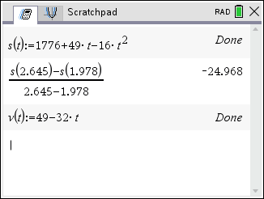
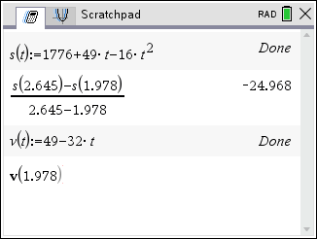

Solution

Slide 27









Solution
$$t=\frac{−b±\sqrt{b^{2}−4ac}}{2a}$$

Slide 28










Example
Solution
Quotient Rule

Slide 29









Solution

Slide 30



