Slide 1

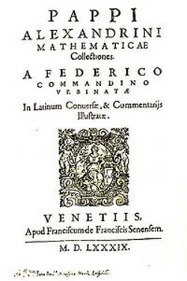
Pappus of Alexandria
290 – 350 A.D.
Pappus of Alexandria is the last of the great Greek geometers and one of his theorems is cited as the basis of modern projective geometry.

Slide 2
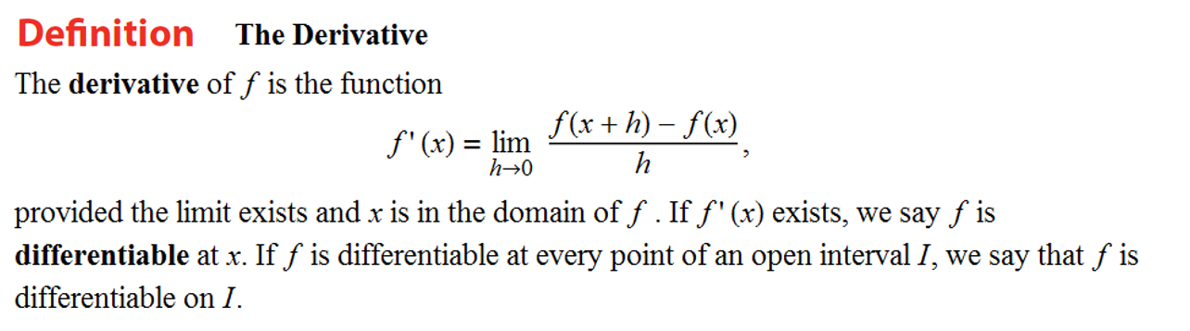

“The derivative of f with respect to x is …” These words are going to become very familiar.
In summary, here are all the forms that represent the derivative of the function f.
There are many ways to write the derivative of

Slide 3
“f prime of x”
or
“the derivative of f with respect to x”
“y prime”
or “the derivative of y with respect to x”
or
“the derivative of y with respect to x”
“dee why dee ecks”
or
“the derivative of f with respect to x”
“dee eff dee ecks”
“the derivative of f with respect to x”
“dee dee ecks uv eff uv ecks”
or

Slide 4

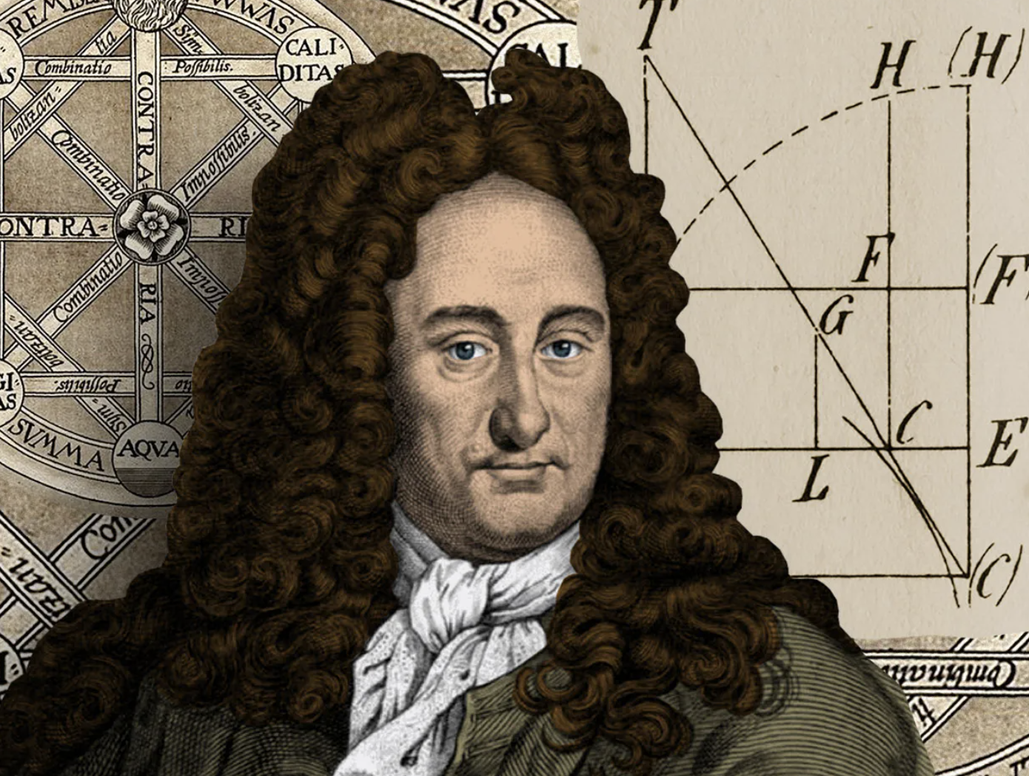
Most Used Derivative Notation
“Optimus” Prime Notation
Leibniz Notation

Slide 5

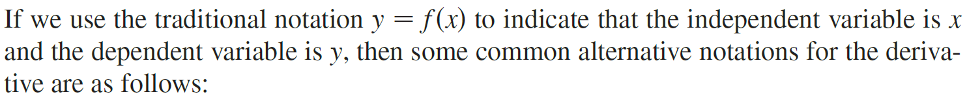

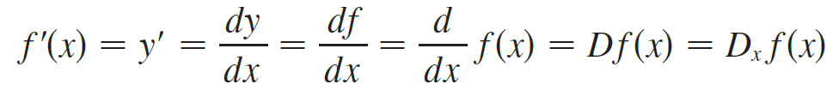
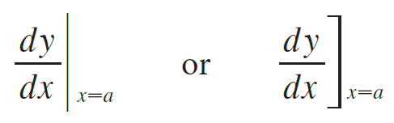
Slope of Tangent Line!!

Slide 6
Note:
dx does not mean d times x
dy does not mean d times y

Slide 7
Note:
does not mean
(except when it is convenient to think of it as division.)
does not mean
(except when it is convenient to think of it as division.)

Slide 8
Note:
does not mean times
(except when it is convenient to treat it that way.)

Slide 9


Slide 10
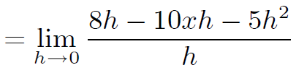







Example
Solution
0

Slide 11
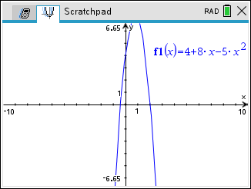

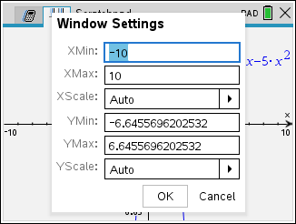
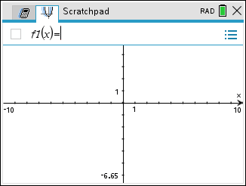
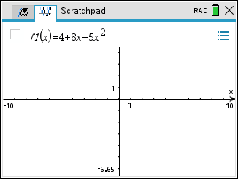
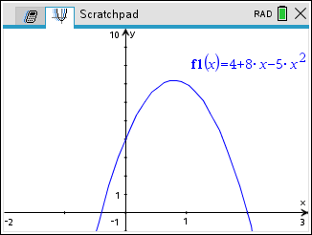
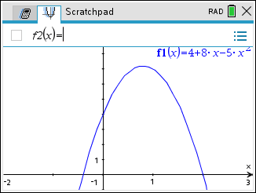
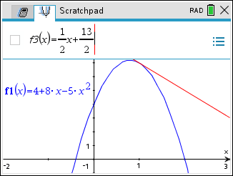
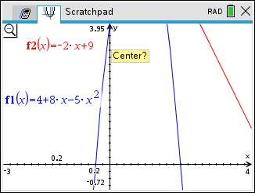
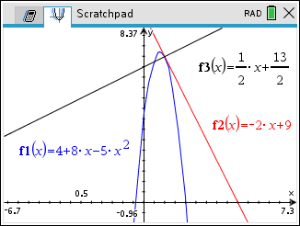
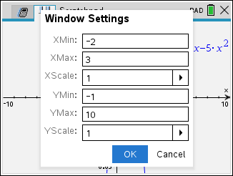
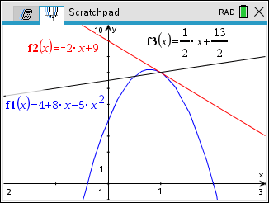
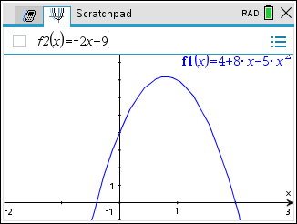
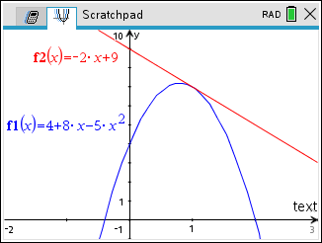
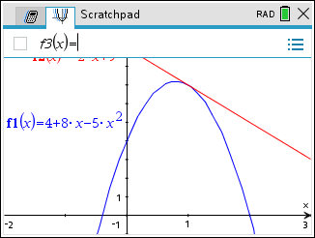
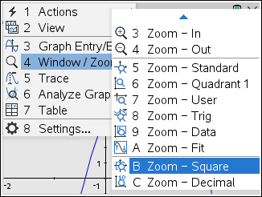
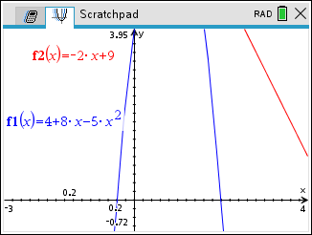
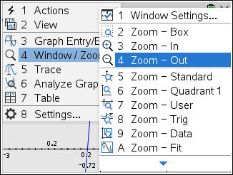
Solution
Tangent line:
Normal line:

Slide 12
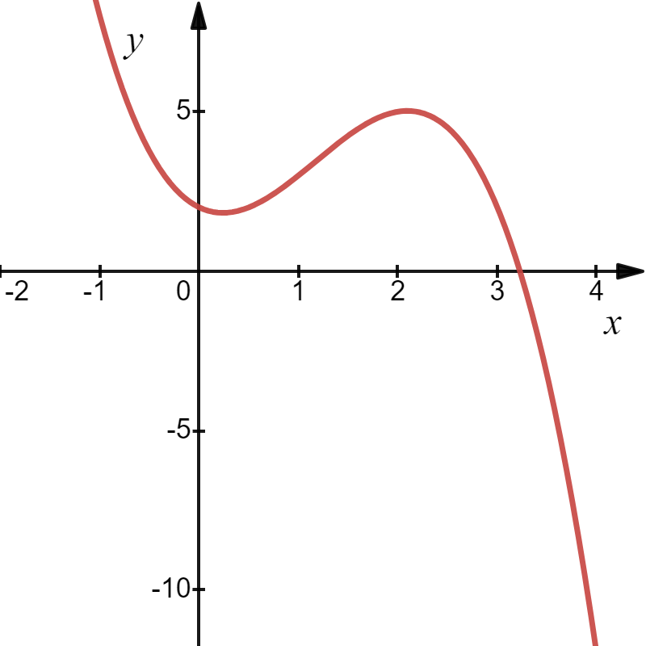

Slide 13
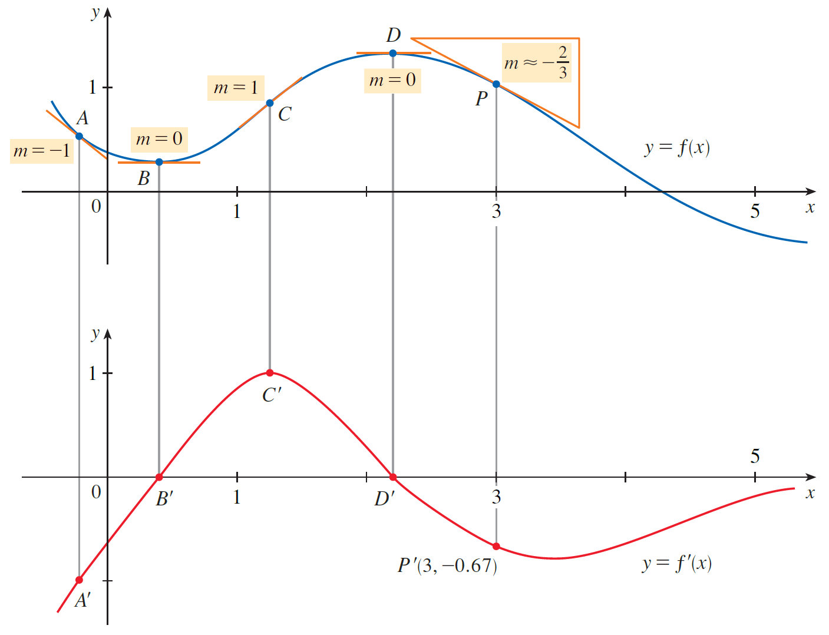

Slide 14
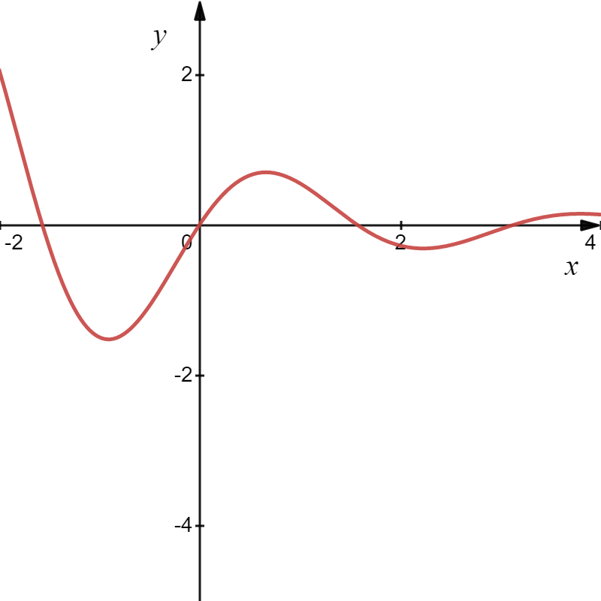
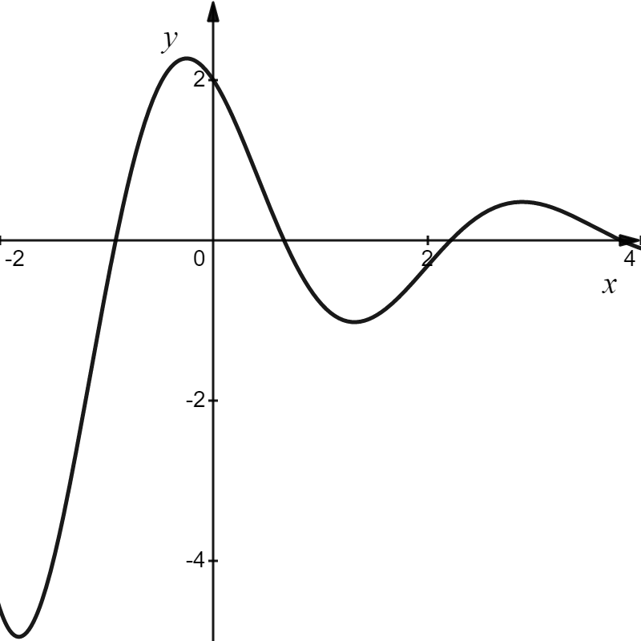

Slide 15
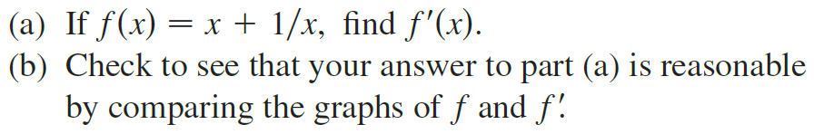

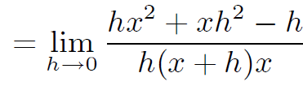

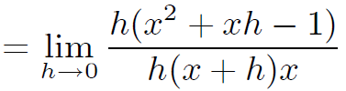
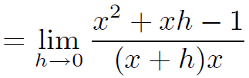
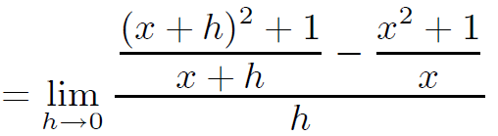
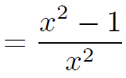

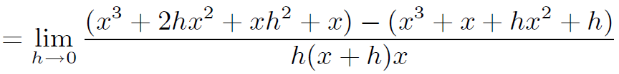

Example
Solution
0
0
$$∙\frac{x(x+h)}{x(x+h)}$$

Slide 16
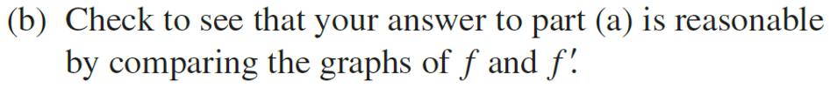
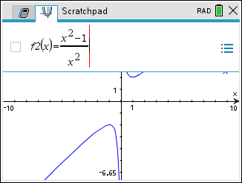
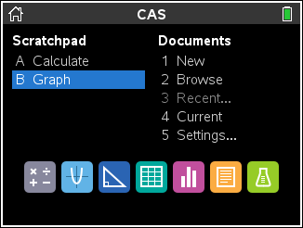
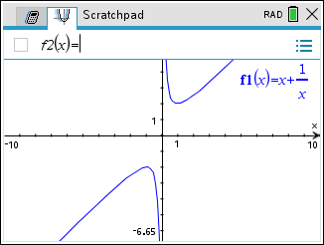
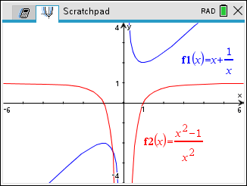
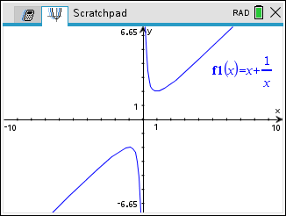
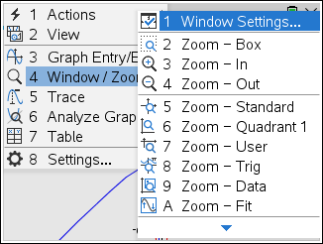
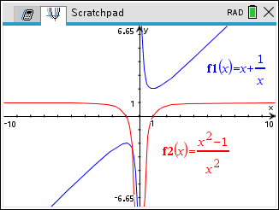
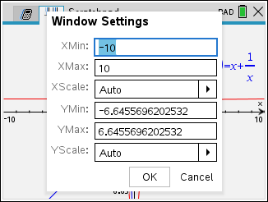
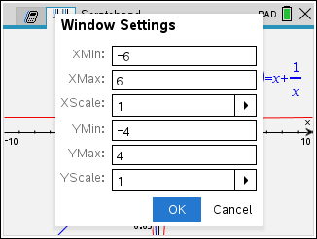
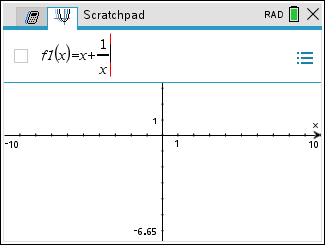
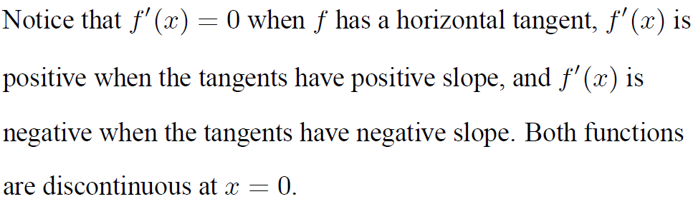
Example
Solution

Slide 17
Example
y
Draw the derivative of f.
x
Solution
y
The derivative is the slope of the original function.
The derivative is defined at the end points of a function on a closed interval.
x

Slide 18
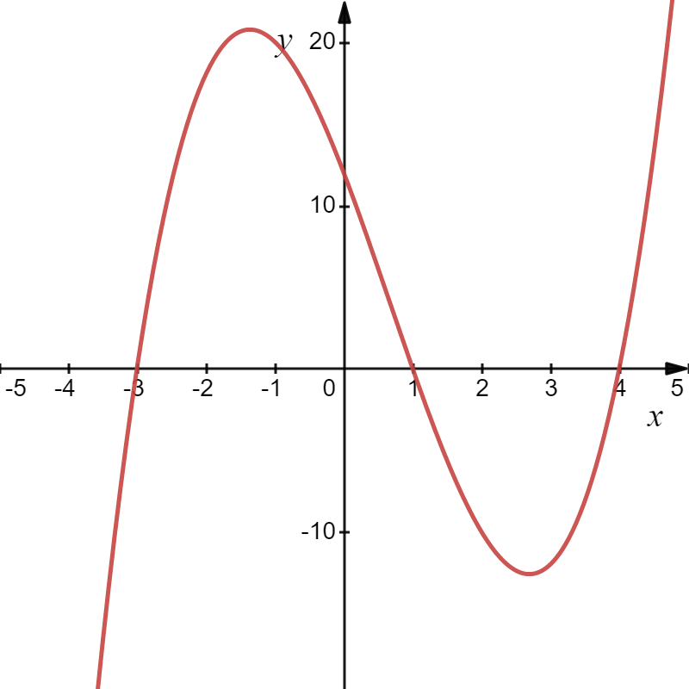
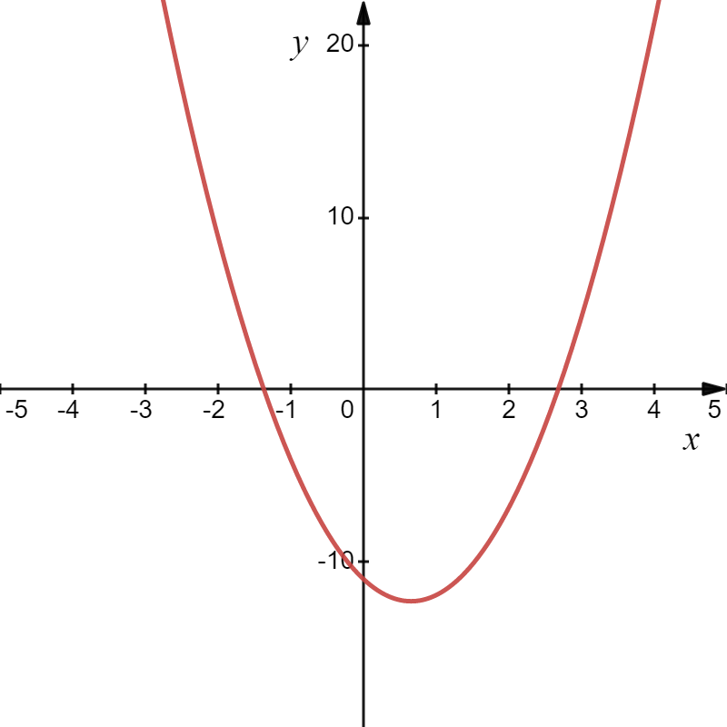
Example
Solution

Slide 19


Example
Solution

Slide 20


Example
Solution

Slide 21


Example
Solution

Slide 22






Example
Thus, f is differentiable at all x except 0.

Slide 23


Both continuity and differentiability are desirable properties for a function to have. The following theorem shows how these properties are related.

Slide 24

Thus, f is differentiable at all x except 0.

Slide 25

Thus, f is differentiable at all x except 0.

Slide 26

Thus, f is differentiable at all x except 0.

Slide 27




To be differentiable, a function must be continuous and smooth.
Derivatives will fail to exist at:
corner
cusp
vertical tangent
discontinuity

Slide 28

Example
Solution

Slide 29
Example
Solution

Slide 30
Example
Solution
y
1
2
x

Slide 31





Slide 32

Example

