Slide 1

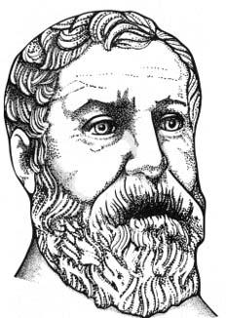
Heron of Alexandria
10 – 75 A.D.
Heron or Hero of Alexandria was an important geometer and worker in mechanics who invented many machines including a steam turbine. He’s best-known mathematical work is the formula for the area of a triangle in terms of the lengths of its sides.

Slide 2

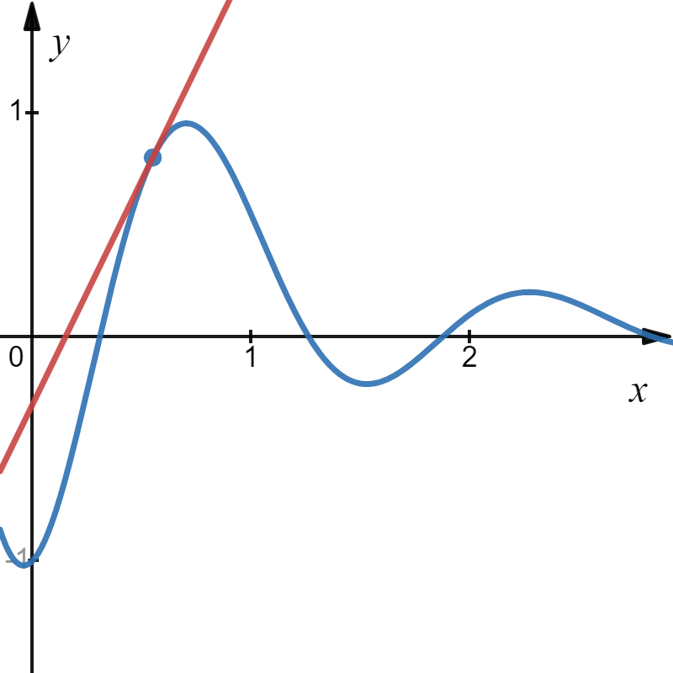
Tangent Line
(a, f (a))
y = f (x)

Slide 3
Secant vs Tangent Lines Definition 1
Slope of Secant Line
y
Secant Line
(a, f (a))
Average Rate of Change
Tangent Line
Difference Quotient
f (a)
(x, f (x))
y = f (x)
Instantaneous Rate of Change
a
x
x

Slide 4
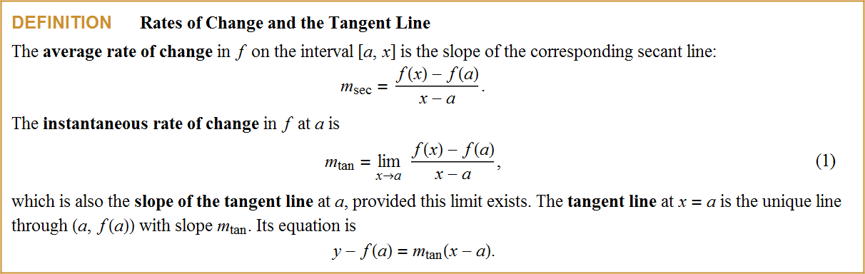


Example
Solution
Provided the limit exists.

Slide 5
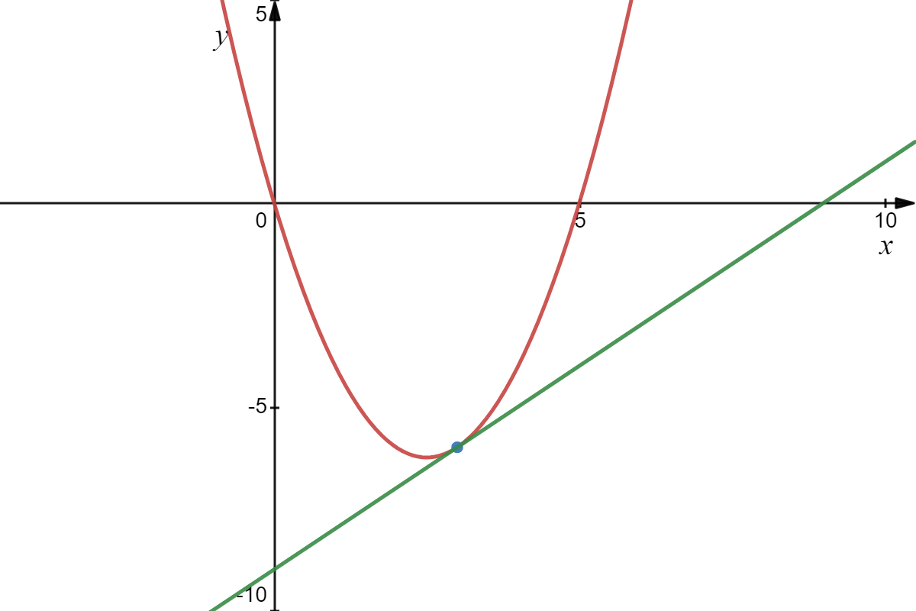

Find the equation of the tangent line at a = 3 for f (x) = x² – 5x.

Slide 6







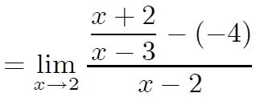


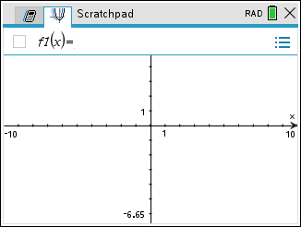
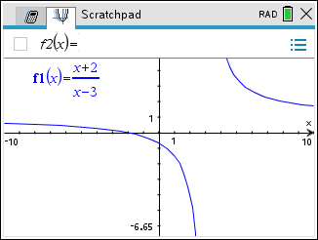
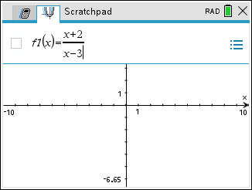
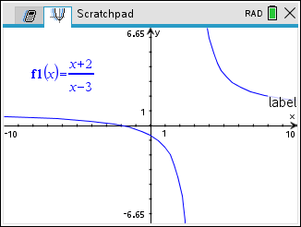
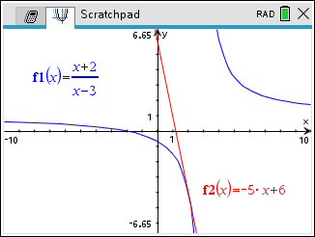
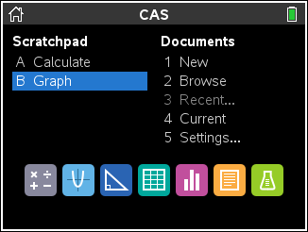
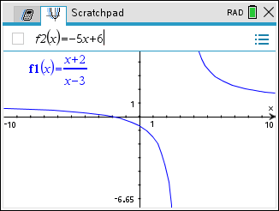
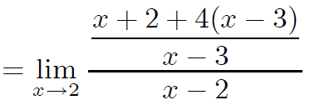

Example
Using definition 1, find an equation of the tangent line to the curve at the given point.
Solution
Provided the limit exists.
Tangent line:

Slide 7
Secant vs Tangent Lines Definition 2
Slope of Secant Line
y
Secant Line
(a, f (a))
Average Rate of Change
Tangent Line
Difference Quotient
f (a)
(a + h, f (a + h))
y = f (x)
h
Instantaneous Rate of Change
a
a + h
x

Slide 8
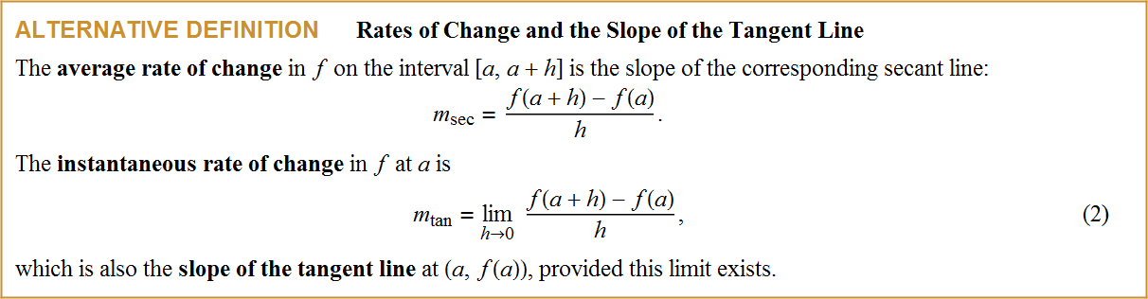


Example
Solution
Provided the limit exists.

Slide 9
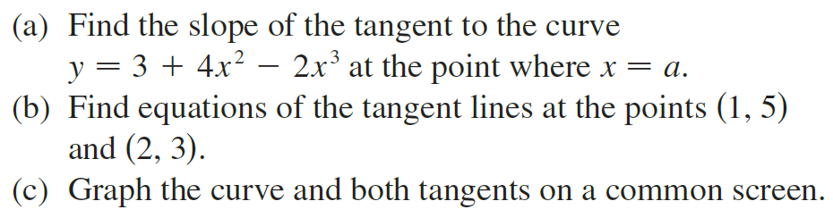




Example
Solution
Provided the limit exists.

Slide 10




Example
Solution
Slope of tangent line at x = a is
m
0
0
0

Slide 11



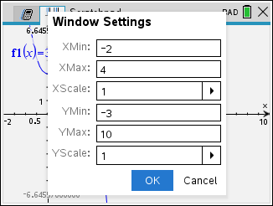
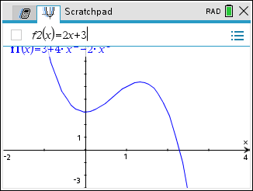
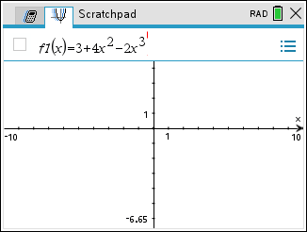
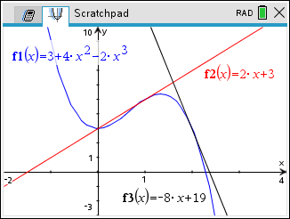
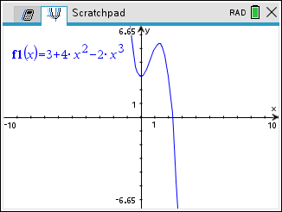
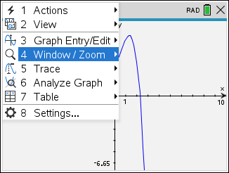
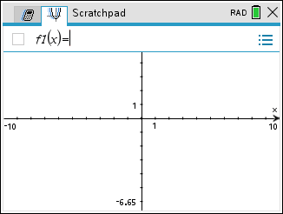
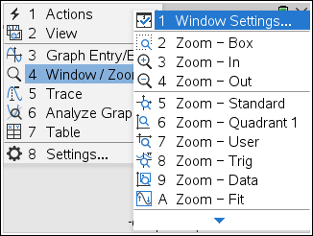
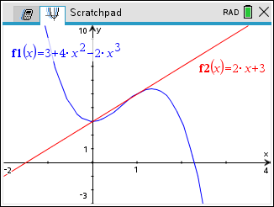
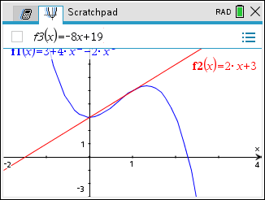
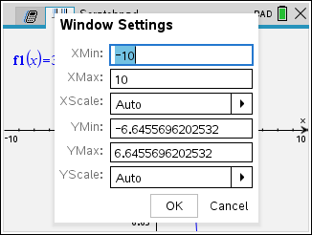
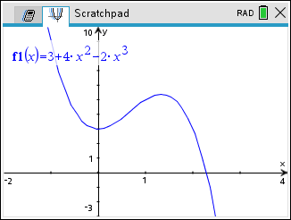







Example
Solution
Tangent line:
Tangent line:

Slide 12
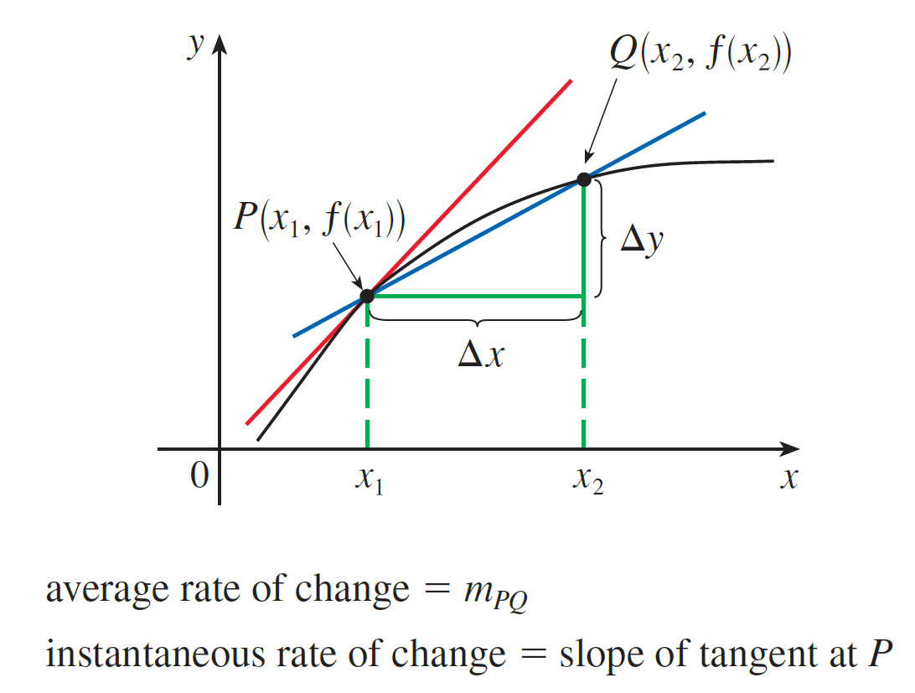


Secant vs Tangent Lines Definitions 3 and 4

Slide 13

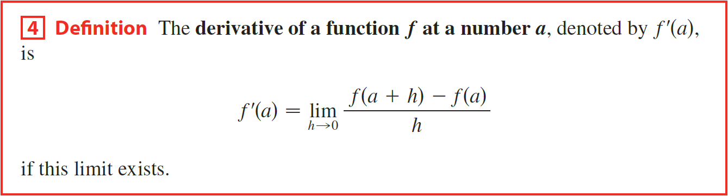
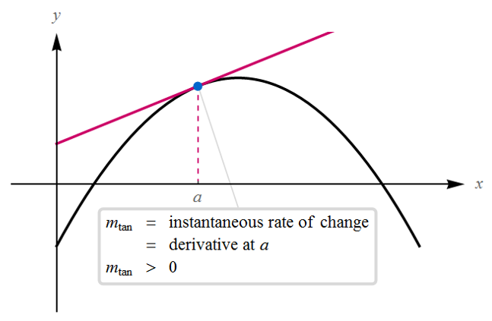

Slide 14
Example
Solution
Hence,

Slide 15
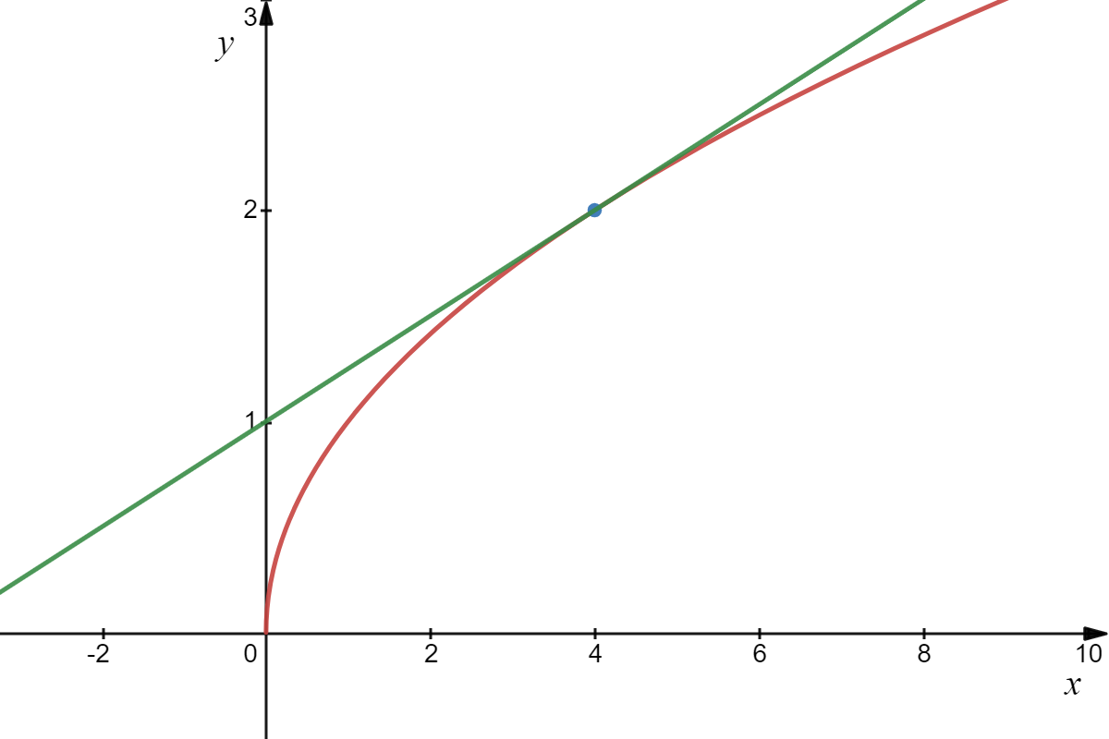
Find the equation of the tangent line at a = 4.

Slide 16





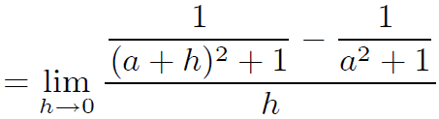

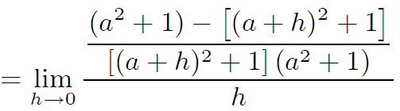


Example
Solution
Provided the limit exists.
0
0

Slide 17
Tangent line:
Normal line:

Slide 18
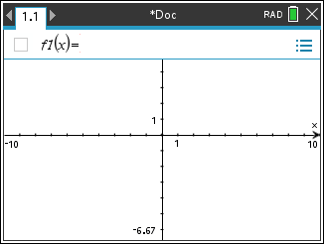
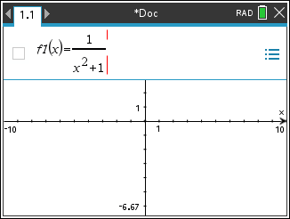
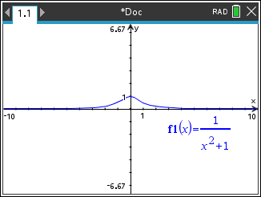
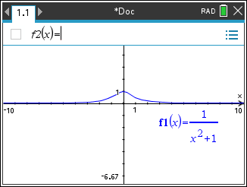
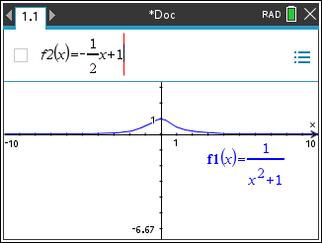
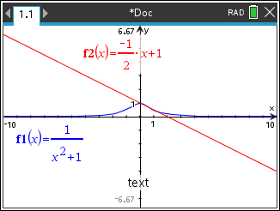
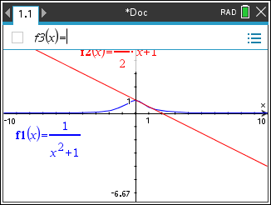
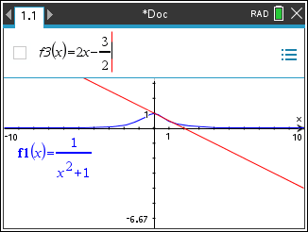
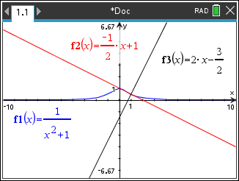
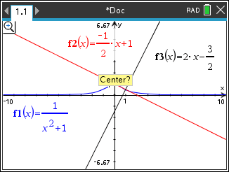
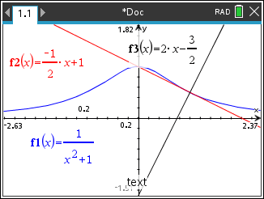
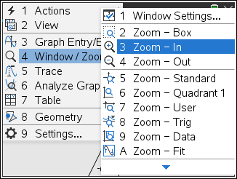

Slide 19
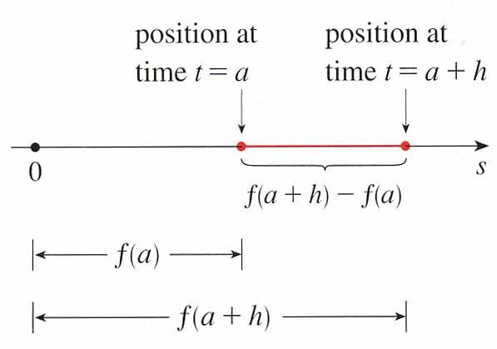
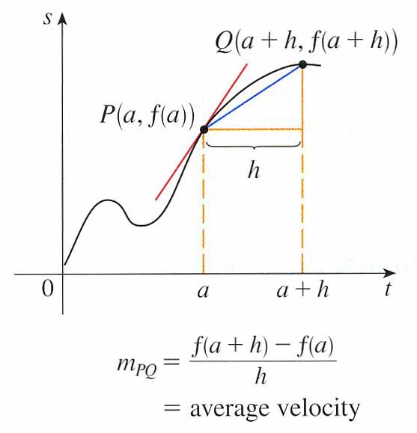
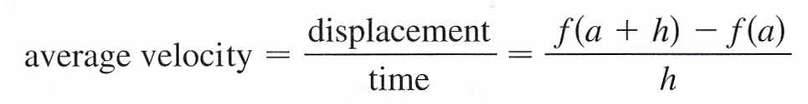
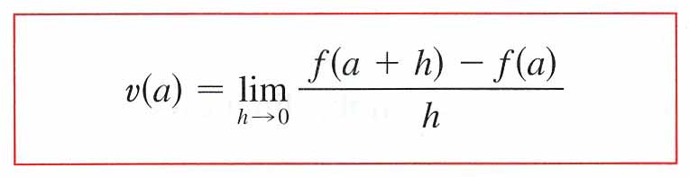

Slide 20
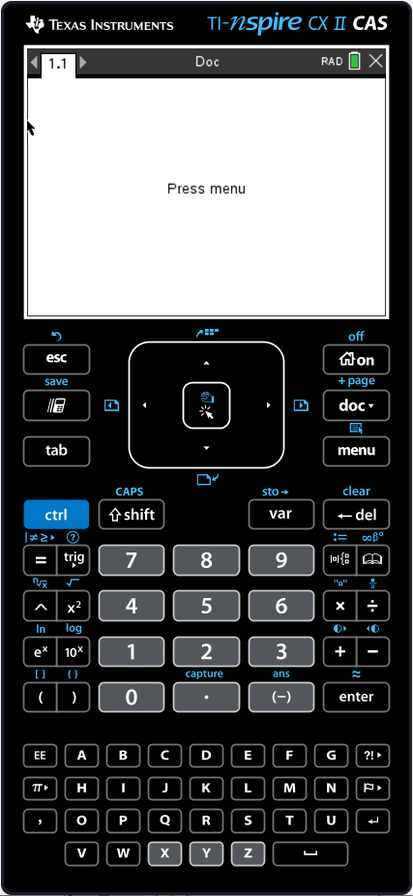









Example
Solution
Provided the limit exists.
0
The velocity of the rock after
one second is 6.28 m/s.

Slide 21








Provided the limit exists.
0

Slide 22








